Slide 1
Proposed Rules for Adoption
November 15, 2018
Portland, Oregon
Notes:
Leah
Hello, Commissioner George and members of the Commission:
Good Afternoon, my name is Leah Feldon, Deputy Director for Oregon DEQ. As you know, DEQ, in partnership with the Oregon Health Authority has worked diligently over the last two years to establish the Cleaner Air Oregon program, a regulatory and rulemaking effort that will address gaps in our current air quality permitting program. Creating this program has been a complex effort, involving a broad range of stakeholder groups, coordinating with national program and technical experts, and recent legislation. This level of effort and consultation mirrors the importance of what we seek to accomplish: a significant new step for Oregon in better understanding health risk from air toxics and, when needed, reducing those risks.
Staff at DEQ and OHA have worked tirelessly to develop a program that balances the many concerns we’ve heard over the last two years. Communities across the state want a program that is thorough, transparent and protective. Businesses want to address these community concerns, and need a program that provides certainty, yet also allows for flexibility when determining what investments to take to address risks.
We are here today to present the results of these efforts. I am pleased to bring forward a recommendation to the Commission for proposed adoption of rules that we believe consider and balance these objectives, while achieving important goals set by Governor Brown when she established the Cleaner Air Oregon effort- to create a program that is health protective, grounded in science, and provides certainty. The rules we are proposing today will allow us to understand what air toxics are emitted, calculate risks they pose to communities, and, when needed, involve communities to work with businesses to reduce those risks.
With me to present is Ali Mirzakhalili, DEQ’s AQ Administrator, Gabriela Goldfarb, the manager of the Environmental Health section at the Oregon Health Authority, and Keith Johnson, our assistant to the Director for Cleaner Air Oregon. We also have program specialists here to help us answer any questions the Commission has about our proposal today.

Slide 2
Outline of Today’s Presentation
CAO rulemaking public process
How CAO would work
Key issues
Steps for implementation
Questions
Recommendation
Notes:
[Leah]
We have a lot to discuss with you today as we walk you through our recommendations.
Today we’d like to review with the Commission several items including:
The extensive stakeholder and public process we engaged in to bring you these proposed rules;
A short review of how CAO would work;
Some of the key policy issues we considered in designing this proposed program, and what we decided;
Some thoughts about how we would implement this program, if adopted;
An opportunity to answer your questions and provide additional information;
And, our recommendation to the Commission to adopt the proposed Cleaner Air Oregon rules.
We are happy to answer Commissioners’ questions throughout the presentation, and will also leave time towards the end.
To get us started, I’d like to turn things over to Ali.

Slide 3
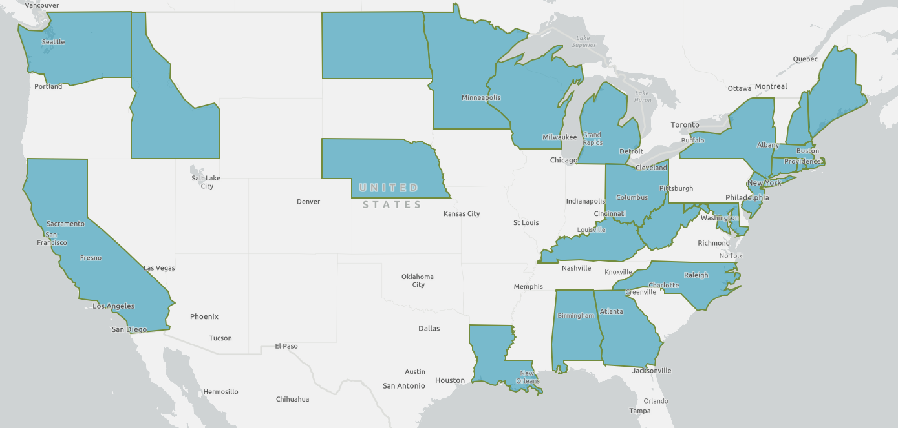
States with health-based air toxics programs
Notes:
[Ali]
[Start of CAO Stakeholder Process]
Thank you Leah. My name is Ali Mirzakhalili, Administrator for Air Quality programs at DEQ. Chair George and members of the Commission:
I want to thank the commission for your interest and input in this process. Over the course of my career I have worked with many businesses, community organizations, and national associations to improve our understanding of the risks we face from the air we breathe. As the incoming co-president of the National Association of Clean Air Agencies, I am keenly aware of the many challenges EPA and states face in establishing new and balanced requirements and updating old ones. Our regulations, like our businesses and communities, must evolve to meet the challenges and utilize the newest science if they are to remain relevant and effective. I believe these proposed rules do just that. As the DEQ’s AQ Administrator, I am dedicated not only to bringing the commission the best rules possible, but also to work diligently within DEQ and with OHA to implement the proposed program efficiently and as seamlessly as possible with our existing and long standing priorities.
Oregon is not the first state to embark on a process to develop health-based air toxics rules. There are currently two dozen other states that already regulate toxic air contaminant emissions based on assessed risks to human health, including our neighbors Washington, Idaho and California. While each state’s program is unique, there are many common themes and requirements to all of them. In developing this program we consulted with experts from many of these states. The program we are proposing today has aspects that are consistent with or informed by those conversations, and builds upon the successes of these programs.

Slide 4
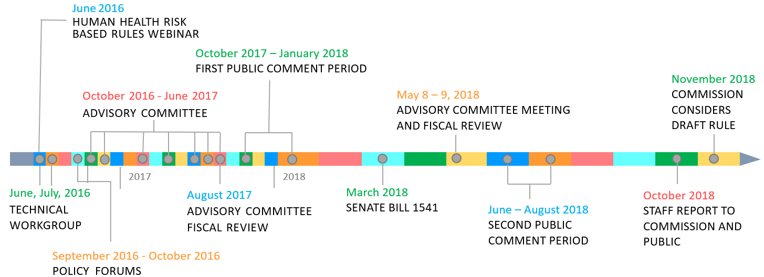
Cleaner Air Oregon Public Process
Notes:
[Ali]
As Leah mentioned, these proposed rules are the result of an extensive public process, starting in June of 2016. This public process has involved many different groups over time, as well as many presentations to this commission. One of the biggest challenges in this process has been the complexity of the science and the rules themselves, and finding ways to communicate this information so the public and stakeholders could provide effective input. Our partners at OHA have been so valuable in this regard. This commission has often provided an excellent forum as well, challenging us to create a program that is understandable to a variety of interests. And we know that if adopted, this challenge will continue as we implement the program.
We would like to take this opportunity to provide an overview of how we got to this day. The timeline here is a snapshot of the some of the significant milestones over the last two and a half years.
I’ll pass the microphone to Keith Johnson to talk through this public process in the following slides.

Slide 5
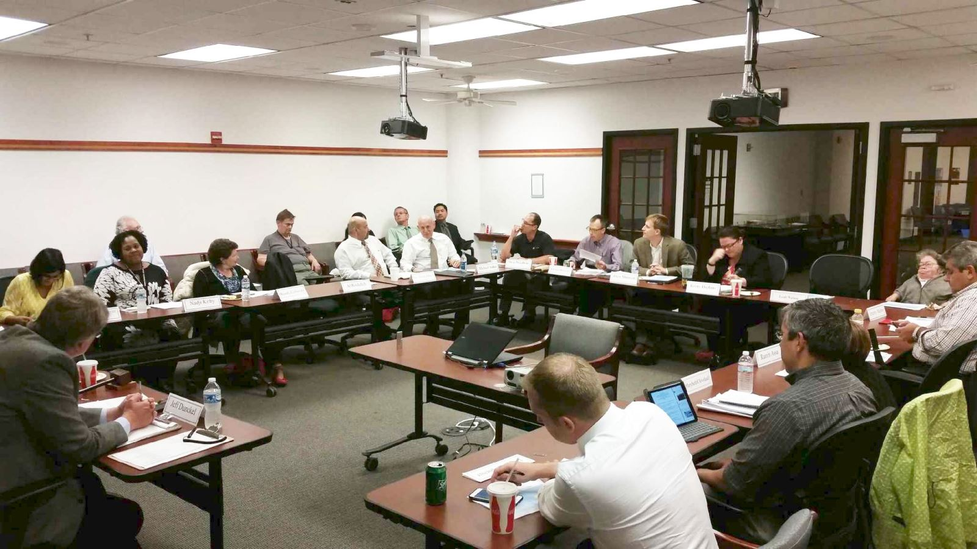
Cleaner Air Oregon Public Process
June - July 2016
4 meetings with a Technical Workgroup of national experts
Notes:
[Keith]
Thank you, Ali.
My name is Keith Johnson, Special Advisor to the Director for Cleaner Air Oregon.
As Ali mentioned, Oregon is not the first state to evaluate a health-based air toxics permitting program. That was good news for us, because it meant there was experience out there for us to draw upon to design the program.
One of the first things DEQ and OHA did was convene a group of experts that have experience in programs in other states. We formed a Technical Workgroup of national experts from these health-based air programs, including officials from EPA, Washington and California. We organized 4 meetings of that group to get their advice. We asked attendees to weigh in on questions such as,
Should the program regulate existing sources, as well as new and modified ones?
What are the right health standards to consider?
Should the program set risk limits at the facility level, or at the level of individual pieces of equipment or emission units?
All of those meetings were open for the public to attend, and we published a summary report on our website.

Slide 6
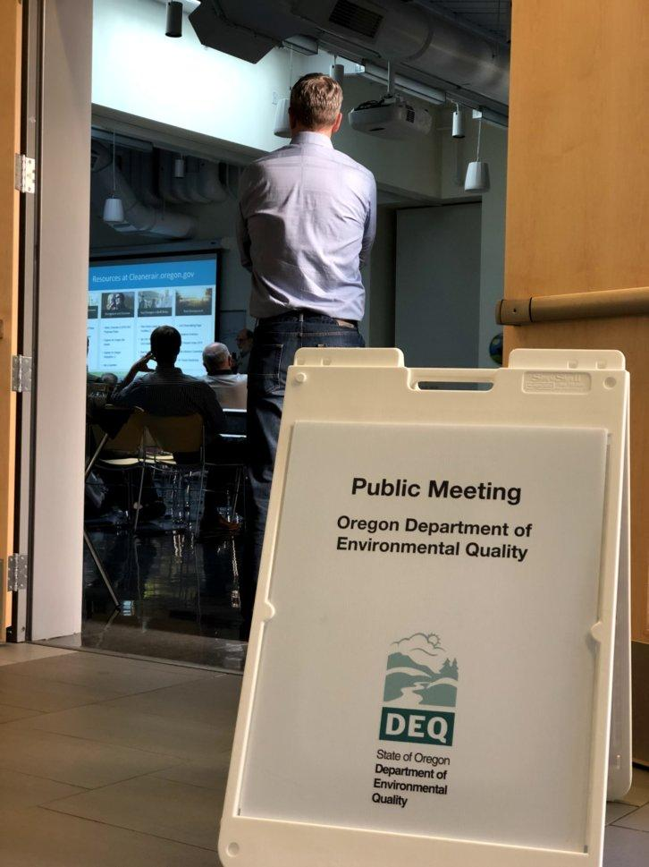
Cleaner Air Oregon Public Process
September - October 2016
4 Public Forums across Oregon to involve & get input from the public at the very beginning
Notes:
[Keith]
Next, DEQ and OHA held a series of public forums, to provide information about air toxics and find out what the public thought DEQ should consider when designing an air toxics program. We held public forums, in Medford, Bend, Pendleton, and Portland.
Each of these meetings had informational presentations from DEQ and OHA, to share information about DEQ’s current air toxics programs, health risks, and what we learned from the Technical Workgroup. Then, we polled the audience to get people’s vote on a set of multiple choice questions. We asked attendees to weigh in on questions like
Should the program regulate both existing facilities and new ones?
Should risk levels for existing facilities be different than for new facilities?
Should DEQ consider the cost of pollution controls when setting risk levels?
What are the most important considerations for a health-based permitting program?
We also posted those questions on our website, so people could weigh in even if they weren’t able to attend a forum in person.
After the multiple choice questions, we had time for people to make open-format comments at a microphone.
After the forums, we published a report on our website to document the input that we got.
------------------
top answers to the sample multiple choice questions, in case someone asks:
Should the program regulate existing facilities, as well as new and modified ones? [top response: New, modified and existing sources]
If regulating existing facilities, should risk levels for existing facilities be different than for new facilities? [top response: strongly disagree]
Should DEQ consider the cost of pollution control when setting allowable risk levels? [top response: somewhat disagree]
What are the most important overall considerations for developing a health/risk-based air toxics permitting program? [top response: Preventing risks to health]

Slide 7
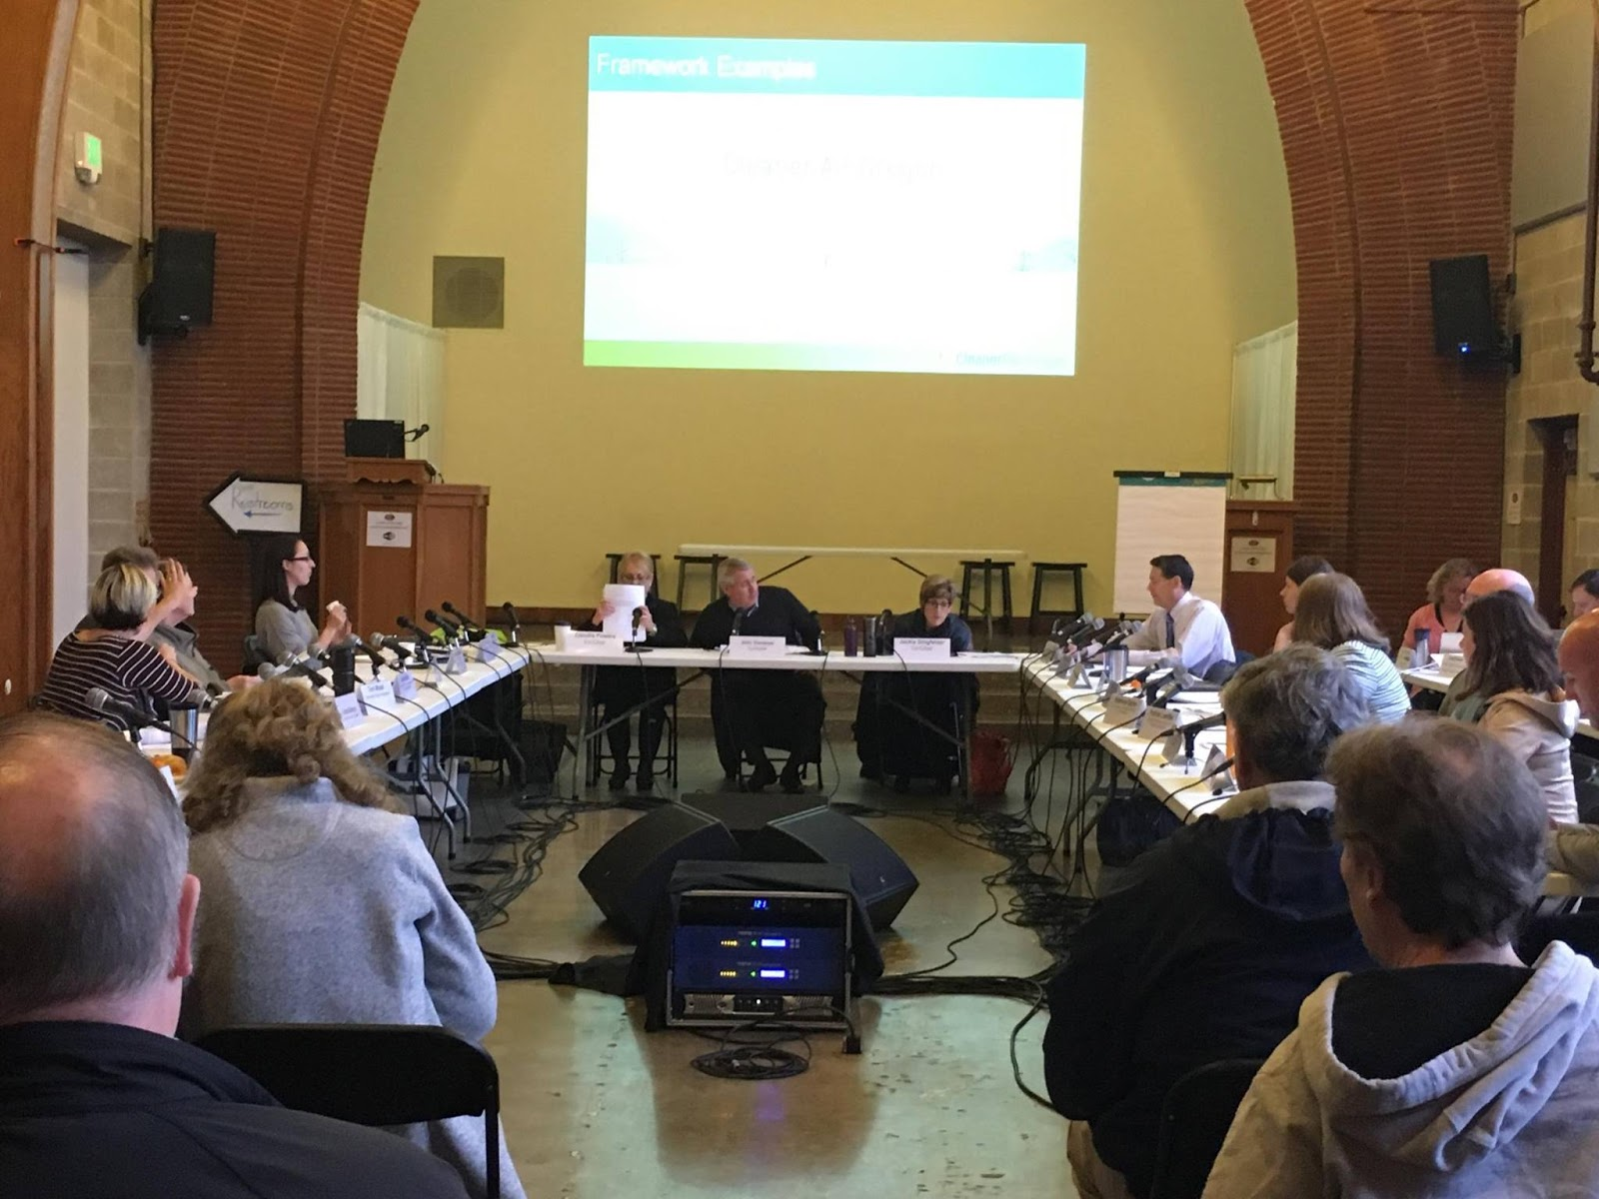
Cleaner Air Oregon Public Process
October 2016 - May 2018
23 member Rules Advisory Committee
met 8 times, for over 60 hours
also served as the Fiscal Advisory Committee
Notes:
[Keith]
DEQ and OHA then formed a 23 person Rules Advisory Committee including stakeholders from industry, environmental and environmental justice groups, health agencies, government and academia.
We organized 8 meetings, some of them over more than 1 day, to get input from the RAC on key policy issues. We met with the RAC for a total of over 60 hours.
In the earlier meetings with the RAC we talked about design concepts, including a proposed framework for the rules. After getting RAC input on the framework, we wrote up draft rules and shared those with the RAC for their input, and considered their input in subsequent rule drafts. All meetings were open to the public for both in-person and remote attendance, and featured opportunities for public comments.
The RAC also served as the fiscal advisory committee for this rulemaking, to provide input on the fiscal impact statement.
We thank the RAC for their engagement and input throughout this process. They were tireless and patient participants and ended up contributing way more time and energy than we originally predicted! The rules we are proposing today are much better because of their input and contributions.

Slide 8
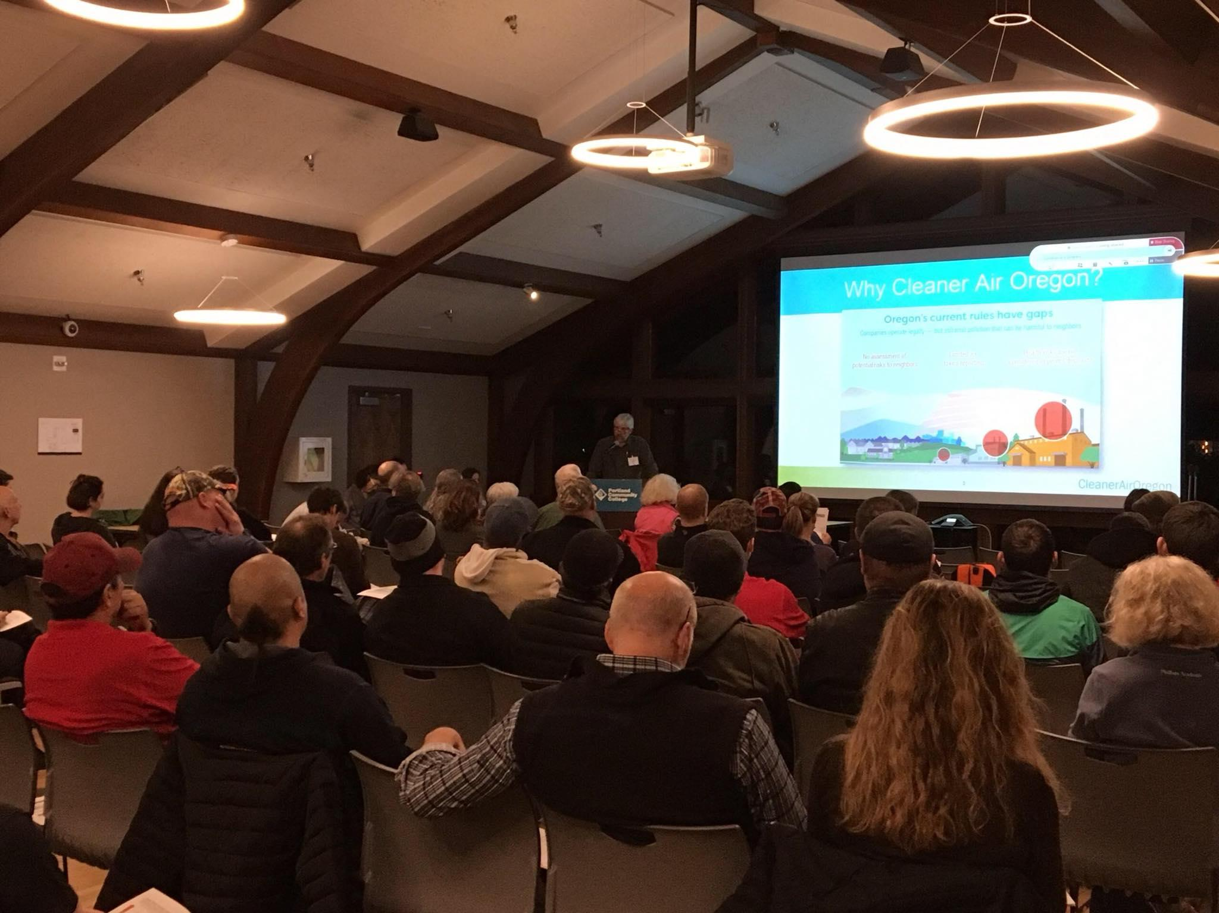
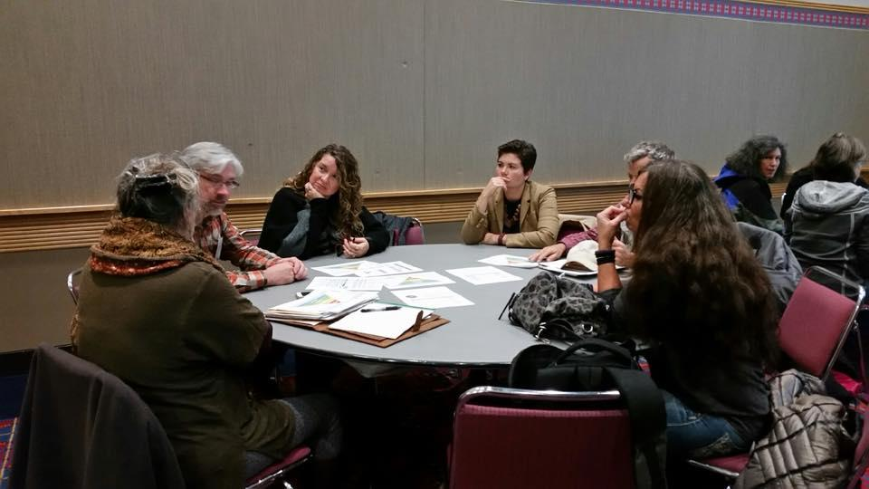
Cleaner Air Oregon Public Process
October 2016 to January 2017
First public comment period included
9 public hearings
Notes:
[Keith]
After writing draft rules and getting input from the RAC on those, we put them out for public comment in the fall of 2017.
Public comment period #1 was open for over 90 days, between October 2017 and January 2018, and included 9 public hearings across the state- a fairly unprecedented number for a single rulemaking effort.
We held public hearings in Medford, Coos Bay, Corvallis, Pendleton, Eugene, Salem (in conjunction with a meeting of Oregon’s Environmental Justice Task Force), the Dalles, and two in Portland, including an all-day meeting at the convention center. There were over 400 in-person attendees at the hearings.
We also collected comments through an online form, by email, and via hard copy.

Slide 9
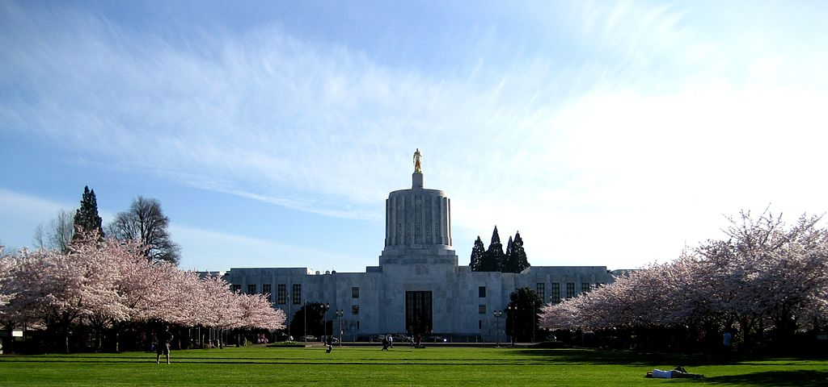
Cleaner Air Oregon Public Process
March 2018
Legislative action taken through Senate Bill 1541
Notes:
[Keith]
In March 2018, the Legislature passed Senate Bill 1541. It:
established one-time fees for development of the program, and authorized ongoing fees to fund implementation of the program
set regulatory benchmarks, or risk action levels, and
set other conditions related to how the program should work, including:
determining that some CAO risk reduction requirements can be met by existing EPA pollution control requirements
community engagement
hazard index rulemaking for non-cancer health risks
and a pilot program to address risk from multiple facilities

Slide 10
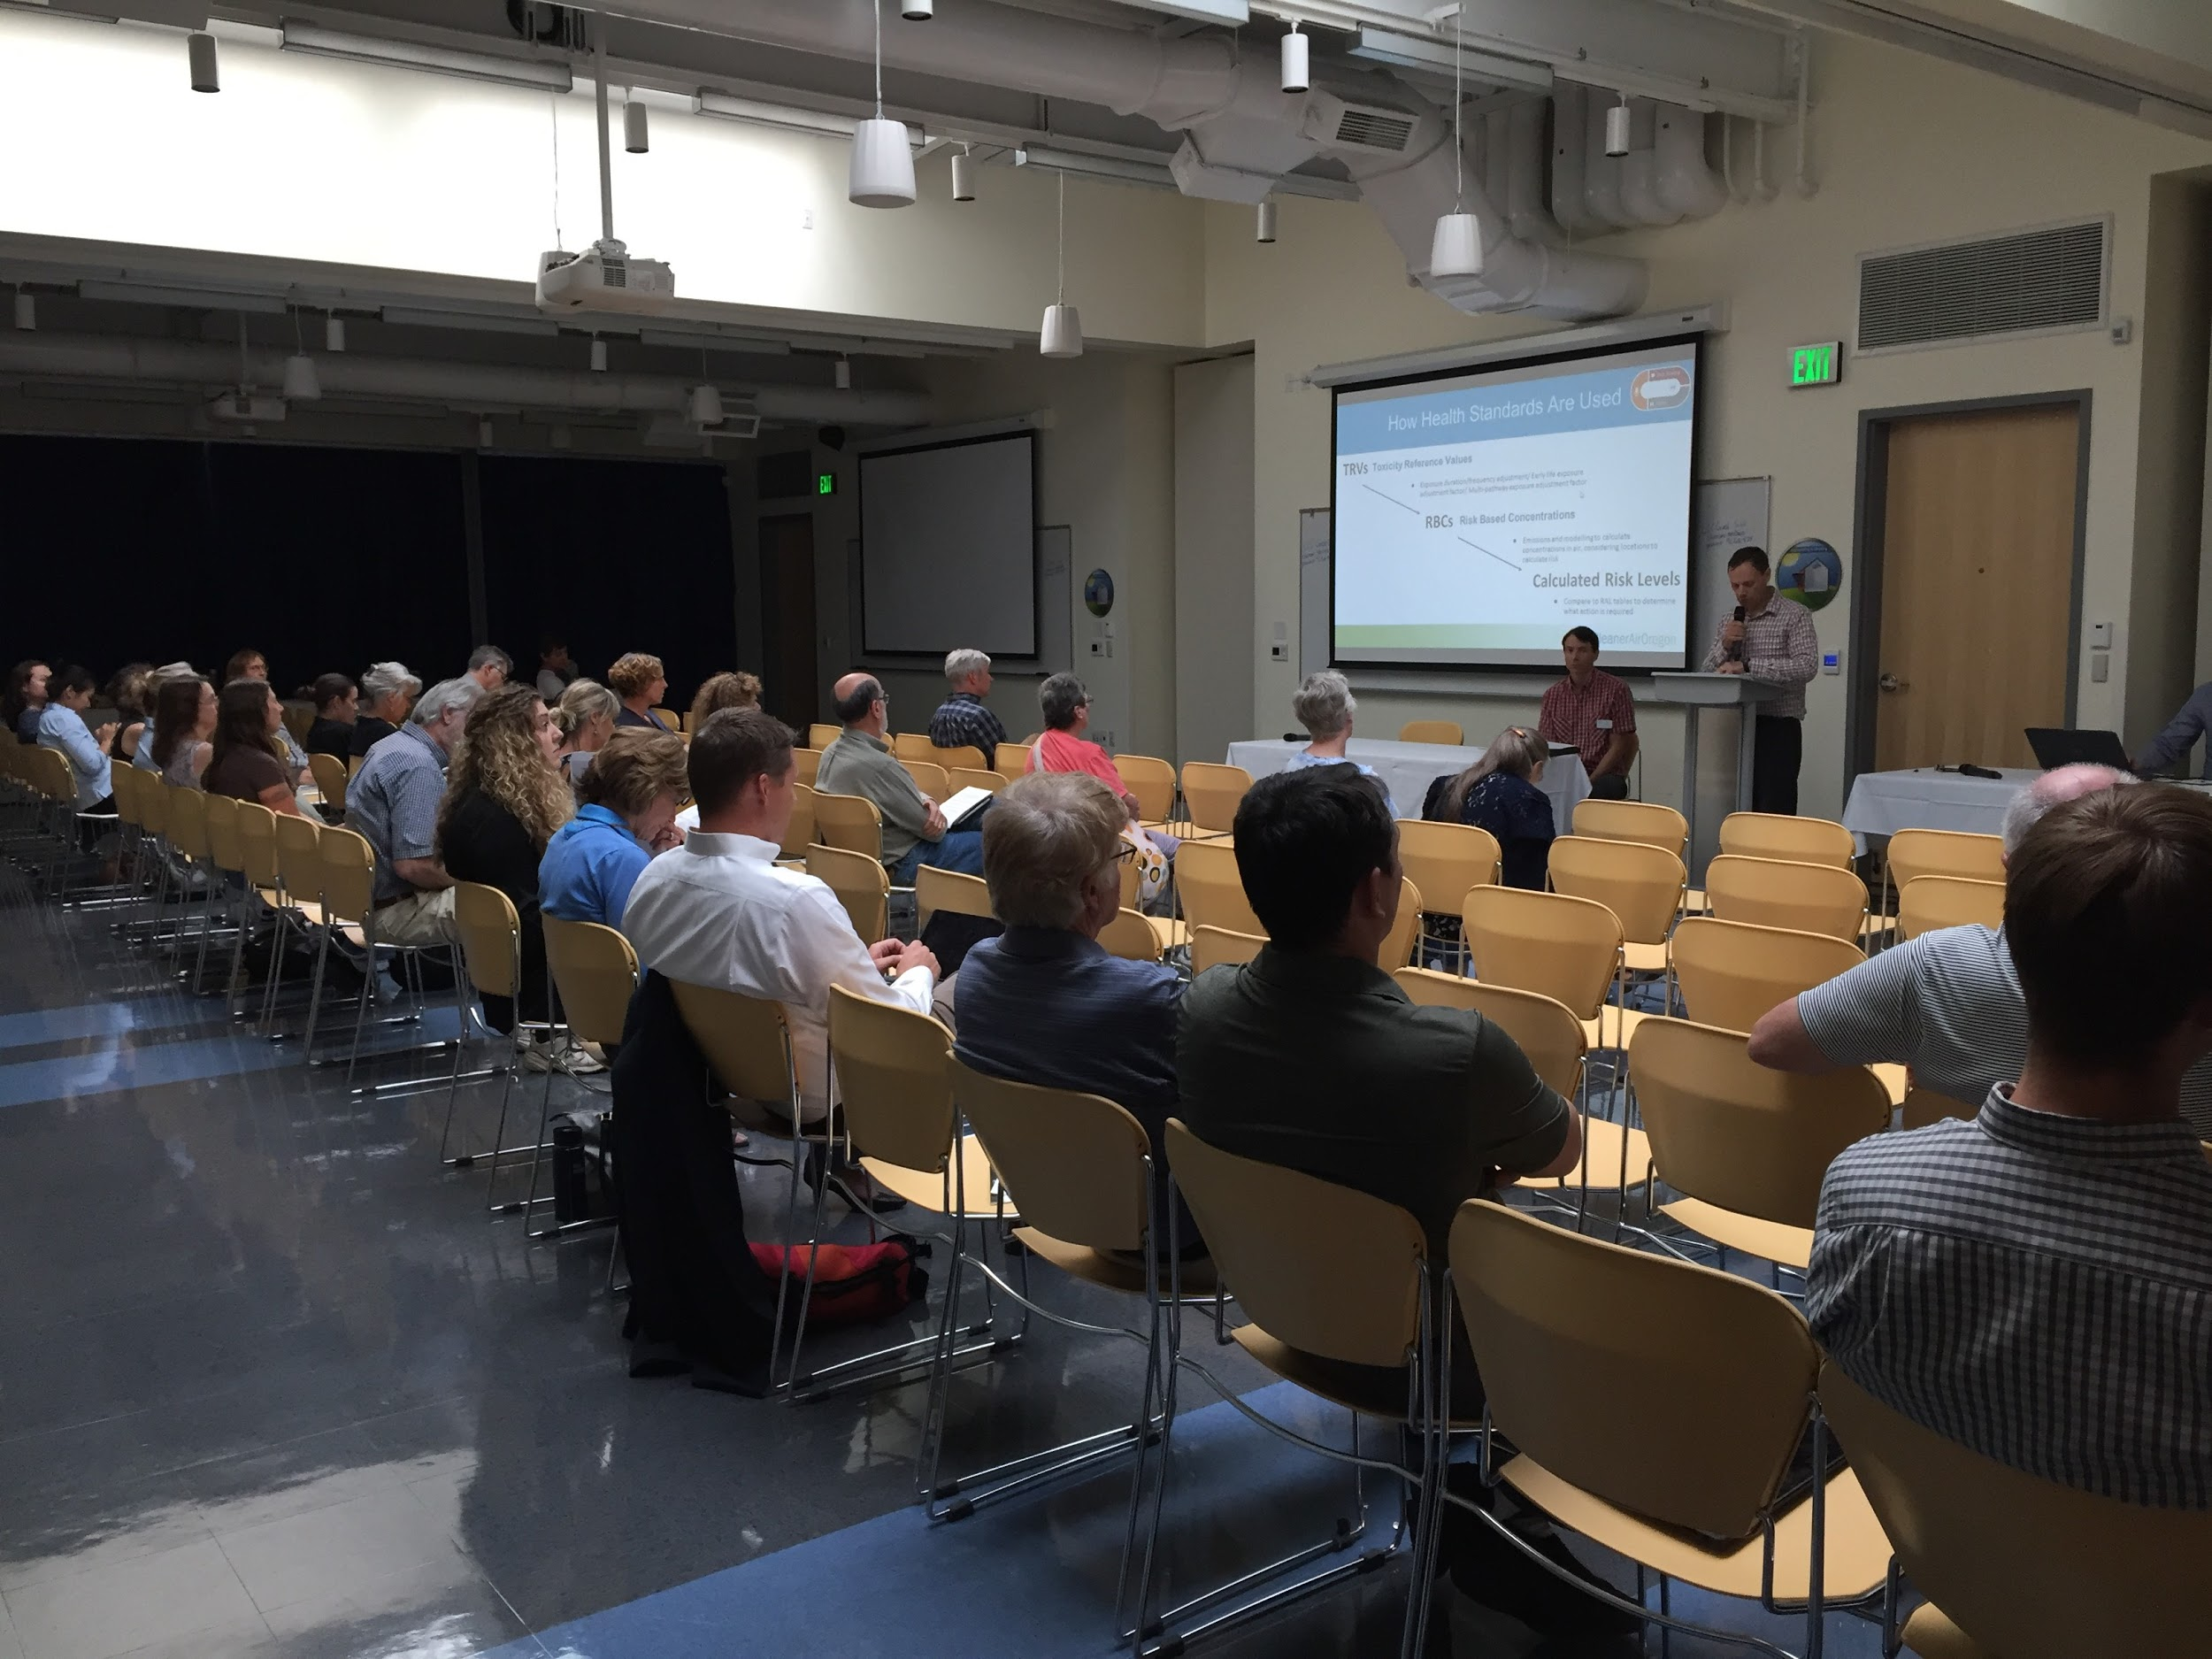
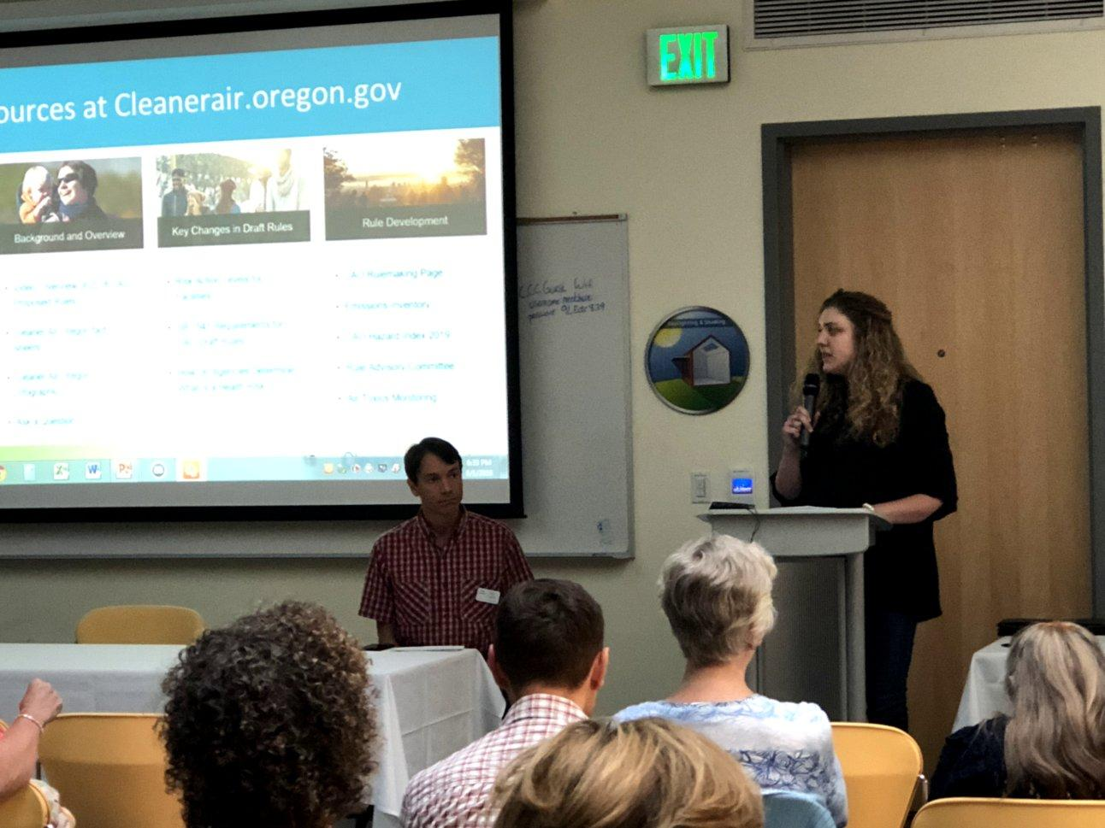
Cleaner Air Oregon Public Process
June - August 2018
Second public comment period included
2 additional public hearings
Notes:
[Keith]
[Public comment period #2]
Given the passage of SB 1541, DEQ needed to incorporate these provisions into the proposed rules. This necessitated substantial changes. To evaluate changes, DEQ and OHA reconvened the RAC to get input on these revisions.
In late June 2018, we developed a refined draft of the rules that incorporated SB 1541. We also took the time to consider input and make changes from comments we received during the first public comment period, and new input from the RAC.
We held a 42-day public comment period between June and August 2018. It included 2 more public hearings, in Portland (in conjunction with and the help of this Commission) and Eugene. There were over 50 attendees at the hearings.
As before, we also collected comments through an online form, by email, and via hard copy.
----------
note: June 25, 2018 to August 6, 2018

Slide 11
Cleaner Air Oregon Public Process
4,243 Commenters
931 Unique comments
410 Categories
Made changes to the
proposed rules based on
85 categories
Notes:
[Keith]
DEQ and OHA staff members read each of the 931 unique public comments we received. Some comments were signed by multiple people, so in total there were actually over 4,200 people submitting a comment to us. In addition, many submitted comments had multiple suggestions for us to consider.
To address all these comments, we grouped them topically according to the nature of those suggestions, and came up with a total of 410 categories. Multiple DEQ and OHA staff reviewed each category, and we wrote a response to each suggestion. These comments, categories and responses are all presented in the Staff Report.
We decided to make changes to the rules in 85 of those categories. An additional 85 categories contained comments we agreed with but didn’t need to make a change for. We decided not to make changes for 190 categories. Many other categories required no responses. We’ll talk through some of the key policy issues we thought through later in this presentation.
Now, I’d like to turn the microphone to my colleague Gabriela Goldfarb to walk us through the origins and development of Cleaner Air Oregon looking through a health lens.

Slide 12
Why Cleaner Air Oregon?
Notes:
[Gabriela]
[start of “How CAO would work” section]
Hello, my name is Gabriela Goldfarb, manager of the Environmental Public Health Section at the Oregon Health Authority.
I’d like to start with a short review of why are we proposing these rules.
For the most part, our current air quality rules come from federal regulations and standards. But those laws, and therefore Oregon’s, have gaps. These federal regulations we’ve been using have done a good job in limiting pollution for some pollutants and with some industries, but they don’t cover all the toxic air contaminants, and they don’t tell us how those emissions might affect your health if you live, work, or go to school nearby.
The current Oregon air quality regulations don’t require an assessment of the potential risks to people who live close to facilities. They require some reporting of the pollution a facility emits, but there are still a lot of toxic air contaminants that facilities aren’t required to report. We also don’t know how the emissions might be impacting the surrounding community, because current rules don’t require us to know the health risks that these air toxics are posing, and offer limited tools to address any changes based on those findings.
Development of Cleaner Air Oregon rules was spurred in large part by the discovery of hazardous air emissions from a facility in Portland. Work by the US Forest Service, DEQ and OHA showed that emissions from this facility greatly exceeded established health benchmarks, but the company was doing everything they were required to do under the existing regulations. Even before all of this happened, communities around the state had regularly expressed concerns about air emissions from local facilities. These proposed rules are designed to find out about facilities with high risk emissions, and to have health standards that would require those risks to be reduced.

Slide 13
Potential Health Effects of Toxic Air Contaminants
Toxic air contaminants increase risk of a wide range of health outcomes:
heart disease
respiratory disease
cancer
liver disease
premature birth
birth defects
miscarriage
impaired fertility
neurological effects
impaired cognitive abilities
reduced immune function
Notes:
[Gabriela]
Filling the gap in toxic air contaminant regulations is important. Health impacts from toxic air contaminants have been measured in the real world. Several national analyses have demonstrated that living near industrial sites that emit various types of toxic air contaminants is associated with a measurable increase in the burden of disease.
For example, one national study found that counties with higher levels of industrial emissions of carcinogenic air pollutants also have significantly higher rates of cancer hospitalizations.
We have also seen that reducing industrial emissions has improved public health in some communities.
For example, a Utah steel mill temporarily ceased production during a labor dispute. During that time, there was a measurable decrease in premature births and in rates of hospital visits for respiratory symptoms in the surrounding community. Both went back up once the plant resumed production.
There are of course other important sources of air toxics, including from mobile sources like cars. In some areas, wood stoves are a big source of emissions. In Oregon the top causes of death include heart disease, stroke, respiratory disease and cancer. While these are closely tied to risk behaviors, such as tobacco use, poor diet, and lack of physical activity, air pollution is a significant contributor. For people who live near industrial facilities, we think these rules could significantly reduce localized health risks from toxic air contaminants
Cancer citation:
Hendryx M, Luo J. Cancer hospitalizations in rural-urban areas in relation to carcinogenic discharges from Toxics Release Inventory facilities. Int J Environ Health Res. 2013;23(2):155-69. doi: 10.1080/09603123.2012.708919
Utah Valley Citations:
Parker JD, Mendola P, Woodruff TJ. Preterm birth after the Utah Valley Steel Mill closure: a natural experiment. Epidemiology. 2008 Nov;19(6):820-3. doi: 10.1097/EDE.0b013e3181883d5d.
Pope CA 3rd.Respiratory disease associated with community air pollution and a steel mill, Utah Valley. Am J Public Health. 1989 May;79(5):623-8.

Slide 14
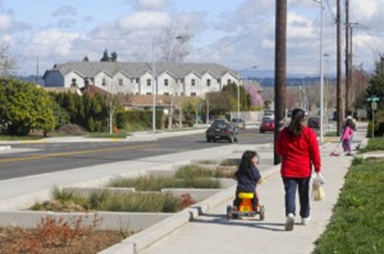
Health Equity and Environmental Justice
Levels set to protect the most vulnerable
Addresses cumulative risk from multiple pollutants at sources
Prioritize sources based on communities of color, low income and children< 5 years old
Public access to information
More opportunities for public involvement
Notes:
[Gabriela?]
Health equity and environmental justice concerns were a major focus in the rulemaking advisory committee for many of stakeholders, and for the rules team. The proposed CAO rules are designed to take account of the disparate impacts of industrial air pollution on communities of color and people with low incomes, and particularly children in those groups. CAO does this in several ways:
One is using by science that considers people who may be most sensitive to the health effects when emissions from an industrial facility are being evaluated.
Another is considering cumulative risk -- the idea that we don’t consider the effects of each chemical separately, but recognize that people are breathing multiple chemicals. The rules take this into account by addressing the combined health risk from all air toxics emitted by an industrial facility. In the upcoming area risk pilot program we will have a chance to research and develop a workable approach to addressing risk from multiple facilities.
In implementing the rules, DEQ would prioritize risk assessment work for sources with the highest risk that impact, communities of color, low income, and where children under the age of 5 live.
Next, the rules would give us all more transparency and access to information than we currently have about the range of air toxics coming from facilities, and people nearby would receive notice when changes are proposed to facilities in their area.
Cleaner Air Oregon places special emphasis on the environmental justice goal of providing communities with meaningful opportunities to participate in decisions that could impact local public health. We have plans to develop a community engagement protocol and conduct effective two way communication with communities impacted by industrial toxic air contaminants.

Slide 15
How Would Cleaner Air Oregon Work?
Report air toxics
Companies to report use of 600 pollutants to state regulators
Assess risk
Facilities calculate potential health risks to people who live, work, and go to school nearby
Regulate to reduce risk
Companies would have to act if the levels of air toxics they emit exceed health risk action levels (RALs)
Notes:
[Gabriela]
So, how would Cleaner Air Oregon work?
The proposed program would have three main parts:
Click - First, facilities would be required to report their emissions of up to 600 toxic air contaminants. This information would be available to the public so people can find out what facilities near them are emitting.
Click - Next, facilities would have to calculate potential health risks from those pollutants to people living, working or going to schools nearby. How this risk is measured also takes into account how close people are to the facility. These risk calculations would consider a wide range of health problems from both short- and long-term exposures. Some examples of possible health problems include an increased risk of cancer, birth defects, breathing problems, and eye and skin irritation.
Click - Lastly, facilities would be regulated based on the specific health risks associated with their emissions. You’ll hear more about the regulatory side from Keith later in this presentation.

Slide 16
How Health Standards Are Used in CAO
Toxicity Reference Values (TRVs)
Exposure duration, exposure frequency, and multi-pathway adjustment factor
Risk Based Concentrations (RBCs)
Emissions modeling to calculate concentrations in air at specific locations
Calculated Risk Levels
Compare calculated risk to Risk Action Levels to determine what action is required
Notes:
[Gabriela]
This slide goes into more detail on how the CAO risk assessment process works.
The basis for those risk assessments are Toxicity Reference Values or TRVs.
Toxicity reference values are the levels of exposure to each chemical that are not expected to harm health. They are set based on values from authoritative agencies such as the Environmental Protection Agency, the California Office of Environmental Health Hazard Assessment, and the Centers for Disease Control.
For CAO, we start with chemical-specific Toxicity Reference Values from these authoritative sources. We then use a series of adjustment factors to set Risk Based Concentrations, or RBCs, that reflect specific exposure scenarios. We would use those RBCs to calculate health risks in specific exposure scenarios.
For example, if there is a residence affected by a facility’s emissions, we would assume a child lives in the residence and is there 24 hours a day. If instead there is a workplace, we would assume exposure to adults working a regular shift.
DEQ will also consider other information, such as distance to where people are, the wind patterns, and facility stack height, when calculating risk. Emissions from a facility that is in a remote location could pose less risk than a similar one located in the middle of a city or town.
Once we calculate a facility risk level, we would then compare that risk to the Risk Action Levels that determine what actions may be required under Cleaner Air Oregon.
I’ll hand it back to Keith now to talk about the risk assessment process and CAO permitting activities

Slide 17
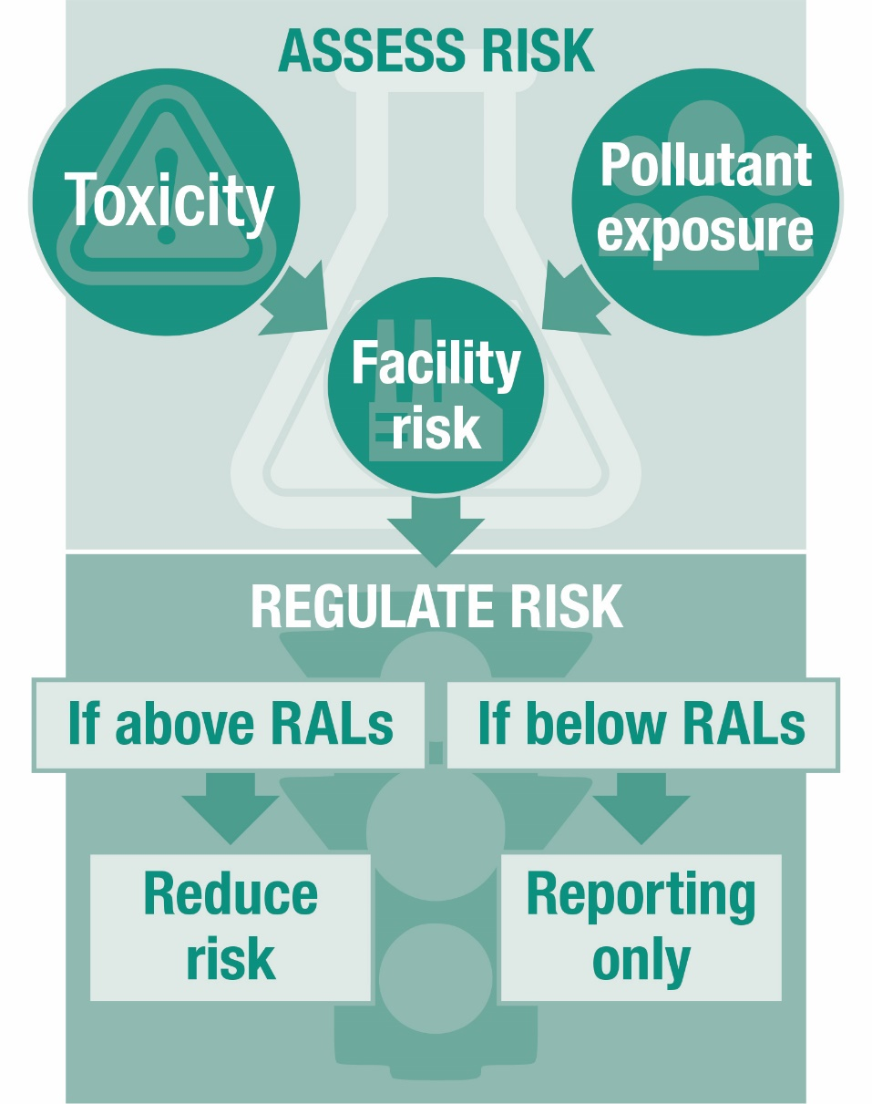
How CAO Would Protect Health
Notes:
[Keith]
Thank you Gabriela. I like to think of this process as having two phases- a risk assessment phase and a risk management phase. So far we’ve covered the assessment phase, which tells us what the risk is.
As noted, once the risk has been calculated, that risk is compared to appropriate benchmarks, or Risk Action Levels. If the risk is above Action Levels, the facility must reduce risk, or show that the best control equipment is already installed. Many businesses will be below action levels, and will not need to make any changes, but would still have to report their emissions. There are separate risk action levels for new facilities and existing facilities, and for cancer and noncancer health effects. They can be found in Table 1 in the rules, and are represented graphically on the next slide.
You could think of this process somewhat like checking someone’s health status. First, you have to measure weight, test your blood for cholesterol, do an EKG, and complete other tests to get a picture of someone’s health. Then those results are compared to what’s considered healthy for that person, and recommendations for specific actions to address any risk factors that may be determined.

Slide 18
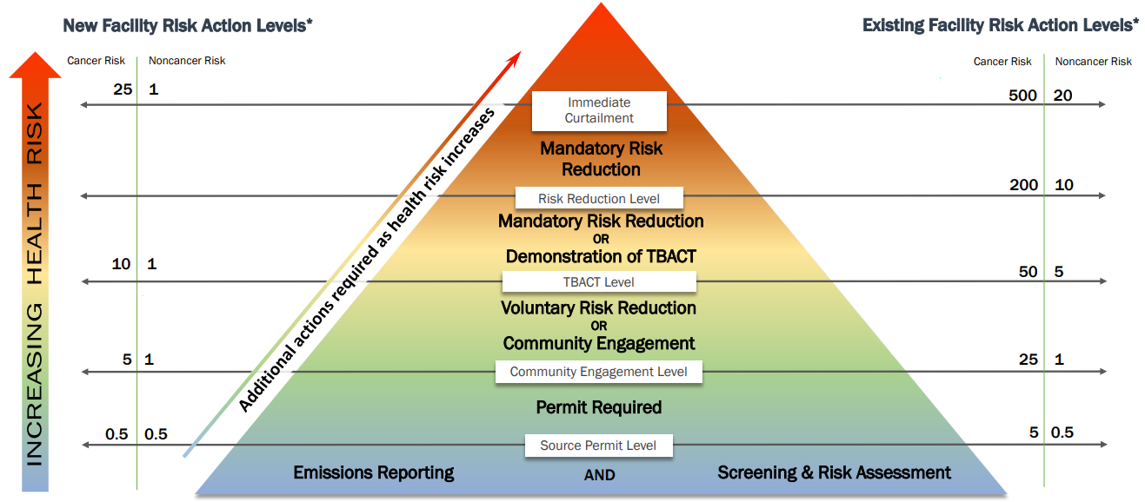
Proposed RALS
Notes:
[Keith]
These Risk Action Levels, or RALs, are another of the key building blocks of the program. Science will tell us what a facility’s risk is, and once that’s known, the RALs represent policy decisions about what level of risk requires action. Risk limits vary from state to state, and sometimes even within states.
The RALs have been the subject of keen interest by all stakeholder groups, including community advocates and industry. There were many debates about these proposed RALs, which eventually were addressed by the Oregon State Legislature. SB 1541 set values for many RALs, including the levels at which a facility would need to reduce their risk.
As you can see there are several different action levels, each triggering different requirements or considerations. On this graphic new facility action levels are on the left side and existing facility action levels are on the right.

Slide 19
Risk Assessment and Permitting Process
Permit addendum issued
Completed Risk Assessment
Permit Application
Emissions Inventory
Facility called in
Modeling Protocol and Risk Assessment Work Plan
Risk Reduction Plan - TBACT analysis
Public Notice / Hearing
Ensuring compliance with permit conditions
Community Engagement
Notes:
[Keith]
Any actions that a facility needs to take based on their assessed risks, and appropriate action levels would then be incorporated in their permits. This diagram is a simplified view of the overall CAO process, showing the risk assessment and permitting process that a facility would go through in CAO. The boxes in green represent actions that the facility would take, and boxes in blue are ones that DEQ and OHA would take. This example is for an existing facility. But, the process for a new or modified facility would be similar.
For an existing facility, their requirements in CAO would start when they are called in to the program. Existing facilities don’t need to do a risk assessment or take other actions until they are called in.
Once an existing facility has been called in to the program, the first thing it would need to do is submit an updated emissions inventory for the full suite of about 600 chemicals. Existing facilities have a head start because they’ve already had to submit an air toxics emissions inventory. But, this one will have some additional details, such as information about the maximum daily emissions, which is needed to calculate acute risk. DEQ would review the emissions inventory.
Once DEQ approved it, the facility would move on to the next step, submitting a Modeling Protocol. If the facility plans to do a relatively complex (Level 3 or Level 4) risk assessment, then they would also need to submit a Risk Assessment Work Plan.
Once DEQ has reviewed and approved those, the facility would then complete the risk assessment and submit that to DEQ. DEQ would review and work with the facility to finalize the assessment.
These review and approval cycles are intended as a way to ensure facilities are on always on track, and will generate a final risk assessment that DEQ and OHA can approve. It sets up a collaborate review cycle so that there are check in’s along the way and that disagreements are identified and resolved as early as possible in the process. It is also intended to give DEQ tools to ensure risk assessments get completed in a timely manner- our experience in the DEQ cleanup program, and in discussions with other state’s air toxics programs is that risk assessments often take too long- over 5 years at times.
If the risks need to be reduced, then the facility would also need to submit a risk reduction plan. This plan could include the steps or equipement the facility has identified to reduce risk, and an analysis of existing controls showing that one or more are the “Best Available”.
All these documents would be part of their application for a CAO permit addendum.
Communities have told us throughout the CAO rulemaking process that information and involvement are important to them. So, we plan to do community engagement throughout the process we’ve just been discussing. Depending on the community, that may include public meetings to review the emissions inventory, risk assessment, permit application and other documents, before DEQ has drafted the permit. Once DEQ has drafted the permit, every CAO permit addendum would have a public notice process, which may include a public hearing in addition to any community engagement that has come before. Once DEQ has issued the permit, DEQ will ensure that the facility is complying with their CAO permit limits through inspections and reviewing required reports.

Slide 20
Engaging Communities
Rules specifically address community engagement
Required if risk above 25 and 1
Notification and meetings before permit is drafted
DEQ and OHA to develop protocol
Stakeholder participation
Use engagement best practices
Engagement will be tailored to community
Detailed pollutant and risk information available
Notes:
[Keith]
Here’s a little more detail on the community engagement process. The proposed rules for existing facilities provide minimum requirements and options for DEQ to conduct community engagement at the cancer risk action level of 25 in a million excess cancer risk and the non cancer hazard index of one. For new facilities those values are 5 and 1.
Community notification and meetings would occur much earlier in the permitting process than under our existing permitting program, and be in addition to the standard draft permit hearing at the end of the process. Sources would be required to attend community engagement meetings but those that agree to voluntarily reduce risk below 25 in a million and a Hazard Index of 1 would not have to attend a formal community meeting or pay the community engagement fee.
SB 1541 and this rule package provide funding for two full-time staff positions to ensure robust, proactive community engagement and coordination: a community coordinator at DEQ and a community engagement and health education specialist at OHA. The specific community engagement rules and legislatively adopted resources for CAO set this program apart from others at DEQ.
As outlined in attachment H to the Staff Report, the new DEQ and OHA positions will lead development of a full set of procedures and guidelines that will allow greater flexibility in working with communities to keep neighbors informed and involved in the process. These procedures will be based on community engagement best practices, and there will be an opportunity for public and stakeholder input as we draft these procedures and develop these tools. Compared to having a prescriptive process in the regulations, this will allow for greater detail and flexibility to tailor the community engagement process to the needs of communities. For example, in a particular community, staff would use demographic and local information to determine the most effective types of communication and meetings, best timing of information and events, and any language translation needs.
It remains an important goal of Cleaner Air Oregon to give communities a chance to understand risk assessments, ask questions, and provide input into key decisions for managing risk from toxic air contaminants. The program is structured to require and provide access to a great deal of new detailed information on pollutants emissions and potential risk to public health.

Slide 21
Flexibility For Business
Have an off ramp for low-risk facilities
Let companies choose the best way to reduce emissions
Consider existing investments in pollution controls
Investment timelines for existing facilities
Notes:
[Keith]
The proposed rules have several parts that DEQ designed in to reduce burdens and make it practical for businesses to comply.
There is an off ramp for facilities with lower risk emissions: smaller facilities will likely not be affected because of this lower risk.
The rules let companies choose the best way to reduce emissions: the proposed rules look at the risk from the whole facility, not stack by stack. If risk needs to be reduced, a company can evaluate any part of its operations to reach this goal, not just one specific stack. They could use safer products, change how they operate, or install new controls. These limits can also be reflected in a variety of ways in a permit addendum- either based on risk, emissions rates, or production.
The rules allow us to consider if a facility has best available emissions control installed. Many facilities have already installed the best controls they can. These “best controls” are often referred to as “TBACT, which stands for Best Available Control Technology for Toxics. If this is the case, the company may not need to make further reductions. Also, emissions from the combustion of natural gas or propane won’t be counted towards the risk that might need to be reduced.
The rules also provide flexible timelines for reducing risks, if warranted. We know that every facility is unique and certain controls may take more or less time to achieve. DEQ can allow more time to address these concerns, if the facility can show the time is needed.

Slide 22
Fee and Funding Overview
As authorized by SB 1541, DEQ has proposed to set ongoing fees in rule to fund the program
Annual base fees
Specific activity fees
Fees would fund 11 new positions at DEQ, and existing OHA staff: a mix of permit writers, toxicologists, air monitoring and modeling analysts, community liaisons and IT support
Notes:
[Keith]
Click - Senate Bill 1541 also authorizes DEQ to set recurring base fees and specific activity fees sources will pay beginning in 2019 to support the program. The bill also allowed DEQ to charge sources a one-time supplemental fee to finish developing and start up the Cleaner Air Oregon program. These supplemental fees are set in statute.
Click - Base fees moving forward need to be established in rule and ratified by the legislature in 2019. Base fees charged in 2019 through 2023 are limited to no more than 35% of a facility’s ACDP or Title V base fee charged in 2018.
Click - Since the base fees do not cover all of the Cleaner Air Oregon costs, DEQ is also proposing a schedule of specific activity fees to cover DEQ’s cost to review risk assessments, risk reduction plans, and other documents. Having specific activity fees keeps costs down for facilities with lower risks.
Click - The legislature authorized 11 new DEQ Limited Duration positions covering a mix of duties including permit writers, toxicologists, air monitoring and modeling analysts, community liaisons and IT support. The legislature also approved a pass through of fees to the Oregon Health Authority to pay for existing staff toxicologists, health education, and risk communication staff to assist with rule development and implementation.
DEQ will seek to convert the DEQ positions to permanent status during the 2019 legislative session along with the fee ratification request.
------------
note:

Slide 23
Fiscal Impact Statement
DEQ used best available information to estimate both negative and positive impacts
Estimated: fees, costs for analysis & different types of pollution control
Considered estimates of number and extent of affected sources, extent of existing public health risks and potential for future risk reduction
Changes from SB 1541
Addressing small business impacts
Notes:
[Keith]
All state agencies are required by law to consider the economic, or fiscal, impact of any new rules. In other words, we have to analyze and understand how much the rules might cost businesses to comply with, and what cost savings there may be. To do this, we performed a fiscal analysis that considers the potential costs to businesses as well as potential benefits to health.
DEQ was able to estimate the fiscal impact of fees, risk assessment and analysis costs, and potential purchase and operational costs of pollution control equipment. However it was not possible to quantify the exact potential costs and benefits of the program before it is implemented. We can’t put dollar amounts on this analysis because we don’t know exactly what each business is emitting, and therefore what steps they may have to take to reduce risk, if any.
The fiscal impact statement is not part of the rules, but was amended to reflect changes in the rules required by Senate Bill 1541. Because Senate Bill 1541 resulted in higher, less protective risk action levels and an allowance for consideration of existing control requirements, there was an estimated decrease in potential costs to business and potential health benefits.
We anticipate that Cleaner Air Oregon will have a wide range of both potential health benefits for the public and costs to business, including potentially significant impact on small businesses. As a result, DEQ included rule provisions to mitigate impacts on small business. Let’s look a little closer at these measures.

Slide 24
Reducing Small Businesses Impacts
Technical Assistance
Emissions inventory and first level risk assessments
Technical assistance in permitting process
Regulatory Thresholds
Higher RALs
Higher de minimis risk level
Consideration for existing controls (TBACT)
Fees
Lower base fees for general or basic ACDP permittees
Timing
Tiered implementation
Additional time to comply with risk levels
Can apply to postpone risk reduction if financial hardship
Notes:
[Keith]
Numerous small business mitigation measures are included in the proposed rules. Some were developed by DEQ, and some were suggested by the fiscal advisory committee.
For the most part, smaller sources on General and Basic Air Contaminant Discharge Permits (approximately 2,200 sources, including gas stations and dry cleaners) would not be required to prepare and submit an emissions inventory, as is required for all other permitted sources. These businesses would not be required to perform Level 1 risk assessment either. DEQ would do both the emissions inventory and the Level 1 risk assessment for these sources. There some business in this category that we would need more information from to do these calculations. This is consistent with fiscal advisory committee small business mitigation recommendations on providing technical assistance.
The program would include a technical assistance staff person to help sources explore and analyze emission reduction options if they are required. Including this staff position is in direct response to recommendations from the Advisory Committee.
Fiscal impacts to businesses, including small businesses, generally decreased between the 2017 and 2018 draft regulations because risk action levels became less stringent under SB 1541. The allowance for existing controls should also decrease costs.
Sources that are de minimis or exempt would not need to take action to obtain a permit or reduce risk under Cleaner Air Oregon. DEQ raised these de minimis levels to reduce the impact on these smaller sources.
Cleaner Air Oregon base fees are a percentage of existing permit base fees. Many smaller facilities are on General or Basic Air Contaminant Discharge Permits, which have lower base fees and whose CAO base fees would also be low. This is consistent with fiscal advisory committee small business mitigation recommendations on providing lower fees for small businesses.
Given the lower potential for higher risk emissions, smaller businesses are likely to be called in later in program implementation, after the higher risk facilities, delaying regulatory costs for some smaller businesses.
Businesses, including small businesses, can apply to delay or postpone risk reduction based on financial hardship.
In addition, DEQ may opt not to require new businesses applying for these simple permits to address CAO requirements immediately. Rather, we intend to evaluate these permits themselves to see if they are protective.

Slide 25
Key Issues in CAO Development- Assessing Risk
Risk assessment vs. risk management
Setting health values and protecting sensitive populations- TRVs, RBCs
Cumulative and Area risks
Benchmarks and Risk Action levels
Notes:
Keith
The next two slides are a summary of some of the most important issues we dealt with over the course of this rulemaking process. We’ve touched on some of these issues in past slides but we thought it would be helpful to provide the commission some discussion on these topics.
Probably the most challenging aspect of the rulemaking process was establishing the risk assessment process, which is really what makes this program “health based”- it’s the “new and different” part of the entire process we’ve been working on. Each state program has unique assumptions and approaches to the risk assessment process. Setting up a risk assessment process involved choosing health values- the TRVs, which are the building blocks for the assessment process. We fielded many comments on what values to use, and we propose to use values only from established, nationally recognized sources (EPA, ATSDR, and California), and using the most recently established or most relevant value from those sources. We’ve also proposed to reevaluate these values periodically. Some commenters wanted us to use more sources, but we don’t have the resources to evaluate all the possible sources and weigh their credibility - in fact, this is what EPA, ATSDR and CA have already done, which is why we propose using those sources. We received many comments about using the most recent values from these sources, which is what we propose in these rules.
Determining how the risk values- or RBCs- should be calculated was also challenging, and another area of policy that varies state to state. We received a lot of input and questions about our proposals- including from this Commission. There are a myriad of assumptions that go into calculating these values- how long people live in their houses, their vulnerabilities and age, and others. In the end we decided to largely follow EPA’s nationally accepted processes. After some in-depth review, some in response to this Commission’s questions, we believe what we are proposing is protective of children, and other sensitive and vulnerable populations.
Part of the risk calculation also involved addressing cumulative risks and we received many comments about this topic. Cumulative risk really means two things- adding risks from a facility emitting different air toxics together to get an “additive” risk, and taking that one step further to then add those risks together with risks from a neighboring facility to get an “area” risk. Some programs will add risks together this way from a single source, others don’t. We didn’t find any programs that regulated risks from multiple facilities. In the end we have proposed to keep the “additive” or “cumulative” approach to risks from a single source. Additionally, the legislature established a pilot “area risk” program, which will be the topic of future program and rule development.
The last bullet on this slide - the benchmarks, or risk action levels, was perhaps the most challenging policy issue in the rulemaking process. These values are the “risk management” part of regulation - they are policy choices of what level of risk is deemed “actionable” and what level isn’t. Again, different states and air juridictions have different values. We received a wide range of input on what these values should be. In the end, the legislature established several of the benchmarks, which we have reflected in these proposed rules.
There are certainly programs with stricter values, but there are many different assumptions that lead to the overall level of protection that a program establishes. Taken in sum, we believe that the risk assessment process- and the associated action levels we are proposing establish one of the more protective programs we’ve seen.

Slide 26
Other Key Issues in CAO Development
Community Engagement
Environmental Justice
Considering existing pollution controls
Risk Action Levels
Director Consultations
De Minimis levels
Community engagement
Risk limits and permitting
Notes:
Keith
WIth this slide we’ll discuss more of the critical program issues, which show the push and pull of establishing a program that protects and involves communities that may be affected by air toxics emissions, yet also is sensitive to the impacts that a program and its costs will have to businesses.
Engaging surrounding communities, and considering environmental justice concerns are a core tenet of the program. While this program as proposed today does not directly address “area” risk from air toxics that may be present in some communities, we are proposing to prioritize those communities, and engage all communities in the evaluations and decisions we make about risk that emissions from a facility may be posing. Again, this is an area where the legislature ended up weighing in by requiring DEQ- not the sources themselves- to conduct the public engagement and involvement activities that the program calls for. We believe having agencies manage the engagement process will give us a lot of flexibility to work with communities in ways that address their needs, rather than prescribed procedures. We also retain the ability to call facilities into those community meetings as needed. Bringing communities and businesses together is always the best way to build trust, communication and solve problems.
Being sensitive about the costs of this program to businesses, as we’ve previously discussed, is certainly important to Oregon industries. A key component in the cost equation is how the program will consider existing emissions controls that facilities have installed to comply with other regulations. While our original proposal in 2017 contained a pathway for these controls to be considered, the legislature codified this consideration, as long as the controls actually address the air toxics emitted by the facility. This will streamline “TBACT” determinations for many facilities, and will allow us to learn a lot more about how these controls work, and what if any gaps remain.
Moving to the fourth bullet on this slide, while the legislature established many of the RALs in statute, other action levels remained for proposal in rule and were the subject of many comments. The “Director Consultation” level was one such issue. We originally proposed a “Director Consultation” for very high levels of risk, which meant the DEQ Director would consider a variety of inputs from business, communities and other agencies and then make a final decision whether to allow higher risk operations at a facility. This concept generated much concern and criticism from all perspectives, and was dropped from further proposals- it was replaced by clear numerical levels for these high risk levels, built off of levels established by the legislature.
In addition to setting maximum risk levels, there are also RALs that set minimum values, below which a facility doesn’t need CAO permit conditions in their permit. We received comments that said that our de minimis levels were too low, so that we would be permitting facilities with risk far below other action levels. After weighing that argument, DEQ and OHA’s new proposal would raise the source permit level for cancer for existing facilities from 0.5/million to 5/million. We believe this will allow agencies to focus important resources on facilities with higher risk emissions, and provide more certainty and less requirements to facilities who pose very little risk. We decided to keep the non-cancer de minimis level as it was, at a Hazard Index of .5.
The proposed rules have a specific action level for community engagement, above which DEQ can require that a representative of the facility attend public meetings. Some comments said formal community engagement should only be required when DEQ can require risk reductions. But, given that the legislative benchmark raised these levels from the existing proposal, community advocates remained concerned about risk below these levels, so we didn’t change the Community Engagement RAL part of our proposal. It remains unchanged from the levels proposed in the 2017 draft rules, as the legislation did not address when community engagement should happen.
Similarly, some comments said that we shouldn’t have permit limits for facilities that are below the level at which DEQ can require reductions- what we call the “TBACT” level. We decided that it was important to keep that feature in the rules, so that facilities with risk below the limits at the time of their risk assessment continue to show that they meet those limits. This will allow both facilities and agencies to better understand emissions and potential emissions into the future.

Slide 27
Steps for Implementation
Preparing for permitting new facilities and major modifications
Existing facility prioritization and call-in
Integrating CAO with existing DEQ permitting
Internal training
Software and tools
Communicating with the public and businesses
Notes:
[Ali]
In conjunction with our work on the proposed rules, DEQ and OHA have also been putting some thought into how we would implement the rules if adopted.
One of the first things that DEQ and OHA would need to be ready for is permitting new facilities, and major modifications of existing facilities. Starting on the effective date of the rules, applications for a new facility permit would need to address the CAO requirements. This would not necessarily apply to applications for smaller permit types such as general and basic permits, such as rock crushers, bakeries, and gas stations- they would not have to go through CAO unless DEQ takes action to require that. Rather, we plan to evaluate these permits “categorically” to see if the general permit itself is protective. Existing facilities that are proposing certain kinds of major modifications would also need to go through CAO.
If the Commission approves the proposed rules, DEQ would also prepare for prioritizing and calling in the first group of existing sources.
To do the work with facilities, DEQ and OHA would also need to integrate these CAO processes with the existing DEQ air permitting programs. This would require intensive internal training as well as new software and program tools, such as updated forms and new guidance.
To implement the program we would also need to ramp up our communication with businesses and the public about the program.

Slide 28
Future Rulemaking Steps
Hazard Index rulemaking
Area Risk Pilot rulemaking
Future updates to CAO rules
Triennial TRV updates
2029 sunset
Notes:
[Ali]
There are additional aspects of the CAO program that aren’t included in the rulemaking package that is proposed to you today.
One of those is the Hazard Index Rulemaking, a process which was established and described in SB 1541. The legislation authorizes the Commission to set a lower noncancer benchmark (which was set at 5) at existing facilities for chemicals that are found to have “developmental” or “other severe” health effects. The new value could be as low as 3. DEQ has formed a technical advisory committee, as required by the legislation, to give us their advice, and has held the first of two meetings that are planned for that group. Proposed rules to implement this lower noncancer benchmark would likely come before the EQC in 2019.
As previously mentioned, SB 1541 also authorizes DEQ to set up an area risk pilot program in the Portland area. The proposed CAO fees would provide funding for one position to develop a program, and possibly rules, as the first step toward creating that pilot program. That position would likely be hired in mid-2019.
If the Commission chooses to adopt the CAO rules package before you today, there will be updates to those rules in the future. In addition to the inevitable rule tweaks that a new program like this will require, the rules also call for agencies to evaluate new toxicology information and propose updated TRVs and RBCs on a triennial basis.
In addition, SB 1541 contains a “sunset” of some of the benchmarks, or RALs, in 2029, after which the Commission could change where the Risk Reduction Level is set. Changes to those levels would need to be implemented through a rulemaking.

Slide 29
CAO Program Reporting
2-year and 5-report to EQC (Attachment I)
Five-year rule review
2026 report to the Legislature
Notes:
[Leah]
We appreciate the Commission’s interest in this proposed program, and you’ve indicated that if adopted you’d like to hear updates in the future about our progress. There are several future reports that DEQ will produce if the Commission adopts the rules.
One is a 2-year report to EQC. This would be a status report with metrics related to the implementation of the program. It would include implementation progress and ideas and plans for future improvements.
There would also be a 5-year report to EQC. It would be a status report with metrics that estimate reduced health risks due to reductions in exposure to air toxics. The report would also assess new science and advances in the protection of children’s health and provide any recommendations for proposed changes to the program. And, it would include an update on the Area Risk Pilot Program.
Both of these reports to the EQC are described in Attachment I, and mentioned in the recommendations to adopt the rules.
In addition, when new rules are adopted, there is an existing requirement for all new rules, for a 5-year review to determine whether:
The rule has had the intended effect;
The anticipated fiscal impact of the rule was underestimated or overestimated;
Subsequent changes in the law require that the rule be repealed or amended; and whether
There is continued need for the rule.
SB 1541 also required DEQ to report to the legislature the “on the costs and benefits of regulating existing air contamination sources based on the benchmark for excess noncancer risk as defined in section 2 of this 2018 Act and based on any adjusted benchmarks for excess noncancer risk that have been applied to existing air contamination sources pursuant to section 7 of this 2018 Act. The report may include recommendations for legislation.”

Slide 30
Questions
?
Notes:
[Leah]
That concludes the informational portion of our presentation today. At this point, we’d like to pause and take any questions that the Commission has, before we make a recommendation to adopt the rules.

Slide 31
Recommendation
Proposed EQC motion language:
“I move that the Oregon Environmental Quality Commission:
Adopt the proposed rules in Attachment A and the proposed rule amendments in Attachment B, as part of chapter 340 of the Oregon Administrative Rules, and adopt the proposed changes to the DEQ source sampling manual in Attachment D; and
Approve incorporating the proposed rule amendments in Attachment B that amend OAR chapter 340, divisions, 12, 200, 209, and 216, with the exception of all references to toxic air contaminants, into the Oregon Clean Air Act State Implementation Plan under OAR 340-200-0040; and
Direct DEQ to submit the SIP revision to U.S. EPA for approval; and
Direct DEQ to prepare reports consistent with Attachment I.”
Notes:
[Leah]
Thank you for your questions. At this point, we’d like to officially make our recommendation to the Commission to adopt the Cleaner Air Oregon rules.
DEQ recommends that the Environmental Quality Commission:
Adopt the proposed rules in Attachment A and the proposed rule amendments in Attachment B, as part of chapter 340 of the Oregon Administrative Rules, and adopt the proposed changes to the DEQ source sampling manual in Attachment D; and
Approve incorporating the proposed rule amendments in Attachment B that amend OAR chapter 340, divisions, 12, 200, 209, and 216, with the exception of all references to toxic air contaminants, into the Oregon Clean Air Act State Implementation Plan under OAR 340-200-0040; and
Direct DEQ to submit the SIP revision to the U.S. Environmental Protection Agency for approval; and
Direct DEQ to prepare reports consistent with Attachment I.
------------
Note: the slide should (and does) say “proposed motion language” but speaker notes should say “DEQ recommends…”

