Slide 1
Proposed Rules for Adoption
November 15, 2018
Portland, Oregon

Slide 2
Outline of Today’s Presentation
CAO rulemaking public process
How CAO would work
Key issues
Steps for implementation
Questions
Recommendation

Slide 3
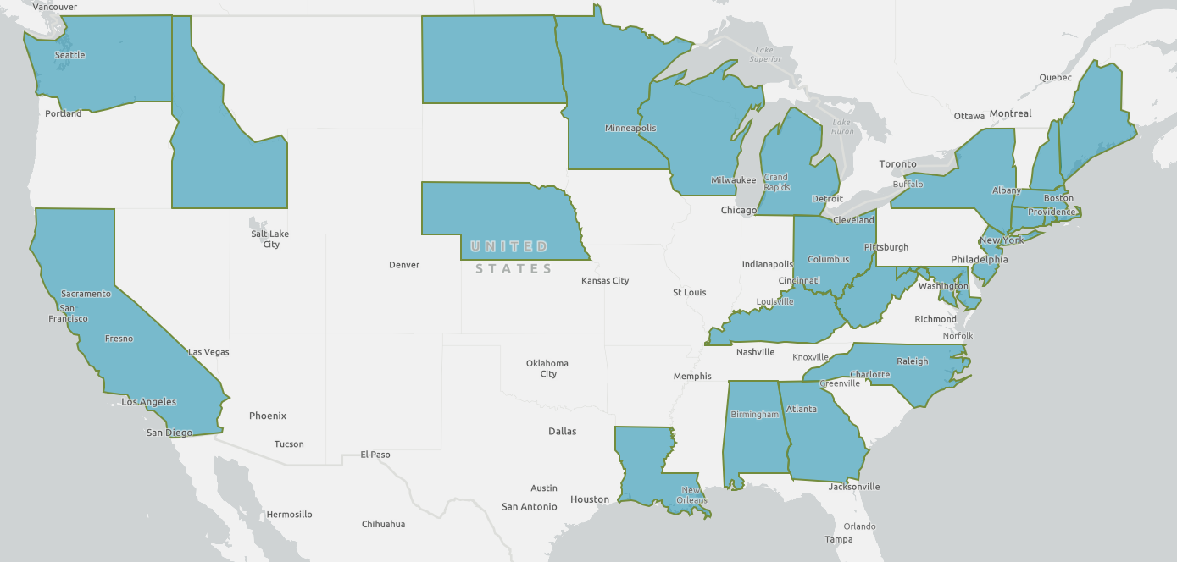
States with health-based air toxics programs

Slide 4
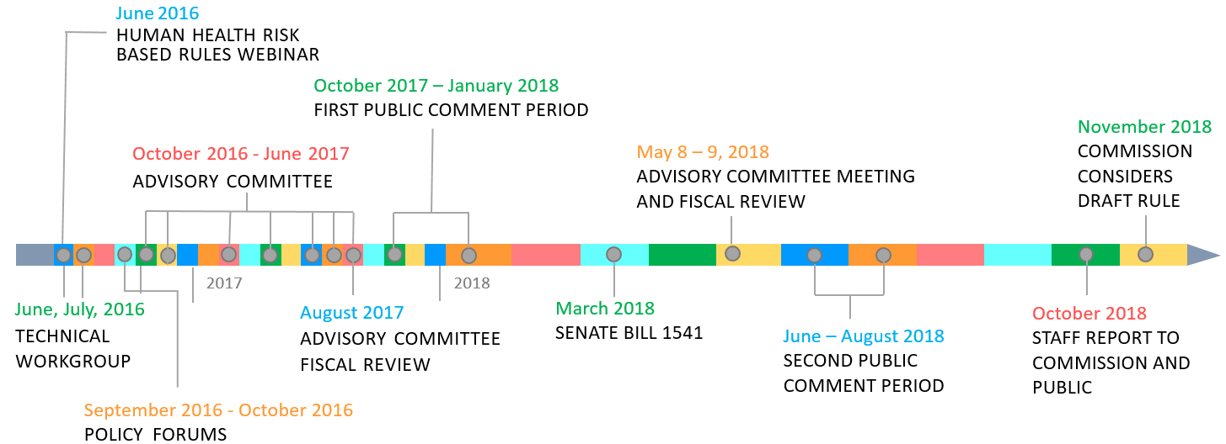
Cleaner Air Oregon Public Process

Slide 5
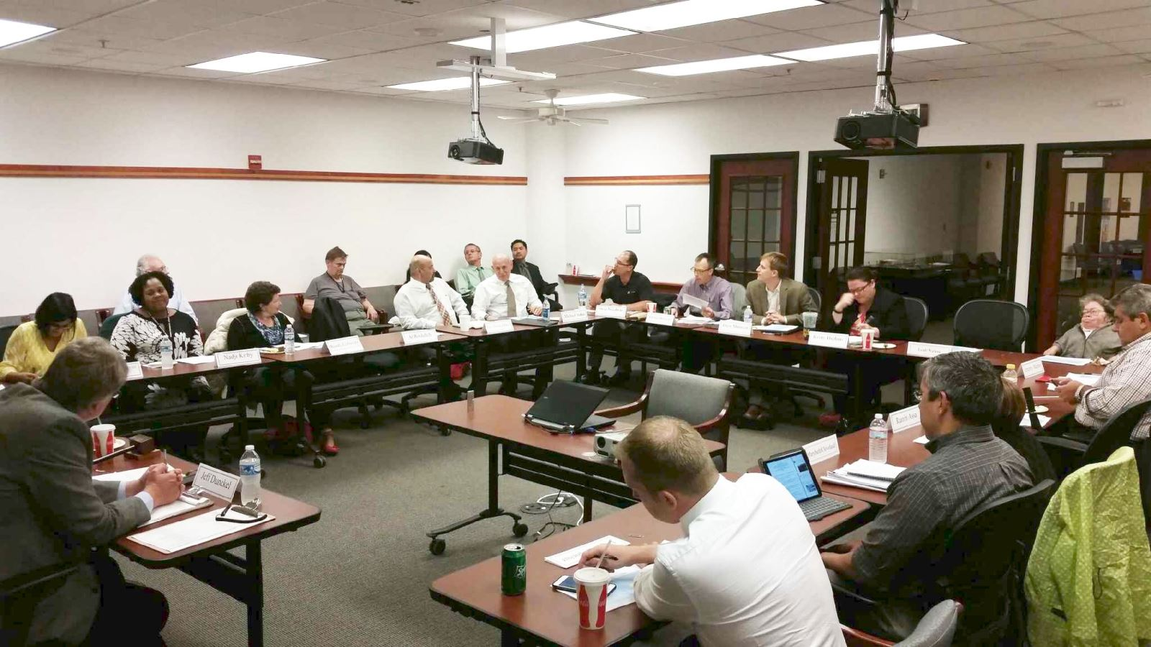
Cleaner Air Oregon Public Process
June - July 2016
4 meetings with a Technical Workgroup of national experts

Slide 6
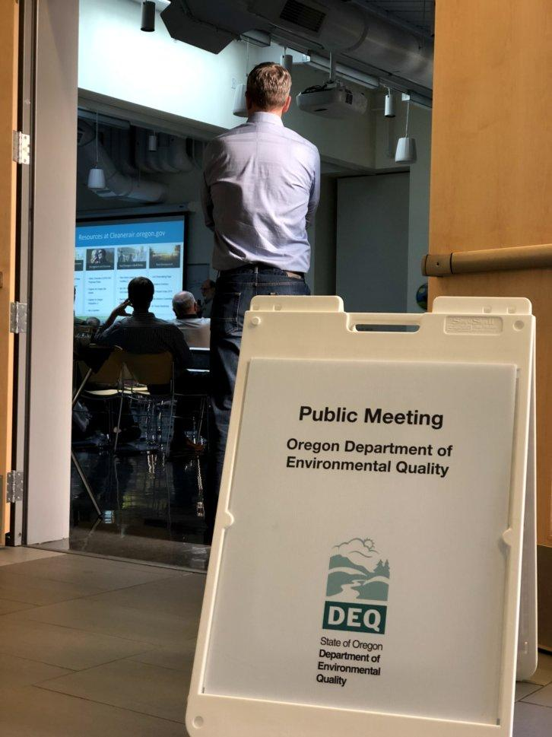
Cleaner Air Oregon Public Process
September - October 2016
4 Public Forums across Oregon to involve & get input from the public at the very beginning

Slide 7
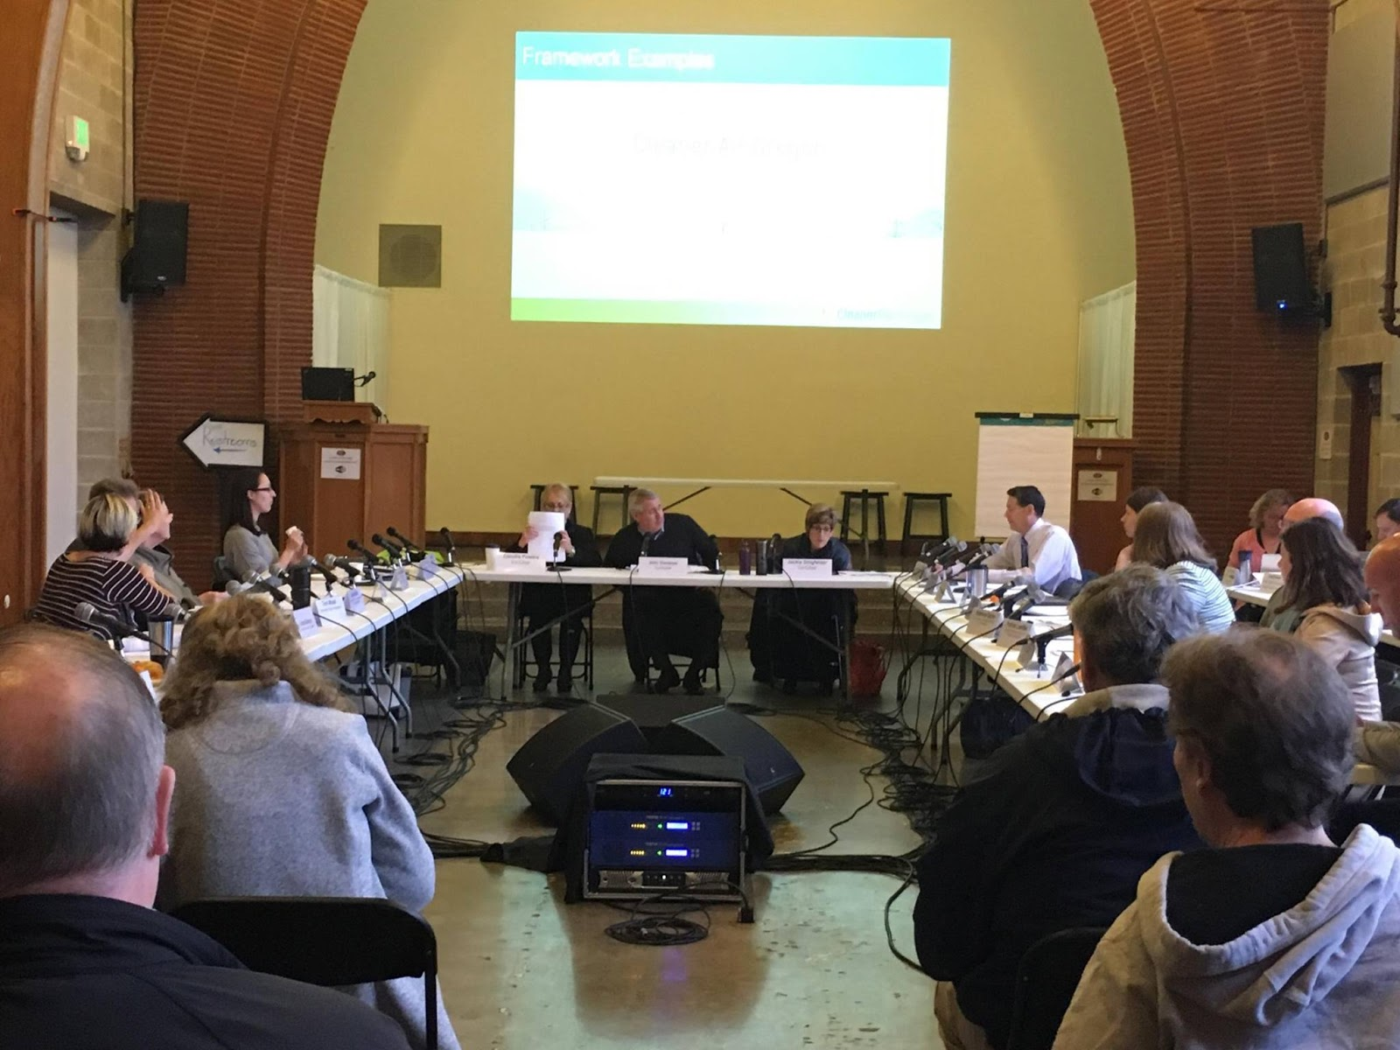
Cleaner Air Oregon Public Process
October 2016 - May 2018
23 member Rules Advisory Committee
met 8 times, for over 60 hours
also served as the Fiscal Advisory Committee

Slide 8
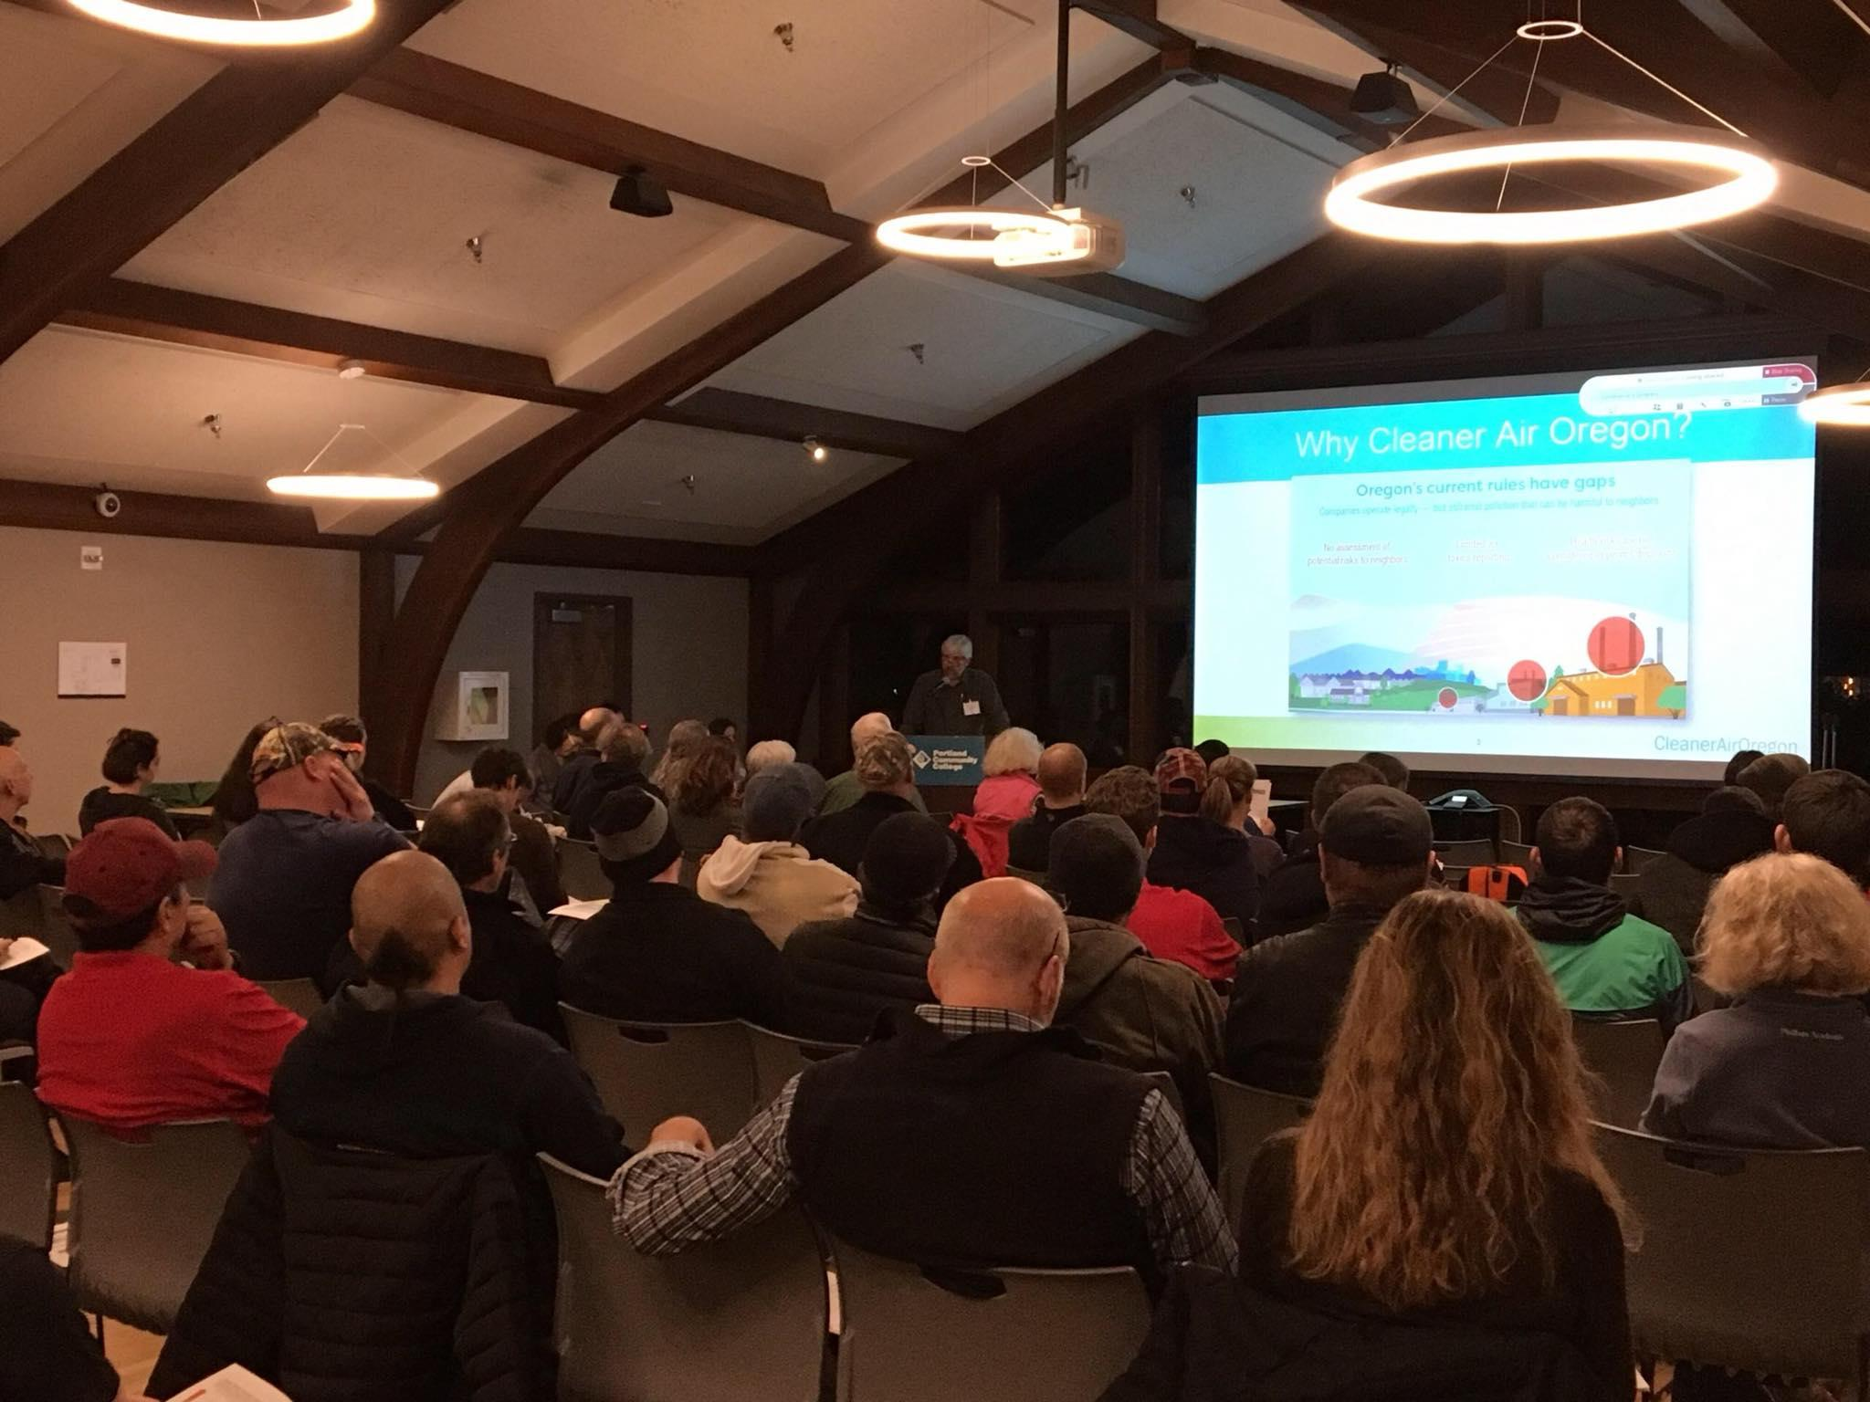
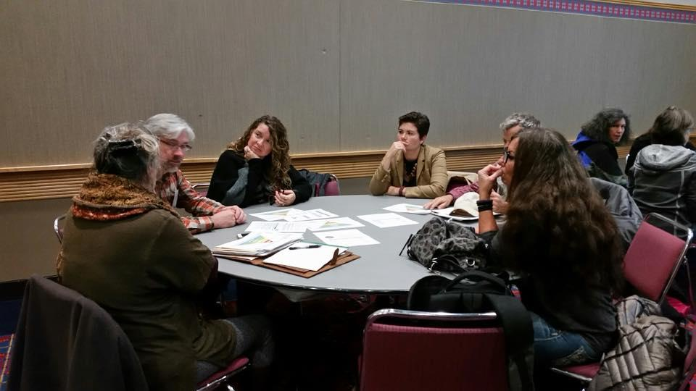
Cleaner Air Oregon Public Process
October 2016 to January 2017
First public comment period included
9 public hearings

Slide 9
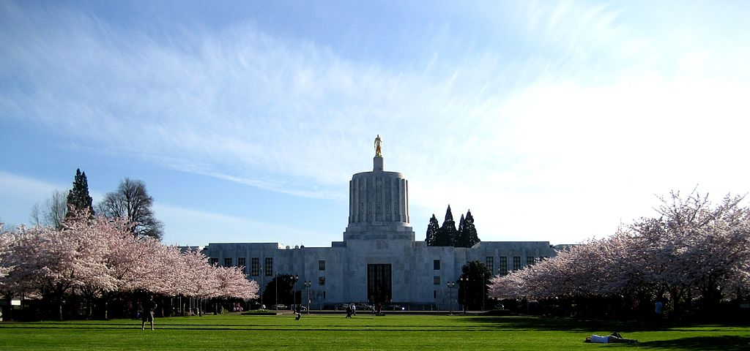
Cleaner Air Oregon Public Process
March 2018
Legislative action taken through Senate Bill 1541

Slide 10
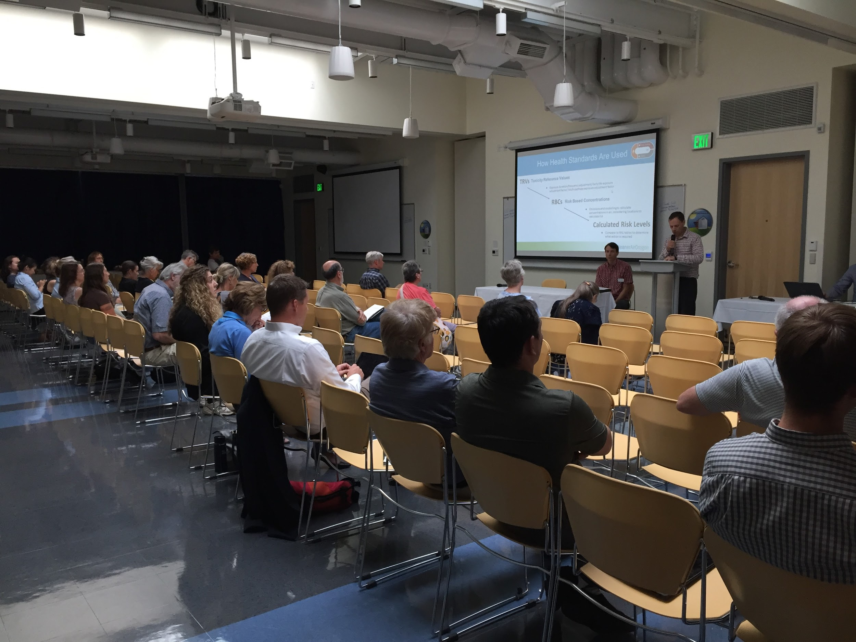
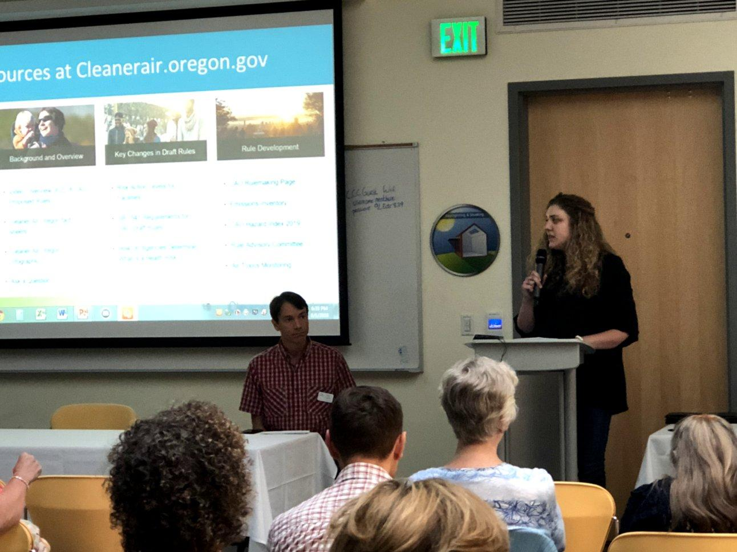
Cleaner Air Oregon Public Process
June - August 2018
Second public comment period included
2 additional public hearings

Slide 11
Cleaner Air Oregon Public Process
4,243 Commenters
931 Unique comments
410 Categories
Made changes to the
proposed rules based on
85 categories

Slide 12
Why Cleaner Air Oregon?

Slide 13
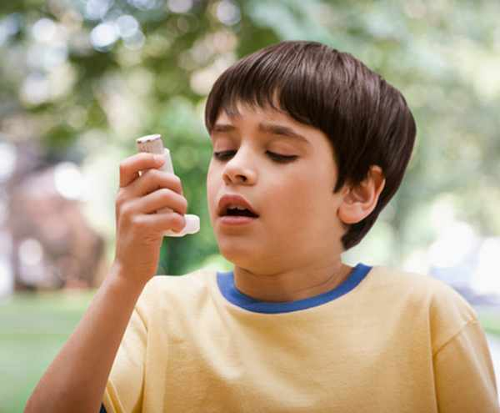
Potential Health Effects of Toxic Air Contaminants
Toxic air contaminants increase risk of a wide range of health outcomes:
heart disease
respiratory disease
cancer
liver disease
premature birth
birth defects
miscarriage
impaired fertility
neurological effects
impaired cognitive abilities
reduced immune function

Slide 14
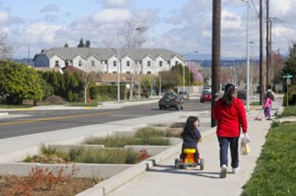
Health Equity and Environmental Justice
Levels set to protect the most vulnerable
Addresses cumulative risk from multiple pollutants at sources
Prioritize sources based on communities of color, low income and children< 5 years old
Public access to information
More opportunities for public involvement

Slide 15
How Would Cleaner Air Oregon Work?
Report air toxics
Companies to report use of 600 pollutants to state regulators
Assess risk
Facilities calculate potential health risks to people who live, work, and go to school nearby
Regulate to reduce risk
Companies would have to act if the levels of air toxics they emit exceed health risk action levels (RALs)

Slide 16
How Health Standards Are Used in CAO
Toxicity Reference Values (TRVs)
Exposure duration, exposure frequency, and multi-pathway adjustment factor
Risk Based Concentrations (RBCs)
Emissions modeling to calculate concentrations in air at specific locations
Calculated Risk Levels
Compare calculated risk to Risk Action Levels to determine what action is required

Slide 17
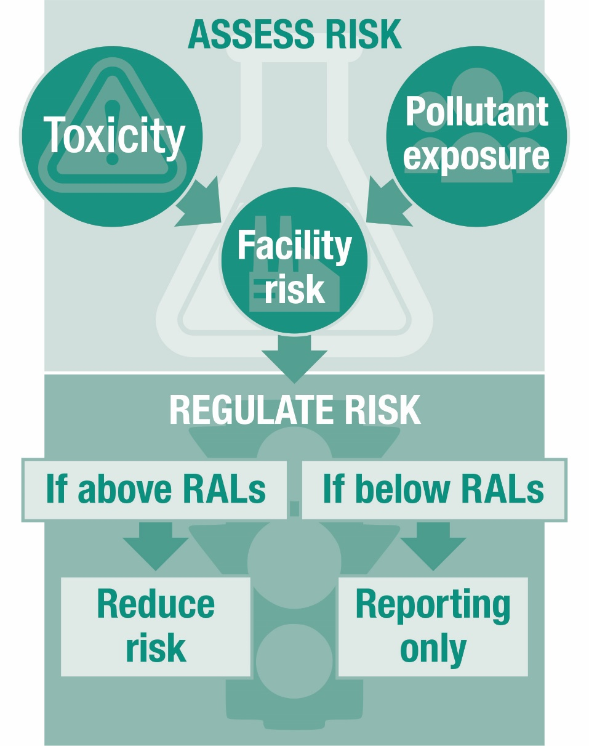
How CAO Would Protect Health

Slide 18
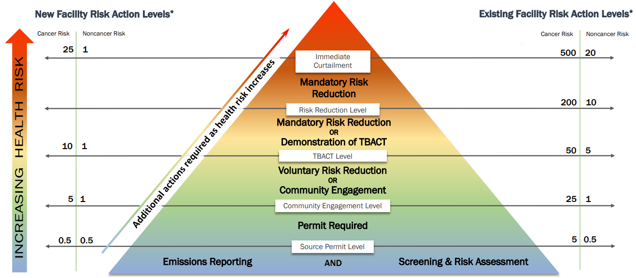
Proposed RALS

Slide 19
Risk Assessment and Permitting Process
Permit addendum issued
Completed Risk Assessment
Permit Application
Emissions Inventory
Facility called in
Modeling Protocol and Risk Assessment Work Plan
Risk Reduction Plan - TBACT analysis
Public Notice / Hearing
Ensuring compliance with permit conditions
Community Engagement

Slide 20
Engaging Communities
Rules specifically address community engagement
Required if risk above 25 and 1
Notification and meetings before permit is drafted
DEQ and OHA to develop protocol
Stakeholder participation
Use engagement best practices
Engagement will be tailored to community
Detailed pollutant and risk information available

Slide 21
Flexibility For Business
Have an off ramp for low-risk facilities
Let companies choose the best way to reduce emissions
Consider existing investments in pollution controls
Investment timelines for existing facilities

Slide 22
Fee and Funding Overview
As authorized by SB 1541, DEQ has proposed to set ongoing fees in rule to fund the program
Annual base fees
Specific activity fees
Fees would fund 11 new positions at DEQ, and existing OHA staff: a mix of permit writers, toxicologists, air monitoring and modeling analysts, community liaisons and IT support

Slide 23
Fiscal Impact Statement
DEQ used best available information to estimate both negative and positive impacts
Estimated: fees, costs for analysis & different types of pollution control
Considered estimates of number and extent of affected sources, extent of existing public health risks and potential for future risk reduction
Changes from SB 1541
Addressing small business impacts

Slide 24
Reducing Small Businesses Impacts
Technical Assistance
Emissions inventory and first level risk assessments
Technical assistance in permitting process
Regulatory Thresholds
Higher RALs
Higher de minimis risk level
Consideration for existing controls (TBACT)
Fees
Lower base fees for general or basic ACDP permittees
Timing
Tiered implementation
Additional time to comply with risk levels
Can apply to postpone risk reduction if financial hardship

Slide 25
Key Issues in CAO Development- Assessing Risk
Risk assessment vs. risk management
Setting health values and protecting sensitive populations- TRVs, RBCs
Cumulative and Area risks
Benchmarks and Risk Action levels

Slide 26
Other Key Issues in CAO Development
Community Engagement
Environmental Justice
Considering existing pollution controls
Risk Action Levels
Director Consultations
De Minimis levels
Community engagement
Risk limits and permitting

Slide 27
Steps for Implementation
Preparing for permitting new facilities and major modifications
Existing facility prioritization and call-in
Integrating CAO with existing DEQ permitting
Internal training
Software and tools
Communicating with the public and businesses

Slide 28
Future Rulemaking Steps
Hazard Index rulemaking
Area Risk Pilot rulemaking
Future updates to CAO rules
Triennial TRV updates
2029 sunset

Slide 29
CAO Program Reporting
2-year and 5-report to EQC (Attachment I)
Five-year rule review
2026 report to the Legislature

Slide 30
Questions
?

Slide 31
Recommendation
Proposed EQC motion language:
“I move that the Oregon Environmental Quality Commission:
Adopt the proposed rules in Attachment A and the proposed rule amendments in Attachment B, as part of chapter 340 of the Oregon Administrative Rules, and adopt the proposed changes to the DEQ source sampling manual in Attachment D; and
Approve incorporating the proposed rule amendments in Attachment B that amend OAR chapter 340, divisions, 12, 200, 209, and 216, with the exception of all references to toxic air contaminants, into the Oregon Clean Air Act State Implementation Plan under OAR 340-200-0040; and
Direct DEQ to submit the SIP revision to U.S. EPA for approval; and
Direct DEQ to prepare reports consistent with Attachment I.”

