Slide 1
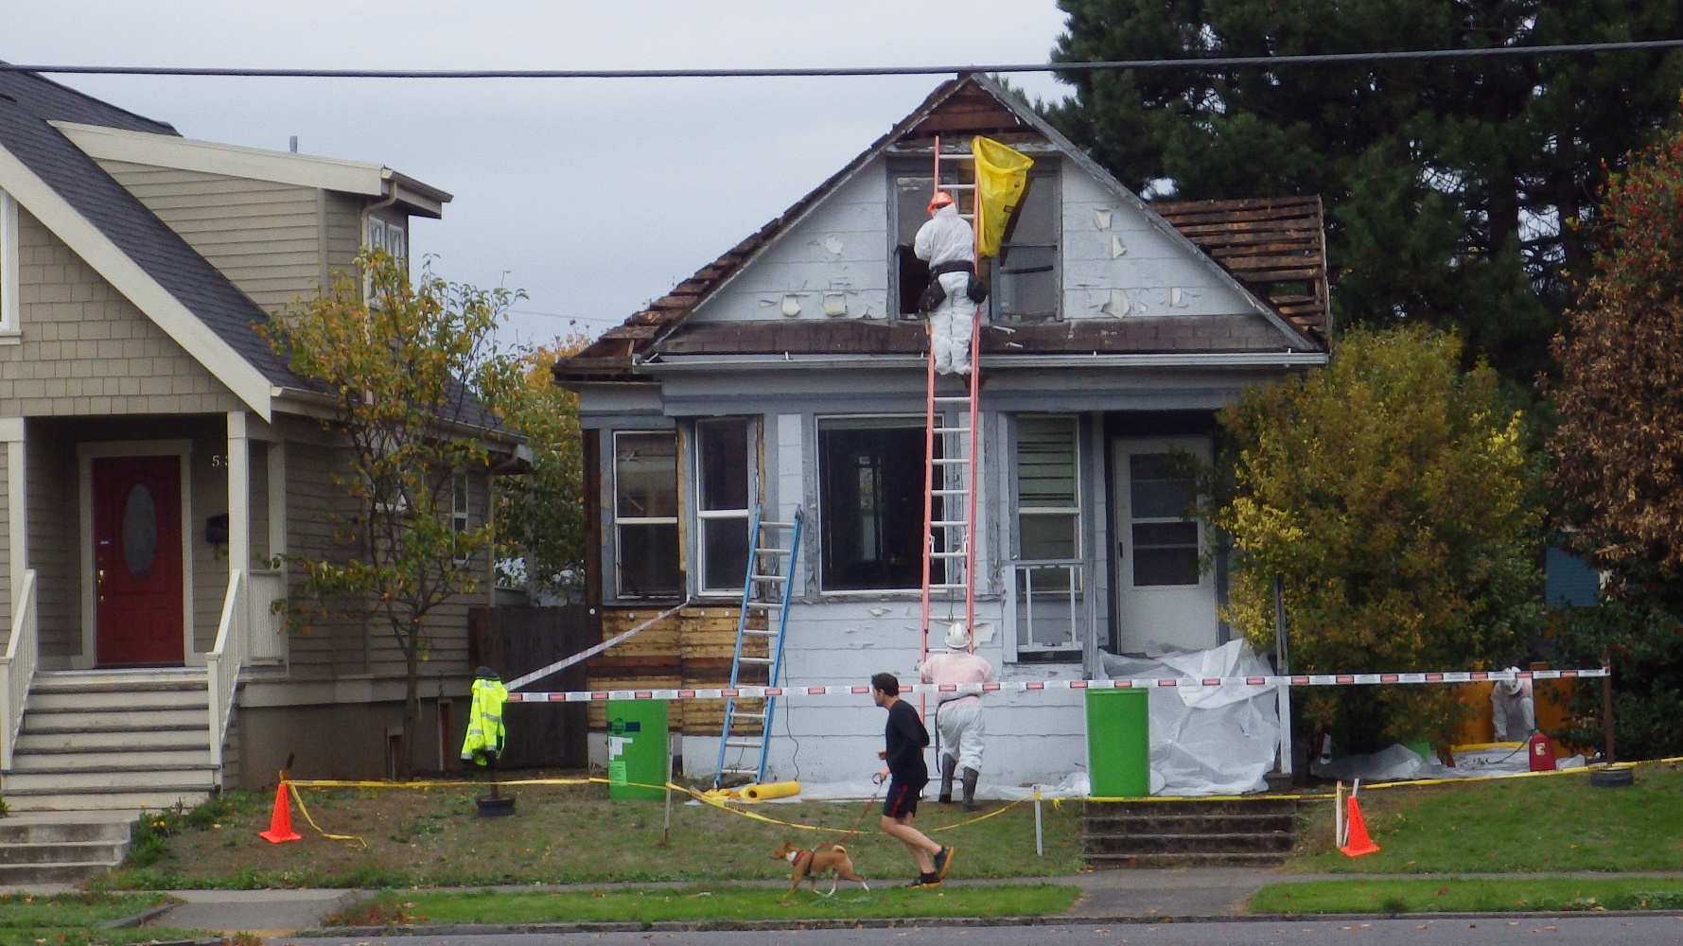
Air Quality, Asbestos 2018 Rulemaking
Program description
Asbestos abatement project
Notes:
Thank you for this opportunity to provide you all with very brief and truncated overview of this year’s asbestos rulemaking. I’m Michele Martin, operations and policy analyst. My role in this rulemaking was to coordinate the process and the rule changes. Joining me is Zeb Bates, NWR Compliance Specialist and Inspector.
I’m very appreciative of the DEQ team that worked with me on these rule changes and I’m especially thankful for Jaclyn’s leadership to get us to successful adoption of the rules by the EQC on November 15. The amendments in this rulemaking strengthen DEQ’s asbestos program by making sure that we are properly identifying, handling, and disposing of asbestos-containing material during demolition and renovation projects to protect the public and industry workers.
The rules
Provide requirements for worker and supervisor certification
requirements for training provider accreditation,
work practices for asbestos abatement projects, and
requirements for asbestos disposal.

Slide 2
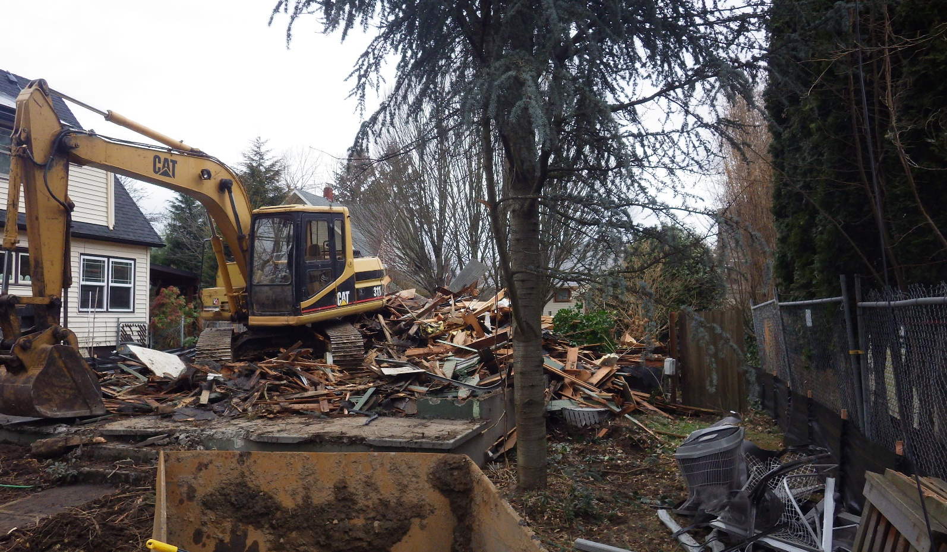
Air Quality, Asbestos 2018 Rulemaking
Background, 2018 rulemaking
Residential demolition
Notes:
The purpose of this rulemaking was to evaluate and clarify the asbestos requirements to reduce the risk of exposure to asbestos fibers.
The changes began with input gathered from a rulemaking held in 2015 to implement Senate Bill 705 that was passed by the Oregon legislature. The bill required asbestos rules to prohibit the demolition of a residential building without first performing an asbestos survey.
The advisory committee for the 2015 rulemaking brought up other changes that were outside of the scope of the Senate Bill. This rulemaking takes into account the 2015 and current stakeholder input.
These rules apply to any person who owns, controls, operates, or supervises asbestos-related projects and processes, including asbestos milling, manufacturing, fabricating, abatement, disposal, or any situation where a potential for exposure to asbestos fibers exists, as described in Oregon Administrative Rules chapter 340, division 248.
We held three advisory committee meetings. The committee was made up of 24 individuals representing a broad spectrum of industry, neighborhood associations, and state agencies.
Among the many rule changes, there are 3 with perhaps the most potential for reducing exposure to asbestos and have greater regulatory impact.
In this presentation, we will use the term friable, meaning asbestos-containing material that can be easily crumbled when disturbed. Examples are sheet vinyl flooring, insulation on piping, ducts, and boilers, fireproofing, surface texturing on ceilings and walls, and soundproofing.
The term Nonfriable refers to asbestos-containing material that is sealed or bound together in a solid form. While nonfriable asbestos-containing material is generally considered safe if maintained in good condition, it can become friable during demolition, renovation, transportation, and at disposal facilities. Examples are: fragmented vinyl floor tile, water pipe, and cement panel siding and roofing.

Slide 3
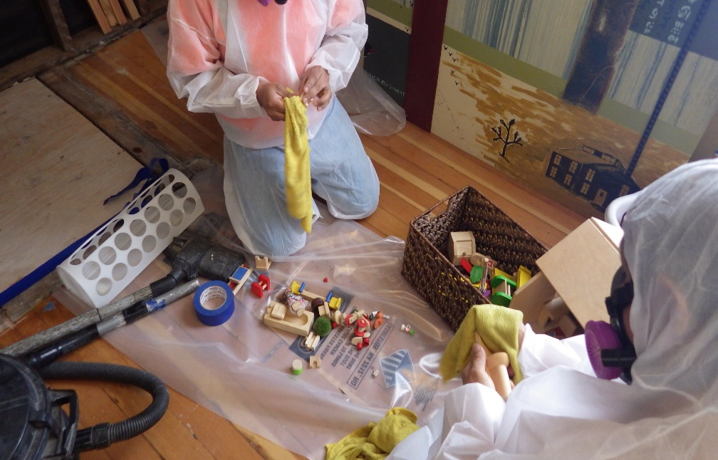
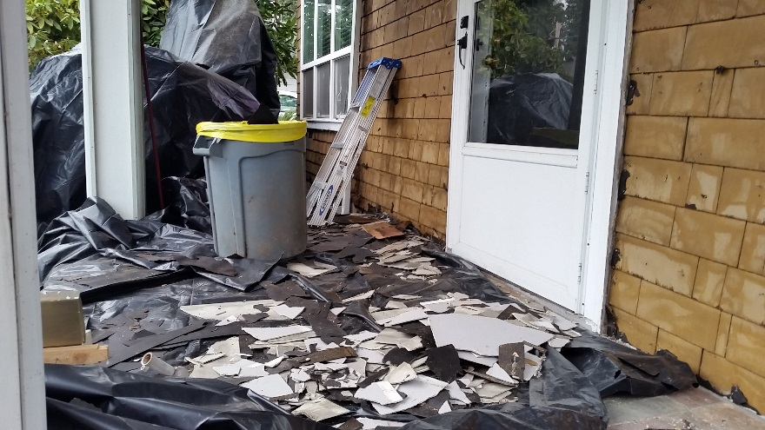
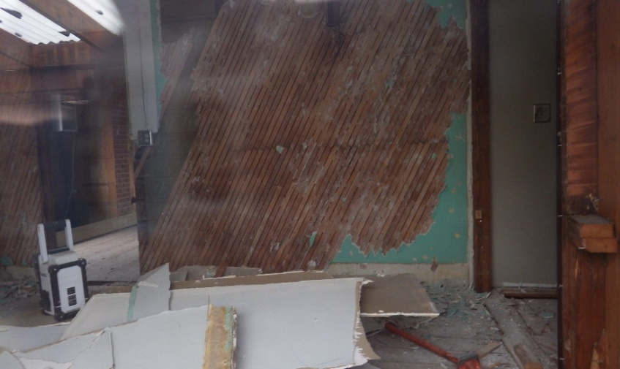
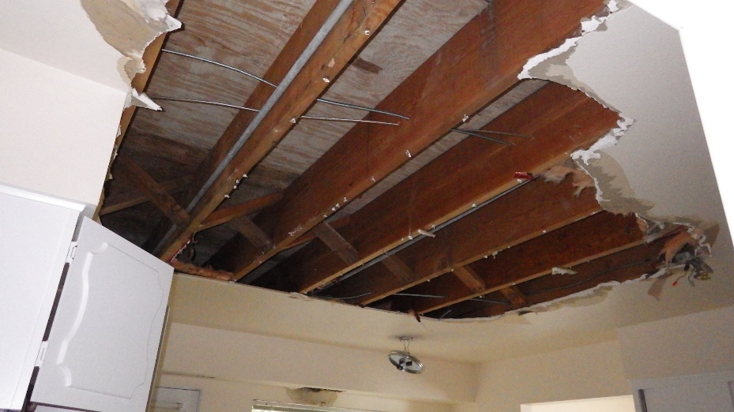
Air Quality, Asbestos 2018 Rulemaking
1. Requirement for a residential renovation survey
Open accumulation
Decontamination
Asbestos-containing materials
Notes:
ZEB: In no particular order – the first new amendment requires an asbestos survey prior to conducting a residential renovation.
A renovation is defined by a project that does not remove a load-supporting structural member. In that case, the project would be defined as a demolition, which does require a survey.
The images you see on slide 6 are examples of improper removal of asbestos-containing material during residential renovation construction projects where asbestos-containing materials have been removed, crumbled, and damaged during the removal resulting in the potential release of asbestos fibers into the air. The images on this slide show work done by unlicensed abatement contractors and uncertified laborers who, along with neighbors, were exposed to friable asbestos-containing material because an asbestos survey was not conducted. This improper removal results in costly decontamination efforts required to be conducted by a licensed asbestos abatement contractor.
The asbestos survey conducted by an accredited inspector prior to a residential renovation will identify the presence of asbestos content in suspect material. With that knowledge, the owner and contractor will reduce the risk of exposure by having a licensed asbestos abatement contractor remove identified asbestos-containing material.
With this rule change, surveys are now required prior to a residential renovation similar to the three other project types that already require an asbestos survey including commercial demolitions and renovations, and residential demolition projects that were constructed prior to Jan. 1, 2004.
DEQ estimated the costs to hire an accredited inspector to perform the asbestos survey, and to hire a licensed asbestos abatement contractor to properly remove, package, and dispose of the asbestos-containing materials are significantly less than the costs associated with improper removal and the decontamination of the project site.

Slide 4
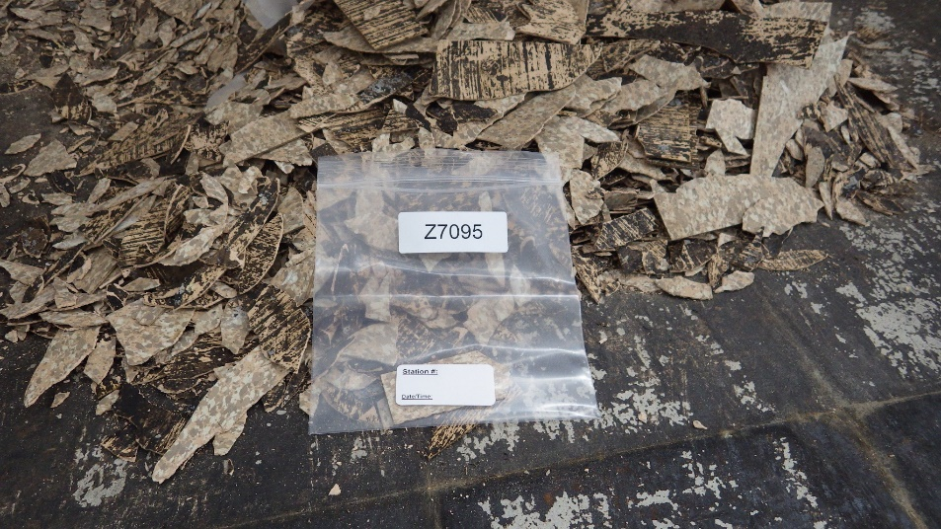
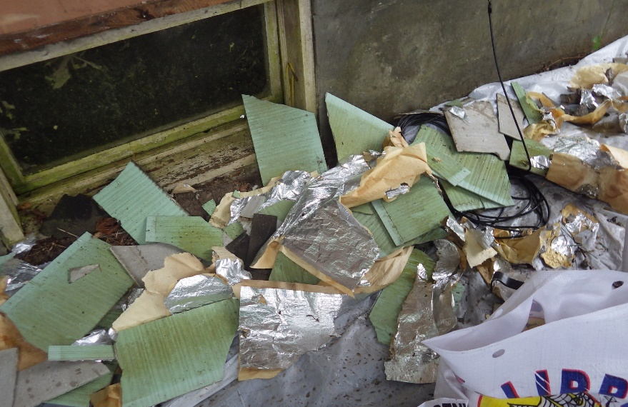
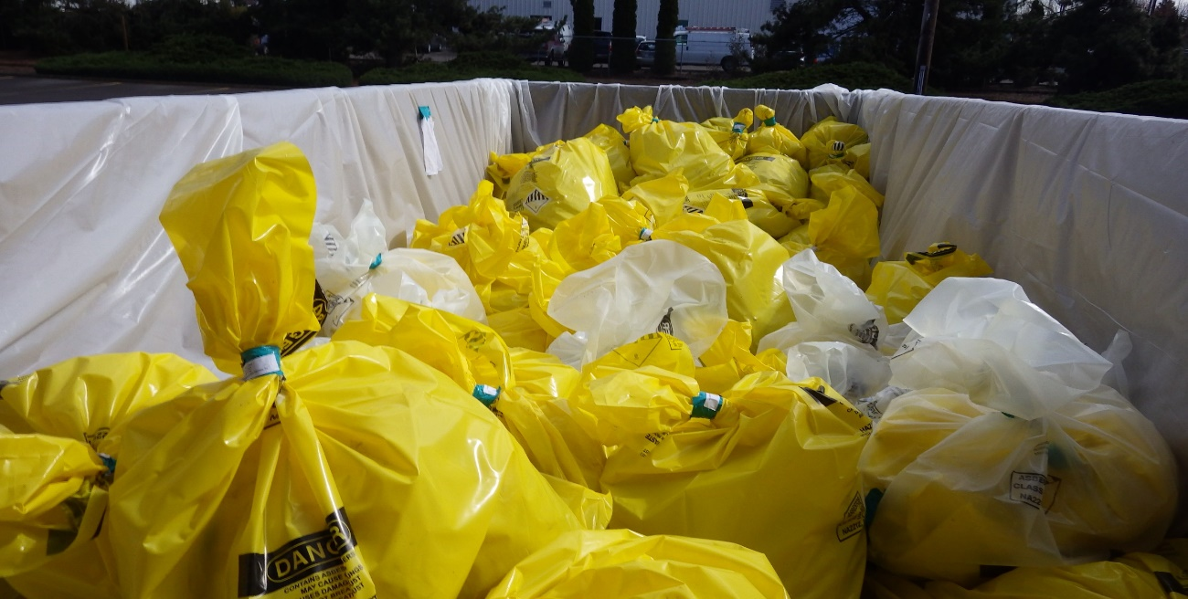
Air Quality, Asbestos 2018 Rulemaking
2. Add nonfriable to friable disposal requirements
Nonfriable rendered friable
Improper removal
Proper packaging
Notes:
Michele
The second rule amendment with the greatest potential to reduce the risk of exposure is to add nonfriable ACWM to the friable disposal requirements. This means that now nonfriable and friable disposal requirements are the same.
This slide shows green siding on the top picture, that started as nonfriable acm and was rendered friable from improper work practices.
This rule change makes the handling of nonfriable ACWM to be similar to friable ACWM for packaging, labeling, and disposal.
This rule change provides a safer environment for employees and neighbors of asbestos abatement projects, citizens during transportation, and for disposal facility workers, if the nonfriable ACWM becomes friable during transportation and disposal.

Slide 5
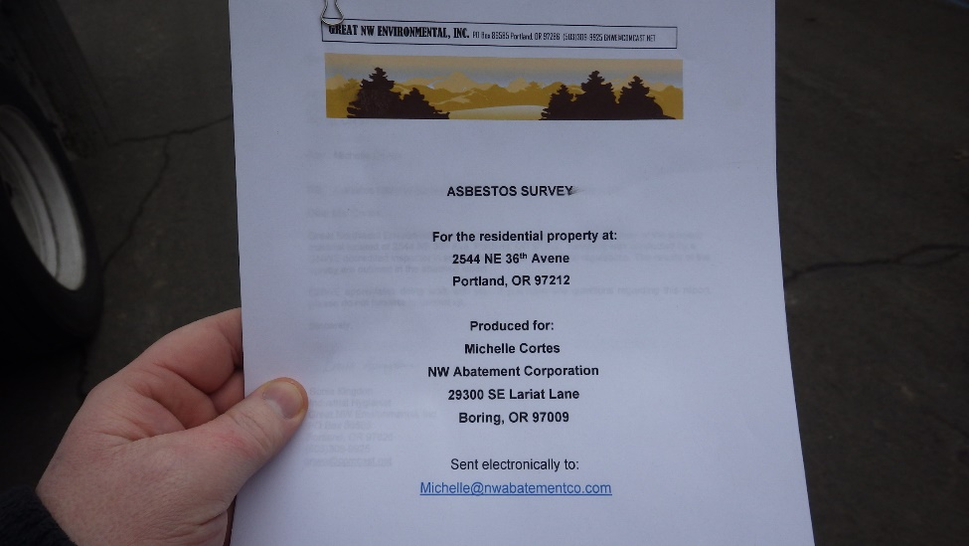
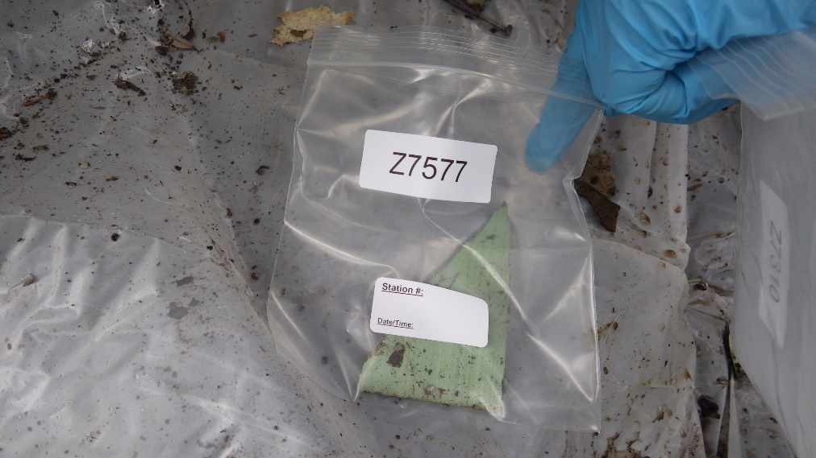
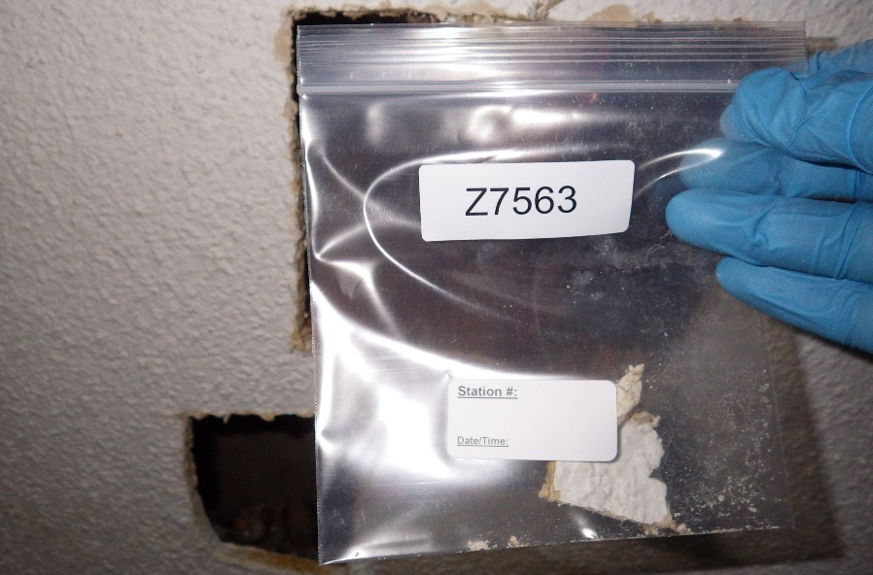
Air Quality, Asbestos 2018 Rulemaking
3. Accredited laboratories for asbestos testing
Home siding rendered friable
Improper removal of “popcorn” ceiling
Notes:
ZEB
The third change is the requirement for laboratories analyzing asbestos bulk samples to meet established standards by participating in a nationally recognized testing program with proficiency testing or an equivalent testing program.
Previously, the asbestos rules did not provide standards for laboratories analyzing materials for asbestos. This amendment levels the playing field by requiring accreditation.
This rule change establishes a common level of competency and reliability in analysis to properly identify asbestos content. DEQ’s laboratory will maintain a list of laboratories available to the public who participate in a nationally recognized accreditation program or equivalent testing program.

Slide 6
Air Quality, Asbestos 2018 Rulemaking
Notes:
Michele
These proposed rule amendments will require DEQ to place an emphasis on education and outreach especially within the first six months of rule adoption.
Some of the outreach includes
Working with training provides to update class materials with the new rules for worker and supervisor trainings
Presentations by DEQ staff to relevant associations and media outlets for broad outreach; and
DEQ outreach to city planning offices and other industry related entities.

