Slide 1
Water Quality Permitting
Agenda Item “”
Action item: WQ Permitting Divisions 45 and 71 Update
Sept. 13, 2017
Bend, OR
Presenters: Ron Doughten, Adam Coutu and William Knight | Oregon Department of Environmental Quality
Notes:
Thank you members of the Commission and Director Whitman.
For the record I am Ron Doughten, manager of DEQ’s Water Quality Permitting & Program Development Section and I’m here today to present DEQ’s proposed amendments to Oregon’s WQ Permitting rules contained in OAR 340 Division 45 and 71. The proposal includes a 3 percent increase to WQ permit fees and other proposed amendments that we’ll cover shortly.
With me is Mike Kucinski, our regional environmental services manager who oversees the statewide Onsite septics program. Our proposal includes a 3 percent increase for non-permit related Onsite fees.
Also with me is William Knight, policy and program analyst for the section who will provide an overview of the rulemaking activities and key issues raised by stakeholders -- and Adam Coutu our Water Quality Budget Analyst who will provide an overview of how we determine our operating budget.
Today’s proposal addresses fees for our WQ permits. There are many types of WQ permits…
(NEXT SLIDE)

Slide 2
Water Quality Permitting
Individual permits and general permits
Permitted Sources:
Municipal and Domestic
Industrial
Stormwater
Municipal, construction and industrial
Other
Notes:
My section oversees the administration of Individual and General NPDES and WPCF Permits – this includes Stormwater and Onsite permits.
An individual permit is a permit assigned to a specific source and is tailored to the facility.
A general permit is a permit assigned to a group of sources with common issues – they follow identical rules – we call these rules and guidelines ‘conditions’ of a permit- to protect WQ.
National Pollutant Discharge Elimination System permits - Discharging effluent – Federal program – EPA.
Water Pollution Control Facilities permits – non-discharging sources. Oregon’s permit program.
Also pretreatment, biosolids, underground injection control and other types of permitting activities.
General permits are useful when there are a number of people/facilities with similar operations that can be adequately regulated with a standard set of conditions. GPs make it quicker to get coverage, less expensive because the cost of developing and administering the permit is spread across a number of people.
I’ll talk more about the types of sources and permits in the next couple of slides…
Here’s a snapshot from last week that shows our current NPDES permits… <<Next Slide>>>

Slide 3
NPDES Permit Universe
Notes:
National Pollutant Discharge Elimination System permits - Discharging effluent – Federal program – EPA.
‘Major’ Permits = The largest sources with higher flows – or sources with a higher risk – treating for toxics. There are 76 individual NPDES permit holders. 50 of those permits are administered to domestic sources.
Individual Domestic –
Majors: The largest WWTPs like City of Portland, Clean Water Services – In this area, The City of Prineville’s WWTP holds an NPDES Individual Major permit.
Individual Industrial –
Majors: The largest sources, sources with toxic treatment or higher risk like Georgia Pacific, International Paper, Wah Chang.
General Stormwater permits
A large category which includes construction and industrial stormwater permits. Construction permits are typically seasonal and the amount of permits can fluctuate significantly each building season.
General Permits –
Cooling water, filter backwash, fish hatcheries, small log ponds, suction dredge mining operations and seafood processors are a few examples of sources covered by NPDES general permits. These sources discharge.
Seque: Oregon’s wineries are covered under our WPCF permit program as are non-discharging petroleum cleanup projects, offstream placer mining and our greywater, recycled water permits. <<Next Slide>>

Slide 4
WPCF Permit Universe
Notes:
Water Pollution Control Facilities permits – non-discharging sources. Oregon’s permit program.
In Eastern Oregon we have a lot of lagoon treatment systems that serve rural towns and cities. In summer months these sources typically land-apply treated water to reduce volume in the lagoon.
The City of Bend Wastewater Control Plant and Septage Receiving Station each hold am Individual WPCF Domestic permit.
There are far more Onsite WPCF permits in the Bend area. Mike is here to talk about these types of permits and provide details on his program’s portion of the proposed rulemaking…
Are there questions before I hand it over to Mike?

Slide 5
Onsite Septic
Permitting & Service Fees
Onsite WPCF Permits
Onsite non-permit related fees
Proposing incremental fee increases
Notes:
Thank you.
For the record.
Brief history and overview of the program.
Please stop me if you have any questions along the way.
History of program authority and funding structure.
30% of Oregonians rely on septic systems.
What does the program do? Siting and permitting; licensing over 600 professionals.
DEQ must run program unless local government chooses to.

Slide 6
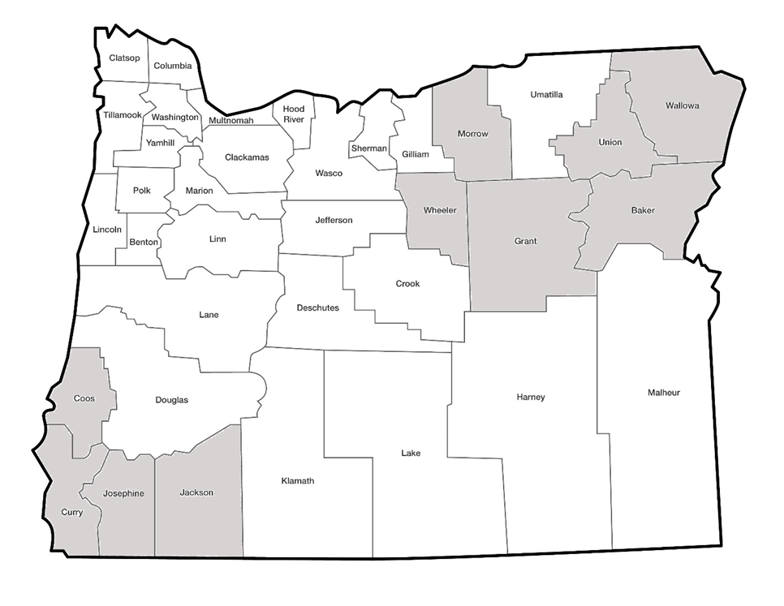
Onsite Program DEQ-run counties and Local Government-run counties
Notes:
DEQ runs in 10 of the 36 counties – refer to map. Office locations.
Statewide oversight paid for by surcharge. Not proposing to increase the surcharge.
Two types of permits for septic systems: WPCF and Construction-Installation.
WPCF covered by 3% statutory authority.
Construction-Installation will need to ratify with Legislature if approved by EQC.
Applications tied to housing market. Difficult to accurately predict for long periods of time.
2009 Recession, staff reduction, 60% fee increase.
Message from EQC, Legislature and Stakeholders – small increases more frequently.

Slide 7
Notes:
Onsite Service Fees
Permit fees for SE, Permits, Inspections (surcharge with them all).
License fees
Product approvals, annual reports, public records requests (over 2,000 PRRs each year).
Why increasing by 3% if costs have increase by over 7%?
Commitment, saved time and money joining forces, applications up more than staffing.
Evaluating staffing needs and forecasting applications for 2019-21 biennium.
Onsite digitization and electronic records management system.
Close
Questions?
RON: Thank you Mike, if there are no further questions for Mike I’ll turn it over to Adam now for an overview on how we determine our budget.

Slide 8
Permit Fee Budget Analysis
Budget Comparison
 | 2017-2019 Legislatively Adopted Budget
Program Costs Covered by Fees | $12,785,975 | 57.9%
Program Costs Covered by General Fund | $7,171,238 | 32.5%
Program Costs Covered by Federal Funding | $1,614,688 | 7.3%
Program Costs Covered by Lottery Funds | $500,000 | 2.3%
Permit Fees Last Changed: Jan. 1, 2016
Notes:
[September 11, 2017 (AC): Should we remove this slide since it is covered by the pie chart on the next page?]
Thank you Ron and thank you members of the commission and director Whitman.
Key Question: Will it be enough to support the program?
Visual Idea: Pie chart and companion Onsite (100%)

Slide 9
Notes:
Thank you, Mike and Ron, Members of the Commission, and Director Whitman.
I am going to briefly describe some basic budget information about our Wastewater Permitting sub-program and our Onsite sub-program. Operationally, we treat these two sub-programs separately. The operating sub-programs have separate funding sources. I will begin by describing the Wastewater Permitting sub-program.
The total budget for the Wastewater Permitting sub-program is approximately $22 million.
By longstanding agreement with stakeholders, DEQ tries to maintain a funding balance of 60% fees and 40% public funds. Public funds include state General Fund, Federal Fund, and Lottery Fund. Lottery Fund was added to the Wastewater Permitting budget in the 2017-19 Legislatively Adopted Budget in support of Policy Option Package 125.

Slide 10
Notes:
The lion’s share of the Wastewater Permitting budget is driven by costs associated with FTE.
The numbers presented on this slide represent the 2017-19 Legislatively Adopted Budget. I should note that these numbers have not yet passed the audit process, but we do not expect them to change significantly.
Personal services costs include:
• Salaries
• Fringe benefits
• PERS contributions
• FICA/Medicare
Services and supplies costs include:
• Facilities rental and taxes [~$1.1 million]
• General Fund and Lottery Fund indirect (intra-agency transfers) [~$1.1 million]
• Attorney General
• Professional services (for things like information system development and maintenance, facilitation and mediation services,
• Telecommunications
• Employee travel and training
Capital outlay costs could include:
• Technical equipment replacement and repair at DEQ’s laboratory
• Telecommunications and computer hardware purchases that exceed $5,000
Special Payments represent the wastewater permitting program’s share of an Oregon State Police Officer.
Agency indirect pays for DEQ central service costs such as Human Resources, Accounting and the Information Technology sections.

Slide 11
WQ Permitting Budget Analysis
Major Category | Amount
Personal Services | 15,871,424
Services and Supplies | 3,963,857
Capital Outlay | 225,790
Special Payments | 116,648
Indirect (for Other Fund and Federal Fund) | 1,894,183
Total | 22,071,901
Budget Period | Cost per FTE
2015-17 Legislatively Adopted Budget | 288,693
2017-19 Leg. Adopted Budget (modified CSL) | 307,496
Percent increase (over a 2 year period) | 6.51%
Notes:
[September 11, 2017 (AC): Suggest removing the first table because the data are presented in the pie chart.]
We determined that the 3% fee percent annual increase is justified by calculating the percent increase in the cost per FTE from the 2015-17 Legislatively Adopted Budget to the modified current service level of the 2017-19 Legislatively Adopted Budget.
I omitted 2017-19 policy option packages from the calculation because this annual fee increase is not intended to fund the new work.

Slide 12
Notes:
The total budget for the Onsite sub-program is $3.6 million.
It is entirely fee funded.

Slide 13
Notes:
Similar to the Wastewater Permitting sub-program, the bulk of expenditures in the Onsite sub-program are driven by FTE.
Questions?

Slide 14
Onsite Septic Fees
Notes:
Total expenditures (including indirect) from 2017-19 Governor’s Recommended Budget
1.7 vs 3 percent – Why aren’t these values consistent? If we raise fees 3 percent why don’t we have a 3 percent increase in revenue?
No surcharge
Need a pie chart for Onsite!
Address difficulty in determining number of transactions and how Onsite activity related to economy.
Update with LAB and caveat the numbers have not been audited yet.
[September 11, 2017 (AC): I wonder if we should include this slide. We do not provide a similar slide for Wastewater Permitting and this table is provided in the staff report (?). If we are going to keep this slide, and we want to update the program cost to reflect the Legislatively Adopted Budget, then we need to find the source table.]

Slide 15
Who would be affected?
Individual and general water quality permit holders
Onsite Septic operators, service providers, installers and homeowners.
Notes:
Individual and General Permits:
Based on recent counts, approx. 3,500 permit holders affected by proposed fee increase. (The total number of permits – approx. 3,800 – affected is higher due to sites with multiple permits.)
Oregon State Agencies: 111 permits
381 Local Gov’s: 629 general and individual permits (includes Ports, School Districts, irrigation districts, water districts, cities, towns, counties, etc.
Large Business: 150 permits
Small business: About 3,0000 permits
ONSITE Fees:
The fees will be paid for by property owners who are developing their property and need to apply for permits for septic system site evaluations, inspections and permits.
Fees will also be paid for by licensed professionals who perform the installation and pumping services.
Most stakeholders are property owners who are one-time customers.
However licensed professionals are repeat customers who must renew their licenses every three years. There are currently approximately 650 licensed professionals.
We sent notices to permit holders and hosted the public comment period as described in the staff report.
DEQ accepted public comment on the proposed rulemaking from May 15, 2017, until 4 p.m. on June 30, 2017. A public hearing was held at DEQ offices and via Webinar, however, there were no attendees.

Slide 16
Permit Fee Rulemaking Action Items
Rulemaking key proposals:
3 percent permit fee increase
3 percent Onsite fee increase
Underground Injection Control Fees
eReporting waiver
Environmental management plans
Notes:
3 percent permit fee increase – Applied to all NPDES and WPCF permit fees and related permitting actions. Includes the Onsite permits which are normally a part of Division 45 and the Onsite service charges from Division 71 except for the 100 surcharge. As noted in the comment response section of the staff report, most of our permittees expressed recognition that DEQ needs to adequately fund it’s permitting program while improving the level of service provided.
In order to share the costs associated with the fee increase rulemaking process the onsite program elected to incorporate this fee increase with the water quality permitting program’s current, annual fee rulemaking which is guided by and approved by statute. As a result of this coordination, the onsite program has adopted a policy to be bound by the maximum three percent fee increase in ORS 468B.051 with the intent to adopt incremental increases in the future in lieu of larger, less frequent increases.
Underground Injection Control Permit Fees and Surcharges – A portion of these fees (the annual and 1st year surcharges) were contained in Oregon Revised Statute 468B.196. DEQ proposes to establish these fees in the Oregon Administrative Rules. We’ve created a new table that contains only UIC fees to better communicate the fees related to the program. DOUBLE CheCK RULE AUTHORIZATION. WPCF Permits Only.
eReporting Waiver – New federal rules require all NPDES permittees report their monthly compliance data electronically.
DEQ has elected to use a EPA’s system called “NetDMR.”
One requirement of the new federal program is that each NPDES program offer permittees a waiver with specific qualifying conditions:
Religious exemption (like Amish), or
No reasonable access to cellular or transmission service in the permittees area.
Would anyone qualify at this time?
Everyone has coverage. city clerk’s office.
In the next couple of years we’ll be bringing General permits into the electronic reporting and we may see qualifiers at this point.

Slide 17
Permit Fee Rulemaking Action Items
(7) “Environmental Management Plan” means a document specified within the conditions of a permit that identifies environmental impacts, establishes environmental goals and periodic review for effectiveness in meeting environmental goals, best management practices, monitoring, corrective actions and other enforceable requirements of the permit.
Notes:
Environmental Management Plan Review
(7) “Environmental Management Plan” means a document specified within the conditions of a permit that identifies environmental impacts, establishes environmental goals and periodic review for effectiveness in meeting environmental goals, best management practices, monitoring, corrective actions and other enforceable requirements of the permit.
Environmental Management Plans defined as required plans in Schedule A
DEQ’s proposal adds the term “Environmental Management Plan” and references Schedule A – the section of a water quality permit that sets conditions for NPDES and WPCF permit holders.
Plans identified as conditions of a permit include stormwater, biosolids, oil & grease and other types of plans that specifically outline how a permittee is going to manage a particular waste stream from their facility or operation that could impact water quality.
For example, many industrial permit holders must also manage stormwater in addition to their facility discharge. A stormwater management plan is often required for these facilities. A domestic wastewater treatment plant may elect to collect biosolids and transport them to a facility for disposal. The WWTP’s permit covers the outfall discharge and operation of the facility and includes a plan for managing the biosolids.
Plans can be updated at renewal or during the term of the permit. However, our current rules and internal management directives specify that a plan that is substantially updated during the term of a current permit must be reviewed and approved by DEQ as a major permit modification.
The fees for a major permit modification are significant. And typically, DEQ would apply this fee when the entire permit requires modification in order to recover costs.
Under current rules an Individual "Tier 1' NPDES Industrial permit holder would pay nearly $30,000 for a major permit modification. A 'Tier 2' source – a smaller source with less risk - nearly $6,000. Domestic permit holders would be required to pay fees ranging from about $2,000 to nearly $20,000.
These fees can be cost prohibitive to many permittees, thus decreasing the likelihood a permittee would elect to update a management plan for immediate environmental benefit to avoid incurring charges for a major permit modification.
And DEQ’s intent in assessing fees and determining our budget needs, as Adam described for you, is always to recover the cost of services provided and maintain stable funding for the permitting program. In this case, our engineers and permit specialists are not ‘reopening the permit’ or rewriting terms and conditions of the permit – they are only reviewing the plan – a subset of the permit contained in the conditions. The permit itself remains unchanged.
DEQ’s intent is to provide a mechanism for reviewing substantially updated environmental management plans required by individual permits independent of a much more expensive and comprehensive permit modification.
Proposed Table 70F now includes a reduced major permit modification fee that DEQ proposes to apply to environmental management plan review.
This action would allow DEQ staff to charge a reduced major permit modification fee to an individual permit holder requesting a significant change to the management plan required in the conditions of the permit (Schedule A).
This fee would not be charged to new applicants for individual permits for initial submittal of environmental management plans.
This issue was a great example of the rulemaking process and why we do it. The initial proposal reviewed by the Fiscal Advisory Committee on March 28 applied an existing fee to “plan only” modifications – the fee for disposal system plan review – which is roughly the same amount of work for DEQ staff.
By definition in the current and proposed rules, there is no real-world difference between a disposal system plan and an environmental management plan – however, remember that adding the new definition clarifies which plans we’re referring too and keeps the two fees distinct.
Disposal system plan review is currently applied to General permits if a plan is required at permit assignment and will remain so. Unchanged.
And our proposal now provides a mechanism for updated environmental management plan review at a cost that is more reflective of the work involved and less cost-prohibitive to permittees seeking to implement systems or practices for immediate environmental benefit.
Expertise from the Fiscal Advisory Committee members and comments submitted during the public comment period led to DEQ revising our initial proposal to apply the disposal system plan review fee, currently reserved for General permits.

Slide 18
Conclusion
DEQ recommends the Commission adopt the
the proposed rules as outlined in
Attachment A of the staff report.
Notes:
In conclusion, DEQ recommends the commission adopt the 3 percent fee increase and the other changes as outlined in Attachment A of the staff report. If approved….
The fees increase will take effect on: Nov. 1, 2017
The increased revenue will help support the program, preserve current staff levels and work to implement improvements to the NPDES permitting portion of the program (2015 Legislature approved independent consultant study of program) and satisfy DEQ’s agreement with EPA under the Performance Partnership agreement.
The Onsite program will be able to continue to seek incremental increases rather than larger increases less frequently.
Are there any questions or comments?
Thank you Chair, members of the commission and Director Whitman.
(FINAL SLIDE)

