Slide 1
Proposal to Incorporate LRAPA Outdoor Burning Rules into the Oregon SIP
July 12-13, 2018 EQC Meeting

Slide 2
LRAPA Rules – Background and What is Proposed
LRAPA regulates air quality in Lane County
Certain corresponding DEQ rule amendments have been in effect in Lane County since adopted by the Commission on April 16, 2015
LRAPA rules are effectively equivalent to DEQ rules
DEQ’s role is to review LRAPA rules to determine compliance with state law and the federal Clean Air Act
EQC’s role is to approve the LRAPA rules if they comply and direct DEQ to submit to EPA for approval as SIP amendments
Rule Amendments:
LRAPA 2017-2018 Outdoor Burning Rules adopted locally October 12, 2017 and April 12, 2018

Slide 3
LRAPA Rules – Outdoor Burning
Adopted October 12, 2017 and April 12, 2018
Quick review of air quality trends in Eugene-Springfield and other parts of Lane County.
The LRAPA Citizens Advisory Committee has recommended local rule changes for Outdoor Burning.
Preliminary meetings were held with several groups around Lane County during 2016-2017.
The first public notice was provided in August 2017 and a public hearing was held on September 14, 2017.
The LRAPA Board of Directors adopted most of the proposed rule revisions on October 12, 2017.

Slide 4
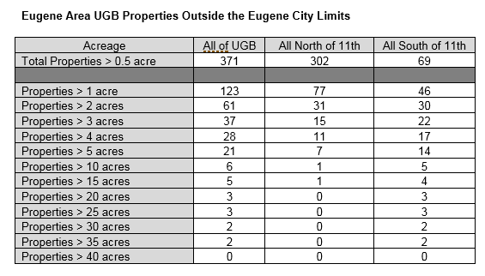

Slide 5
LRAPA Rules – Outdoor Burning, continued
The one exception: LRAPA Board postponed action on the proposed ban on outdoor burning in the Eugene Urban Growth Boundary (UGB).
With Board direction, LRAPA staff put the new recommendations out for public notice in January 2018 and held a second public hearing on February 8, 2018.
On April 12, 2018, the Board of Directors adopted a final revision which allows outdoor burning of woody yard trimmings on lots of two acres or more on approved burn days from March 1 through June 15 and October 1 through October 31 outside Eugene city limits but inside the Eugene UGB. A change from the previous ½ acre or more allowance.
The recommendation from the Board was to use the time between the adoption and the beginning of the fall burning season to do outreach and education about the rule changes with the revision to the Eugene UGB burning requirements becoming effective on October 1, 2018.

Slide 6
Recommended motion if EQC approves rulemaking action item
“In the matter of outdoor burning requirements adopted by LRAPA on October 12, 2017 and April 12, 2018, I move that we:
Adopt the proposed rules in Attachment A of the staff report as part of chapter 340 of the Oregon Administrative Rules; and
Approve incorporating these rule amendments into the Oregon Clean Air Act State Implementation Plan under OAR 340-200-0040”

Slide 7
LRAPA Rules – Questions and Contact Information
Merlyn Hough
Director
Lane Regional Air Protection Agency
1010 Main St.
Springfield, OR 97477
541-736-1056, ext. 216
www.lrapa.org

