Slide 1

Water Quality Permitting
Agenda Item “D”
Action item: Water Quality program fee rule proposal
Sept. 13, 2017
Bend, OR
Presenters: Ron Doughten, Mike Kucinski, Adam Coutu and William Knight | Oregon Department of Environmental Quality
Notes:
Thank you members of the Commission and Director Whitman.
For the record my name is Ron Doughten. I am the Water Quality Permit Program Manager in DEQ’s Water Quality Permitting & Program Development Section. I, and others, are here today to present DEQ’s proposed amendments to Oregon’s WQ Permitting rules contained in OAR 340 Divisions 45 and 71. Today, I’ll provide some general information on DEQ’s wastewater permit program as well as a proposal for a 3 percent increase to WQ permit fees.
With me is Mike Kucinski, DEQ’s onsite program manager, who is based in DEQ’s Eugene office. Mike will provide general information on DEQ’s onsite program as well as a proposal for a 3 percent increase for non-permit related Onsite fees.
Also with me is Adam Coutu, DEQ’s Water Quality Budget Analyst. Adam will provide an overview of how DEQ’s water quality permit program and onsite program are funded as well as information on the water quality budgeting process.
William Knight, the water quality permit program policy analyst who led the rulemaking process is unable to join us today, but I’d like to acknowledge his contribution to the rulemaking effort.
We welcome questions as we proceed through the presentation, so please feel free to stop us at any time. If a particular question will be addressed later in the presentation, we’ll defer that question until we reach that point.
(NEXT SLIDE)

Slide 2
Water Quality Permitting
Individual permits and general permits
Permitted Sources:
  Municipal and Domestic
  Industrial
  Stormwater
    Municipal, construction and industrial
  Other
Notes:
DEQ regulates the discharge of pollutants to Oregon’s surface water and groundwater by issuing water quality permits. We issue National Pollutant Discharge Elimination System (or NPDES) permits for surface water discharges and Water Pollution Control Facility (or WPCF) permits for groundwater discharges.
DEQ operates the NPDES permit (or surface water) program under delegated authority from the US Environmental Protection Agency. Oregon’s NPDES permit program must meet minimum requirements under the Clean Water Act and may not be less stringent than federal requirements. Oregon’s water quality program aims to maintain and improve surface waters to support specific beneficial uses.
DEQ operates the WPCF permit (or groundwater) program largely under state authority, although discharges to drinking water source areas must also meet federal requirements under the Safe Drinking Water Act. Oregon recognizes the value on maintaining high-quality groundwater and DEQ’s administrative rules include an anti-degradation policy to protect groundwater quality.
Under both the NPDES and the WPCF permit programs, DEQ issues two categories of permits—individual permits and general permits.
An individual permit is a customized, site-specific permit that accounts for wastewater dischargers from individual wastewater treatment facilities at specific locations. Developing these permits is very time and resource intensive—both for DEQ as well as the discharging facility.
A general permit is a permit assigned to a group of sources with common discharges that can be regulated under similar types of conditions. After DEQ issues a general permit, individual discharges that meet specific eligibility requirements are assigned coverage under the permit. Issuing a general permit is also a very time and resource intensive process; however, assigning individual coverage under a general permit generally requires much less time and resources.
DEQ issues both individual and general NPDES and WPCF permits for categories of discharges. The most common categories of discharges include:
Municipal wastewater discharges with includes Publically Owned sewage treatment facilities.
Industrial wastewater dischargers from businesses and industries, which are dominated by private businesses and industries, but also include some public facilities, such as port authorities, universities, and prisons.
DEQ also regulates stormwater discharges from cities, construction sites, and industrial sites.
Under the federal Clean Water Act, the term of an NPDES permit is limited to 5 years, at which time, the permit is to renewed with new permit requirements necessary to continually protect and improve water quality. If a permitted entity submits a timely permit application and DEQ fails to renew the permit before the permit expires, the permit is administratively extended. Approximately 80% of Oregon’s individual NPDES permits are currently administratively extended.
Under state requirements, the term of a WPCF permit is limited to 10 years, at which time the permit is renewed with update permit requirements to protect groundwater. Much like the federal program, if a permit holder submits a timely application for renewal and DEQ fails to reissue the permit, the permit is administratively extended. Approximately, 25% of Oregon’s individual WPCF permit s are currently administratively extended.
I’ll talk more about the types of sources and permits in the next couple of slides…

Slide 3
NPDES Permit Universe
Notes:
This pie chart provides a visual depiction of DEQ’s NPDES permit universe.
Individual NPDES permits are generally classified into two categories: major dischargers and minor dischargers.
In general, ‘Major’ Permits represent the largest point sources discharges with higher flows. For domestic sources, facilities discharge 1MGD or more are classified as majors. All others are minors. The classification of industrial discharges into major and minor discharges is more complex and also accounts for sources with a higher risk.
Although individual domestic and individual industrial permits comprise only 11% of DEQ’s total NPDES permitting universe, these permits continue to be the major focus for current process improvement efforts.
DEQ currently regulates 76 major individual NPDES permit holders, including:
50 domestic sources, or sewage treatment facilities. These are largest wastewater treatment facilities in the state, such as the City of Portland, Salem, and Eugene. The closest NPDES domestic major discharge to Bend, is the City of Prineville, which due to increased discharge volumes recently moved from a minor to a major discharger.
DEQ regulates discharges from 19 major industrial facilities, which include facilities such as Georgia Pacific, International Paper, and ATI-Wah Chang.
DEQ also regulates stormwater discharges from 7 jurisdictions under individual permits. These discharges represent a special category of discharge and regulation under the federal NPDES Municipal Separated Storm Sewer System or MS4 program.
By far the largest number of NPDES discharges in Oregon are regulated under DEQ’s general permits for stormwater discharge.
DEQ regulates stormwater discharges from over 1,000 facilities under industrial stormwater general permits. In addition, approximately 1,000 additional constructions sites are regulated under DEQ’s construction stormwater program. Whereas the regulated number of facilities under most NPDES program remains fairly stable over time, stormwater construction permits are typically vary both seasonally as well as with changes in state and local economies.
Finally, DEQ regulates a large number of other NPDES discharges through general permits, including:
Cooling water, fish hatcheries, suction dredge mining operations, and seafood processors.

Slide 4
WPCF Permit Universe
Notes:
The profile of Oregon’s WPCF permit program is shown by this diagram.
Individual domestic and industrial WPCF permits accounts for only 7% of the total WPCF universe. A large number of the individual domestic WPCF permits are lagoon treatment systems that serve rural towns and cities. In the summer months these sources typically land-apply treated water to pastures and hayfields, thereby providing a valuable source of moisture and nutrients to local agriculture.
Locally, under DEQ’s recycled water program, the City of Bend treats wastewater to high standards and provides it for reuse local on golf courses and other landscapes.
By far the largest number of regulated discharges under DEQ’s WPCF program are general permits. Typical discharges regulated under WPCF general permits include offstream placer mining as well as wastewater from food processing operations, such as wineries and fruit packing operations.
Large onsite systems, regulated under individual WPCF operational permits, account for nearly a quarter of Oregon’s non-discharging permits. WPCF onsite permits typically serve high volume discharges from commercial or institutional facilities or facilities that discharge high-strength wastewater. Onsite permits discharge wastewater to the subsurface through drain fields.
Mike is here to provide additional information on DEQ’s onsite program.
Are there questions before I hand it over to Mike?

Slide 5
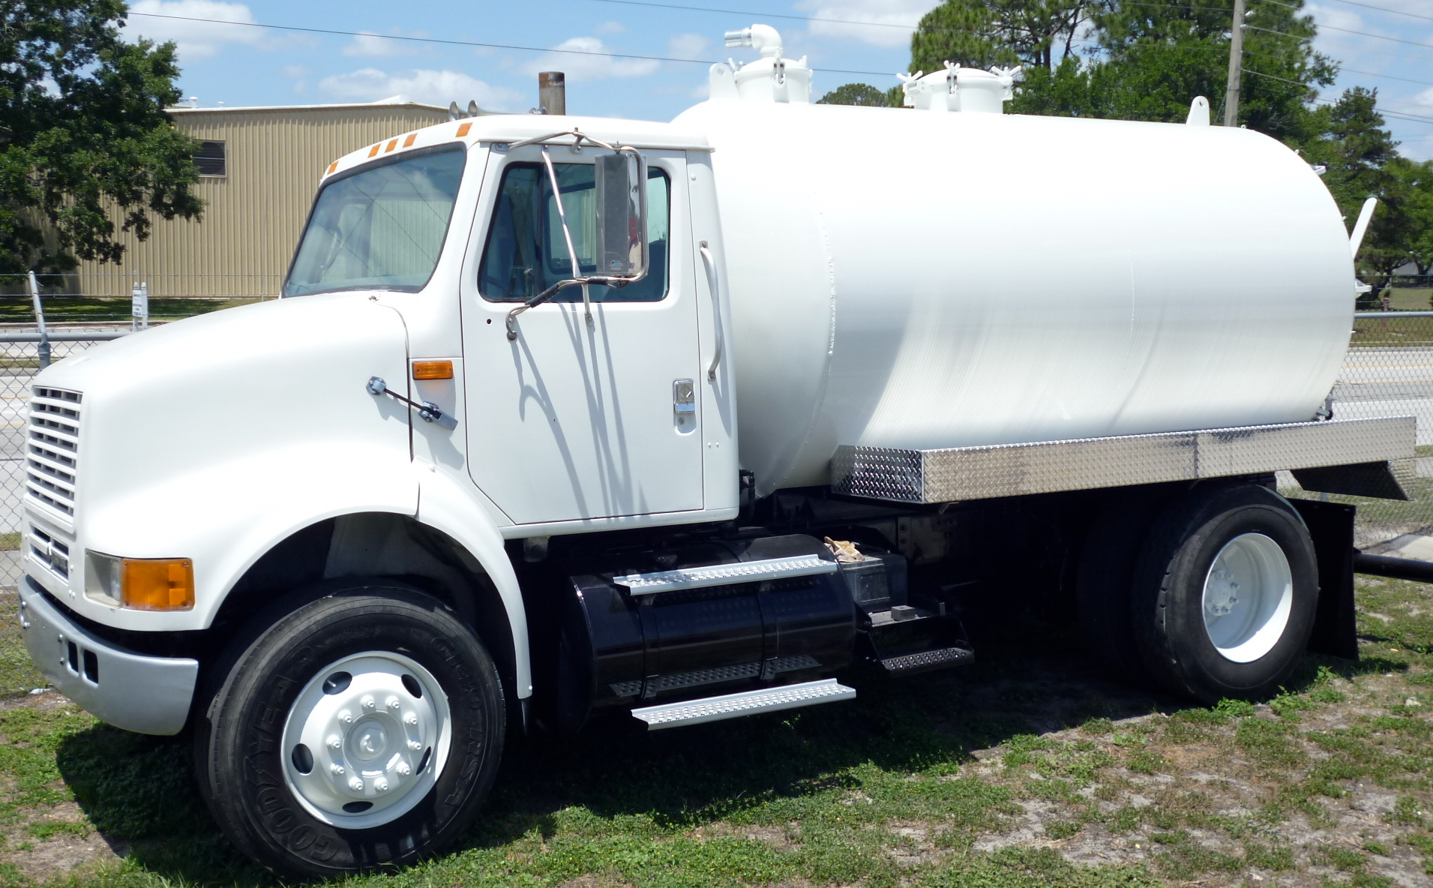
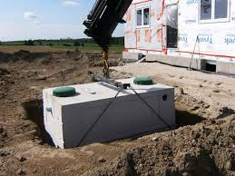
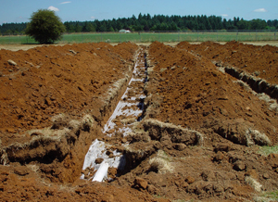
Onsite Septic
Permitting and Service Fees
Onsite program overview
Water Pollution Control Facilities permits
Construction-Installation permits
Onsite program fees
Incremental fee increase
Current program news
Notes:
Thank you Ron, members of the Commission, and Director Whitman. For the record, my name is Mike Kucinski and as Ron mentioned, I manage the statewide onsite septic system program.
I’ve prepared a brief overview of the onsite program including what we do, what types of permits we issue, what fees we charge, the proposed onsite fee increase and I also want to share some exciting news about the program. Please feel free to stop me and ask questions at any time.
About 30% of Oregonians rely on septic systems to treat their wastewater and the onsite program is responsible for siting and permitting these systems. The program is also responsible for licensing professionals who construct septic systems and pump septic tanks and portable toilets. There are over 600 licensed professionals in Oregon. The program reviews and approves products that are used in septic systems such as septic tanks and wastewater treatment units, and responds to the largest number of public records requests of any program at DEQ – over 2,000 this past year.
<<Next Slide>>

Slide 6
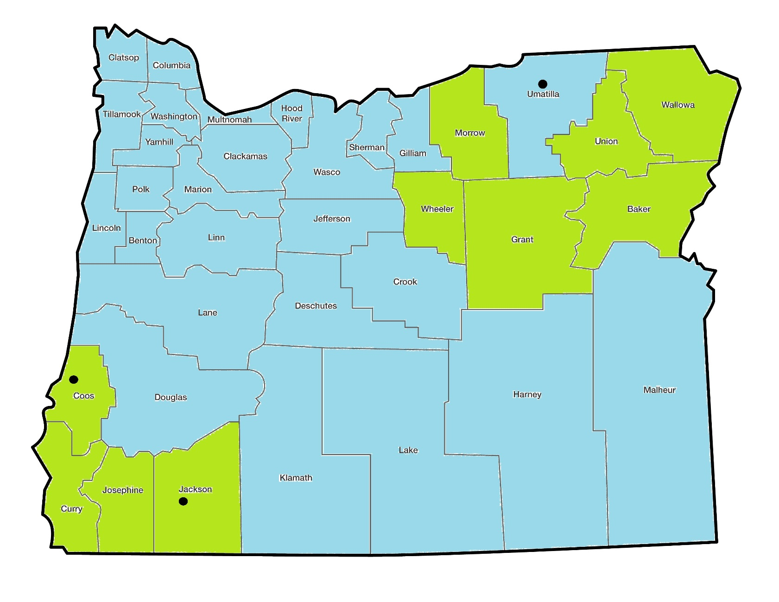
Onsite Program in Oregon
Notes:
DEQ must run the program in each county in the state, unless a local government chooses to run the program through a contract with us. We run the program in 10 of the 36 counties as shown on this map with offices in Coos Bay, Medford and Pendleton.
We provide statewide oversight of both DEQ and local government counties which is paid for through a surcharge fee collected with each application, whether the application is submitted in a DEQ county or local government county. DEQ offices collect the surcharge fee directly, and local governments collect the surcharge fee and forward them to DEQ each month. The surcharge fee was last increased in 2013 and is not part of this fee increase proposal.
There are two types of permits that are issued for septic systems. The first is a water pollution control facilities permit for large sewage flows and high strength wastewater from commercial facilities. Common facilities for these types of permits include RV parks and mobile home parks, schools, campgrounds, subdivisions and even some small cities. There are 728 facilities in Oregon with septic systems that have these permits. The largest system serves Mill City in Linn County with 180,000 gallons per day sewage flow. Just up the road from here is Eagle Crest Resort at about 120,000 gallons per day. Most applications are renewals or modifications of existing permits; we only received 12 new permit applications for septic systems this past year. The proposed fees for these permits are covered by the 3% statutory authority with the other WQ permitting fees that Ron mentioned.
The second type of permit, and the most common is a construction-installation permit. Both DEQ and local government staff issue these permits that typically serve single family homes. This past year, DEQ offices alone received over 1,500 applications; about half of those were in our Medford office. Most customers are one-time customers submitting applications for new permits for development of new property, and inspections of existing systems for the redevelopment of existing property, such as a home remodel or replacement of a manufactured home. The cost of the permit fee is a fraction of the overall cost of development, but there are exceptions and we do try to account for the financial burden to our customers. For example, the cost of repairing a septic system when it fails is typically an unplanned expense that can create a hardship for the property owner. We intentionally keep repair permit fees low in an effort to encourage homeowners to come in and apply for a permit instead of pirating something in over the weekend. We are proposing to increase the repair permit fee to $551, which might seem like a lot, but compared to the permitting costs for a new system that ranges from $1,700 to $2,300, it is significantly lower. We’ve also partnered with non-profit organization Craft3 to provide low interest loans for septic system repairs throughout the state. Last year, more than $600,000 in loans to were made to Oregonians. An additional $1.3 million was approved for this loan program in the 2017 legislative session.
Unlike the proposed water pollution control facilities permit fees, these proposed fees for onsite construction-installation permits and licenses are not covered by the 3% statutory authority. We will need to ratify these fees with the Legislature if they are approved by the Commission.
The number of onsite applications we receive is closely tied to the housing market so when there is a lot of building going on, there are a lot of applications submitted, and vice versa. In 2009 the recession hit the program hard and the number of applications being submitted was half of what it had been for the prior seven years. The program reduced staff from 23 to 12 and still needed to increase fees by 60% in 2011. Although the Legislature and the Commission approved the fee increase, the program received a strong message from both, along with our stakeholders that small, more frequent fee increases were much more preferable to large, infrequent, fee increases.
<<next slide>>

Slide 7
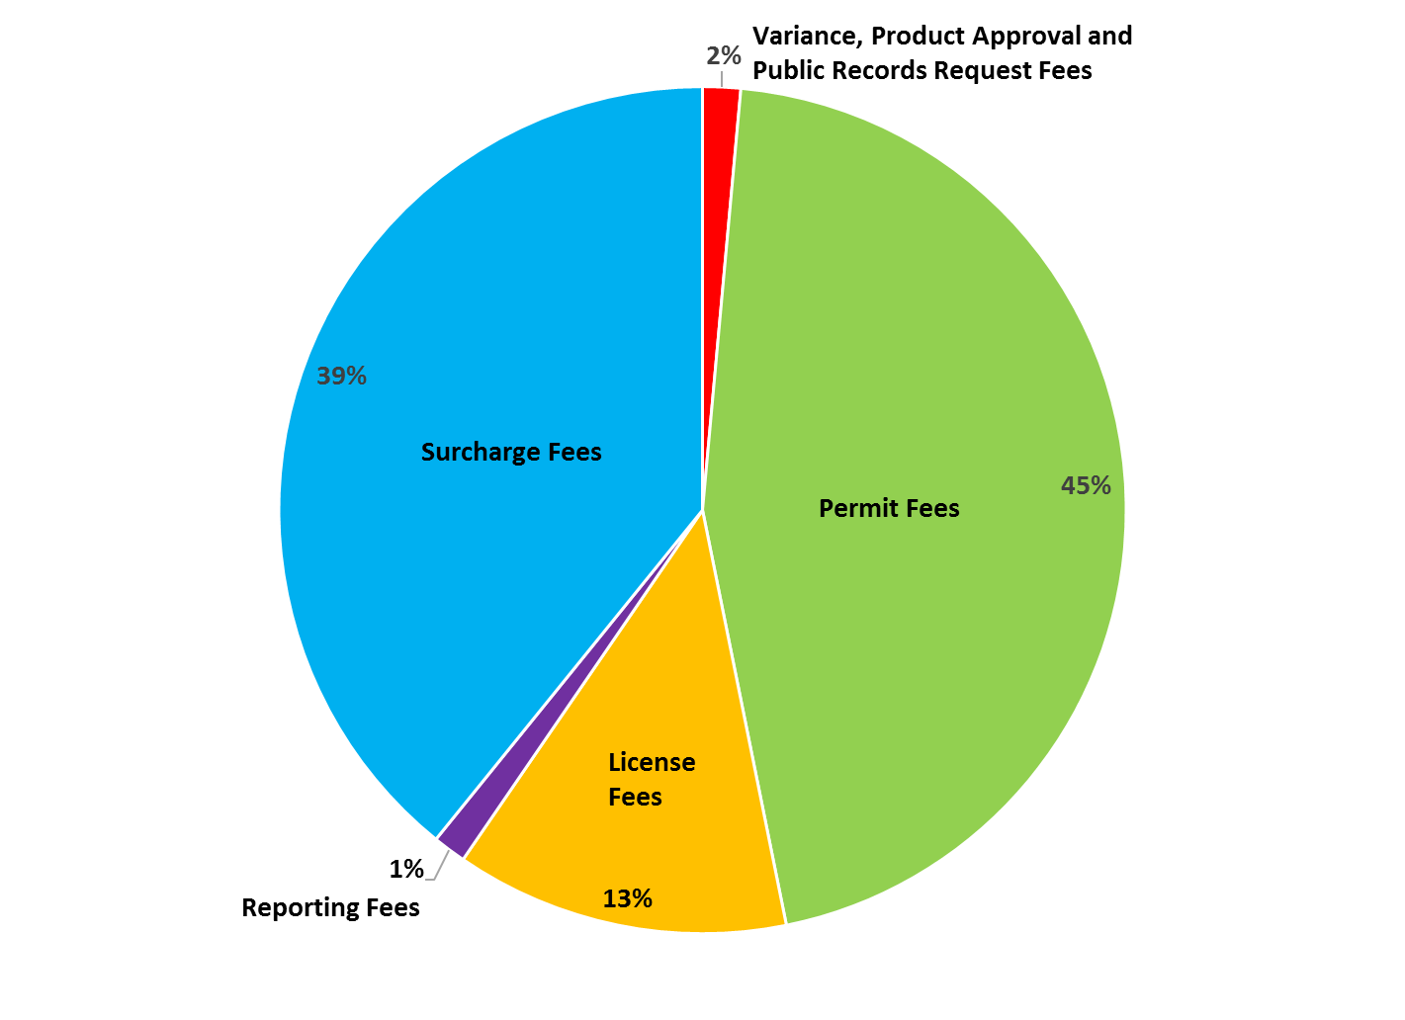
Onsite Budget by Fee Type
Notes:
As you can see from the pie chart, the program is primarily funded by the fees associated with applications related to the development of property – that is the largest funding source at 45% of the total budget (green). Permit fees are submitted for applications including site evaluations, permits, and inspections. Surcharge fees are collected with license applications, and as mentioned before, they are collected with each of the permit applications, regardless of the county, which is why surcharge fees account for 39% of the program’s budget (blue). Licensing fees are the next largest source of funding at 13% (orange) and the rest of the fees such as product approval fees and public records request fees make up the remaining 3%. All of the onsite fees except for the surcharge are proposed to increase by 3%.
You might ask why the onsite program fee increase proposal is only 3% when the costs of the program have increased by more than 3%, and the onsite fees are not limited to the 3% maximum increase like the other WQ permitting fees. In addition to the direction from elected officials and stakeholders to plan for small, more frequent fee increases rather than large, infrequent fee increases, the program also saved time and money by joining forces with the WQ permitting program instead of conducting a separate rulemaking, but most importantly, application submittals have steadily increased over the past 6 years. Over the same time period we have seen 20% more applications while our staffing levels have only increased by about 10%. So far, the program has been able to cover our costs because fewer staff are responding to a larger number of applications. However, there is a point where the number of applications will be too large for current staff to handle and additional staff will be necessary to meet the demand. The program is currently forecasting the number of applications expected in the 2019-2021 biennium and evaluating what staffing level will be needed to respond to those applications.
An exciting project the onsite program is currently undertaking is the scanning of all onsite records in the three offices and an electronic records management system. Along with our evaluation of application submittals and staffing levels for the next biennium, we are also evaluating if we can provide access to the records free of charge or if we will need to continue to charge a fee. With over 2,000 public records requests submitted each year for the onsite program alone, that equals about $15,000 in fee revenue but it takes a lot of resources to fulfill those public records requests. If we can provide direct online access for the public to search and download records without DEQ staff involvement, the savings could outweigh the costs of the electronic records management system. With approval of the proposed 3% fee increase, the onsite program budget will be able to pay for these costs in the current biennium, and we are determining if the budget will be able to pay for these costs next biennium and beyond, which may involve another fee increase and may involve a request for additional staff. As we learn more about the 2019-2021 budget, these details and our plans will become clearer.
<<next slide>>

Slide 8
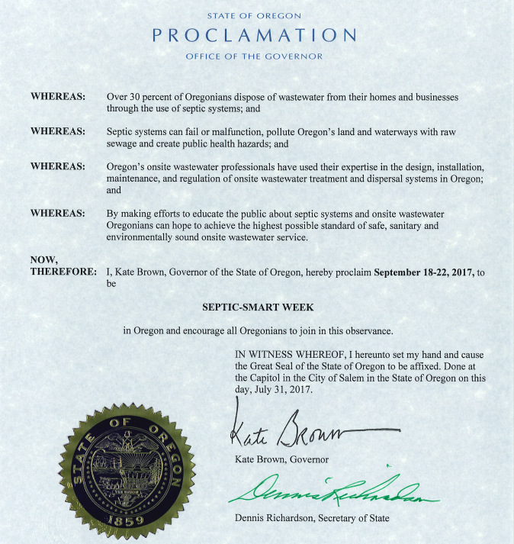
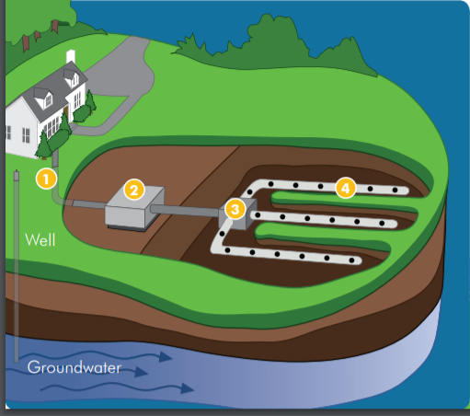

Notes:
In closing, for those of you who may not have heard, next week has been proclaimed Septic-Smart Week by Governor Brown. This is an annual event sponsored by EPA to educate homeowners and communities on the proper care and maintenance of their septic systems. This is the third year Governor Brown has made the Septic-Smart Week proclamation in the State of Oregon, and many other states have also made this proclamation. DEQ will issue a news release and will post updates on Facebook and Twitter all week to get the word out. I have some brochures for you all that I will leave with Stephanie.
Thank you for your time.
I am happy to answer any questions.
RON: Thank you Mike, if there are no further questions for Mike I’ll turn it over to Adam now for an overview on how we determine our budget.

Slide 9
Notes:
Thank you, Mike and Ron, Members of the Commission, and Director Whitman.
I am going to briefly describe some basic budget information about our Wastewater Permitting sub-program and our Onsite sub-program. Operationally, we treat these two sub-programs separately. The operating sub-programs have separate funding sources. I will begin by describing the Wastewater Permitting sub-program.
The total budget for the Wastewater Permitting sub-program is approximately $22 million.
By longstanding agreement with stakeholders, DEQ tries to maintain a funding balance of 60% fees and 40% public funds. Public funds include state General Fund, Federal Fund, and Lottery Fund. Lottery Fund was added to the Wastewater Permitting budget in the 2017-19 Legislatively Adopted Budget in support of Policy Option Package 125.

Slide 10
Notes:
The lion’s share of the Wastewater Permitting budget is driven by costs associated with FTE.
The numbers presented on this slide represent the 2017-19 Legislatively Adopted Budget. I should note that these numbers have not yet passed the audit process, but we do not expect them to change significantly.
Personal services costs include:
• Salaries
• Fringe benefits
• PERS contributions
• FICA/Medicare
Services and supplies costs include:
• Facilities rental and taxes [~$1.1 million]
• General Fund and Lottery Fund indirect (intra-agency transfers) [~$1.1 million]
• Attorney General
• Professional services (for things like information system development and maintenance, facilitation and mediation services,
• Telecommunications
• Employee travel and training
Capital outlay costs could include:
• Technical equipment replacement and repair at DEQ’s laboratory
• Telecommunications and computer hardware purchases that exceed $5,000
Special Payments represent the wastewater permitting program’s share of an Oregon State Police Officer.
Agency indirect pays for DEQ central service costs such as Human Resources, Accounting and the Information Technology sections.

Slide 11
WQ Permitting Budget Analysis
Budget Period | Cost per FTE
2015-17 Legislatively Adopted Budget | 288,693
2017-19 Leg. Adopted Budget (modified CSL) | 307,496
Percent increase (over a 2 year period) | 6.51%
Notes:
[September 11, 2017 (AC): Suggest removing the first table because the data are presented in the pie chart.]
We determined that the 3% fee percent annual increase is justified by calculating the percent increase in the cost per FTE from the 2015-17 Legislatively Adopted Budget to the modified current service level of the 2017-19 Legislatively Adopted Budget.
I omitted 2017-19 policy option packages from the calculation because this annual fee increase is not intended to fund the new work.

Slide 12
Notes:
The total budget for the Onsite sub-program is $3.6 million.
It is entirely fee funded.

Slide 13
Notes:
Similar to the Wastewater Permitting sub-program, the bulk of expenditures in the Onsite sub-program are driven by FTE.
Even with the 3% annual increase, it doesn’t cover the cost increase.
Questions?
Ron: Thank you Adam. William will now spend a few minutes describing the proposed rule changes as well as the public process associated with the rulemaking.

Slide 14
Permit Fee Rulemaking Action Items
Rulemaking key proposals:
3 percent permit fee increase
3 percent Onsite fee increase
Underground Injection Control Fees
eReporting waiver
Environmental management plans
Notes:
Thank you, Ron. Good afternoon Commissioners and Director Whitman. For the record, my name is William Knight, WQ permit program operations and policy analyst.
As you know, today we’re here asking you to consider the approval of a number of changes to Oregon Administrative Rules, Chapter 340, Divisions 45 and 71 that pertain to water quality permit fees for wastewater discharges and onsite systems. Key rule changes includes.
First, DEQ proposes a 3 percent permit fee increase to water quality wastewater permits. This fee increase would apply to all NPDES and WPCF wastewater permit fees with a few minor exceptions. DEQ has statutory authority to increases up to 3% and as noted in the comment response section of the staff report, most permit holders expressed recognition that DEQ needs to adequately fund it’s permitting program.
Second, DEQ proposes a 3 permit fee increase to non-permit related onsite fees. This fee increase applies to the Onsite service charges from Division 71 except for the 100 surcharge. In order to share the costs associated with the fee increase rulemaking process the onsite program elected to incorporate this fee increase with the water quality permitting program’s current, annual fee rulemaking which is guided by and approved by statute. As a result of this coordination, the program intends to adopt incremental increases in the future in lieu of larger, less frequent increases.
Third, DEQ proposes changes to clarify the Underground Injection Control Permit Fees. Currently, a portion of the UIC fees are contained in statute {{Oregon Revised Statute 468B.196}}. DEQ proposes to establish these fees in the Oregon Administrative Rules to improve the administrative process as well as clarify fees for permit holders.
Fourth, DEQ proposed a new eReporting Waiver. New federal rules require all NPDES permittees report their compliance data electronically. One requirement of the new federal requirements is that each NPDES permitting authority offer waivers under specific qualifying conditions. DEQ is offering an exemption from eReporting under two circumstances:
Religious exemption where use electronic devices conflicts with religious beliefs, or
Where broadband internet access is unavailable to the permit holders.
DEQ has not identified any individual permit holders that would qualify for an eReporting waiver. However, in the next couple of DEQ will begin requiring smaller, general permits holders to reporting electronically and some may qualify for a waiver. The eReporting waiver covers DEQ’s costs for hand-entering data into the database.
Fifth, DEQ is clarifying the fees associated with review of disposal system plans and environmental management plans. Under DEQ’s current rules, DEQ may charge a fee for “disposal system plan review” associated with general permits. DEQ proposes to clarify the use of this fee as general permits are renewed.
In addition, DEQ is providing a new definition for environmental management plans and how the fee will be applied to plans that are associated with individual permits.
“Environmental management plan” means a document specified within the conditions of a permit that identifies environmental impacts, establishes environmental goals and periodic review for effectiveness in meeting environmental goals, best management practices, monitoring, corrective actions and other enforceable requirements of the permit.
When used with individual permits, environmental management plan are enforceable permit conditions and are used to provide the permit holder with the flexibility of tailoring specific actions to their individual needs and circumstances. Examples of environmental management plans includes biosolids management plans, recycled water use plans, and mercury minimization plans. Because the plans contain substantive permit requirements, DEQ reviews and approves each plan. Moreover, under DEQ’s current rules a change to an environmental management plan during the permit cycle may result in a major permit modification, with fees up to 10s of thousands of dollars. Under the proposed rules, DEQ would charge an environmental management plan review fee that is more commensurate with the level of DEQ effort.
Finally, DEQ proposes a number of changes to clarify the rules by removing old or redundant language, improving the readability of tables, and applying plain language guidelines.

Slide 15
Who would be affected?
Individual and general water quality permit holders
Onsite Septic operators, service providers, installers and homeowners.
Notes:
During the rulemaking process, DEQ determined the following groups would impacted by the fee increases:
Approximately 3,500 individual and general wastewater permit holders will be affected by proposed fee increase, including:
Oregon State Agencies which collectively hold 111 permits
381 Local Governments which hold 629 general and individual permits. {{This group of permit holders includes Ports, School Districts, irrigation districts, water districts, cities, towns, counties, etc.}}
Approximately 150 Large Business; and
Approximately 3,000 small businesses
The proposed increase to ONSITE Fees will affect individuals and individual home owners.
The fees will be paid by property owners developing their property who requires an onsite septic system, including site evaluations, inspections, and permits. Generally, property owners will pay the fees one time when developing their property.
Fees will also be paid by licensed professionals who perform installation and pumping services on onsite septic systems. In Oregon approximately 650 licensed professionals must renew their licenses every three years and will be subject to the increased fees on a recurring basis.
During the rulemaking process, DEQ sent notices to permit holders and hosted a public comment period as described in the staff report. DEQ accepted public comment on the proposed rules from May 15, 2017, until 4 p.m. on June 30, 2017. A public hearing was held at DEQ offices and via Webinar; however, there were no attendees at the public hearing.

Slide 16
Conclusion
DEQ recommends the Commission adopt the
the proposed rules as outlined in
Attachment A of the staff report.
Notes:
RON:
The current fees – both NPDES and WPCF wastewater permit fees as well as the non-permit related onsite fees– will not sustain the programs.
The proposed fees will *not* fund position restorations or wastewater program enhancements approved in the 2017-19 Legislatively Approved Budget. However, if adopted, DEQ expects the proposed fees will partially sustain staffing levels through FY 2018, which ends June 30, 2018.
DEQ recommends the Commission adopt the 3 percent fee increase and the other changes as outlined in Attachment A of the staff report. If approved, the fees increase will take effect on: Nov. 1, 2017 and partially support staffing levels through Fiscal Year 2018, ending June 30, 2018.
Are there any questions or comments?
Thank you Chair, members of the commission and Director Whitman.
(FINAL SLIDE)

