Slide 1

Water Quality Permitting
Agenda Item “”
Action item: WQ Permitting Divisions 45 and 71 Update
Sept. 13, 2017
Bend, OR
Presenters: Ron Doughten, Mike Kucinski, Adam Coutu and William Knight | Oregon Department of Environmental Quality
Notes:
Thank you members of the Commission and Director Whitman.
For the record my name is Ron Doughten. I am the Water Quality Permit Program Manager in DEQ’s Water Quality Permitting & Program Development Section. I, and others, are here today to present DEQ’s proposed amendments to Oregon’s WQ Permitting rules contained in OAR 340 Divisions 45 and 71. Today, I’ll provide some general information on DEQ’s wastewater permit program as well as a proposal for a 3 percent increase to WQ permit fees.
With me is Mike Kucinski, DEQ’s onsite program manager, who is based in DEQ’s Eugene office. Mike will provide general information on DEQ’s onsite program as well as a proposal for a 3 percent increase for non-permit related Onsite fees.
Also with me is Adam Coutu, DEQ’s Water Quality Budget Analyst. Adam will provide an overview of how DEQ’s water quality permit program and onsite program are funded as well as information on the water quality budgeting process.
William Knight, the water quality permit program policy analyst who led the rulemaking process is unable to join us today, but I’d like to acknowledge his contribution to the rulemaking effort.
We welcome questions as we proceed through the presentation, so please feel free to stop us at any time. If a particular question will be addressed later in the presentation, we’ll defer that question until we reach that point.
(NEXT SLIDE)

Slide 2
Water Quality Permitting
Individual permits and general permits
Permitted Sources:
  Municipal and Domestic
  Industrial
  Stormwater
    Municipal, construction and industrial
  Other
Notes:
DEQ regulates the discharge of pollutants to Oregon’s surface water and groundwater by issuing water quality permits. We issue National Pollutant Discharge Elimination System (or NPDES) permits for surface water discharges and Water Pollution Control Facility (or WPCF) permits for groundwater discharges.
DEQ operates the NPDES permit (or surface water) program under delegated authority from the US Environmental Protection Agency. Oregon’s NPDES permit program must meet minimum requirements under the Clean Water Act and may not be less stringent than federal requirements. Oregon’s water quality program aims to maintain and improve surface waters to support specific beneficial uses.
DEQ operates the WPCF permit (or groundwater) program largely under state authority, although discharges to drinking water source areas must also meet federal requirements under the Safe Drinking Water Act. Oregon recognizes the value on maintaining high-quality groundwater and DEQ’s administrative rules include an anti-degradation policy to protect groundwater quality.
Under both the NPDES and the WPCF permit programs, DEQ issues two categories of permits—individual permits and general permits.
An individual permit is a customized, site-specific permit that accounts for wastewater dischargers from individual wastewater treatment facilities at specific locations. Developing these permits is very time and resource intensive—both for DEQ as well as the discharging facility.
A general permit is a permit assigned to a group of sources with common discharges that can be regulated under similar types of conditions. After DEQ issues a general permit, individual discharges that meet specific eligibility requirements are assigned coverage under the permit. Issuing a general permit is also a very time and resource intensive process; however, assigning individual coverage under a general permit generally requires much less time and resources.
DEQ issues both individual and general NPDES and WPCF permits for categories of discharges. The most common categories of discharges include:
Municipal wastewater discharges with includes Publically Owned sewage treatment facilities.
Industrial wastewater dischargers from businesses and industries, which are dominated by private businesses and industries, but also include some public facilities, such as port authorities, universities, and prisons.
DEQ also regulates stormwater discharges from cities, construction sites, and industrial sites.
Under the federal Clean Water Act, the term of an NPDES permit is limited to 5 years, at which time, the permit is to renewed with new permit requirements necessary to continually protect and improve water quality. If a permitted entity submits a timely permit application and DEQ fails to renew the permit before the permit expires, the permit is administratively extended. Approximately 80% of Oregon’s individual NPDES permits are currently administratively extended.
Under state requirements, the term of a WPCF permit is limited to 10 years, at which time the permit is renewed with update permit requirements to protect groundwater. Much like the federal program, if a permit holder submits a timely application for renewal and DEQ fails to reissue the permit, the permit is administratively extended. Approximately, 25% of Oregon’s individual WPCF permit s are currently administratively extended.
I’ll talk more about the types of sources and permits in the next couple of slides…

Slide 3
NPDES Permit Universe
Notes:
This pie chart provides a visual depiction of DEQ’s NPDES permit universe.
Individual NPDES permits are generally classified into two categories: major dischargers and minor dischargers.
In general, ‘Major’ Permits represent the largest point sources discharges with higher flows. For domestic sources, facilities discharge 1MGD or more are classified as majors. All others are minors. The classification of industrial discharges into major and minor discharges is more complex and also accounts for sources with a higher risk.
Although individual domestic and individual industrial permits comprise only 11% of DEQ’s total NPDES permitting universe, these permits continue to be the major focus for current process improvement efforts.
DEQ currently regulates 76 major individual NPDES permit holders, including:
50 domestic sources, or sewage treatment facilities. These are largest wastewater treatment facilities in the state, such as the City of Portland, Salem, and Eugene. The closest NPDES domestic major discharge to Bend, is the City of Prineville, which due to increased discharge volumes recently moved from a minor to a major discharger.
DEQ regulates discharges from 19 major industrial facilities, which include facilities such as Georgia Pacific, International Paper, and ATI-Wah Chang.
DEQ also regulates stormwater discharges from 7 jurisdictions under individual permits. These discharges represent a special category of discharge and regulation under the federal NPDES Municipal Separated Storm Sewer System or MS4 program.
By far the largest number of NPDES discharges in Oregon are regulated under DEQ’s general permits for stormwater discharge.
DEQ regulates stormwater discharges from over 1,000 facilities under industrial stormwater general permits. In addition, approximately 1,000 additional constructions sites are regulated under DEQ’s construction stormwater program. Whereas the regulated number of facilities under most NPDES program remains fairly stable over time, stormwater construction permits are typically vary both seasonally as well as with changes in state and local economies.
Finally, DEQ regulates a large number of other NPDES discharges through general permits, including:
Cooling water, fish hatcheries, suction dredge mining operations, and seafood processors.

Slide 4
WPCF Permit Universe
Notes:
The profile of Oregon’s WPCF permit program is shown by this diagram.
Individual domestic and industrial WPCF permits accounts for only 7% of the total WPCF universe. A large number of the individual domestic WPCF permits are lagoon treatment systems that serve rural towns and cities. In the summer months these sources typically land-apply treated water to pastures and hayfields, thereby providing a valuable source of moisture and nutrients to local agriculture.
Locally, under DEQ’s recycled water program, the City of Bend treats wastewater to high standards and provides it for reuse local on golf courses and other landscapes.
By far the largest number of regulated discharges under DEQ’s WPCF program are general permits. Typical discharges regulated under WPCF general permits include offstream placer mining as well as wastewater from food processing operations, such as wineries and fruit packing operations.
Large onsite systems, regulated under individual WPCF operational permits, account for nearly a quarter of Oregon’s non-discharging permits. WPCF onsite permits typically serve high volume discharges from commercial or institutional facilities or facilities that discharge high-strength wastewater. Onsite permits discharge wastewater to the subsurface through drain fields.
Mike is here to provide additional information on DEQ’s onsite program.
Are there questions before I hand it over to Mike?

Slide 5
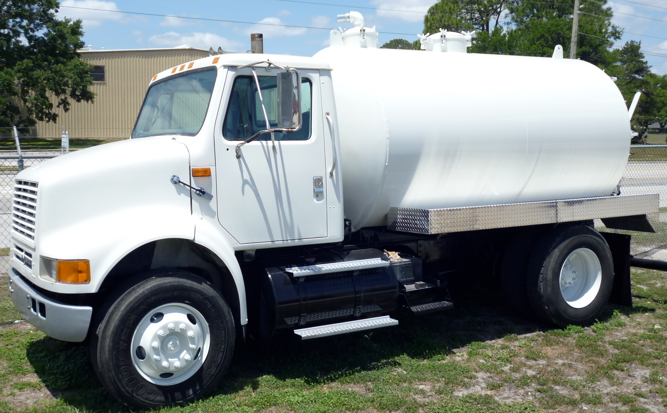
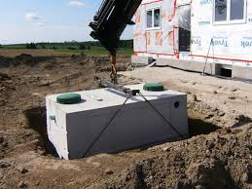
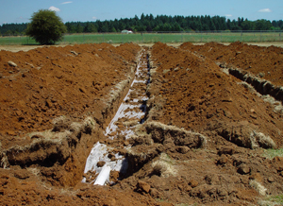
Onsite Septic
Permitting and Service Fees
Onsite Water Pollution Control Facilities (WPCF) Permits
Onsite non-permit related fees
Proposing incremental fee increases
Current projects and news
Notes:
Thank you.
For the record.
Brief history and overview of the program
Please stop me if you have any questions along the way.
History of program authority and funding structure.
30% of Oregonians rely on septic systems.
What does the program do? Siting and permitting; licensing over 600 professionals.
DEQ must run program unless local government chooses to.

Slide 6
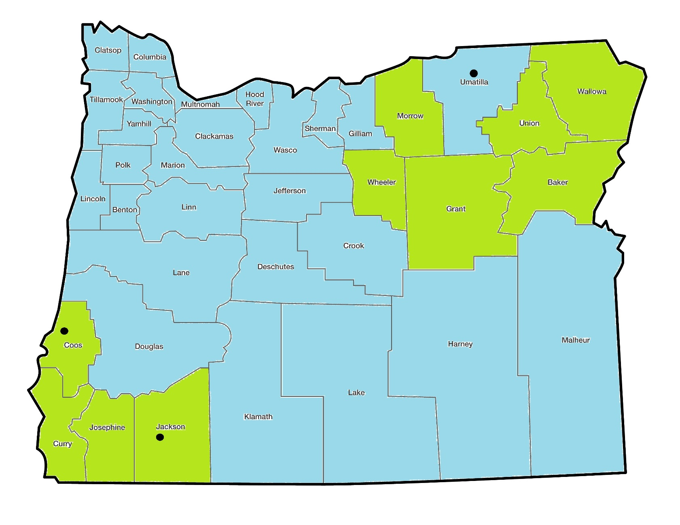
Onsite Program in Oregon
Notes:
DEQ runs in 10 of the 36 counties – refer to map. Office locations.
Statewide oversight paid for by surcharge. Not proposing to increase the surcharge.
Two types of permits for septic systems: WPCF and Construction-Installation.
WPCF covered by 3% statutory authority.
Construction-Installation will need to ratify with Legislature if approved by EQC.
Applications tied to housing market. Difficult to accurately predict for long periods of time.
2009 Recession, staff reduction, 60% fee increase.
Message from EQC, Legislature and Stakeholders – small increases more frequently.

Slide 7
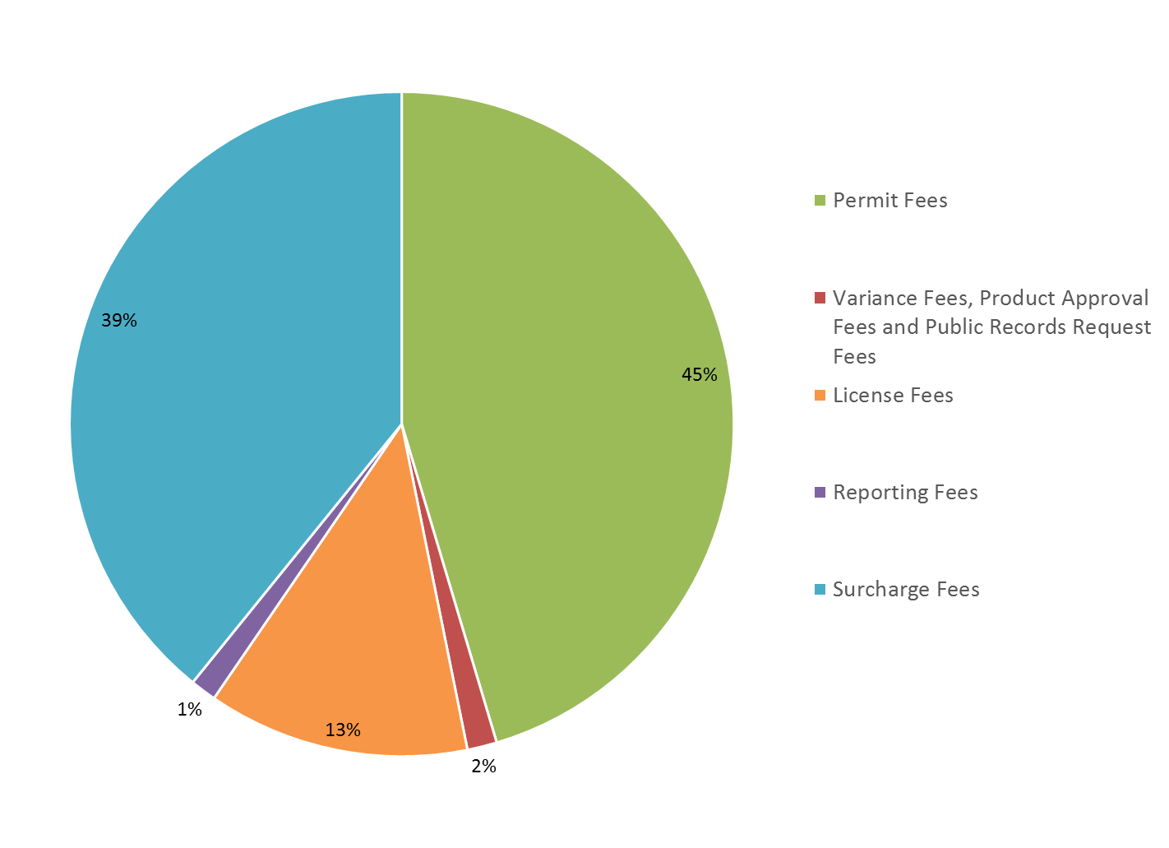
Onsite Budget by Fee Type
Notes:
Onsite Service Fees
Permit fees for SE, Permits, Inspections (surcharge with them all).
License fees
Product approvals, annual reports, public records requests (over 2,000 PRRs each year).
Why increasing by 3% if costs have increase by over 7%?
Commitment, saved time and money joining forces, applications up more than staffing.
Evaluating staffing needs and forecasting applications for 2019-21 biennium.
Onsite digitization and electronic records management system.

Slide 8
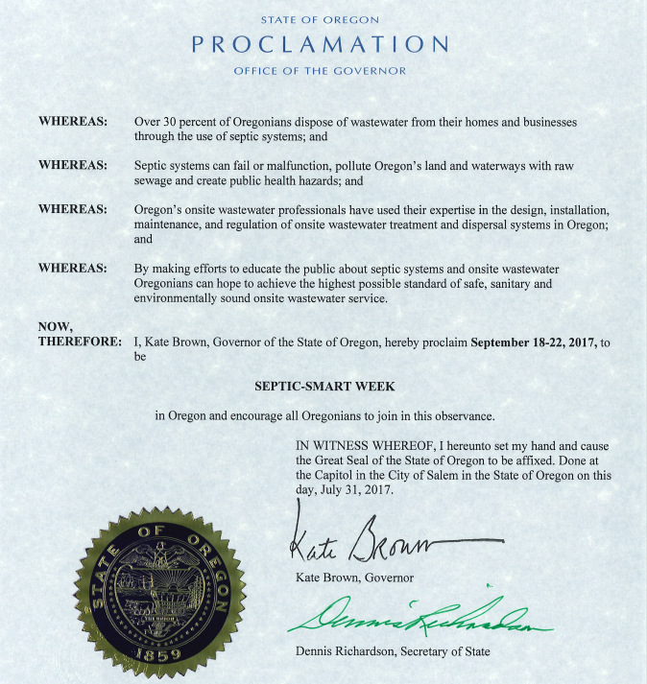
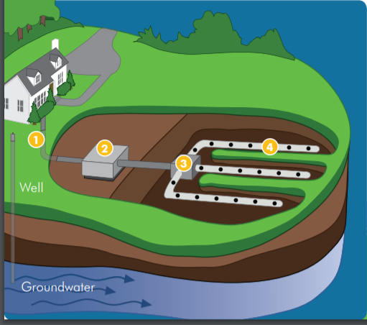

Notes:
Septic-Smart Week is next week.
Educate homeowners and communities on the proper care and maintenance of their septic systems.
3rd year Governor Brown has made the Septic-Mart Week proclamation in the State of Oregon.
Close
Questions?
RON: Thank you Mike, if there are no further questions for Mike I’ll turn it over to Adam now for an overview on how we determine our budget.

Slide 9
Notes:
Thank you, Mike and Ron, Members of the Commission, and Director Whitman.
I am going to briefly describe some basic budget information about our Wastewater Permitting sub-program and our Onsite sub-program. Operationally, we treat these two sub-programs separately. The operating sub-programs have separate funding sources. I will begin by describing the Wastewater Permitting sub-program.
The total budget for the Wastewater Permitting sub-program is approximately $22 million.
By longstanding agreement with stakeholders, DEQ tries to maintain a funding balance of 60% fees and 40% public funds. Public funds include state General Fund, Federal Fund, and Lottery Fund. Lottery Fund was added to the Wastewater Permitting budget in the 2017-19 Legislatively Adopted Budget in support of Policy Option Package 125.

Slide 10
Notes:
The lion’s share of the Wastewater Permitting budget is driven by costs associated with FTE.
The numbers presented on this slide represent the 2017-19 Legislatively Adopted Budget. I should note that these numbers have not yet passed the audit process, but we do not expect them to change significantly.
Personal services costs include:
• Salaries
• Fringe benefits
• PERS contributions
• FICA/Medicare
Services and supplies costs include:
• Facilities rental and taxes [~$1.1 million]
• General Fund and Lottery Fund indirect (intra-agency transfers) [~$1.1 million]
• Attorney General
• Professional services (for things like information system development and maintenance, facilitation and mediation services,
• Telecommunications
• Employee travel and training
Capital outlay costs could include:
• Technical equipment replacement and repair at DEQ’s laboratory
• Telecommunications and computer hardware purchases that exceed $5,000
Special Payments represent the wastewater permitting program’s share of an Oregon State Police Officer.
Agency indirect pays for DEQ central service costs such as Human Resources, Accounting and the Information Technology sections.

Slide 11
WQ Permitting Budget Analysis
Budget Period | Cost per FTE
2015-17 Legislatively Adopted Budget | 288,693
2017-19 Leg. Adopted Budget (modified CSL) | 307,496
Percent increase (over a 2 year period) | 6.51%
Notes:
[September 11, 2017 (AC): Suggest removing the first table because the data are presented in the pie chart.]
We determined that the 3% fee percent annual increase is justified by calculating the percent increase in the cost per FTE from the 2015-17 Legislatively Adopted Budget to the modified current service level of the 2017-19 Legislatively Adopted Budget.
I omitted 2017-19 policy option packages from the calculation because this annual fee increase is not intended to fund the new work.

Slide 12
Notes:
The total budget for the Onsite sub-program is $3.6 million.
It is entirely fee funded.

Slide 13
Notes:
Similar to the Wastewater Permitting sub-program, the bulk of expenditures in the Onsite sub-program are driven by FTE.
Even with the 3% annual increase, it doesn’t cover the cost increase.
Questions?
Ron: Thank you Adam. William will now spend a few minutes describing the proposed rule changes as well as the public process associated with the rulemaking.

Slide 14
Permit Fee Rulemaking Action Items
Rulemaking key proposals:
3 percent permit fee increase
3 percent Onsite fee increase
Underground Injection Control Fees
eReporting waiver
Environmental management plans
Notes:
Thank you, Ron. Good afternoon Commissioners and Director Whitman. For the record, my name is William Knight, WQ permit program operations and policy analyst.
As you know, today we’re here asking you to consider the approval of a number of changes to Oregon Administrative Rules, Chapter 340, Divisions 45 and 71 that pertain to water quality permit fees for wastewater discharges and onsite systems. Key rule changes includes.
First, DEQ proposes a 3 percent permit fee increase to water quality wastewater permits. This fee increase would apply to all NPDES and WPCF wastewater permit fees with a few minor exceptions. DEQ has statutory authority to increases up to 3% and as noted in the comment response section of the staff report, most permit holders expressed recognition that DEQ needs to adequately fund it’s permitting program.
Second, DEQ proposes a 3 permit fee increase to non-permit related onsite fees. This fee increase applies to the Onsite service charges from Division 71 except for the 100 surcharge. In order to share the costs associated with the fee increase rulemaking process the onsite program elected to incorporate this fee increase with the water quality permitting program’s current, annual fee rulemaking which is guided by and approved by statute. As a result of this coordination, the program intends to adopt incremental increases in the future in lieu of larger, less frequent increases.
Third, DEQ proposes changes to clarify the Underground Injection Control Permit Fees. Currently, a portion of the UIC fees are contained in statute {{Oregon Revised Statute 468B.196}}. DEQ proposes to establish these fees in the Oregon Administrative Rules to improve the administrative process as well as clarify fees for permit holders.
Fourth, DEQ proposed a new eReporting Waiver. New federal rules require all NPDES permittees report their compliance data electronically. One requirement of the new federal requirements is that each NPDES permitting authority offer waivers under specific qualifying conditions. DEQ is offering an exemption from eReporting under two circumstances:
Religious exemption where use electronic devices conflicts with religious beliefs, or
Where broadband internet access is unavailable to the permit holders.
DEQ has not identified any individual permit holders that would qualify for an eReporting waiver. However, in the next couple of DEQ will begin requiring smaller, general permits holders to reporting electronically and some may qualify for a waiver. The eReporting waiver covers DEQ’s costs for hand-entering data into the database.
Fifth, DEQ is clarifying the fees associated with review of disposal system plans and environmental management plans. Under DEQ’s current rules, DEQ may charge a fee for “disposal system plan review” associated with general permits. DEQ proposes to clarify the use of this fee as general permits are renewed.
In addition, DEQ is providing a new definition for environmental management plans and how the fee will be applied to plans that are associated with individual permits.
“Environmental management plan” means a document specified within the conditions of a permit that identifies environmental impacts, establishes environmental goals and periodic review for effectiveness in meeting environmental goals, best management practices, monitoring, corrective actions and other enforceable requirements of the permit.
When used with individual permits, environmental management plan are enforceable permit conditions and are used to provide the permit holder with the flexibility of tailoring specific actions to their individual needs and circumstances. Examples of environmental management plans includes biosolids management plans, recycled water use plans, and mercury minimization plans. Because the plans contain substantive permit requirements, DEQ reviews and approves each plan. Moreover, under DEQ’s current rules a change to an environmental management plan during the permit cycle may result in a major permit modification, with fees up to 10s of thousands of dollars. Under the proposed rules, DEQ would charge an environmental management plan review fee that is more commensurate with the level of DEQ effort.
Finally, DEQ proposes a number of changes to clarify the rules by removing old or redundant language, improving the readability of tables, and applying plain language guidelines.

Slide 15
Who would be affected?
Individual and general water quality permit holders
Onsite Septic operators, service providers, installers and homeowners.
Notes:
During the rulemaking process, DEQ determined the following groups would impacted by the fee increases:
Approximately 3,500 individual and general wastewater permit holders will be affected by proposed fee increase, including:
Oregon State Agencies which collectively hold 111 permits
381 Local Governments which hold 629 general and individual permits. {{This group of permit holders includes Ports, School Districts, irrigation districts, water districts, cities, towns, counties, etc.}}
Approximately 150 Large Business; and
Approximately 3,000 small businesses
The proposed increase to ONSITE Fees will affect individuals and individual home owners.
The fees will be paid by property owners developing their property who requires an onsite septic system, including site evaluations, inspections, and permits. Generally, property owners will pay the fees one time when developing their property.
Fees will also be paid by licensed professionals who perform installation and pumping services on onsite septic systems. In Oregon approximately 650 licensed professionals must renew their licenses every three years and will be subject to the increased fees on a recurring basis.
During the rulemaking process, DEQ sent notices to permit holders and hosted a public comment period as described in the staff report. DEQ accepted public comment on the proposed rules from May 15, 2017, until 4 p.m. on June 30, 2017. A public hearing was held at DEQ offices and via Webinar; however, there were no attendees at the public hearing.

Slide 16
Conclusion
DEQ recommends the Commission adopt the
the proposed rules as outlined in
Attachment A of the staff report.
Notes:
RON:
The current fees – both NPDES and WPCF wastewater permit fees as well as the non-permit related onsite fees– will not sustain the programs.
The proposed fees will *not* fund position restorations or wastewater program enhancements approved in the 2017-19 Legislatively Approved Budget. However, if adopted, DEQ expects the proposed fees will partially sustain staffing levels through FY 2018, which ends June 30, 2018.
DEQ recommends the Commission adopt the 3 percent fee increase and the other changes as outlined in Attachment A of the staff report. If approved, the fees increase will take effect on: Nov. 1, 2017 and partially support staffing levels through Fiscal Year 2018, ending June 30, 2018.
Are there any questions or comments?
Thank you Chair, members of the commission and Director Whitman.
(FINAL SLIDE)

