Slide 1
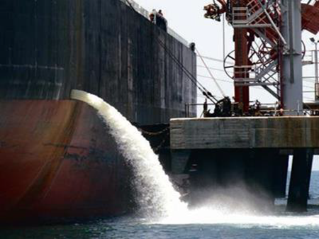
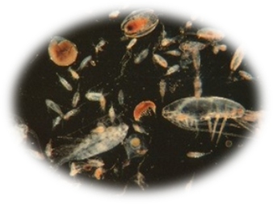

Aquatic Invasive Species Prevention &
Ballast Water Management
Rulemaking
Environmental Quality Commission
January 2017
Hillsboro, OR
Rian vanden Hooff Oregon Department of Environmental Quality

Slide 2
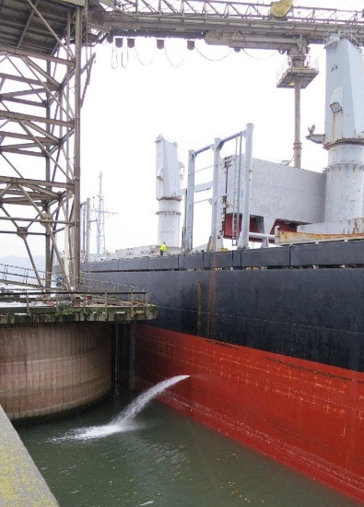

Rulemaking Overview
  Ballast Water Management
    Respond to federal policy changes.
    Prevent introduction of aquatic invasive species (AIS) from high-risk ballast water transfer.
  Noise Control Regulations
    No change to policy or practices
    Administrative action to provide enhanced clarity and efficiency.
Ballast Water Management Rulemaking 2016
Notes:
Before launching into the primary focus of this presentation on IS prevention and BWM strategies, I want to point out that this rulemaking package includes a second, unrelated topic concerning Noise Control regulations.
DEQ is asking the EQC to approve amendments that merely incorporate directly into the noise control rules, the tables and documents that the rules already refer to. This will make it easier for users of these rules to find the information they need to interpret and apply the rules. It will also relieve DEQ from the cost and responsibility of maintaining these documents on its web site. The rule change does not have any effect on the meaning or application of these rules nor does it change any policies or practices.
I will not be providing any further details on this, but Meyer Goldstein – our agencies rules coordinator – is here and available to answer any questions you might have following my presentation.

Slide 3
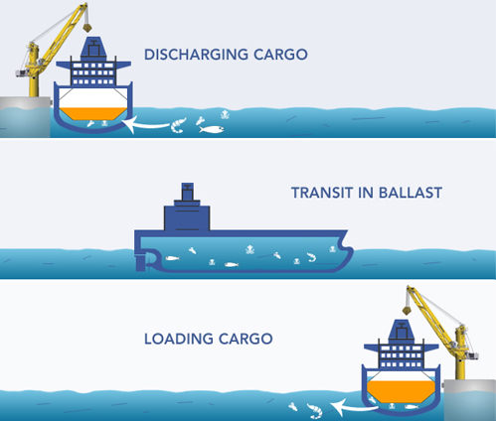
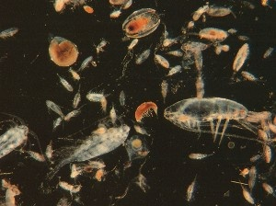
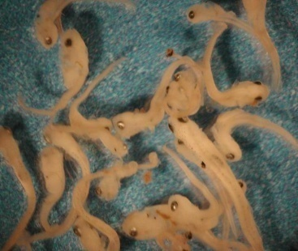
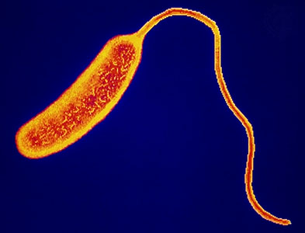
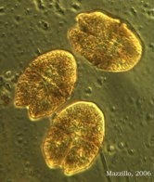
Ballast Water: Operations & Ecology
Ballast Water Management Rulemaking 2016
Notes:
So, BW. Because oceangoing ships are designed to travel at full cargo capacity they rely on the routine uptake/discharge of BW to compensate for changes in cargo load status and ensure proper trim and stability.
Generally, a vessel will take on ballast water from their ambient surroundings as the cargo is unloaded, and conversely, will discharge its ballast water when loading cargo.
*Intake of large volumes of water into dedicated ballast tanks effectively entraps an entire planktonic community of organisms– from larval fish and invertebrates to microbes and viruses – and unfortunately the transport and discharge of this water can be a vector for a unique form of biological pollution
SEGWAY: When organisms get introduced and establish a new population to regions outside their native range it may result in a bio invasion that can cause severe environmental, economic and/or human health consequences.

Slide 4
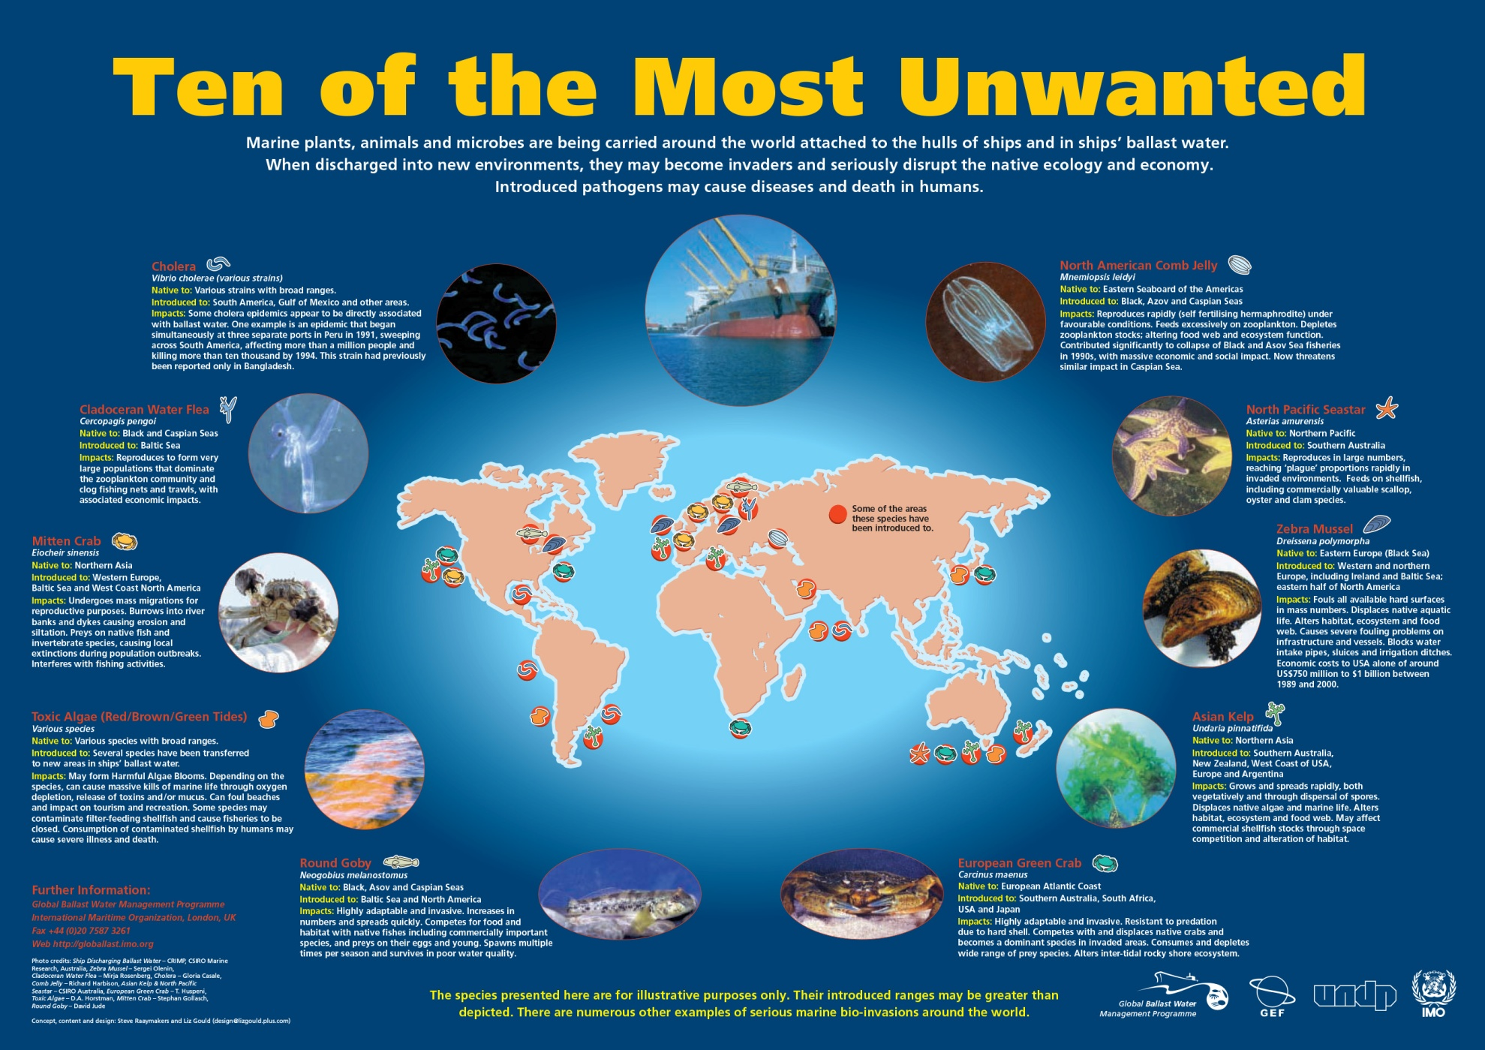
Ballast Water Management Rulemaking 2016
Notes:
BW transport has been implicated as the source of bioinvasions by everything from invasive fish and crab species, to HAB’s and Cholera outbreaks.
One of the most notorious examples in North America – and our best poster child for local prevention efforts are Q/Z mussels – small freshwater fouling organisms that have severely affected water resources and conveyance infrastructure; and disrupted a variety of ecosystem processes including food web dynamics relied upon by native species.
Economic losses attributed to Q/Z in N.A. are estimated to be in the ballpark of 1 Billion dollars per year and could rise significantly higher if this nuisance species becomes established throughout the PNW.

Slide 5
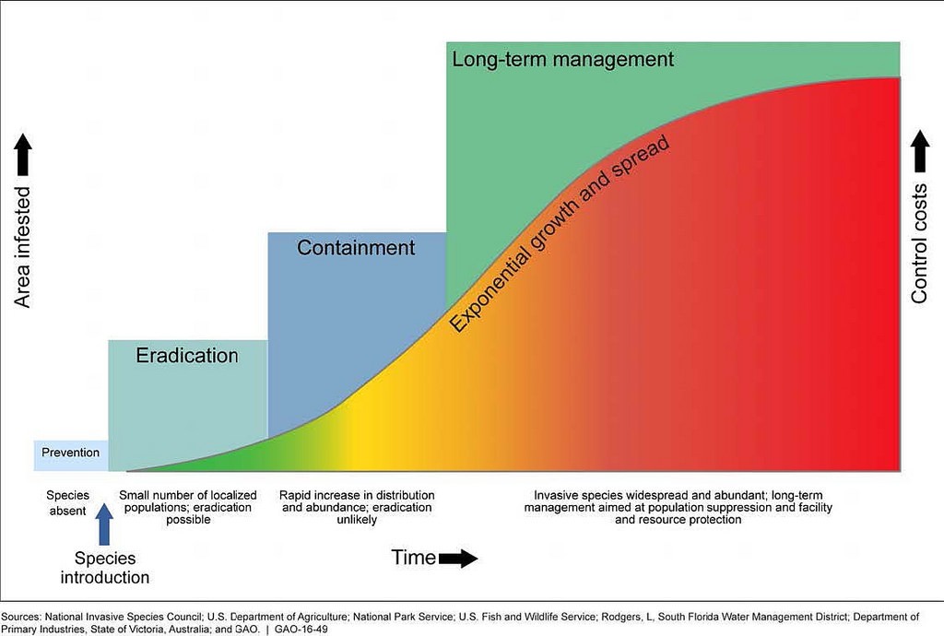
The ‘Invasion Curve’
& the Value of Prevention
$$$$
$$$
$$
$
Ballast Water Management Rulemaking 2016
Notes:
Bioinvasions follow a typical pattern of exponential population growth and spread. As this occurs – particularly in aquatic environments –options for eradication or containment diminish and an entire region can be left with irreversible long term management costs.
*To avoid the much greater costs associated with controlling and managing a nuisance species, case studies repeatedly point to the cost:benefit value of investing in prevention….
… which is what our states ballast water regulations and programmatic efforts are built around.

Slide 6
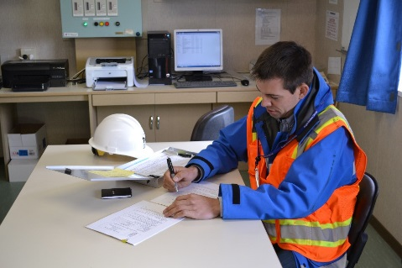
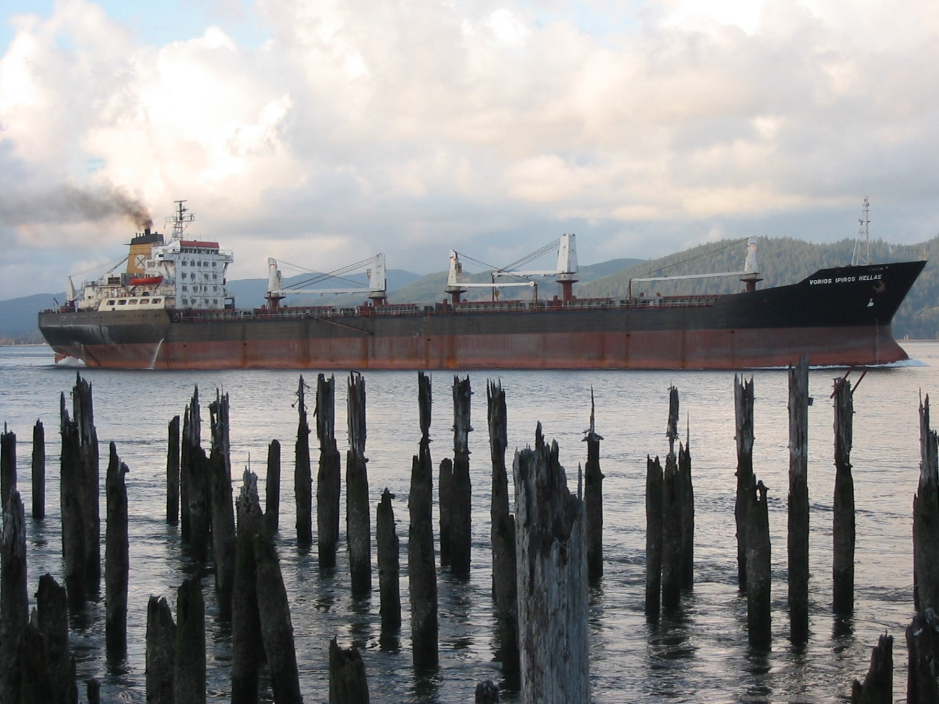
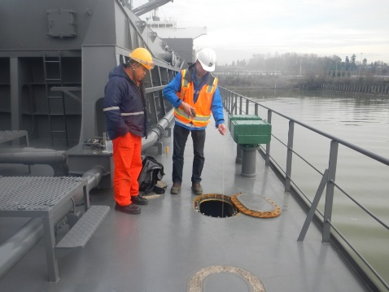
DEQ Ballast Water Program
Regulations established in 2001 (ORS 783.620-992)
Program funding supported by 50/50 cost share between fee revenue and GF allocation
Program activities include:
  Pre-arrival reporting form screening
  Vessel inspections
  Outreach & technical support
  Enforcement
  Policy development
  Regional and inter-agency coordination
Ballast Water Management Rulemaking 2016
Notes:
ORS 783 prohibits BWD unless it meets specific management criteria.
It also establishes EQC responsibility to adopt rules and procedures that “minimize the risk of introducing AIS into the waters of this state”.
DEQ’s BWP efforts are based on a 1.5 FTE resource: supported by a 50/50 cost share between GF allocations and revenue generated from an $88 per vessel arrival fee.
*Our routine program operations include monitoring ship arrivals and screening pre-arrival reporting forms to identify high-risk vessels where we focus our outreach, inspection and compliance verification efforts.

Slide 7
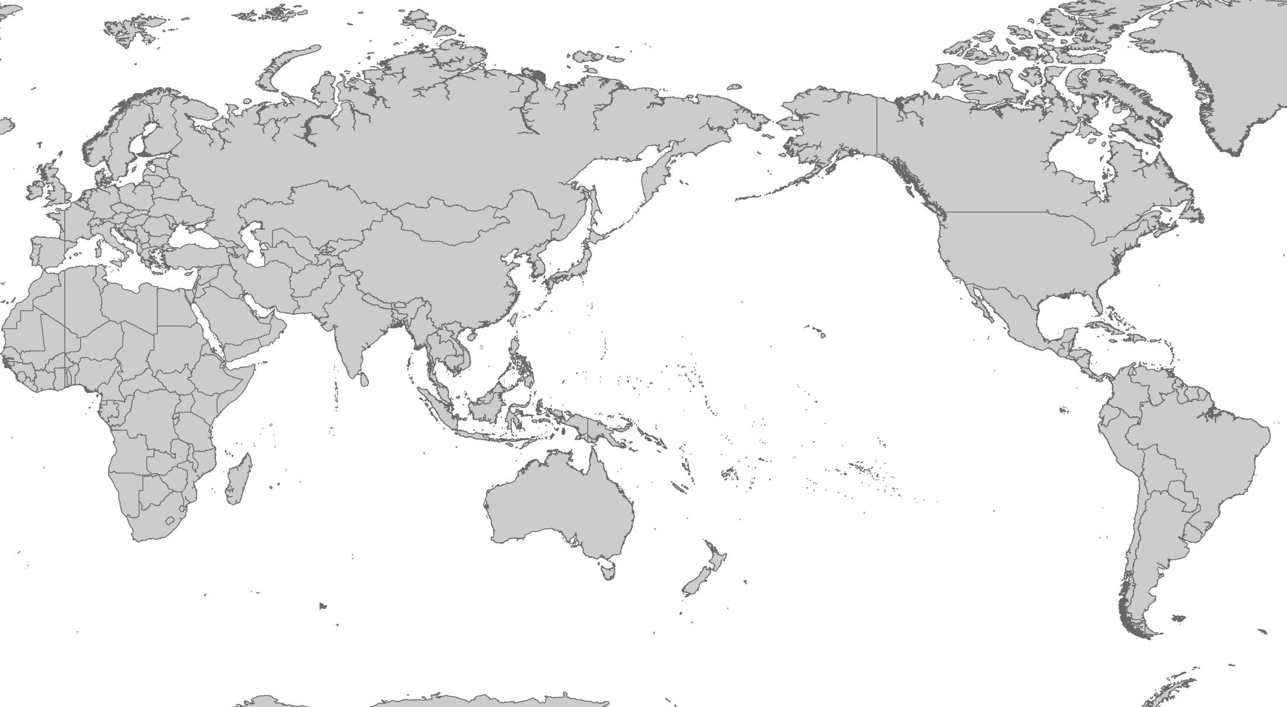
Original Source of Oregon Ballast Discharge
& Related Risk Factors
> 12 Million m3 discharged to Oregon each year
●
●
●
●
●
●
●
●
●
●
●
●
●
●
●
●
●
●
●
> 4 M
2-4 M
●
●
●
●
●
1-2 M
100k – 1M
< 100k
●
Risk Factors:
Propogule Pressure (Discharge Volume)
Environmental ‘Match’ (Source vs. Receiving port)
●
7
Ballast Water Discharged to Oregon (Millions of m³)
by Source Region
Notes:
Commercial vessels discharge over 12 M m3 of ballast water to Oregon ports each year. Each month, that equates to roughly 400 Olympic sized swimming pools (265 Million gallons) – a vast majority of which is being discharged in a 50 mile stretch of river from Broadway Bridge on the lower Willamette to the Rainier/Longview vicinity on the Columbia. Although vessels carry BW to OR from ports all around the world, over 90% was originally sourced from ports in China, Japan and Korea.
*There are two key factors to keep in mind when considering BW transfer risk for AIS. First, we generally refer to BWD volume as a surrogate measure for estimate propagule pressure - the number of living organisms being transported and discharged that could seed and establish a new population. The second is ‘environmental match’ or the similarity between the source location and the port environment receiving the discharged ballast.
In this regard, it important to note that compared to the larger west coast ports of LA/SF/PS, Oregon is managing port environments that are predominantly freshwater or low-salinity, not marine – (a difference that has important implications when evaluating available BWM strategies)
SEGWAY: Fortunately, this substantial volume of BW discharged to OR each year is not directly transferred from these foreign harbors, but instead – due to our regulations - has undergone risk-reduction management practices……

Slide 8
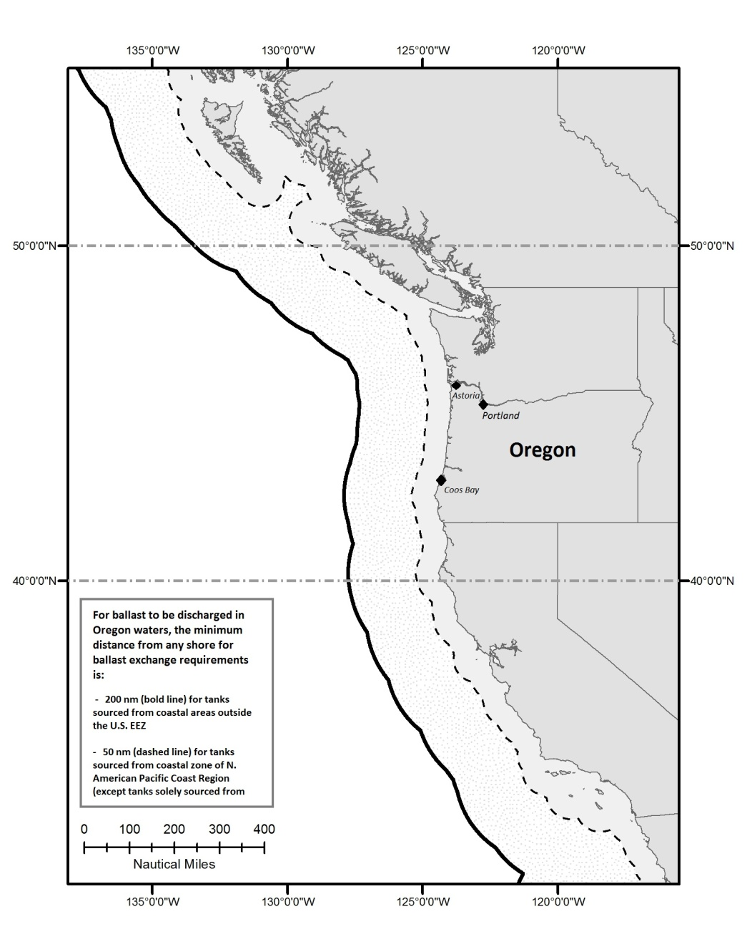
Oregon Ballast Management Requirements
(OAR 340-143)
Ballast Water Exchange (BWE), or
Shipboard Treatment (BWT), or
Meet exemption criteria.
Ballast Water Management Rulemaking 2016
Notes:
Currently, vessel operators may discharge ballast to state waters if it meets one of three management options:
Ballast water exchange is achieved mid-voyage by replacing the water sourced from a coastal or inland port environment with water from the open ocean. For transoceanic voyages this operation is supposed to occur >200nm from shore, whereas coastwise voyages may conduct their exchange 50 or more nm from shore.
The second option is to use shipboard treatment technology in a manner consistent with standards established by the USCG - language that has been on the books since 2001 despite there not having been any federal discharge standards to guide BWTS development until very recently.
Lastly, vessel operators may discharge ballast without conducting exchange or treatment is they meet one of various exemptions that are provided, including for safety reasons or short voyages (e.g. Puget Sound to CR).
SEGWAY: So, ballast exchange has been the primary management strategy that we have relied on for the past 15+ years and – when combined with adequate compliance verification resources/efforts – we are confident that has been a valuable and effective strategy for protecting our ports.

Slide 9
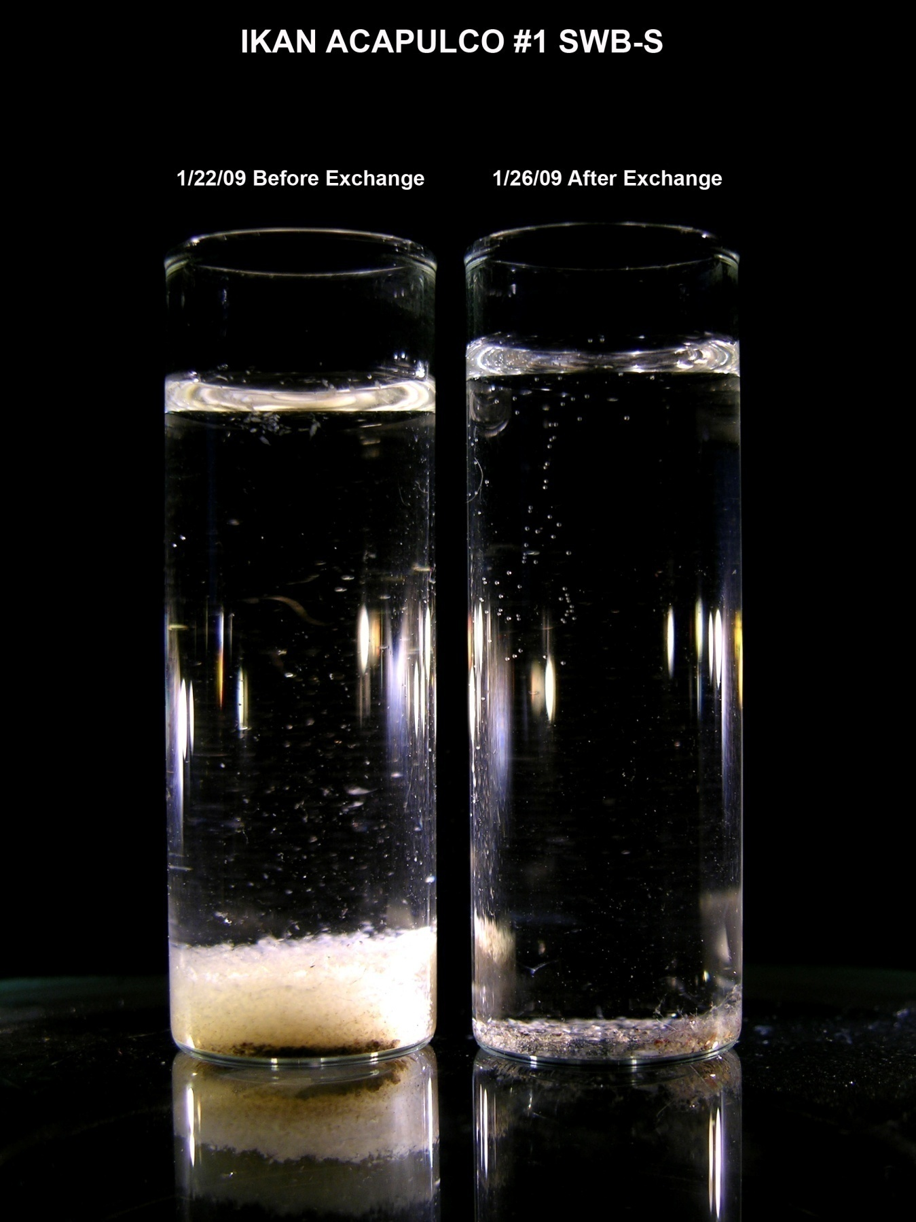
Ballast Exchange Efficacy
Exchange: Before & After
~ 28,000 ind./m³
85% high-risk taxa
~ 10 ind./m³
<4% high-risk taxa
Credit: Jeff Cordell (Univ. of WA)
Notes:
To briefly demonstrate, this picture shows a vial containing the concentrated zooplankton sample collected from a ship that had entered CR without conducting BWE of its ballast tanks:
The small white dots in this vial and accumulated at the bottom show zooplankton from the before sample…..
*…and this second vial is the result of the same sampling method collected from the same tank, but after the vessel had transited offshore 50 miles to conduct BWE, and then came back so that it could proceed with their loading operations.
Both visually and quantitatively you can see that BWE dramatically decreased the risk that BWD from this tank would introduce a new non-native species to our rivers.
SEGWAY: Despite the efficacy of BWE for preventing AIS transfer to low-salinity ports - it has long been considered to be a stop-gap measure. With the aim to eventually replace BWE with a one-size fits all strategy that would be more protective of marine ports, not just FW ports.

Slide 10
Ballast Regulatory Landscape
Oceanic Ballast Water Exchange (BWE)
Numeric discharge standards and ballast water treatment (BWT)
Management Shift Underway
USCG 2012 Rule
National Aquatic Nuisance Control & Prevention Act (1990)
EPA 2013 VGP
CA Marine Protection Act 2006
National Invasive Species Act (1996)
State Programs Established (CA/OR/WA )
IMO Convention Implementation
2017
IMO
2004 BWM Convention
1990
2000
2010
Ballast Water Management Rulemaking 2016
Notes:
The BWM regulatory landscape started to get particularly interesting circa 2004 when various regulatory jurisdictions started adopting strategies aimed at replacing BWE with BWT.
First the IMO, then CA, USCG and EPA have adopted numeric standards limiting the number of living organisms in BWD.

Slide 11
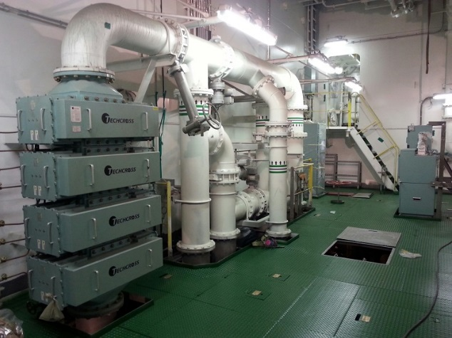
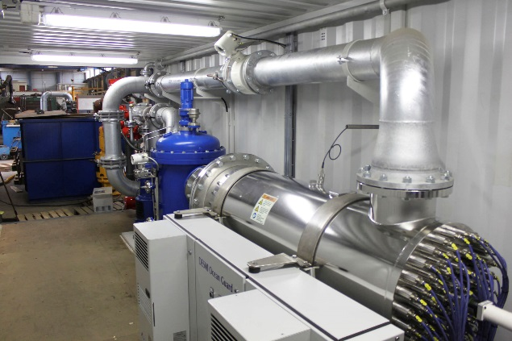
Paradigm Shift: Discharge Standards
Effective 2014 for new build vessels;
Effective January 2016 for existing vessels (following 1st drydock) .
Notes:
The BWDS are based on number of living organisms allowed per unit volume for 2 different plankton size classes and 3 additional pathogen indicator categories.
In most cases meeting BWDS will require shipboard BWTS ….. new technologies – some involving combined filtration/UV systems, others using active ingredient biocides. It is important to note that at this time, no silver bullet industry standard has emerged and there are over 60 different systems conditionally approved on the market but still being tested.
The entire breadth of stakeholders have identified concerns about the current status of this transition towards reliance on shipboard treatment systems.
For vessel owners/operators, the concerns include cost, ongoing delays in the certification/approval process, and evidence that the current BAT ‘may not always live up to the required standards under real operating conditions onboard ships’ (BIMCO 2016).
From an environmental protection standpoint, researchers, advocates and many regulators are concerned that the federal BWDS is not sufficiently protective to prevent AIS. California and New York, for example, have responded by adopting state-specific BWDS.
Also, there continues to be a lack of standardized sampling methodologies and tools to provide efficient real-time compliance verification to ensure that the systems are functioning properly.
Despite these problems, BWTS implementation is underway and we are currently facing an increasing number of vessel arrivals to Oregon that are using provisionally approved BWTS. Based on current regulations, these vessels are no longer required to conduct BWE.

Slide 12
Strategy Efficacy Dependent Upon Environmental Conditions
  Saltwater → Saltwater
  (High risk = marine organisms)
  Freshwater → Freshwater
  (High risk = freshwater organisms)
  End-of-pipe discharge following:
  End-of-pipe discharge following:
BWE
BWT
BWE
BWT
  1000’s per m3
  <10 per m3
  1000’s per m3
  <10 per m3
Based on Ruiz and Reid 2007, J. Cordell (unpublished), and Briski et al. 2013
Ballast Water Management Rulemaking 2016
Notes:
When comparing the efficacy of BWE versus treatment under the federal BWDS, it is clear that switching to BWT represents a dramatic reduction in the number of organisms released, and for ballast transfer to marine environments this is widely regarded as an improvement compared to BWE.
However, replacing BWE with BWT for ballast transfer to freshwater ports like the CR/CB may not represent an improvement at all under circumstances when the ballast had been sourced from a low-salinity or freshwater environment.
This is because the comparison can’t simply be about number of organisms per unit discharge – but also is about the type of organisms being released and whether they represent an environmental match risk to the receiving environment.
Without the mid-ocean exchange, low-salinity organisms in the tank will not be exposed to high mortality from osmotic shock. Following BWT under federal BWDS, the allowable living organisms that remain may be high-risk species for introduction to Oregon waters. Under BWE, there may be 1000’s of living zooplankton per m3, but since they are organisms suited to marine conditions, they don’t represent a risk to our FW ports.
SEGWAY; Multiple other regulatory jurisdictions have responded to these concerns/challenges…….

Slide 13
Response to Int’l/USCG Management Shift
(Other Jurisdictions)
  State of California
    State-specific Numeric BWDS (~ 100x more stringent).
  EPA (Vessel General Permit)
    ‘Exchange + Treatment’ (BWE+BWT) for low-salinity ballast transfer to the Great Lakes.
  Other States (MA, MI, MN, NY, RI, WI)
    ‘Exchange + Treatment’ (BWE+BWT) for all BWD.
  Canada (proposed)
    ‘Exchange + Treatment’ (BWE+BWT) for all ballast transfer to freshwater environments.
Ballast Water Management Rulemaking 2016
Notes:
Including the State of California which adopted a state-specific BWDS that is roughly 100x more stringent and essentially would not allow for any larval fish or invertebrate plankton in BWD.
However, it is important to note that due to a lack of available technology to meet this higher standard, CA has repeatedly delayed its implementation timelines, most recently to 2020.
Other, more recent responses that have informed our rule development activities include:
EPA 2013 Vessel General Permit
Other States (MA, MI, MN, NY, RI, WI)
Canada (proposed)

Slide 14
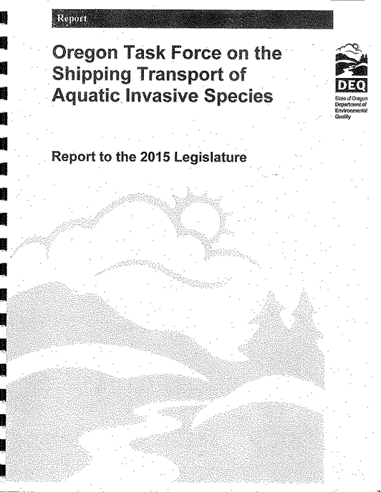
Rulemaking Stakeholder Engagement
2015
Legislation
(HB 2207)
Rulemaking Advisory Committee
STAIS
Task Force
Report to the
OR Legislature
➔
NPRM
2014
2015
2016
Ballast Water Management Rulemaking 2016
Notes:
Developing a policy response to these Federal changes that are suitable to Oregon conditions has been a process that began over 3 years ago…..
First, the legislatively mandated STAIS TF convened throughout 2014 to prepare a report to the 2015 Legislature. There was unanimous TF support for numerous report recommendations including increasing the vessel arrival fee to help support BWP efforts. But on the issue of whether Oregon should establish BWE+BWT provisions, a majority of TF members were in favor, while most maritime industry reps voiced a minority opinion in opposition – arguing that the strategy was unproven, and unnecessary at that time.
In response to the TF recommendations and further stakeholder engagement with legislators, HB2207 was passed to clarify EQC authority for establishing BWE+BWT under Division 143 Rules, following further stakeholder engagement and regional coordination.
After the 2015 Leg session, the publication of additional scientific studies supporting BWE+BWT, and dramatic increase in the number of Oregon vessel arrivals that have begun using shipboard BWTS, DEQ formally launched rulemaking efforts and a RAC in late 2015. The RAC met 3x prior to our development and publication of NPRM in April 2016.

Slide 15
Ballast Management Rulemaking Objectives
  Protect Oregon waters from aquatic invasive species threats by preventing discharge of high-risk ballast water.
  Managing risks from ‘empty’ ballast tanks
  Implementation of Shipboard Treatment Systems
      Support implementation of numeric ballast water discharge standards, but…..
      Mitigate concerns by establishing additional prevention practices for high-risk ballast transfer scenarios.
  Housekeeping
Ballast Water Management Rulemaking 2016
Notes:
Our rulemaking set out to address 3 general areas:
First, to establish management practices that reduce risks associated with ‘empty’ ballast tanks that may be used for ballasting and de-ballasting while in state waters.
Second, to support implementation and development of shipboard ballast treatment systems, but to mitigate concerns about federal BWDS and BAT status by establishing local strategies that are still compatible within the broader federal and international regulatory framework.
And lastly, to take the opportunity to make any relevant but non-substantive housekeeping amendments to Division 143 rules.

Slide 16
Managing ‘Empty’ Ballast Tank Risks
  Proposed Strategy:
  Amend OAR 340-143-0010 to require salt-water flushing management practices for ‘empty’ ballast tanks that may be used for ballasting and de-ballasting while in state waters.
  Why?
  ‘Empty’ tanks harbor a wide range of organisms.
  Salt-water flushing is highly effective at removing and killing fresh/brackish water organisms.
  Already required by EPA – would enable enforcement by DEQ.
Ballast Water Management Rulemaking 2016
Notes:
So, regarding the first issue - to address concerns that ‘empty’ ballast tanks are never truly empty and residual water and sediments represent a vector for AIS, the proposed rules would require that vessel operators conduct a mid-ocean salt water flushing of any tanks that they want to be able to use for ballasting and subsequent de-ballasting operations while in state waters.
This ‘swish and spit’ operation aims to ensure that residual ballast have salinity > 30 ppt which has been shown to be highly effective at removing and killing fresh/brackish water organisms that may inhabit residual contents of ‘empty’ tanks and represent a threat to our local ports.
This management practice is already required under the EPA Vessel General Permit and would simply enable OR DEQ inspection and compliance verification efforts to be applied toward this important prevention practices.

Slide 17
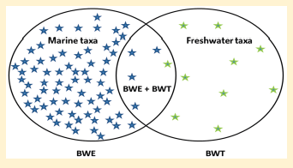
Implementation of Shipboard Treatment Systems
  Proposed Strategy:
  Amend OAR 340-143-0050 to require ballast water exchange – in addition to use of treatment systems (BWE+BWT) - for subset of vessel arrivals representing a high-risk for introducing AIS to Oregon.
  Why?
“BWE plus BWT proved to be more effective at reducing invasion risk to freshwater recipient systems than BWT alone”
Briski et al. (2015) Combining ballast water exchange and treatment to maximize prevention of species introductions to freshwater ecosystems. Environmental Science & Technology 49, 9566−9573
Ballast Water Management Rulemaking 2016
Notes:
Next, to address concerns about federal standards implementation and 1st gen BWTS reliability, we have proposed adopting a BWE+BWT strategy similar to the model already established by EPA for vessels operating in the GL.
There are a multitude of supporting arguments for why BWE+BWT would be a valuable and practicable solution for protecting Oregon ports during this transition towards a new management paradigm.
The principal benefits of this strategy include:
The fact that it targets both propogule pressure reduction as well as disrupting an environmental mismatch between source and receiving locations
The strategy does not require anything ‘new’ of vessel operators – it simply retains a management practice that has been the standard operational requirement for 15+ years.
It provides a precautionary safeguard against 1st generation technology uncertainties and reliability.
And perhaps most convincing, studies have demonstrated that low-salinity ports could be more vulnerable to AIS if they rely on BWT alone, rather than BWE+BWT.

Slide 18
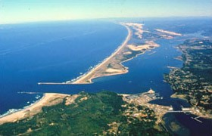
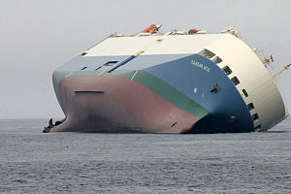
Proposed BWE+BWT Rule Elements
  Scope
    Source salinity criteria - <18 ppt
    Receiving waters – all OR waters
  Exemptions
    Safety
    Treatment systems meeting more stringent standards
  Repeal Date – 2025
Ballast Water Management Rulemaking 2016
Notes:
The strategy can also be applied strategically to only target highest risk voyages – specifically, our proposed rule established that BWE – in addition to meeting federal BWDS – would only be required of ballast tanks that were sourced with water that is less than 18 ppt and for BWD to low-salinity environments of Oregon.
Because essentially all BWD to Oregon occurs to environments that are FW or low-salinity for at least some parts of the year, the RAC had generally agreed that applying the rule to all Oregon waters would alleviate potential confusion of trying to define affected Oregon waters by geographical boundaries, river miles or salinity conditions.
*The proposed rule also establishes exemptions in cases where vessel or crew safety were at risk, and a forward looking exemption from BWE for any vessels that had invested in BWTS that meet higher BWDS such as those sought by CA.
Also, because this strategy is intended to provide a safeguard bridge until we can establish greater confidence in shipboard BWTS efficacy, we proposed a repeal date for this section of the rule in 2025.

Slide 19
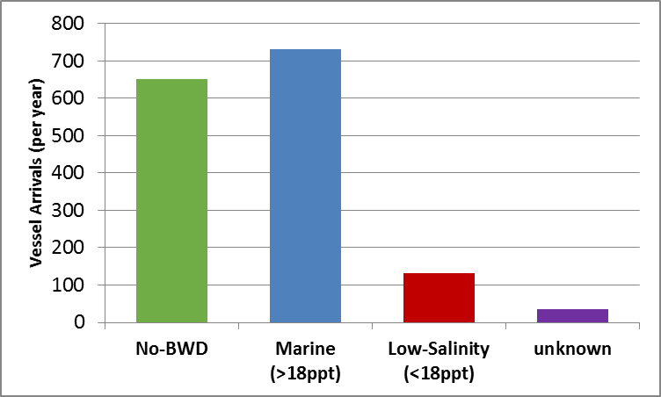
Effected Vessel Arrivals to Oregon Waters
Effect of proposed rule on Oregon vessel traffic:
14.7% of BWD (volume) to Oregon sourced from low-salinity ports*
49%
40%
8.8%
2%
(* derived from 2013-15 OR DEQ Ballast Reporting Records and Keller et al 2011)
< 9% of vessel arrivals to state waters
(~ 135 per year) may be subject to BWE + BWT rule proposal
Ballast Water Management Rulemaking 2016
Notes:
Unless there is a significant shift in global shipping patterns – resulting in more vessels carrying low-salinity ballast to Oregon– we are confident that the proposed rule will affect less than 15% of the total BWD volume to Oregon waters
*which translates to less than 10% of vessel arrivals to the state (or ~ 135 per year).
And, as I hope that I have made clear, the proposed rules will not prohibit those high-risk vessels from conducting their normal cargo loading operations in Oregon, but rather would simply require that they conduct mid-ocean exchange – in addition to meeting Federal treatment requirements – before entering Oregon waters.

Slide 20
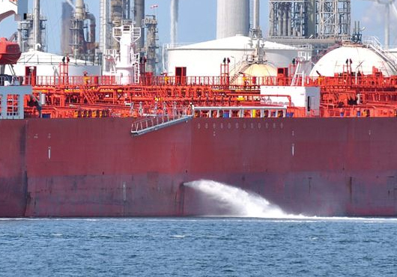
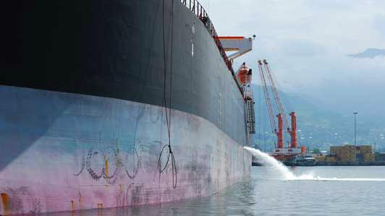
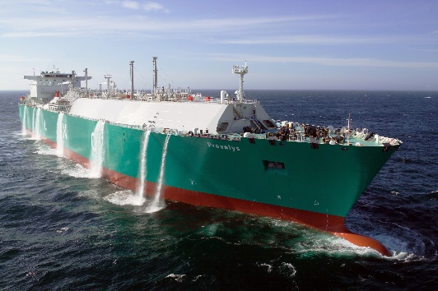
Summary of Comments Received
  Public Comment Periods
    Three Open Periods: April, July, and October
  16 submittals
  49 itemized comments (11 categories)
    No comments regarding Noise Control
    Support for ‘empty tank’ salt-water flush
    BWE+BWT: Postponement
    BWE+BWT: Source Criteria
    BWE+BWT: Receiving Waters Affected
    BWE+BWT: Exemptions
    BWE+BWT: Repeal Date
Ballast Water Management Rulemaking 2016
Notes:
Due to new concerns raised by some stakeholders during the public comment period we re-opened the comment period two additional times to allow for further engagement with concerned parties and with the RAC.
Over the course of the three public comment periods, comments were submitted by 16 entities, individuals or coalitions.
Generally speaking,
There were zero comments on the Noise control portion of the proposed changes;
And there was only supporting comments for the salt-water flushing requirements of empty tanks;
All other substantive comments an/or suggested changes were focused on the BWE+BWT portion of the rules.
Some members of the maritime industry continued to question the need for BWE+BWT and requested further postponement of this rule effort. However, barring postponement, they asked for some specific revisions to the proposed rule if we opted to go forth with recommending a final rule to the EQC.
Conversely, various members representing environmental, research, tribal or other regulatory jurisdictions voiced support for the BWE+BWT rule, some advocating that we adopt the more protective version of the policy that has been established by states such as WI, MN, MI, NY and RI.

Slide 21
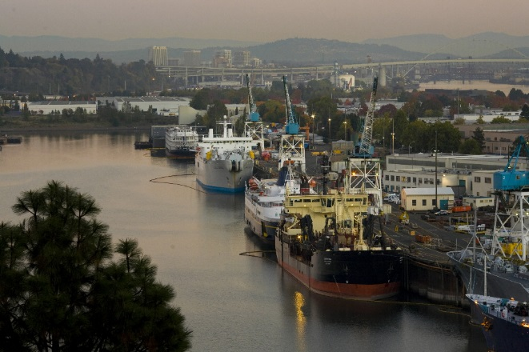
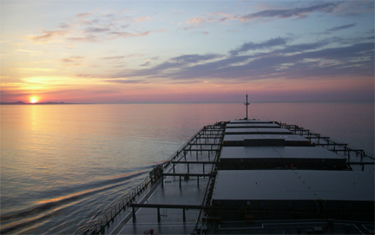
Response to Comments
  Modifications to Proposed Rule:
  Greater specificity for receiving water criteria.
  Added exemption for incompatible treatment systems.
  Added exemption for short voyages using active biocides.
  Moved repeal date to 2023.
Ballast Water Management Rulemaking 2016
Notes:
The revised final rule that we are presenting for your consideration includes four modifcations to the original NPRM.
Despite the perceived unanimous RAC support for applying BWE+BWT for all low-salinity BWD to any location in OR, some commenters requested that we define areas more specifically within the state where there is greatest concern. We have responded by revising the rule to specify that BWE+BWT is required for BWD to CR, CB, and YB…
We provided additional exemption specificity from the exchange portion of the rule for vessels that have BWTS or piping configurations that are incompatible with or preclude conducting BWE prior to BWT, per manufacturer specifications.
We have also added exemption language to reduce the possibility that vessels using an active biocide BWTS, but under short voyage timelines, would feel tempted to discharge treated ballast that had not undergone the required deactivation times.
Lastly, per request from industry, we moved the repeal date up by two years to 2023 to be in line with the five-year re-issuance cycle of the EPA VGP.

Slide 22
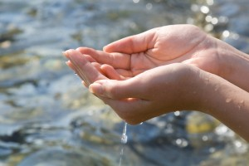
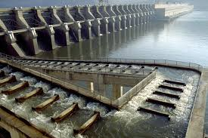

Benefits of Ballast Management
& AIS Prevention
Maintain Healthy Habitats & Ecosystem Services
Preserve Commercial Prosperity and Opportunities
Sustain Tourism and Recreational Opportunities
Ballast Water Management Rulemaking 2016
Notes:
DEQ recognizes that preventing AIS is critical to maintaining healthy habitats and ecosystem services; preserving commercial prosperity and opportunities; and sustaining tourism and recreational opportunities.
And based on the concerns over implementation of new federal policies aimed at a one-size fits all strategy - and the importance of preventing AIS before they become established - we recommend that the EQC adopt the Division 143 rule amendments, as revised.

Slide 23
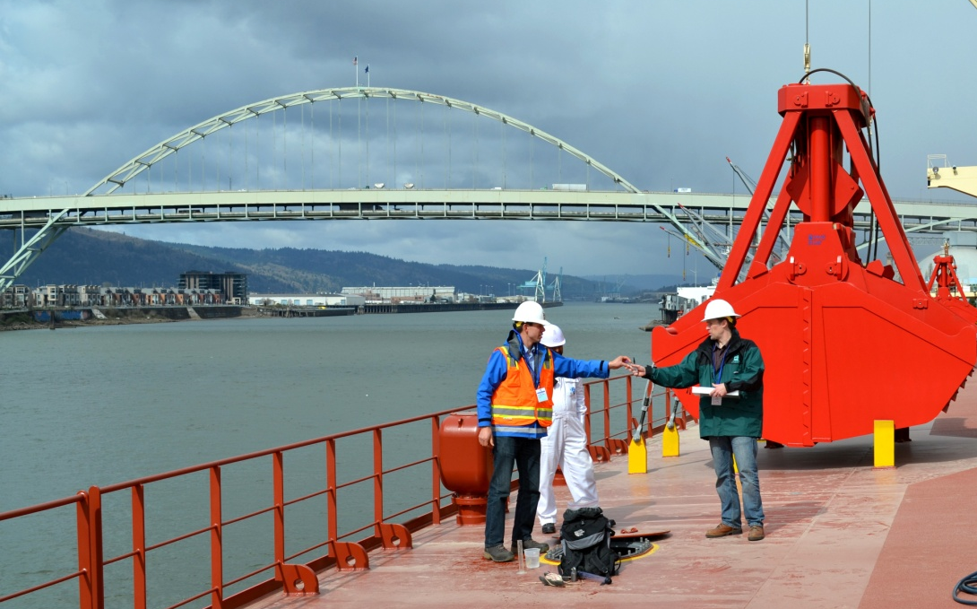
Questions?
2015
2016
DEQ BW Program webpage: http://www.deq.state.or.us/lq/cu/emergency/ballast.htm
Ballast Water Management Rulemaking 2016
Notes:
That concludes my presentation and I would be happy to answer any questions you may have.
Thank you.

