Slide 1
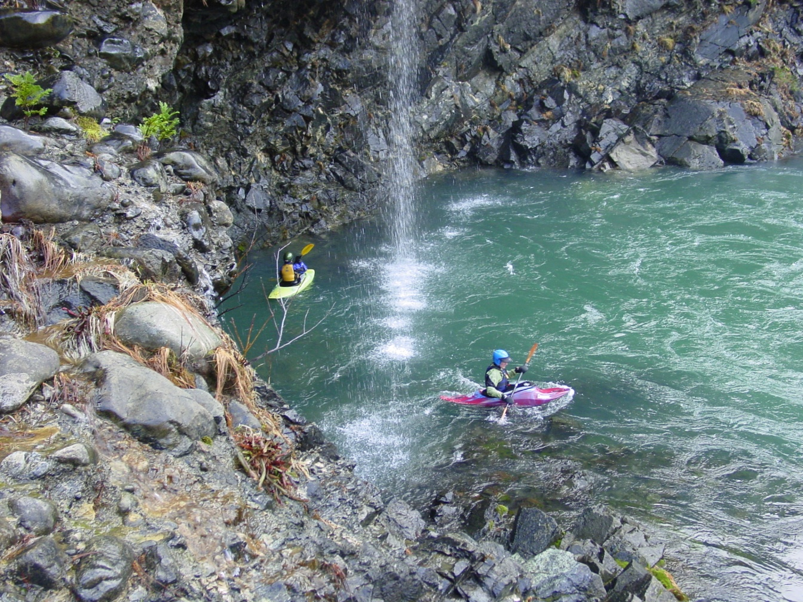

Water Quality Standards Program
Petition to
Designate
Outstanding
Resource
Waters
EQC Meeting
April 20, 2016
Portland, Oregon
North Fork Smith River
Debra Sturdevant | Oregon Department of Environmental Quality
Notes:
Introduce self
This agenda item is an action item on a citizen petition for rulemaking to designate outstanding resources waters.
First, I will present:
information on what the petition proposes and the decision before the Commission today,
provide background information on the petition process and the state’s Outstanding Resource Water Policy, and
summarize DEQ’s evaluation of the petition and the public comment received.
Second, the petitioner, Gordon Lyford and a colleague will speak to the Commission.
Third, the Forest Supervisor, Robert MacWhorter, of the Rogue River-Siskiyou NF, the primary land owner and manager of the watershed, will provide a few remarks.
There are members of the public present who are interested in commenting to the EQC as well.
Lastly, there will be time for questions and discussion and your action on the petition.

Slide 2
EQC Action
Received a petition Feb. 23, 2016
  From Gordon Lyford of O’Brien, Oregon
Act no later than May 22, 2016
Options:
  Deny petition
  Initiate rulemaking proceedings
  Deny and direct DEQ to take other action
DEQ recommendation
  initiate rulemaking proceedings
Notes:
slide
According to the administrative rules for petitions, you have 90 days, which would be May 22.
The options for your decision on the petition are:…slide
The action recommended at this time is to initiate rulemaking proceedings on the rule amendments proposed by the petition. If the EQC directs DEQ to conduct rulemaking, this does not pre-suppose the outcome of the rulemaking process. During the rulemaking process, there will be an opportunity for the public to comment on the proposed rule language. Ultimately, the EQC could adopt decide not to adopt the rule or to adopt revised rule language.

Slide 3
Petition Request
Requests rulemaking to:
  Designate NF Smith River and its tributaries and associated wetlands as Outstanding Resource Waters (ORW)
  Establish policies to maintain & protect current water quality and ecological integrity
Proposes to amend:
  ORW Policy
  South Coast Basin criteria
Notes:
ORW Policy: OAR 340-041-0004(8)
SC Basin criteria: OAR 340-041-0305

Slide 4
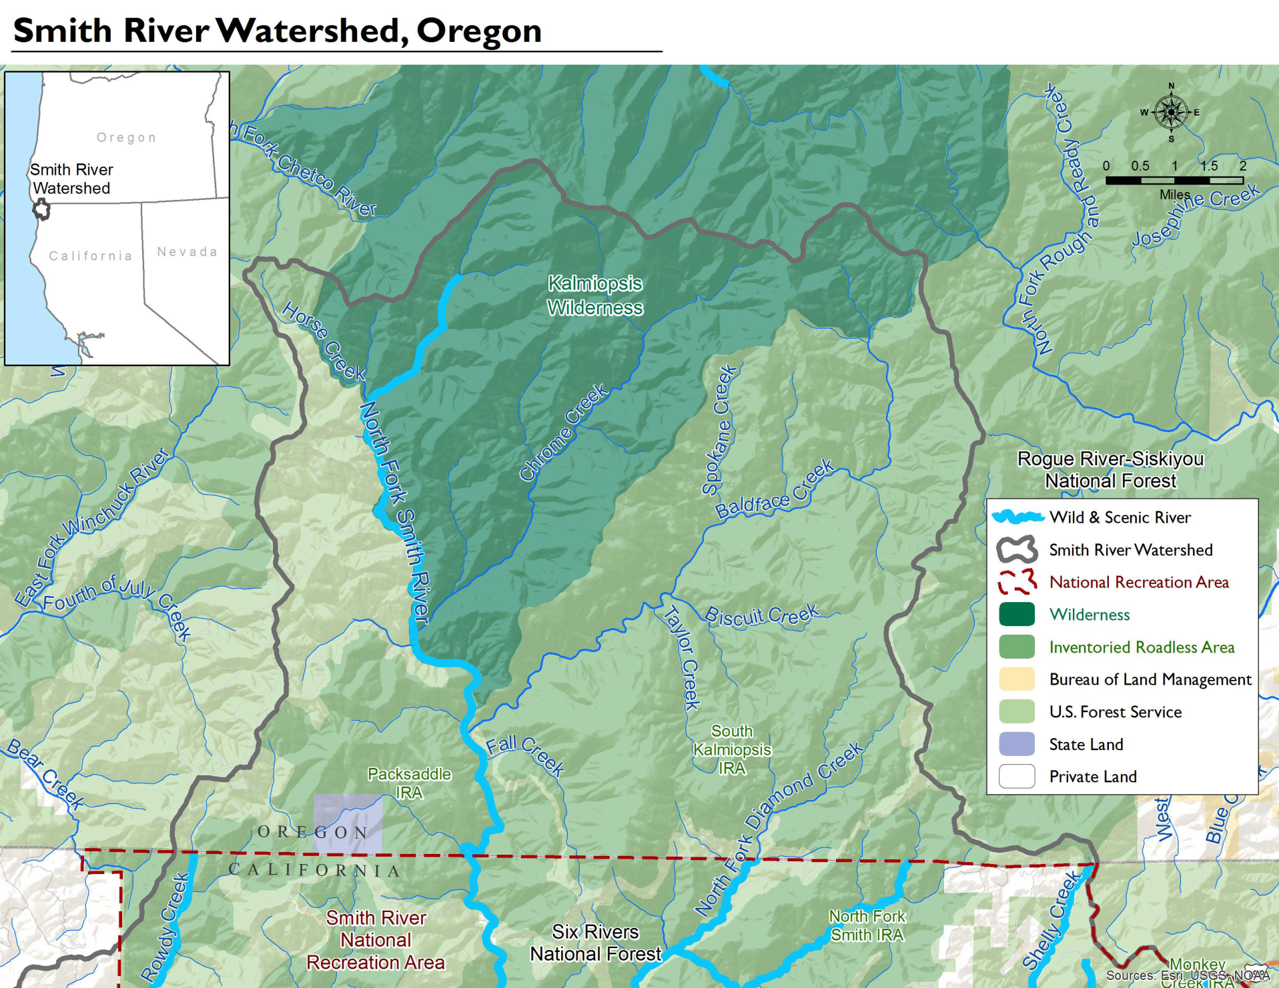
Notes:
Map shows:
NF Smith River – wild and scenic river – 13 miles in OR, designated in 1988
Ownership: USFS, BLM and State land ownership (555 acres)
Wilderness and roadless areas
According to USFS, 84% of the land in the watershed is USFS and 16% is BLM
Of the land on the RRS NF, 98% is federal, 1% state and 1% private

Slide 5
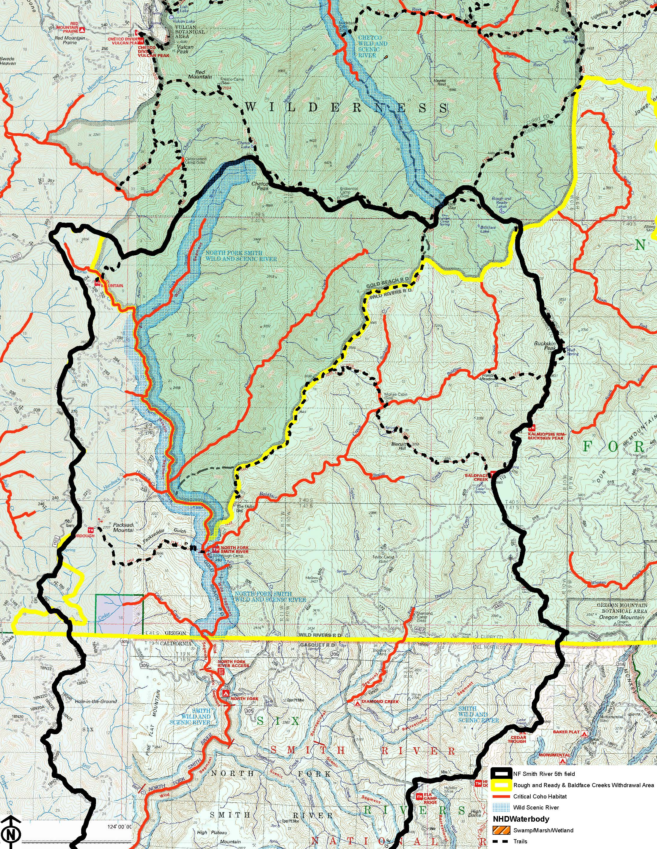
Notes:
Shows extension of basin into N. CA
Coho critical habitat
W&S river
Wilderness area
State land
Proposed mineral entry withdrawal area

Slide 6
Proposed Protections
Protect existing water quality, ecological values and beneficial uses
Prohibits new NPDES discharges
Prohibits degradation of the existing water quality and ecological values
Allows exceptions for a limited duration:
  to respond to an emergency or
  to restore or enhance water quality or ecological integrity
Notes:
The proposed rule amendments include a policy to maintain and protect the existing water quality, ecological values and beneficial uses.
Prohibit activities that would degrade or lower water quality
slide
subjective, yes
kayaking, hiking, trail maintenance likely could be done in a manner that would not degrade wq
Exceptions: example wildfires – fight fire, restore after fire

Slide 7
Background: Petitions
Any person can submit a petition requesting that an agency adopt, amend or repeal a rule
The petition must:
  clearly show the proposed revisions
  provide supporting facts and arguments
  address several considerations
Agency has 90 days to act on the petition
Agency may deny, initiate rulemaking proceeding, or direct other action
Notes:
Before we move to DEQ’s evaluation of the petition, I’d like to give you a little background on rulemaking petitions and on the state’s outstanding resource water policy.
Slide
Must invite public comment before denying a petition; so we invited public comment
Rulemaking process: take public comment on rule amendments proposed in the petition, but agency can adopt the rules as proposed, adopt alternative language in response to public comment or ultimately decide not to adopt the rule.
[Petition requirements in OAR 137-001-0070 ]

Slide 8
Outstanding Resource Water Policy
State antidegradation policy:
  3 classes of waters: impaired, high quality and outstanding resource
  Where high quality waters constitute an outstanding state resource, the existing water quality must be maintained & protected
Required by federal regulation
  Where high quality waters constitute an outstanding national resource…
Notes:
Oregon’s ORW policy is contained within the antidegradation policy, which is required by federal regulation as a component of the state’s water quality standards. [OAR 340-041-0004 (8)]
slide
[40CFR 131.12 (3) Where high quality waters constitute an outstanding National resource, such as waters of National and State parks and wildlife refuges and waters of exceptional recreational or ecological significance, that water quality shall be maintained and protected.]

Slide 9
ORW Policy
Existing rule states that:
  DEQ will develop screening process & list of nominations
  EQC may establish water quality values to be protected and process to determine what activities are allowed
  EQC may not allow activities that lower water quality below levels establish
  Short term exception for emergencies or for long term benefits

Slide 10
Petition Evaluation
Petition meets requirements to include:
  Information about the petitioner
  Proposed rule amendments, clearly indicated
  Facts and arguments to show reasons for and effects of the proposal
  Comment on considerations
Proposed rule amendments consistent with state’s ORW policy
Notes:
Now I’d like to share a summary of DEQ’s evaluation of the petition and whether it meets the administrative requirements for rulemaking petitions. More detail is provided in the staff report.
Slide
Then a brief overview of the required considerations
[Petition requirements in OAR 137-001-0070 ]

Slide 11
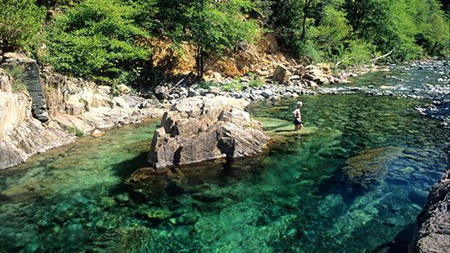
Baldface Creek, just above where it flows into the National Wild and Scenic North Fork Smith River. The Creek’s waters are startling clear (© Barbara Ullian photos)
Notes:
Facts and arguments are presented to show the reasons for the proposal
(This picture and the next 2 were sent as part of the public comment.)
One reason is to protect current outstanding Water Quality
Petition provides information on the water quality:
Reported observations of outstanding water clarity and color
Data showing very low turbidity, dissolved solids and nutrient levels in one tributary and in the Middle Fork Smith R. downstream

Slide 12
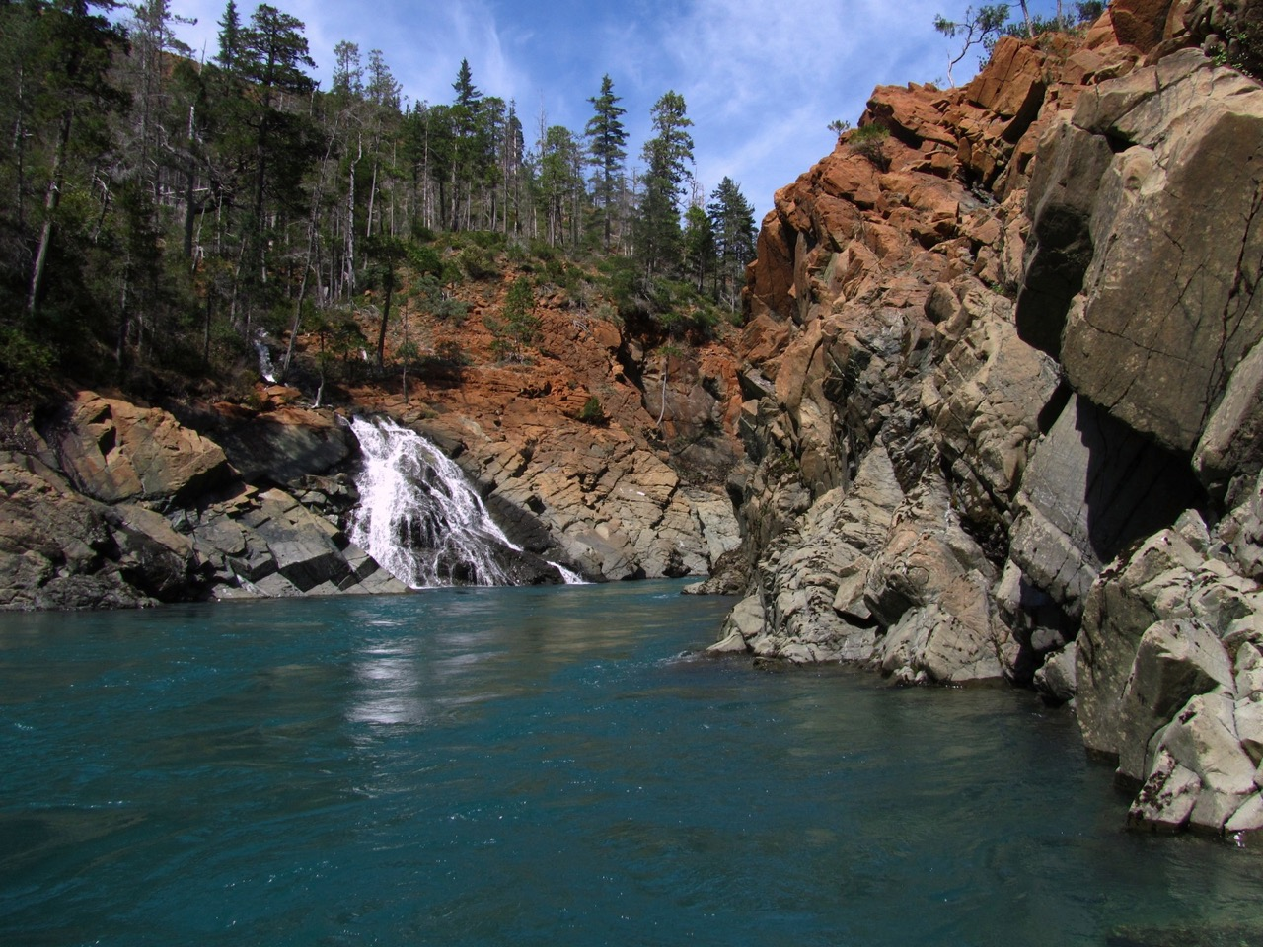
Notes:
“Wild and Scenic” designation for 13 miles of the NF Smith R (all of the river in OR)
based on nationally outstanding water quality, fisheries and scenic values
Remote and pristine
A large portion of the watershed is in wilderness or road less areas
Nearly the entire watershed is federally owned (98%)

Slide 13

Notes:
Water-related recreation highly valued
kayaking, fishing, hiking, swimming
Provides high quality water to Smith R. downstream
Municipal drinking water, fisheries and recreation
Redwood National Park

Slide 14
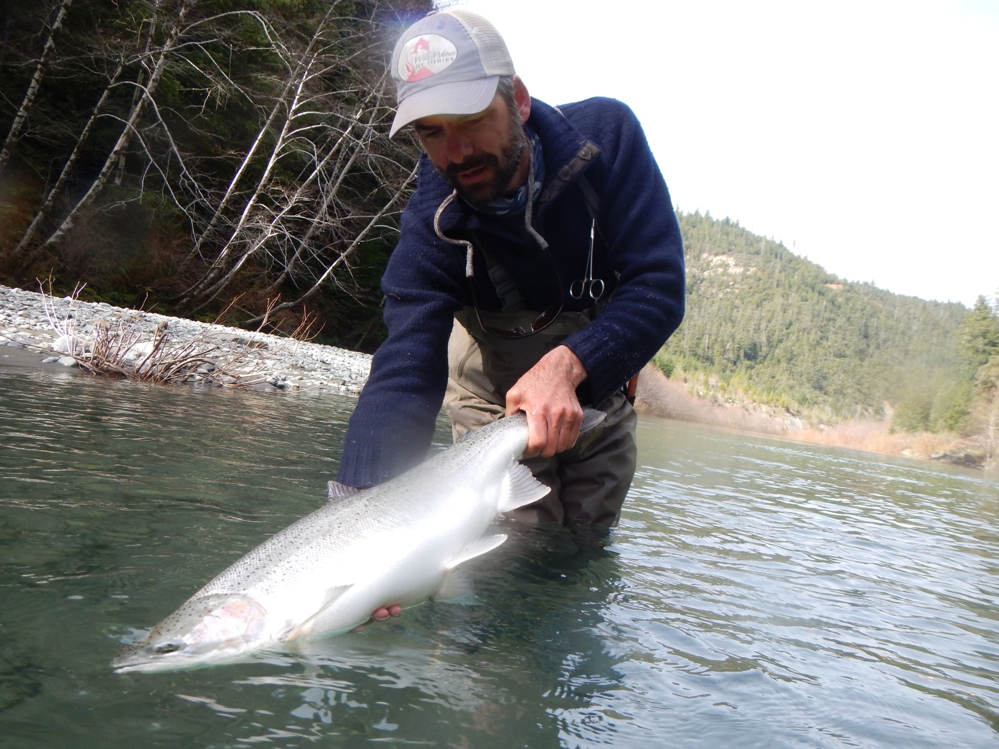
Notes:
Another reason for the proposed ORW Designation: protect the Ecological Value of the waters
High quality habitat for salmon, steelhead and trout
Key Watershed under Forest Service Aquatic Conservation Strategy
Important watershed for recovery of listed Coho salmon
[Southern Oregon and Northern California (SONCC) unit]
Wild & Scenic river - one of the values for designation is the fisheries
Rare and unique plants supported by wetlands in the watershed
Serpentine Darlingtonia

Slide 15
Effects of the Proposed
Rule Amendments
As drafted, proposed rules would:
  Provide added protections to these waters
  Prohibit new permitted wastewater discharges
  Prohibit activities that would degrade the current water quality and ecological value of these waters
Notes:
The effect of the proposed rule amendments would be to prohibit the lowering or degradation of water quality and ecological integrity.

Slide 16
Affected parties
Degradation of these waters may affect:
  Tribal, sport and commercial fishers
  Rafters and kayakers
  Hikers and naturalists
  Recreation-related businesses
  Others interested in maintaining pristine waters, recovering endangered species or protecting rare plants and biodiversity
Notes:
Based on information from the petition and from public comment, DEQ has identified these parties as potentially affected by the ORW designation.
slide

Slide 17
Affected parties
Protections that limit economic activity may affect:
  Mining interests
  Those interested in future use of these lands for grazing and logging, should USFS management goals change
  Common School Trust Lands
Notes:
slide
Common school trust: 555 acre parcel on tributary
On border with CA
There does not appear to be revenue generating activity occurring on these lands at this time.
Option – could be to not include this tributary

Slide 18
Considerations: Business Impacts
Local businesses related to recreation and fishing activities would benefit
There do not appear to be grazing or timber businesses currently operating in the watershed
There is interest in mining exploration, there may be a negative impact to business; if mining would otherwise be permitted
Notes:
In reviewing the petition, the agency shall consider several items, which I will go through now.
For any proposed amendment or repeal of an existing rule:
“options for achieving the existing rule’s substantive goals while reducing the negative economic impact on businesses”
Potential impacts to businesses could include…slide
Information so far indicates:
no grazing on the USFS lands, it is not allowed in the W&S River area; Not certain about BLM lands,
2 permit applications for suction dredge gold mining
3 mining claims in the area, only 1 within the watershed, for exploratory drilling, on hold due pending outcome of mineral withdrawal
If the rulemaking process moves forward, DEQ will obtain more information so we fully understand the current and potential future activities that could occur on these lands

Slide 19
Consideration: Continued Need for the Existing Rule
Petition does not propose to revise or delete any current rule language
Proposed amendments:
  implement the existing rule
  fulfill state responsibilities under the CWA
Oregon’s ORW policy has been in place for more than 20 years and no waters have yet been designated
Notes:
Another required consideration is the continued need for the existing rule

Slide 20
Considerations
Complexity
  The proposed rule is not complex
  Implementation should not be complex
Duplication or conflict with other regulation
  ORW designation is consistent with management goals of the US Forest Service
  Supports Coho salmon recovery plans
  Adds clear, enforceable water quality protection policy
Notes:
Additional considerations include: slide
- Complexity of the rule
Extent to which the rule overlaps, duplicates or conflicts with other state and federal regulations
A couple other items addressed in the staff report

Slide 21
Public Comment as of April 1
Should EQC should deny the petition or initiate a rulemaking process?
  ~1070 support proceeding with rulemaking
    fishers, kayakers and other recreational users of and visitors to the NF Smith River and the Smith River,
    residents of local and downstream communities
    Tribes
    Naturalists/researchers – rare wetland plants, geology
    recreation-related business owners
  ~10 support denial of petition
    agriculture, grazing and logging organizations
    mining interests
Notes:
And finally – the agency shall consider the nature of comments from the public
DEQ summarized in the staff report the comment received as of April 1st.
52 supporting rulemaking
7 supporting denial
Since then, we have received many more comments. This slide reflects the approximate count as of this morning.

Slide 22
Supporting Comment
Qualities and values of NF Smith R.:
  Exceptional water quality and clarity
  Pristine, healthy, free-flowing (undammed)
  Valuable, productive fisheries, including threatened species and critical habitat
  Unique geology and rare wetland plants
  Outstanding recreation opportunities
  Natural beauty
Importance to users of Smith R. downstream, including Tribes, community drinking water supply
Protect from mining and logging impacts
Please protect this special place for future generations

Slide 23
Comments requesting EQC denial
ORW designation not needed to protect water quality
DEQ has not developed screening process
Inconsistent with RRNF management plans
May restrict timber harvest and grazing, prevent economic opportunity
Creates impediments to mining
Eliminates ability to obtain new water right
Eliminates activities with minor impacts that would not violate water quality standards
Dredge miners do more good than harm

Slide 24
Key Issue: Process
Rules say DEQ will develop a screening process and list of nominated waters - we have not
Commenters suggested therefore should not designate ORW in response to petition
EQC may initiate rulemaking to designate an ORW despite lack of agency screening process or nominations
Notes:
I would now like to highlight a couple of the policy issues to consider in your decision-making that relate to the comment received.
First …slide
The ORW policy has been in our rules for more than 20 years and we have not yet designated an ORW in the state.

Slide 25
Key Issue: Need for ORW
Fulfills unique Clean Water Act role:
  Protect waters with outstanding water quality and ecological values
Complements program efforts to:
  Control pollution discharges and
  Correct water quality impairments
  Useful and efficient way to fulfill DEQ responsibilities
Notes:
Is the ORW designation needed?
CWA objectives: protect chemical, physical and biological integrity of the state’s waters;
ensure waters are “fishable swimmable”

Slide 26
Designation consistent with:
Management goals and plans of the Rogue River-Siskiyou National Forest
Federal Wild & Scenic River designation
Southern Oregon Northern California Coho Salmon Recovery Plan by NMFS
Rulemaking by CA Water Board to consider ORW designation for the Smith R.
Rulemaking by OWRD to consider classifying the NF Smith R. for instream purposes only
Proposed federal mineral withdrawal
Notes:
Based on information DEQ has to date…
Racquel Rancier, WRD
- Agencies will coordinate and look into ways to potentially align the public processes

Slide 27
Key Issue: Qualifications
Based on the information provided in the petition and through public comment, DEQ finds that the NF Smith River qualifies for consideration as an outstanding state and national resource for its water quality, fish habitat and ecological values.

Slide 28
Questions ?

