Slide 1
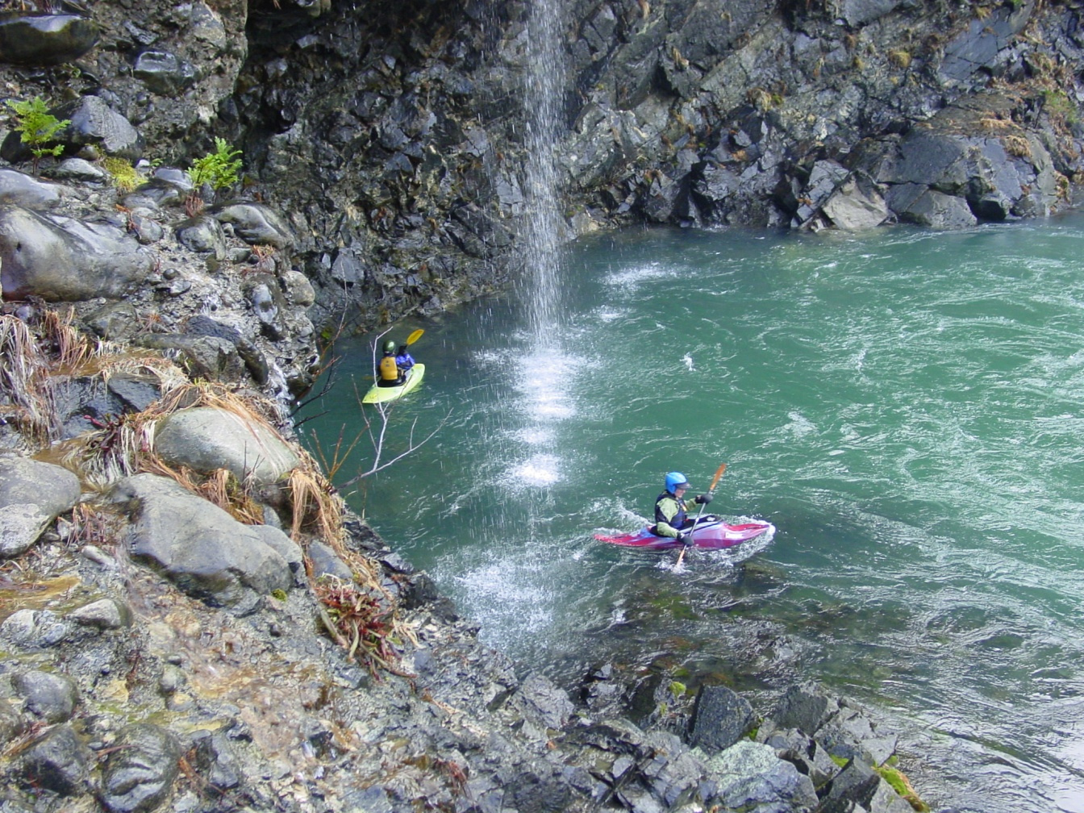
Water Quality Standards Program
Petition to
Designate
Outstanding
Resource
Waters
EQC Meeting
April 20, 2016
Portland, Oregon
North Fork Smith River
Debra Sturdevant | Oregon Department of Environmental Quality

Slide 2
EQC Action
Received a petition Feb. 23, 2016
From Gordon Lyford of O’Brien, Oregon
Act no later than May 22, 2016
Options:
Deny petition
Initiate rulemaking proceedings
Deny and direct DEQ to take other action
DEQ recommendation
initiate rulemaking proceedings

Slide 3
Petition Request
Requests rulemaking to:
Designate NF Smith River and its tributaries and associated wetlands as Outstanding Resource Waters (ORW)
Establish policies to maintain & protect current water quality and ecological integrity
Proposes to amend:
ORW Policy
South Coast Basin criteria

Slide 4
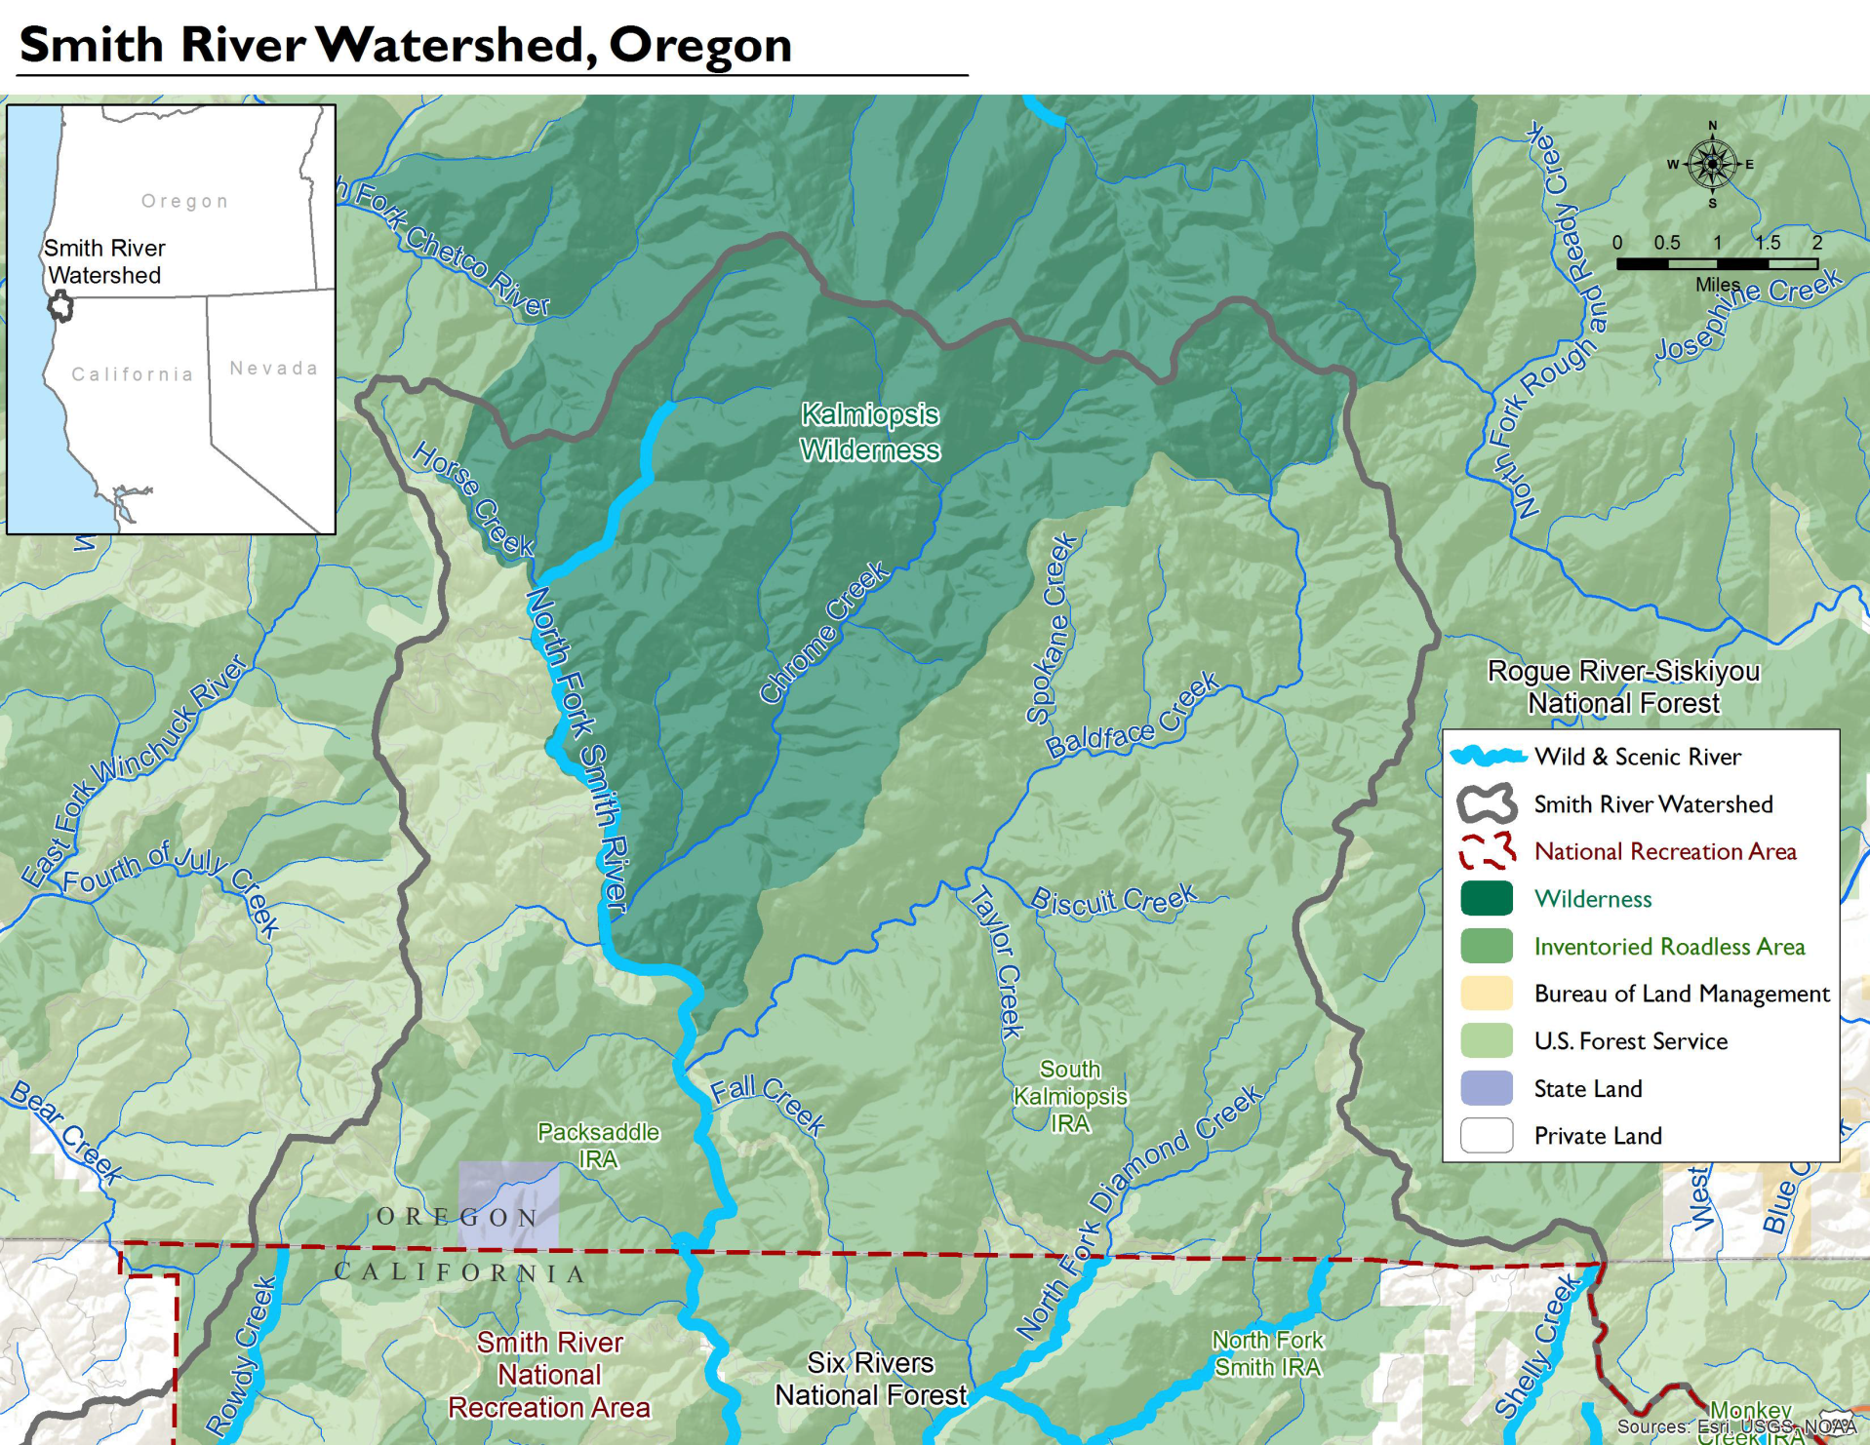

Slide 5
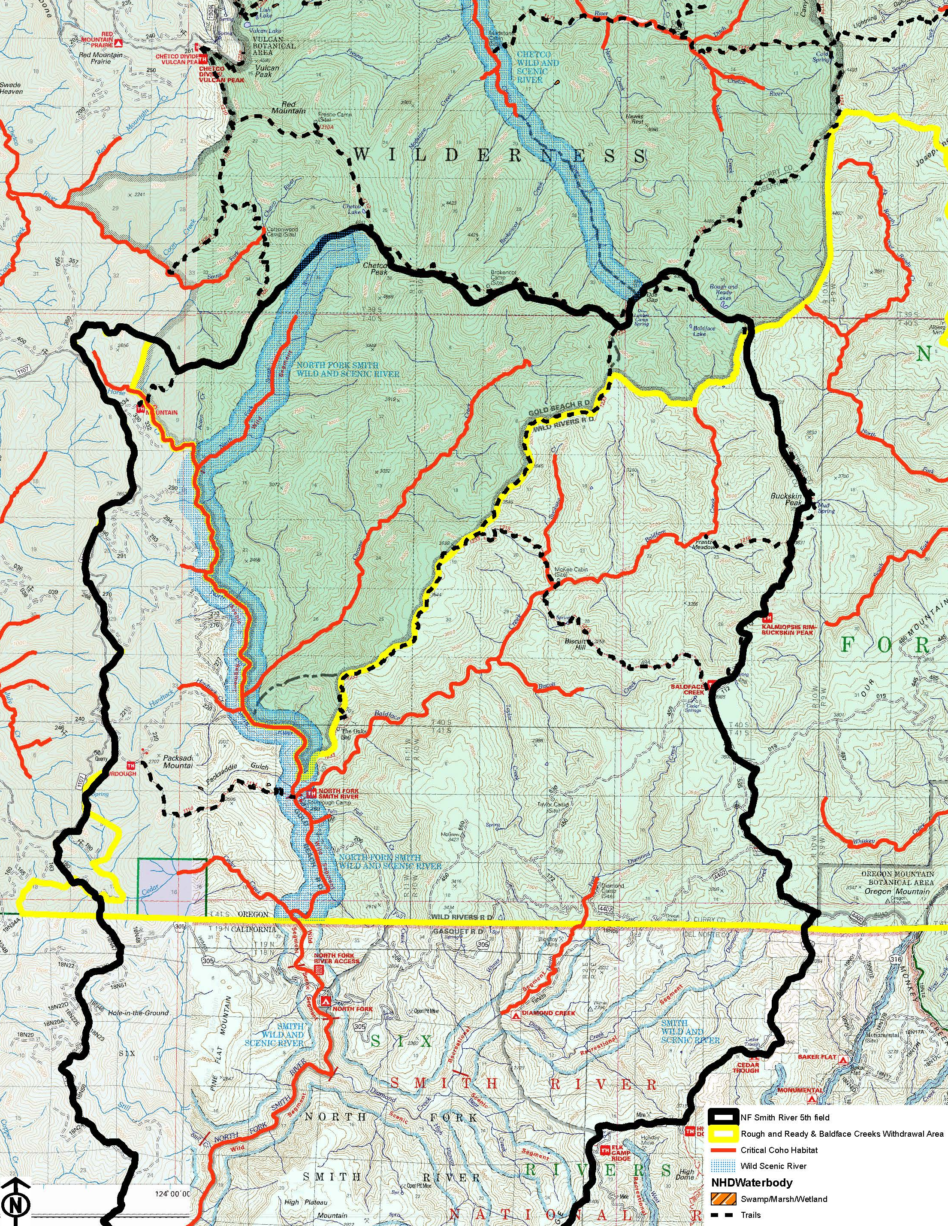

Slide 6
Proposed Protections
Protect existing water quality, ecological values and beneficial uses
Prohibits new NPDES discharges
Prohibits degradation of the existing water quality and ecological values
Allows exceptions for a limited duration:
to respond to an emergency or
to restore or enhance water quality or ecological integrity

Slide 7
Background: Petitions
Any person can submit a petition requesting that an agency adopt, amend or repeal a rule
The petition must:
clearly show the proposed revisions
provide supporting facts and arguments
address several considerations
Agency has 90 days to act on the petition
Agency may deny, initiate rulemaking proceeding, or direct other action

Slide 8
Outstanding Resource Water Policy
State antidegradation policy:
3 classes of waters: impaired, high quality and outstanding resource
Where high quality waters constitute an outstanding state resource, the existing water quality must be maintained & protected
Required by federal regulation
Where high quality waters constitute an outstanding national resource…

Slide 9
ORW Policy
Existing rule states that:
DEQ will develop screening process & list of nominations
EQC may establish water quality values to be protected and process to determine what activities are allowed
EQC may not allow activities that lower water quality below levels establish
Short term exception for emergencies or for long term benefits

Slide 10
Petition Evaluation
Petition meets requirements to include:
Information about the petitioner
Proposed rule amendments, clearly indicated
Facts and arguments to show reasons for and effects of the proposal
Comment on considerations
Proposed rule amendments consistent with state’s ORW policy

Slide 11
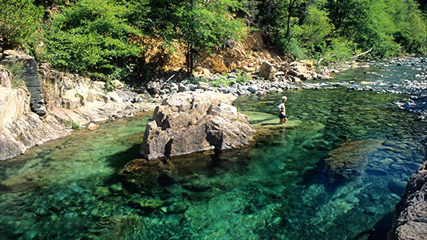
Baldface Creek, just above where it flows into the National Wild and Scenic North Fork Smith River. The Creek’s waters are startling clear (© Barbara Ullian photos)
Notes:
Facts and arguments are presented to show the reasons for the proposal
(This picture and the next 2 were sent as part of the public comment.)
One reason is to protect current outstanding Water Quality
Petition provides information on the water quality:
Reported observations of outstanding water clarity and color
Data showing very low turbidity, dissolved solids and nutrient levels in one tributary and in the Middle Fork Smith R. downstream

Slide 12
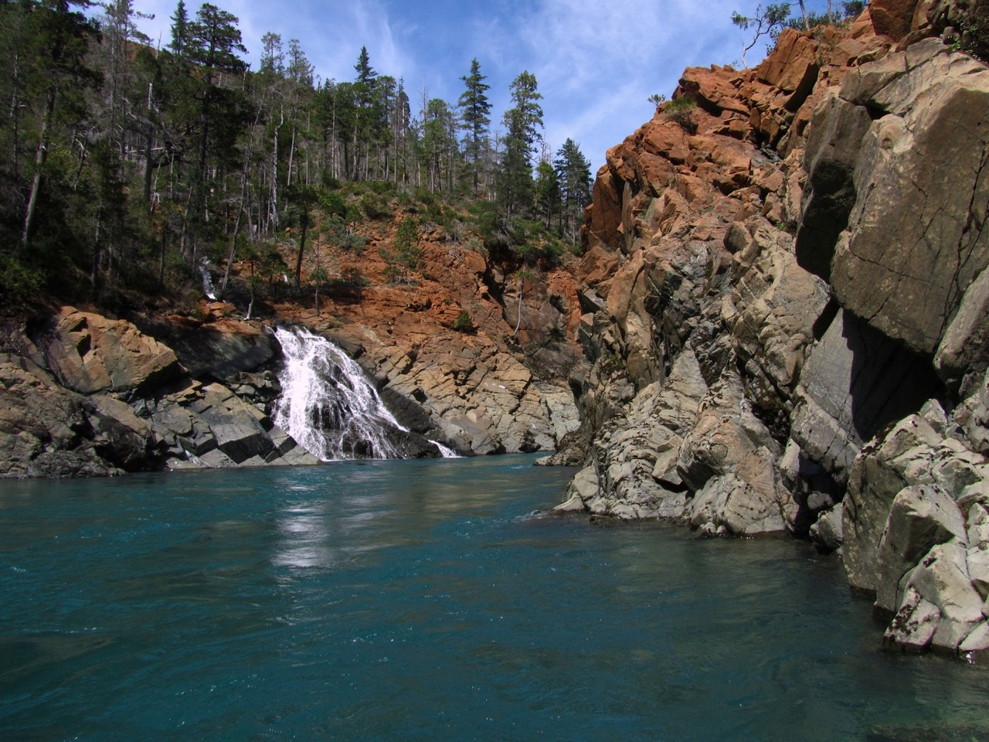
Notes:
“Wild and Scenic” designation for 13 miles of the NF Smith R (all of the river in OR)
based on nationally outstanding water quality, fisheries and scenic values
Remote and pristine
A large portion of the watershed is in wilderness or road less areas
Nearly the entire watershed is federally owned (98%)

Slide 13
Notes:
Water-related recreation highly valued
kayaking, fishing, hiking, swimming
Provides high quality water to Smith R. downstream
Municipal drinking water, fisheries and recreation
Redwood National Park

Slide 14
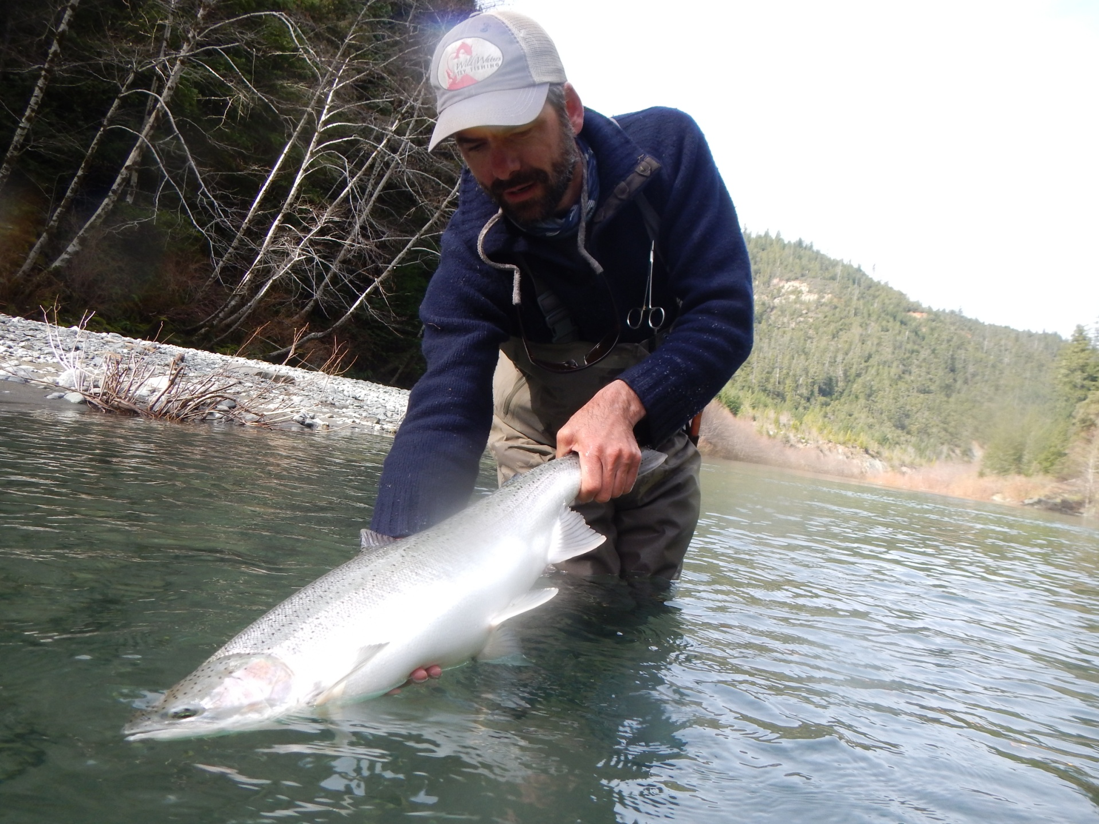
Notes:
Another reason for the proposed ORW Designation: protect the Ecological Value of the waters
High quality habitat for salmon, steelhead and trout
Key Watershed under Forest Service Aquatic Conservation Strategy
Important watershed for recovery of listed Coho salmon
[Southern Oregon and Northern California (SONCC) unit]
Wild & Scenic river - one of the values for designation is the fisheries
Rare and unique plants supported by wetlands in the watershed
Serpentine Darlingtonia

Slide 15
Effects of the Proposed Rule Amendments
As drafted, proposed rules would:
Provide added protections to these waters
Prohibit new permitted wastewater discharges
Prohibit activities that would degrade the current water quality and ecological value of these waters
Notes:
The effect of the proposed rule amendments would be to prohibit the lowering or degradation of water quality and ecological integrity.

Slide 16
Affected parties
Degradation of these waters may affect:
Tribal, sport and commercial fishers
Rafters and kayakers
Hikers and naturalists
Recreation-related businesses
Others interested in maintaining pristine waters, recovering endangered species or protecting rare plants and biodiversity

Slide 17
Affected parties
Protections that limit economic activity may affect:
Mining interests
Those interested in future use of these lands for grazing and logging, should USFS management goals change
Common School Trust Lands
Notes:
Common school trust: 555 acre parcel on tributary
On border with CA
There does not appear to be revenue generating activity occurring on these lands at this time.

Slide 18
Considerations: Business Impacts
Local businesses related to recreation and fishing activities would benefit
There do not appear to be grazing or timber businesses currently operating in the watershed
There is interest in mining exploration, there may be a negative impact to business; if mining would otherwise be permitted

Slide 19
Consideration: Continued Need for the Existing Rule
Petition does not propose to revise or delete any current rule language
Proposed amendments:
implement the existing rule
fulfill state responsibilities under the CWA
Oregon’s ORW policy has been in place for more than 20 years and no waters have yet been designated
Notes:
Another required consideration is the continued need for the existing rule

Slide 20
Considerations
Complexity
The proposed rule is not complex
Implementation should not be complex
Duplication or conflict with other regulation
ORW designation is consistent with management goals of the US Forest Service
Supports Coho salmon recovery plans
Adds clear, enforceable water quality protection policy

Slide 21
Public Comment as of April 1
Should EQC should deny the petition or initiate a rulemaking process?
~1070 support proceeding with rulemaking
fishers, kayakers and other recreational users of and visitors to the NF Smith River and the Smith River,
residents of local and downstream communities
Tribes
Naturalists/researchers – rare wetland plants, geology
recreation-related business owners
~10 support denial of petition
agriculture, grazing and logging organizations
mining interests

Slide 22
Supporting Comment
Qualities and values of NF Smith R.:
Exceptional water quality and clarity
Pristine, healthy, free-flowing (undammed)
Valuable, productive fisheries, including threatened species and critical habitat
Unique geology and rare wetland plants
Outstanding recreation opportunities
Natural beauty
Importance to users of Smith R. downstream, including Tribes, community drinking water supply
Protect from mining and logging impacts
Please protect this special place for future generations

Slide 23
Comments requesting EQC denial
ORW designation not needed to protect water quality
DEQ has not developed screening process
Inconsistent with RRNF management plans
May restrict timber harvest and grazing, prevent economic opportunity
Creates impediments to mining
Eliminates ability to obtain new water right
Eliminates activities with minor impacts that would not violate water quality standards
Dredge miners do more good than harm

Slide 24
Key Issue: Process
Rules say DEQ will develop a screening process and list of nominated waters - we have not
Commenters suggested therefore should not designate ORW in response to petition
EQC may initiate rulemaking to designate an ORW despite lack of agency screening process or nominations
Notes:
The ORW policy has been in our rules for more than 20 years and we have not yet designated an ORW in the state.

Slide 25
Key Issue: Need for ORW
Fulfills unique Clean Water Act role:
Protect waters with outstanding water quality and ecological values
Complements program efforts to:
Control pollution discharges and
Correct water quality impairments
Useful and efficient way to fulfill DEQ responsibilities
Notes:
CWA objectives: protect chemical, physical and biological integrity of the state’s waters;
ensure waters are “fishable swimmable”

Slide 26
Designation consistent with:
Management goals and plans of the Rogue River-Siskiyou National Forest
Federal Wild & Scenic River designation
Southern Oregon Northern California Coho Salmon Recovery Plan by NMFS
Rulemaking by CA Water Board to consider ORW designation for the Smith R.
Rulemaking by OWRD to consider classifying the NF Smith R. for instream purposes only
Proposed federal mineral withdrawal

Slide 27
Key Issue: Qualifications
Based on the information provided in the petition and through public comment, DEQ finds that the NF Smith River qualifies for consideration as an outstanding state and national resource for its water quality, fish habitat and ecological values.

Slide 28
Questions ?

