Slide 1
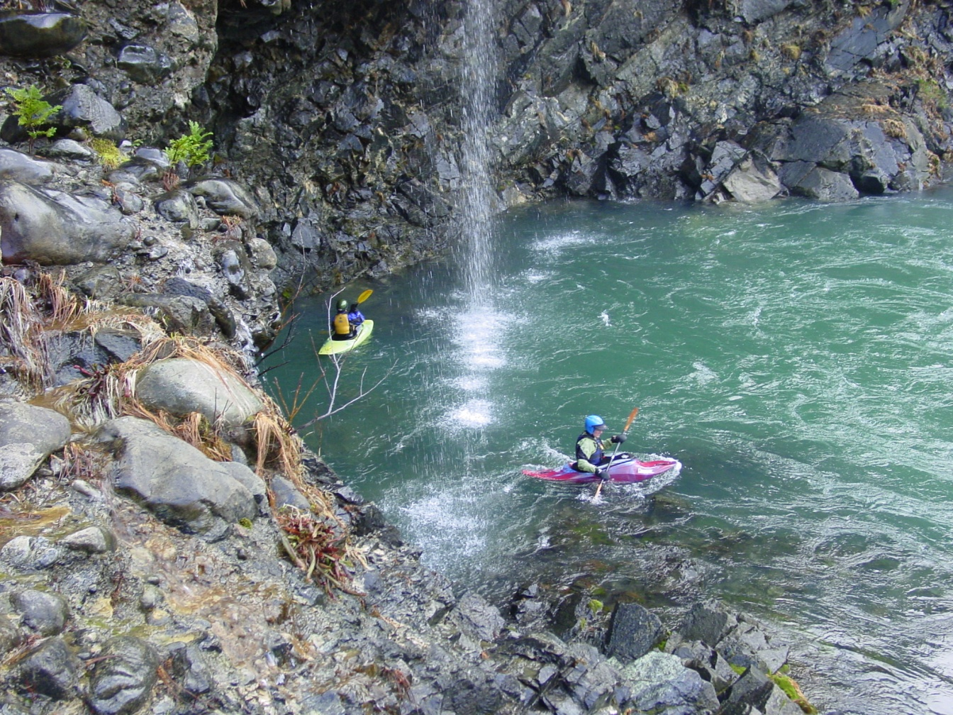

Water Quality Standards Program
Petition to
Designate
Outstanding
Resource
Waters
EQC Meeting
April 20, 2016
Portland, Oregon
North Fork Smith River
Debra Sturdevant | Oregon Department of Environmental Quality

Slide 2
EQC Action
Received a petition Feb. 23, 2016
Act no later than May 22, 2016
Options:
  Deny petition
  Initiate rulemaking proceedings
  Deny and direct DEQ to take other action
DEQ recommendation: initiate rulemaking proceedings

Slide 3
Petition Request
Requests rulemaking to:
  Designate NF Smith River and its tributaries and associated wetlands as Outstanding Resource Waters (ORW)
  Establish policies to protect current water quality and ecological integrity
Proposes rule amendments to water quality standards regulation:
  ORW Policy
  South Coast Basin criteria

Slide 4
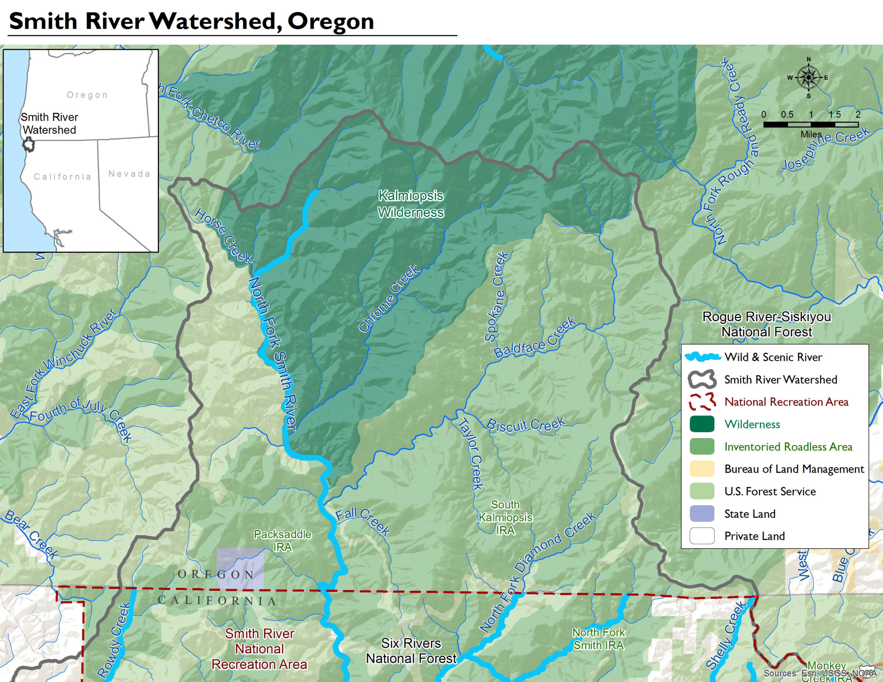

Slide 5
Proposed Protections
Protect existing water quality, ecological values and beneficial uses
Prohibits new NPDES discharges
Prohibits activities that would degrade the existing water quality and ecological values
Allows exceptions for a limited duration:
  to respond to an emergency or
  to restore or enhance water quality or ecological integrity
Notes:
Prohibit activities that would degrade: subjective, yes; road building could degrade; kayaking, hiking, trail maintenance likely could be done in a manner that would not
Exception: example wildfires – fight fire, restore after fire

Slide 6
Background: Petitions
Any person can submit a petition to adopt, amend or repeal a rule
The petition must:
  clearly show the proposed revisions
  provide supporting facts and arguments
  address several considerations
Agency has 90 days to act on the petition
Agency must invite public comment before denial

Slide 7
Outstanding Resource Water Policy
Part of state’s antidegradation policy contained in WQS regulation:
  3 classes of waters: impaired, high quality and outstanding resource
  Where high quality waters constitute an outstanding state resource, the existing water quality must be maintained & protected
Antidegradation policy required by federal regulation
  Where high quality waters constitute an outstanding national resource…
Notes:
ORW policy within antideg policy OAR 340-041-0004 (8)
40CFR 131.12 (3) Where high quality waters constitute an outstanding National resource, such as waters of National and State parks and wildlife refuges and waters of exceptional recreational or ecological significance, that water quality shall be maintained and protected.

Slide 8
ORW Policy
Existing rule states that:
  DEQ will develop screening process & list of nominations
  EQC may establish water quality values to be protected and process to determine what activities are allowed
  EQC may not allow activities that lower water quality below levels establish
  Short term exception for emergencies or for long term benefits

Slide 9
Petition Evaluation
Petition meets requirements to include:
  Information about the petitioner
  Proposed rule amendments, clearly indicated
  Facts and arguments to show reasons for and effects of the proposal
  Comment on considerations
Proposed rule amendments consistent with state’s ORW policy
Notes:
OAR 137-001-0070

Slide 10
Considerations for ORW designation: Water Quality
Water quality attributes:
  Clarity and color
  Very low turbidity, dissolved solids and nutrient levels in tributary and downstream
“Wild and Scenic” designation
  based on nationally outstanding water quality, fisheries and scenic values
Remote and pristine
  88% of the watershed in federal wilderness or roadless areas

Slide 11
Considerations for ORW Designation: Water Quality
Water-related recreation highly valued
  kayaking, fishing, hiking, swimming
Provides high quality water to Smith R. downstream
  Municipal drinking water, fisheries and recreation
  Redwood National Park

Slide 12
Considerations for ORW Designation: Ecological Value
High quality habitat for salmon, steelhead and trout
  Key Watershed under Forest Service Aquatic Conservation Strategy
  Important watershed for recovery of listed Coho salmon of the Southern Oregon and Northern California (SONCC) unit
  Wild & Scenic river
Rare and unique plants in wetlands
  Serpentine Darlingtonia

Slide 13
Effects of the Proposed
Rule Amendments
As drafted, proposed rules would:
  Provide added protections to these waters
  Prohibit new permitted wastewater discharges
  Prohibit activities that would degrade the current water quality and ecological value of these waters

Slide 14
Affected parties
Degradation of these waters may affect:
  Tribal, sport and commercial fishers
  Rafters and kayakers
  Hikers and naturalists
  Recreation-related businesses
  Others interested in maintaining pristine waters, recovering endangered species or protecting rare plants and biodiversity

Slide 15
Affected parties
Protections that limit economic activity may affect:
  Mining interests
  Those interested in future use of these lands for grazing and logging, should USFS management goals change

Slide 16
Considerations: Business Impacts
DEQ requested comment on options to achieve the goals of the existing rule while reducing negative economic impact on businesses
No commenter suggested an option that achieves the goal while reducing business impacts

Slide 17
Considerations: Business Impacts
Local businesses related to recreation and fishing activities would benefit
There do not appear to be businesses currently operating in the area that would be negatively impacted
Red Flat Nickel Corp. has an interest in mining in the watershed, may be negatively impacted if mining would otherwise be permitted

Slide 18
Consideration: Continued Need for the Existing Rule
Petition does not propose to revise or delete any current rule language
Proposed amendments:
  implement the existing rule
  fulfill state responsibilities under the CWA
Oregon’s ORW policy has been in place for more than 20 years and no waters have yet been designated

Slide 19
Considerations
Complexity?
  The proposed rule is not complex
  Implementation should not be complex
Duplication or conflict with other regulation?
  ORW designation is consistent with management goals of the US Forest Service
  Supports Coho salmon recovery plans
  Adds clear, enforceable water quality protection policy

Slide 20
Public Comment as of April 1
Should EQC should deny the petition or direct DEQ to begin a rulemaking process as proposed by the petition?
  52 support proceeding with rulemaking
    fishers, kayakers and other recreational users of and visitors to the NF Smith River and the Smith River,
    residents of local and downstream communities
    Tribes
    Naturalists/researchers – rare wetland plants, geology
    recreation-related business owners
  7 supporting denial of petition
    agriculture, grazing and logging organizations
    mining interests

Slide 21
Supporting Comment
Qualities and values of NF Smith R.:
  Exceptional water quality and clarity
  Pristine, healthy, free-flowing (undammed)
  Valuable, productive fisheries, including threatened species and critical habitat
  Unique geology and rare wetland plants
  Outstanding recreation opportunities
  Natural beauty
Importance to users of Smith R. downstream, including Tribes, community drinking water supply
Protect from mining and logging impacts
Please protect this special place for future generations

Slide 22
Comments requesting EQC denial
ORW designation not needed to protect wq
DEQ has not developed screening process
Inconsistent with RRNF management plans
May restrict timber harvest and grazing, prevent economic opportunity
Creates impediments to mining
Eliminates ability to obtain new water right,
Eliminates activities with minor impacts that would not violate water quality standards
Dredge miners do more good than harm

Slide 23
Total Public Comment
500+ supporting
10+ opposing

Slide 24
Key Issue: Process
Rules say DEQ will develop a screening process and list of nominated waters - we have not
Commenters suggested therefore should not designate ORW in response to petition
EQC may initiate rulemaking to designate an ORW despite lack of agency screening process or nominations

Slide 25
Key Issue: Need for ORW
Fulfills unique CWA role to prevent degradation of outstanding water quality and ecological values
Complement efforts to control pollution discharges and correct water quality impairments
Useful and efficient way to fulfill DEQ responsibilities to protect water quality, ecological integrity and beneficial uses, such as native salmon

Slide 26
Designation consistent with:
Management goals and plans of the Rogue River-Siskiyou National Forest
Rulemaking in progress by California water board to designate the Smith R. an ORW
Southern Oregon Northern California Coho Salmon Recovery Plan by NMFS
Federal Wild & Scenic River designation
Rulemaking in progress by OWRD to classify waters for instream purposes only
Notes:
Based on information DEQ has to date…

Slide 27
Key Issue: Qualifications
Based on the information provided in the petition and through public comment, DEQ finds that the NF Smith River qualifies for consideration as an outstanding state and national resource for its water quality, fish habitat and ecological values.

Slide 28
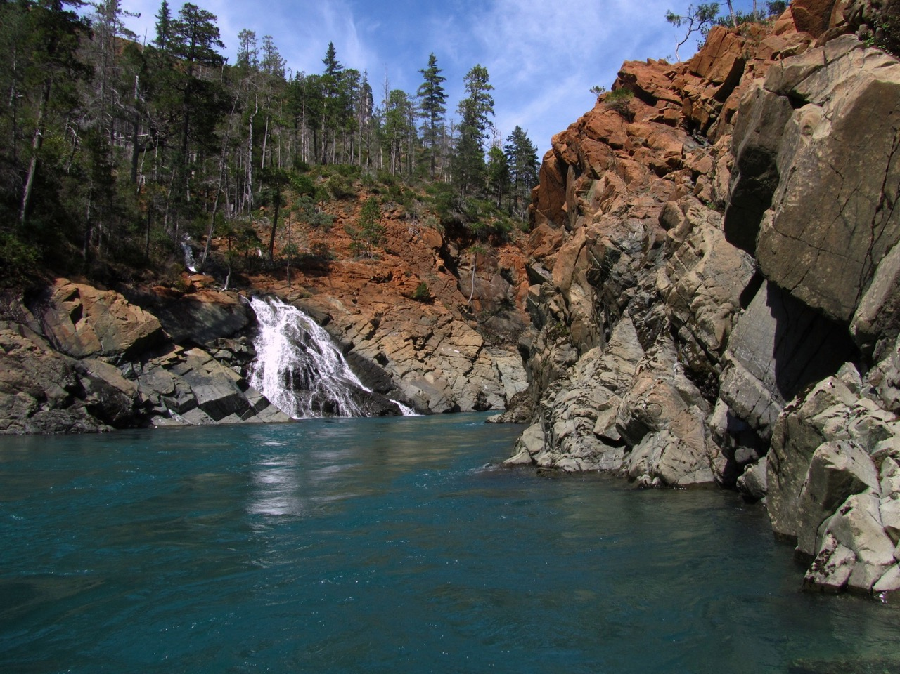
Questions ?

Slide 31
Questions:
USFS – current use in entire basin, any grazing or logging?
Mineral rights – Which would not be effected by mineral entry withdrawal
Private lands?
State common school trust lands?
Road decommisioning?
Suction dredging?
Wq data, monitoring, stream surveys?5

Slide 32


