Slide 1

Updated Oakridge-Westfir PM2.5 Attainment Plan
Overview of plan for proposed adoption by Environmental Quality Commission as part of the State of Oregon Clean Air Act Implementation Plan in January 2017
January 18-19, 2017
EQC Meeting
Merlyn Hough, Director | Lane Regional Air Protection Agency

Slide 2
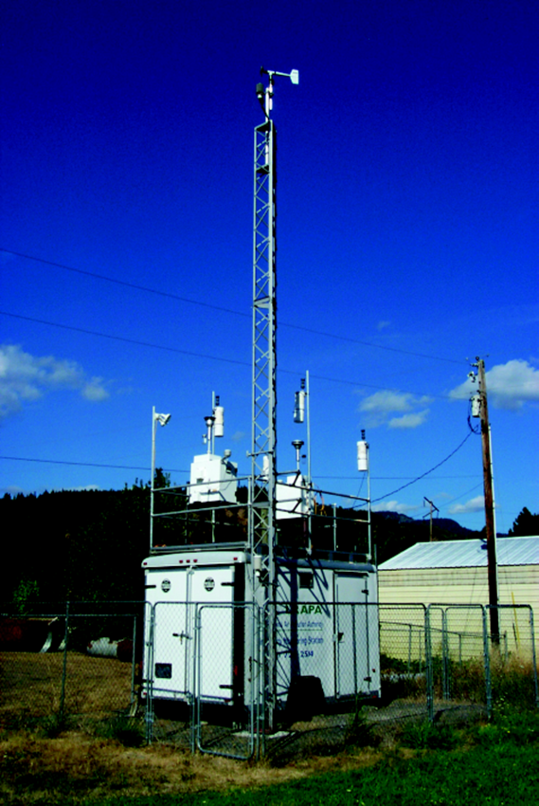
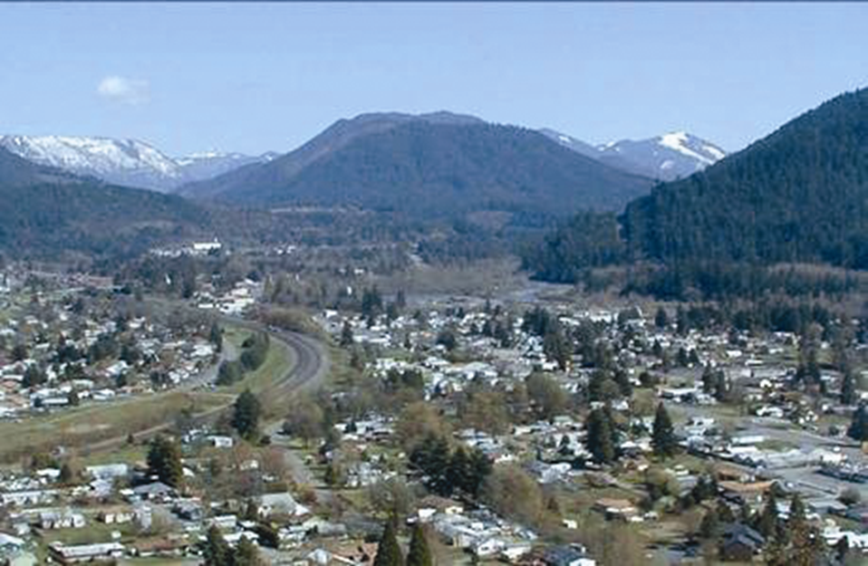
Updated Oakridge-Westfir PM2.5 Attainment Plan
Merlyn Hough, Director | Lane Regional Air Protection Agency

Slide 3
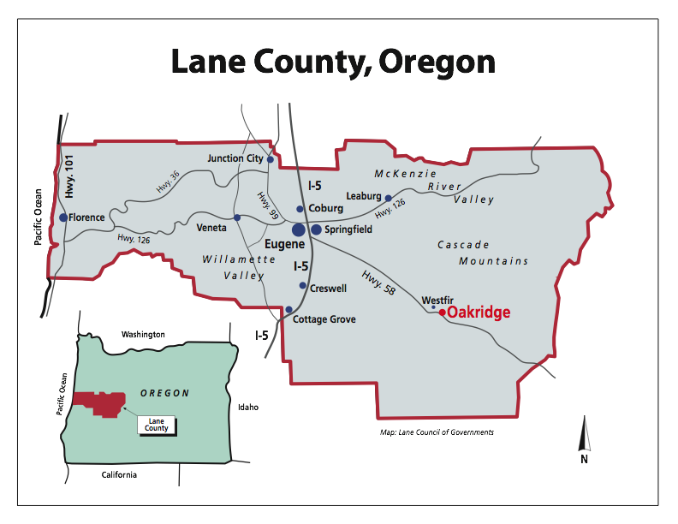
Updated Oakridge-Westfir PM2.5 Attainment Plan
Merlyn Hough, Director | Lane Regional Air Protection Agency

Slide 4

Updated Oakridge-Westfir PM2.5 Attainment Plan
Merlyn Hough, Director | Lane Regional Air Protection Agency

Slide 5
Updated Oakridge-Westfir PM2.5 Attainment Plan
Why needed?
Sierra Club vs EPA case regarding CAA Part 1 or Part 4 issues, CBD vs McCarthy consent decree in May 2016, etc.;
Partial disapproval of 2012 Attainment Plan by EPA in July-October 2016;
Updated EPA implementation guidance during July-August 2016;
Failure to attain 24-hour standard by the initial 12/31/2014 target or court-clarified 12/31/2015 CAA deadline, and CAA deadline extension to 12/31/2016 during December 2015 to August 2016.
Merlyn Hough, Director | Lane Regional Air Protection Agency

Slide 6
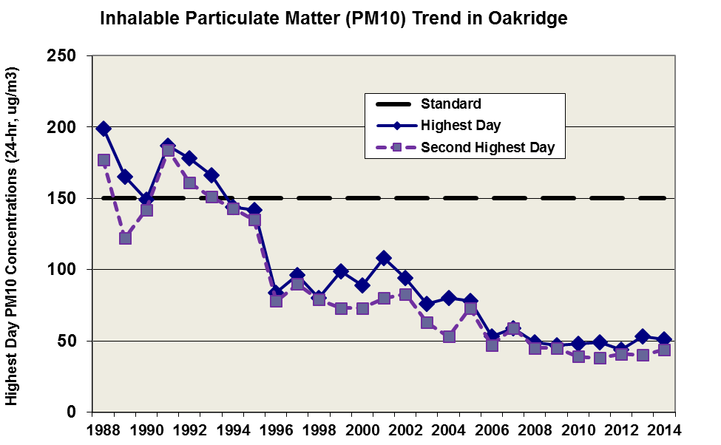
Updated Oakridge-Westfir PM2.5 Attainment Plan
Merlyn Hough, Director | Lane Regional Air Protection Agency

Slide 7
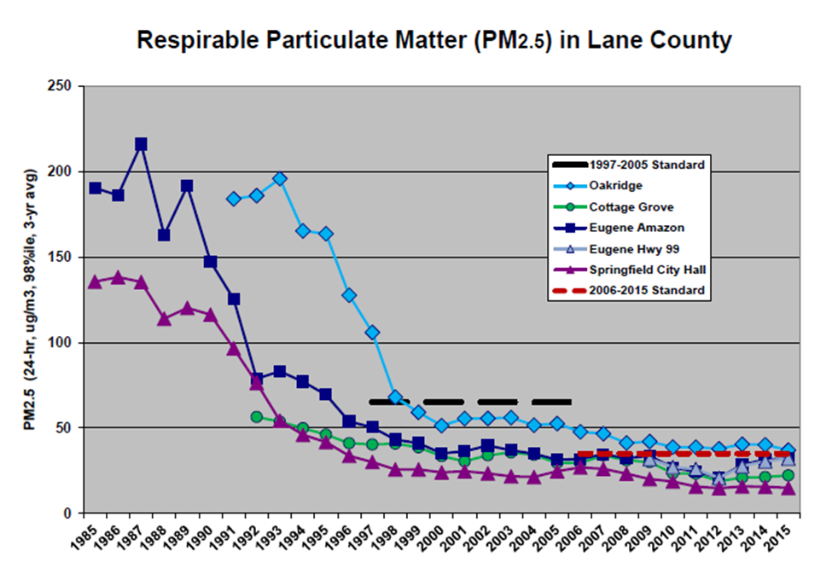
Updated Oakridge-Westfir PM2.5 Attainment Plan
Merlyn Hough, Director | Lane Regional Air Protection Agency

Slide 8
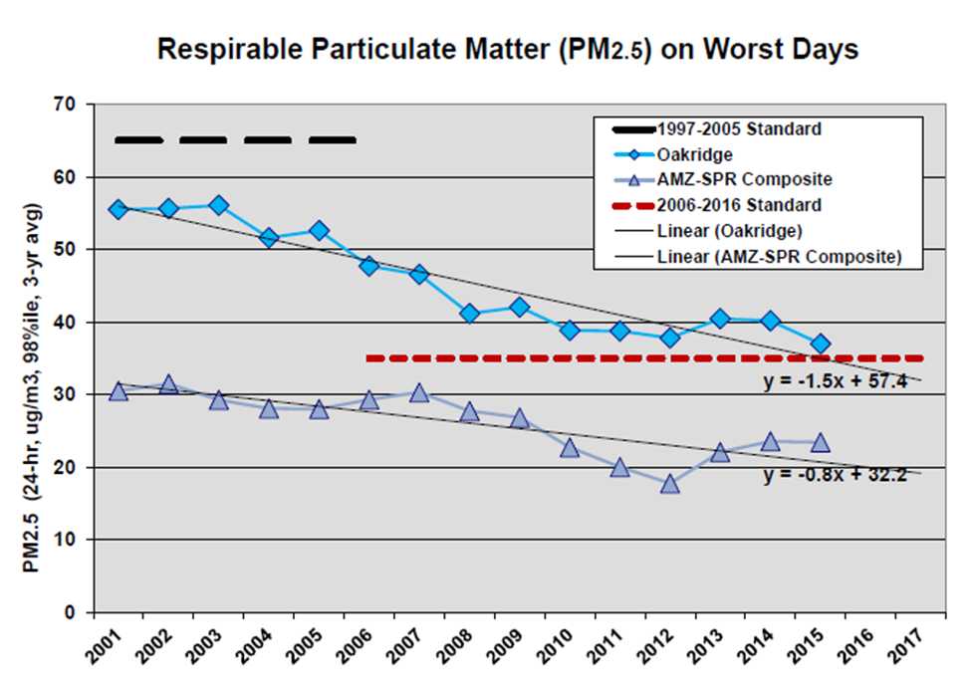
Updated Oakridge-Westfir PM2.5 Attainment Plan
Merlyn Hough, Director | Lane Regional Air Protection Agency

Slide 9
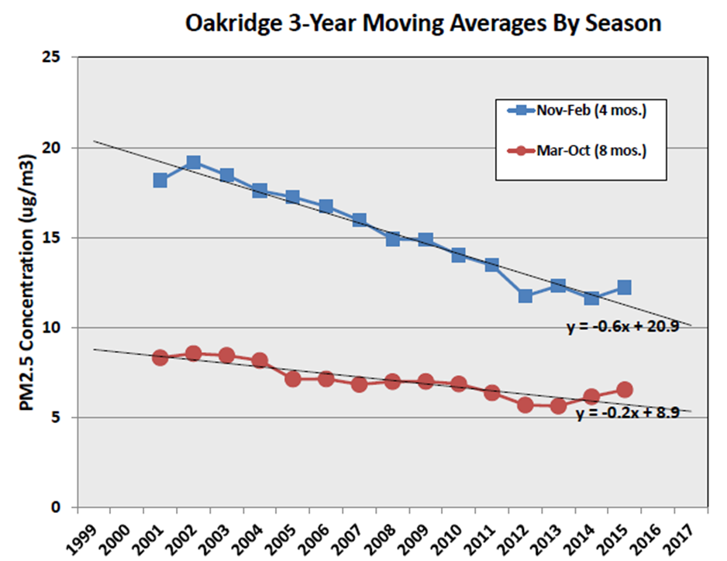
Updated Oakridge-Westfir PM2.5 Attainment Plan
Merlyn Hough, Director | Lane Regional Air Protection Agency

Slide 10
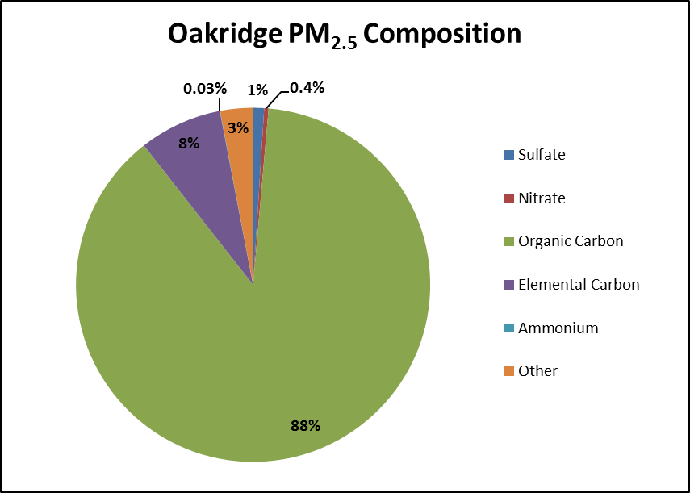
Updated Oakridge-Westfir PM2.5 Attainment Plan
Merlyn Hough, Director | Lane Regional Air Protection Agency

Slide 11
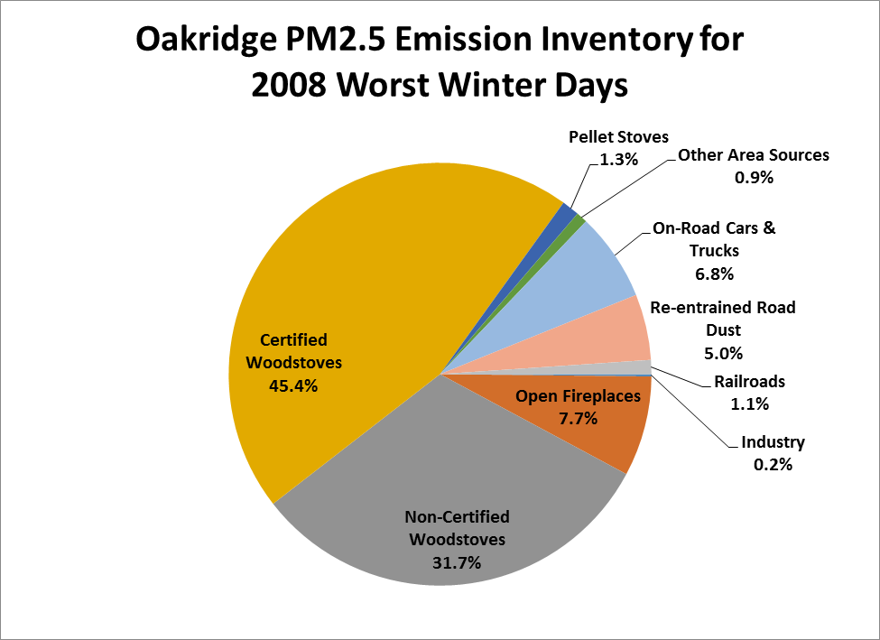
Updated Oakridge-Westfir PM2.5 Attainment Plan
Merlyn Hough, Director | Lane Regional Air Protection Agency

Slide 12
Updated Oakridge-Westfir PM2.5 Attainment Plan
Key components of 2016 updated plan:
Code enforcement officer hired by City of Oakridge with LRAPA field compliance officer support;
Continued HeatSmart woodstove replacements upon home sale, and continued ductless heat pump installations by Lane Electric;
Tightened City ordinances, including 20% opacity limits and lower curtailment cutpoints; and
Extended daily red-yellow-green woodburning advisory season (from Nov-Feb to Oct-May).
Merlyn Hough, Director | Lane Regional Air Protection Agency

Slide 13
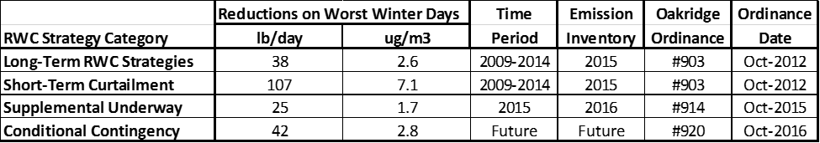
Updated Oakridge-Westfir PM2.5 Attainment Plan
Merlyn Hough, Director | Lane Regional Air Protection Agency

Slide 14


Updated Oakridge-Westfir PM2.5 Attainment Plan
Merlyn Hough, Director | Lane Regional Air Protection Agency

Slide 15

Updated Oakridge-Westfir PM2.5 Attainment Plan
Merlyn Hough, Director | Lane Regional Air Protection Agency

Slide 16
Updated Oakridge-Westfir PM2.5 Attainment Plan
Merlyn Hough, Director | Lane Regional Air Protection Agency

Slide 17
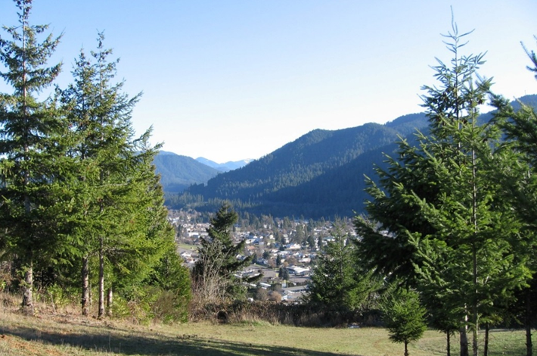
Updated Oakridge-Westfir PM2.5 Attainment Plan
Merlyn Hough, Director | Lane Regional Air Protection Agency

Slide 18
Updated Oakridge-Westfir PM2.5 Attainment Plan
LRAPA and DEQ recommend that the Environmental Quality Commission:
Adopt the Updated Oakridge-Westfir PM_{2.5} Attainment Plan in Attachment A as part of Chapter 340 of the Oregon Administrative Rules;
Approve incorporating these rule amendments into the Oregon Clean Air Act State Implementation Plan under OAR 340-200-0040; and
Direct DEQ to submit the SIP revision to the U.S. Environmental Protection Agency for approval.
Merlyn Hough, Director | Lane Regional Air Protection Agency

Slide 19
Documents can be provided upon request in an alternate format for individuals with disabilities or in a language other than English for people with limited English skills. To request a document in another format or language, call LRAPA in Springfield at 541-736-1056; or email lrapa@lrapa.org

