Slide 1

Environmental Solutions: Water Quality Standards
EQC Action Item:
Water Quality Standards
for Copper
November 2, 2016
Ashland, Oregon
Presenter: Debra Sturdevant | Oregon Department of Environmental Quality

Slide 2

Presentation Topics
Proposed action
Why use the Biotic Ligand Model (BLM)
Background
The proposed standard
Implementation of the standard
Public comment
Key issues
Notes:
Background: history of copper standard, background on aquatic life criteria and copper

Slide 3
Proposed Action
DEQ proposes that the Commission amend OAR 340-041-0033 and Table 30 as shown in Appendix A.
The amendments:
revise Oregon’s copper criteria for freshwater aquatic life, and
make plain language and “housekeeping” revisions

Slide 4
Why use the Biotic Ligand Model?
DEQ proposes the BLM standard for copper because:
The BLM results in criteria that protect freshwater organisms
The BLM is based on newer science and is more accurate than the hardness-based equation
The Environmental Protection Agency and the National Marine Fisheries Service both recommended Oregon adopt the BLM for copper

Slide 5
History of the Copper Standard in Oregon
Current copper standard
Based on EPA’s 1986 recommendations
Equation - toxicity changes with water hardness
Expressed as total recoverable copper
DEQ revised criteria in 2004
Based on EPA’s 1995 recommendations
Equation - toxicity changes with water hardness
Expressed as dissolved copper
Never approved by EPA; never effective
Notes:
-updated factors in the hardness equation
-at time of adoption, EPA’s 1995 criteria were based on the latest science

Slide 6
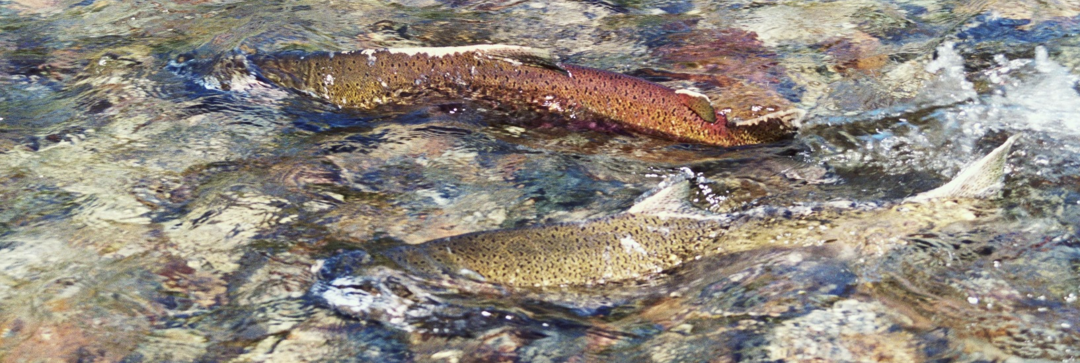
NMFS Jeopardy Decision: Aug. 2012
Endangered Species Act (ESA) consultation
EPA must consult before approving a water quality standard that may affect threatened and endangered species
Lengthy: Almost 8 years for the consultation
National Marine Fisheries Service - jeopardy
U.S. Fish & Wildlife Service - no jeopardy
Notes:
-updated factors in the hardness equation
-at time of adoption, EPA’s 1995 criteria were based on the latest science

Slide 7
EPA Disapproval: Jan. 2013
Copper
Hardness-dependent criteria are potentially under-protective or overly stringent, depending on ambient water chemistry
2004 criteria did not adequately protect some vulnerable salmon life stages
Remedy: Adopt 2007 recommended criteria: “acute and chronic criteria concentrations calculated by the Biotic Ligand Model”
Notes:
--not consistently protective to ensure the protectiveness of aquatic life
--Cu criteria currently in effect (1985?)
-Also disapproved:
-11 pesticides, selenium
copper
cadmium (acute)
aluminum
ammonia

Slide 8
NWEA Citizen Suit: April 2015
EPA did not “promptly” promulgate replacement criteria
Criteria disapproved in January 2013
Ammonia, cadmium (acute only), aluminum and copper
Results of litigation:
EPA to promulgate criteria for Oregon by January 16, 2017
Or approve criteria adopted by the State
EPA published a draft copper criteria rule
public comment ended in May 2016

Slide 9
DEQ’s Response
Rulemaking to revise copper criteria
Goal: submit revised criteria in time for EPA approval
State standard preferable to federal rule
Developed rule based on analysis of Oregon data
Appropriate balance between protection and conservatism
Considered implementation issues
EPA draft criteria overly stringent
Did not revise acute criteria for cadmium
EPA will promulgate
Notes:
Generally Oregon prefers to adopt its own water quality standards
Standards are applied and implemented by the state
Significant differences between federal and state proposed rules
by November 16
Cadmium – acute only disapproved, still hardness based equation, dissolved like other metals, just some updates to the equation values based on new data
Also, weren’t sure EPA and NMFS agreed on value

Slide 10
DEQ’s Process
Data collection and analysis, run model
to answer a variety of technical questions
Technical Review Panel
national experts
review analyses and findings
Stakeholder Advisory Committee
provide input on options
Public comment on proposed rule
Submit copper standard to EPA
by Nov. 16
for approval before their January deadline
Notes:
Questions, how variable are conditions and resultant criteria
How much data is needed
Which input data is most important – model most sensitive to it
What to do when input data is missing
Can we estimate the ions and alkalinity using specific conductance
Is there a way to estimate DOC
How should default values be derived, how conservative should they be, how should they be used
Stakeholder committee
Options for:
How to handle missing data
Whether to adopt conservative default numeric copper criteria, or adopt conservative default input parameter values and how to use those
Justification for DEQ’s rule, why we believe EPA’s rule is not necessary

Slide 11
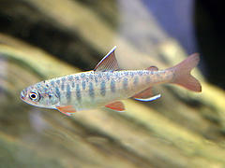
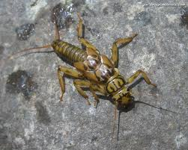
What are Aquatic Life Criteria?
Beneficial use:
Fish and aquatic life
Maximum pollutant concentrations that protect aquatic life
Acute and chronic durations
Used for Clean Water Act programs, including:
wastewater discharge permits,
water quality assessments (303d list)
TMDLs
Notes:
-Cu is one of the aquatic life toxic pollutants. OR has a total of 41 aquatic life pollutants. These criteria, including Cu, apply in waterbodies where the beneficial use is for fish and aquatic life. Although OR has a number of beneficial uses, the protection of fish and aquatic life is usually the most sensitive beneficial use to protect. Most waterbodies in OR have fish and aquatic life as a beneficial use.
-Toxics criteria are used in a number of CWA programs, so the criteria serve as a foundation for other programs. For example, wastewater and industrial facilities which discharge wastes to rivers could also be affected by changes to WQS, including Cu.

Slide 12
Aquatic Life Effects of Copper
Essential element, but toxic at certain levels
Fish gills lose ability to regulate ions, such as sodium and chloride, in the bloodstream
Reduction in growth, survival rates and reproduction
Inhibits sense of smell in Pacific salmon, which can affect migration
Notes:
Na/Cl: These ions are important for the normal functioning of the cardiovascular and nervous systems.
Oncorhynchus—Pacific salmon and trout

Slide 13
Sources of Copper
Municipal wastewater
Water distribution system pipes
Commercial / industrial inputs
Manufacturing wastewater
Metal / electrical
Stormwater runoff
Asphalt / Roofing materials
Roads (brake pads)
Agricultural / residential pesticides
Marine anti-fouling paint
Wood preservatives
Mining / erosion
Naturally occurring earth metal

Slide 14
Why Use the Biotic Ligand Model?
Reflects current science about copper toxicity
Accounts for the effects of water chemistry on copper bioavailability
Accurate criteria that protect aquatic life
Notes:
-Product of almost 15 yrs. of development incorporating decades of copper toxicity research

Slide 15
Performance-based criterion
DEQ proposes to use the BLM as a performance-based approach
Similar to metals and ammonia equations
Results are predictable and repeatable
EPA approves the method, not each result
Each model run derives acute and chronic instantaneous WQ criteria (IWQC)
Based on the water chemistry conditions at a particular site and time
Notes:
-provide an understanding of what the BLM criteria are to understand the next slide
- We’ll be talking more about a performance-based approach this afternoon

Slide 16
Why is it important to be accurate?
Copper criteria can vary significantly
in response to organic carbon and the pH
Overly stringent criteria may:
indicate impairment where/when copper toxicity does not actually occur
make real impairments more difficult to identify
lead to unnecessary expense
Notes:
Why not set a conservative criterion and apply it everywhere – keep it simple?
-Product of almost 15 yrs. of development incorporating decades of copper toxicity research

Slide 17
How the Biotic Ligand Model Works
The BLM predicts the accumulation of copper at a biotic ligand, which leads to toxicity
“Ligand” = ion, molecule, molecular group that binds to a metal
“Biotic Ligand” = when the ligand is on an organism, such as a fish gill

Slide 18
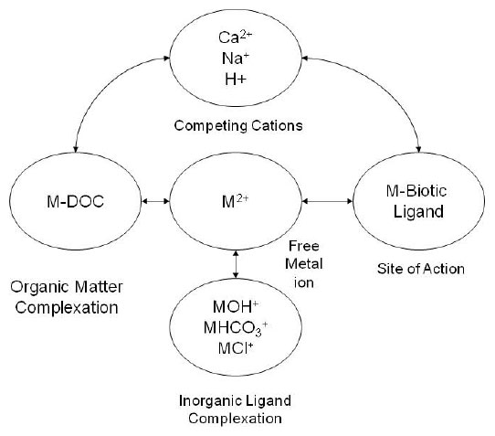
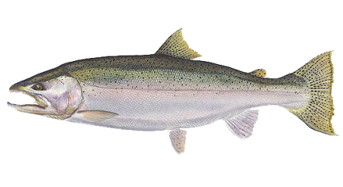
Biotic Ligand Model Overview
Chemical Equilibria /
Environment
Organism
(biotic ligand)
Water Chemistry
Bioavailability
Organism Toxicity
adapted from Di Toro et al., 2001
Notes:
-Even if the biochemical receptor (where the mode of toxicity occurs) of an organism is not a gill the principles of the model should apply to any other site of toxic action. Therefore, any derived BLM criteria would generally be protective of aquatic species despite differences in the toxic site of action.
Concentration of free copper ion
Complexation of Cu with DOC, anions
Competition with cations for ligand binding site

Slide 19
BLM Input Parameters
13 BLM Input Parameters
temperature
pH
dissolved organic carbon (DOC)
calcium (Ca)
magnesium (Mg)
sodium (Na)
potassium (K)
sulfate (SO4)
chloride (Cl)
alkalinity
humic acid fraction (model default value) sulfide (model default value) inorganic carbon (model default value)
Do not need Cu data to derive criteria
Need measured values for 10 input parameters
Based on dissolved parameters
Notes:
Some of these routinely collected, such as pH and temperature
Others have not been routinely collected, such as dissolved organic carbon and some of the ions
- DOC commonly originates from decaying natural organic matter (NOM)
-Values for dissolved inorganic carbon (DIC) can be entered directly if known, or the model allows users to enter alkalinity as a replacement for DIC
-Ten percent is the expected proportion of humic acid represented in DOC in many natural systems. The remaining DOC percentage is assumed to be fulvic acid.
-The sulfide module is not currently used in the calculation of IWQC’s for copper, so the model assigns a default value of 1x10⁻⁶ mg/L.
-mention that James will talk more about what to do if some of this data is missing

Slide 20
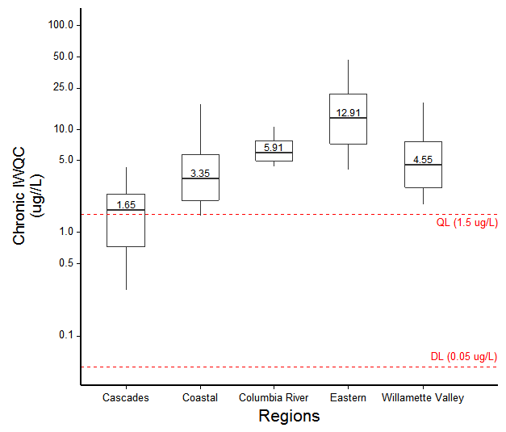
Water quality criteria results
Range of BLM criteria results by region
Notes:
Enter measured input parameter values and run the model to calculate acute and chronic criteria
total of 4600 sample sets

Slide 21
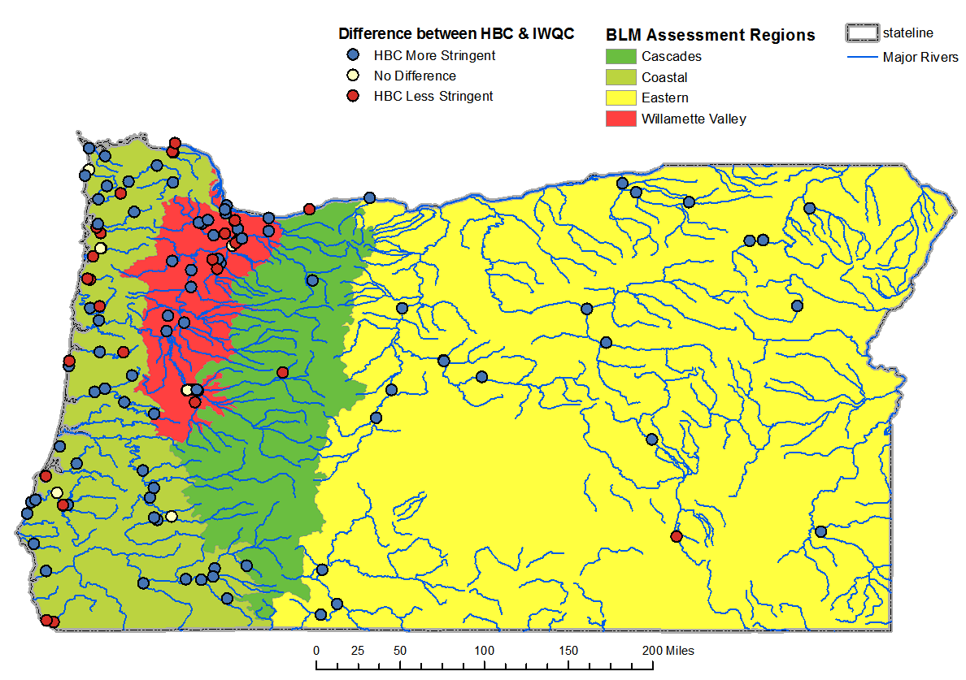
Instantaneous water quality criteria results
Notes:
How BLM criteria differ from hardness-based criteria
342 samples
ALL parameters measured

Slide 22
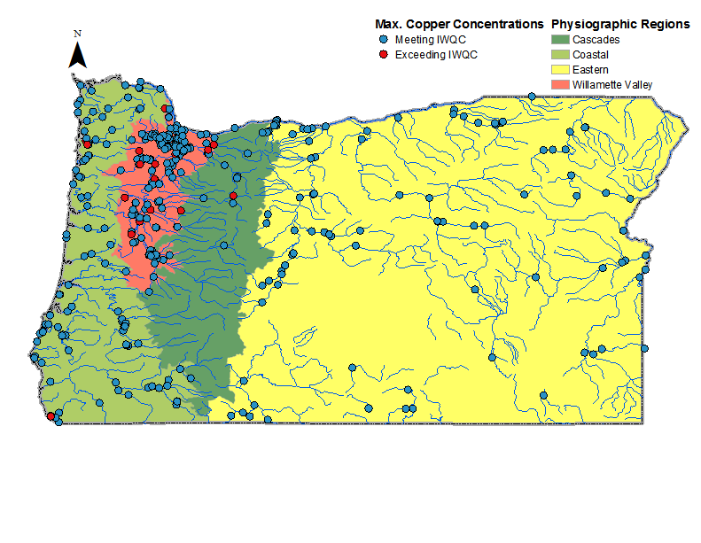
Copper data compared to BLM criteria
Region | Samples (n) | [Cu] > IWQC | %
Cascades | 205 | 15 | 7.3
Coastal | 929 | 5 | 0.5
Eastern | 1,133 | 8 | 0.7
Willamette Valley | 2,340 | 64 | 2.7
Statewide | 4,402 | 77 | 1.7

Slide 23
Procedures when model input data
is not available
Applying the BLM Standard
DEQ must be able to derive BLM criteria results for any time and location
DEQ has collected a lot of data over the last couple of years
Will collect BLM input parameter data with all copper samples
Where measured input data is not available, use an estimate or default value
ions & alkalinity - estimate using specific conductance
organic carbon - use conservative default value
Method to calculate default included in the rule
One default value for each region based on data from the region
Notes:
Whenever a copper sample needs to be evaluated or a discharge needs to be evaluated to determine whether it will meet the standard, DEQ must be able to produce criteria results with the BLM, even if all the model parameters were not measured at the same time.
DEQ has collected a lot of data and will continue to collect BLM input parameter data with all copper samples
Specific, detailed procedures in the rule for substituting estimates or conservative default values when measured input parameter data is not available.
These clearly defined procedures help to ensure that the standard includes the elements needed to be a performance based standard: repeatable and replicable
--------------------------
Default values can be published for public information, likely only updated periodically (perhaps with each assessment cycle) based on additional data

Slide 24
Applying the Biotic Ligand Model standard
Applying the BLM Standard
Criteria based on measured data are more accurate and supersede default criteria values
Permitting:
Must protect the site during bioavailable / sensitive conditions
Therefore need sufficient data to evaluate range of conditions reasonably expected to occur at the site
Without data, must rely on default values
It will likely be in the interest of dischargers to collect the BLM parameter data
If effluent copper is measurable
At least major dischargers

Slide 25
Summary of Public Comment
DEQ received 13 comment submittals
EPA, municipal and industrial dischargers, one tribe, one environmental organization, agriculture & forestry organizations
High level of support for:
Biotic Ligand Model standard to replace hardness-based equations
Performance-based approach
DEQ’s proposed rule rather than EPA’s draft rule

Slide 26
Key Issues
Standard must protect aquatic life during the most bioavailable conditions
Rule must include the elements required of a performance –based standard
Procedures for missing input parameter data
The rule includes clear procedures for substituting estimated or default values when measured input data is not available
The rule includes accurate methods to estimate when possible
Conservative default values for DOC, where estimates not possible
Notes:
High probability that default as stringent as the accurate criteria

Slide 27
Summary of Public Comment
Ability to transition from using default values to accurate criteria in timely and efficient manner
WQ Assessment and 303d listings
Use accurate BLM criteria to evaluate copper data
Use default values when there is not sufficient data to assess based on accurate criteria
NPDES permit limits
Applicability of anti-backsliding policy
Costs / time to re-open and modify a permit once data becomes available

Slide 28
Conclusions and Next Steps
The proposed copper standard will protect aquatic life and qualifies as a performance-based standard
DEQ rule preferable to federal rule
Following EQC action, DEQ will submit the copper standard to EPA immediately for their review and action
DEQ will continue to work with EPA and stakeholders to finalize implementation procedures

Slide 29
DEQ Recommendation
DEQ proposes that the Commission amend OAR 340-041-0033 and Table 30 as shown in Appendix A, to:
revise Oregon’s copper criteria for freshwater aquatic life, and
make plain language and “housekeeping” revisions.

Slide 30
Conclusions / Next Steps

Slide 31
Fiscal Impact
Fiscal Impact
Stormwater permits:
Potential monitoring and treatment costs
Fishing and recreation businesses:
Potential benefits due to improved fish health and population size

Slide 32
Fiscal Impacts
Fiscal Impact
State government
Increased staff time to calculate BLM-based criteria and apply them in permits
Individual permit holders
Monitoring to provide BLM data:
approx. $5000-8500 per outfall per permit renewal
Potential relief if less stringent effluent limits

Slide 33
DOC Default Values

Slide 34
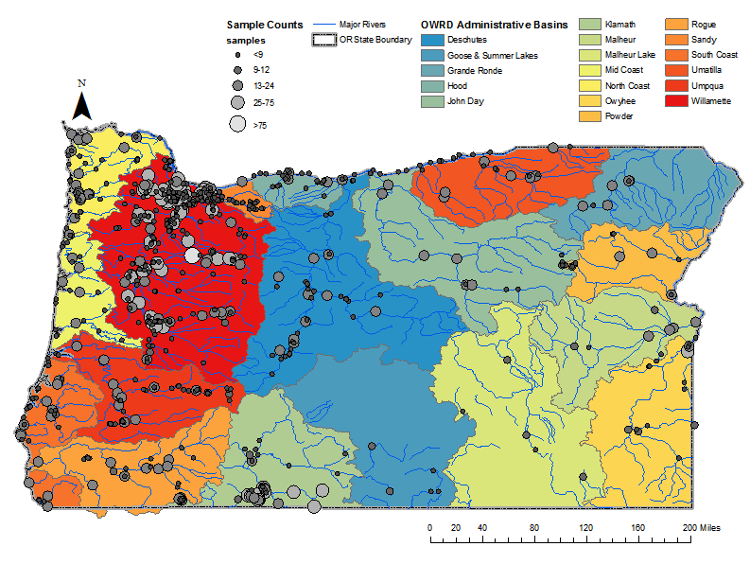
Availability of BLM Parameter Data Sets
Notes:
Re-map watersheds as OWRD administrative basins.

Slide 35
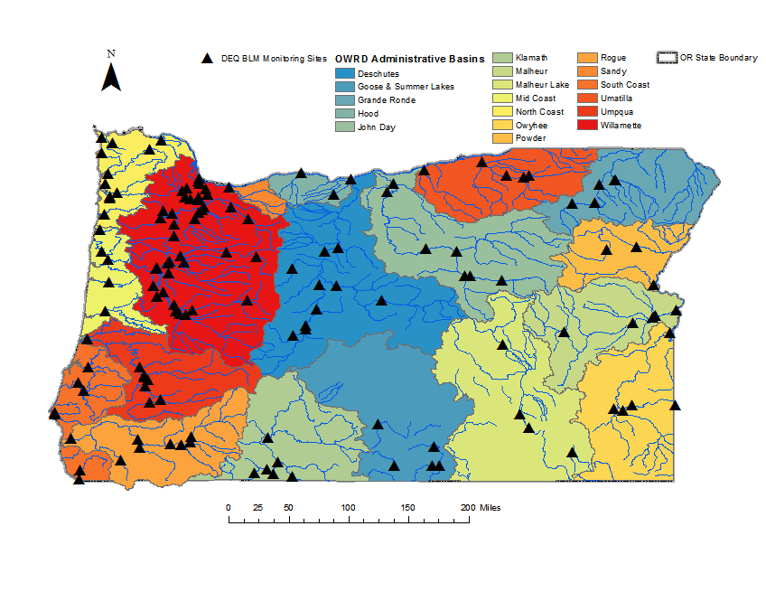
DEQ BLM Parameter Monitoring

