Slide 1

Environmental Solutions: Water Quality Standards
EQC Action Item:
Water Quality Standards
for Copper
November 2, 2016
Ashland, Oregon
Presenter: Debra Sturdevant | Oregon Department of Environmental Quality

Slide 2

Presentation Topics
Proposed action
Background
The proposed copper standard
Implementation
Public Comment
Notes:
Introduce proposed action
Provide some background: what has led to this revision at this time, background on aquatic life criteria and copper
Describe the proposed standard in more detail
Discuss a few application and implementation issues
Summarize public comment
Reiterate DEQ’s recommendation
Answer Questions

Slide 3
Proposed Action
DEQ proposes that the Commission amend the water quality standards for toxic substances (OAR 340-041-0033 and Table 30) as shown in Appendix A.
The amendments:
revise Oregon’s copper criteria for freshwater aquatic life, and
make plain language and “housekeeping” revisions

Slide 4
Why revise the copper standard?
    The proposed copper standard:
      Will protect freshwater organisms
      Incorporates newer science and is more
      accurate – the Biotic Ligand Model
      Responds to EPA disapproval
      The Environmental Protection Agency and the National Marine Fisheries Service recommend the Biotic Ligand Model

Slide 5
History of the Copper Standard in Oregon
Current copper standard
  Based on EPA’s 1986 recommendations
  Equation - toxicity changes with water hardness
  Expressed as total recoverable copper
DEQ revised criteria in 2004
  Based on EPA’s 1995 recommendations
  Equation - toxicity changes with water hardness
  Expressed as dissolved copper
  Never approved by EPA; never effective
Notes:
Next I’d like to provide some background that helps to explain why we are proposing this revision at this time.
-updated factors in the hardness equation
-at time of adoption, EPA’s 1995 criteria were based on the latest science

Slide 6
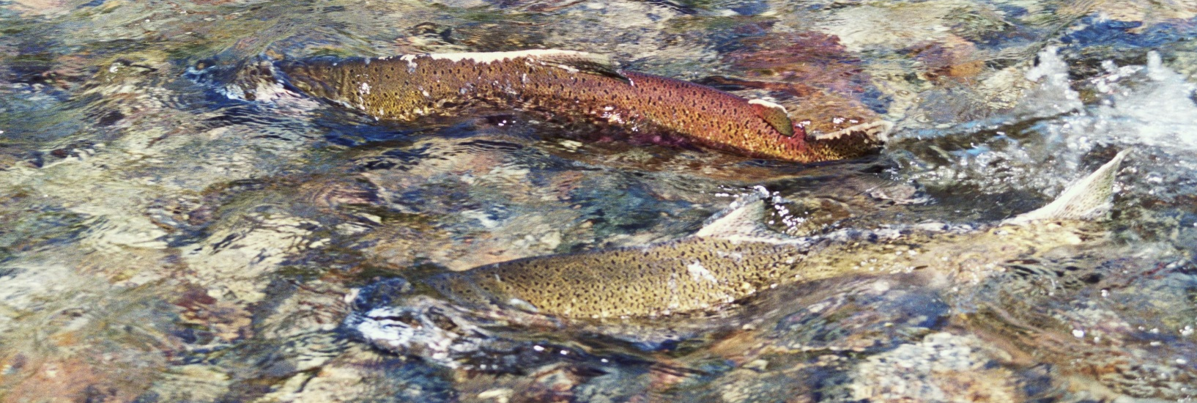
NMFS Jeopardy Decision: Aug. 2012
Endangered Species Act (ESA) consultation
          Almost 8 years for the consultation
National Marine Fisheries Service - jeopardy
Notes:
EPA must consult before approving a water quality standard that may affect threatened and endangered species
U.S. Fish & Wildlife Service - no jeopardy
-updated factors in the hardness equation
-at time of adoption, EPA’s 1995 criteria were based on the latest science

Slide 7
EPA Disapproval: Jan. 2013
Copper
Hardness-dependent criteria are potentially under-protective or overly stringent, depending on ambient water chemistry
2004 criteria did not adequately protect some vulnerable salmon life stages
Remedy: Adopt 2007 recommended criteria: “acute and chronic criteria concentrations calculated by the Biotic Ligand Model”
Notes:
Criteria disapproved in January 2013
Copper:
- not consistently protective to ensure the protectiveness of aquatic life
- Cu criteria currently in effect (1985?)
-Also disapproved:
-11 pesticides, selenium
copper
cadmium (acute)
aluminum
ammonia

Slide 8
NWEA Citizen Suit: April 2015
EPA did not “promptly” promulgate replacement criteria
Results of litigation - schedule:
      EPA to promulgate criteria by Jan. 16, 2017
      Or approve criteria adopted by the State
      EPA published draft criteria, spring 2016
Notes:
EPA published draft copper and acute cadmium criteria for Oregon this spring, public comment ended in May

Slide 9
DEQ’s Response
Rulemaking to revise copper criteria
      Goal: submit criteria in time for EPA approval
State standard preferable to federal rule
      Collected and analyzed Oregon data
      Appropriate balance between protection and
      over-conservatism
      Considered implementation issues
      EPA draft criteria overly stringent
Did not revise acute criteria for cadmium
Notes:
SLIDE
to provide EPA enough time to review and act on the state’s criteria, we are targeting November 16 for submittal (603ays)
Generally Oregon prefers to adopt its own water quality standards
Standards are applied and implemented by the state
Significant differences between federal and state proposed rules
- Not necessary nor practical to use extremely conservative assumptions for default values, the defaults in Oregon’s rule are adequately conservative, will be at least as stringent as the accurate criteria
Problematic to have federal rule effective first and then adopt state rule
- EPA rule is generally overly stringent
- EPA rule would remain effective for CWA purposes until they withdraw it, which required publication in federal register for public comment
Cadmium – acute only disapproved, still hardness based equation, dissolved like other metals, just some updates to the equation values based on new data
Also, weren’t sure EPA and NMFS agreed on value

Slide 10
DEQ’s Process
Data collection and analysis
Technical Review Panel
      national experts
Stakeholder Advisory Committee
Public comment on proposed rule
Submit copper standard to EPA
      by Nov. 16
      for approval before their January deadline
Notes:
As soon as it became apparent that DEQ needed to consider using the Biotic Ligand Model as the criteria, we began talking to model experts and other states. It turns out Oregon is one of the first states in the nation to consider using the BLM as a statewide standard. There were many questions about of how to go about it and not much precedence or guidance.
Andrea Matzke, the project lead at the time, worked with the DEQ lab to collect data needed to run the Model and evaluate the results and options. She also assembled a Technical Review Panel of local and national experts, including the model developers to help us analyze the data and to review our findings. James McConaghie with our program assembled data from multiple sources, ran the model and did most of the data analysis. Because of these efforts, DEQ believes we have a solid foundation of information that we have used to develop the proposed standard.
Questions, how variable are conditions and resultant criteria
How much data is needed
Which input data is most important – model most sensitive to it
What to do when input data is missing
Can we estimate the ions and alkalinity using specific conductance
Is there a way to estimate DOC
How should default values be derived, how conservative should they be, how should they be used
Stakeholder committee
Options for:
How to handle missing data
Whether to adopt conservative default numeric copper criteria, or adopt conservative default input parameter values and how to use those

Slide 11
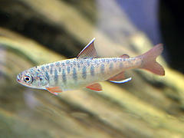
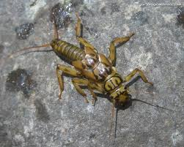
What are Aquatic Life Criteria?
Beneficial use:
Fish and aquatic life
Maximum pollutant concentrations that protect aquatic life
Used for Clean Water Act programs, including:
      wastewater discharge permits
      water quality assessments (303d list)
      401 certifications
      TMDLs
Notes:
Copper is one of 41 toxic pollutants for which OR has adopted criteria to protect fish and aquatic life.
Copper is an essential element, but toxic at certain levels
Effects:
Fish gills lose ability to regulate ions, such as sodium and chloride, in the bloodstream
Reduction in growth, survival rates and reproduction
Inhibits sense of smell in Pacific salmon, which can affect migration
Toxics criteria are used in a number of CWA programs, so the criteria serve as a foundation for other programs. For example, wastewater and industrial facilities which discharge wastes to rivers could also be affected by changes to WQS, including Cu.

Slide 12
Sources of Copper
Municipal wastewater
      Water distribution system pipes
      Commercial / industrial inputs
Manufacturing wastewater
      Metal / electrical
Runoff
    Asphalt / Roofing materials
    Roads (brake pads)
    Agricultural / residential pesticides
    Marine anti-fouling paint
    Wood preservatives
Mining / erosion
      Naturally occurring earth metal

Slide 13
Why Use the Biotic Ligand Model?
Based on current science about copper toxicity
Accounts for the effects of water chemistry on copper bioavailability
The BLM criteria are accurate and protect aquatic life
Notes:
-Product of almost 15 yrs. of development incorporating decades of copper toxicity research

Slide 14
Why is it important to be accurate?
Copper bioavailability can vary significantly
      in response to organic carbon and the pH
Overly stringent criteria may:
      indicate impairment where/when copper toxicity does not actually occur
      make real impairments more difficult to identify
      lead to unnecessary expense
Notes:
Why not set a conservative criterion and apply it everywhere – keep it simple?

Slide 15
Performance-based criterion
The BLM as performance-based approach
    DEQ adopts the BLM and procedures
    EPA approves the method
    Results are predictable and repeatable
  Each model run derives acute and chronic instantaneous WQ criteria (IWQC) based on the water chemistry conditions at a particular site and time
Notes:
slide
Therefore, DEQ proposes using the BLM as a performance – based standard.
Similar to metals and ammonia equations
-provide an understanding of what the BLM criteria are to understand the next slide

Slide 16
How the Biotic Ligand Model Works
The BLM predicts the accumulation of copper at a biotic ligand, which leads to toxicity
      “Ligand” = ion, molecule, molecular group that binds to a metal
      “Biotic Ligand” = when the ligand is on an organism, such as a fish gill

Slide 17
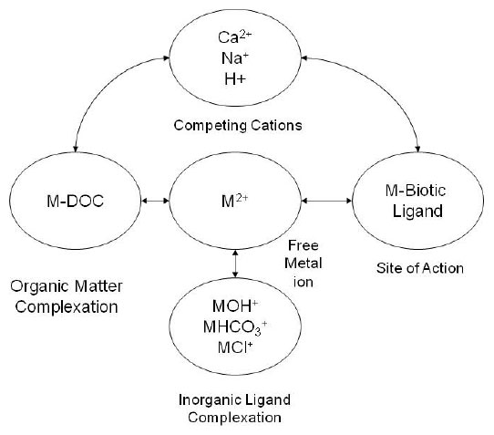
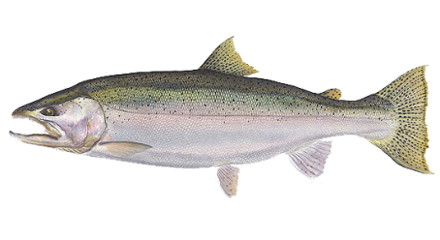
Biotic Ligand Model Overview
Chemical Equilibria /
Environment
Organism
(biotic ligand)
Water Chemistry
Bioavailability
Organism Toxicity
adapted from Di Toro et al., 2001
Notes:
-Even if the biochemical receptor (where the mode of toxicity occurs) of an organism is not a gill the principles of the model should apply to any other site of toxic action. Therefore, any derived BLM criteria would generally be protective of aquatic species despite differences in the toxic site of action.
Concentration of free copper ion
Complexation of Cu with DOC, anions
Competition with cations for ligand binding site

Slide 18
BLM Input Parameters
13 BLM Input Parameters
temperature
pH
dissolved organic carbon (DOC)
calcium (Ca)
magnesium (Mg)
sodium (Na)
potassium (K)
sulfate (SO4)
chloride (Cl)
alkalinity
humic acid fraction (model default value) sulfide (model default value) inorganic carbon (model default value)
Do not need Cu data to derive criteria
Need measured values for 10 input parameters
Based on dissolved parameters
Notes:
SLIDE
Some of these routinely collected, such as pH and temperature
Others have not been routinely collected, such as dissolved organic carbon and some of the ions
Enter the input parameter data and run the model to derive BLM criteria results.
---------------------------------
- DOC commonly originates from decaying natural organic matter (NOM)
-Values for dissolved inorganic carbon (DIC) can be entered directly if known, or the model allows users to enter alkalinity as a replacement for DIC
-Ten percent is the expected proportion of humic acid represented in DOC in many natural systems. The remaining DOC percentage is assumed to be fulvic acid.
-The sulfide module is not currently used in the calculation of IWQC’s for copper, so the model assigns a default value of 1x10⁻⁶ mg/L.

Slide 19
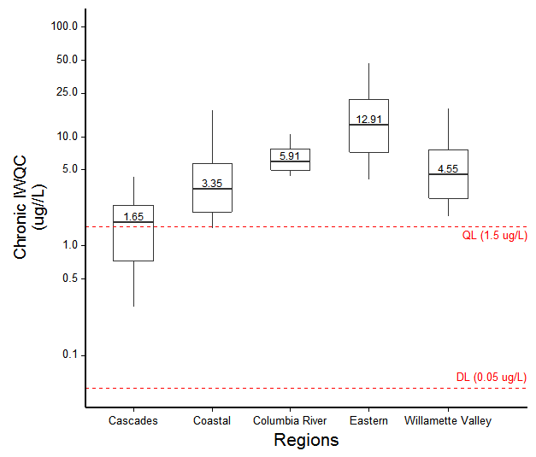
Water quality criteria results
Range of BLM criteria results by region
Notes:
This slide illustrates the variability in the copper criteria that result from using the BLM.
The shows the data by region and the values are the median of all the results in that region, which vary by location and time.
All of these BLM criteria results protect aquatic life; you can see there is a range of protective criteria within each region and there is some variability between regions.
cascades tend to be lower
eastern region tends to be higher
Compared to the hardness based criteria, about half are more and half are less stringent. (Based on 342 samples compared)
total of 4600 sample sets

Slide 20
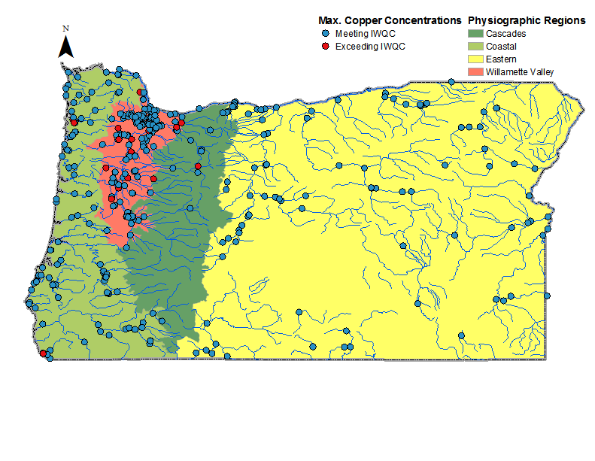
Copper data compared to BLM criteria
Region | Samples (n) | [Cu] > IWQC | %
Cascades | 205 | 15 | 7.3
Coastal | 929 | 5 | 0.5
Eastern | 1,133 | 8 | 0.7
Willamette Valley | 2,340 | 64 | 2.7
Statewide | 4,402 | 77 | 1.7
Notes:
Based on the highest copper value for the site

Slide 21
Procedures when model input data
is not available
Applying the BLM Standard
DEQ must be able to derive BLM criteria results for any time and location
Where measured input data is not available, use an estimate or default value
      ions & alkalinity - estimate using specific conductance
      organic carbon - use conservative default value
Criteria based on measured data are more accurate and supersede default criteria values
Notes:
Whenever a copper sample needs to be evaluated, DEQ must be able to produce criteria results using the model, even if all the model parameters were not measured at the same time.
DEQ has collected a lot of data and will continue to collect BLM input parameter data with all copper samples
But for those times the data is not available, detailed procedures are included in the rule for substituting estimates or conservative default values when measured input parameter data is not available.
These clearly defined procedures help to ensure that the standard includes the elements needed to be a performance based standard: repeatable and replicable
--------------------------
Method to calculate default included in the rule
One default value for each region based on data from the region
Default values can be published for public information, likely only updated periodically (perhaps with each assessment cycle) based on additional data

Slide 22
Applying the Biotic Ligand Model standard
Applying the BLM Standard
Permitting:
    Must protect the site during bioavailable / sensitive conditions
    Need sufficient data to evaluate range of conditions reasonably expected to occur at the site
    Without data, must rely on default values
It will likely be in the interest of dischargers to collect the BLM parameter data
    If effluent copper is measurable
    At least major dischargers

Slide 23
Summary of Public Comment
DEQ received 13 comment submittals
      EPA, municipal and industrial dischargers, one tribe, one environmental organization, group of agriculture & forestry organizations
High level of support for:
      Biotic Ligand Model standard to replace hardness-based equations
      Performance-based approach
      DEQ’s proposed rule rather than EPA’s draft rule

Slide 24
Key Topics
Standard must protect aquatic life during the most bioavailable conditions
Rule must include the elements required of a performance –based standard
Procedures for missing input parameter data
Notes:
High probability that default as stringent as the accurate criteria
Procedures for missing data:
The rule includes clear procedures for substituting estimated or default values when measured input data is not available
The rule includes accurate methods to estimate when possible
Conservative default values for DOC, where estimates not possible

Slide 25
Key Topics
Ability to transition from using default values to accurate criteria in timely manner
      WQ Assessment and 303d listings
      NPDES permits
Notes:
Use accurate BLM criteria to evaluate copper data
Use default values when there is not sufficient data to assess based on accurate criteria
Applicability of anti-backsliding policy
Costs / time to re-open and modify a permit once data becomes available
DEQ understand there will need to be a plan for how to make the transition from actions based on default values to accurate criteria;
We believe it can be done and wil continue to work with EPA
The intent is that we will not need to rely on defaults in very many situations, and fewer in the future as more data is collected.

Slide 26
Conclusions and Next Steps
The proposed copper standard:
    will protect aquatic life
    performance-based standard
If adopted, DEQ will submit the copper standard to EPA
Implementation!
Notes:
Again, DEQ finds that the state rule is much preferable to the federal rule
DEQ will continue to work with critical partners – EPA, stakeholders – to develop implementation procedures
we have worked closely with the permitting program to develop the rule and wil continue to do so

Slide 27
DEQ Recommendation
DEQ proposes that the Commission amend OAR 340-041-0033 and Table 30 as shown in Appendix A, to:
revise Oregon’s copper criteria for freshwater aquatic life, and
make plain language and “housekeeping” revisions.

Slide 28
Conclusions / Next Steps

Slide 29
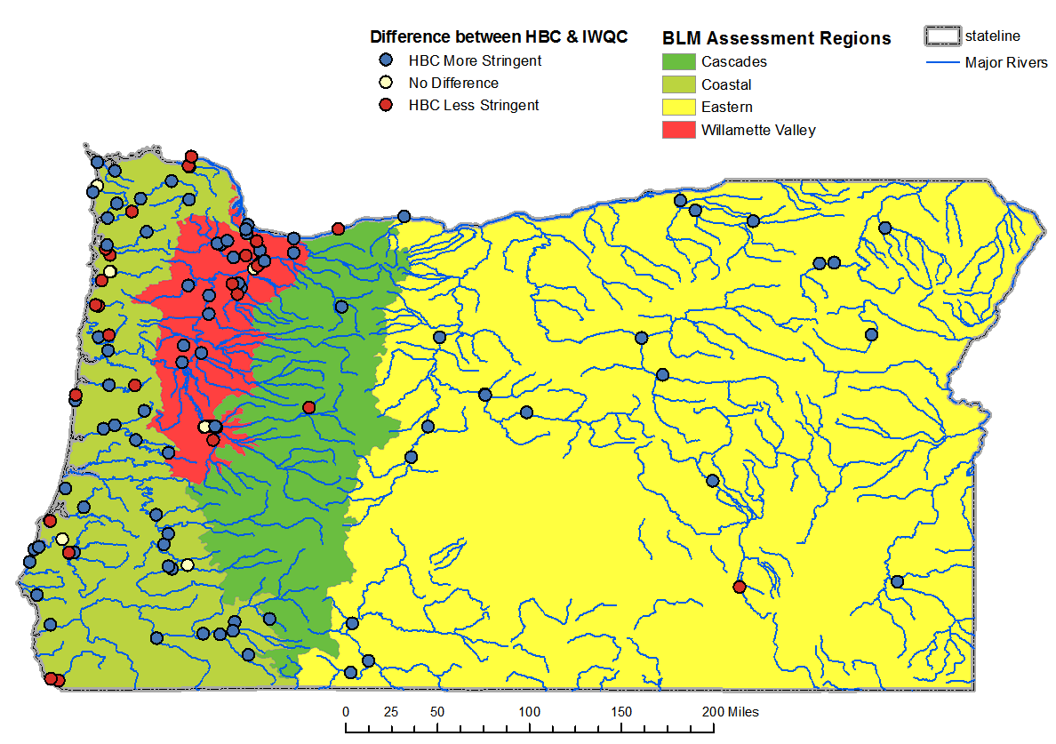
Instantaneous water quality criteria results
Notes:
How BLM criteria differ from hardness-based criteria
342 samples
ALL parameters measured

Slide 30
10th % Site IWQC
Quant. Limits
4.2 ug/L
QL=1.5 ug/L
DL=0.05 ug/L
2.2 ug/L
QL=1.5 ug/L
DL=0.05 ug/L

Slide 34
Fiscal Impact
Fiscal Impact
  Stormwater permits:
    Potential monitoring and treatment costs
    Fishing and recreation businesses:
      Potential benefits due to improved fish health and population size

Slide 35
Fiscal Impacts
Fiscal Impact
State government
      Increased staff time to calculate BLM-based criteria and apply them in permits
Individual permit holders
  Monitoring to provide BLM data:
    approx. $5000-8500 per outfall per permit renewal
  Potential relief if less stringent effluent limits

Slide 36
DOC Default Values

Slide 37
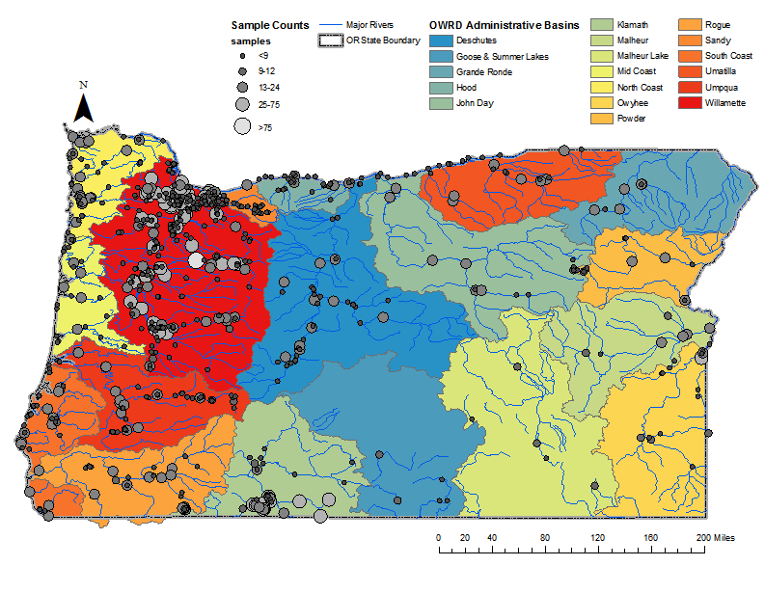
Availability of BLM Parameter Data Sets
Notes:
Re-map watersheds as OWRD administrative basins.

Slide 38
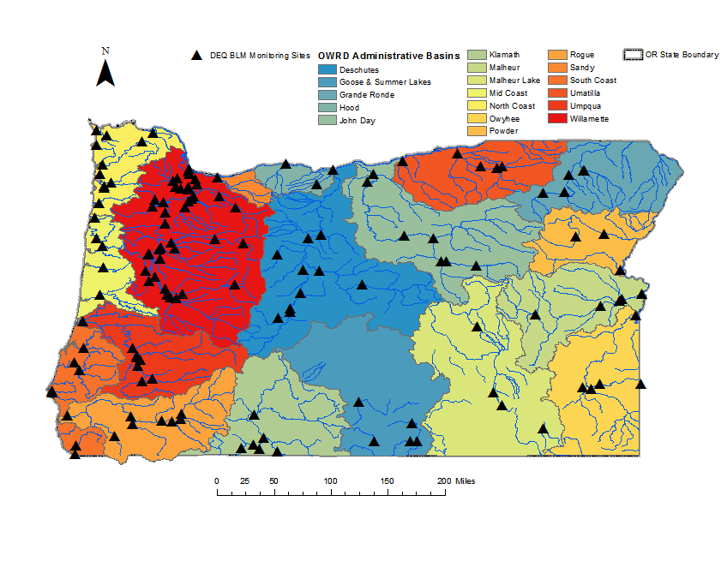
DEQ BLM Parameter Monitoring

