Slide 1

Air Quality Program
Proposed Permanent
Colored Art Glass Manufacturing (CAGM) Rules
Sept. 29, 2016
Portland
Jaclyn Palermo and George Davis | Oregon Department of Environmental Quality
Notes:
(1 min.)
Good morning Chair O’Keeffe, Commissioners, my name is Jaclyn Palermo and I manage the Air Quality Operations Section at the Department of Environmental Quality. With me today is George Davis, engineer and senior permit writer for DEQ’s northwest region. David Farrer from Oregon Health Authority is also here and will be able to answer any toxicology related questions after the presentation. Feel free to answer clarifying questions during the presentation. We left room at the end of the presentation for the three of us to answer your questions.
We are here today to present to you a proposal for permanant rules that would apply to colored art glass manufacturers throughout Oregon.
We proposed rules temporary glass rules at the Commission’s meeting on April 21 2016, which the Commission adopted. The temporary glass rules sunset on October 18, 2016. We are here today to present the proposed rules, which would replace the temporary rules and make the requirements permanent.

Slide 2
Outline of Today’s Presentation
Brief History/refresher
Summary of public comments
Summary of the changes from the temporary art glass rulemaking
Recommendations
Notes:
(1 min.)
Here is an outline of what we will discuss today, and we want to leave plenty of time for questions at the end of the presentation.
First we will provide you with a brief refresher of the history of the temporary glass rulemaking. This has been in the forefront of my mind since April, but that might not be the case for everyone.
Then we will discuss the comment process for this proposed rule as well as the nature and categorization of the public comments received;
Next we will walk you through the proposed rule and the deviations from the portions of temporary glass rulemaking adopted in April 2016; along with the rationale for making the changes.
Finally, we will make our recommendation to you.

Slide 3
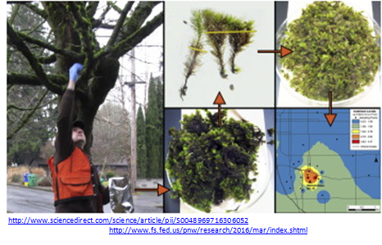
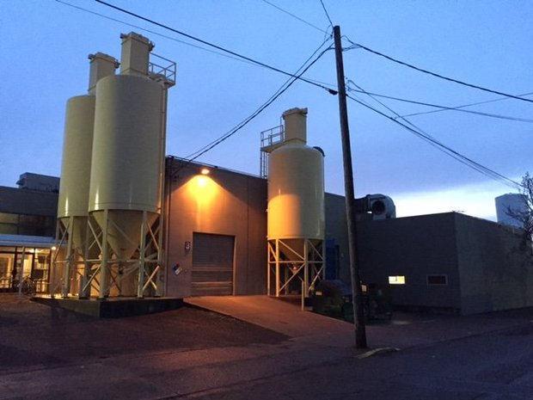
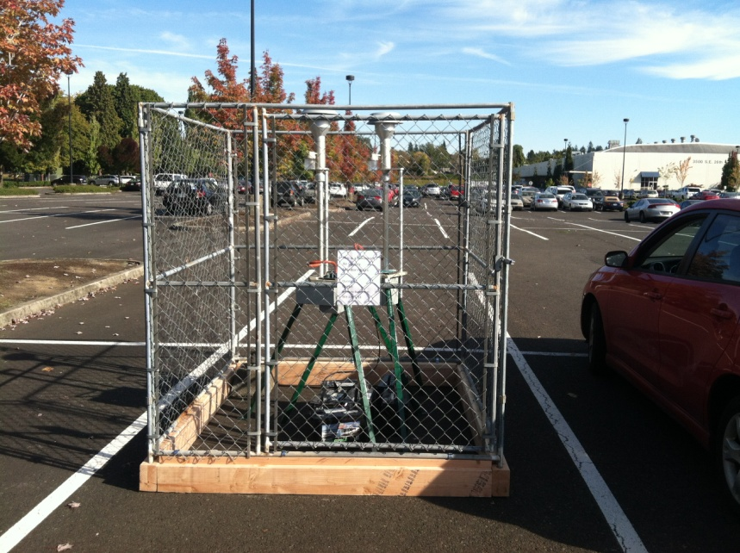
History
Glass facility
DEQ Monitor
Notes:
(1 min.)
I give an abridged history of this proposed rule and an large overview. George will then give the technical basis and rationale.
Elevated levels of hazardous air pollutants were found in the air around two glass manufacturing facilities in Portland. After a moss study and subsequent air monitoring in October 2015, DEQ confirmed that a glass company was the likely source. DEQ completed its quality assurance and quality control review of those samples in late January 2016 and then shared its analysis of the findings with the Oregon Health Authority and the Multnomah County Health Department. DEQ also identified a second area of concern near the glass company in North Portland.
The glass companies were operating in compliance with the current law. One company was operating within its permit and the other company was not required to have a permit. To address the gap and the elevated levels of hazardous air pollutants, DEQ proposed an art glass manufacturing temporary rulemaking, which was approved on April 21, 2016. If no action is taken the temporary rules will expire 180 days after they were adopted, which is Oct. 18, 2016. The proposed rule DEQ is presenting today would replace the temporary rules and make the requirements permanent.
The permanent rules that DEQ proposes for EQC adoption are intended to ensure that air emissions from colored art glass manufacturers do not cause unsafe levels of glassmaking hazardous air pollutants (arsenic, cadmium, chromium, lead, manganese, nickel and selenium) in the air nearby.

Slide 4
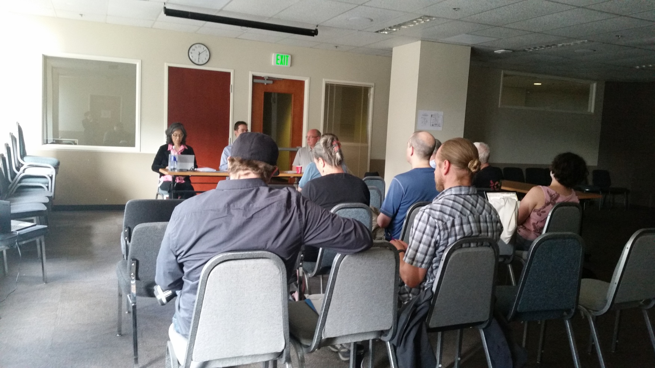
Public Comment
July 19, 2016 public hearing
Notes:
(1 min.)
In addition to holding two fiscal committee meetings, DEQ held a public hearing on July 19, 2016 and accepted public comments from June 15, 2016 thru July 29, 2016. DEQ received 151 comments from 136 commenters.
DEQ’s public notice for this rulemaking included proposed rule language that was unchanged from the temporary rule, along with a request from DEQ for comments on several possible changes that were noted from the committee meetings:
Should the rule be modified to apply to sources that make less than 10 tons per year of colored art glass?
Should the rule be modified to apply statewide, rather than only in the Portland Air Quality Maintenance Area?
The temporary rule requires control devices be shown to capture at least 99.0 percent of incoming particulate matter. Should that standard be replaced with one based on the particulate matter at the outlet of the control device?
We consider all of the comments we receive, no matter how many people made the comment.
This is a high level depiction of the public comments.
Through the public comment process, we received comments from about 136 individuals and organizations, 41% of the commenters were from people of Oregon, 54% were from parties outside of Oregon, and 5% of the commenters did not state where they reside.
Some of the comments were from organizations representing the interests of their members. The total number of people represented by these comments is much greater than the number of comments we received.
As you can imagine, there are many perspectives expressed by those comments.

Slide 5
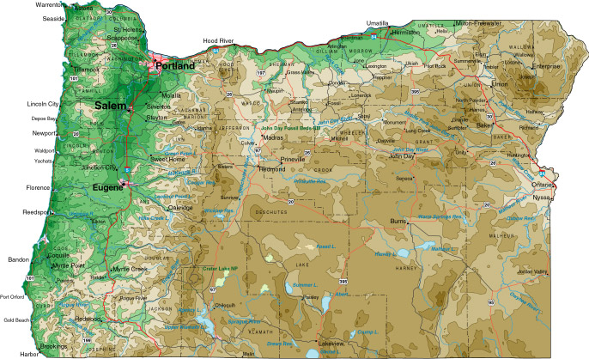


Public Comment continued
41% people of Oregon
136 commenters
47% elsewhere in the US
7% outside of the US
Notes:
We consider all of the comments we receive, no matter how many people made the comment.
This is a high level depiction of the public comments.
Through the public comment process, we received comments from about 136 individuals and organizations, 41% of the commenters were from people of Oregon, 54% were from parties outside of Oregon, and 5% of the commenters did not state where they reside.
Some of the comments were from organizations representing the interests of their members. The total number of people represented by these comments is much greater than the number of comments we received.
As you can imagine, there are many perspectives expressed by those comments.

Slide 6
Public Comment continued
 | 10 Categories | 60 Subcategories
151 comments by 131 commenters,organized into 10 categories and 60 subcategories | Rule APpplicability | 10
 | Enforcement | 2
 | General Rulemaking | 4
 | Health | 7
 | Other Pollution Sources | 2
 | Permitting | 2
 | Pollution Control Devices | 7
 | Public Outreach | 6
 | Rule Requirements (???) | 14
 | Source Testing | 6
 | Total: | 60
 | Note: Some commenters fall into multiple categories
Notes:
(1 min.)
To review and respond effectively, we have organized the comments into the above 12 categories and further into 60 subcategories and that is also how we responded to them. Therefore you’ll see in your materials that we have __ responses to comments.
We received a number of comments around many topics. Later in the presentation, George will discuss the changes we made from the temporary rule based on the comments. First I want to discuss a common theme we heard about adopting a human health and risk based approach to regulating industrial air toxics. Many of those comments identified that this rulemaking will not address risk from other types of industries beyond art glass manufacturing. We addressed those in the response to comments but wanted to reiterate here that the proposed rules are designed to address emissions solely from colored art glass manufacturers that was initially identified from ambient air monitoring. This temporary rule is not and never was designed to address any of these larger concerns. In order to do that, we established a much larger stakeholder and public involvement process and is being handled in a separate regulatory reform rulemaking.
In this proposed permanant rule, we have included some elements of a human health and risk based program and are also using some elements of a technology based program. You’ll hear more about those as we go through some of the changes we made in response to comments. You will now hear from George Davis. He will be discussing the changes and the associated rationale.

Slide 7
Background
Need to add in change of Cr VI 24-hr health std from 36 to 5
George Davis and Jaclyn Palermo| Oregon Department of Environmental Quality

Slide 8
Background
Need to add in change of Cr VI 24-hr health std from 36 to 5
George Davis and Jaclyn Palermo | Oregon Department of Environmental Quality

Slide 9
Background
Need to add in change of Cr VI 24-hr health std from 36 to 5
George Davis and Jaclyn Palermo | Oregon Department of Environmental Quality

Slide 10
Background
Need to add in change of Cr VI 24-hr health std from 36 to 5
George Davis and Jaclyn Palermo | Oregon Department of Environmental Quality

Slide 11
Background
Need to add in change of Cr VI 24-hr health std from 36 to 5
George Davis and Jaclyn Palermo | Oregon Department of Environmental Quality

Slide 12
Background
Need to add in change of Cr VI 24-hr health std from 36 to 5
George Davis and Jaclyn Palermo | Oregon Department of Environmental Quality

Slide 13
George Davis and Jaclyn Palermo | Oregon Department of Environmental Quality

Slide 14
Background
Elevated metals levels in SE Portland
CAGM emissions contribute
EQC adopted temporary CAGM rules April
Regulate emissions from CAGMs
2 larger (Tier 2) CAGMs
3 smaller (Tier 1) CAGMs
George Davis and Jaclyn Palermo | Oregon Department of Environmental Quality

Slide 15
Temporary rule requirements
Only applied in Portland AQMA
Tier 1 (smaller) | Tier 2 (larger)
3 options: Install emission controls; Test/model to show exempt; or Permit limit prohibiting use of 1 or more HAPs | Install emission controls, Limitation on chromium usage
 | Test for chromium VI emissions and model to establish chromium usage limits
Test emission control device to show 99.0 percent particulate matter removal efficiency | Test emission control device to show 99.0 percent particulate matter removal efficiency
George Davis and Jaclyn Palermo | Oregon Department of Environmental Quality

Slide 16
Summary of Proposed Changes
TEMPORARY RULES | PROPOSED Permanant | BASIS FOR CHANGE
Only applied in Portland AQMA | Apply rules statewide | Comments
Applicability threshold 10 tons/yr colored glass | Reduce threshold to 5 tons/yr colored glass | Comments
HAPs: As, Cd, Cr, Mn, Ni, Pb | Add selenium | Comments
No compliance extensions | Compliance extensions up to 1 year for Tier 1 CAGMs to install controls | Staff suggestion
Definition of “raw material” caused confusion | Clarify definition | Comments
Demonstrate 99.0% PM control efficiency | Demonstrate 0.005 gr/dscf; bag leak detection system; HEPA afterfilter | Comments
George Davis and Jaclyn Palermo | Oregon Department of Environmental Quality

Slide 17
Make rules apply statewide
Requested input in public notice
Many comments suggest statewide applicability
Discussed with LRAPA
George Davis and Jaclyn Palermo | Oregon Department of Environmental Quality

Slide 18
Lower applicability threshold to 5 tpy
Requested input in public notice
Many comments suggested lowering threshold
DEQ agrees, but rules should not apply to individual artists/hobbyists
Some Tier 1 CAGMs in Portland AQMA
Below threshold now
Will likely exceed threshold as production increases
George Davis and Jaclyn Palermo | Oregon Department of Environmental Quality

Slide 19
Add selenium to list of HAPs
Original list of HAPs: As, Cd, Cr, Mn, Ni, Pb
Comments suggested adding more HAPs
High levels of Se monitored during the summer in SE Portland
Phase-in with later compliance dates
George Davis and Jaclyn Palermo | Oregon Department of Environmental Quality

Slide 20
Add compliance extensions for Tier 1
Building permits required for baghouses
Building permit approvals significantly delayed
Allow compliance extensions up to 1 year for reasons beyond CAGM’s control
George Davis and Jaclyn Palermo | Oregon Department of Environmental Quality

Slide 21
Clarify “raw material” to exclude glassworkers
Temporary rules regulate “making colored glass with raw materials containing HAPs”
“Raw material” includes glass materials used to color glass
Term “glass materials” causes confusion
Definition revised to clarify
George Davis and Jaclyn Palermo | Oregon Department of Environmental Quality

Slide 22
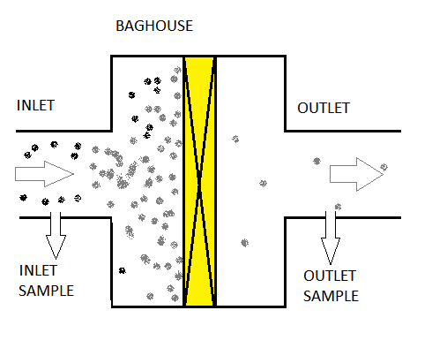
Demonstrate 99.0% PM control efficiency
Critical that “Mass Out” be a valid numerical result
Valid numerical result requires large enough sample
Amount of PM at outlet is very small
→ very long
sampling time
→ very high cost
CE = (Mass In – Mass Out) x 100
Mass In
George Davis and Jaclyn Palermo | Oregon Department of Environmental Quality

Slide 23
Reasons for 99.0 percent CE test
1. To help determine chromium VI emission rate
from chromium III to VI conversion test
2. Indicator that the baghouse is working
Not intended to be an emission standard
Not health-based
George Davis and Jaclyn Palermo | Oregon Department of Environmental Quality

Slide 24
A little rule history…
Major question in early 2016 was:
How much Cr III converts to Cr VI?
Rule required test for Cr VI at baghouse INLET – to ensure a valid result
INLET test does not give Cr VI emissions
Complex and expensive test – is there another way to get Cr VI emissions?
Yes…
George Davis and Jaclyn Palermo | Oregon Department of Environmental Quality

Slide 25
Cr VI emissions from INLET test
If Cr VI control efficiency = PM control efficiency
Then, Cr VI INLET result and PM control efficiency → Cr VI OUTLET
DEQ assumed true
Test for PM at baghouse INLET and OUTLET → PM Removal Efficiency
George Davis and Jaclyn Palermo | Oregon Department of Environmental Quality

Slide 26
Is removal efficiency assumption valid?
Bullseye tested,
Cr VI removal efficiency < PM removal efficiency
Result calls assumption into question
Propose to abandon that approach, measure Cr directly at baghouse OUTLET
Bullseye test indicates that conversion of Cr III to Cr VI is 100%
Assume 100% conversion unless testing shows otherwise
George Davis and Jaclyn Palermo | Oregon Department of Environmental Quality

Slide 27
Reasons for 99.0% CE test
99.0 % PM Control Efficiency chosen for two reasons:
1. To help determine chromium VI emission rate
2. Indicator that the baghouse is working
George Davis and Jaclyn Palermo | Oregon Department of Environmental Quality

Slide 28
Indicator that baghouse is working
For Tier 1, showing 99.0% removal requires very long, very expensive testing
Other ways to indicate that baghouse is working?
Three options identified
George Davis and Jaclyn Palermo | Oregon Department of Environmental Quality

Slide 29
Indicator that baghouse is working
Test PM emission rate, show emission rate not more than 0.005 grains per dry standard cubic foot
Install a Bag Leak Detection System
Install a HEPA afterfilter
George Davis and Jaclyn Palermo | Oregon Department of Environmental Quality

Slide 30
Opt. 1: 0.005 gr/dscf
0.005 gr/dscf is a concentration measure (7,000 gr = 1 lb)
Statewide general grain loading standard is ~ 0.10 gr/dscf
0.005 gr/dscf suggested by EPA and DEQ staff
A “less than” 0.005 result is acceptable; allows shorter, less expensive testing
George Davis and Jaclyn Palermo | Oregon Department of Environmental Quality

Slide 31
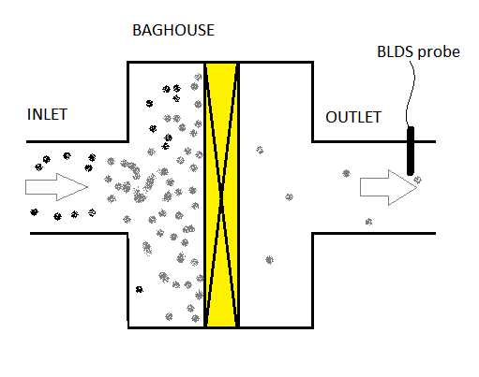
Opt. 2: Bag Leak Detection System
BLDS probe installed in baghouse outlet, connected to data system
BLDS can sense a change (increase) in PM emissions – indicates bag leak
Maintenance required to find/repair leak
George Davis and Jaclyn Palermo | Oregon Department of Environmental Quality

Slide 32
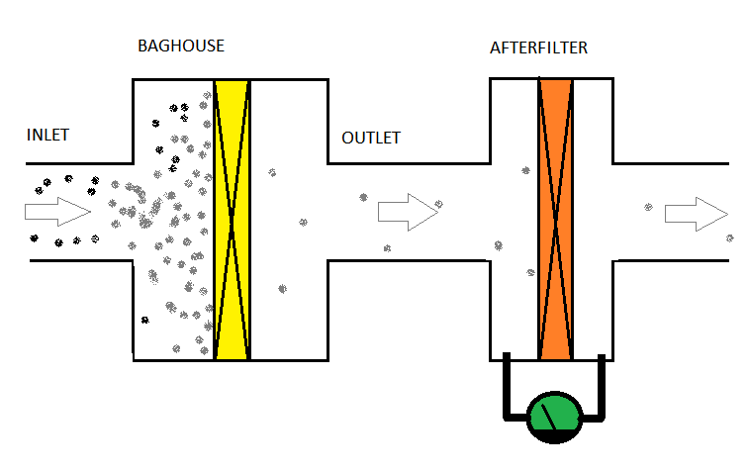
Opt. 3: HEPA Afterfilter
HEPA filter too fine for primary filter, would quickly clog
OK as afterfilter
If bags leak, HEPA begins clogging
Maintenance required
George Davis and Jaclyn Palermo | Oregon Department of Environmental Quality

Slide 33
Control device options
For an indicator that the baghouse is working, 3 new options
Rule proposals:
Tier 1 – test for 0.005 gr/dscf OR
install BLDS OR
install HEPA afterfilter
Tier 2 – test for 0.005 gr/dscf AND
{install BLDS OR install HEPA afterfilter}
George Davis and Jaclyn Palermo | Oregon Department of Environmental Quality

Slide 34
Recommendation
DEQ recommends that the Environmental Quality Commission:
approve and adopt the findings justifying adoption of a permanant rule as set forth in the staff report.
George Davis and Jaclyn Palermo | Oregon Department of Environmental Quality
Notes:
(1 min.)

Slide 35
End
Questions?
George Davis and Jaclyn Palermo | Oregon Department of Environmental Quality

