Slide 1

Air Quality Program
Proposed Permanent
Colored Art Glass Manufacturing (CAGM) Rules
Sept. 29, 2016
Portland
Jaclyn Palermo and George Davis | Oregon Department of Environmental Quality
Notes:
(1 min.)
Good morning Chair O’Keeffe, Commissioners, my name is Jaclyn Palermo and I manage the Air Quality Operations Section at the Department of Environmental Quality.
With me today is George Davis, engineer and senior permit writer for DEQ’s northwest region. David Farrer from Oregon Health Authority is also here and will be able to answer any toxicology related questions after the presentation. Feel free to ask clarifying questions during the presentation. We left room at the end of the presentation for the three of us to answer your questions.
We are here today to present to you a proposal for permanant rules that would apply to colored art glass manufacturers.
We proposed rules temporary glass rules at the Commission’s meeting on April 21 2016, which the Commission adopted. We are here today to present the proposed rules, which would replace the temporary rules and make the requirements permanent. If no action is taken, the temporary rules will expire on Oct. 18, 2016.

Slide 2
Outline of Today’s Presentation
Brief history
Summary of public comments
Summary of changes from the temporary art glass rules
Recommendations
Notes:
(1 min.)
Here is an outline of what we will discuss today.
First we will provide you with a brief refresher of the history of the temporary glass rulemaking.
Then we will discuss the comment process for this proposed rule as well as the nature and categorization of the public comments received;
Next we will walk you through the proposed rule and the changes from the temporary glass rulemaking adopted in April 2016; along with the rationale for making the changes.
Finally, we will make our recommendation to you.

Slide 3
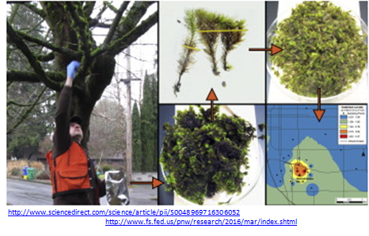
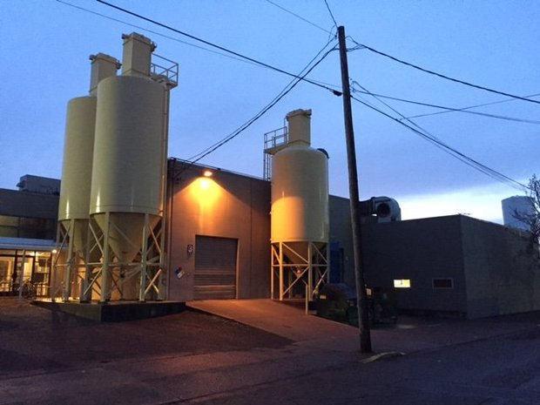
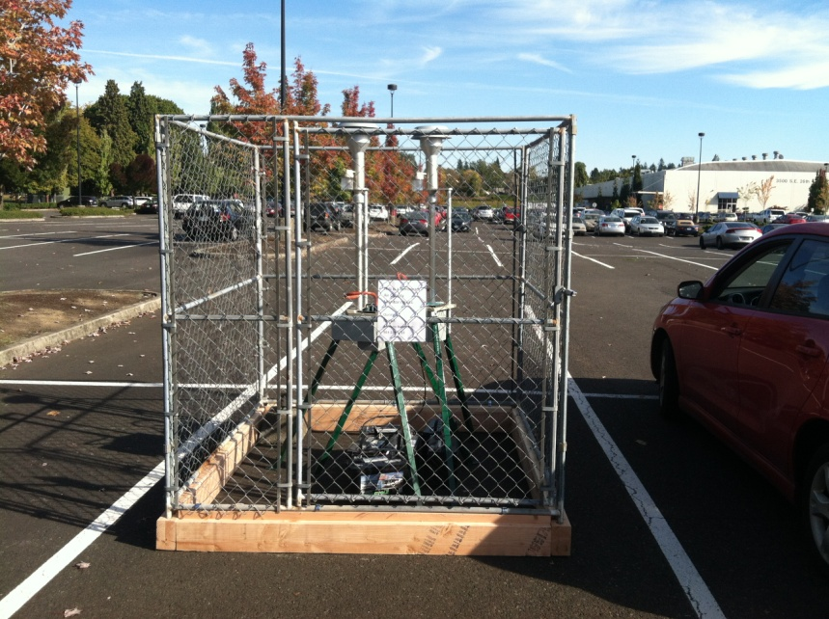
History
Glass facility
DEQ Monitor
Notes:
(1 min.)
I give an abridged history of this proposed rule. George will then give the technical basis and rationale.
Elevated levels of hazardous air pollutants were found in the air around two glass manufacturing facilities in Portland. After a moss study and subsequent air monitoring in October 2015, DEQ confirmed that a glass company was the likely source. DEQ also identified a second area of concern near the glass company in North Portland.
The glass companies were operating in compliance with the current laws at the time. To address this regulatory gap and the elevated levels of hazardous air pollutants, DEQ proposed an art glass manufacturing temporary rulemaking, which was approved on April 21, 2016.

Slide 4
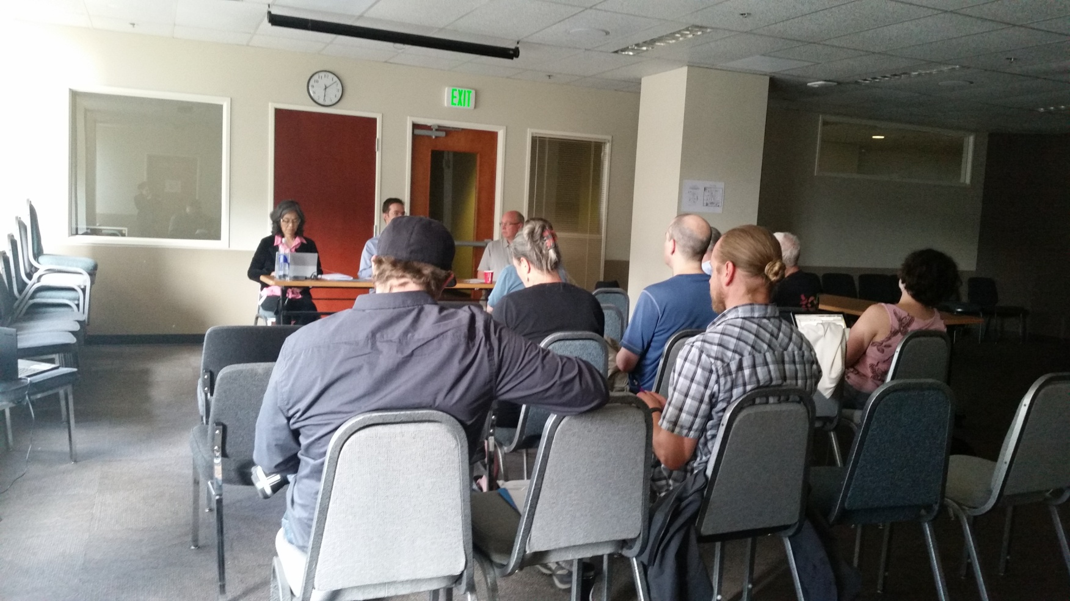
Public Comment
July 19, 2016 public hearing
Notes:
(1 min.)
In addition to holding two fiscal committee meetings, DEQ held a public hearing on July 19, 2016 and accepted public comments from June 15, 2016 thru July 29, 2016.
DEQ’s public notice for this rulemaking included proposed rule language that was unchanged from the temporary rule, along with a request from DEQ for comments on several possible changes that were identified during the fiscal committee meetings. The three questions that were included in the public notice were:
Should the rule be modified to apply to sources that make less than 10 tons per year of colored art glass?
Should the rule be modified to apply statewide, rather than only in the Portland Air Quality Maintenance Area?
Should the test to show that the control device is working properly be changed from the 99.0% control efficiency test to another method or methods that can also show the control device is working properly?

Slide 5
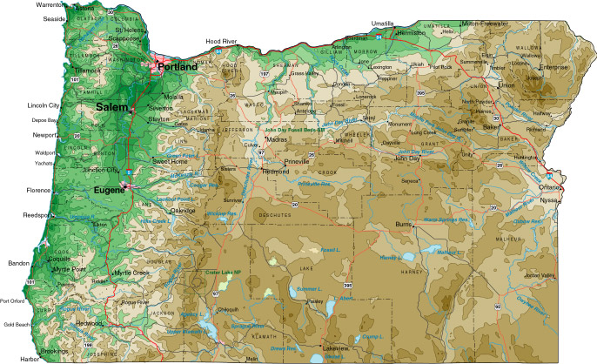


Public Comment continued
41% From Oregon
136 commenters, which includes businesses & organizations
47% elsewhere in the US
7% outside of the US
Notes:
This is a high level depiction of the public comments.
DEQ received 151 comments from the 136 individuals and organizations. 41% of the commenters were from Oregon, 54% were from parties outside of Oregon, and 5% of the commenters did not state where they reside.
As you can imagine, there are many perspectives expressed by those comments.
We consider all of the comments we receive, no matter how many people made the comment.

Slide 6
Public Comment continued
 | 10 Categories | 60 Subcategories
151 comments by 136 commenters, organized into 10 categories and 60 subcategories | Rule Applicability | 10
 | Enforcement | 2
 | General Rulemaking | 4
 | Health | 7
 | Other Pollution Sources | 2
 | Permitting | 2
 | Pollution Control Devices | 7
 | Public Outreach | 6
 | Rule Requirements | 14
 | Source Testing | 6
Notes:
(1 min.)
To review and respond effectively, we have organized the comments into the above 10 categories and further into 60 subcategories and that is also how we responded to them. Therefore you’ll see in your materials that we have 60 responses to comments.
In this proposed permanant rule, we have included some elements of a human health and risk based program and are also using some elements of a technology based program. You’ll hear more about those as we go through some of the changes we made in response to comments. You will now hear from George Davis. He will be discussing the changes and the associated rationale.

Slide 7
Temporary Colored Art Glass Manufacturer rules
Intended to regulate emissions from:
2 larger (Tier 2) CAGMs
3 smaller (Tier 1) CAGMs
Rules only applied in Portland area
George Davis and Jaclyn Palermo | Oregon Department of Environmental Quality
Notes:
Thank you, Jaclyn.
Chair O’Keefe, Commissioners,
the temporary colored art glass manufacturer rules were intended to regulate 5 colored art glass manufacturing facilities in the Portland area. The five facilities were split into two tiers based on how much glass they made and the type of glassmaking furnaces they used.

Slide 8
Temporary rule requirements
Tier 1 (smaller) | Tier 2 (larger)
Three options: Install emission controls; or Test/model to show exempt; or Permit limit prohibiting use of one or more glassmaking HAPs | Install emission controls Limit chromium usage Test/model to establish chromium usage limits
Test emission control device to show 99.0 percent particulate matter (PM) control efficiency
George Davis and Jaclyn Palermo | Oregon Department of Environmental Quality
Notes:
The rules imposed different requirements for the two tiers.
The smaller Tier 1 facilities were given three compliance options: install emission controls; or do emissions testing and modeling to demonstrate that the ambient impacts of their emissions were below specified protective levels; or request permit prohibitions on the use of one or more of the glassmaking hazardous air pollutants.
The larger Tier 2 facilities were required to install emission controls, and the rules required that usage limits be established for the use of chromium. Associated with the chromium usage limitation was a requirement to perform emissions testing and modeling to determine the chromium usage limit.
Both Tiers were required to test their emission control devices and show that the emissions controls could meet a 99.0 % control efficiency.

Slide 9
PROPOSED PERMANENT RULES | TEMPORARY RULES
(1) Apply at 5 tons per year | 10 tons per year or more of glass using glassmaking HAPs
(2) Apply statewide | Portland AQMA only
(3) & (5) Test to show 0.005 gr/dscf; Bag leak detection system; HEPA afterfilter | Test to show 99.0% particulate matter (PM) control efficiency
(4) Add selenium to glassmaking HAPs | Arsenic, cadmium, chromium, lead, manganese, nickel
(6) Set 24-hr health benchmark for chromium VI to 5 nanograms per cubic meter | 36 nanograms per cubic meter
(7) Test chromium emissions at control device outlet | (Tier 2) Test chromium at control device inlet; calculate chromium out using PM control efficiency
(8) Compliance extensions to install emission controls; up to 1 year Tier 1 | No compliance extensions
Notes:
This slide summarizes the most significant differences between the proposed permanent glassmaking rules and the temporary rules. All of the changes are based on comments that were received during the public comment period.
Eight changes are listed on pages 3 and 4 in the staff report, but the third and fifth changes are closely related so they’ve been combined for this presentation. The numbers in the first column correspond to the list in the staff report. I’ll quickly go down the list, and will then provide a little more information on each item in the following slides.
Change the rule applicability threshold from 10 tons per year of glass to 5 tons per year.
Make the rules apply statewide instead of only in the Portland area.
(3) and (5) Replace the 99.0% particulate matter control efficiency test with three other options.
(4) Add selenium to the list of glassmaking hazardous air pollutants regulated under this rule.
(6) Lower the 24-hour health benchmark for chromium VI from 36 ng/m3 to 5 ng/m3.
(7) Test chromium emissions at the emission control device outlet instead of at the control device inlet.
(8) Provide compliance extensions for Tier 1 facilities of up to 1 year.
In addition to the more significant changes listed here, a number of other changes were made, such as giving facilities outside the Portland area additional time to comply with the rules, to help clarify parts of the rules that some people found confusing, and for general housekeeping.

Slide 10
(1) Apply at 5 tons per year or more of glass using glassmaking HAPs
Requested input in public notice
Many comments suggested lower threshold
DEQ agrees, but rules should not apply to individual artists/hobbyists
Some Tier 1 CAGMs in Portland AQMA
Below threshold now
Will likely exceed threshold as production increases
George Davis and Jaclyn Palermo | Oregon Department of Environmental Quality
Notes:
Item 1, DEQ is proposing to lower the rule applicability threshold from 10 tons per year of glass to 5 tons per year. Only glass made using glassmaking hazardous air pollutants is counted toward the threshold.
Some commenters suggested making the rules apply if any amount of glass were made using hazardous air pollutants, but DEQ is instead seeking an appropriate balance between under- and over-regulating colored art glass manufacturers.
Staff estimated that producing 5 tons of glass per year would require two small glass making furnaces, each making 50 pounds of glass two times per week.
DEQ considers this level of production to reasonably represent a level that defines a manufacturing operation, but is high enough to exclude artists and hobbyists who might make their own glass for special purposes.

Slide 11
(2) Apply statewide
Requested input in public notice
Many comments suggest statewide applicability
LRAPA agrees
George Davis and Jaclyn Palermo | Oregon Department of Environmental Quality
Notes:
Item 2, many comments suggested making the rules apply statewide.
Since the rules are intended to reduce the possible health threat from colored art glass manufacturers, DEQ agrees that the rules should apply statewide.
Staff have discussed the rules with the Lane Regional Air Pollution Authority, and Lane Regional agrees with making the rules apply statewide.

Slide 12
(3) & (5) Test to show 0.005 gr/dscf; Bag leak detection system; HEPA afterfilter
Temporary rules: test emission control device
Show it meets 99.0 percent control efficiency for particulate matter
DEQ expected relatively simple, inexpensive testing
Test cost estimates far exceed DEQ’s expectations
Three alternatives identified
George Davis and Jaclyn Palermo | Oregon Department of Environmental Quality
Notes:
Items 3 and 5. The temporary rules required the affected glass manufacturers to test their emission control devices and show that they meet a 99.0% control efficiency for particulate matter. This is not a health-based standard, since DEQ has no information to correlate particulate matter emissions with glassmaking hazardous air pollutant emissions. The primary purpose of this test was to ensure that the emission control system was working properly.
Staff expected this test to be relatively simple and inexpensive, but estimates for testing at some facilities are well over $100,000. This is because emissions will be so low that extraordinarily long test times will be required to collect enough sample to get a valid result.
Staff considered whether there are other ways to provide assurance that the emission control systems are working properly, and identified 3 alternatives, which are shown on the following slides.

Slide 13
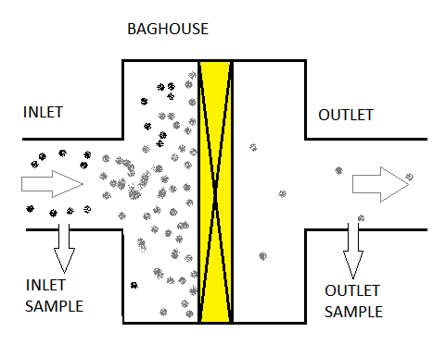
Alt. 1: Outlet test for 0.005 gr/dscf
99.0% test requires sampling inlet and outlet
Very long sample time required to get usable outlet result
Option 1: 0.005 gr/dscf
Gen. std. 0.10 - 0.17
Sample outlet only
Good result possible with short sampling time
George Davis and Jaclyn Palermo | Oregon Department of Environmental Quality
Notes:
This is a general illustration of a baghouse, with dusty air entering at the inlet. The yellow area represents the filters that filter the dusty air, and the filtered air then exits from the baghouse outlet.
An alternative to the 99.0% control efficiency test is to simply test at the outlet to show that emissions are below a specified level.
The proposed level of 0.005 grains per dry standard cubic foot was suggested by EPA staff, and would be a good indicator that the emission control device is working properly.
Oregon’s air quality rules include a general particulate matter standard that ranges from 0.10 to 0.17 grains per dry standard cubic foot. The proposed level is well below this.
Emissions sampling would only be required at the outlet, and a good result can be obtained with a much shorter sampling time.
(Short explanation of why sampling time is so long requires 5 sentences, total of 89 words).

Slide 14
Optional slide
CE % = (amount in – amount out) x 100 (amount in)
Sample size must be large enough to give usable analytical result
Inlet relatively concentrated, short sampling time
Outlet concentration much less than inlet concentration → much longer sampling time required
Notes:
89 words
To calculate control efficiency, or CE, we need test samples from both the inlet and the outlet of the baghouse.
To get good analytical results, each sample size has to be equal to or greater than the minimum amount specified for the test.
Since the inlet concentration is relatively high, enough sample can be collected in a relatively short time.
However, the outlet concentration is much lower, so it takes much longer to collect enough sample.
Test personnel must be on site much longer, so cost is much higher.

Slide 15
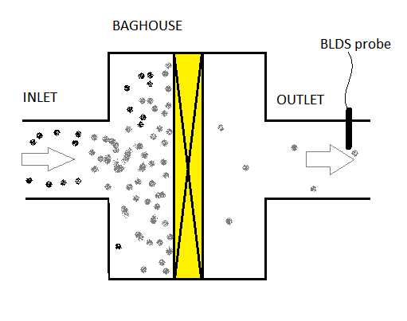
Alt. 2: Bag Leak Detection System
George Davis and Jaclyn Palermo | Oregon Department of Environmental Quality
Notes:
A second alternative is a bag leak detection system. A probe that can sense particulate matter is installed in the outlet duct and is connected to an electronic monitoring and recording system.
These systems are very sensitive and can detect leakage in a baghouse that is too small to be detected by other means.

Slide 16
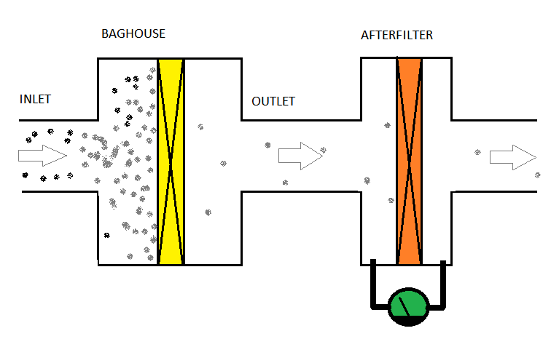
Alt. 3: HEPA Afterfilter
George Davis and Jaclyn Palermo | Oregon Department of Environmental Quality
Notes:
A third alternative is a HEPA afterfilter, which is installed on the baghouse outlet and provides additional filtering.
HEPA stands for High Efficiency Particulate Arrestance, and HEPA filters are so fine that they would plug up rapidly if used as the primary filters.
However, this tendency to plug up makes them work like a leak detection system.
If the primary filter begins to leak, the HEPA filter will rapidly plug up, restricting air flow and increasing pressure across the filter, which gives an indication that there is a leak in the baghouse.
Further, even though the baghouse may be leaking, the HEPA filter will continue to provide filtration to minimize emissions.

Slide 17
(3) & (5) Test to show 0.005 gr/dscf; Bag leak detection system; HEPA afterfilter
Tier 1 – test for 0.005 grains/dry std. cubic foot OR
install BLDS OR
install HEPA afterfilter
Tier 2 – test for 0.005 grains/dry std. cubic foot AND
{install BLDS OR install HEPA afterfilter}
George Davis and Jaclyn Palermo | Oregon Department of Environmental Quality
Notes:
Based on these 3 alternatives, DEQ is proposing that the smaller Tier 1 facilities have the option of testing for 0.005 gr/dscf, or installing a bag leak detection system, or installing a HEPA afterfilter.
However, the larger Tier 2 facilities would be required to test for 0.005 gr/dscf, and would then have the option of installing a bag leak detection system or a HEPA afterfilter.

Slide 18
(4) Add selenium to glassmaking HAPs
Original list of glassmaking HAPs: arsenic, cadmium, chromium, lead, manganese and nickel
Comments suggested adding more/all HAPs
High levels of selenium monitored during the summer in SE Portland
Levels of other glassmaking HAPs low
George Davis and Jaclyn Palermo | Oregon Department of Environmental Quality
Notes:
Getting back to the list of differences, item 4, commenters suggested that more hazardous air pollutants should be regulated under this rule.
Staff do not recommend regulating all HAPs under this rule because the temporary rule was originally narrowly focused to solve a particular problem and staff recommend keeping these rules narrowly focused. In addition, DEQ is working to develop a broader Cleaner Air Oregon rules to regulate toxic air emissions from all industrial sources, which most likely will also apply to the colored art glass manufacturers and is expected to regulate a larger number of hazardous air pollutants.
However, staff do recommend adding selenium to the list of glassmaking HAPs regulated under this rule because relatively high levels of selenium were monitored in SE Portland several times during the summer.
Phase in of selenium requires extending some compliance dates, since affected facilities have only learned about this change very recently.

Slide 19
(6) Set 24-hour health benchmark for chromium VI to 5 nanograms per cubic meter
24-hr health benchmarks were established in addition to the annual Ambient Benchmark Concentrations
Are under review by OHA and DEQ at this time
OHA recommended lowering to 5 ng/m3
George Davis and Jaclyn Palermo | Oregon Department of Environmental Quality
Notes:
Item 6, DEQ is proposing that the 24-hour health benchmark for chromium VI be lowered from 36 ng/m3 to 5 ng/m3.
24-hour health benchmarks were established in the temporary rule, and were based on a survey of other states’ regulations.
The 24-hour health benchmarks are under review by OHA at this time, with chromium VI being one of the first to be reviewed. Based on this review, OHA recommends lowering the level to 5 ng/m3 and DEQ agrees with this recommendation.

Slide 20
(7) Test chromium emissions at control device outlet (Tier 2)
Temporary rules required testing for chromium VI at control device inlet
Use this result and PM control efficiency to calculate chromium VI emissions (at control device outlet)
Testing indicates this is a poor assumption
DEQ recommends testing directly at outlet
George Davis and Jaclyn Palermo | Oregon Department of Environmental Quality
Notes:
Item 7. The temporary rules required testing for chromium VI at the inlet of the emission control device.
This was done to determine how much chromium III converted to chromium VI. It was also assumed that the inlet result and control efficiency test result could be used to calculate how much chromium VI was emitted. However, testing done this summer does not support that approach.
DEQ is therefore proposing that chromium be tested directly at the control device outlet using a simpler, less expensive test method.
However, this test method cannot differentiate between chromium VI and other forms of chromium, so the proposed rule also specifies that if this test method is used, the facility must assume that 100% of the chromium is in the +6 form.
The facilities may use the more expensive chromium VI test if they choose to, but they are not required to use it.

Slide 21
(8) Compliance extensions up to 1 year for Tier 1
Installation of emission control systems can be delayed
Some delays are beyond the facility’s control:
Strikes, accidents, bad weather, etc.
DEQ recommends allowing compliance extensions for delays beyond a facility’s control
George Davis and Jaclyn Palermo | Oregon Department of Environmental Quality
Notes:
And finally, item 8. Rules that require installation of emission control systems typically include a provision for facilities to request compliance extensions if installation is delayed for reasons beyond their control.
This can occur, for example, because of a strike at the control system manufacturer’s facility, or if delivery is delayed because of bad weather, or for a number of other reasons.
Without a provision for granting compliance extensions, facilities could find themselves in violation of the rules despite making a good faith effort to comply.
DEQ therefore recommends including a provision for granting compliance extensions of up to 1 year for reasons beyond the facilities’ control.

Slide 22
End of rules presentation
Questions?
George Davis and Jaclyn Palermo | Oregon Department of Environmental Quality
Notes:
This concludes my part of the presentation. We’d be happy to answer your questions before Jaclyn gives DEQ’s recommendation to the commission.

Slide 23
Recommendation
DEQ recommends that the Environmental Quality Commission:
approve and adopt the findings justifying adoption of a permanant rule as set forth in the staff report.
George Davis and Jaclyn Palermo | Oregon Department of Environmental Quality
Notes:
(1 min.)

