Slide 1
AQ 101 Slide Library
4/1/16

Slide 2
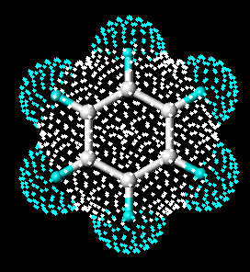

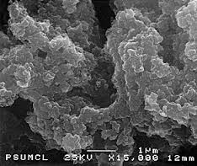
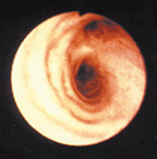
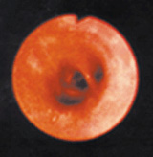
Air Pollutants of Concern in Oregon
Particulate Matter
Toxic Air Pollutants
Benzene
Fine particles enter
deeply into the lungs
Ground Level Ozone (smog)
Healthy Airway
Inflamed Airway
Diesel Particulate
Notes:
- Over the last 30 years, we have successfully controlled many air pollutants in Oregon.
The DEQ’s goal is to achieve healthy air quality for all Oregonians.
- Air quality standards and goals are set to protect sensitive populations such as the elderly and children.
- Through regulations, permitting, and local area planning DEQ, business, and citizens can achieve healthy air.
- Our greatest challenges right now are reducing particulate concentrations to safe levels, and understanding and protecting people from toxic air pollutants such as benzene and diesel particulate, and maintaining compliance with the federal ozone standard.
- Particulate matter can cause respiratory inflammation, heart disease, bronchitis, asthma, emphysema and cancer. Of most concern are the very fine particles that lodge deep in the lungs and can introduce toxins into the bloodstream.
- The sources are wind-blown dust, diesel engine exhaust, wood stoves, forest slash burning, field burning and industry.
- Ground-level ozone or smog can cause irritation of the nose, throat and lungs and can cause increased airway resistance and decreased efficiency of the respiratory system.
- The pollutants contributing to ozone formation come mainly from motor vehicles, consumer and commercial product use, combustion processes, and the evaporation of fuels, paints coatings and solvents.
- Toxic air pollutants, also known as “air toxics” or “hazardous air pollutants,” are air pollutants known or suspected to cause serious health problems.
There are hundreds of toxic air pollutants, and Congress has listed 188 of these pollutants for regulation under the federal Clean Air Act.
Some toxic air pollutants are found in the air as particles while others are gases. They can be released directly from a wide variety of sources, from manufacturing to driving cars to home heating to small business activities.
Benzene and diesel particulate are two examples of common air toxics.

Slide 3
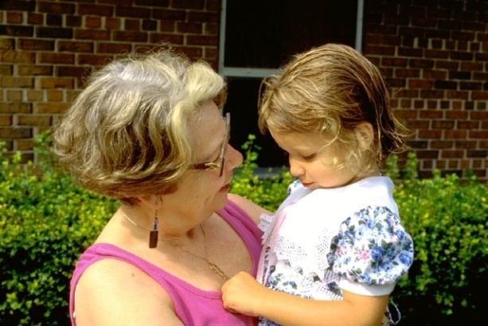
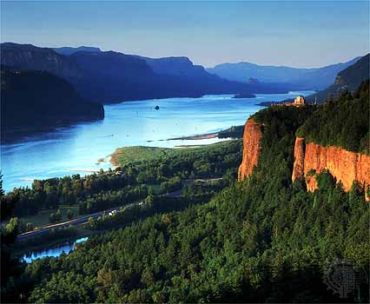
Air Quality
Ensure healthy air to breathe, clear views of scenic vistas and reduced greenhouse gases
Permitting and Inspections
Burning and Woodstoves
Asbestos Abatement
Vehicle Inspection
Clean Diesel
Clean Cars and Fuels

Slide 4
Federal – State Roles
Clean Air Act
Title I
Criteria Pollutants
Title I
Air Toxics
Title I
Source Performance Standards
Title V
Operating Permits
Title II
Motor Vehicles
EPA: Adopt National Ambient Air Quality Standards
EPA: Industrial Air Toxics Standards (NESHAPs)
DEQ: Oregon Air Toxics Benchmarks
EPA: Federal Gasoline and Diesel Engine Standards
EPA: Adopt New Source and Existing Source Performance Standards (NSPS , 111(d))
DEQ: Title V and ACDP Program Approval
DEQ: Monitoring, Attainment Planning,
State Implementation Plan
(SIP)
DEQ: NESHAPS Delegation
DEQ: Opt in to Low Emission Gasoline Vehicles
EPA: SIP Approval
DEQ:Statewide and Community- Based Air Toxics Reduction Actions
DEQ and Communities: SIP Emission Reduction Actions
DEQ: NSPS and 111(d) Delegation
DEQ: Clean Diesel Incentives
DEQ: NESHAPS Compliance through Permitting
DEQ: NSPS and 111(d) Compliance through Permitting
DEQ: Title V and ACDP Permitting

Slide 5
Air Quality by the numbers
Permits 2,600 industrial sources
In 2014:
  Emissions tested approximately 575,000 vehicles
  Responded to more than 2,000 air complaints
  Reviewed more than 600 asbestos removal notifications
  Licensed almost 1,000 asbestos workers, contractors and supervisors
  Issued more than 1,500 tanker truck vapor certifications

Slide 6
Progress Meeting Federal Air Standards
Portland
La Grande
Salem
Prineville
Eugene-Springfield
Oakridge
Burns
Grants Pass
Klamath Falls
Medford-Ashland
Lakeview
Ozone and PM 2.5 attainment & maintenance areas
PM 2.5 non- attainment areas
Violating PM 2.5 but not officially designated non-attainment
PM2.5 Areas of Concern
Notes:
- This map provides an overview of areas in Oregon where DEQ and communities have achieved air quality standards, are currently working to reduce air pollution, or are working to prevent problems based on monitoring and trends.
- Since the 1980s we have been working with communities statewide to restore air quality. When communities don’t meet federal standards, the main concern is air quality, but violating federal standards also result in significant limitations to economic growth.
- The green stars on this map show success stories – communities that have reduced emissions to come back into compliance with federal standards.
- For example, Portland has plans in place that resulted in compliance with carbon monoxide and ozone standards.
Other communities around the state have worked hard and succeeded in reducing particulate pollution, however the geography and weather that contributed to original violation, continue to pose challenges as EPA has tightened standards.
The black triangles represent current particulate non-attainment areas, as seen in the particulate chart.
The gray triangles represent areas that have violated the particulate standard, but have not yet been designated in non-attainment by EPA. We have been working with these communities to lower particulate and avoid the nonattainment designation that carries economic restrictions.
The white triangles show areas of concern for particulate pollution, where there have been recent levels above the standard, but the three year average does not reach the level for a violation. DEQ is also working with these communities to prevent future violations.
Backpocket:
Portland: carbon monoxide, ozone
Salem: carbon monoxide, ozone
Eugene – Springfield: particulate, carbon monoxide
Oakridge: particulate
Grants Pass: particulate, carbon monoxide
Medford-Ashland: particulate, carbon monoxide
Klamath Falls: particulate, carbon monoxide,
Lakeview: particulate
La Grande: particulate

Slide 7
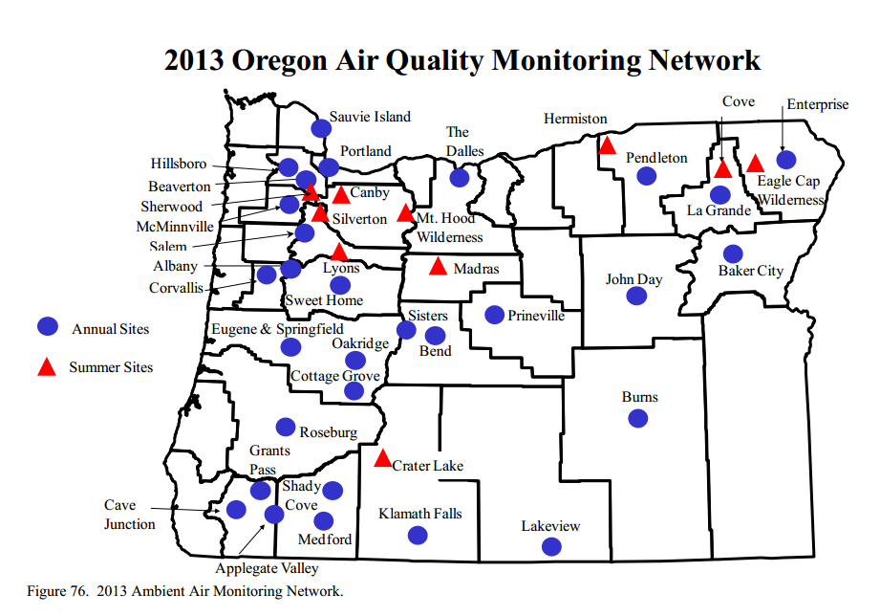
Assessing Air Quality
Notes:
This map shows the distribution of air monitoring locations statewide.
Monitoring lets us know about compliance with federal standards and air toxics clean air goals.
We have about 45 air monitoring sites across the state. In addition, we gather and analyze emissions information and use modeling to assess pollution levels and its impact on communities and neighborhoods.
Some monitors are for single pollutants and others monitor a full spectrum of pollutants.
In this map, the blue dots show annual sites where we monitor primarily for particulates like smoke, soot; and smog (ozone); and 63 air toxics.
The red triangles represent summer sites where we monitor for pollutants that peak in the summer, such as ozone and particulate from forest fires and agricultural burning.
We also use monitoring to inform communities about forest fire impacts, days when wood burning is not advised and pollutant levels that could cause problems for people with respiratory problems.
Backpocket: Mill City monitor, how are monitors paid for, where do we expect to put the next monitor?
DEQ has covered much of the state

Slide 8
More Protective Federal Standards
Particulate Pollution Trends in Portland

Slide 9
Particulate Pollution Statewide
Notes:
This graph shows three year averages of fine particulate monitored in Oregon communities violating or at risk of violating the standard.
In 2011 and 2013 there were particularly bad weather inversions statewide with fewer winter storms and less wind.
During years when we have El Nino or La Nina ocean temperature patterns, there tend to be more storms, more atmospheric ventilation and lower particulate levels.

Slide 10
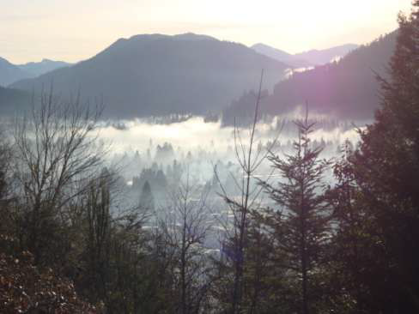
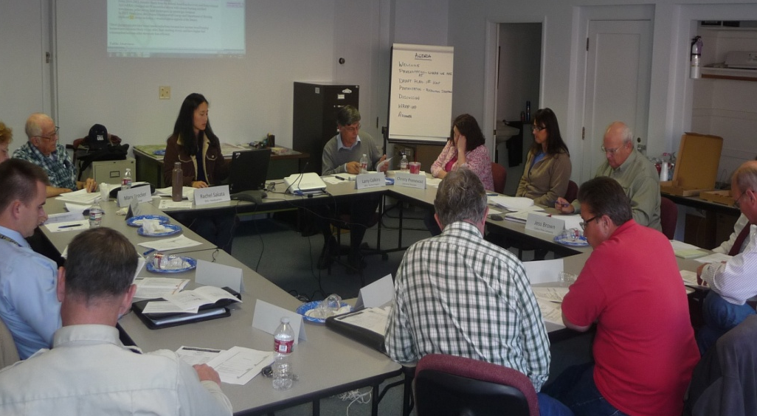
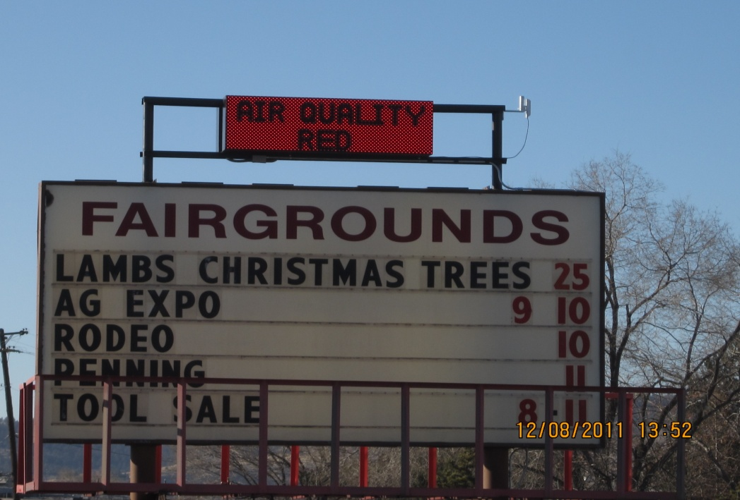
Communities Working to Reduce Particulate Pollution
- Federally required attainment plans
  - Klamath Falls
  - Oakridge
- Particulate prevention plans
  - Lakeview
  - Washington County
  - Prineville
  - Burns
Smoke inversion over Oakridge
Lakeview PM2.5 Advisory Committee
Klamath Falls Community Burn Advisory Sign
Notes:
- DEQ works very closely with local governments and community to figure out what measures work best for each community while ensuring that the air will meeting federal standards.
- Many communities have really taken the initiative to try and address PM2.5 and DEQ wants to acknowledge the hard work they have been putting in for many years.
Klamath Falls
DEQ has worked closely with the community of Klamath Falls to clean up their air and they have been working hard to ensure the area will come into compliance. A local advisory committee was key in developing an attainment plan with strategies to reduce PM2.5 pollution through woodstove reduction measures and education. The county officials, including the health department have been critical in implementing a woodstove curtailment program, education and outreach efforts. The health department conducts daily surveys during poor air quality days to identify people who might be burning, leave informational packets to residents to help educate them on proper burning techniques, and in some instances issue fines or penalties. They also go into the schools to work with the kids to run a school flag program to identify poor air quality days. The community has really come together to address the air quality issue.
Oakridge
LRAPA has been mostly working with the community to clean up the air. They have also been the beneficiary of woodstove changeout funds, roughly $415K. The photo shows a weather inversion keeping smoke very low to the ground where is becomes highly concentrated.
In other areas, we’ve worked closely with the local governments, elected officials, and non-profits to tackle PM2.5 pollution.
Lakeview
Is an area that is violating the standard but not designated nonattainment
The community volunteered to participate in an EPA program to bring PM2.5 levels down – called EPA’s PM Advance Program. A local advisory committee developed a plan and with assistance from DEQ held a number of local meetings to help identify strategies that would work best for the community. This included a mandatory woodstove curtailment program and an open burn ban within the air quality zone.
Woodstove changeouts have also been occurring:
2010-2011 – ARRA funding of about $300K+ for low income full replacement and rebates
2013 – SEP funds of $80K for changeouts
2013-2014 received part of the $270K funding from ODOE to conduct changeouts and weatherizations
2015 – will receive $750K from a regional solutions air quality project
Roughly 145 stoves changed out so far
Prineville
Another area that is violating standard but not designated nonattainment
DEQ is working with a local advisory committee to try and identify and address PM2.5 sources
Focus on educating the community about the problem
Burns
- Area is close to violating the standard
- DEQ has been working with local officials, county judge, senior center to identify ways to lower emissions.
- Received $252K in 2010-2011 (ARRA grant) to conduct changeouts. 70 stoves replaced
Washington County
- Area is close to violating the standard
- DEQ is working with local officials and is part of an air quality task force to address PM2.5.
The primary way communities can reduce particulate pollution is by decreasing smoke from residential burning.
Statewide, the most effective strategy is the wood burning advisory, requiring residents to limit burning during winter inversions and air stagnation.
There are exceptions for low income residents who heat solely with wood.
Another effective long term strategy is to provide assistance for people to change out their old dirty wood burning appliances.
DEQ has organized grants funding changeouts of old dirty stoves to replace them with certified devices, pellet stoves, and ductless heat pumps.
In 2010 and 2011, ARRA funded grants helped replace 695 old woodstoves with cleaner alternatives.
These programs have offered:
full rebates for low income residents that covers the full purchase price of a new heating device and installation costs
partial rebates towards the purchase of a new device
The changeout programs are also coupled with weatherization efforts to improve the quality of the home
-Heat Smart is a statewide law aimed at removing old, high polluting uncertified stoves out from homes. It requires removal of uncertified stove at time of home sale and provides a gradual reduction of smoke as homes change ownership.
Since legislation requiring removal of old woodstoves was adopted in 2010, 761 woodstoves have been removed when homes were sold.
A third strategy to reduce particulate emissions limits on how much PM2.5 a source can emit.
There can be certain requirements on industry in special control areas such as nonattainment or even maintenance areas.
Requiring industry to apply reasonably available control technology
Offsets – DEQ has provided a mechanism for industry to obtain offsets through funding woodstove changeouts. This allows industry to obtain the offsets it needs while addressing one of the main contributors of PM2.5 in the area.
DEQ has partnerships with the USFS/BLM to monitor for smoke impacts from prescribed burning and forest fires.
We work closely with these agencies to ensure smoke from these burning activities does not affect areas of concern (e.g. Klamath Falls, Lakeview, Hillsboro)
We work with the Dept of Ag and some county health departments by monitoring for field burning smoke impacts. – DEQ’s works with local fire districts on open burning complaint response.
DEQ also coordinates field burning activities with ODA and wildfire and prescribed burns with ODF.

Slide 11
Ozone Pollution Statewide
Notes:
This graph shows three year averages of ozone monitored in six Oregon communities with historically higher ozone levels.
We are currently in compliance with the current ozone standard, the blue line at 75 parts per billion.
The green lines show the range that EPA has proposed for a new more protective ozone standard.
This action is in response to scientific research which shows that exposure to lower levels of ozone air pollution is more harmful than previously thought.
EPA is currently taking comments on the proposed range and plans to finalize a standard in _____
- Current ozone strategies in place in Portland and Medford are insurance for maintaining current levels.
- Ozone pollution strategies include:
Clean cars
Vehicle inspection in Portland and Medford
We test more than 550,000 vehicles each year and Vehicle Inspection reduces tons of pollution per year from Oregon’s air.
Limiting emissions of solvents and volatile gases from permitted facilities
Limiting emissions from gasoline handling
WHI IS HERMISTON SO HIGH – PEOPLE WILL ASK.

Slide 12
Oregon’s Air Toxics Program
Federal Air Toxics Standards for Industry
Oregon Benchmarks
Federal Engine and Fuel Standards
Assessment and Solutions
Cleaner Diesel Vehicles and Equipment
Opt in to Low Emission Gasoline Vehicles
Permits
Large Facilities
  Wood Products
  Foundries
  Vehicle Painting
Smaller Facilities
  Dry Cleaners
  Auto Body Shops
  Metal Plating
Statewide:
Clean Diesel Engines
Heat Smart
Gasoline Fueling
Oregon Low Emission Vehicles
Portland Air Toxics Solutions:
Wood Burning
Diesel Engines
Cars and Trucks
Metals Facilities

Slide 13
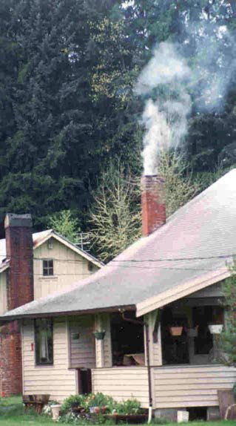
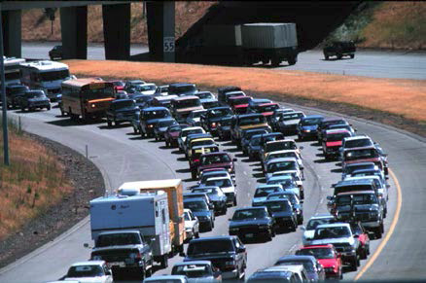
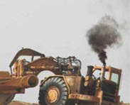
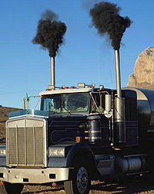
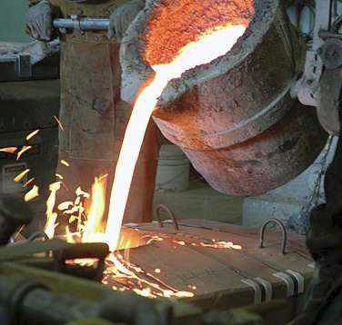
Sources of toxic air pollutants

Slide 14
Air Toxics Monitoring
Community air toxics assessment in North Portland
Air toxics monitoring equipment
Year-long assessments
  Hillsboro
  North Portland
Longer-term monitors
  Portland
  La Grande

Slide 15
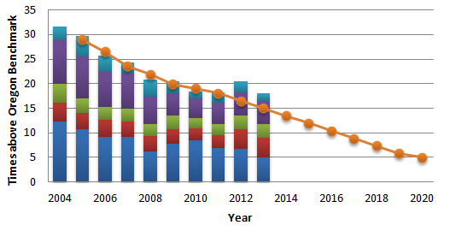

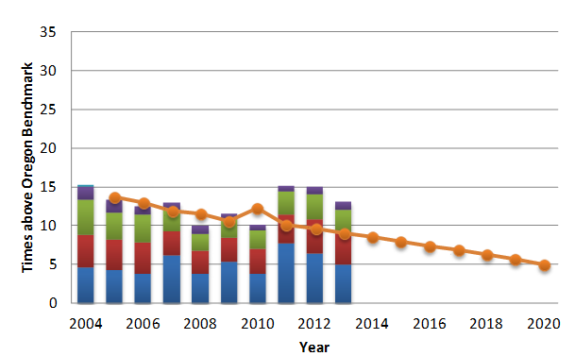
Monitored
Air Toxics Trends
Portland
La Grande

Slide 16
Air Quality Permits
Basic Air Contaminant Discharge Permits (114)
Simplest permits, smallest emitters
Rock Crushers, Asphalt Paving, Auto body Shops, Crematories
General Air Contaminant Discharge Permits (2212)
Simpler permits, small emitters
Gasoline stations, Dry Cleaners, Coffee Roasters, Grain Elevators
Simple Air Contaminant Discharge Permits (146)
Simple permits, small emitters
Data Centers, Metal Foundries, Wastewater Treatment Plants, Printers, Publishers
Standard Air Contaminant Discharge Permits (139)
Complex permits, medium emitters
Particleboard, Plywood, Fuel Terminals, Semiconductor, Bakeries
Title V Permits (110)
Most complex permits, largest emitters
Electricity Generation, Landfills, Fiberglass, Pulp and Paper, Steel Mills

Slide 17
Federal and State Climate Change Work
Federal
Clean Power Plan (111(d))
Federal Mileage Standards
Oregon
Greenhouse Gas Reduction Goals
Clean Fuel Standards
Clean Car Standards
Clean Power Standards
Transportation and Land Use Planning Rules
Notes:
EPA
Change Federal Mileage Stds. to GHG Emission Limits and Fuel Economy Stds. [CAFÉ Stds. are set by USDOT but the two are effectively the same.]
GHG Reduction Rules for HD Trucks and Buses
State
Oregon LEV III GHG Limits for Light Vehicles. [Helped to stimulate adoption of the harmonized federal measures]
Oregon ZEV Program [~13% of new vehicle sales to ZEVs by 2025]
Oregon Clean Fuels Program
West Coast Electric Hwy. (Fed. grants and transportation funds used to install EV chargers.]
ODOT Statewide Transportation Strategy
DLCD’s Scenario Planning Rules [Includes Metro’s Climate Smart Communities Strategy to achieve additional GHG emission cuts from LDVs]

Slide 18
Reduce greenhouse gas emissions
Oregon’s emissions by source type

Slide 19
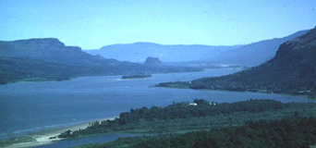
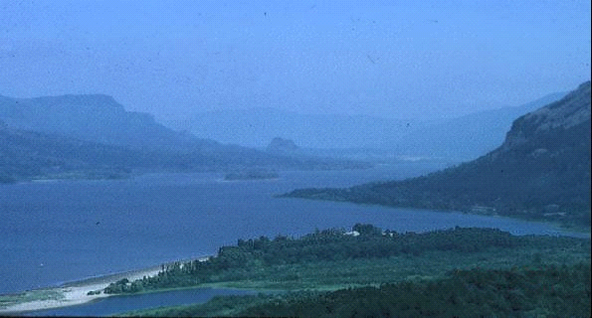
Regional Haze Control
Good visibility day Bad visibility day
Crater Lake National Park
Columbia River Gorge National Scenic Area

Slide 20
Particulate
Air Toxics
Ozone
Greenhouse
Gases
Regional Haze/Visibility
Clean engines
Clean fuels
Smoke controls
Industrial regulations

