Slide 1
Federal – State Roles
Clean Air Act
Title I
Criteria Pollutants
Title I
Air Toxics
Title I
Source Performance Standards
Title V
Operating Permits
Title II
Motor Vehicles
EPA: Adopt National Ambient Air Quality Standards
EPA: Industrial Air Toxics Standards (NESHAPs)
DEQ: Oregon Air Toxics Benchmarks
EPA: Federal Gasoline and Diesel Engine Standards
EPA: Adopt New Source and Existing Source Performance Standards (NSPS , 111(d))
DEQ: Title V and ACDP Program Approval
DEQ: Monitoring, Attainment Planning,
State Implementation Plan
(SIP)
DEQ: NESHAPS Delegation
DEQ: Opt in to Low Emission Gasoline Vehicles
EPA: SIP Approval
DEQ:Statewide and Community- Based Air Toxics Reduction Actions
DEQ and Communities: SIP Emission Reduction Actions
DEQ: NSPS and 111(d) Delegation
DEQ: Clean Diesel Incentives
DEQ: NESHAPS Compliance through Permitting
DEQ: NSPS and 111(d) Compliance through Permitting
DEQ: Title V and ACDP Permitting

Slide 2
Oregon’s Air Toxics Program
Federal Air Toxics Standards for Industry
Oregon Benchmarks
Federal Engine and Fuel Standards
Assessment and Solutions
Cleaner Diesel Vehicles and Equipment
Opt in to Low Emission Gasoline Vehicles
Permits
Large Facilities
Wood Products
Foundries
Vehicle Painting
Smaller Facilities
Dry Cleaners
Auto Body Shops
Metal Plating
Statewide:
Clean Diesel Engines
Heat Smart
Gasoline Fueling
Oregon Low Emission Vehicles
Portland Air Toxics Solutions:
Wood Burning
Diesel Engines
Cars and Trucks
Metals Facilities

Slide 3
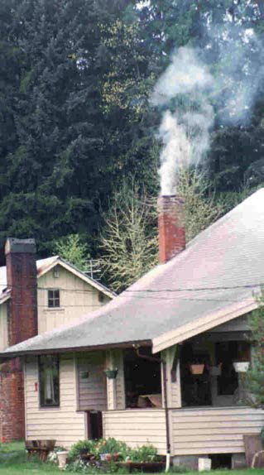
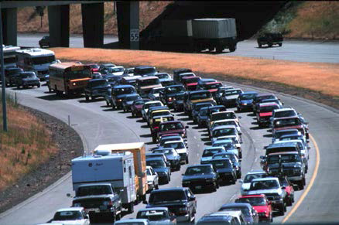
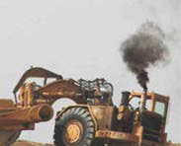
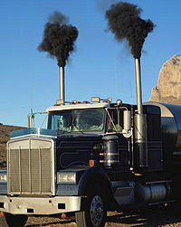
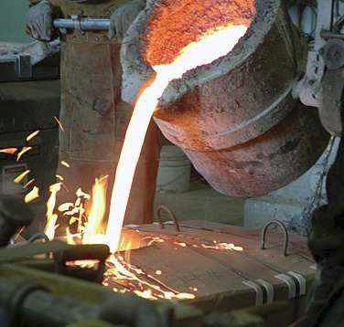
Sources of toxic air pollutants

Slide 4
Air Toxics Monitoring
Community air toxics assessment in North Portland
Air toxics monitoring equipment
Year-long assessments
Hillsboro
North Portland
Longer-term monitors
Portland
La Grande

Slide 5
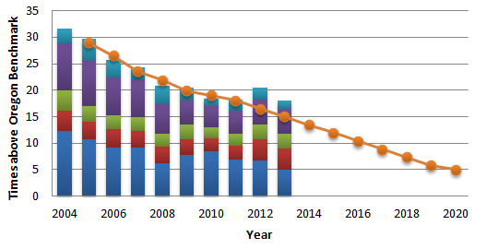

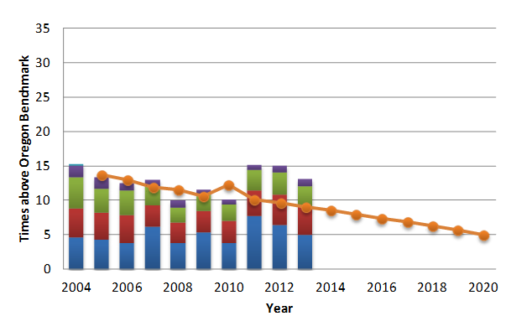
Monitored Air Toxics Trends
Portland
La Grande

Slide 6
Particulate
Air Toxics
Ozone
Greenhouse
Gases
Regional Haze/Visibility
Clean engines
Clean fuels
Smoke controls
Industrial regulations

