Slide 1

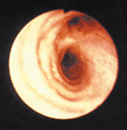
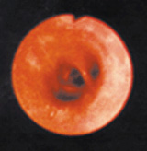
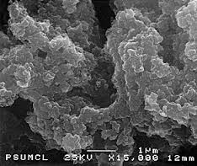
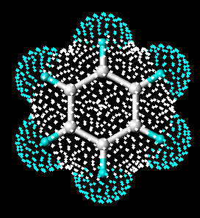
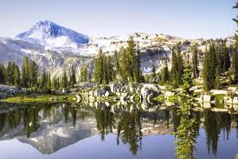
Air Pollutants of Concern in Oregon
Particulate Matter
Ground Level Ozone (smog)
Healthy Airway
Inflamed Airway
Fine particles enter
deeply into the lungs
Pollution Affecting
Climate Change (GHG)/
Ecosystems
Toxic Air Pollutants
Industrial metals
Graphic?
Diesel Particulate
Benzene
Metals
Notes:
2 -3 minute s- You can say a lot form this first slide
In the Air Program, our main challenges and focus for public health protection are: Fine Particulate, Ozone, and Air Toxics.
Our other environmental priorities are Climate Change and helping protect Oregon’s Wilderness Areas and National Park. (Crater Lake) :
This work in Climate Change and Visibility (i.e. Regional Haze) - involves other types of air pollution such as greenhouse gases (CO2, methane); or sulfur and nitrogen particles that can degrade visibility or have other effects in ecosystems at relatively low levels that aren’t a risk for public health.
Many of the sources we deal with, like woodstoves, diesel engines, motor vehicles, emit many different kinds of air pollution, and we'll talk more about multi-pollutant strategies as part of our presentation.
Action Examples;
Ozone: Successfully worked in Portland and Medford to meet and maintain ozone standards. We’re starting work this year in Hermiston area with EPA & WA agencies to look at high ozone levels and interstate transport of ozone. (no violation – but high enough to investigate)
PM: Great successes helping communities like Medford, Klamath Falls, Grants Pass, Lakeview, LaGrande, Eugene come into compliance with health standards
Visibility: Our Regional Haze Plan shows generally improving visibility trends across Oregon (wildfires still impact
Viz & health).
- Example of Emission Reduction Action: Emission controls and closure of Boardman coal-fired power pant is
a regional haze strategy.
Air Toxics: Clean Diesel, Woodstoves, AQ assessment , and ABCs

Slide 2
Air Quality Program
Notes:
(1 minute)
This diagram illustrates what we do in DEQ’s Air Quality Program. The same basic structure also applies to DEQ water and materials management work.
Generally speaking, in air quality, EPA sets national air quality standards and goals.
We monitor and assess,
develop strategies,
Implement the strategies through regulatory activities and permits,
assist people with compliance,
and perform compliance and enforcement.
DEQ is responsible for air quality in all parts of Oregon except for Lane county where Lane Regional Air Protection Agency has jurisdiction. DEQ provides oversight of the Lane County program.
History----- Put at start of Merlyn’s presentation
We’ll hear more about LRAPA from their Director Merlyn Hough in a few minutes.
DEQ’s air quality program has a very broad range of responsibility and activity. Our presentation will hit some highlights of our program, and we will provide more detail about our air toxics program.
[OPTIONAL] The air program is constantly evolving ……….through better understanding of science, health standards, and the impacts of pollution sources; discovering more effective ways to reduce pollution; and (as we’ve seen recently), sometimes identifying gaps and shortfalls in our program that provide opportunities to improve what we do.

Slide 3
Federal – State Roles
Clean Air Act
Oregon Initiatives
Criteria
Pollutants
Air Toxics
Industrial
Source
Permitting
Motor
Vehicles
Air Toxics
Motor
Vehicles
Climate
Change
EPA health-based standards
Ozone, PM, Lead,
CO, SO2, NO2
DEQ: monitors,
works with at risk communities to
meet standards (prevention and nonattainment)
Federal technology-based standards with follow-up risk review
Title V
Operating Permits
(for larger industries)
Federal
Motor Vehicle Emission Stds (Cars & Trucks)
DEQ AQ Health Benchmarks
Clean Cars Program
Clean
Power
Plan
Vehicle Inspection & Maintenance
Geographic assessment – Portland Air Toxics Solutions
Clean
Fuels
(low carbon)
ACDP
(Permits)
(for smaller industries)
Federal
Fuel Stds.
Gasoline & Diesel
(low sulfur)
EPA Industrial Air Toxics
Technology
Standards (NESHAPs)
New Source and Existing Source Performance Standards
NESHAPs
can also cover small businesses
(DEQ implements)
Legislative
Initiatives
(i.e. Cap & Trade Study
Special monitoring studies
(source identification, & health risks)
GHG Emission Reporting
Clean Diesel Program.
(vehicles, engines)
Risk based permitting program overhaul
Key Partnerships: EPA, Health Division, ODOE, PUC, ODF, ODA, ODOT, USFS, and many others.
Notes:
(2-4 Minutes) Can say a lot from this slide and next..
Greatly Simplified…. Overview .. Key Elements of Federal and Oregon Programs
Talk about :
Federal program elements, (Under the Clean Air Act………………….
Fed programs that DEQ implements (delegation) include………………….
Oregon only programs. (Oregon has its own programs that complement or go beyond federal requirements.)
-------------------------------------------------------------------------------------------------
If needed (as time allows) or for questions
NSPS and NESHAPs are “Technology” Standards. They are established by EPA for different types of pollutants and source types. They typically require the installation of control equipment, or process changes, or best practices.
They reduce the rate of pollution generated (like improved miles per gallon standards for cars), but don’t limit the total amount of pollution a source can emit; and they don’t address ambient air quality impacts from a source. They are a great tool for improving AQ not a comprehensive tool.
We’ll get into this very important point more deeply in a few minutes.
NESHAPs: Examples………………..
New Source and Existing Source Performance Standards: (NSPS , 111(d)) Example: GHG emission standards for new Power Plants
NSPS and some NESHAPS are incorporated into industrial permits.
Some NESHAPS affect smaller industries and businesses that don’t have permits, and DEQ uses other ways to do outreach and Technical Assistance to these sources. (Example: Small business assistance program.)

Slide 4
Federal – State Roles
Clean Air Act
Oregon Initiatives
Criteria
Pollutants
Air Toxics
Industrial
Source
Permitting
Motor
Vehicles
Air Toxics
Motor
Vehicles
Climate
Change
EPA health-based standards
Ozone, PM, Lead,
CO, SO2, NO2
DEQ: monitors,
works with at risk communities to
meet standards (prevention and nonattainment)
Federal technology-based standards with follow-up risk review
Title V
Operating Permits
(for larger industries)
Federal
Motor Vehicle Emission Stds (Cars & Trucks)
DEQ AQ Health Benchmarks
Clean Cars Program
Clean
Power
Plan
Vehicle Inspection & Maintenance
Multi-Pollutant Connections and Strategies
Across spectrum of air quality work are opportunities for multi-pollutant reduction.
Woodstove Strategies Reduce: Fine Particulate + Air Toxics
Clean Diesel Reduces: Air Toxics + Fine Particulate + Climate Change pollution
Industrial emission standards & permitting can reduce: Criteria pollutants + air toxics + visibility impairing pollution
Clean vehicles/VIP reduce: ozone + GHG + air toxics
Geographic assessment – Portland Air Toxics Solutions
Clean
Fuels
(low carbon)
ACDP
(Permits)
(for smaller industries)
Federal
Fuel Stds.
Gasoline & Diesel
(low sulfur)
EPA Industrial Air Toxics
Technology
Standards (NESHAPs)
New Source and Existing Source Performance Standards
NESHAPs
can also cover small businesses
(DEQ implements)
Legislative
Initiatives
(i.e. Cap & Trade Study
Special monitoring studies
(source identification, & health risks)
GHG Emission Reporting
Clean Diesel Program.
(vehicles, engines)
Risk based permitting program overhaul
Key Partnerships: EPA, Health Division, ODOE, PUC, ODF, ODA, ODOT, USFS, and many others.
Notes:
(1 minute)
Quickly note examples on slide.
Much of our work has benefits for multiple pollutants, and that’s an important lens we’ll be using in our future work.

Slide 5
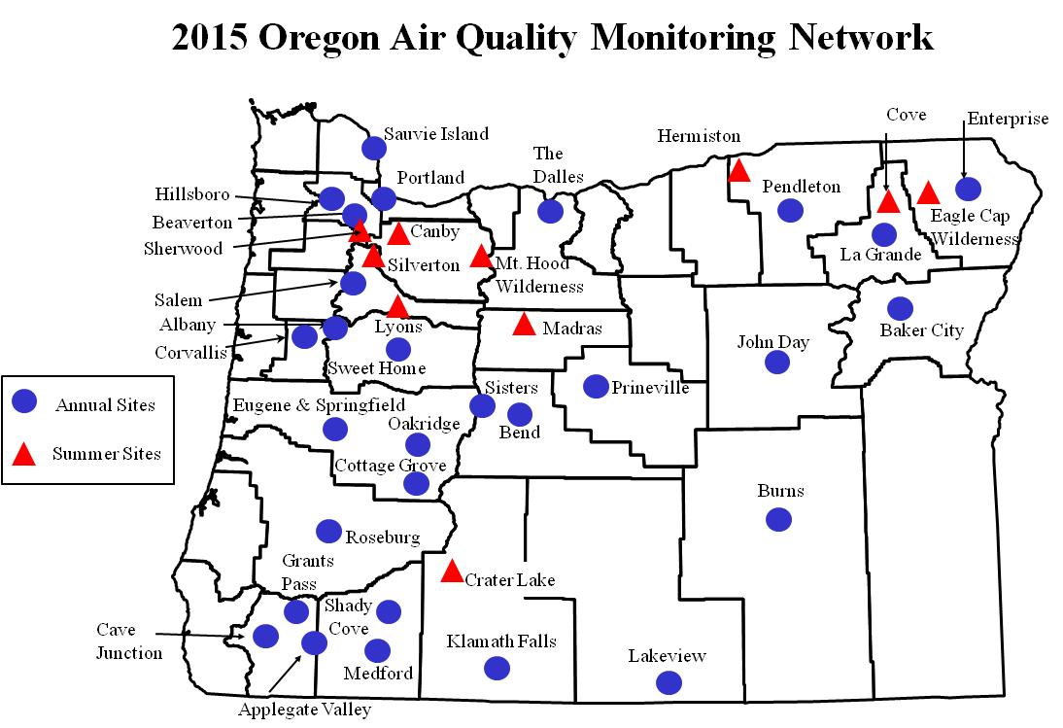
Assessing Air Quality
Notes:
(1 minute)
Returning to Air Quality Assessment
This map shows the distribution of air monitoring locations statewide.
Monitoring lets us know about compliance with federal standards and air toxics clean air goals.
We have about 45 air monitoring sites across the state. In addition, we gather and analyze emissions information and use modeling to assess pollution levels and its impact on communities and neighborhoods.
Some monitors are for single pollutants and others monitor a full spectrum of pollutants.
In this map, the blue dots show annual sites where we monitor primarily for particulates like smoke, soot; and smog (ozone); and 63 air toxics.
The red triangles represent summer sites where we monitor for pollutants that peak in the summer, such as ozone and particulate from forest fires and agricultural burning.
We also use monitoring to inform communities about forest fire impacts, days when wood burning is not advised and pollutant levels that could cause problems for people with respiratory problems.
Backpocket: Mill City monitor, how are monitors paid for, where do we expect to put the next monitor?

Slide 6
Air Toxics Monitoring
Community air toxics assessment in North Portland
Air toxics monitoring equipment
Year-long assessments
Hillsboro
North Portland
Longer-term
monitors
Portland
La Grande
Special Studies
SW Portland, North Portland
Notes:
We’ll talk more about the air toxics program in a few minutes, but broadly speaking, we do 3-Types of air toxics monitoring:
Year-Long assessments: to collect data that we can compare to Oregon's’ air toxics health benchmarks.
Long Term Trend Monitoring: To track long term trends in air toxics (both in an urban and rural setting)
Special Studies to support investigations: For example: the air toxics monitoring we did in SE Portland was part of a special study and partnership with the USFS to investigate air toxics levels and potential impacts on the public. (obviously we need to vet this.. But I think it’s a good first opportunity to briefly acknowledge our really good work and that these types of investigation and partnership are a normal part of what we do.)
• Because there are so many toxic air pollutants and monitoring is resource intensive, we have only four sites statewide. They include:
o Two long-term trend sites funded by EPA – North Portland and La Grande. Portland monitoring gives us trends for an urban area and the LaGrande monitor shows levels typical of a small town.
- The photo on the upper left shows air toxics monitoring equipment at the long-term site in North Portland.
o We also operate two state-funded sites for year-long assessments where modeling shows there are likely higher concentrations of air toxics.
o In the past, we have assessed Medford, Salem and Klamath Falls.
o We are currently doing assessment monitoring in Hillsboro and North Portland close to Swan Island.
• The photo on the right shows the North Portland Swan Island monitoring project, which was funded by the 2014 Legislature for a year-long community monitoring assessment in this location.
• Monitors are shown by the yellow dots and weather monitoring stations are the blue dots. This project will help DEQ and partners understand air toxics in a dense urban
16
area. If the legislature continues funding in 2015-2017, DEQ will move this equipment to assess other communities.
Backpocket notes:
For siting the next monitoring locations we are working on developing and prioritizing a list of locations around the state.
Last time we considered monitors, the Gresham East County area was highest on our list because it is growing and has not been monitored.
Other area: Oregon City/Clackamas.
Sarah, anything else you’d like to say at this point?

Slide 7
Progress Meeting Federal Air Standards
Portland
La Grande
Salem
Prineville
Eugene-Springfield
Oakridge
Burns
Grants Pass
Klamath Falls
Medford-Ashland
Lakeview
Ozone and PM10 attainment & maintenance areas
PM 2.5 non- attainment areas
Violating PM 2.5 but not officially designated non-attainment
PM2.5 Areas of Concern
Notes:
(2 minutes)
When you mention Eugene/Oakridge: note they’ll be hearing from Merlyn next about Lane County and the operation of a local Air District.
Map - overview of areas where DEQ and communities work to meet and maintain compliance with federal health standards:
Green stars show success stories – communities reduced emissions, came back into compliance. (Now we work to maintain compliance)
Back triangles show current PM non-attainment areas.
Gray triangles show areas that violated the PM standard, but not yet designated non-attainment by EPA. DEQ working with these communities and EPA to lower PM and avoid nonattainment.
White triangles are areas of concern for PM2.5. Recent levels above standard, but no violation yet (Burns, Hillsboro). DEQ working with these communities to prevent future violations.
Note: PM10 is old particulate standard for 1980;s In 2000’s EPA added PM2.5.. (Smaller size particle, lower health threshold. More risk to health)

Slide 8
Merlyn’s Presentation

Slide 9
Multipollutant Opportunities
Particulate
Air Toxics
Ozone
Greenhouse
Gases
Regional Haze/Visibility
Clean engines
Clean fuels
Smoke controls
Industrial regulations
Notes:
Before we move into more detail about our air toxics program; both DEQ and LRAPA are excited that much of our work has benefits for multiple pollutants, and that’s an important lens we’ll be using in our future work.
Traditionally we addressed one pollutant at a time, but now we think more in terms of multi pollutant benefits.
On the left side of this chart are some of our key source control efforts, and across the top are the key pollutants we need to reduce.
Because sources of air pollution emit multiple pollutants, our source control efforts are effective for multiple pollutants
For example: cleaner engines and cleaner fuels reduce particulate, air toxics, ozone, greenhouse gases, and pollutants affecting visibility
Woodsmoke reduction efforts control particulates, air toxics and pollutants affecting visibility.
Looking at our emission reduction effectors through a multi-pollutant lens when appropriate can really help us understand and explain to the public and community leaders the full public health benefit and value of our work.

Slide 11
Oregon’s Air Toxics Program
Federal Air Toxics Standards for Industry
Oregon Benchmarks
Federal Engine and Fuel Standards
Assessment and Solutions
Cleaner Diesel Vehicles and Equipment
Opt in to Low Emission Gasoline Vehicles
Permits
Large Facilities
Wood Products
Foundries
Vehicle Painting
Smaller Facilities
Dry Cleaners
Auto Body Shops
Metal Plating
Statewide:
Clean Diesel Engines
Heat Smart
Gasoline Fueling
Oregon Low Emission Vehicles
Portland Air Toxics Solutions:
Wood Burning
Diesel Engines
Cars and Trucks
Metals Facilities
Notes:
When air toxics monitoring shows a problem, we have three program areas that provide solutions.
• This chart shows the elements of Oregon’s air toxics program.
o In purple, we implement federal standards for industry through permits.
o In green we use our air toxics benchmarks to assess problems and provide solutions statewide and in impacted communities.
o In blue, we have progressively cleaner engines as EPA sets standards for new gasoline and diesel powered vehicles.
• Examples of our current actions to reduce air toxics are in gray boxes below.
• Implementing federal standards for industry has resulted in significant reductions of air toxics statewide for our largest facilities under Title V permits, and a spectrum of medium and smaller facilities under state permits.
o Some examples of facilities where federal standards have required air toxics reductions are the larger wood products manufacturers, foundries and vehicle painting businesses.
o In the past 5 years EPA air toxics standards have also applied to many medium and smaller facilities, requiring air toxics controls at dry cleaners, auto body shops and metal plating facilities.
o DEQ partners with industry associations to provide technical assistance to hundreds of the smaller facilities each year.
• To supplement industrial and engine standards, DEQ uses a geographic approach to assess and solve problems in communities.
o Portland Air Toxics Solutions is our first project working with a community to identify and make plans to reduce air toxics from sources causing the most risk. These include plans for wood burning, diesel engines, gasoline cars and trucks and metals facilities.
19
• We also consider actions to reduce air toxics emissions from sources statewide.
o Examples of these actions are DEQ’s Clean Diesel Program, providing incentives for cleaner engines, Heat Smart, which David described earlier, and our gasoline fueling regulations to capture benzene vapors.
• Under federal clean engine laws, both gasoline and diesel cars and trucks have gotten much cleaner – causing less ozone, particulate, green house gas and toxic air pollution.
o Oregon accelerated this process by opting in to California low emission vehicle standards.
Backpocket:
Industrial permitting –
Title V program is an operating permit for 111 major sources of air emissions.
Air Contaminant Discharge Permit (ACDP) program, which is the operating permit for about 2,600 medium and smaller sources.
Clean Cars
Beginning with the 2009 model years, new vehicles sold in Oregon meet Oregon’s Low Emission Vehicle standards. Reduces greenhouse gas emissions, smog forming emissions and toxic air pollution.
Clean diesel
Diesel is one of the most potent air toxics to which Oregonians are exposed.
Grant program that provides federal funds for the installation of particulate filters on existing vehicles. Since 2008, DEQ has awarded approximately $4,250,000 in grant funding.
We have upgraded 113 school buses, 73 municipal vehicles and 158 other vehicles such as garbage trucks, buses and barges.

Slide 12
What is the Risk Gap in Oregon air regs?
Lack of comprehensive risk-based protocols and screening concentrations in Oregon air permitting program – DEQ only implements federal regulations (NESHAPS).
Federal regulations may impose emission limits, work practices or control requirements that generically control risk but are not specific to each facility.
DEQ’s geographic approach is not designed to assess and control point source risk for people living nearby, instead it covers whole airsheds.
Notes:
Right now, air emissions are technologically controlled through emission limits defined in permits, described using a rate: tons emitted per year.

Slide 13
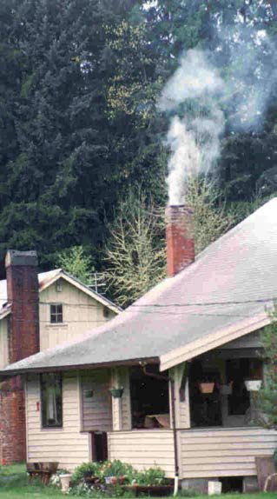
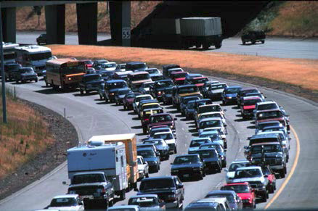
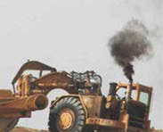
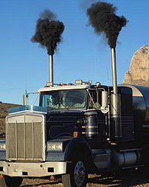
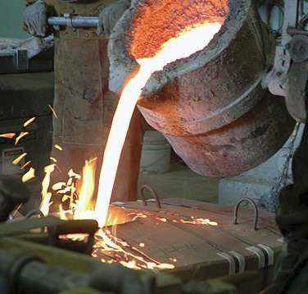
Sources of toxic air pollutants
Notes:
As you are aware, air toxics come from many sources, many of which also produce criteria pollutants such as particulate or chemical precursors to ozone. Generally, people are exposed to the most risk from area sources such as wood burning and mobile sources such as gasoline and diesel engines. For those living close to industrial facilities, these emissions can also add unwanted increases in health risk, as we have recently discovered near art glass facilities.

Slide 14
Monitored Air Toxics Trends
Portland
La Grande
Notes:
These charts provide an overview of air toxics monitoring data for five pollutants at our longer term monitors in Portland and LaGrande.
• The vertical axis is times above air toxics benchmarks or clean air goals.
• The five pollutants are stacked in bars for each year to show air toxics trends.
• The orange line and dots show our targets for air toxics reduction.
• In general, levels of air toxics are decreasing.
• You can see that levels of these five pollutants are about twice as high in Portland as they are in LaGrande.
• The resurgence in the economy and more vehicle and truck traffic likely shows in the increased levels in the last couple of years.
Meteorology has a large influence on pollutant concentrations – stagnant patterns vs unsettled windy weather.

Slide 15
Particulate
Air Toxics
Ozone
Greenhouse
Gases
Regional Haze/Visibility
Clean engines
Clean fuels
Smoke controls
Industrial regulations
Notes:
We would like to conclude with some good news that much of our work has benefits for multiple pollutants.
• Traditionally we addressed one pollutant at a time, but now we think more in terms of multi pollutant benefits.
• On the left side of this chart are some of our key source control efforts, and across the top are the key pollutants we need to reduce.
• Because sources of air pollution emit multiple pollutants, our source control efforts are effective for multiple pollutants
o For example: cleaner engines and cleaner fuels reduce particulate, air toxics, ozone, greenhouse gases, and pollutants affecting visibility
o Woodsmoke reduction efforts control particulates, air toxics and pollutants affecting visibility.
o Industrial controls in place statewide have benefits for all categories of pollutants as well.
• This concludes our information, thank you for your time, and we would be happy to answer any questions.

Slide 16
Back Pocket Slides

Slide 17
Particulate Pollution Statewide
Notes:
This graph shows three year averages of fine particulate monitored in Oregon communities violating or at risk of violating the standard.
In 2011 and 2013 there were particularly bad weather inversions statewide with fewer winter storms and less wind.
During years when we have El Nino or La Nina ocean temperature patterns, there tend to be more storms, more atmospheric ventilation and lower particulate levels.

Slide 18
Ozone Pollution Statewide
Notes:
This graph shows three year averages of ozone monitored in six Oregon communities with historically higher ozone levels.
We are currently in compliance with the current ozone standard, the blue line at 75 parts per billion.
The green lines show the range that EPA has proposed for a new more protective ozone standard.
This action is in response to scientific research which shows that exposure to lower levels of ozone air pollution is more harmful than previously thought.
EPA is currently taking comments on the proposed range and plans to finalize a standard in _____
- Current ozone strategies in place in Portland and Medford are insurance for maintaining current levels.
- Ozone pollution strategies include:
Clean cars
Vehicle inspection in Portland and Medford
We test more than 550,000 vehicles each year and Vehicle Inspection reduces tons of pollution per year from Oregon’s air.
Limiting emissions of solvents and volatile gases from permitted facilities
Limiting emissions from gasoline handling
WHI IS HERMISTON SO HIGH – PEOPLE WILL ASK.

Slide 19
Oregon’s Air Toxics Program
Federal Air Toxics Standards for Industry
Oregon Benchmarks
Federal Engine and Fuel Standards
Assessment and Solutions
Cleaner Diesel Vehicles and Equipment
Opt in to Low Emission Gasoline Vehicles
Permits
Large Facilities
Wood Products
Foundries
Vehicle Painting
Smaller Facilities
Dry Cleaners
Auto Body Shops
Metal Plating
Statewide:
Clean Diesel Engines
Heat Smart
Gasoline Fueling
Oregon Low Emission Vehicles
Portland Air Toxics Solutions:
Wood Burning
Diesel Engines
Cars and Trucks
Metals Facilities
Notes:
This chart shows the three areas of Oregon’s air toxics program.
We implement federal standards for industry through permits, use our benchmarks to assess air toxics problems and solutions statewide, and have progressively cleaner engines as EPA sets standards for new gasoline and diesel powered vehicles.
The resulting current actions from each of these areas are in gray boxes below.
Implementation of federal standards for operation of industrial facilities has resulted in significant reductions of air toxics statewide for our largest facilities under Title V permits, and a spectrum of medium and smaller facilities.
Some examples of facilities where federal standards have required air toxics reductions are the larger wood products manufacturers, foundries and vehicle painting businesses.
In the past 5 years EPA air toxics standards have also applied to many smaller facilities, requiring air toxics controls at dry cleaners, autobody shops and metal plating facilities.
DEQ partners with industry associations to provide technical assistance to hundreds of the smaller facilities each year.
In DEQ’s risk based air toxics program we consider air toxics beyond permit requirements, using primarily a geographic approach to assess and solve problems in communities.
DEQ is currently working with an expert Science Advisory Committee on a 5 year update of the air toxics benchmarks to reflect current medical knowledge.
More populated and developed areas have greater risk from air toxics. You may have heard about a recent effort in the Portland area to understand and reduce air toxics risks.
In the Portland Air Toxics Solutions project we worked with community stakeholders to identify and make recommendations to reduce air toxics from categories of sources causing the most risk. These include wood burning, diesel engines, gasoline cars and trucks and metals facilities.
We also consider actions to reduce air toxics emissions from sources statewide.
Examples of these actions are DEQ’s Clean Diesel Program, providing incentives for cleaner engines, Heat Smart, which David described earlier, an our gasoline fueling regulations to capture benzene vapors.
Under federal laws for clean engines, both gasoline and diesel cars and trucks have gotten much cleaner – causing less ozone, particulate, green house gas and toxic air pollution.
Oregon accelerated this process by opting in to California low emission vehicle standards.
Backpocket:
Industrial permitting –
Title V program is an operating permit for 111 major sources of air emissions.
Air Contaminant Discharge Permit (ACDP) program, which is the operating permit for about 2,600 medium and smaller sources.
Clean Cars
Beginning with the 2009 model years, new vehicles sold in Oregon meet Oregon’s Low Emission Vehicle standards. Reduces greenhouse gas emissions, smog forming emissions and toxic air pollution.
Clean diesel
Diesel is one of the most potent air toxics to which Oregonians are exposed.
Grant program that provides federal funds for the installation of particulate filters on existing vehicles.
Since 2008, DEQ has awarded approximately $4,250,000 in grant funding.
We have upgraded 113 school buses, 73 municipal vehicles and 158 other vehicles such as garbage trucks, buses and barges.

Slide 20
Federal – State Roles
Clean Air Act
Title I
Criteria Pollutants
Title I
Air Toxics
Title I
Source Performance Standards
Title V
Operating Permits
Title II
Motor Vehicles
EPA: Adopt National Ambient Air Quality Standards
EPA: Industrial Air Toxics Standards (NESHAPs)
DEQ: Oregon Air Toxics Benchmarks
EPA: Federal Gasoline and Diesel Engine Standards
EPA: Adopt New Source and Existing Source Performance Standards (NSPS , 111(d))
DEQ: Title V and ACDP Program Approval
DEQ: Monitoring, Attainment Planning,
State Implementation Plan
(SIP)
DEQ: NESHAPS Delegation
DEQ: Opt in to Low Emission Gasoline Vehicles
EPA: SIP Approval
DEQ:Statewide and Community- Based Air Toxics Reduction Actions
DEQ and Communities: SIP Emission Reduction Actions
DEQ: NSPS and 111(d) Delegation
DEQ: Clean Diesel Incentives
DEQ: NESHAPS Compliance through Permitting
DEQ: NSPS and 111(d) Compliance through Permitting
DEQ: Title V and ACDP Permitting

