Slide 1
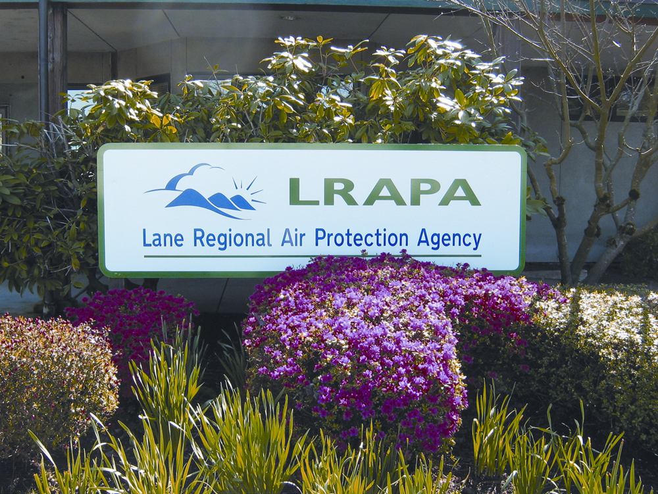
Notes:
Good morning, Chair O’Keefe and Commissioners. I’m Merlyn Hough, Director of the Lane Regional Air Protection Agency based in Springfield-Eugene, Oregon.

Slide 2
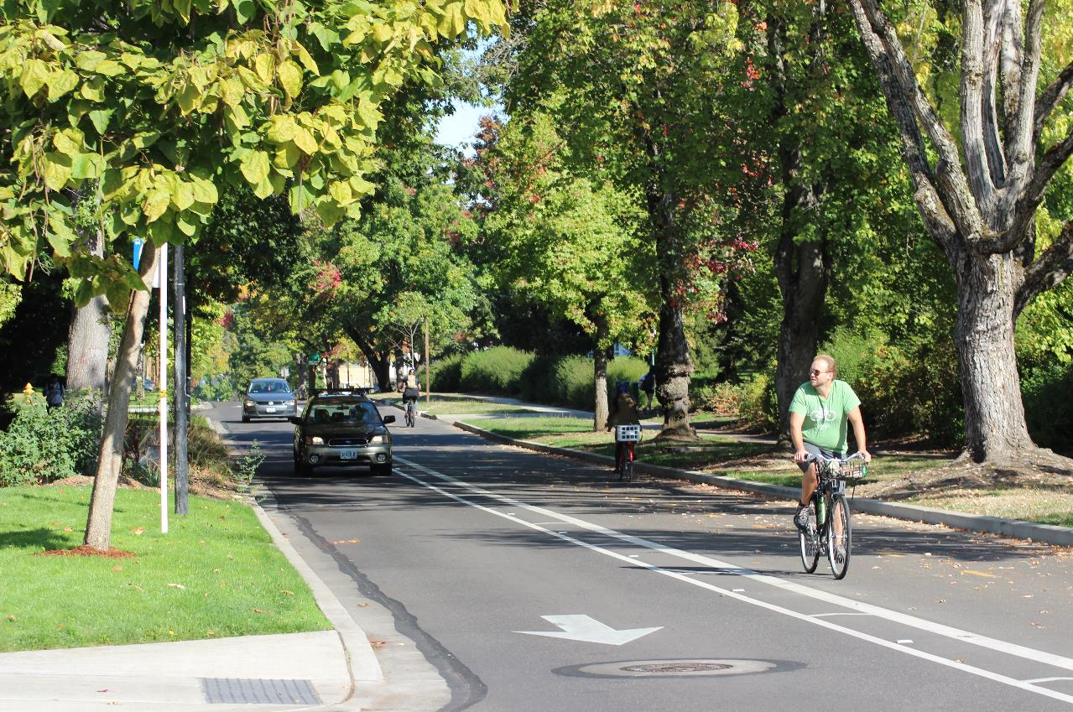
Vision
Community partners working together to ensure clean air for everyone.
Mission
To protect public health, quality of life, and the environment as a leader and advocate for the continuous improvement for air quality in Lane County.
Notes:
LRAPA is a local air quality agency but our Vision and Mission are very similar to those of DEQ’s air quality program.
Regional air quality control authorities are allowed under state statutes (now ORS 468A.100-180) since 1967 for areas of at least 130,000 population and at least two contiguous local governments with an intergovernmental agreement.
When authorized to do so by the EQC, regional authorities are empowered to do essentially the same air quality functions as DEQ.

Slide 3
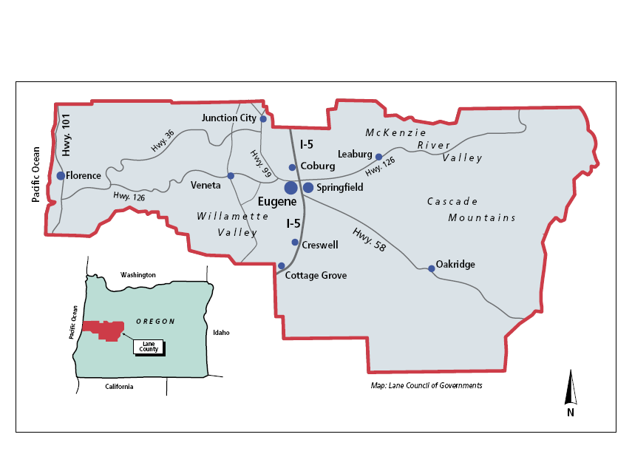

Slide 4

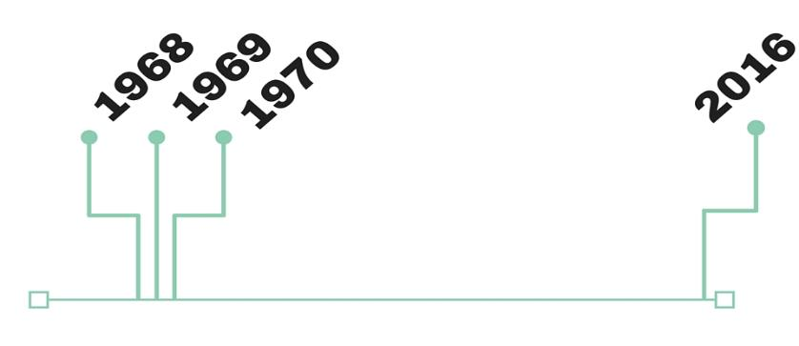
Air Pollution Control
Act of 1955 adopted
LRAPA only local air
agency in Oregon
ODEQ founded
LRAPA founded
US EPA founded
and Clean Air Act adopted
Notes:
Lane county is the size of the state of Connecticut, stretching from the Oregon Cascades to the Pacific Coast, with several distinct airsheds within it..
The airsheds of Lane County include a mix of nonattainment/maintenance/attainment areas.
LRAPA is the regulatory agency for air quality in Lane County.
We are the only local agency in Oregon. In 1968, three regional air authorities were established that covered the entire Willamette Valley: CWAPA, MWVAPA, and LRAPA.
The Clean Air Act was amended in 1977 and 1990 with new provisions and increased air quality responsibilities. CWAPA and MWVAPA were dissolved by the late 1970s, leaving only LRAPA.

Slide 5
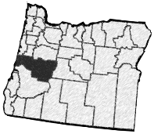
AIR QUALITY
INVOLVEMENT
SERVICE
PARTNERSHIPS
Notes:
Four goals of LRAPA
Air quality – ensure healthful air quality for all Lane County citizens.
Involvement - Inform and involve citizens and businesses in improving air quality.
Service – serve citizens and other stakeholders fairly, courteously, and in a timely manner.
Partnerships - Work with our partners to leverage resources to make a difference in local air quality.
Don’t go into this detail on progress:
Air Quality: We have been remarkably successful in achieving and maintaining compliance with air quality health standards for particulate matter, ozone and carbon monoxide in Eugene for over 20 years, despite the tightening of national standards in 1988, 1997, 2006, and 2008.
Involvement: LRAPA provides local control and decision-making, instead of in Salem or Portland, and frequent meetings/inspections of permitted facilities and asbestos abatement projects.
Service: Annual surveys conducted by the LRAPA Advisory Committee consistently report exceptional staff service on permit modifications, permit renewals, new permit applications, and construction permit reviews. Industry representatives appreciate the focus at LRAPA to minimize air pollution by working with industrial sources to maximize compliance with the prescribed standards.
Partnerships: Independent of business permitting programs (which pay their own way), LRAPA has been successful in leveraging other funds. LRAPA has been able to provide multiple dollars of services for every dollar of local dues, as well as multiple dollars of pass-through funding assistance to businesses, schools and residents for clean air projects.

Slide 6
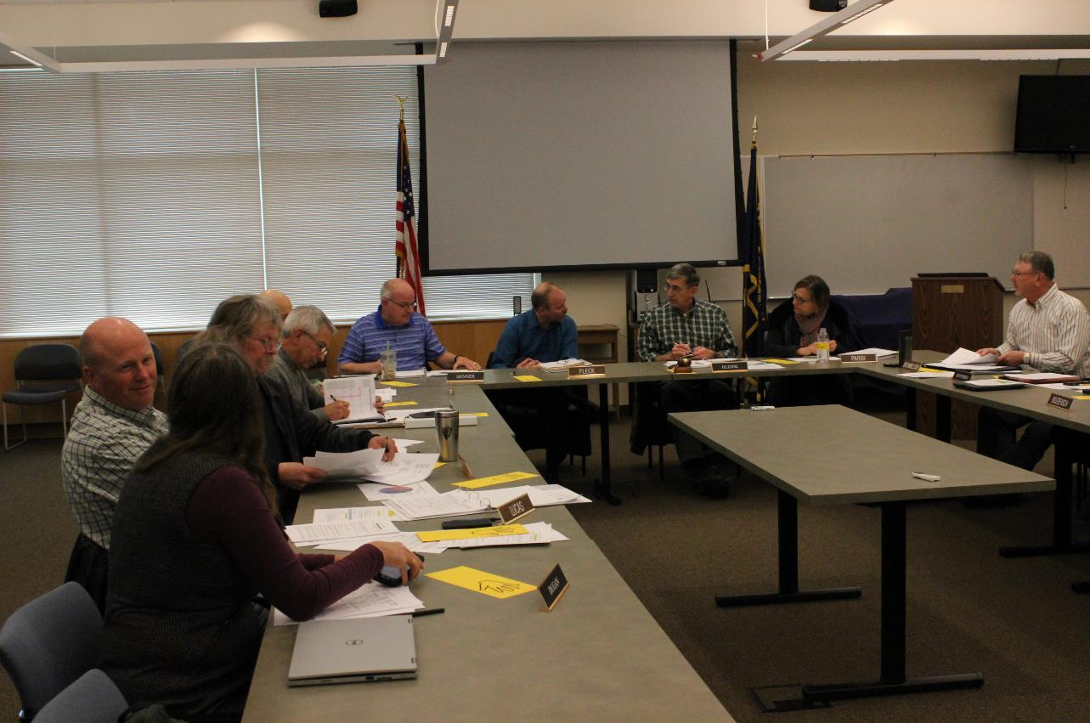
Local Agency = Local Control
Board of directors and advisory committee comprised of local elected officials and citizen appointees
Programs target local air quality problems
Decisions made here, not in Salem or Portland
Local rules must be at least as stringent as state and federal requirements
Notes:
Local control is viewed as a key reason for a local air agency. But…
LRAPA must be at least as stringent as DEQ and EPA, so don’t forget we need 10-15% of resources for new programs!
(based on population and number of permitted facilities)

Slide 7
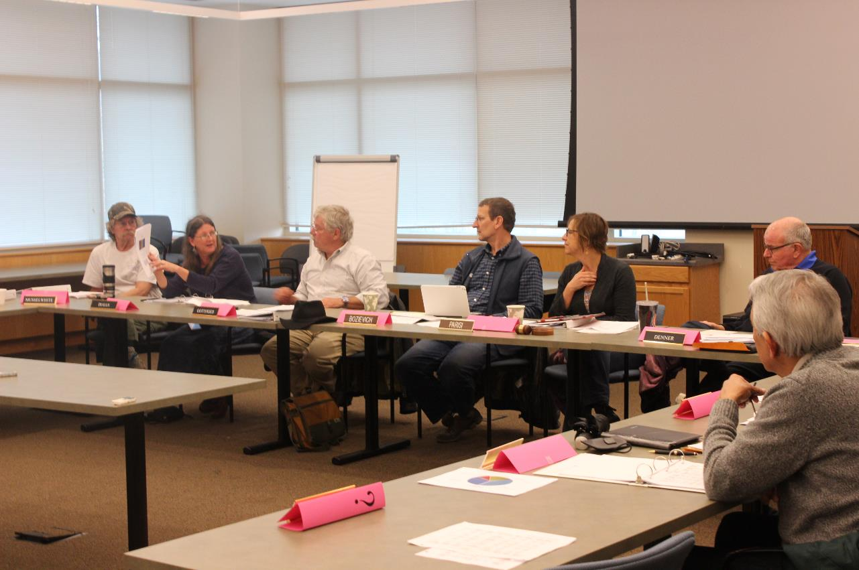
Lane Regional Air Protection Agency (LRAPA) Board of Directors
Jurisdiction Representative Category Appointing Authority
Eugene Betty Taylor Eugene City Councilor Appointed by Mayor
Eugene Joe Gonzales Eugene appointee Appointed by Mayor
Eugene Jeannine Parisi* Eugene appointee Appointed by Mayor
Eugene Scott Lucas Eugene appointee Appointed by Mayor
Springfield Dave Ralston Springfield City Councilor Appointed by Mayor
Springfield Bill Carpenter Springfield appointee Appointed by Mayor
Lane County Jay Bozievich** Lane County Commissioner Appointed by Chair of BCC
Cottage Grove Mike Fleck Cottage Grove City Councilor Appointed by Mayor
Oakridge Jim Coey Oakridge Mayor Appointed by Mayor
* 2016 Chair
** 2016 Vice-Chair

Slide 8

Our Functions
Monitoring
Permitting
Enforcement
Education and Outreach
The Congress, the Administration and the public all share a profound commitment to the rescue of our natural environment,
and the preservation of the Earth as a place both habitable by and hospitable to man.
—President Richard Nixon (1913-1994), "Reorganization Plan No. 3," message to Congress about establishing EPA, July 1970
Notes:
Our air quality functions are very similar to those of DEQ.
A few differences: no vehicle inspection and maintenance program, and no geographic approach (like PATS and PATSAC) yet for air toxics, and no direct involvement in the Clean Power Plan development.

Slide 9
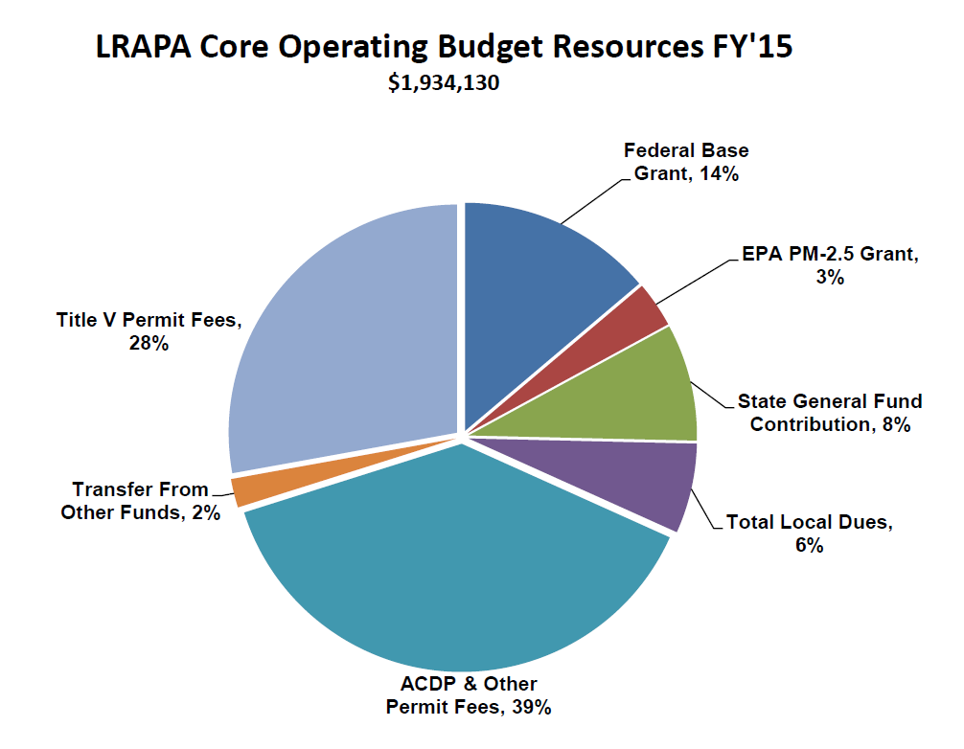

Slide 10
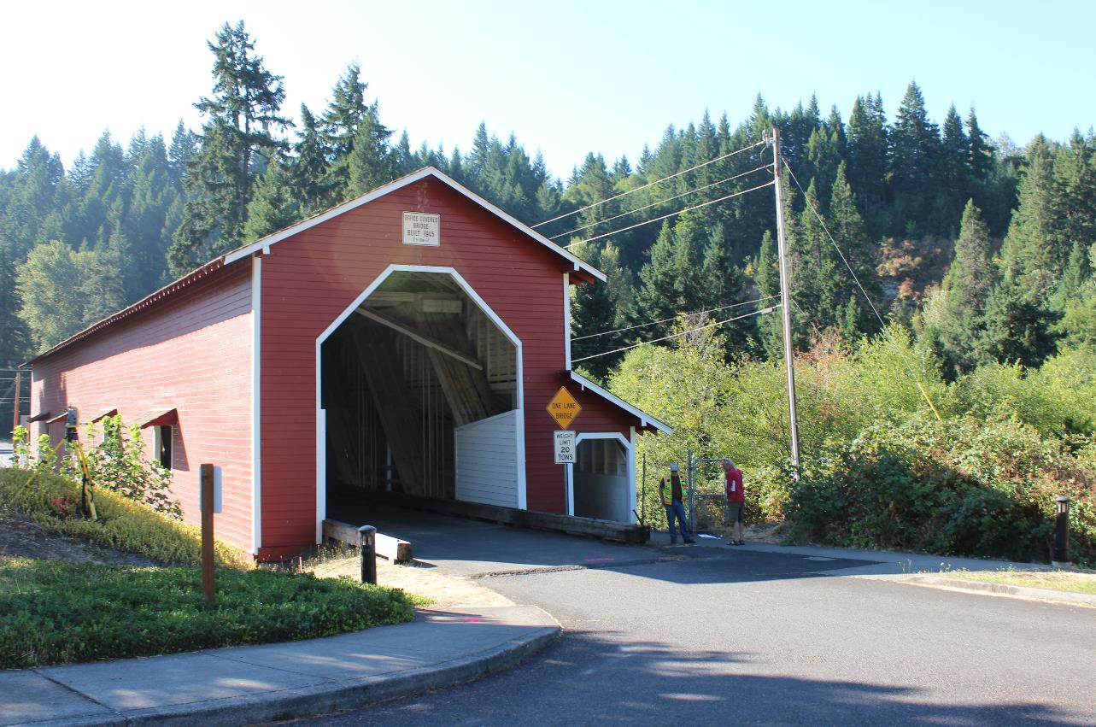
Status of Federal Air Quality Health Standards in Lane County
Lane County currently meets federal air quality standards in most areas
Oakridge violates the standard for respirable Particulate Matter: PM 2.5
Eugene/Springfield are maintenance areas for PM10 and Carbon Monoxide
Notes:
Similar to DEQ, we have made good progress over the years.
Most areas of Lane County meet the national air quality health standards.
The exception is Oakridge for PM2.5 – but the levels measured there over the last three years are the lowest ever recorded in Oakridge.
LRAPA and DEQ requested an extension from EPA to the end of 2016. We are confident we will meet the 3-year standard by then.
Former Eugene-Springfield problems with PM10 and Carbon Monoxide are well under control.

Slide 11
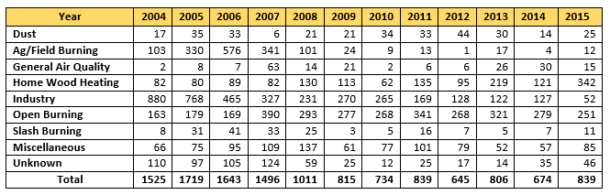
Air Pollution Complaints in Lane County:
Notes:
LRAPA receives several hundred complaints each year.
Most categories are decreasing or low and steady, but the exceptions are Home Wood Heating and Outdoor Open Burning.

Slide 12
LRAPA-DEQ Example of Differences: Coffee Roasters
Permit Type | LRAPA Number | Facility Name | Location | Activity | Category | Description
Basic | 206122 | Caffe Pacori | Eugene | Coffee Roaster | A10* | Roasting < 30 tons per year)
Basic | 201312 | Coffee Plant Roaster | Eugene | Coffee Roaster | A10* | Roasting < 30 tons per year)
Basic | 203153 | Global Delights | Eugene | Coffee Roaster | A10* | Roasting < 30 tons per year)
Basic | 207526 | Siuslaw River Coffee Roaster (By the Bridge) | Florence | Coffee Roaster | A10* | Roasting < 30 tons per year)
Basic | 208300 | Tailored Coffee Roasters LLC | Eugene | Coffee Roaster | A10* | Roasting < 30 tons per year)
Basic | 208669 | Voyage Coffee Roasters | Eugene | Coffee Roaster | A10* | Roasting < 30 tons per year)
General 1 | 201270 | Cafeto Custom Roasting | Eugene | Coffee Roaster | B21 | Roasting 30+ tons per year)
General 1 | 201283 | Cascade Estate Coffees | Eugene | Coffee Roaster | B21 | Roasting 30+ tons per year)
General 1 | 202541 | Equator Coffee | Eugene | Coffee Roaster | B21 | Roasting 30+ tons per year)
General 1 | 200573 | Full City Coffee Roasters (Beans & Leaves) | Eugene | Coffee Roaster | B21 | Roasting 30+ tons per year)
General 1 | 208939 | Wandering Goat Coffee | Eugene | Coffee Roaster | B21 | Roasting 30+ tons per year)
 |  |  | Note: | * Below statewide permitting threshold.
Notes:
LRAPA has historically received a lot of odor complaints due to coffee roasters, so LRAPA regulates smaller coffee roasters than does DEQ.

Slide 13
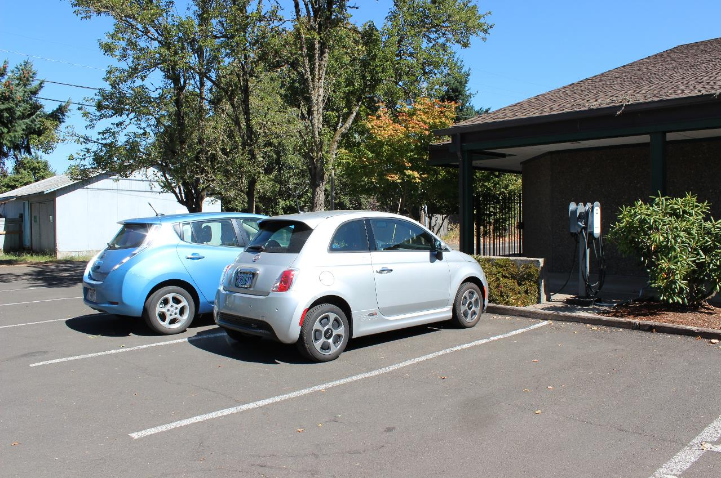
DEQ-LRAPA Partnership Example: Benzene
Benzene is recognized by Oregon (DEQ and LRAPA) and U.S. EPA as one of the highest air toxics priorities.
In 2007, DEQ and LRAPA joined forces with other state and local agencies in the Pacific Northwest and the U.S. Senators from Oregon-Washington to convince EPA to further reduce benzene in gasoline.

Slide 14
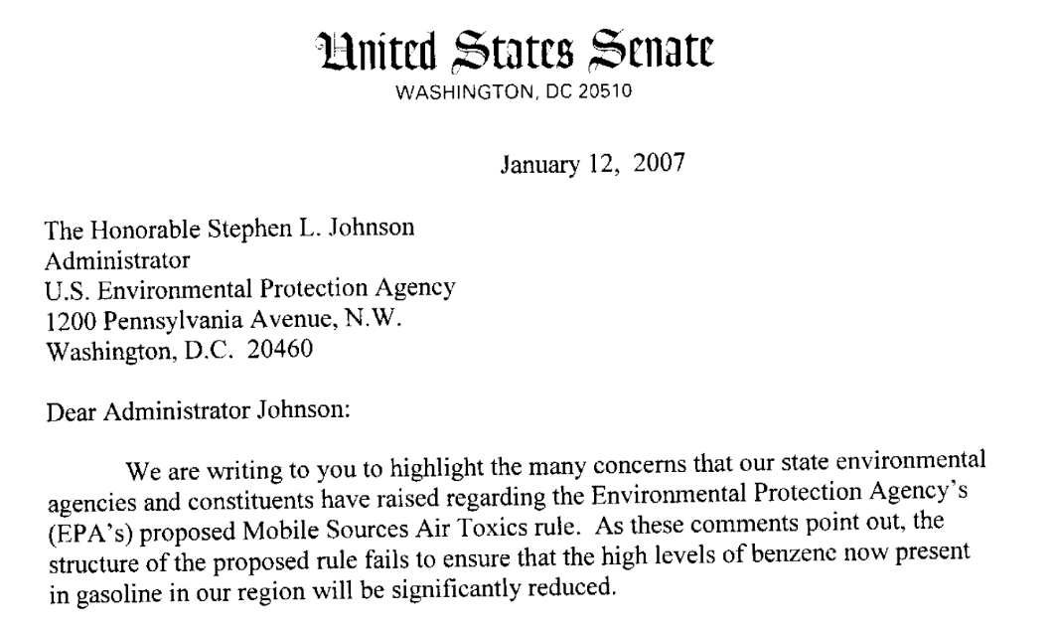
Notes:
This slide reminds me to tell the benzene story.

Slide 15
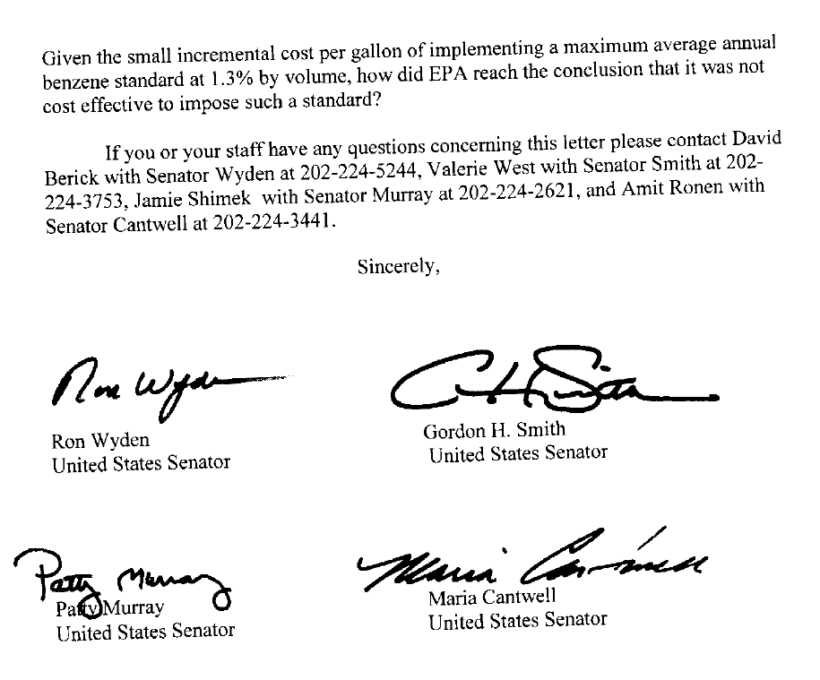
Notes:
This slide emphasizes that all four of the OR-WA Senators were on board.

Slide 16
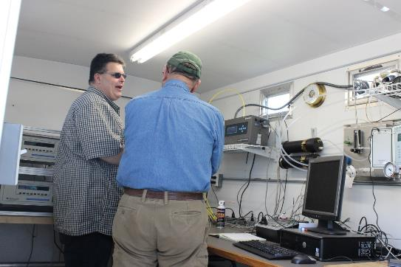
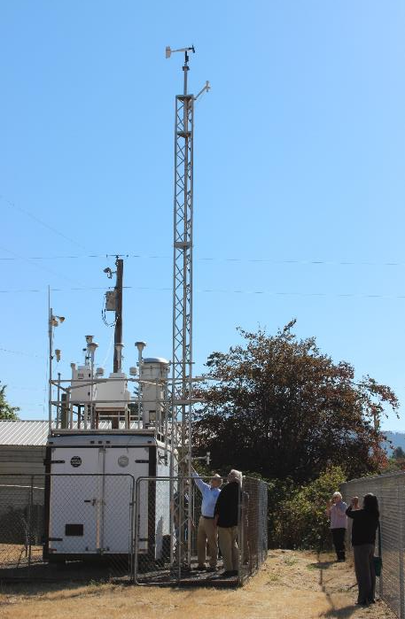
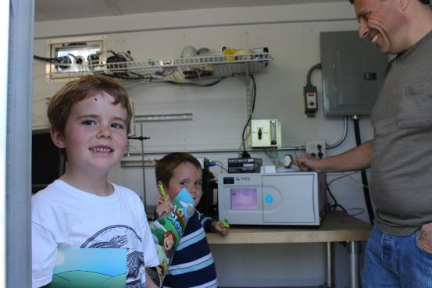
Notes:
Another example of partnerships is air monitoring equipment. The door opens both directions.

Slide 17


Merlyn Hough, Director 1010 Main Street Springfield, OR 97477 541-736-1056 Ext. 216 www.lrapa.org
Notes:
Our partnership with DEQ is one of our most valued partnerships.
Thank you for the invitation to join in this presentation!

