Slide 1
What does “health-based” air permitting mean?
Control of toxics in air based on health-based concentrations for air toxics, rather than on rate of air emissions.
Control of air
toxics
concentrations
(micrograms/
cubic meter)
Permitted air emissions (tons/year)
Notes:
Good morning, Chair O’Keefe and members of the commission,
My name is Sue MacMillan
Toxicologist with Oregon’s Air Quality program, Air Toxics Science and Policy Analyst.
I am here to tell you about how California’s and Washington’s risk-based air permitting programs work.
In my previous life, I did toxicology and risk assessment work in the private sector for over 20 years, so am very familiar with risk-based protocols.
Because I only have a short time to present this information, I will be giving you a broad overview of what I’ve reviewed.
So what does health-based, or risk-based, air permitting actually mean?
Means regulating air emissions based on concentrations of toxics in air, rather than on controlling rates of emissions of air toxics.
Controlling emissions rates, in and of itself, is a type of health-based process, because it has done a really good job of decreasing the emissions of air toxics.
But this doesn’t go far enough, and now we need to consider regulating emissions based on the quantifiable health impacts that they might cause, as in the case of residents living adjacent to an operating facility (Fenceline risk).

Slide 2
Risk Assessment Basics
Emissions Inventory
How much of Chemical Z are people taking into their bodies?
Estimated cancer risk
Estimated non-cancer hazard
How toxic is Chemical Z?
Notes:
What the CA and WA programs, and federal and other states’ programs, share, is a foundational use of risk assessment concepts.
In risk assessment as applied to air permitting, there are four basic steps.
Facilities are brought into program as a permit requirement, or a source registration process, for example. Let’s say for this example, that Facility A is emitting Chemical Z.
Daily intake.
Toxicity information from scientific literature.
Cancer risk and non-cancer hazards can then be estimated. But so what? You need to be able to compare these risks and hazards to goal levels in order to determine whether Chemical Z is being emitted at levels of concern in terms of health impacts.

Slide 3
Health-Based Decisions
Estimated cancer risk
Is potential cancer risk > 1 in a million?
Yes
Risk reduction/risk mgmt
No
Meets limit
Estimated non-cancer hazard
Is potential non-cancer hazard > 1 ?
Risk reduction/risk mgmt
Yes
No
Meets limit
Notes:
For this slide, I am choosing to use a cancer limit for Chemical Z of 1 additional incidence of cancer in a population of one million people; for non-cancer hazard, Chemical Z cannot exceed a hazard level of 1 (non-cancer hazards are calculated differently from cancer risks).
Different risk-based air permitting programs set their own cancer and non-cancer risk limits.
Many times, a single carcinogen is not to exceed a risk (or a chance) of one additional incidence of cancer among a population of 1 million people; however, some programs (for example) choose to set this particular limit at 10 possible additional incidences of cancer among a population of 1 million people.
EPA first set “acceptable” risk limits back in 1980, related to Superfund. Even back then, choosing an “acceptable” risk level was a policy decision.
For non-cancer health effects, the term “hazard” is used, and the hazard level is not to exceed 1.0. (calculated differently from cancer risks).
Risk reduction: filters, baghouses, use of a different chemical.
Risk management: considers feasibility of attaining risk-based limits, costs, benefits to small groups versus larger community.

Slide 4
Tiered Approach
` Increasingly complex levels of human health risk assessment “tests”:
1) Screening human health risk assessment
2) HHRA using worst-case exposure assumptions
3) HHRA using project-specific assumptions
Risk reduction measures /risk management decisions
Notes:
Screening risk assessment – simple comparison of measured or modeled air concentrations to calculated air concentrations that are protective of human health. If pass, no need for further assessment – confident that risk or hazards are acceptable. If fail, can conduct HHRA.
Easiest HHRA: use worst-case exposure assumptions (e.g., EPA Exposure Handbook values) for adult inhalation rate, child inhalation rate, body weights, how many days exposed, how many years.
More-complex HHRA that uses project-specific information to calculate probable risks and hazards; results should more accurately reflect what’s happening at that particular site with those particular neighbors. Ridiculous example: Applicant documents that nearby residents only live in the adjacent houses for 8 months of every year.

Slide 5
Similarities between CA and WA programs
Emissions inventory of some kind required
Risk-based evaluation, using tiered risk assessment process
Risk reduction / risk management
Fees paid by applicant support program
CA air quality management districts (35), WA clean air authorities (11): ADOPTED AT THE STATE LEVEL

Slide 6
Differences between CA and WA programs
Types of facilities in program --
CA: new and existing sources vs. WA: new sources only
Risk levels used --
CA: risk levels: vary among screening, use of TBACT, significant risk, and risk reduction goals vs. WA: risk levels used (10⁻⁶ for screening, 10⁻⁵ Second Tier)
Risk tiers --
CA South Coast Air Quality Mgmt District: 4 tiers (screening, risk assessment, dispersion modeling, detailed risk assessment using program software) vs. WA: 3 tiers (screening, Health Impact Assessment, Risk Mgmt)

Slide 7
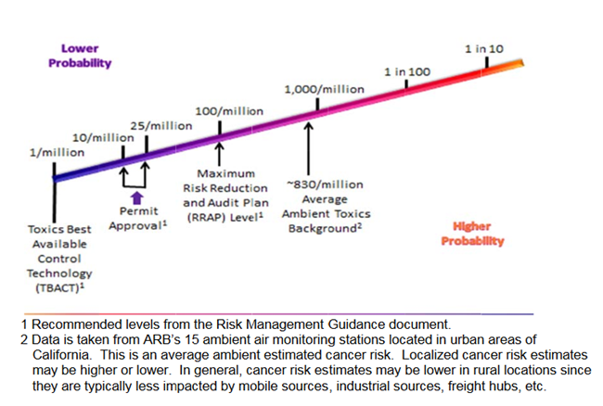
Health risk – a relative perspective
Source: California Air Resources Board
Risk Management Guidance for Stationary Sources of Air Toxics, 2015
Notes:
An example of how a California district utilizes different levels of acceptable cancer risks to make permitting decisions.

