Slide 1

Air Quality Program Vision
The air quality program is dedicated to ensuring healthy air quality
for all Oregonians.
We do so by using good science, collaboration, and Oregon law.
Our work reflects our values of:
Leadership, partnership, integrity and commitment;
Open and clear communication;
Consistent implementation of federal and state regulations; and
Empowering skilled staff to solve problems.
Notes:
Good morning chair O’Keeffe and member of the Commission, my name is Sarah Armitage and I am the air toxics lead in DEQ’s air quality planning section. With me here today are Merlyn Hough the director of the Lane Regional Air Protection Agency, and Susan MacMillan in DEQ’s Air Quality Technical Services Section. Thank you for the opportunity to give you an overview of the Air Quality programs, air toxics program, and Washington and California air toxics permitting programs.
For over 40 years, DEQ’s air quality program, has been reducing air pollution and making Oregon safer.
We’ve had great successes reducing pollution and restoring Oregon’s air to meet federal health standards.
Over the years, in both urban and rural communities across the state, DEQ’s air quality program has drastically reduced Smog also known as Ozone pollution, Carbon Monoxide, Fine Particulate, and other types of pollution to better protect Public Health.
And we have much more to do:
Federal air quality standards for ozone and fine particulate (for example) have become even more protective in recent years as we gain a better understanding of the effect those pollutants have on public health.
Climate Change is a major challenge and opportunity for DEQ to work with a wide variety of partners to reduce greenhouse gas pollution.
The emissions of air toxics can be a significant risk to public health, and they are one of the most challenging and scientifically complex areas for air quality.
The air quality science we do (monitoring, modeling, and emissions estimation) tells us more each day about air pollution in Oregon; and all our partnerships help us learn where we need to focus our resources to be effective.
Our existing strategies are very effective at reducing a wide variety of air pollutants, and we are continuously evaluating our progress.
We feel good about all that we’ve accomplished, and the high quality staff work that went into it. We’re also excited and challenged by the new work ahead to meet federal air standards, address Climate Change, and further reduce toxic air pollution.
Our current air toxics regulatory overhaul under Cleaner Air Oregon is a big step forward to give us all more tools to protect air quality and public health for all Oregonians in all locations.

Slide 2

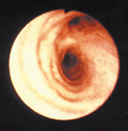
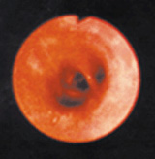
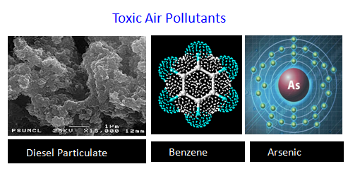
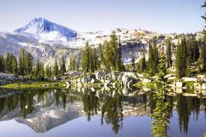
Air Pollutants of Concern in Oregon
Particulate Matter
Ground Level Ozone (smog)
Healthy Airway
Inflamed Airway
Fine particles enter
deeply into the lungs
Pollution Affecting
Climate Change and Ecosystems
Notes:
In the Air Program, our main challenges and focus for public health protection are:
Fine Particulate (lung and heart health effects)
Ozone (airway inflammation), and
Air Toxics (three examples pictured here, multiple serious health effects like elevated cancer risk, neurological damage and airway inflammation).
Our other environmental priorities are Climate Change and helping protect visibility in Oregon’s many Wilderness Areas and Crater Lake National Park.
Many of the sources we deal with, like woodstoves, diesel engines, motor vehicles, emit many different kinds of air pollution, and we'll talk more about multi-pollutant strategies as part of our presentation.
Action Examples:
Ozone: Successfully worked in Portland and Medford to meet and maintain ozone standards. We’re starting work this year in the Hermiston area with EPA & WA agencies to look at high ozone levels and interstate transport of ozone. (no violation – but high enough to investigate)
PM: Great successes helping communities like Medford, Klamath Falls, Grants Pass, Lakeview and LaGrande come into compliance with health standards
Visibility: Our Regional Haze Plan shows generally improving visibility trends across Oregon (wildfires still impact visibility & health).
The work in Climate Change and Visibility (also called Regional Haze) involves other types of air pollution such as greenhouse gases (CO2, methane); or sulfur and nitrogen particles that can degrade visibility or have other effects in ecosystems at relatively low levels that aren’t a direct risk for public health.
Air Toxics: We have operated an incentive based Clean Diesel program since 2012, have had recent success in the Portland area working with local government to control woodsmoke, are in the process of updating our air toxics benchmarks, or clean air goals, and we have multiple assessments in progress for pollutants recently revealed through moss screening.

Slide 3
Air Quality Program
Notes:
This diagram illustrates what we do in DEQ’s Air Quality Program. The same basic structure also applies to DEQ water and materials management work.
Generally speaking, in air quality, EPA sets national air quality standards and goals.
We monitor and assess,
Develop strategies,
Implement the strategies through regulatory activities and permits,
Assist people with compliance,
and perform compliance and enforcement.
DEQ is responsible for air quality in all parts of Oregon except for Lane county where Lane Regional Air Protection Agency has jurisdiction. DEQ provides oversight of the Lane County program.
We’ll hear more about Lane Regional Air Protection Agency from Director Merlyn Hough in a few minutes.
DEQ’s air quality program has a very broad range of responsibility and activity. Our presentation will hit some highlights of our program, and we will provide more detail about our air toxics program.
- The air program is constantly evolving. Through better understanding of science, health effects, the impacts of pollution sources; discovering more effective ways to reduce pollution; and (as we’ve seen recently), identifying gaps in coverage of our program that provide opportunities to improve what we do.

Slide 4
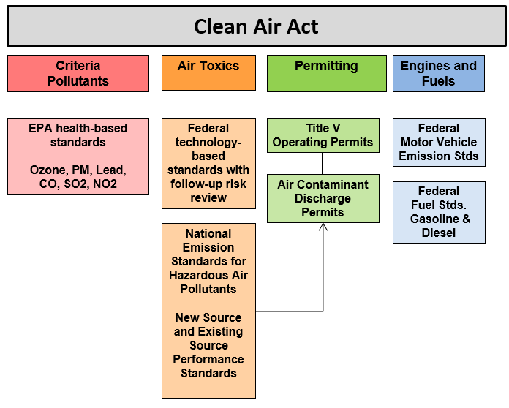
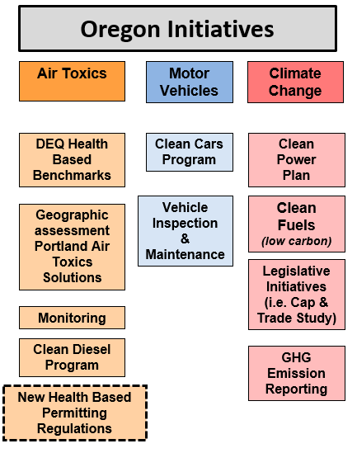
Federal – State Roles
Multi-Pollutant Reduction Strategies
Notes:
To understand DEQ’s air program, it is helpful to consider elements stemming from federal requirements and those initiated by DEQ.
Here is a greatly simplified overview of key federal elements of the Oregon air program.
We implement criteria pollutant standards for pollutants like ozone, particulate and carbon monoxide using an airshed approach under the State Implementation Plan.
We take delegation of numerous federal technology based standards known as National Emission Standards for Hazardous Air Pollutants and New Source Performance Standards. We implement these standards by including them in Title V permits for our largest facilities, or Air Contaminant Discharge Permits. The Air Contaminant Discharge Permit Program is actually a state initiated program, but a key tool for implementing federal requirements.
Nationally, EPA has enacted requirements for cleaner cars and other engines, and regulations that decrease harmful emissions from gasoline and diesel fuels.
Here is a simplified structure of Oregon only programs that complement or go beyond federal requirements.
We have a state air toxics program with air concentrations or goals for 52 air toxics. These are known as benchmarks, and are extremely protective levels that people could breathe for a lifetime without additional cancer risk beyond one in a million or the initiation of non cancer health effects. Oregon is one of the few states with ambient clean air goals for air toxics.
Our primary approach under the state air toxics program is to assess cumulative air toxics in airsheds. The first of these efforts is the Portland Air Toxics Solutions Project.
We also have a state air toxics assessment plan for monitoring.
In our incentive based Clean Diesel Program we have had recent analysis and discussion of ways to expand our diesel efforts.
The health based permitting regulations which are under development will make our state based approach to air toxics more complete.
For motor vehicles Oregon goes beyond federal regulations by adopting and implementing the California clean car standards and we have supported the electrical charging infrastructure. We have also operated vehicle inspection and maintenance programs in Portland and Medford that ensure that existing vehicles operate as cleanly as possible.
DEQ has several significant programs to address greenhouse gas emissions in both the electricity sector and from transportation fuels.
- Within the electric sector, DEQ is the lead agency for developing Oregon’s plan to achieve federally required CO2 emission reductions at fossil fuel power plants.
- Within the transportation sector, DEQ is now implementing the Clean Fuels program to reduce the intensity of greenhouse gases associated with Oregon’s transportation fuels.
- DEQ also has our Zero Emission Vehicle program that requires auto manufacturers to sell increasing amounts of battery electric and other non-emitting vehicles in Oregon.
- Finally, the 2016 legislature tasked DEQ with conducting a study on how a market-based greenhouse gas reduction program, such as cap-and-trade, might operate in Oregon.
We approach much of our work from a multipollutant perspective, targeting and reducing the many pollutants that come from common sources. This can be more complex, but it is also efficient, effective and utilizes many partnerships.
Key partnerships include: EPA, the US Forest Service, State and local health agencies, Oregon Department of Energy, the Public Utility Commission, Oregon Department of Forestry, Oregon Department of Agriculture, and the Oregon Department of Transportation.

Slide 5
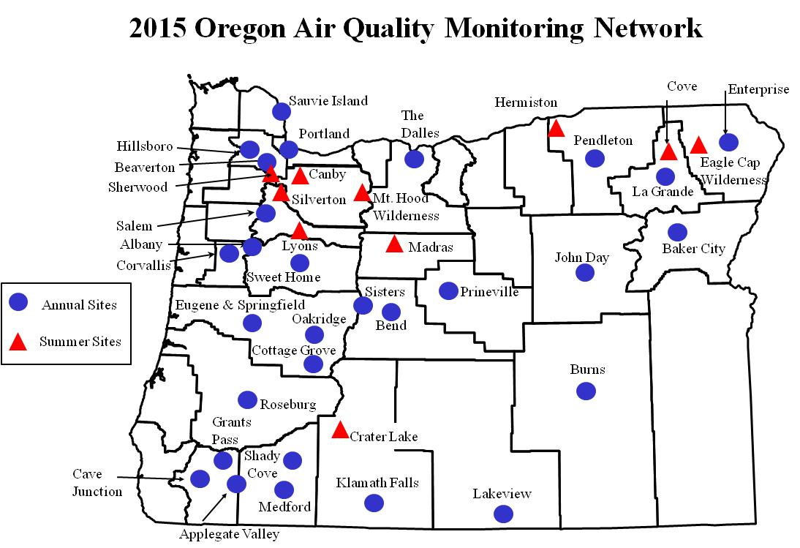
Assessing Air Quality
Notes:
Returning to our core task of air quality assessment, here is a map showing the distribution of air monitoring locations statewide.
Monitoring lets us know about compliance with federal standards and air toxics clean air goals.
We have about 45 air monitoring sites across the state. Some monitors are for single pollutants and others monitor multiple pollutants.
In addition, we gather and analyze emissions information and use computer modeling to estimate pollution levels and their impact on communities and neighborhoods.
In this map, the blue dots show annual sites where we monitor primarily for particulates like smoke, soot; and smog (ozone); and some air toxics sites.
The red triangles represent summer sites where we monitor for pollutants that peak in the summer, such as ozone and particulate from forest fires and agricultural burning.
We operate three monitors to sample for the full spectrum of air toxics. As part of the response to Portland metals concerns, DEQ is currently running 11 short term metals monitors.
We also use monitoring to inform communities about forest fire impacts, days when wood burning is not advised and pollutant levels that could cause problems for people with respiratory problems.

Slide 6
Air Toxics Monitoring
Community air toxics assessment in North Portland
Air toxics monitoring equipment
Longer-term
trend monitors
  Portland
  La Grande
Year-long assessments
  Medford
  Klamath Falls
  Hillsboro
  North Portland
Special Studies
    North Portland, SE Portland
Notes:
Air toxics monitoring is key to understanding emissions and potential health impacts, and in many ways is an evolving science.
The photo on the upper left shows air toxics monitoring equipment at the long-term site in North Portland.
The reasons we monitor are:
To develop new methods and techniques and explore what monitoring can and cannot tell us. For example there is no method to directly measure diesel emissions, but pollutants like black carbon can be used to some extent as a surrogate.
To assess trends over time - we do this with two longer term EPA funded monitors in Portland, our largest city, and La Grande a smaller community.
To survey and assess communities statewide - we have conducted year long assessments in Medford, Klamath Falls, and Hillsboro. We recently finished an assessment in North Portland above Swan Island currently doing an assessment in the Johnson Creek neighborhood of SE Portland. We are also prepared to monitor in the Rockwood neighborhood of Gresham, and would like to monitor in Clackamas county within the next few years.
We also conduct special studies to support investigations. For example, the air toxics monitoring we did in SE Portland was part of a special study to identify sources of cadmium and a partnership with the USFS to use moss as an urban air pollution screening tool. Our technologies to monitor near sources are evolving and tools like moss screening will help us place monitors in the future.
• The photo on the right shows the North Portland Swan Island monitoring project, which was funded by the 2014 Legislature for a year-long community monitoring assessment.
• Monitors are shown by the yellow and orange dots and weather monitoring stations are the blue dots. This project has helped DEQ and partners understand air toxics in a dense urban area.

Slide 7
Progress Meeting Federal Air Standards
Portland
La Grande
Salem
Prineville
Eugene-Springfield
Oakridge
Burns
Grants Pass
Klamath Falls
Medford-Ashland
Lakeview
Ozone and PM10 attainment & maintenance areas
PM 2.5 non- attainment areas
Violating PM 2.5 but not officially designated non-attainment
PM2.5 Areas of Concern
Notes:
Map - overview of areas where DEQ and communities work to meet and maintain compliance with federal health standards:
Green stars show success stories – these communities reduced emissions and came back into compliance . (Now we work to maintain compliance)
Back triangles show current particulate non-attainment areas.
Gray triangles show areas that violated the particulate standard, but are not yet designated non-attainment by EPA. DEQ working with these communities and EPA to lower particulate and avoid nonattainment.
White triangles are areas of concern for PM2.5. Recent levels have bumped above the standard, but there are no official violation yet (Burns, Hillsboro). DEQ is working with these communities to prevent future violations.
Note: PM10 is old particulate standard for 1980;s In 2000’s EPA added PM2.5.. (Smaller size particle, lower health threshold. More risk to health)

Slide 8
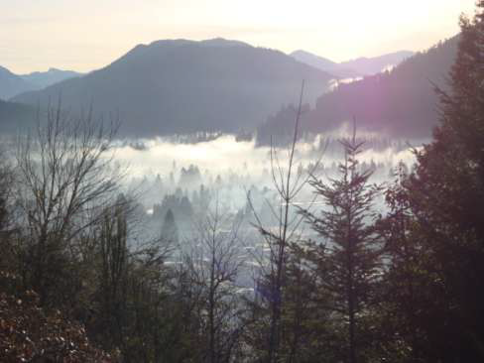
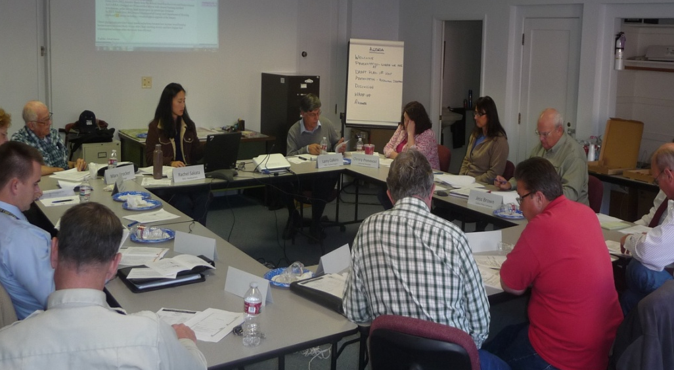
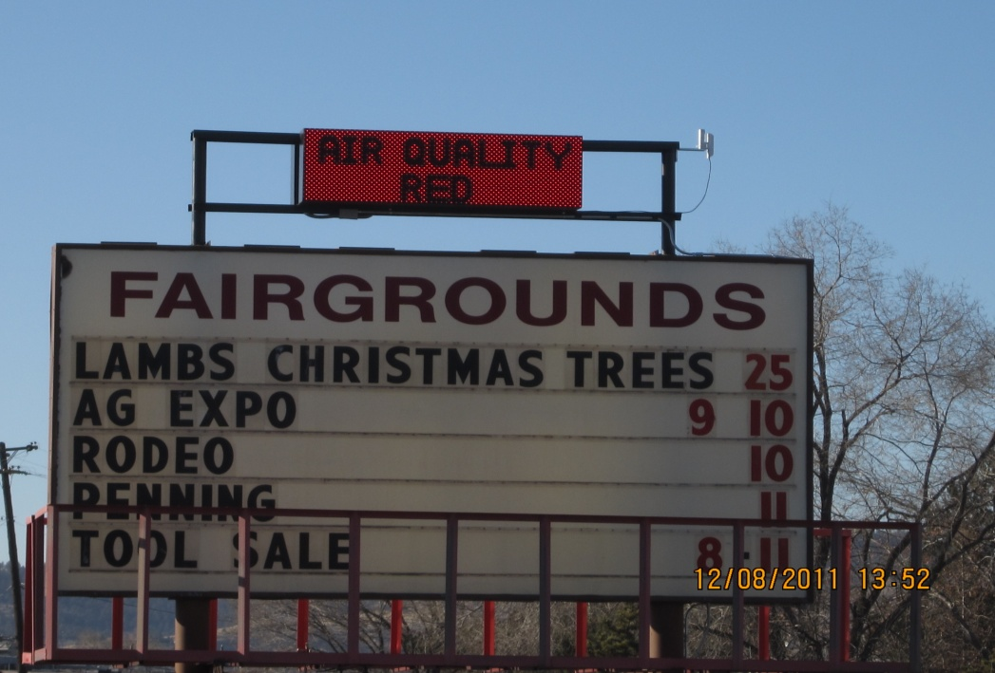
Communities Working to Reduce Particulate Pollution
- Federally required attainment plans
  - Klamath Falls
  - Oakridge
- Particulate prevention plans
  - Lakeview
  - Washington County
  - Prineville
  - Burns
Smoke inversion over Oakridge
Lakeview PM2.5 Advisory Committee
Klamath Falls Community Burn Advisory Sign
Notes:
- DEQ works very closely with local governments and communities to figure out what measures work best for each community while ensuring that the air will meet federal standards.
- Many communities have really taken the initiative to try and address PM2.5 and DEQ wants to acknowledge the hard work they have been putting in for many years.
Klamath Falls
In Klamath Falls, a local advisory committee was key in developing an attainment plan with strategies to reduce PM2.5 pollution through woodstove reduction measures and education. The county officials, including the health department have been critical in implementing a woodstove curtailment program, education and outreach efforts. The health department conducts daily surveys during poor air quality days to identify people who might be burning, leave informational packets to residents to help educate them on proper burning techniques, and in some instances issue fines or penalties. They also go into the schools to work with the kids to run a school flag program to identify poor air quality days. This community has really come together to address the air quality issue.
Oakridge
In Oakridge, LRAPA has been working with the community to clean up the air. They have also been the beneficiary of woodstove changeout funds, roughly $415K. The photo shows a weather inversion keeping smoke very low to the ground where is becomes highly concentrated.
Now Merlyn will give you an overview of Lane Regional Air Protection Agency’s program and we will return to air toxics after that.

Slide 9
LRAPA

Slide 10
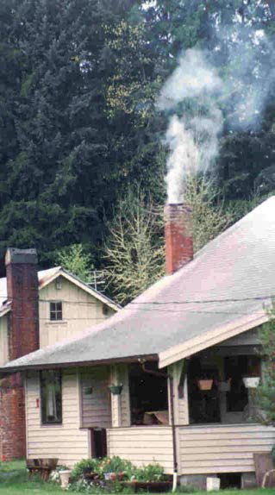

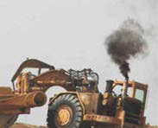
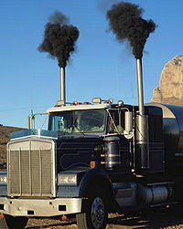
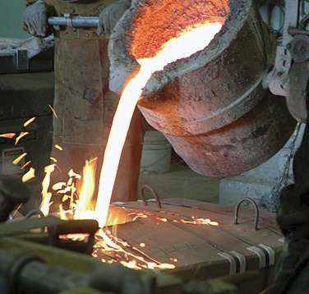
Sources of toxic air pollutants
Notes:
Now we will discuss Oregon’s air toxics program and explain it in more detail.
As I mentioned earlier, air toxics come from many sources, the majority of which also produce criteria pollutants such as particulate or chemical precursors to ozone. Generally, people are exposed to the most risk from area sources such as wood burning and mobile sources such as gasoline and diesel engines. For those living close to industrial facilities, these emissions can also add unwanted increases in health risk, as we have recently discovered near art glass facilities.

Slide 11
Oregon’s Air Toxics Program
Federal Air Toxics Standards for Industry
Oregon Benchmarks
Federal Engine and Fuel Standards
Assessment and Solutions
Cleaner Diesel Vehicles and Equipment
Opt in to Low Emission Gasoline Vehicles
Permits
Large Facilities
  Wood Products
  Foundries
  Vehicle Painting
Smaller Facilities
  Dry Cleaners
  Auto Body Shops
  Metal Plating
Statewide:
Clean Diesel Engines
Heat Smart
Gasoline Fueling
Oregon Low Emission Vehicles
Portland Air Toxics Solutions:
Wood Burning
Diesel Engines
Cars and Trucks
Metals Facilities
Notes:
• This chart shows the elements of Oregon’s air toxics program.
o In purple, we implement federal standards for industry through permits.
o In green we use our air toxics benchmarks to assess problems and provide solutions statewide and in impacted communities.
o In blue, we have progressively cleaner engines as EPA sets standards for new gasoline and diesel powered vehicles.
• Examples of our current actions to reduce air toxics are in gray boxes below.
• Implementing federal standards for industry has resulted in significant reductions of air toxics statewide for our largest facilities under Title V permits, and a spectrum of medium and smaller facilities under state permits.
o Some examples of facilities where federal standards have required air toxics reductions are the larger wood products manufacturers, foundries and vehicle painting businesses.
o In the past 5 years EPA air toxics standards have also applied to many medium and smaller facilities, requiring air toxics controls at dry cleaners, auto body shops and metal plating facilities.
o DEQ partners with industry associations to provide technical assistance to hundreds of the smaller facilities each year.
• To supplement industrial and engine standards, DEQ uses a geographic approach to assess and solve problems in communities.
Portland Air Toxics Solutions is our first project working with a community to identify and make plans to reduce air toxics from sources causing the most risk. These include plans for wood burning, diesel engines, gasoline cars and trucks and metals facilities.
• We also consider actions to reduce air toxics emissions from sources statewide.
o Examples of these actions are DEQ’s Clean Diesel Program, providing incentives for cleaner engines, Heat Smart, which requires changeout of old dirty woodstoves upon home sale, and our gasoline fueling regulations to capture benzene vapors.
• Under federal clean engine laws, both gasoline and diesel cars and trucks have gotten much cleaner – causing less ozone, particulate, green house gas and toxic air pollution.
o Oregon accelerated this process by opting in to California low emission vehicle standards.
Backpocket:
Industrial permitting –
Title V program is an operating permit for 111 major sources of air emissions.
Air Contaminant Discharge Permit (ACDP) program, which is the operating permit for about 2,600 medium and smaller sources.
Clean Cars
Beginning with the 2009 model years, new vehicles sold in Oregon meet Oregon’s Low Emission Vehicle standards. Reduces greenhouse gas emissions, smog forming emissions and toxic air pollution.
Clean diesel
Diesel is one of the most potent air toxics to which Oregonians are exposed.
Grant program that provides federal funds for the installation of particulate filters on existing vehicles. Since 2008, DEQ has awarded approximately $4,250,000 in grant funding.
We have upgraded 113 school buses, 73 municipal vehicles and 158 other vehicles such as garbage trucks, buses and barges.

Slide 12
What is the Industrial Facility Risk Gap?
Unregulated or Unaddressed Air Toxics Emissions
Oregon Air Toxics Program
Federal Air Toxics Regulations
  Technology – best performing
  Residual risk – 8 year review
  Substantial emission reductions
  Generic – gaps in coverage
Notes:
The current situation where we identified metals emissions at levels of concern from art glass facilities has highlighted what we and others have called a gap or a risk gap in our regulations for air toxics.
This graphic roughly illustrates that gap.
-The yellow oval shows the body of federal regulations for air toxics. They are technologically controlled through emission limits defined in permits, described using a rate: tons emitted per year. This is coupled with a federal effort to go back and look at each category eight years after a technology standard to evaluate remaining or residual risk. EPA will further regulate a category if they determine that the technology standard does not adequately control risk to public health with an ample margin of safety. EPA also reviews technology requirements periodically and requires further controls if new technology is available.
-The federal air toxics regulations have been very effective at reducing emissions and risk nationally. They have limitations based on their generic nature – they are not tailored to each facility, and do not require site specific risk assessment or risk reduction. So in some cases they may adequately control risk, and in others they may not.
The green ring shows DEQ’s geographically based air toxics program. This approach, which we have used in the Portland Air Toxics Solutions Project, evaluates industrial emissions as part of the whole airshed, but has not been exact enough to understand or control risk to people in neighborhoods close to facilities. The geographic approach may be better suited to assessing and controlling emissions from area and mobile sources.
- The blue ring represents industrial air toxics emissions that are not adequately addressed by either federal regulations or Oregon’s current risk based approach.

Slide 13
Monitored
Air Toxics Trends
Portland
La Grande
Notes:
These charts show air toxics trends for five key pollutants at our longer term monitors in Portland and LaGrande. They show generally good news that on a larger scale, emissions of air toxics are decreasing.
• The vertical axis is times above air toxics benchmarks or clean air goals.
• The five pollutants are stacked in bars for each year to show air toxics trends.
• The orange line and dots show our targets for air toxics reduction.
• You can see that levels of these five pollutants are generally about twice as high in Portland as they are in LaGrande. Higher levels of air toxics come with density and development.
• The resurgence in the economy and more vehicle and truck traffic likely shows in the increased levels in 2012 and 2013.
Meteorology also has a large influence on pollutant concentrations – stagnant patterns vs. unsettled windy weather. This may explain the drop in pollutant concentrations in 2014 in Portland. We know that was a year with good ventilation and few periods of stagnation.

Slide 14
Particulate
Air Toxics
Ozone
Greenhouse
Gases
Regional Haze/Visibility
Clean engines
Clean fuels
Smoke controls
Industrial regulations
Notes:
Before we move to Sue’s overview of California and Washington programs, I would like to emphasize further good news that much of our work has benefits for multiple pollutants.
• Traditionally we addressed one pollutant at a time, but now we think more in terms of multi pollutant benefits.
• On the left side of this chart are some of our key source control efforts, and across the top are the key pollutants we need to reduce.
• Because sources of air pollution emit multiple pollutants, our source control efforts are effective for multiple pollutants
o For example: cleaner engines and cleaner fuels reduce particulate, air toxics, ozone, greenhouse gases, and pollutants affecting visibility
o Woodsmoke reduction efforts control particulates, air toxics and pollutants affecting visibility.
o Industrial controls in place statewide have benefits for all categories of pollutants as well.

