Slide 1
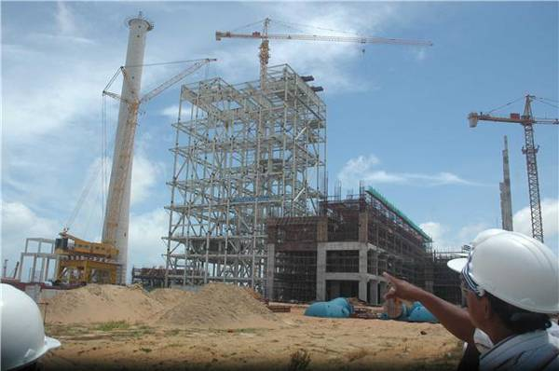
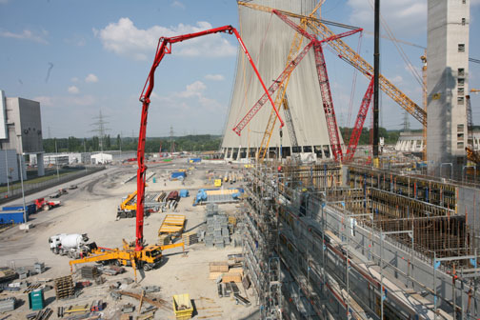
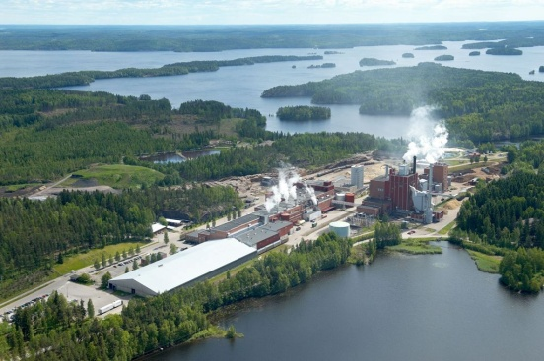
Proposed Adoption of Federal Air Quality Regulations
National Emission Standards for Hazardous Air Pollutants (NESHAP)
New Source Performance Standards (NSPS)
Jerry Ebersole
DEQ - AQ Division
Notes:
Good ___________ Chair O’Keeffe, Commissioners
My name is Jerry Ebersole
I am here to present rules to implement federal air quality regulations in Oregon

Slide 2
Presentation Outline
Background
Proposed adoption of new federal regulations
Proposed rules to implement new federal emission guidelines
Proposed adoption of new federal plan
Proposed re-adoption of amended federal regulations
Motion
Notes:
During my presentation, I will:
Provide background on the federal AQ regulations included in this rulemaking
Talk about the specific regulations proposed for adoption; and
Present DEQ’s recommendation to the Commission

Slide 3
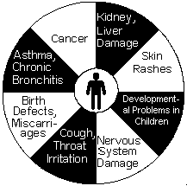

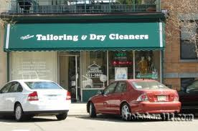
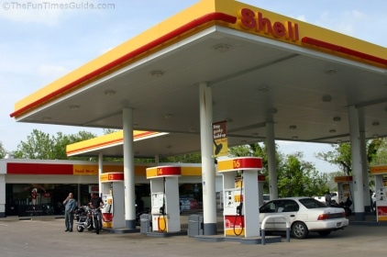
Background Information –
Federal AQ Regulations
National Emission Standards for Hazardous Air Pollutants (NESHAP)
New Sources
Existing Sources
Pollutants
Sources
Hazardous Air Pollutants (HAP)
Major Sources
(> 10/25 tons)
Area Sources
(< 10/25 tons)
Notes:
The first type of regulations included in this rulemaking are the
National Emission Standards for Hazardous Air Pollutants or NESHAPs
As the name implies, NESHAPs regulate hazardous air pollutant emissions
There are currently 185 or so hazardous air pollutants or HAPs, such as benzene and mercury
NESHAPs apply to new and existing sources
NESHAPs apply to major sources, such as pulp mills, that emit more than 10 tons of a single HAP or 25 tons of HAP combined
NESHAPs can also apply to area sources,
such as dry cleaners and gasoline stations,
that emit less than 10 tons of a single HAP or 25 tons of HAP combined,
that may or may not pose a risk to public health
but in aggregate, pose or contribute to public health risk

Slide 4
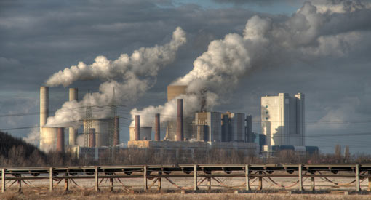
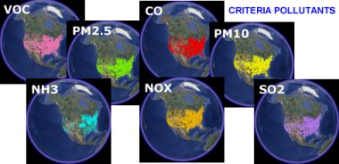
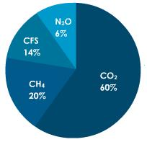
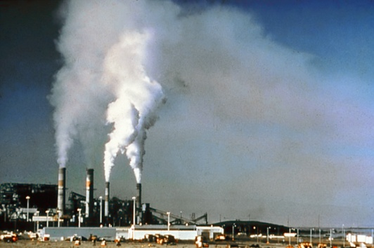
Background Information –
Federal AQ Regulations
New Source Performance Standards (NSPS)
Emission Guidelines
New Sources
Existing Sources
Pollutants
Sources
HAPs
Criteria Pollutants
Greenhouse Gases
Significant Sources
Notes:
The second type of regulations included in this rulemaking are:
New Source Performance Standards or NSPSs
NSPSs only regulate new emission sources, but an NSPS could be accompanied by an Emission Guideline for existing sources
NSPSs typically regulate criteria pollutants, but can also regulate hazardous air pollutant, and more recently GHGs
NSPSs apply to significant sources of air pollution, such as power plants

Slide 5
Background Information –
Federal AQ Regulations
New Source Performance Standards (NSPS)
National Emission Standards for Hazardous Air Pollutants (NESHAP)
Emission Guidelines
EPA Adoption
Do not apply upon EPA adoption
EPA Adoption
Apply upon EPA adoption
State Adoption/Implementation
Apply upon state adoption or adoption of federal plan
Notes:
One important distinction between NESHAPs and NSPSs and Emission Guidelines is that:
NESHAPs and NSPSs apply upon EPA adoption
Emission guidelines on the other hand do not apply on EPA adoption
They apply upon adoption of state rules to implement them, or
In the absence of state rules, upon adoption of a federal plan

Slide 6
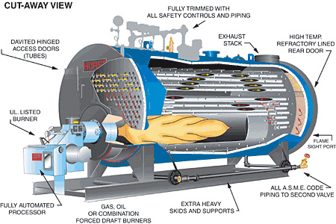
Proposed Rules
Adopt new federal standards
Boilers
Adopt by reference
  New major source NESHAP
  New area source NESHAP
    For permitted sources only
      Permit threshold unchanged
      10 million BTU per hour heat input
    Unpermitted sources
      Periodic tune-ups
      EPA to implement
      DEQ provided outreach
Notes:
That was the background portion of my presentation, now I will talk about new federal standards that are proposed for adoption
DEQ is proposing the adoption of the new major and area source NESHAPs for boilers
For the area source boiler NESHAP, DEQ is proposing the adoption be for permitted sources only
In other words, for boilers rated at > 10 MMBtu per hour of heat input, which is the current permit threshold for boilers

Slide 7
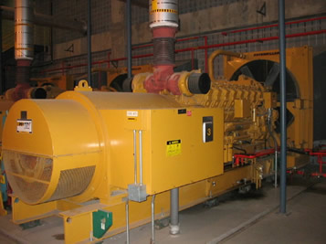
Proposed Rules
Adopt new federal standards
Stationary Internal Combustion Engines
Adopt by reference
  New NESHAP (for major and area sources)
    For permitted sources only
      New permit threshold
        Non-emergency - 500 HP
    Unpermitted sources
      Periodic tune-ups
      EPA to implement
      DEQ provided outreach
Notes:
DEQ is proposing the adoption of the new NESHAP for stationary internal combustion engines, which applies to major and area sources
DEQ is also proposing the adoption of this NESHAP for permitted sources only
Jill’s rulemaking adopted a new 500 HP permitting threshold for non-emergency engines to correspond to the more stringent requirements of the NESHAP

Slide 8
Proposed Rules
Adopt new federal standards
Stationary Internal Combustion Engines
Adopt by reference
  New NSPS for spark ignition engines
    Excluding manufacturer requirements
      Engine certification
    For permitted sources only
      New permit thresholds
        Non-certified non-emergency - 500 HP
Notes:
DEQ is proposing the adoption of the new NSPS for spark ignited stationary internal combustion engines
DEQ is proposing the adoption of this NSPS for permitted sources only, and
Excluding the engine manufacturer requirements, which are better implemented by EPA on the national level
Jill’s rulemaking adopted a new 500 HP permitting threshold for non-certified non-emergency spark ignited engines to correspond to the more stringent requirements of the NSPS

Slide 9
Proposed Rules
Adopt new federal standards
Stationary Internal Combustion Engines
Adopt by reference
  New NSPS for compression ignition engines
    Excluding manufacturer requirements
      Engine certification
      Better implemented by EPA on national level
    For permitted sources only
      New permit thresholds
        Non-emergency
      30 liters per cylinder displacement
      Non-certified - 500 HP
Notes:
DEQ is proposing the adoption of the NSPS for compression ignition stationary internal combustion engines
DEQ is also proposing the adoption of this NSPS for permitted sources only, excluding the engine manufacturer requirements
Jill’s rulemaking adopted new permitting thresholds of
30 liters per cylinder of displacement; and
500 HP for non-certified non-emergency engines
To correspond to the more stringent requirements of the NSPS

Slide 10
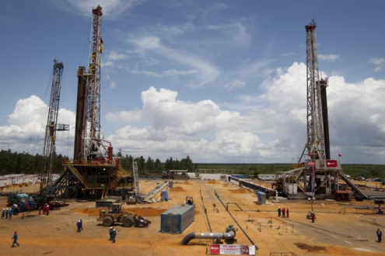
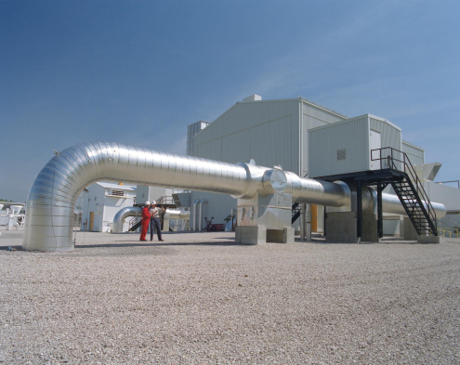
Proposed Rules
Adopt new federal standards
Crude oil and natural gas production, transmission and distribution
Adopt by reference
  New NSPS
Notes:
DEQ is proposing a straight adoption by reference for the NSPS for crude oil and natural gas production, transmission and distribution

Slide 11
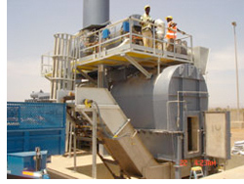
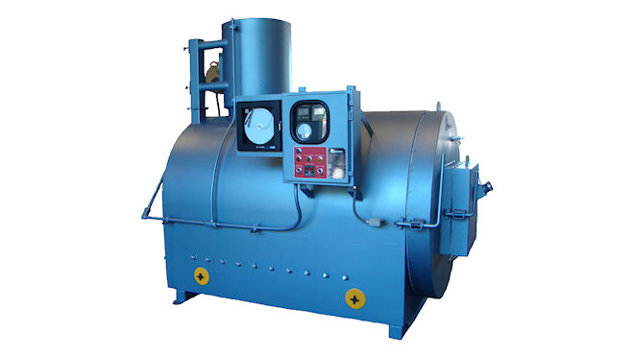
Proposed Rules – Adopt rules to implement federal emission guidelines
Commercial/Industrial Solid Waste Incinerators
Adopt mostly by reference
  New emission guidelines
Hospital/Medical/Infectious Waste Incinerator
Adopt by reference
  New federal plan
Notes:
DEQ is proposing a rule to implement the federal Emission Guideline for commercial and industrial solid waste incinerators
The proposed rule adopts the language in the Code of Federal Regulations to the extent allowed by EPA
Included in the rule package is a state plan that DEQ is required to submit to EPA
DEQ is proposing the adoption by reference of the federal plan to implement the emission guidelines for hospital, medical and infectious waste incinerator Emission Guidelines
Oregon has only one affected source
The only requirement for this source is to keep records
DEQ therefore determined it made more sense to just adopt the federal plan by reference than to adopt rules to implement the Emission Guidelines

Slide 12
Proposed Rules
Adopt by reference – amended federal standards
NESHAPs:
  Chromium electroplating
  Electric utility steam generating units
  Natural gas transmission and storage
  Portland cement
  Pulp and paper
NSPSs:
  Commercial/industrial solid waste incineration units
  Electric steam generating units
  Hospital/medical/infectious waste incinerators
  Nitric acid plants
  Portland cement plants
Notes:
This slides shows NESHAPs and NSPSs that have been amended by EPA since they were last adopted by the Commission
DEQ is asking the Commission to update the adoption of these NESHAPs and NSPSs by reference

Slide 13
Summary
This rulemaking proposes:
  Adoption of new federal standards
  Re-adoption of amended standards
  Rules to implement new federal emission guidelines for commercial and industrial solid waste incineration units
  Adoption of the federal plan for hospital, medical and infectious waste incinerators
Notes:
To summarize , this rulemaking proposes the:
Adoption of new federal standards
Re-adoption of amended standards
Rules to implement new federal emission guidelines for commercial and industrial solid waste incineration units
Adoption of the federal plan for hospital, medical and infectious waste incinerators

Slide 14
DEQ Recommendation
Adopt the proposed permanent rules in Attachment A as part of chapter 340 of the Oregon Administrative Rules.
Approve the state plan to implement new federal emission guidelines for commercial and industrial solid waste incineration units seen in Attachment B;
Approve the request for delegation of the federal plan for hospital, medical, and infectious waste incinerators seen in Attachment C; and
Direct DEQ to submit the state plan and delegation requests to the EPA for approval.
Notes:
This slide shows DEQ’s recommendation to the Commission:
Adopt the proposed permanent rules in Attachment A as part of chapter 340 of the Oregon Administrative Rules.
Approve the state plan to implement new federal emission guidelines for commercial and industrial solid waste incineration units seen in Attachment B;
Approve the request for delegation of the federal plan for hospital, medical, and infectious waste incinerators seen in Attachment C; and
Direct DEQ to submit the state plan and delegation requests to the EPA for approval

