Slide 1
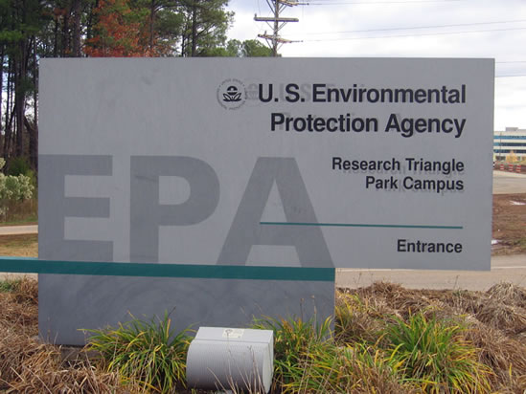
Proposed Adoption of Federal Air Quality Regulations
Jerry Ebersole
DEQ - AQ Division

Slide 2
Presentation Outline
Background
Proposed adoption of new federal regulations
Proposed rules to implement new federal emission guidelines
Proposed adoption of new federal plan
Proposed re-adoption of amended federal regulations
Recommendation

Slide 3
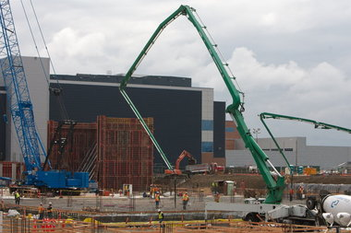
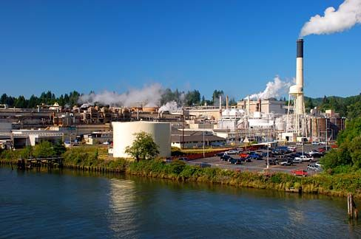
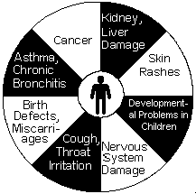
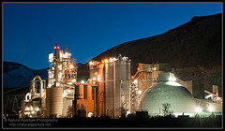
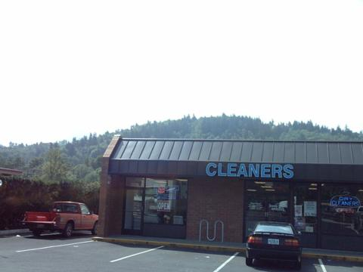
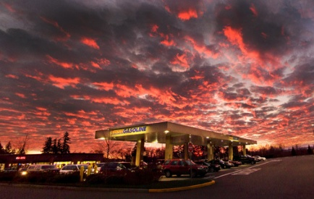
Background Information – Federal AQ Regulations
National Emission Standards for Hazardous Air Pollutants (NESHAP)
New Sources
Existing Sources
Pollutants
Sources
Hazardous Air Pollutants (HAP)
Major Sources
(> 10/25 tons)
Area Sources
(< 10/25 tons)

Slide 4
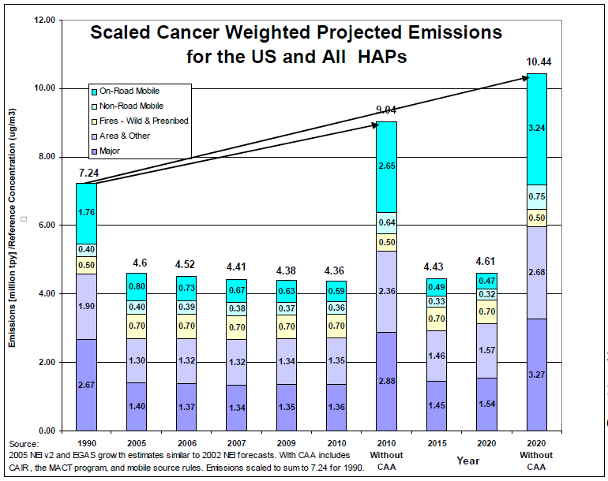
Background Information – NESHAP Program Benefits

Slide 5
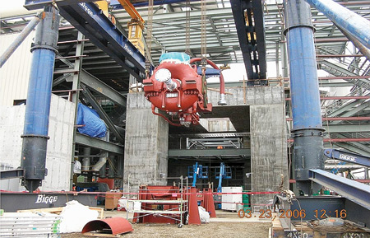
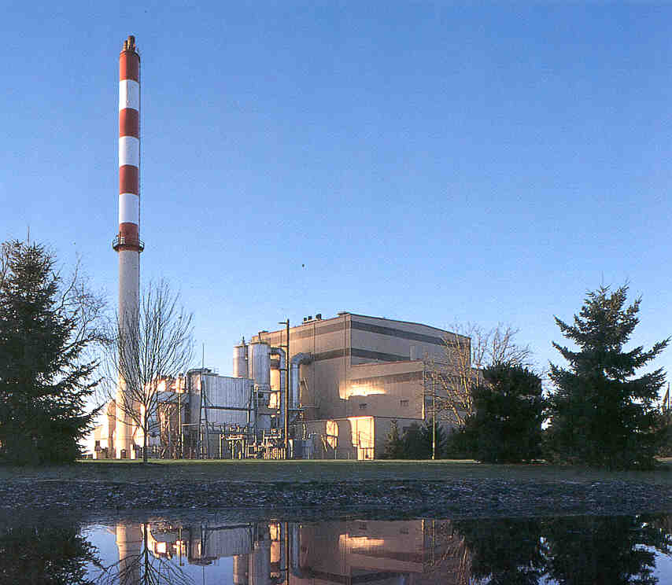
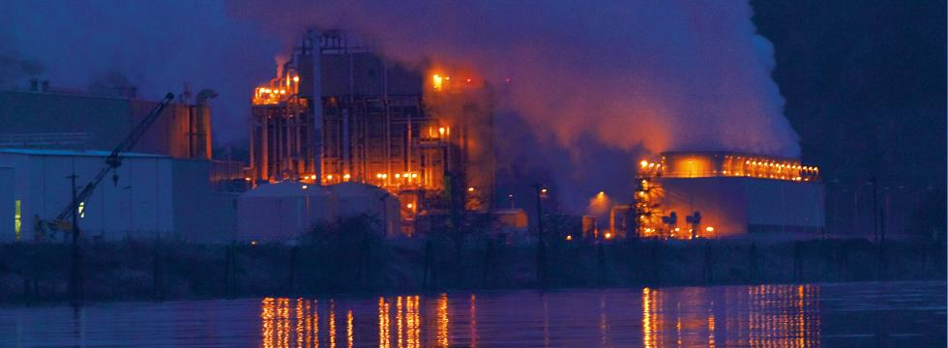
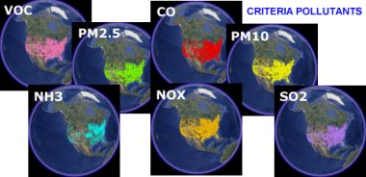
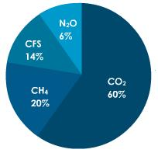
Background Information – Federal AQ Regulations
New Source Performance Standards (NSPS)
Emission Guidelines
New Sources
Existing Sources
Sources
Pollutants
HAPs
Criteria Pollutants
GHGs
Significant Sources

Slide 6
Background Information – Federal AQ Regulations
New Source Performance Standards (NSPS)
National Emission Standards for Hazardous Air Pollutants (NESHAP)
Emission Guidelines
(minimum performance standards)
EPA Adoption
Do not apply upon EPA adoption
(more flexibility for states)
EPA Adoption
Apply upon EPA adoption
(not much flexibility for states)
State Adoption/Implementation
Apply upon state adoption or adoption of federal plan

Slide 7
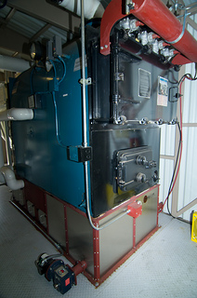
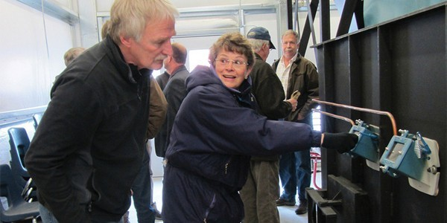
Proposed Rules Adopt new federal standards
New major source NESHAP (full adoption)
New area source NESHAP (partial adoption)
Permitted sources (Title V and ACDP)
DEQ implementation through permitting programs
Larger boilers (> 10 million Btu per hour)
Requirement - emission controls, tune-ups, energy assessment
Unpermitted sources
EPA implementation
Smaller boilers (< 10 million Btu per hour)
Requirement - tune-ups
Mostly schools
DEQ Small Business Program Assistance
HAPs reductions (nationwide)
HAPs addressed – acid HAPs, metal HAPs, organic HAPs
HAPs reduced – 32,000+ tons per year
PM and VOC reduced – 54,000+ tons per year
Boilers

Slide 8
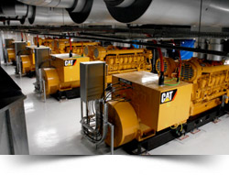
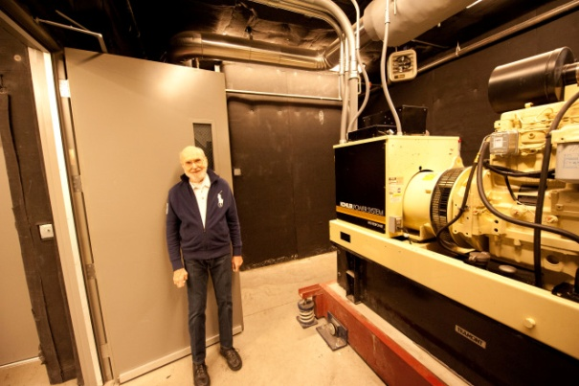
Proposed Rules Adopt new federal standards
New NESHAP and two new NSPSs (partial adoption)
Permitted sources (Title V and ACDP)
DEQ implementation through permitting programs
Large uncertified engines - significant requirements (see next slide)
Requirements - emission controls and ongoing testing
Unpermitted sources
EPA implementation
Certified engines; or
Small uncertified engines - less significant requirements
Emission controls and one-time testing; or
Tune-ups
Mostly schools
DEQ Small Business Program Assistance
HAPs reductions (nationwide)
HAPs addressed – acid HAPs, metal HAPs, organic HAPs
HAPs reduced – 2,700+ tons per year
PM, CO, NOx and VOC reduced – 85,000+ tons per year
Stationary Internal
Combustion Engines

Slide 9
Proposed Rules Adopt new federal standards
Stationary Internal Combustion Engines
 |  |  |  |  | Who
 | Engine | Engine | Compliance | Testing | Would
Standard | Type | Size | Option | Requirements | Implement
NESHAP | Non-emergency | > 500 HP | Emission standards | Initial/Ongoing | DEQ
 |  | 300 < HP < 500 | Emission standards | Initial | EPA
 |  | < 300 HP | Tune-ups | None | EPA
 | Emergency | Any | Tune-ups | None | EPA
NSPS Spark Ignition | Non-emergency | > 500 HP | Certified engine | None | EPA
 |  |  | Emission standards | Initial/Ongoing | DEQ
 |  | < 500 HP | Certified engine | None | EPA
 |  |  | Emission standards | Initial | EPA
 | Emergency | Any | Certified engine | None | EPA
 |  |  | Emission standards | Initial | EPA
NSPS Compression Ignition | Non-emergency | > 30 liters per cylinder | Emission standards | Initial/Ongoing | DEQ
 |  | > 500 HP | Certified engine | None | EPA
 |  |  | Emission standards | Initial/Ongoing | DEQ
 |  | < 30 liters/cylinder & < 500 HP | Certified engine | Initial | EPA
 |  |  | Emission standards | Initial | EPA
 | Emergency | Any | Certified engine | Initial | EPA
 |  |  | Emission standards | Initial | EPA

Slide 10
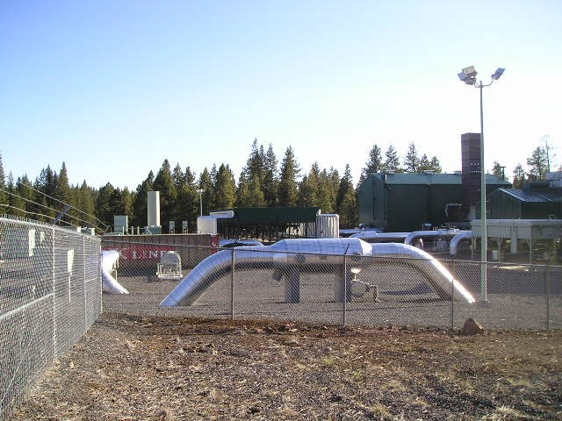
Proposed Rules Adopt new federal standards
Adopt by reference two additional new NSPSs:
Crude oil and natural gas production, transmission and distribution
Constructed after Aug. 23, 2011
Nitric acid plants
Constructed after Oct. 14, 2011

Slide 11
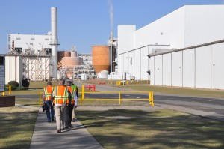
Proposed Rules – Adopt rules to implement federal emission guidelines
Emission Guidelines
Minimum performance standards
State required to:
Submit negative declaration (no sources);
Adopt rules and submit state plan; or
Request delegation of federal plan
Commercial/Industrial Solid Waste Incinerators
Two Oregon sources subject to standards
Adopt emission guidelines mostly by reference
Submit state plan
Hospital/Medical/Infectious Waste Incinerator
One Oregon source subject to recordkeeping, not standards
Adopt federal plan by reference
Submit delegation of federal plan request

Slide 12
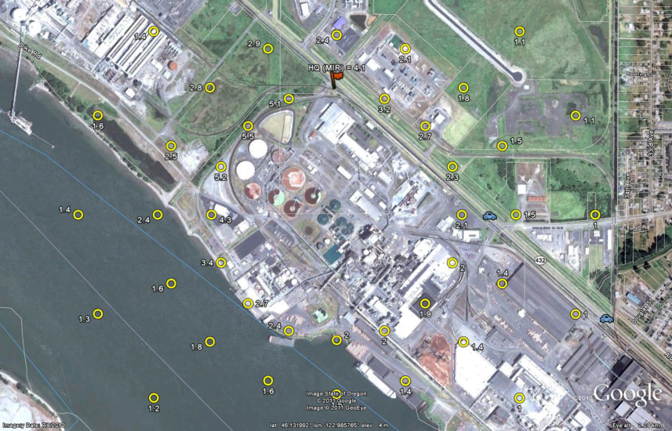
Proposed Rules Adopt by reference – amended federal standards
NESHAPs:
Address residual risk and technology advances
Chromium electroplating
Natural gas transmission and storage
Oil and natural gas production
Pulp and paper
Provide flexibility, technical corrections, clarification
Chemical manufacturing
Electric utility steam generating units
Petroleum refineries
Portland cement
NSPSs:
Provide flexibility, technical corrections, clarification
Commercial/industrial solid waste incinerators
Electric steam generating units
Hospital/medical/infectious waste incinerators
Petroleum refineries
Portland cement plants

Slide 13
Summary
This rulemaking proposes:
Adoption of new federal standards
Re-adoption of amended standards
Rules to implement new federal emission guidelines for commercial and industrial solid waste incineration units
Adoption of the federal plan for hospital, medical and infectious waste incinerators

Slide 14
Public Process
Public comment period – Nov. 18, 2013 – Dec. 23, 2013
Public hearing – Dec. 18, 2013
Attendees – 2
Comments
Northwest Pulp and Paper Association
Requested public comment period extension
DEQ extended public comment period
Associated Oregon Industries
Asked to be informed of any additional rule changes
EPA
Comments related to rules, CISWI Plan and HMIWI Delegation Request
DEQ made all requested changes

Slide 15
DEQ Recommendation
Adopt the proposed permanent rules in Attachment A as part of chapter 340 of the Oregon Administrative Rules.
Approve the state plan to implement new federal emission guidelines for commercial and industrial solid waste incineration units seen in Attachment B;
Approve the request for delegation of the federal plan for hospital, medical, and infectious waste incinerators seen in Attachment C; and
Direct DEQ to submit the state plan and delegation requests to the EPA for approval.

