Slide 1
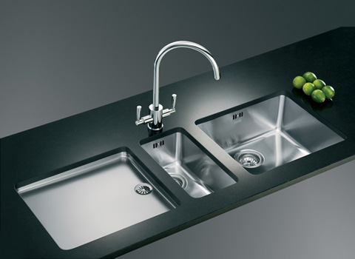
PERMITTING PROGRAM UPDATES
AKA Kitchen sink rules

Slide 2

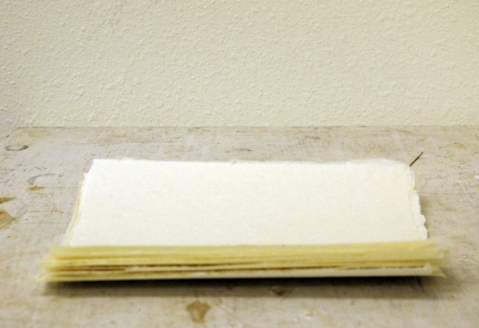
In a nutshell:
Move procedural requirements from definitions in Division 200
Division 200 after
Division 200 before

Slide 3
Nutshell 2
Combine redundant definitions and move to Division 200
Clarify requirements for how to:
Permit emergency generators
Permit sources that want to be combined or split
Grant extensions for NSR/PSD permits
Determine compliance for all standards

Slide 4

Nutshell 3:
Update Continuous Monitoring and Source Sampling Manuals (1992).
It’s about time!
CMM

Slide 5
Repeal:
4-County Rules (Clackamas, Columbia, Multnomah, Washington)
Primary Aluminum
Sulfite Pulp Mill
Laterite Ore Production of Ferronickel
Charcoal Plant
Spray Paint

Slide 6
NEW SOURCE REVIEW
Separate Major New Source Review from Minor New Source Review
Redefine Federal Major Source
100 tpy in NAA, transitional or maintenance area
Non-Federal Major = SER to 100 tpy

Slide 7
New Source Review (cont.)
Define “Transitional” Area:
Nonattainment Area that has 3 years of “clean” data but not yet designated maintenance by EPA
Define “Potential Nonattainment” Areas
Area that has monitored exceedances but not yet designated NAA by EPA or close to exceeding

Slide 8
New Source Review (cont.)
Source | Attainment | Potential NAA | NAA | Transitional | Maintenance
Federal Major | BACT Offsets Modeling | Preconstruction monitoring OR Can’t build | LAER Offsets (<1.2:1) | LAER Offsets (<1.2:1) | BACT Offsets (1.0:1) Modeling
Non-Federal Major | Modeling | Modeling OR Offsets (<1.0:1) | BACT Offsets (<1.0:1) | BACT Modeling OR Offsets (<1.0:1) | BACT Modeling OR Offsets (<1.0:1)

Slide 9

New Source Review (cont.)
Redefine Net Air Quality Benefit for Federal Major Sources (sorry Pat H! )
Require 1.2:1 offsets or
Reduce to 1.0:1 offsets by offsetting emissions from “priority” sources:
Woodstoves
Sources causing NAA problem
Modeling for PSD Class II Increments

Slide 10
New Source Review (cont.)
Give non-federal major sources more flexibility
Modeling OR
Allow < 1.0:1 offsets
Reduce to 0.5:1 offsets by offsetting emissions from “priority” sources:
Woodstoves
Sources causing NAA problem

Slide 11
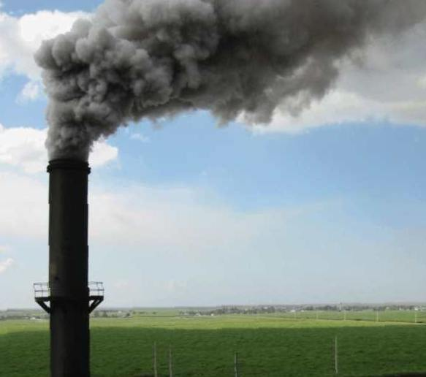

Last but not least……
Tighten grain loading and opacity standards for older sources that were built before June 1, 1970.
Change opacity from 3 minute aggregate in 60 minutes to 6-minute averages
WOLF!

