Slide 1

PERMITTING PROGRAM UPDATES
AKA Kitchen sink rules

Slide 2

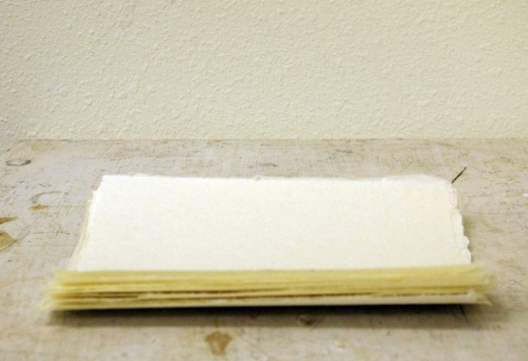
In a nutshell:
Move procedural requirements from definitions in Division 200
Division 200 after
Division 200 before

Slide 3
In a nutshell: (cont.)
Move procedural requirements from definitions to Division 222
actual emissions
netting basis
Division 222 before
baseline emission rate
baseline period
Division 222 after

Slide 4
Nutshell 2
Combine redundant definitions and move to Division 200
Move Division 200 tables to text
Clarify requirements for how to:
  Permit emergency generators
  Permit small sources subject NSPS/NESHAP
  Permit sources that want to be combined or split
  Grant extensions for NSR/PSD permits
  Determine compliance for all standards

Slide 5
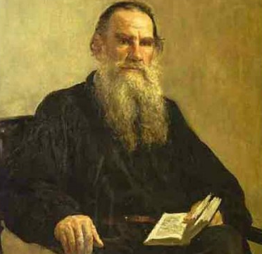
Nutshell 3:
Update Continuous Monitoring and Source Sampling Manuals (1992).
It’s about time!
CMM

Slide 6


Nutshell 4:
Require sources to keep copy of permit onsite
Require sources to submit permit application 180 days before permit needed
Where’s your permit?
Right here
ACDP

Slide 7
Repeal:
4-County Rules (Clackamas, Columbia, Multnomah, Washington)
Primary Aluminum
Sulfite Pulp Mill
Laterite Ore Production of Ferronickel
Charcoal Plant
Spray Paint
Federal Acid Rain Program rules for Western Backstop SO₂ Federal Trading Program (regional haze)
Sulfur Dioxide Emission Inventory

Slide 8
NEW SOURCE REVIEW
Separate Major New Source Review from State New Source Review
Redefine Major Source for Major NSR
  Federal major = 100 tpy in NAA, reattainment or maintenance area
  Federal major = 100/250 tpy in attainment and sustainment areas (retain current federal major definition)

Slide 9
NEW SOURCE REVIEW
Establish “state NSR” (anti-backsliding) program for
  New sources with SER to federal major source emission levels
  Major modifications at existing sources with SER to federal major source emission levels
  Federal major sources with PSEL increases more than SER that are not due to a major modification.
Move definition of “major modification” to Division 224.

Slide 10
New Source Review (cont.)
Define “Reattainment” Area:
  Nonattainment Area that has 3 years of “clean” data but not yet re-designated as attainment by EPA
Define “Sustainment” Areas
  Area with monitoring data close to or exceeding ambient standard but not yet designated NAA by EPA
Procedures for designating areas reattainment or sustainment

Slide 11
New Source Review (cont.)
Source | Attain-ment | Sustain-ment | Nonattain-ment | Reattain-ment | Main-tenance
Federal major (new source or major modification at existing source) | PSD: BACT Modeling | PSD Pre-construction monitoring OR can’t build Offsets (<1.0:1) | LAER Offsets (<1.2:1) | LAER Offsets (≤1.2:1) | BACT Modeling OR Offsets (1.0:1)
Non-federal major source or federal major source w/o major modification | Modeling | BACT if major modification Modeling OR Offsets (<1.0:1) | BACT if major modification Offsets (<1.0:1) | BACT if major modification Modeling OR Offsets (<1.0:1) | BACT if major modification Modeling OR Offsets (<1.0:1)

Slide 12
NSR Old vs. New
 | NONATTAINMENT AREAS
 | Current | Proposed
Source Classification | Major (SER or greater) | Federal Major | State NSR
Preconstruction Monitoring | n/a | n/a | n/a
Control Technology | LAER | LAER | BACT, if major modification
AQ analysis AQRV | n/a Federal majors | n/a Federal majors | n/a n/a
NAQB | Offsets 1.1:1 for ozone 1.0:1 for other pollutants, and NAQB Reduce impacts at majority of receptors; and Impacts less than SIL at all receptors | Offsets 1.1:1 for ozone ≤1.2:1 for other pollutants with provision to reduce the ratio to 1:1 if offsets are obtained from priority sources, and NAQB <SIL, or Competing source analysis <10% of NAAQS | Offsets 1.1:1 for ozone ≤1.0:1 for other pollutants with provision to reduce the ratio to 0.5:1 if offsets are obtained from priority sources, and NAQB <SIL, or Competing source analysis <10% of NAAQS

Slide 13
NSR Old vs. New (cont.)
 | MAINTENANCE AREAS
 | Current | Proposed
Source Classification | Major (SER or greater) | Federal Major | State NSR
Preconstruction Monitoring | √ | √ | n/a
Control Technology | BACT | BACT | BACT, if major modification
AQ Analysis AQRV | √ Federal Majors | √ Federal majors | √ Federal majors
NAQB | Offsets 1.1:1 for ozone 1.0:1 for other pollutants and NAQB Reduce impacts at majority of receptors; and Impacts less than SIL at all receptors Or Growth allowance Or Model below maintenance area limits | Offsets 1.1:1 for ozone ≤1.0:1 for other pollutants and NAQB Or Growth allowance Or Model below maintenance area limits | Offsets 1.1:1 for ozone ≤1.0:1 for other pollutants and NAQB <SIL, or Competing source analysis <10% of NAAQS Or Growth allowance Or Model below maintenance area limits

Slide 14

Net Air Quality Benefit
Redefine Net Air Quality Benefit for Federal Major Sources (sorry Pat H! )
  Require 1.2:1 offsets or
  Reduce ratio to 1.0:1 by offsetting emissions with “priority” source emissions:
    Woodstoves
    Sources causing NAA problem
  NAQB modeling backstop:
    Source analysis<SIL, or
    Competing source analysis <10% of NAAQS

Slide 15
Net Air Quality Benefit (cont.)
Give non-federal major sources more flexibility for NAQB:
  Allow < 1.0:1 offsets
    Reduce ratio to 0.5:1 by offsetting emissions with “priority” source emissions:
      Woodstoves
      Sources causing NAA problem
  NAQB modeling backstop:
    Source analysis<SIL, or
    Competing source analysis <10% of NAAQS

Slide 16
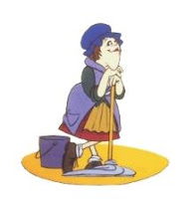
Housekeeping
Delete unused definitions
Correct spelling, rule references, etc
“the Department” to “DEQ”
Cite CFR date in definition and delete elsewhere
Diesel for Kevin Downing
Heat Smart for Rachel Sakata

Slide 17
Opacity
Change opacity from 3 minute aggregate in 60 minutes to 6-minute averages – EPA Method 9
Repeal 4-county 20% opacity for 30 seconds for non-fuel burning equipment

Slide 18
Opacity (cont.)
Tighten grain loading and opacity standards for older sources that were built before June 1, 1970.
Grate cleaning or soot blowing operations get 40% opacity as a six minute average
Defer grain loading compliance until January 31, 2016 for sources outside special control areas

Slide 19
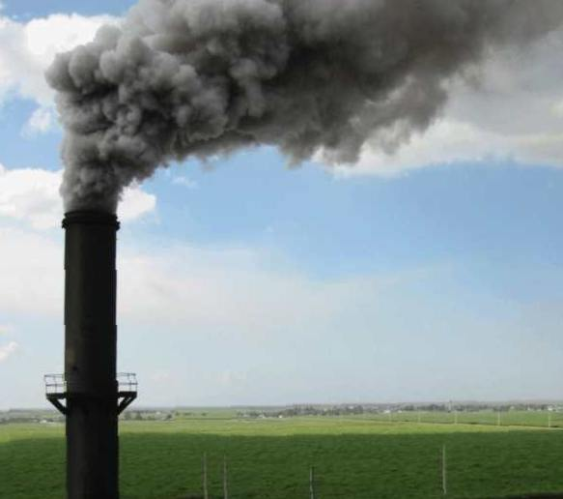

Last but not least……
Tighten grain loading and opacity standards if Andy agrees…………..
WOLF!

