Slide 1
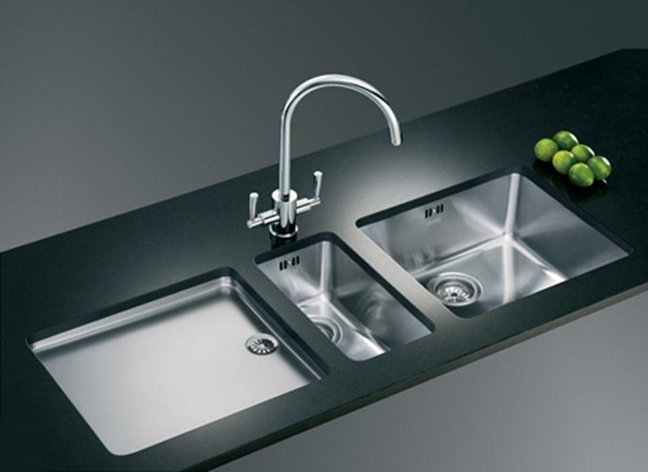
AKA Kitchen Sink Rules

Slide 2
Overview
Rule Improvements
Emission limits and standards
Compliance
Permitting Changes
New Source Review Program overhaul

Slide 3
Rule Improvements
Make the rules easier to use by reorganizing
Provide clarification when needed
Make housekeeping changes

Slide 4

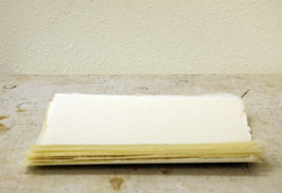
Move procedural requirements from definitions in Division 200
actual emissions
netting basis
baseline emission rate
baseline period
Division 200 after
Division 200 before

Slide 5


Combine redundant definitions and move to Division 200
Move Division 200 tables to text
Where are those tables??

Slide 6
Clarify requirements for how to:
Permit emergency generators and small fuel burning equipment
Permit small sources subject to NSPS/NESHAP
Permit sources that want to be combined or split
Grant extensions for NSR/PSD permits
Determine compliance for all standards

Slide 7
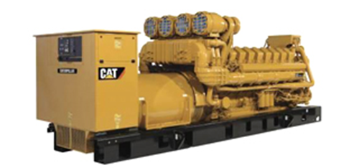
Permit emergency generators and pumps
rated individually at less than 500 horsepower
used only during loss of primary equipment or utility service due to circumstances beyond the reasonable control or to address a power emergency
emissions in aggregate are greater than the de minimis levels based on the readiness and testing hours of operation allowed by NSPS or NESHAP requirements or some other hours of operation specified in a permit;

Slide 8
Permit emergency generators and pumps – General Permit
27. Stationary reciprocating internal combustion engines used for electrical power generation or to power pumps or compressors, with a site rating of 500 horsepower or more, excluding 2-stroke lean burn engines
28. Stationary emergency generators and firewater pumps that are each rated at 500 horsepower or more

Slide 9
Permit emergency generators and pumps - PSEL
340-222-0041
(6) If a PSEL is established or revised to include emissions from activities that existed at a source prior to April 1, 2014 and which were previously considered categorically insignificant activities prior to April 1, 2014 , and results in a PSEL greater than the netting basis by greater than or equal to an SER as a result of this revision, the requirements of OAR 340-222-0041(4) do not apply. If the revised PSEL is greater than or equal to the SER above the netting basis, any future increase in the PSEL for any reason would be subject to OAR 340-222-0041(4).

Slide 10
Permit emergency generators and pumps – ____ ACDP
Sources with emissions less than the significant emission rate for any applicable pollutant that are subject to RACT, an NSPS adopted in OAR 340-238-0060 or a NESHAP adopted in OAR 340-244-0220, and which qualify for a Simple ACDP.
Simple ACDPs are SER-1

Slide 11
Permit sources that want to be combined or split
(2) When one source is split into two or more separate sources, the netting basis and SER can only be transferred to the new source or sources with the same primary 2-digit SIC as the original source or to a combined heat and power facility that had been supporting the primary SIC.
(a) The netting basis and the SER for the original source is split amongst the new sources as requested by the original permittee.

Slide 12
Permit sources that want to be combined or split
(b) The split of netting basis and SER must either:
(A) be sufficient to avoid Major New Source Review for each of the newly created sources or
(B) the newly created source(s) that become subject to Major New Source Review must comply with the requirements of OAR 340 division 224 before beginning operation under the new arrangement.

Slide 13
Permit sources that want to be combined or split
(c) The amount of the netting basis that is transferred to the combined heat and power facility may not exceed its potential to emit.
( DISINCENTIVE FOR SOURCES THAT WANT TO DO EPA’S COMBINED HEAT AND POWER? ALLOCATE NETTING BASIS BASED ON EMISSION UNITS? BUT NB IS PLANT WIDE. LOOK AT HISTORY?

Slide 14
Permit sources that want to be combined or split
(3) The owner or operator of the device or emissions unit must maintain records of physical changes and changes in operation occurring since the baseline period or most recent Major New Source Review action.

Slide 15
Grant extensions for NSR/PSD permits
(B) For the second extension the owner or operator must provide the following for the original pollutants subject to major NSR/PSD:
(i) A review of the original LAER or BACT analysis for potentially lower limits and a review of any new control technologies that may have become available since the original LAER or BACT analysis; and
(ii) A review of the air quality analysis to address any of the following;
(I) all ambient standards or increments that were subject to review under the original application;
(II) any new competing sources or changes in ambient air quality, including any redesignation of the area impacted, since the original application was submitted;
(III) any new ambient standards or increments for the regulated pollutants that were subject to review under the original application; and
(IV) any changes to EPA approved models since the original application was submitted.

Slide 16
Grant extensions for NSR/PSD permits
(C) DEQ will not grant a third extension and the original major NSR/PSD permit is automatically terminated no later than five years after it was issued.
(i) If the owner or operator wants approval to construct beyond the second extension, the owner or operator must submit a new major NSR/PSD permit application.
(ii) The owner or operator may continue to use the original emission reduction credits and any additional emission reduction credits that may become necessary for the project provided that the changes to the project do not result in a change to the two digit Standard Industrial Classification (SIC) code associated with the project and that the emission reduction credits will continue to satisfy the offset and net air quality benefit criteria.

Slide 17
Grant extensions for NSR/PSD permits
(b) If the owner or operator requests a construction extension as provided in subsection (a), DEQ will make the proposed permit available in accordance with the following public participation procedures:
(A) Category II for an extension that does not require an air quality analysis; or
(B) Category III for an extension that requires an air quality analysis.

Slide 18
Emission limits and standards
Repeal outdated rules
Neutral Sulfite Semi-Chemical (NSSC) Pulp Mills in division 234
Sulfite Pulp Mills in division 234
Primary Aluminum Standards in division 236
Laterite Ore Production of Ferronickel in division 236
Charcoal Producing Plants in division 240
Spray Paint in division 242
Federal Acid Rain Program rules for Western Backstop SO₂ Federal Trading Program in division 228 (regional haze)

Slide 19
Emission limits and standards
Update existing limits to address PM2.5
Opacity
Grain loading

Slide 20
3. New Source Review Program overhaul
Redefine major source - use EPA major source definition (EXAMPLES)
Define two new types of areas to improve or maintain air quality:
SUSTAINMENT – to help prevent an attainment area from becoming nonattainment (LAKEVIEW)
REATTAINMENT – to help transition an area from nonattainment back to maintenance (attainment) more quickly
Mandatory ambient air quality monitoring in some cases
Define State New Source Review Program (component of overall Minor New Source Review Program)
Redefine net air quality benefit
Revise offset ratios and provide incentives to obtain offsets from priority sources (GRAPHS)
Improve modeling procedures for demonstrating net air quality benefit (FIGURE)
Enhancements to Major and State New Source Review Programs
Offsets from “priority” sources
Increased offset ratio

Slide 21
4. Compliance
Update continuous monitoring and source test manuals
Excess emissions
Test methods with all standards

Slide 22
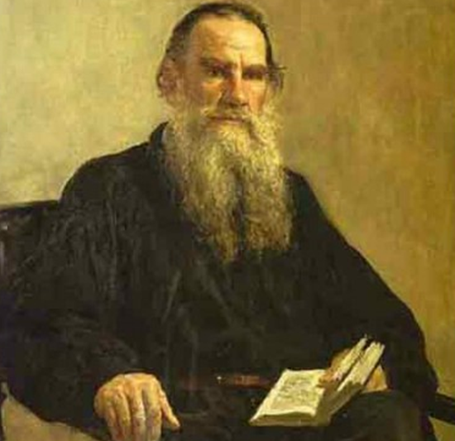

Update Continuous Monitoring and Source Sampling Manuals (1992).
It’s about time!

Slide 23
Compliance
Excess emissions

Slide 24
Determine compliance for all standards
Some standards do not include test methods so compliance demonstrations are not clear. DEQ is adding test methods to all standards along with a testing and monitoring section to rules that do not already have them.

Slide 25
Rule Improvements
Make the rules easier to use by reorganizing
Provide clarification when needed
Make housekeeping changes
Emission limits and standards
Repeal outdated rules
Update existing limits to address PM2.5
Opacity
Grain loading
New Source Review Program overhaul
Redefine major source - use EPA major source definition (EXAMPLES)
Define two new types of areas to improve or maintain air quality:
SUSTAINMENT – to help prevent an attainment area from becoming nonattainment (LAKEVIEW)
REATTAINMENT – to help transition an area from nonattainment back to maintenance (attainment) more quickly
Mandatory ambient air quality monitoring in some cases
Define State New Source Review Program (component of overall Minor New Source Review Program)
Redefine net air quality benefit
Revise offset ratios and provide incentives to obtain offsets from priority sources (GRAPHS)
Improve modeling procedures for demonstrating net air quality benefit (FIGURE)
Enhancements to Major and State New Source Review Programs
Offsets from “priority” sources
Increased offset ratio
Compliance
Update continuous monitoring and source test manuals
Excess emissions
Test methods with all standards
Permitting Changes
Revise definition of categorically insignificant activities
Update ACDP source categories - Table 1 changes
Improve ACDP timeliness

Slide 26
Permitting Changes
Revise definition of categorically insignificant activities
Update ACDP source categories - Table 1 changes
Improve ACDP timeliness

Slide 27
Categorically insignificant activities
Distillate oil, kerosene, and gasoline fuel burning equipment rated at less than or equal to 0.4 million Btu/hour each unless the emissions from this activity, in aggregate, are greater than the de minimis levels for any pollutant;
Natural gas and propane burning equipment rated at less than or equal to 2.0 million Btu/hour each unless the emissions from this activity, in aggregate, are greater than the de minimis levels for any pollutant;

Slide 28
Permitting Changes
Update ACDP source categories - Table 1 changes

Slide 29
Permitting Changes
Improve ACDP timeliness
DEQ is proposing a change to when Air Contaminant Discharge Permit holders are required to submit renewal or modification applications. Currently these businesses are required to submit applications 60 days before a permit is needed. Some ACDPs are quite complicated and changes to the permit cannot be completed in 60 days. Therefore, DEQ is requiring these applications to be submitted 180 days before a permit is needed, rather than 60 days. This change will help DEQ issue more timely permits.

Slide 30



Require sources to keep copy of permit onsite
Require sources to submit permit application 180 days before permit needed
Right here
ACDP

Slide 31
Repeal:
Primary Aluminum
Sulfite Pulp Mill
Laterite Ore Production of Ferronickel
Charcoal Plant
Spray Paint
Federal Acid Rain Program rules for Western Backstop SO₂ Federal Trading Program (regional haze)
Sulfur Dioxide Emission Inventory

Slide 32
Grant extensions for NSR/PSD permits
(A) For the first extension, the owner or operator must provide a LAER or BACT analysis, as applicable, if any new control technologies become commercially available since the original LAER or BACT analysis for the original pollutants subject to major NSR/PSD.

Slide 33
NEW SOURCE REVIEW
Separate Major New Source Review from State New Source Review
Redefine Major Source for Major NSR
Federal major = 100 tpy in NAA, reattainment or maintenance area
Federal major = 100/250 tpy in attainment and sustainment areas (retain current federal major definition)

Slide 34
NEW SOURCE REVIEW
Establish “state NSR” (anti-backsliding) program for
New sources with SER to federal major source emission levels
Major modifications at existing sources with SER to federal major source emission levels
Federal major sources with PSEL increases more than SER that are not due to a major modification.
Move definition of “major modification” to Division 224.

Slide 35
New Source Review (cont.)
Define “Reattainment” Area:
Nonattainment Area that has 3 years of “clean” data but not yet re-designated as attainment by EPA
Define “Sustainment” Areas
Area with monitoring data close to or exceeding ambient standard but not yet designated NAA by EPA
Procedures for designating areas reattainment or sustainment

Slide 36
New Source Review (cont.)
Source | Attain-ment | Sustain-ment | Nonattain-ment | Reattain-ment | Main-tenance
Federal major (new source or major modification at existing source) | PSD: BACT Modeling | PSD Pre-construction monitoring OR can’t build Offsets (<1.0:1) | LAER Offsets (<1.2:1) | LAER Offsets (≤1.2:1) | BACT Modeling OR Offsets (1.0:1)
Non-federal major source or federal major source w/o major modification | Modeling | BACT if major modification Modeling OR Offsets (<1.0:1) | BACT if major modification Offsets (<1.0:1) | BACT if major modification Modeling OR Offsets (<1.0:1) | BACT if major modification Modeling OR Offsets (<1.0:1)

Slide 37
NSR Old vs. New
 | NONATTAINMENT AREAS
 | Current | Proposed
Source Classification | Major (SER or greater) | Federal Major | State NSR
Preconstruction Monitoring | n/a | n/a | n/a
Control Technology | LAER | LAER | BACT, if major modification
AQ analysis AQRV | n/a Federal majors | n/a Federal majors | n/a n/a
NAQB | Offsets 1.1:1 for ozone 1.0:1 for other pollutants, and NAQB Reduce impacts at majority of receptors; and Impacts less than SIL at all receptors | Offsets 1.1:1 for ozone ≤1.2:1 for other pollutants with provision to reduce the ratio to 1:1 if offsets are obtained from priority sources, and NAQB <SIL, or Competing source analysis <10% of NAAQS | Offsets 1.1:1 for ozone ≤1.0:1 for other pollutants with provision to reduce the ratio to 0.5:1 if offsets are obtained from priority sources, and NAQB <SIL, or Competing source analysis <10% of NAAQS

Slide 38
 | MAINTENANCE AREAS
 | Current | Proposed
Source Classification | Major (SER or greater) | Federal Major | State NSR
Preconstruction Monitoring | √ | √ | n/a
Control Technology | BACT | BACT | BACT, if major modification
AQ Analysis AQRV | √ Federal Majors | √ Federal majors | √ Federal majors
NAQB | Offsets 1.1:1 for ozone 1.0:1 for other pollutants and NAQB Reduce impacts at majority of receptors; and Impacts less than SIL at all receptors Or Growth allowance Or Model below maintenance area limits | Offsets 1.1:1 for ozone ≤1.0:1 for other pollutants and NAQB Or Growth allowance Or Model below maintenance area limits | Offsets 1.1:1 for ozone ≤1.0:1 for other pollutants and NAQB <SIL, or Competing source analysis <10% of NAAQS Or Growth allowance Or Model below maintenance area limits

Slide 39
Net Air Quality Benefit
Redefine Net Air Quality Benefit for Federal Major Sources
Require 1.2:1 offsets or
Reduce ratio to 1.0:1 by offsetting emissions with “priority” source emissions:
Woodstoves
Sources causing NAA problem
NAQB modeling backstop:
Source analysis<SIL, or
Competing source analysis <10% of NAAQS

Slide 40
Net Air Quality Benefit (cont.)
Give non-federal major sources more flexibility for NAQB:
Allow < 1.0:1 offsets
Reduce ratio to 0.5:1 by offsetting emissions with “priority” source emissions:
Woodstoves
Sources causing NAA problem
NAQB modeling backstop:
Source analysis<SIL, or
Competing source analysis <10% of NAAQS

Slide 41
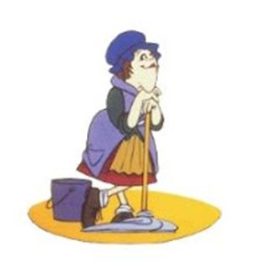
Housekeeping
Delete unused definitions
Correct spelling, rule references, etc
“the Department” to “DEQ”
Cite CFR date in definition and delete elsewhere
Diesel for Kevin Downing
Heat Smart for Rachel Sakata

Slide 42
Opacity
Change opacity from 3 minute aggregate in 60 minutes to 6-minute averages – EPA Method 9
Repeal 4-county 20% opacity for 30 seconds for non-fuel burning equipment

Slide 43
Opacity (cont.)
Tighten opacity standard for older sources that were built before June 1, 1970.
Grate cleaning or soot blowing operations get 40% opacity as a six minute average

Slide 44
Grain Loading
Tighten grain loading standard for older sources that were built before June 1, 1970.
Defer grain loading compliance until January 31, 2016 for sources outside special control areas

Slide 52

Any Questions?

