Slide 1

AKA Kitchen Sink Rules

Slide 2
Overview
Rule improvements
Update emission limits and standards
Compliance
Improve permit timeliness
New Source Review program overhaul

Slide 3

Rule Improvements
  Make the rules easier to use by reorganizing
  Provide clarification when needed
  Make housekeeping changes

Slide 4

Housekeeping
Delete unused/redundant definitions
Correct spelling, rule references, etc.
Change “the Department” to “DEQ”
Cite date of CFR in one rule and delete elsewhere
Diesel for Kevin Downing
Heat Smart for Rachel Sakata

Slide 5
Emission limits and standards
Repeal outdated rules:
Spray Paint VOC limits – replaced by EPA rules
Old regional haze rules:
  Western Backstop SO₂ Federal Trading Program
  Sulfur Dioxide Emission Inventory

Slide 6
Emission limits and standards
Repeal rules for sources that no longer exist in Oregon:
Neutral Sulfite Semi-Chemical Pulp Mills
Sulfite Pulp Mills
Primary Aluminum Standards
Laterite Ore Production of Ferronickel
Charcoal Producing Plants

Slide 7
Emission limits and standards
Update existing limits to address PM_{2.5} NAAQS
    Opacity
    Grain loading
      Requires changes to all permits – by addendum?

Slide 8
Justification
Analysis of a typical source with 40% opacity and 0.2 gr/dscf
Located in Klamath Falls PM2.5 NAA
Single source impacts approximately 30% of ambient standard
Add background (e.g. woodstove emissions) and impacts approximately 75% of standard.

Slide 9
Justification
Other affected sources are located in areas similar to Klamath Falls:
  Small communities that rely on woodstoves to heat homes
  Similar terrain
  Similar weather with potential for air stagnation periods in winter time.
One strategy to prevent violations of the PM2.5 ambient air quality standard

Slide 10
Opacity
Change opacity from 3 minute aggregate in 60 minutes to 6-minute averages – EPA Method 9 (consistent with other states)
Repeal 4-county 20% opacity for 30 seconds for non-fuel burning equipment

Slide 11
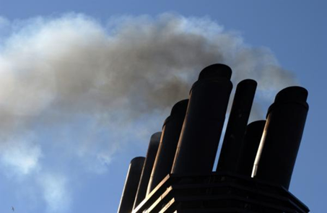
Opacity
Change opacity limit from 40% to
  20% for old sources (before 06/01/70) outside special control areas
Grate cleaning or soot blowing operations get one six minute period per hour at 40% opacity
Defer compliance until January 1, 2015 for sources outside special control areas

Slide 12
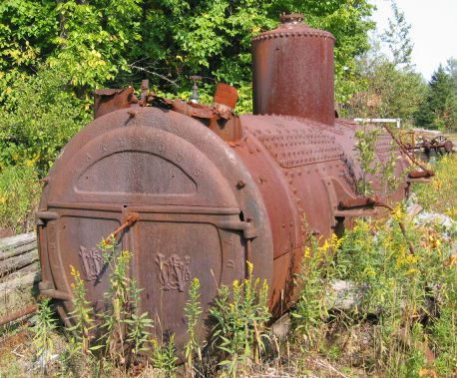
Grain loading
Source | Grain Loading Standards (gr/dscf)
 | Current Limit | Effective upon Rule Adoption | 2019
Built before 06/01/70 | 0.2 | 0.20 | 0.10
Built after 06/01/70 within 5 miles of “sensitive” area | 0.1 | 0.10 | 0.10
Built after 06/01/70 outside 5 miles of “sensitive” area | 0.1 | 0.1 | 0.10
“sensitive area” = sustainment area, nonattainment area, reattainment area, or maintenance area

Slide 13
Grain loading – sources may not meet 0.10 gr/dscf
Source | Permit No. | Emissions Unit | Comment
Boise Cascade (Pilot Rock) | 30-0016 | 3 wood-fired boilers | Backup to natural gas fired boiler. Boiler 1: 0.08-0.17 ; Boiler 3: 0.08-0.19
Collins (Fremont Sawmill) | 19-0002 | Two wood-fired boilers | Boiler 1: 0.13
Columbia Forest Products | 18-0014 | 2 wood-fired boilers (BLR-S and BLR-N) | BLR-S: 0.08 – 0.19; BLR-N: 0.09 – 0.14
Frank Lumber | 22-2525 | Wood fired boiler w/multiclones | 0.137
Harney Rock and Paving | 13-0010 | Asphalt plant | 0.22
Rogers Asphalt Paving | 31-0001 | Asphalt plant | 0.11
Swanson Group (Roseburg) | 10-0030 | Wood fired boiler | 0.17
Hampton Lumber | 04-0041 | Wood fired boiler | Trouble meeting 0.10, currently closed

Slide 14
Grain loading – sources may not meet 0.10 gr/dscf
Many of the sources have tested below the proposed limits, but do not comply all of the time.
What will sources have to do to comply with grain loading?
  Tuning – Boise Cascade Willamina 1977 28-MMBtu wood fired boiler; pre-test out of compliance; post-test less than 0.1 gr/dscf
  Consistent and dry fuel
  ESP = $450,000 to $1,500,000 (not likely, probably replace boiler with natural gas – fired boiler before adding ESP)

Slide 15
Clarify requirements for how to:
  Permit emergency generators and small fuel burning equipment
  Permit small sources subject to NSPS/NESHAP
  Permit sources that want to combine or split
  Determine compliance for all standards

Slide 16
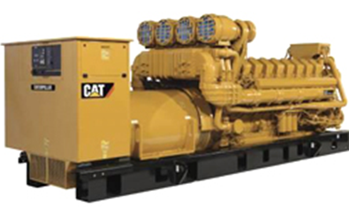
Permit emergency generators and pumps
  Currently all categorically insignificant, now significant if:
  rated individually at greater than 500 horsepower; or
emissions in aggregate are greater than 10 tons/year based on the readiness and maintenance testing hours of operation
General permit for few sources plus changes to other permits

Slide 17
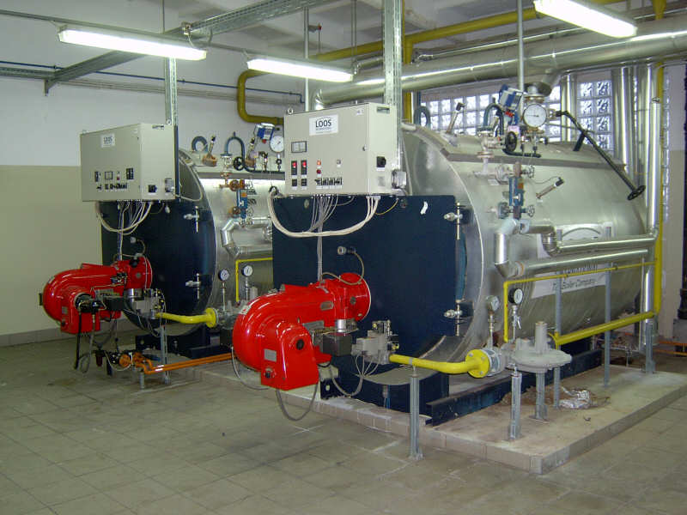
  Permit small fuel burning equipment
Currently considered categorically insignificant no matter how many at a source
Proposed rule will no longer consider small boilers categorically insignificant if emissions in aggregate are greater than the de minimis levels
More permits and changes to other permits upon renewal

Slide 18
  Permit small sources subject to NSPS or NESHAP
Sources with emissions less than 10 tons/year the significant emission rate that are subject to RACT, an NSPS or a NESHAP, and which qualify for a Simple ACDP.
Small increase in workload

Slide 19
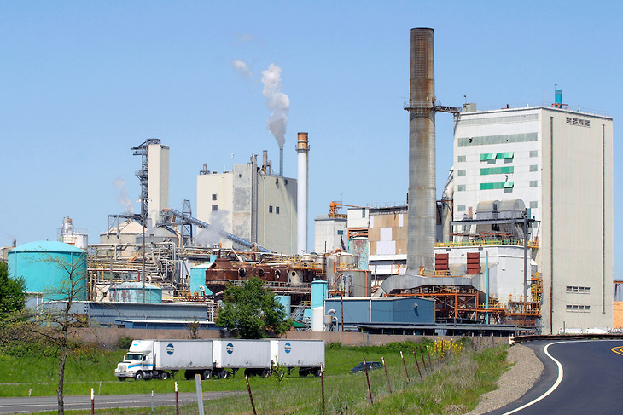
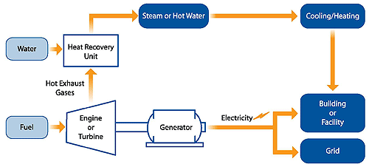
  Sources combining or splitting:
When one source splits, permitted emissions transfer to the new sources with the same primary 2-digit SIC as the original source or to a combined heat and power facility (aka co-gen) supporting the primary SIC.

Slide 20
Specify Compliance Methods for all Standards
Update continuous monitoring and source test manuals
Include test methods with all standards

Slide 21

  Improve ACDP timeliness
  Require applications to be submitted in line with permit timeliness targets:
      General ACDP reassignments: 30 days
      Basic ACDP renewal: 30 days
      Simple ACDP renewal: at least 120 days
      Standard ACDP renewal: at least 180 days

Slide 22
New Source Review (NSR)
Redefine the split between Major NSR and State NSR
Clarify all NSR requirements with separate sections for Major NSR and State NSR
Define two new area designations for maintaining and improving air quality

Slide 23
New Source Review (NSR)
No backsliding for federal major sources
Allow more flexibility for permitting small sources
Provide incentives for sources to get offsets from priority sources that have the most impact on air quality in an area

Slide 24
New Source Review
Source | Attain-ment | Sustain-ment | Nonattain-ment | Reattain-ment | Main-tenance
Federal major (new or modified source) | PSD: BACT Modeling | PSD Pre-construction monitoring OR can’t build Offsets (<1.0:1) | LAER Offsets (<1.2:1) | LAER Offsets (≤1.2:1) | BACT Modeling OR Offsets (1.0:1)
Non-federal major source or federal major source w/o major modification | Modeling | BACT if major modification Modeling OR Offsets (<1.0:1) | BACT if major modification Offsets (<1.0:1) | BACT if major modification Modeling OR Offsets (<1.0:1) | BACT if major modification Modeling OR Offsets (<1.0:1)

Slide 25
NSR Old vs. New
 | NONATTAINMENT AREAS
 | Current | Proposed
Source Classification | Major (SER or greater) | Federal Major | State NSR
Control Technology | LAER | LAER | BACT, if major modification
NAQB | Offsets 1.1:1 for ozone 1.0:1 for other pollutants, and NAQB Reduce impacts at majority of receptors; and Impacts less than SIL at all receptors | Offsets 1.1:1 for ozone ≤1.2:1 for other pollutants, reduce to 1:1 for offsets from priority sources, and NAQB <SIL, or Competing source analysis <10% of NAAQS | Offsets 1.1:1 for ozone ≤1.0:1 for other pollutants, reduce to 0.5:1 for offsets from priority sources, and NAQB <SIL, or Competing source analysis <10% of NAAQS

Slide 26
NSR Old vs. New
 | MAINTENANCE AREAS
 | Current | Proposed
Source Classification | Major (SER or greater) | Federal Major | State NSR
Preconstruction Monitoring | √ | √ | n/a
Control Technology | BACT | BACT | BACT, if major modification
NAQB | Offsets 1.1:1 for ozone 1.0:1 for other pollutants and NAQB Reduce impacts at majority of receptors; and Impacts less than SIL at all receptors | Offsets 1.1:1 for ozone ≤1.0:1 for other pollutants and NAQB | Offsets 1.1:1 for ozone ≤1.0:1 for other pollutants, reduce to 0.5:1 for offsets from priority sources, and NAQB <SIL, or Competing source analysis <10% of NAAQS

Slide 27
New Source Review
Define “Reattainment” Area:
  Nonattainment Area that has 3 years of “clean” data but not yet re-designated as attainment by EPA (undesignated maintenance area)
Define “Sustainment” Area:
  Area with monitoring data close to or exceeding ambient standard but not yet designated NAA by EPA (undesignated nonattainment area)

Slide 28
New Source Review
Lakeview will be first “Sustainment” Area
  Will help address AQ problems
  Could allow construction of smaller sources that currently couldn’t get permitted
  Will provide incentives for sources to get offsets are from “priority” sources (woodstoves)
  Will require pre-construction ambient monitoring for large sources

Slide 29
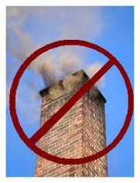
Net Air Quality Benefit
Redefine Net Air Quality Benefit for Federal Major Sources
  Require 1.2:1 offsets or
  Reduce ratio to 1.0:1 by offsetting emissions with “priority” source emissions:
    Woodstoves
    Sources causing NAA problem
  Modeling

Slide 30
Net Air Quality Benefit
Give non-federal major sources more flexibility for NAQB:
  Allow < 1.0:1 offsets
    Reduce ratio to 0.5:1 by offsetting emissions with “priority” source emissions:
      Woodstoves
      Sources causing NAA problem
  NAQB modeling

Slide 31
  Clarify extensions for NSR/PSD permits
Construction must begin within 18 months; if not:
First Extension:
Provide a control technology analysis if any new control technologies become commercially available since the original analysis

Slide 32
  Extensions for NSR/PSD permits
Second Extension:
Review of the original control technology analysis for potentially lower limits and if any new control technologies that become commercially available
Review of the air quality analysis to address:
all ambient standards or increments in original application;
any new competing sources or changes in ambient air quality, including any redesignation of the area impacted
any new ambient standards or increments
any changes to EPA approved models

Slide 33
  Extensions for NSR/PSD permits
No third extension allowed:
A new permit application is required
Source can continue to use the original emission reduction credits as long as changes to the project do not result in a change to the two digit SIC

Slide 34

Any Questions?

