Slide 1

AKA Kitchen Sink Rules

Slide 2
Overview
Rule improvements
Update emission limits and standards
Compliance
Improve permit timeliness
New Source Review program overhaul

Slide 3
Rule Clean-Up
Issue
Outdated rules
Unclear rules
Background/
Affected
State rules have been replaced by EPA rules
Sources no longer exist in Oregon

Slide 4
Rule Clean-Up
Recommendations
Repeal outdated rules
Reorganize rules so they are easier to use
Provide clarification when needed
Initial increased workload to update permits
DEQ Workload
Overall improved timeliness and efficiency down the road

Slide 5
Rule Clean-Up
No anticipated impact
Impacts on Industry
Rules will be easier to use
Impacts on Environmental Groups
Rules will be easier to use
No backsliding

Slide 6
Repeal outdated rules:
Spray Paint VOC limits – replaced by EPA rules
Old regional haze rules:
  Western Backstop SO₂ Federal Trading Program
  Sulfur Dioxide Emission Inventory

Slide 7
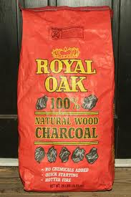
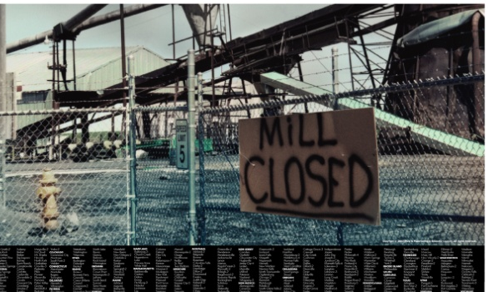
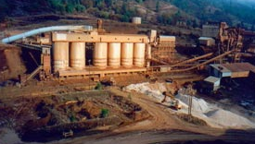
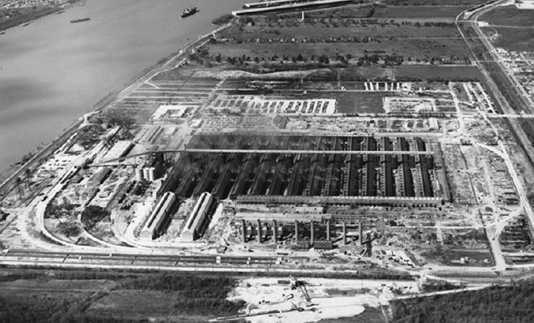
Repeal rules for sources that no longer exist in Oregon:
Neutral Sulfite Semi-Chemical Pulp Mills
Sulfite Pulp Mills
Primary Aluminum Standards
Laterite Ore Production of Ferronickel
Charcoal Producing Plants

Slide 8
Specify Compliance Methods for all Standards
Update continuous monitoring and source test manuals
Include test methods with all standards

Slide 9

  Improve ACDP timeliness
  Require applications to be submitted in line with permit timeliness targets:
      General ACDP reassignments: 30 days
      Basic ACDP renewal: 30 days
      Simple ACDP renewal: at least 120 days
      Standard ACDP renewal: at least 180 days

Slide 10
  Permit small sources subject to NSPS or NESHAP
Sources with emissions less than 10 tons/year the significant emission rate that are subject to RACT, an NSPS or a NESHAP, and which qualify for a Simple ACDP.
Small increase in workload

Slide 11
Update PM Standards
Issue
Potential exceedance of PM_{2.5} ambient standards in small communities that rely on woodstoves to heat homes
Background/
Affected
Pre-1970 sources have higher opacity and grain loading standards that were adopted when there was a much higher PM ambient standard
PM_{2.5} ambient standards adopted in 2007
Insufficient ambient data for most communities but data available for some communities suggest a larger problem

Slide 12
Update PM Standards
Recommendations
Reduce opacity and grain loading limits
Update all source specific permits primarily at renewal
DEQ Workload
Provide compliance schedule for sources that need more time to comply with lower limits

Slide 13
Update PM Standards
~ 6 hog fuel boilers
Impacts on Industry
Better air quality
Impacts on Environmental Groups
2 asphalt plants
May be able to comply with improved operation and maintenance programs

Slide 14
Emission limits and standards
Update existing limits to address PM_{2.5} NAAQS
    Opacity
    Grain loading
      Requires changes to all permits – by addendum?

Slide 15
Justification
Analysis of a typical source with 40% opacity and 0.2 gr/dscf
Located in Klamath Falls PM2.5 NAA
Single source impacts approximately 30% of ambient standard
Add background (e.g. woodstove emissions) and impacts approximately 75% of standard.

Slide 16
Justification
Other affected sources are located in areas similar to Klamath Falls:
  Small communities that rely on woodstoves to heat homes
  Similar terrain
  Similar weather with potential for air stagnation periods in winter time.
One strategy to prevent violations of the PM2.5 ambient air quality standard

Slide 17
Opacity
Change opacity from 3 minute aggregate in 60 minutes to 6-minute averages – EPA Method 9 (consistent with other states)
Repeal 4-county 20% opacity for 30 seconds for non-fuel burning equipment

Slide 18
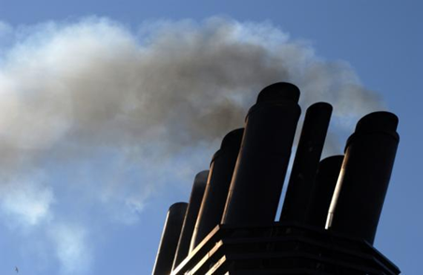
Opacity
Change opacity limit from 40% to
  20% for old sources (before 06/01/70) outside special control areas
Grate cleaning or soot blowing operations get one six minute period per hour at 40% opacity
Defer compliance until January 1, 2015 for sources outside special control areas

Slide 19
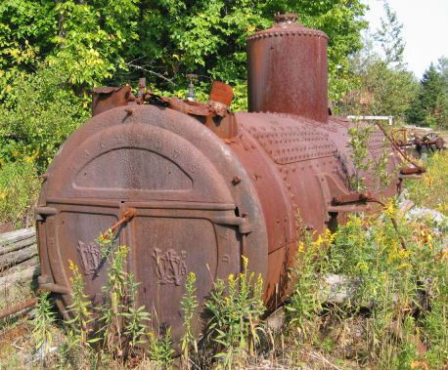
Grain loading
Source | Grain Loading Standards (gr/dscf)
 | Current Limit | Effective upon Rule Adoption | 2019
Built before 06/01/70 | 0.2 | 0.20 | 0.10
Built after 06/01/70 within 5 miles of “sensitive” area | 0.1 | 0.10 | 0.10
Built after 06/01/70 outside 5 miles of “sensitive” area | 0.1 | 0.1 | 0.10
“sensitive area” = sustainment area, nonattainment area, reattainment area, or maintenance area

Slide 20
Grain loading – sources may not meet 0.10 gr/dscf
Source | Permit No. | Emissions Unit | Comment
Boise Cascade (Pilot Rock) | 30-0016 | 3 wood-fired boilers | Backup to natural gas fired boiler. Boiler 1: 0.08-0.17 ; Boiler 3: 0.08-0.19
Collins (Fremont Sawmill) | 19-0002 | Two wood-fired boilers | Boiler 1: 0.13
Columbia Forest Products | 18-0014 | 2 wood-fired boilers (BLR-S and BLR-N) | BLR-S: 0.08 – 0.19; BLR-N: 0.09 – 0.14
Frank Lumber | 22-2525 | Wood fired boiler w/multiclones | 0.137
Harney Rock and Paving | 13-0010 | Asphalt plant | 0.22
Rogers Asphalt Paving | 31-0001 | Asphalt plant | 0.11
Swanson Group (Roseburg) | 10-0030 | Wood fired boiler | 0.17
Hampton Lumber | 04-0041 | Wood fired boiler | Trouble meeting 0.10, currently closed

Slide 21
Grain loading – sources may not meet 0.10 gr/dscf
Many of the sources have tested below the proposed limits, but do not comply all of the time.
What will sources have to do to comply with grain loading?
  Tuning – Boise Cascade Willamina 1977 28-MMBtu wood fired boiler; pre-test out of compliance; post-test less than 0.1 gr/dscf
  Consistent and dry fuel
  ESP = $450,000 to $1,500,000 (not likely, probably replace boiler with natural gas – fired boiler before adding ESP)

Slide 22
Permitting Small Sources
Issue
New NESHAP standards for previously insignificant sources
Background/
Affected
Emergency generators and small boilers originally thought to have insignificant emissions so did not account for them
Some small sources in aggregate have potentially significant emissions

Slide 23
Permitting Small Sources
Recommendations
Permit sources or include in existing permits
Need to revise a few existing permits
DEQ Workload
Rules include provisions to avoid triggering other regulatory requirements as a result of this rule change
May need to issue a few new permits (i.e., general permit)

Slide 24
Permitting Small Sources
Impacts on Industry
Better accounting of emissions from sources
Impacts on Environmental Groups
Source needs to provide permit information
A few sources will need to get permits (i.e., data centers)
Small emission increases in the future may trigger regulatory requirements for some larger sources

Slide 25
Clarify requirements for how to:
  Permit emergency generators and small fuel burning equipment
  Permit small sources subject to NSPS/NESHAP
  Permit sources that want to combine or split
  Determine compliance for all standards

Slide 26

Permit emergency generators and pumps
  Currently all categorically insignificant, now significant if:
  rated individually at greater than 500 horsepower; or
emissions in aggregate are greater than 10 tons/year based on the readiness and maintenance testing hours of operation
General permit for few sources plus changes to other permits

Slide 27
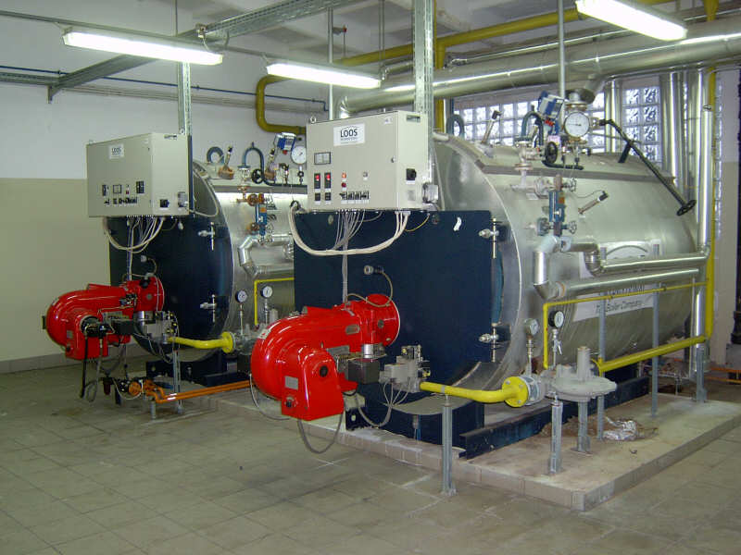
  Permit small fuel burning equipment
Currently considered categorically insignificant no matter how many at a source
Proposed rule will no longer consider small boilers categorically insignificant if emissions in aggregate are greater than the de minimis levels
More permits and changes to other permits upon renewal

Slide 28
New Source Review
Issue
Need prevention provisions in problem areas
Background/
Affected
The requirement for EPA redesignation delays implementing appropriate programs
Need incentives to address priority sources
Current rules prevent environmentally beneficial projects from going forward
Current program treats large and small sources the same but the federal program treats them differently

Slide 29
New Source Review
Recommendations
Establish sustainment areas to help prevent nonattainment
Initial workload increase for NSR permit writers to learn program revisions
DEQ Workload
Establish reattainment areas to remove barriers to development
Separate Major NSR from non-Major NSR
Potentially fewer major NSR permit actions

Slide 30
New Source Review
Higher offset ratios if using non-priority source offsets
Impacts on Industry
Improve AQ in areas near or over standard by providing incentives to reduce emissions from priority sources
Impacts on Environmental Groups
BACT instead of LAER in nonattainment areas for smaller sources
Required preconstruction monitoring for major sources in problem areas
More flexibility for smaller sources in problem areas

Slide 31
New Source Review (NSR)
Redefine the split between Major NSR and State NSR
Clarify all NSR requirements with separate sections for Major NSR and State NSR
Define two new area designations for maintaining and improving air quality

Slide 32
New Source Review (NSR)
No backsliding for federal major sources
Allow more flexibility for permitting small sources
Provide incentives for sources to get offsets from priority sources that have the most impact on air quality in an area

Slide 33
New Source Review
Source | Attain-ment | Sustain-ment | Nonattain-ment | Reattain-ment | Main-tenance
Federal major (new or modified source) | PSD: BACT Modeling | PSD Pre-construction monitoring OR can’t build Offsets (<1.0:1) | LAER Offsets (<1.2:1) | LAER Offsets (≤1.2:1) | BACT Modeling OR Offsets (1.0:1)
Non-federal major source or federal major source w/o major modification | Modeling | BACT if major modification Modeling OR Offsets (<1.0:1) | BACT if major modification Offsets (<1.0:1) | BACT if major modification Modeling OR Offsets (<1.0:1) | BACT if major modification Modeling OR Offsets (<1.0:1)

Slide 34
NSR Old vs. New
 | NONATTAINMENT AREAS
 | Current | Proposed
Source Classification | Major (SER or greater) | Federal Major | State NSR
Control Technology | LAER | LAER | BACT, if major modification
NAQB | Offsets 1.1:1 for ozone 1.0:1 for other pollutants, and NAQB Reduce impacts at majority of receptors; and Impacts less than SIL at all receptors | Offsets 1.1:1 for ozone ≤1.2:1 for other pollutants, reduce to 1:1 for offsets from priority sources, and NAQB <SIL, or Competing source analysis <10% of NAAQS | Offsets 1.1:1 for ozone ≤1.0:1 for other pollutants, reduce to 0.5:1 for offsets from priority sources, and NAQB <SIL, or Competing source analysis <10% of NAAQS

Slide 35
NSR Old vs. New
 | MAINTENANCE AREAS
 | Current | Proposed
Source Classification | Major (SER or greater) | Federal Major | State NSR
Preconstruction Monitoring | √ | √ | n/a
Control Technology | BACT | BACT | BACT, if major modification
NAQB | Offsets 1.1:1 for ozone 1.0:1 for other pollutants and NAQB Reduce impacts at majority of receptors; and Impacts less than SIL at all receptors | Offsets 1.1:1 for ozone ≤1.0:1 for other pollutants and NAQB | Offsets 1.1:1 for ozone ≤1.0:1 for other pollutants, reduce to 0.5:1 for offsets from priority sources, and NAQB <SIL, or Competing source analysis <10% of NAAQS

Slide 36
New Source Review
Define “Reattainment” Area:
  Nonattainment Area that has 3 years of “clean” data but not yet re-designated as attainment by EPA (undesignated maintenance area)
Define “Sustainment” Area:
  Area with monitoring data close to or exceeding ambient standard but not yet designated NAA by EPA (undesignated nonattainment area)

Slide 37
New Source Review
Lakeview will be first “Sustainment” Area
  Will help address AQ problems
  Could allow construction of smaller sources that currently couldn’t get permitted
  Will provide incentives for sources to get offsets are from “priority” sources (woodstoves)
  Will require pre-construction ambient monitoring for large sources

Slide 38
Net Air Quality Benefit (NAQB)
Issue
Current rules don’t allow environmentally beneficial offset projects because they cannot show NAQB unless offsetting source is co-located with new source
Background/
Affected
NAQB impossible to show unless co-located offsets
Sources that want to locate in or impact nonattainment areas cannot build
Low PM_{2.5} standard has revealed this problem

Slide 39
Net Air Quality Benefit (NAQB)
Recommendations
Create more offset provisions to provide incentives for using offsets from priority sources
Initial workload increase for permit writers/modelers to learn program revisions
DEQ Workload
Revise criteria for demonstrating NAQB that focuses more on the air quality problems in the area

Slide 40
Net Air Quality Benefit (NAQB)
Provides ability to show NAQB
Impacts on Industry
Increases offset ratios unless priority sources addressed
Impacts on Environmental Groups
Ensures ambient air quality standards are protected
Provides incentives to address priority sources

Slide 41
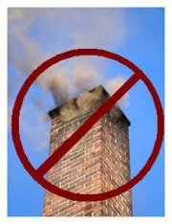
Net Air Quality Benefit
Redefine Net Air Quality Benefit for Federal Major Sources
  Require 1.2:1 offsets or
  Reduce ratio to 1.0:1 by offsetting emissions with “priority” source emissions:
    Woodstoves
    Sources causing NAA problem
  Modeling

Slide 42
Net Air Quality Benefit
Give non-federal major sources more flexibility for NAQB:
  Allow < 1.0:1 offsets
    Reduce ratio to 0.5:1 by offsetting emissions with “priority” source emissions:
      Woodstoves
      Sources causing NAA problem
  NAQB modeling

Slide 43
Extensions for NSR/PSD permits
Issue
If construction is delayed, ensure compliance with current rules
Background/
Affected
Unclear requirements for granting extensions
Recommendations
Specify requirements for 1st and 2nd extensions
No 3rd extensions

Slide 44
Extensions for NSR/PSD permits
Issue
If construction is delayed, ensure compliance with current rules
Background/
Affected
Unclear requirements for granting extensions
Recommendations
Specify requirements for 1st and 2nd extensions
No 3rd extensions

Slide 45
New Source Review
Recommendations
Establish sustainment areas to help prevent nonattainment
Initial workload increase for NSR permit writers to learn program revisions
DEQ Workload
Establish reattainment areas to remove barriers to development
Separate Major NSR from non-Major NSR
Potentially fewer major NSR permit actions

Slide 46
Extensions for NSR/PSD permits
Provides ability to show NAQB
Impacts on Industry
Increases offset ratios unless problem sources addressed
Impacts on Environmental Groups
Initial workload increase for NSR permit writers/modelers to learn program revisions
DEQ Workload
Provides incentives to address problem sources
Ensures NAAQS are protected

Slide 47
Extensions for NSR/PSD permits
Provides ability to show NAQB
Impacts on Industry
Increases offset ratios unless problem sources addressed
Impacts on Environmental Groups
Initial workload increase for NSR permit writers/modelers to learn program revisions
DEQ Workload
Provides incentives to address problem sources
Ensures NAAQS are protected

Slide 48
  Clarify extensions for NSR/PSD permits
Construction must begin within 18 months; if not:
First Extension:
Provide a control technology analysis if any new control technologies become commercially available since the original analysis

Slide 49
  Extensions for NSR/PSD permits
Second Extension:
Review of the original control technology analysis for potentially lower limits and if any new control technologies that become commercially available
Review of the air quality analysis to address:
all ambient standards or increments in original application;
any new competing sources or changes in ambient air quality, including any redesignation of the area impacted
any new ambient standards or increments
any changes to EPA approved models

Slide 50
  Extensions for NSR/PSD permits
No third extension allowed:
A new permit application is required
Source can continue to use the original emission reduction credits as long as changes to the project do not result in a change to the two digit SIC

Slide 51
Combining/Splitting Sources
Issue
If a source shuts down and/or repurposes, what happens to its emissions?
Background/
Affected
Sources could avoid NSR/PSD if they use emissions from a shutdown source
Recommendations
Transfer emissions to new source in same primary 2-digit SIC
Allow for cogen that supports primary activity

Slide 52
New Source Review
Recommendations
Establish sustainment areas to help prevent nonattainment
Initial workload increase for NSR permit writers to learn program revisions
DEQ Workload
Establish reattainment areas to remove barriers to development
Separate Major NSR from non-Major NSR
Potentially fewer major NSR permit actions

Slide 53
Combining/Splitting Sources
Limits ability to use emissions for unrelated projects
Impacts on Industry
Prevents NSR/PSD avoidance
Impacts on Environmental Groups
Initial workload increase for permit writers to learn program revisions
DEQ Workload
Clarifies requirements for splitting sources

Slide 54
Impacts on Industry
Impacts on Enviros
DEQ Workload
Sources that use retail spray paint in cans
Options/
Recommendations
Sources no longer exist in Oregon
State rules have been replaced by EPA
Background/Affected
Outdated rules
Issue

Slide 55

Any Questions?

