Slide 1
Air Quality
Comprehensive Rules
Overhaul
Notes:
Thank you for coming.....
DEQ is taking a comprehensive approach in this rulemaking that will move the AQ program ahead effectively
The AQ program needs to be maintained to keep the permitting program working well so we decided to undertake this rulemaking to not only maintain the program but to improve it.

Slide 2
Rulemaking Goals
Make rules easier to use
Update rules
Provide more flexibility for smaller businesses while addressing air quality problems
Provide incentives to address air quality problems
Notes:
An example of making our rules easier to make sure the language is easy to understand so businesses know exactly what they have to do to comply.
While providing more flexibility for smaller sources, we are making sure that air quality requirements are maintained.

Slide 3
Overview
Rule clean-up
Update particulate matter (PM) standards
Permitting small sources
Splitting businesses
New Source Review (NSR)
Net air quality benefit for sensitive areas
Extensions for NSR permits
Notes:
The particulate matter standards we’re updating are the general statewide grain loading and opacity standards. We are not changing the industry specific standards.
New Source Review is a construction approval program that applies when major sources want to build or modify.
We are proposing chances to the criteria for demonstrating that emissions offsets required for new or modified businesses in nonattainment and sensitive areas will provide a net air quality benefit to the area.
Our rules don’t address what happens if construction gets delayed for an NSR permit so we are adding more details.

Slide 4
Rule Clean-Up
Issue
Outdated rules
Unclear rules
Background/
Affected
State rules have been replaced by EPA rules
Businesses no longer exist in Oregon
Some definitions should be rules, not definitions
Notes:
Make the rules easier to use by reorganizing
Provide clarification when needed
Make housekeeping changes
Delete unused/redundant definitions
Correct spelling, rule references, etc.
Update Continuous Monitoring and Source Sampling Manual

Slide 5
Rule Clean-Up
Recommendations
Repeal outdated rules
Reorganize rules so they are easier to use
Provide clarification when needed
Initial increase in workload to update permits
DEQ Workload
Overall improved timeliness and efficiency down the road
Will not change stringency
Notes:
Repeal outdated rules:
Spray Paint VOC limits – replaced by EPA rules
Old regional haze rules:
Western Backstop SO₂ Federal Trading Program
Sulfur Dioxide Emission Inventory
Repeal rules for sources that no longer exist in Oregon:
Neutral Sulfite Semi-Chemical Pulp Mills
Sulfite Pulp Mills
Primary Aluminum Standards
Laterite Ore Production of Ferronickel
Charcoal Producing Plants
Specify Compliance Methods for all Standards
Update continuous monitoring and source test manuals
Include test methods with all standards

Slide 6
Rule Clean-Up
No anticipated impact
Impacts on Business
Rules will be easier to use and comply with
Impacts on Environment
Rules will be easier to use for businesses not familiar with OR program
Maintain overall stringency
Notes:
Improve ACDP timeliness
Require applications to be submitted in line with permit timeliness targets:
General ACDP reassignments: 30 days
Basic ACDP renewal: 30 days
Simple ACDP renewal: at least 120 days
Standard ACDP renewal: at least 180 days

Slide 7
Rule Clean-Up
Delete after other changes are made to keep numbering

Slide 8
Rule Clean-Up
Repeal rules:
Spray Paint VOC limits – replaced by EPA rules
Western Backstop SO₂ Federal Trading Program – Old regional haze rules:

Slide 9
Repeal existing source rules:
Neutral Sulfite Semi-Chemical Pulp Mills
Sulfite Pulp Mills
Primary Aluminum Standards
Laterite Ore Production of Ferronickel
Charcoal Producing Plants

Slide 10
Update PM Standards
Issue
Potential exceedances of PM_{2.5} ambient standards
Background/
Affected
Pre-1970 equipment have higher opacity and grain loading standards
PM_{2.5} ambient standards adopted in 2007
Data available for some communities suggest there might be a problem in other communities
Standards were adopted when there was a much higher PM ambient standard
Notes:
Justification
Analysis of a typical source with 40% opacity and 0.2 gr/dscf
Located in Klamath Falls PM2.5 NAA
Single source impacts approximately 30% of ambient standard
Add background (e.g. woodstove emissions) and impacts approximately 75% of standard.
Other affected sources are located in areas similar to Klamath Falls:
Small communities that rely on woodstoves to heat homes
Similar terrain
Similar weather with potential for air stagnation periods in winter time.
One strategy to prevent violations of the PM2.5 ambient air quality standard

Slide 11
Update PM Standards
Recommendations
Reduce opacity limit from 40% to 20%
Update all source specific permits, primarily at renewal
DEQ Workload
Phase in changes for businesses that need more time to comply
Reduce grain loading limit from 0.2 to 0.10 gr/dscf
Notes:
Change opacity from 3 minute aggregate in 60 minutes to 6-minute averages – EPA Method 9 (consistent with other states)
Repeal 4-county 20% opacity for 30 seconds for non-fuel burning equipment
Change opacity limit from 40% to 20% for old sources (before 06/01/70) outside special control areas
Grate cleaning or soot blowing operations get one six minute period per hour at 40% opacity
Defer compliance until January 1, 2015 for sources outside special control areas

Slide 12
Update PM Standards
11 wood fired boilers & 2 asphalt plants may not meet lower grain loading standard
Impacts on Business
Better air quality
Impacts on Environment
May be able to comply with improved O&M
Lower opacity not an issue – grate cleaning allowance provided
Notes:
Many of the sources have tested below the proposed limits, but do not comply all of the time.
What will sources have to do to comply with grain loading?
Tuning – Boise Cascade Willamina 1977 28-MMBtu wood fired boiler; pre-test out of compliance; post-test less than 0.1 gr/dscf
Consistent and dry fuel
ESP = $450,000 to $1,500,000 (not likely, probably replace boiler with natural gas – fired boiler before adding ESP)

Slide 13
Opacity
Change opacity from 3 minute aggregate in 60 minutes to 6-minute averages – EPA Method 9 (consistent with other states)
Repeal 4-county 20% opacity for 30 seconds for non-fuel burning equipment

Slide 14
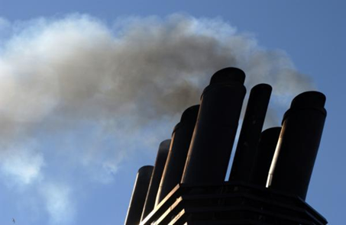
Opacity
Change opacity limit from 40% to
  20% for old equipment (before 06/01/70) outside special control areas
Grate cleaning or soot blowing operations get one six minute period per hour at 40% opacity
Defer compliance until January 1, 2015 for businesses outside special control areas

Slide 15
Justification
Analysis of a typical source with 40% opacity and 0.2 gr/dscf
Located in Klamath Falls PM2.5 NAA
Single source impacts approximately 30% of ambient standard
Add background (e.g., woodstove emissions) and impacts approximately 75% of standard.

Slide 16
Justification
Other affected businesses are located in areas similar to Klamath Falls:
  Small communities that rely on woodstoves to heat homes
  Similar terrain
  Similar weather with potential for air stagnation periods in winter time.
Help prevent violations of the PM2.5 ambient air quality standard

Slide 17
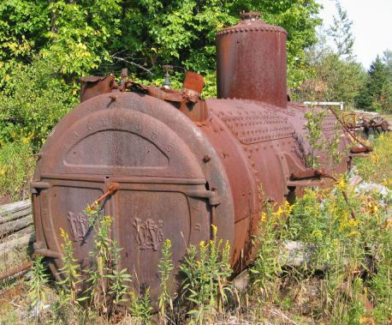
Grain loading
Source | Grain Loading Standards (gr/dscf)
 | Current Limit | Effective upon Rule Adoption | 2019
Built before 06/01/70 | 0.2 | 0.20 | 0.10
Built after 06/01/70 within 5 miles of “sensitive” area | 0.1 | 0.10 | 0.10
Built after 06/01/70 outside 5 miles of “sensitive” area | 0.1 | 0.1 | 0.10
“sensitive area” = sustainment area, nonattainment area, reattainment area, or maintenance area

Slide 18
Grain loading – businesses may not meet 0.10 gr/dscf
Many of the units have tested below the proposed limits, but do not comply all of the time.
What will businesses have to do to comply with grain loading?
  Tuning: 1977 28 MMBtu wood fired boiler; pre-test out of compliance; post-test less than 0.1 gr/dscf
  Consistent and dry fuel
  Some may need improved combustion controls, ESP, or will convert to natural gas

Slide 19
OPACITY CHART AND MOVE
Categories most affected by grain loading change:
  Pre – 1970 wood fired boilers
Grain loading ranges from 0.06 to 0.21 gr/dscf
Source | Permit No. | Emissions Unit | Comment
Boise Cascade (Pilot Rock) | 30-0016 | 3 wood-fired boilers | 0.06-0.19
Collins (Fremont Sawmill) | 19-0002 | 2 wood-fired boilers | 0.08 - 0.13
Columbia Forest Products | 18-0014 | 2 wood-fired boilers | 0.08 – 0.19
Interfor Pacific | 18-0005 | 2 wood-fired boilers | 0.086 - 0.21
Frank Lumber | 22-2525 | Wood fired boiler | 0.137 , multiclone
Swanson Group (Roseburg) | 10-0030 | Wood fired boiler | 0.17

Slide 20
Permitting Small Sources
Issue
New NESHAP standards for previously insignificant sources
Background/
Affected
Emergency generators and small boilers were originally thought to have insignificant emissions
Multiple small sources in aggregate have potentially significant emissions
DEQ did not account for them
Notes:
Currently all categorically insignificant, now significant if:
rated individually at greater than 500 horsepower; or
emissions in aggregate are greater than 10 tons/year based on the readiness and maintenance testing hours of operation
General permit for few sources plus changes to other permits

Slide 21
Permitting Small Sources
Recommendations
Require approval to construct, may need a permit, or include in existing permit
Need to revise a few existing permits
DEQ Workload
Rules include provisions to avoid triggering other regulatory requirements solely as a result of this rule change
May need to issue a few new permits (i.e., general permit)

Slide 22
Permitting Small Sources
Impacts on Business
Better accounting of emissions from businesses
Impacts on Environment
Businesses need to provide emissions information
A few businesses will need permits (data centers)
Future small emission increases may trigger regulatory requirements for some larger businesses
Notes:
Currently considered categorically insignificant no matter how many at a source
Proposed rule will no longer consider small boilers categorically insignificant if emissions in aggregate are greater than the de minimis levels

Slide 23
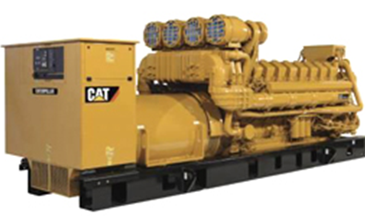
Permit emergency generators and pumps
  Currently all categorically insignificant
  Proposed significant if:
    Any individual engine rated at greater than 500 horsepower; or
  emissions in aggregate are greater than de minimis levels based on the readiness and maintenance testing hours of operation

Slide 24
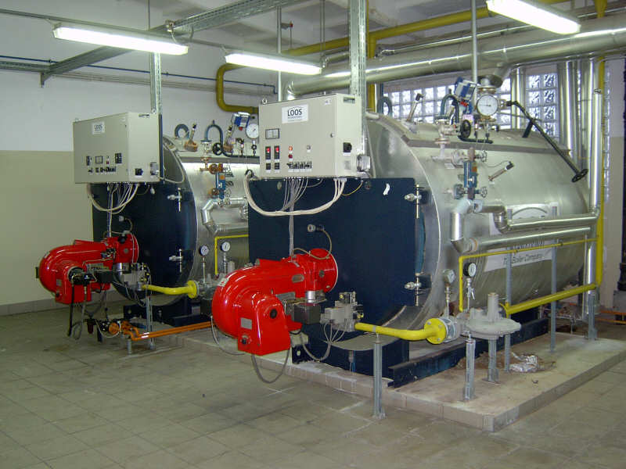
  Permit small fuel burning equipment
Currently considered categorically insignificant no matter how many at a source
Proposed rule considers small boilers significant if emissions in aggregate are greater than the de minimis levels

Slide 25
Splitting Businesses
Issue
If a business shuts down and/or repurposes, what happens to its emissions?
Background/
Affected
Potential for businesses to avoid construction approval if they use emissions from a shutdown

Slide 26
Splitting Businesses
Recommendations
Transfer emissions to:
Initial workload increase for permit writers to learn program revisions
DEQ Workload
a cogen that supported primary activity
Provides clarification that will reduce workload
new business in same primary 2-digit SIC, or

Slide 27
Splitting Businesses
Limits ability to use emissions for unrelated projects
Impacts on Business
Ensures construction approval
Impacts on Environment
Clarifies requirements for splitting sources

Slide 28
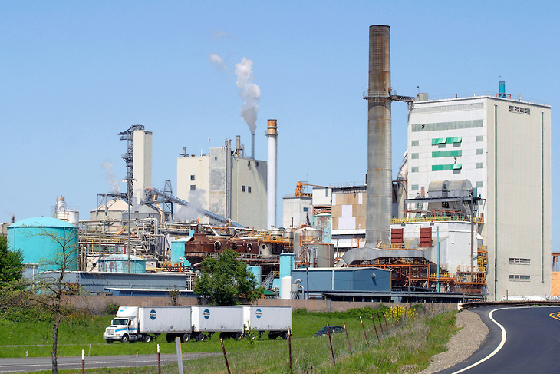
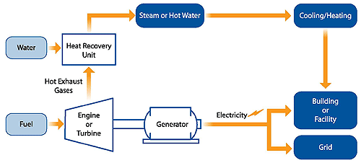
Splitting Businesses
When one business splits, permitted emissions transfer to the new businesses with the same primary 2-digit SIC as the original business or to a combined heat and power facility (aka co-gen) that supported the primary SIC. (√ing w/BRAY)

Slide 29
New Source Review (NSR)
Issue
Need prevention provisions in problem areas
Background/
Affected
The requirement for EPA redesignation delays implementing appropriate programs
Need incentives to address priority sources
Current rules prevent environmentally beneficial projects from going forward
Current program treats large and small businesses the same but the federal program treats them differently
Notes:
What would PSD permitting be for Dallasport, WA?

Slide 30
New Source Review (NSR)
Recommendations
Establish sustainment areas to help prevent nonattainment
Training for NSR permit writers to learn program revisions
DEQ Workload
Establish reattainment areas to remove barriers to development
Separate Major NSR from non-Major NSR
Potentially fewer major NSR permit actions
Identify areas and develop prevention plans (e.g., PM Advance)
Notes:
Define “Reattainment” Area:
Nonattainment Area that has 3 years of “clean” data but not yet re-designated as attainment by EPA (undesignated maintenance area)
Define “Sustainment” Area:
Area with monitoring data close to or exceeding ambient standard but not yet designated NAA by EPA (undesignated nonattainment area)
Lakeview will be first “Sustainment” Area
Will help address AQ problems
Could allow construction of smaller sources that currently couldn’t get permitted
Will provide incentives for sources to get offsets are from “priority” sources (woodstoves)
Will require pre-construction ambient monitoring for large sources

Slide 31
New Source Review (NSR)
Higher offset ratios if using non-priority source offsets
Impacts on Business
Improve AQ in areas near or over standard by providing incentives to reduce emissions from priority sources
Impacts on Environment
Required preconstruction monitoring for major businesses in problem areas
More flexibility for smaller businesses that are not the cause of the problem
For smaller businesses in nonattainment areas require BACT instead of LAER
Notes:
Provides additional protection for areas at risk
Prevents NAA
Preconstruction monitoring could throw off financing. RST? Timelines?
Opens the door for Lakeview
Enables smaller sources to build at BACT before redesignated as maintenance

Slide 32
New Source Review (NSR)
Separate Major New Source Review from State New Source Review
Redefine Major Source for Major NSR
  Federal major = 100 tpy in NAA, reattainment or maintenance area
  Federal major = 100/250 tpy in attainment and sustainment areas (retain current federal major definition)

Slide 33
New Source Review (NSR)
Establish “state NSR” (equivalent stringency) program for
  New businesses with SER to federal major source emission levels
  Major modifications at existing businesses with SER to federal major source emission levels
  Federal major sources with PSEL increases more than SER that are not due to a major modification.

Slide 34
New Source Review (NSR)
Define “Reattainment” Area:
  Nonattainment Area that has 3 years of “clean” data but not yet re-designated as attainment by EPA
Define “Sustainment” Areas
  Area with monitoring data close to or exceeding ambient standard but not yet designated NAA by EPA
Procedures for designating areas reattainment or sustainment

Slide 35
New Source Review (NSR)
Source | Attainment | Sustainment | Nonattainment | Reattainment | Maintenance
Federal major (new or modified source) | PSD: BACT Modeling | PSD Pre-construction monitoring OR can’t build Offsets (<1.0:1) | LAER Offsets (<1.2:1) | LAER Offsets (≤1.2:1) | BACT Modeling OR Offsets (1.0:1)
Non-federal major source or federal major source w/o major modification | Modeling | BACT if major modification Modeling OR Offsets (<1.0:1) | BACT if major modification Offsets (<1.0:1) | BACT if major modification Modeling OR Offsets (<1.0:1) | BACT if major modification Modeling OR Offsets (<1.0:1)
Area designation for EPA purposes | Attainment | Attainment | Nonattainment | Nonattainment | Attainment
Notes:
Go over these tables now or later?

Slide 36
NSR Old vs. New
 | NONATTAINMENT AREAS
 | Current | Proposed
Source Classification | Major (SER or greater) | Federal Major | State NSR
Control Technology | LAER | LAER | BACT, if major modification
NAQB | Offsets 1.1:1 for ozone 1.0:1 for other pollutants, and NAQB Reduce impacts at majority of receptors; and Impacts less than SIL at all receptors | Offsets 1.1:1 for ozone ≤1.2:1 for other pollutants, reduce to 1:1 for offsets from priority sources, and NAQB <SIL, or Competing source analysis <10% of NAAQS | Offsets 1.1:1 for ozone ≤1.0:1 for other pollutants, reduce to 0.5:1 for offsets from priority sources, and NAQB <SIL, or Competing source analysis <10% of NAAQS

Slide 37
NSR Old vs. New
 | MAINTENANCE AREAS
 | Current | Proposed
Source Classification | Major (SER or greater) | Federal Major | State NSR
Preconstruction Monitoring | √ | √ | n/a
Control Technology | BACT | BACT | BACT, if major modification
NAQB | Offsets 1.1:1 for ozone 1.0:1 for other pollutants and NAQB Reduce impacts at majority of receptors; and Impacts less than SIL at all receptors | Offsets 1.1:1 for ozone ≤1.0:1 for other pollutants and NAQB | Offsets 1.1:1 for ozone ≤1.0:1 for other pollutants, reduce to 0.5:1 for offsets from priority sources, and NAQB <SIL, or Competing source analysis <10% of NAAQS

Slide 38
Net Air Quality Benefit (NAQB)
Issue
Current rules don’t allow community & environmentally beneficial offset projects because the source cannot show NAQB unless offsetting source is co-located with new source
Background/
Affected
Businesses that want to locate in or impact nonattainment areas cannot build
Lower PM_{2.5} standard has revealed this problem with the rules

Slide 39
Net Air Quality Benefit (NAQB)
Recommendations
Increase offset ratios
Training for permit writers/modelers to learn program revisions
DEQ Workload
Revise modeling criteria for NAQB
Reduce ratios if from priority sources
Focus on the local air quality problems
Notes:
Redefine Net Air Quality Benefit for Federal Major Sources
Require 1.2:1 offsets or
Reduce ratio to 1.0:1 by offsetting emissions with “priority” source emissions:
Woodstoves
Sources causing NAA problem
Modeling
Give non-federal major sources more flexibility for NAQB:
Allow < 1.0:1 offsets
Reduce ratio to 0.5:1 by offsetting emissions with “priority” source emissions:
Woodstoves
Sources causing NAA problem
NAQB modeling

Slide 40
Net Air Quality Benefit (NAQB)
Provides ability to show NAQB
Impacts on Business
Increases offset ratios unless priority sources addressed
Impacts on Environment
Ensures ambient air quality standards are protected
Provides incentives to address priority sources
Allow some projects to go forward
Notes:
Lakeview example

Slide 41
Net Air Quality Benefit (NAQB)
Redefine Net Air Quality Benefit for Federal Major Sources
  Require 1.2:1 offsets or
  Reduce ratio to not less than 1.0:1 by offsetting emissions with “priority” source emissions:
    Woodstoves
    Sources causing NAA problem
  NAQB modeling backstop:
    Source analysis<SIL, or
    Competing source analysis <10% of NAAQS

Slide 42
Net Air Quality Benefit (NAQB)
Give non-federal major sources more flexibility for NAQB:
  Allow < 1.0:1 offsets
    Reduce ratio to not less than 0.5:1 by offsetting emissions with “priority” source emissions:
      Woodstoves
      Sources causing NAA problem
  NAQB modeling backstop:
    Source analysis<SIL, or
    Competing source analysis <10% of NAAQS

Slide 43
Extensions for NSR/PSD permits
Issue
If construction is delayed, ensure compliance with current rules
Background/
Affected
Unclear requirements for granting extensions

Slide 44
Extensions for NSR/PSD permits
Recommendations
Specify requirements for 1st and 2nd extensions
Initial workload increase for NSR permit writers and modelers to learn program revisions
DEQ Workload
No 3rd extensions

Slide 45
Extensions for NSR/PSD permits
Clarifies requirements for extensions
Impacts on Business
Ensures NAAQS are protected
Impacts on Environment
Requires updates to application for additional delays
Ensures latest control technology used
Allows continued use of offsets if applicable

Slide 46
Extensions for NSR/PSD permits
For the first extension:
Review LAER or BACT analysis:
  for any new control technologies commercially available since the original LAER or BACT analysis
  for the original pollutants subject to major NSR/PSD

Slide 47
Extensions for NSR/PSD permits
For the second extension:
Review of the original LAER or BACT analysis for potentially lower limits and any new control technologies
Review of the air quality analysis to address the following since the original application was submitted:
    all ambient standards or increments reviewed under the original application
    any new competing sources or changes in ambient air quality, including any redesignation of the area impacted
    any new ambient standards or increments for pollutants that were reviewed under the original application
    any changes to EPA approved models

Slide 48
Extensions for NSR/PSD permits
No third extensions:
  Original major NSR/PSD permit automatically terminated five years after it was issued
  For approval beyond second extension, a new major NSR/PSD permit application must be submitted.
  Continued use of original emission reduction credits provided changes do not result in a change to the two digit SIC code and emission reduction credits continue to satisfy the offset and net air quality benefit criteria.

Slide 49
Extensions for NSR/PSD permits
Public participation procedures for extensions:
  minimum of 30 days to submit written comments for an extension that does not require an air quality analysis or
  minimum of 35 days to submit written comments and 30 day notice for a hearing if scheduled for an extension that requires an air quality analysis.

Slide 50

Any Questions?

Slide 51
Contact Information
Jill Inahara
503-229-5001
Inahara.jill@deq.state.or.us

