Slide 1
Permitting Small Sources
Issue/Background
Similar small sources previously considered insignificant not actually so when considered in aggregate
New NESHAP standards issued by EPA for small sources
DEQ did not previously account for emissions from these sources

Slide 2
Permitting Small Sources
Recommendations
No longer consider three classes of sources as categorically insignificant
Require construction approvals, permits in some cases, and include emission in existing permits
Exempt existing sources from triggering other regulatory requirements solely as a result of this rule change

Slide 3
Permitting Small Sources
Impacts on Business
Will need to provide emissions information for these small sources
A few businesses will need to get permits (data centers) and construction approval required for all
Small future emission increases may trigger other regulatory requirements for larger businesses
Impacts on Environment
Better accounting of emissions

Slide 4
2 Source Types Being Affected
Emergency generators and pumps
Small fuel burning equipment (boilers)
Natural gas
Propane
Distillate oil
Kerosene
Gasoline

Slide 5

Emergency generators and pumps
Currently all categorically insignificant no matter how large or how many at site
Proposed significant if:
Any individual engine rated at greater than 500 horsepower; or
emissions in aggregate are greater than de minimis levels of 1 ton/year based on the readiness and maintenance testing hours of operation

Slide 6
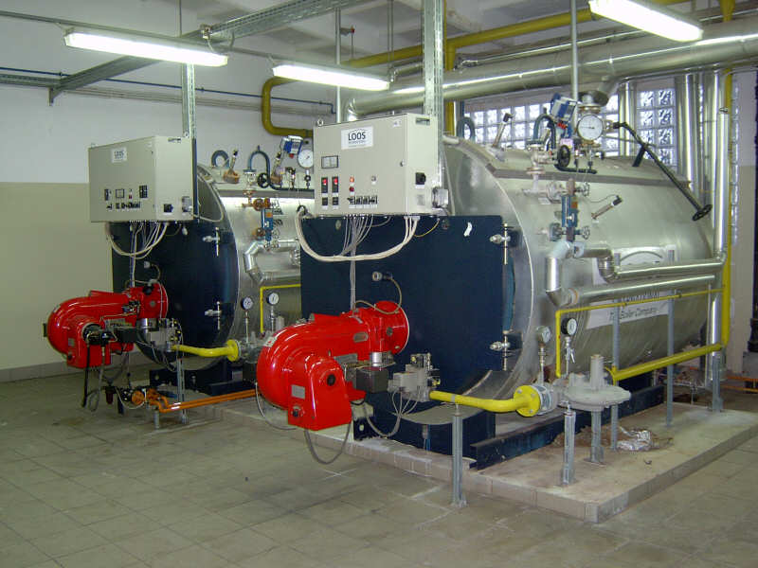
Small fuel burning equipment
Currently considered categorically insignificant no matter how many at a source
Proposed significant if emissions in aggregate are greater than the de minimis levels of 1 ton/year
Notes:
Units no longer considered insignificant. More stringent or have to get a permit? Not more stringent.

Slide 7
Splitting Businesses
Issue/Background
If a business shuts down, splits, and/or repurposes, what happens to its emissions?
Current rule allows for splitting but needs clarification
Potential for new business to avoid construction approval if they use emissions from a shutdown

Slide 8
Splitting Businesses
Recommendations
Clarify how emissions are treated when a business splits
Allow for transfer of emissions only to:
New business with same primary 2-digit SIC, or
A cogen that supported the original primary activity

Slide 9
Splitting Businesses
Impacts on Business
Limits ability to use emissions for unrelated projects
Clarifies requirements for splitting a source
Impacts on Environment
Ensures construction approval process if new type source is proposed

