Slide 1
Air Quality
Comprehensive Rules
Overhaul
Notes:
Thank you for coming.....
DEQ is taking a comprehensive approach in this rulemaking that will move the AQ program ahead effectively
The AQ program needs to be maintained to keep the permitting program working well so we decided to undertake this rulemaking to not only maintain the program but to improve it.

Slide 2
Rulemaking Goals
Make rules clearer and easier to comply with
Update rules
Address air quality problems while providing more flexibility for smaller businesses
Provide incentives to address air quality problems
Notes:
An example of making our rules easier to make sure the language is easy to understand so businesses know exactly what they have to do to comply.
While providing more flexibility for smaller sources, DEQ will ensure that air quality requirements will be maintained.

Slide 3
Overview
Rule clean-up -j
Update particulate matter (PM) standards -m
Permitting small sources –ga/ge
Extensions for NSR permits – ge
Splitting businesses – ga/ge
New Source Review (NSR) -m
Net air quality benefit for sensitive areas -m
Notes:
The PM standards we are updating are the general statewide standards for opacity and grain loading. We’ll talk more about that later.
The NSR rules apply when major sources want to build or modify.
Net Air Quality Benefit ensures that sources contribute to the AQ solution rather thn the problem

Slide 4
Rule Clean-Up
Issue
Outdated rules replaced by EPA rules
Businesses no longer exist in Oregon
Unclear rules, not organized well
Recommendation
Reorganize rules so they are easier to use and clarify when needed
Repeal outdated rules
Repeal unnecessary rules

Slide 5
Rule Clean-Up
Impacts on Business
No anticipated impact
Impacts on Environment
Rules will be easier to use and comply with
Maintain overall stringency
Rules will be easier to use for businesses not familiar with OR program

Slide 6
Rule Clean-Up
Repeal rules:
Spray Paint VOC limits – replaced by EPA rules
Western Backstop SO₂ Federal Trading Program – Old regional haze rules:
Notes:
Spray paint rules were part of plan to reduce ozone from consumer products. EPA adopted national rules that are based on the reactivity of the VOC. OR rules are just limits on weights so sources cannot comply with both rules at the same time.
DEQ worked with the western states on a SO₂ trading program but dropped out because it was not cost effective. There are now specific rules but PGE is not involved in trading.

Slide 7
Repeal existing source rules:
Neutral Sulfite Semi-Chemical Pulp Mills
Sulfite Pulp Mills
Primary Aluminum Standards
Laterite Ore Production of Ferronickel
Charcoal Producing Plants
Notes:
Repeal rules for sources that no longer exist in Oregon. Sources would still need to address new source rules – more stringent than existing rules
End of section, any questions on rule clean-up?

Slide 8
Update PM Standards
Issue
Pre-1970 equipment have higher opacity and grain loading standards
Standards were adopted when there was a much higher PM ambient standard
Potential exceedances of PM_{2.5} ambient standards
Recommendation
Reduce opacity limit from 40% to 20%– grate cleaning allowance provided
Reduce grain loading limit from 0.2 to 0.10 gr/dscf
Phase in changes for businesses that need more time to comply

Slide 9
Update PM Standards
Impacts on Business
11 wood fired boilers & 2 asphalt plants may not meet lower grain loading standard
May be able to comply with improved O&M
Potential exceedances of PM_{2.5} Lower opacity not an issueambient standards
Impacts on Environment
Better air quality

Slide 10
Opacity
Change opacity from 3 minute aggregate in 60 minutes to 6-minute averages – EPA Method 9 (consistent with other states)
Repeal 4-county 20% opacity for 30 seconds for non-fuel burning equipment

Slide 11
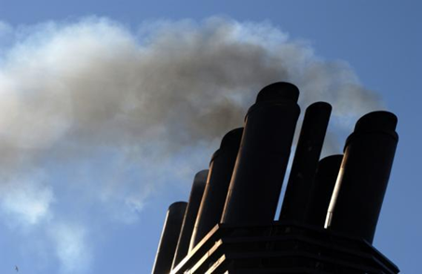
Opacity
Change opacity limit from 40% to
20% for old equipment (before 06/01/70) outside special control areas
Grate cleaning or soot blowing operations get one six minute period per hour at 40% opacity
Defer compliance until January 1, 2015 for businesses outside special control areas
Notes:
In going from 40% down to 20%, we are making standard the same as for post-1970 units.
Required operation and maintenance plans will ensure emissions are minimized and limit the amount of time for grate cleaning or soot blowing

Slide 12
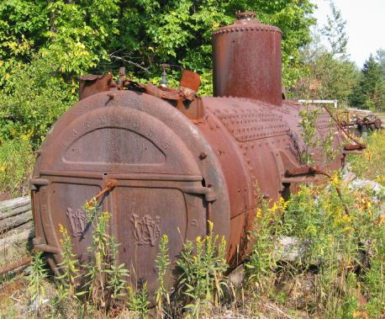
Grain loading
Source | Grain Loading Standards (gr/dscf)
 | Current Limit | Effective upon Rule Adoption | 2019
Built before 06/01/70 | 0.2 | 0.20 | 0.10
Built after 06/01/70 within 5 miles of “sensitive” area | 0.1 | 0.10 | 0.10
Built after 06/01/70 outside 5 miles of “sensitive” area | 0.1 | 0.1 | 0.10
“sensitive area” = sustainment area, nonattainment area, reattainment area, or maintenance area
Notes:
This is an overview of the proposed changes to the grain loading standards.
“Sensitive areas” are designated because of air quality problems

Slide 13
Justification
Analysis of a typical source with 40% opacity and 0.2 gr/dscf
Located in Klamath Falls PM2.5 NAA
Single source impacts approximately 30% of ambient standard
Add background (e.g., woodstove emissions) and impacts approximately 75% of standard.
Notes:
If impacts are up to 75% of standard, we run the risk of violating the standard. This is a huge risk for public health and economic development. It affects our ability to deal with new facilities in an airshed.
The same concept is used in the Clean Air Act….new standards for newer sources.
DEQ believed that older units would be retired pr modifed/updated but this is not the case. Older sources use up a lot of the PM standard so that puts areas at risk. Even if the unit is not a large percentage of the airshed, it is still impacting public health. If it created a problem we would have to address it so we are addressing it now before there is a problem.
Other states??

Slide 14
Justification
Other affected businesses are located in areas similar to Klamath Falls:
Small communities that rely on woodstoves to heat homes
Similar terrain
Similar weather with potential for air stagnation periods in winter time.
Help prevent violations of the PM2.5 ambient air quality standard

Slide 15
Grain loading – businesses may not meet 0.10 gr/dscf
Many of the units have tested below the proposed limits, but do not comply all of the time.
What will businesses have to do to comply with grain loading?
Tuning: 1977 28 MMBtu wood fired boiler; pre-test out of compliance; post-test less than 0.1 gr/dscf
Consistent and dry fuel
Some may need improved combustion controls, ESP, or will convert to natural gas

Slide 16
Categories most affected by grain loading change:
Pre – 1970 wood fired boilers
Grain loading ranges from 0.06 to 0.21 gr/dscf
Source | Permit No. | Emissions Unit | Comment
Boise Cascade (Pilot Rock) | 30-0016 | 3 wood-fired boilers | 0.06-0.19
Collins (Fremont Sawmill) | 19-0002 | 2 wood-fired boilers | 0.08 - 0.13
Columbia Forest Products | 18-0014 | 2 wood-fired boilers | 0.08 – 0.19
Interfor Pacific | 18-0005 | 2 wood-fired boilers | 0.086 - 0.21
Frank Lumber | 22-2525 | Wood fired boiler | 0.137 , multiclone
Swanson Group (Roseburg) | 10-0030 | Wood fired boiler | 0.17
Notes:
Units that were built before 1970

Slide 17
Permitting Small Sources
Issue
New NESHAP standards for previously insignificant sources
Background/
Affected
Emergency generators and small boilers were originally thought to have insignificant emissions
Multiple small sources in aggregate have potentially significant emissions
DEQ did not account for them
Notes:
DEQ has a list of categorically insignificant activities in our rules that include such things as lawn maintenance and emergency generators
Categorically insignificant activities versus aggregate. The entire category of CIA were just not counted.
In the past, CIA were not included in permits
Currently all categorically insignificant, now significant if:
rated individually at greater than 500 horsepower; or
emissions in aggregate are greater than 10 tons/year based on the readiness and maintenance testing hours of operation
General permit for few sources plus changes to other permits

Slide 18
Permitting Small Sources
Recommendations
Require approval to construct, may need a permit, or include in existing permit
Need to revise a few existing permits
DEQ Workload
Rules include provisions to avoid triggering other regulatory requirements solely as a result of this rule change
May need to issue a few new permits (i.e., general permit)
Notes:
DEQ is not going back and second guess past permitting. The consequence is that if a company has these small units, it could trigger permitting in the future with a very small increase in emissions
For example, internet service providers or cloud storage areas are sources that need a lot of energy.

Slide 19
Permitting Small Sources
Impacts on Business
Better accounting of emissions from businesses
Impacts on Environment
Businesses need to provide emissions information
A few businesses will need permits (data centers)
Future small emission increases may trigger regulatory requirements for some larger businesses
Notes:
Currently considered categorically insignificant no matter how many at a source
Proposed rule will no longer consider small boilers categorically insignificant if emissions in aggregate are greater than the de minimis levels
Some businesses that have these units are already on permits. Adding emissions may cause some sources to go over permitting thresholds. This will ensure we are tracking all emissions for applicability. It won’t change the stringency but will provide better tracking.

Slide 20
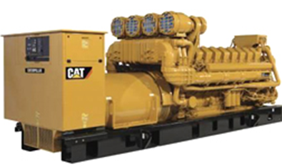
Permit emergency generators and pumps
Currently all categorically insignificant
Proposed significant if:
Any individual engine rated at greater than 500 horsepower; or
emissions in aggregate are greater than de minimis levels of 1 ton/year based on the readiness and maintenance testing hours of operation

Slide 21
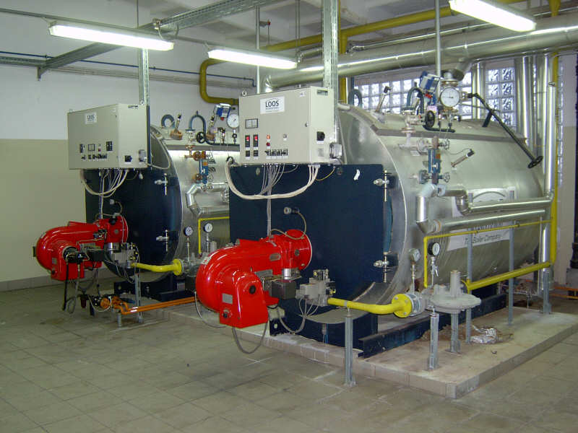
Permit small fuel burning equipment
Currently considered categorically insignificant no matter how many at a source
Proposed rule considers small boilers significant if emissions in aggregate are greater than the de minimis levels
Notes:
Units no longer considered insignificant. More stringent or have to get a permit? Not more stringent.

Slide 22
New Source Review (NSR)
Issue
Need prevention provisions in problem areas
Background/
Affected
The requirement for EPA redesignation delays implementing appropriate programs
Need incentives to address priority sources
Current rules prevent environmentally beneficial projects from going forward
Current program treats large and small businesses the same but the federal program treats them differently
Notes:
What would PSD permitting be for Dallasport, WA?

Slide 23
New Source Review (NSR)
Recommendations
Establish sustainment areas to help prevent nonattainment
Training for NSR permit writers to learn program revisions
DEQ Workload
Establish reattainment areas to remove barriers to development
Separate Major NSR from non-Major NSR
Potentially fewer major NSR permit actions
Identify areas and develop prevention plans (e.g., PM Advance)
Notes:
Define “Reattainment” Area:
Nonattainment Area that has 3 years of “clean” data but not yet re-designated as attainment by EPA (undesignated maintenance area)
Define “Sustainment” Area:
Area with monitoring data close to or exceeding ambient standard but not yet designated NAA by EPA (undesignated nonattainment area)
Lakeview will be first “Sustainment” Area
Will help address AQ problems
Could allow construction of smaller sources that currently couldn’t get permitted
Will provide incentives for sources to get offsets are from “priority” sources (woodstoves)
Will require pre-construction ambient monitoring for large sources

Slide 24
New Source Review (NSR)
Higher offset ratios if using non-priority source offsets
Impacts on Business
Improve AQ in areas near or over standard by providing incentives to reduce emissions from priority sources
Impacts on Environment
Required preconstruction monitoring for major businesses in problem areas
More flexibility for smaller businesses that are not the cause of the problem
For smaller businesses in nonattainment areas require BACT instead of LAER
Notes:
Provides additional protection for areas at risk
Prevents NAA
Preconstruction monitoring could throw off financing. RST? Timelines?
Opens the door for Lakeview
Enables smaller sources to build at BACT before redesignated as maintenance

Slide 25
New Source Review (NSR)
Separate Major New Source Review from State New Source Review
Redefine Major Source for Major NSR
Federal major = 100 tpy in NAA, reattainment or maintenance area
Federal major = 100/250 tpy in attainment and sustainment areas (retain current federal major definition)

Slide 26
New Source Review (NSR)
Establish “state NSR” (equivalent stringency) program for
New businesses with SER to federal major source emission levels
Major modifications at existing businesses with SER to federal major source emission levels
Federal major sources with PSEL increases more than SER that are not due to a major modification.

Slide 27
New Source Review (NSR)
Define “Reattainment” Area:
Nonattainment Area that has 3 years of “clean” data but not yet re-designated as attainment by EPA
Define “Sustainment” Areas
Area with monitoring data close to or exceeding ambient standard but not yet designated NAA by EPA
Procedures for designating areas reattainment or sustainment

Slide 28
New Source Review (NSR)
Source | Attainment | Sustainment | Nonattainment | Reattainment | Maintenance
Federal major (new or modified source) | PSD: BACT Modeling | PSD Pre-construction monitoring OR can’t build Offsets (<1.0:1) | LAER Offsets (<1.2:1) | LAER Offsets (≤1.2:1) | BACT Modeling OR Offsets (1.0:1)
Non-federal major source or federal major source w/o major modification | Modeling | BACT if major modification Modeling OR Offsets (<1.0:1) | BACT if major modification Offsets (<1.0:1) | BACT if major modification Modeling OR Offsets (<1.0:1) | BACT if major modification Modeling OR Offsets (<1.0:1)
Area designation for EPA purposes | Attainment | Attainment | Nonattainment | Nonattainment | Attainment
Notes:
Go over these tables now or later?

Slide 29
NSR Old vs. New
 | NONATTAINMENT AREAS
 | Current | Proposed
Source Classification | Major (SER or greater) | Federal Major | State NSR
Control Technology | LAER | LAER | BACT, if major modification
NAQB | Offsets 1.1:1 for ozone 1.0:1 for other pollutants, and NAQB Reduce impacts at majority of receptors; and Impacts less than SIL at all receptors | Offsets 1.1:1 for ozone ≤1.2:1 for other pollutants, reduce to 1:1 for offsets from priority sources, and NAQB <SIL, or Competing source analysis <10% of NAAQS | Offsets 1.1:1 for ozone ≤1.0:1 for other pollutants, reduce to 0.5:1 for offsets from priority sources, and NAQB <SIL, or Competing source analysis <10% of NAAQS

Slide 30
NSR Old vs. New
 | MAINTENANCE AREAS
 | Current | Proposed
Source Classification | Major (SER or greater) | Federal Major | State NSR
Preconstruction Monitoring | √ | √ | n/a
Control Technology | BACT | BACT | BACT, if major modification
NAQB | Offsets 1.1:1 for ozone 1.0:1 for other pollutants and NAQB Reduce impacts at majority of receptors; and Impacts less than SIL at all receptors | Offsets 1.1:1 for ozone ≤1.0:1 for other pollutants and NAQB | Offsets 1.1:1 for ozone ≤1.0:1 for other pollutants, reduce to 0.5:1 for offsets from priority sources, and NAQB <SIL, or Competing source analysis <10% of NAAQS

Slide 31
Net Air Quality Benefit (NAQB)
Issue
Current rules don’t allow community & environmentally beneficial offset projects because the source cannot show NAQB unless offsetting source is co-located with new source
Background/
Affected
Businesses that want to locate in or impact nonattainment areas cannot build
Lower PM_{2.5} standard has revealed this problem with the rules

Slide 32
Net Air Quality Benefit (NAQB)
Recommendations
Increase offset ratios
Training for permit writers/modelers to learn program revisions
DEQ Workload
Revise modeling criteria for NAQB
Reduce ratios if from priority sources
Focus on the local air quality problems
Notes:
Redefine Net Air Quality Benefit for Federal Major Sources
Require 1.2:1 offsets or
Reduce ratio to 1.0:1 by offsetting emissions with “priority” source emissions:
Woodstoves
Sources causing NAA problem
Modeling
Give non-federal major sources more flexibility for NAQB:
Allow < 1.0:1 offsets
Reduce ratio to 0.5:1 by offsetting emissions with “priority” source emissions:
Woodstoves
Sources causing NAA problem
NAQB modeling

Slide 33
Net Air Quality Benefit (NAQB)
Provides ability to show NAQB
Impacts on Business
Increases offset ratios unless priority sources addressed
Impacts on Environment
Ensures ambient air quality standards are protected
Provides incentives to address priority sources
Allow some projects to go forward
Notes:
Lakeview example

Slide 34
Net Air Quality Benefit (NAQB)
Redefine Net Air Quality Benefit for Federal Major Sources
Require 1.2:1 offsets or
Reduce ratio to not less than 1.0:1 by offsetting emissions with “priority” source emissions:
Woodstoves
Sources causing NAA problem
NAQB modeling backstop:
Source analysis<SIL, or
Competing source analysis <10% of NAAQS

Slide 35
Net Air Quality Benefit (NAQB)
Give non-federal major sources more flexibility for NAQB:
Allow < 1.0:1 offsets
Reduce ratio to not less than 0.5:1 by offsetting emissions with “priority” source emissions:
Woodstoves
Sources causing NAA problem
NAQB modeling backstop:
Source analysis<SIL, or
Competing source analysis <10% of NAAQS

Slide 36
Extensions for NSR/PSD permits
Issue
If construction is delayed, ensure compliance with current rules
Background/
Affected
Unclear requirements for granting extensions

Slide 37
Extensions for NSR/PSD permits
Recommendations
Specify requirements for 1st and 2nd extensions
Initial workload increase for NSR permit writers and modelers to learn program revisions
DEQ Workload
No 3rd extensions

Slide 38
Extensions for NSR/PSD permits
Clarifies requirements for extensions
Impacts on Business
Ensures NAAQS are protected
Impacts on Environment
Requires updates to application for additional delays
Ensures latest control technology used
Allows continued use of offsets if applicable

Slide 39
Extensions for NSR/PSD permits
For the first extension:
Review LAER or BACT analysis:
for any new control technologies commercially available since the original LAER or BACT analysis
for the original pollutants subject to major NSR/PSD

Slide 40
Extensions for NSR/PSD permits
For the second extension:
Review of the original LAER or BACT analysis for potentially lower limits and any new control technologies
Review of the air quality analysis to address the following since the original application was submitted:
all ambient standards or increments reviewed under the original application
any new competing sources or changes in ambient air quality, including any redesignation of the area impacted
any new ambient standards or increments for pollutants that were reviewed under the original application
any changes to EPA approved models

Slide 41
Extensions for NSR/PSD permits
No third extensions:
Original major NSR/PSD permit automatically terminated five years after it was issued
For approval beyond second extension, a new major NSR/PSD permit application must be submitted.
Continued use of original emission reduction credits provided changes do not result in a change to the two digit SIC code and emission reduction credits continue to satisfy the offset and net air quality benefit criteria.

Slide 42
Extensions for NSR/PSD permits
Public participation procedures for extensions:
minimum of 30 days to submit written comments for an extension that does not require an air quality analysis or
minimum of 35 days to submit written comments and 30 day notice for a hearing if scheduled for an extension that requires an air quality analysis.

Slide 43
Splitting Businesses
Issue
If a business shuts down and/or repurposes, what happens to its emissions?
Background/
Affected
Potential for businesses to avoid construction approval if they use emissions from a shutdown
Notes:
Concern about how splitting could affect NSR/PSD. The topic doesn’t come up very often but when it does, each case is unique. We are clarifying how to split up the emissions when a business splits up.
If Company A sells a portion of its business to Company B, now we have 2 separate sources.
MOVE SPSLITTING TO AFTER NSR.

Slide 44
Splitting Businesses
Recommendations
Transfer emissions to:
Initial workload increase for permit writers to learn program revisions
DEQ Workload
a cogen that supported primary activity
Provides clarification that will reduce workload
new business in same primary 2-digit SIC, or
Notes:
Same major industrial classification or 2-digit SIC as original business. A business can’t change from a pulp mill to a power plant.

Slide 45
Splitting Businesses
Limits ability to use emissions for unrelated projects
Impacts on Business
Ensures construction approval
Impacts on Environment
Clarifies requirements for splitting sources

Slide 46
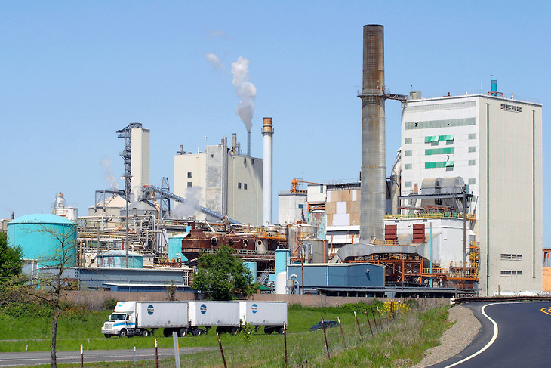
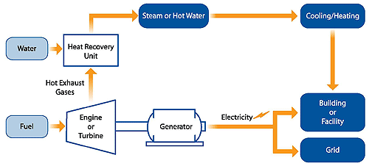
Splitting Businesses
When one business splits, permitted emissions transfer to the new businesses with the same primary 2-digit SIC as the original business or to a combined heat and power facility (aka co-gen) that supported the primary SIC. (√ing w/BRAY)

Slide 47

Any Questions?

Slide 48
Contact Information
Jill Inahara
503-229-5001
Inahara.jill@deq.state.or.us

