Slide 1
Air Quality
Rule Changes and Updates
Notes:
Thank you for taking the time to come today.....
Started out as a rule clean-up, blossomed into a much bigger effort. Used to call it the Kitchen Sink but…..
DEQ is taking a comprehensive approach in this rulemaking that will move the AQ program ahead effectively
The AQ program needs to be maintained to keep the permitting program working well so we decided to undertake this rulemaking to not only maintain the program but to improve it.

Slide 2
Rulemaking Goals
Make rules clearer
Update rules
Address air quality problems while providing more flexibility for smaller businesses
Provide incentives to address air quality problems
Notes:
An example of making our rules clearer is to make sure the language is easy to understand so businesses know exactly what they have to do to comply.
DEQ will ensure that air quality requirements will be maintained, while providing more flexibility for smaller sources,

Slide 3
Rulemaking Schedule
Public Notice: October – November
Public Hearing: November
Proposed EQC Rule Adoption: March 2014

Slide 4
Overview
Rule clean-up
Update particulate matter (PM) standards
Categorically Insignificant Activities
Extensions for NSR permits
Splitting businesses
New Source Review (NSR)
Net air quality benefit for sensitive areas
Notes:
The PM standards we are updating are the general statewide standards for opacity and grain loading. We’ll talk more about that later.
The NSR rules apply when major sources want to build or modify.
Net Air Quality Benefit ensures that sources contribute to the AQ solution rather than the problem

Slide 5
Rule Clean-Up
Unclear rules, not organized well
  Reorganize by moving procedures out of definitions
  Provide clarification when needed, especially regarding compliance requirements
  Delete unused/redundant definitions
  Correct errors
  Maintain overall stringency
Notes:
Examples of moving procedures:
Major modification to division 224
Actual emissions and netting basis to division 222
Baseline period/Baseline emission rate

Slide 6
Rule Clean-Up
Outdated rules repealed:
    Spray Paint VOC limits replaced by EPA rules
    Western Backstop SO2 Federal Trading Program – Old regional haze rules
Notes:
Spray paint rules were part of plan to reduce ozone from consumer products. EPA adopted national rules that are based on the reactivity of the VOC. OR rules are just limits on weights so sources cannot comply with both rules at the same time.
DEQ worked with the western states on a SO₂ trading program but dropped out because it was not cost effective. There are now specific rules but PGE is not involved in trading.

Slide 7
Rule Clean-Up
Repeal rules for sources that no longer exist in Oregon:
  Neutral Sulfite Semi-Chemical Pulp Mills
  Sulfite Pulp Mills
  Primary Aluminum Standards
  Laterite Ore Production of Ferronickel
  Charcoal Producing Plants
New sources must comply with federal requirements
Notes:
Repeal rules for sources that no longer exist in Oregon. Sources would still need to address new source rules – more stringent than existing rules
All of my sources – don’t want me for your permit writer!
End of section, any questions on rule clean-up?

Slide 8
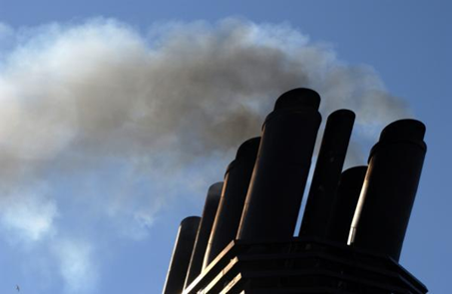
PM and Opacity Standards - Topics
Background
Changes being considered
Rationale for changes
Implementation schedule
Affected sources
Compliance issues

Slide 9
PM and Opacity Standards - Background
Standards adopted in early 1970’s as part of initial State Implementation Plan (SIP)
  SIP required by Clean Air Act to maintain or attain compliance with National Ambient Air Quality Standards (NAAQS)
  NAAQS for particulate matter was based on total particulate matter and was much less stringent than today’s standards.
Rules include different standards for pre and post 1970 sources (grandfathering provisions)

Slide 10
PM and Opacity Standards - Background
Opacity standards based on “aggregate time”
  Uniform procedures (e.g., reference test method) have never been established for determining compliance
  Federal standards are based on 6-minute average in accordance with EPA Reference Method 9
PM standards include only one significant digit
  compliance rounding issue
  EPA guidance/policy states that all ‘federal’ standards have at least 2 significant digits when not stated

Slide 11
Opacity Standard – potential changes
Change all opacity standards from 3 minute aggregate in 60 minutes to 6-minute averages
  Compliance can be based on EPA Method 9
  Change is consistent with other states
  No change in stringency (either aggregate time or 6-minute average is theoretically more or less stringent)
Repeal Portland 4-county 20% opacity for 30 seconds for non-fuel burning equipment
  No uniform procedures for determining compliance
  Not a SIP provision

Slide 12
Opacity Standard – potential changes
Change opacity limit for old equipment (before 06/01/70) from 40% to 20%
Retain 40% limit for grate cleaning or soot blowing operations if:
  Following grate or soot blowing plan; and
  Plan approved by DEQ
Defer compliance until January 1, 2015 for businesses not located near sensitive air quality areas
Notes:
In going from 40% down to 20%, we are making standard the same as for post-1970 units.
Required operation and maintenance plans will ensure emissions are minimized and limit the amount of time for grate cleaning or soot blowing

Slide 13
PM Standard – potential changes
Add significant digit to standards consistent with EPA policy
  0.1 » 0.10
  0.2 » 0.20
Phase out 0.20 standard for older sources to help address newer/tighter ambient air quality standards
Provide schedule for complying with revised standards depending on location
All sources must comply with 0.10 standard by January 1, 2019.
Notes:
In going from 40% down to 20%, we are making standard the same as for post-1970 units.
Required operation and maintenance plans will ensure emissions are minimized and limit the amount of time for grate cleaning or soot blowing

Slide 14
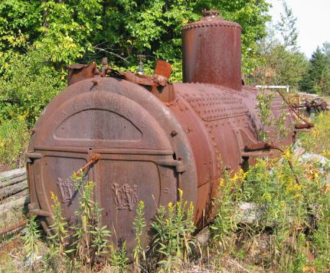
PM Grain loading standards
Source | Grain Loading Standards (gr/dscf)
 | Current Limit | Effective upon Rule Adoption | 2019
Built before 06/01/70 | 0.2 | 0.20 | 0.10
Built after 06/01/70 within 5 miles of “sensitive” area | 0.1 | 0.10 | 0.10
Built after 06/01/70 outside 5 miles of “sensitive” area | 0.1 | 0.1 | 0.10
“sensitive area” = nonattainment and maintenance areas; and, proposed sustainment and reattainment areas (to be covered later in presentation)
Notes:
This is an overview of the proposed changes to the grain loading standards.
“Sensitive areas” are designated because of air quality problems

Slide 15
Justification
Analysis of a typical source with 40% opacity and 0.2 gr/dscf
Located in Klamath Falls PM_{2.5} NAA
Potential single source impacts approximately 30% of ambient standard
Add background (e.g., woodstove emissions) and total impacts approximately 70% of ambient standard.
Impacts when meeting 0.10 standard » 13% of ambient standard (53% of ambient standard with background)
Notes:
If impacts are up to 75% of standard, we run the risk of violating the standard. This is a huge risk for public health and economic development. It affects our ability to deal with new facilities in an airshed.
The same concept is used in the Clean Air Act….new standards for newer sources.
DEQ believed that older units would be retired pr modifed/updated but this is not the case. Older sources use up a lot of the PM standard so that puts areas at risk. Even if the unit is not a large percentage of the airshed, it is still impacting public health. If it created a problem we would have to address it so we are addressing it now before there is a problem.
Other states??

Slide 16
Justification
Other affected businesses are located in areas similar to Klamath Falls:
  Small communities that rely on woodstoves to heat homes
  Similar terrain
  Similar weather with potential for air stagnation periods in winter time.

Slide 17
Justification
Changes are proactive measures for helping to prevent violations of current PM2.5 standards and potentially more stringent standards in the future.
In the past, similar/more stringent changes were made to the standards in areas that were designated nonattainment for PM10 as reactive measures that were included the attainment plans.

Slide 18
Affected Sources
  Approximately 11 wood-fired boilers
  Two asphalt plants
Many of the units have tested below the proposed limits, but do not comply all of the time.
  Test results range from 0.06 to 0.21 gr/dscf
Notes:
Units that were built before 1970

Slide 19
What might be necessary to comply with standards
Conduct more frequent tuning/maintenance
  1977 28 MMBtu wood fired boiler; pre-test out of compliance; post-test less than 0.1 gr/dscf
Maintain consistent/high quality fuel
Improve combustion controls
Install additional control equipment
Add co-firing of natural gas
Replace boiler with natural gas-fired boiler

Slide 20
Categorically Insignificant Activities
Background
Potential changes
Effect of changes in relation to other regulatory programs

Slide 21
Categorically Insignificant Activities - background
Categorically insignificant activities identified in mid 90’s for Title V program – examples:
    Food service activities;
    Janitorial activities;
    Groundskeeping activities including, but not limited to building painting and road and parking lot maintenance;
    Instrument calibration;
    Maintenance and repair shop;
Some activities at facilities that were previously considered insignificant are not actually insignificant when considered in aggregate

Slide 22
Categorically Insignificant Activities - background
Some of these activities are subject to new standards issued by EPA
Emissions from these activities were not considered when:
  Determining what permits are necessary;
  Establishing Plant Site Emissions Limits

Slide 23
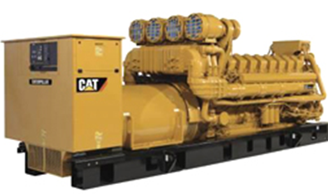
Emergency generators and pumps
  Currently considered insignificant no matter how large or how many at site
  Proposing to change categorically insignificant criteria to:
    Any individual engine rated at less than 500 horsepower; or
  emissions in aggregate are less than de minimis levels of 1 ton/year based on the readiness and maintenance testing hours of operation specified in the regulations or permit.

Slide 24
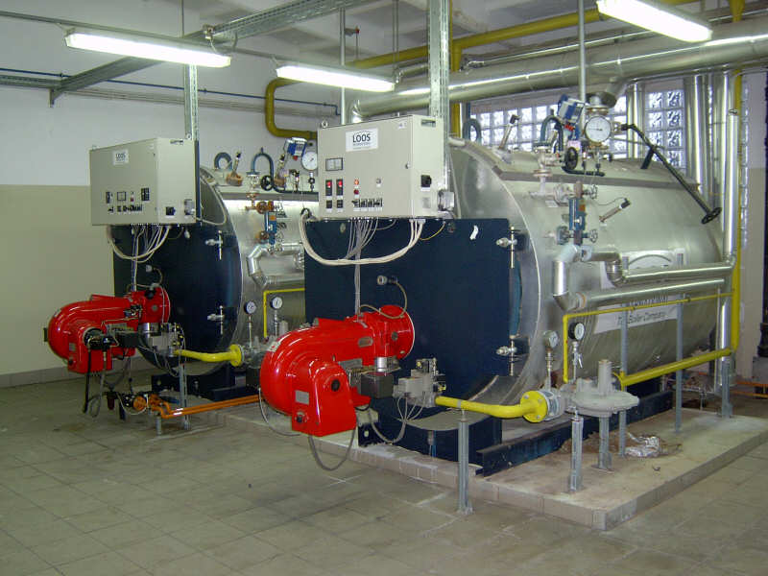
  Small fuel burning equipment
Currently considered categorically insignificant no matter how many at a source
Proposing to change categorically insignificant criteria to:
  Retain current size threshold for individual units; and add
  emissions in aggregate are less than de minimis levels of 1 ton/year
Notes:
Units no longer considered insignificant. More stringent or have to get a permit? Not more stringent.

Slide 25
Regulatory Considerations
The following regulatory programs may now apply to emergency generators and boilers:
  Notice of intent to construct may apply to small sources not otherwise required to have permits
  Air Contaminant Discharge Permits may be required for some sources – e.g., data centers with numerous emergency generators
Notes:
Impacts on Business
Will need to provide emissions information for these small sources
A few businesses will need to get permits (data centers) and construction approval required for all
Small future emission increases may trigger other regulatory requirements for larger businesses
Impacts on Environment
Better accounting of emissions

Slide 26
Regulatory Considerations
Plant Site Emissions Limits (PSELs) for existing sources may need to be revised
Adding emissions to PSELs for existing sources will not trigger other requirements solely as a result of this rule change
Notes:
Impacts on Business
Will need to provide emissions information for these small sources
A few businesses will need to get permits (data centers) and construction approval required for all
Small future emission increases may trigger other regulatory requirements for larger businesses
Impacts on Environment
Better accounting of emissions

Slide 27
Extensions for NSR/PSD permits
Current rules allow extensions provided there is a “demonstrated need”
The rules do not specify how many extensions can be approved
The rules do not specify what requirements must be met to approve an extension
Potential for proposed projects to tie up increment indefinitely
Potential for proposed projects to cause significant impacts on air quality if delayed

Slide 28
Extensions for NSR/PSD permits – Proposed Changes
For the first extension:
  Review LAER or BACT analysis for the original pollutants subject to NSR/PSD
  Review limited to determining whether new control technologies have become commercially available since the original LAER or BACT analysis

Slide 29
Extensions for NSR/PSD permits – Proposed Changes
For the second extension:
  Review the original LAER or BACT analysis for pollutants that were reviewed under the original application for potentially lower limits and any new control technologies
  Review the air quality analysis for pollutants that were reviewed under the original application
    any new competing sources or changes in ambient air quality, including any redesignation of the area impacted
      any new ambient standards or increments
      any changes to EPA approved models

Slide 30
Extensions for NSR/PSD permits – Proposed Changes
No third extensions:
    Original NSR/PSD permit automatically terminated five years after it was issued
    For approval beyond second extension, a new major NSR/PSD permit application must be submitted.
    May continue to use original emission reduction credits provided the project remains the same (e.g., same two digit SIC code), and emission reduction credits are still contemporaneous and continue to satisfy the offset and net air quality benefit criteria.

Slide 31
Extensions for NSR/PSD permits
Public participation procedures for extensions:
  If no air quality analysis:
    minimum of 30 days to submit written comments; or
    If air quality analysis:
      minimum of 35 days to submit written comments; and
      public hearing if requested.

Slide 32
Splitting Businesses - Issues
If a business shuts down, splits, and/or repurposes, what happens to its allowable emissions (e.g., netting basis and plant site emission limits)?
Current rule allows for splitting but needs clarification
Potential for new business to avoid construction approval if they use emissions from shutdown of one source to operate another source.

Slide 33
Splitting Businesses – Proposed Changes
Clarify how emissions are treated when a business splits
Emissions may only be transferred to:
    New business(es) with same primary 2-digit SIC, or
    A combined heat and power unit that supported the original primary activity

Slide 34
Splitting Businesses
  Limits ability to use emissions for unrelated projects
  Clarifies rules to ensure new type of source is subject to construction approval process programs

Slide 35
Next section about NSR and changes, break for lunch? Can leave or come back
Questions?

Slide 36
New Source Review (NSR)
This section is about New Source Review
  Short explanation of what NSR is
  Goals and why changes are suggested
  Description of suggested changes

Slide 37
New Source Review (NSR)
What is NSR?
Nationwide regulatory program, ensures new or modified facilities:
  install up to date emission control systems
  do not adversely affect AQ
NSR program applies to:
  Emission increases above certain levels at:
  new facilities
  existing facilities that modify or add new equipment and want to increase emissions

Slide 38
New Source Review (NSR)
Two broad divisions, Major and Minor
Major NSR
  Total emissions ≥ “federal major” levels, with physical change ≥ SER (100, 40, 10, etc.)
Minor NSR
  Total emissions ≥ SER but < federal major, with
  physical change ≥ SER
  Total emissions ≥ SER with
  physical change < SER or no physical change

Slide 39
New Source Review (NSR)
Minor NSR also includes smallest category
  Emissions < SER w/ or w/o physical change
    No changes from current rules

Slide 40
New Source Review (NSR)
NSR requirements depend on area designation
3 types of areas:
  Attainment/unclassified
  Nonattainment
  Maintenance
Area designation is done by EPA

Slide 41
New Source Review (NSR)
Attainment/unclassified area = air quality is (or is assumed to be) below NAAQS
Nonattainment area = air quality is above NAAQS
Maintenance area = area was nonattainment but is back in attainment
  Maintenance includes provisions to prevent going back into nonattainment

Slide 42
New Source Review (NSR)
Rulemaking Goals
Clarify major and minor NSR requirements
Create provisions to help
  Prevent areas from becoming nonattainment
  Get back into attainment sooner
Protect/improve air quality in sensitive areas
Increase permitting flexibility for new development

Slide 43
New Source Review (NSR)
Rulemaking Goals, cont.
Provide incentives to address priority sources in sensitive areas
  Priority sources = main source of the AQ problem (e.g. woodstoves)
Reduce the time that areas are “between area designations”
  Takes years, must be done by EPA
  Puts area in permitting limbo

Slide 44
New Source Review (NSR)
Suggested Changes
Establish “state NSR” program
  Minor NSR, excluding the lowest level (<SER)
  Not new program; reorganizing and clarifying existing rules
  Some changes
Put Major and State NSR rules in one place (Division 224)

Slide 45
New Source Review (NSR)
Suggested Changes
Change part of Federal Major Source definition
Attainment/unclassified areas:
  No change
  Still ≥ 100*/250 tons per year
  * 100 tpy for 28 source categories listed in rule (e.g. pulp and paper mills, iron and steel mills, chemical process plants)

Slide 46
New Source Review (NSR)
Suggested Changes
Nonattainment and maintenance areas:
Federal major source = emissions ≥ 100 tpy
  Currently ≥ Significant Emission Rate (SER)
  Aligns DEQ definition with EPA definition
State NSR will apply to emissions ≥ SER but
< federal major (“non-federal major”)
  Overall stringency remains the same

Slide 47
New Source Review (NSR)
Offsets and Net Air Quality Benefit (NAQB)
Part of New Source Review - nonattainment and maintenance areas
Offsets: new or increased emissions > SER must be offset by emission reductions
Amount of emission reduction is specified by an offset ratio

Slide 48
New Source Review (NSR)
NAQB: DEQ requires modeling, demonstrate that air quality is being protected
For EPA, NAQB = offsets; Oregon’s program more stringent
Currently 2 modeling criteria, but 1 is nearly impossible to meet

Slide 49



New Source Review (NSR)
Current criteria requires offsets
and new emissions to overlap
at all times
Only happens
if sources and
wind line up
offsetting source
new source

Slide 50
New Source Review (NSR)
Lower PM2.5 NAAQS has revealed this problem with current NAQB rules
New development is prevented, along with ability to obtain environmental benefits from new development

Slide 51
New Source Review (NSR)
Suggestions
Focus on addressing local air quality problems
  EQC can designate priority sources (i.e. woodstoves)
Create incentive to address priority sources:
  Increase offset ratio
  Reduce ratio if offsets obtained from priority sources
Revise modeling criteria
  Continue to protect air quality
  Eliminate near impossibility of meeting criteria

Slide 52
New Source Review (NSR)
Offsets and NAQB for Federal Major Sources
  Require 1.2:1 offsets
  Allow reduction to not less than 1.0:1 by offsetting emissions with “priority” source emissions
    Woodstoves
    Sources causing NAA problem
  NAQB modeling:
    Source analysis<SIL at all receptors in neighborhood scale area around monitoring site
    Competing source analysis <10% of NAAQS

Slide 53
New Source Review (NSR)
Give non-federal major sources more flexibility for offset and NAQB
  Require 1.0:1 offsets
  Allow reduction to not less than 0.5:1 by offsetting emissions with “priority” source emissions
      Woodstoves
      Sources causing NAA problem
  NAQB modeling backstop:
    Source analysis<SIL at all receptors in neighborhood scale area around monitoring site
    Competing source analysis <10% of NAAQS

Slide 54
New Source Review (NSR)
Suggestion
  Define two new types of areas
  Fit between existing areas
Attainment Nonattainment Maintenance
Sustainment Reattainment
  Provide greater permitting flexibility for areas in transition
  Structure requirements so new/expanding sources help attain goals

Slide 55
New Source Review (NSR)
“Sustainment” Areas
  Monitoring data close to or exceeding NAAQS
  Not yet designated NAA by EPA
  Purpose: help prevent becoming nonattainment
“Reattainment” Areas:
  NAA that has 3 years of data < NAAQS
  Not yet re-designated as attainment by EPA
  Purpose: permitting flexibility for State NSR

Slide 56
New Source Review (NSR)
  Sustainment or Reattainment designated only by EQC
  New areas overlay EPA designations
  Federal major sources must still meet minimum federal requirements for EPA designated area
State designation |  | EPA designation
Attainment | --- | Attainment
Sustainment | --- | Attainment
Nonattainment | --- | Nonattainment
Reattainment | --- | Nonattainment
Maintenance | --- | Attainment

Slide 57
New Source Review (NSR)
Suggested pieces of the NSR program have been described
Some tables follow to summarize and show how the pieces fit together
Apologies in advance: tables are rather busy
No changes in attainment areas (no table)
No changes to ozone offsets

Slide 58
NONATTAINMENT AREAS
Current | Proposed
Major (SER or greater) | Federal Major (>100 tpy) | State NSR
LAER | LAER | BACT, if major modification
Offsets/NAQB 1.0:1 Modeling Reduce impacts at majority of receptors; and Impacts less than SIL at all receptors | Offsets/NAQB 1.2:1, can reduce to NLT 1:1 for offsets from priority sources Modeling <SIL in area around monitor Competing source analysis <10% of NAAQS | Offsets/NAQB 1.0:1, can reduce to NLT 0.5:1 for offsets from priority sources Modeling <SIL in area around monitor Competing source analysis <10% of NAAQS

Slide 59
MAINTENANCE AREAS
Current | Proposed
Major (SER or greater) | Federal Major | State NSR
BACT | BACT | BACT, if major modification
NAAQS and Increments | NAAQS and Increments | NAAQS and Increments
 |  | OR
Offsets/NAQB 1.0:1 Modeling Reduce impacts at majority of receptors; and Impacts less than SIL at all receptors | Offsets/NAQB 1.0:1, can reduce to NLT 0.5:1 for offsets from priority sources | Offsets/NAQB 1.0:1, can reduce to 0.5:1 for offsets from priority sources Modeling <SIL in area around monitor Competing source analysis <10% of NAAQS

Slide 60
Source | Attainment | Sustainment | Non- attainment | Re- attainment | Main- tenance
Major NSR | BACT AQ Analysis | BACT AQ Analysis Offsets (10% to 5%) | LAER Offsets (1.2:1 to 1.0:1) | LAER Offsets (1.2:1 to 1.0:1) | BACT AQ Analysis Offsets (1.0:1 to 0.5:1) or alternatives currently in rules
State NSR | AQ Analysis | AQ Analysis OR BACT if major modification Offsets (10% to 5%) | BACT if major modification Offsets (1.0:1 to 0.5:1) | BACT if major modification AQ Analysis OR Offsets (1.0:1 to 0.5:1) | BACT if major modification AQ Analysis OR Offsets (1.0:1 to 0.5:1)
EPA Designation | Attainment | Attainment | Non- attainment | Non- attainment | Attainment
Notes:
Go over these tables now or later?

Slide 61
New Source Review (NSR)
Questions?

