Slide 1
Air Quality
Rule Changes and Updates
Notes:
Thank you for taking the time to come today.....
Started out as a rule clean-up, blossomed into a much bigger effort. Used to call it the Kitchen Sink but…..
DEQ is taking a comprehensive approach in this rulemaking that will move the AQ program ahead effectively
The AQ program needs to be maintained to keep the permitting program working well so we decided to undertake this rulemaking to not only maintain the program but to improve it.

Slide 2
Rulemaking Goals
Make rules clearer
Update rules
Address air quality problems while providing more flexibility for smaller businesses
Provide incentives to address air quality problems
Notes:
An example of making our rules clearer is to make sure the language is easy to understand so businesses know exactly what they have to do to comply.
DEQ will ensure that air quality requirements will be maintained, while providing more flexibility for smaller sources,

Slide 3
Rulemaking Schedule
Public Notice: October – November
Public Hearing: November
Proposed EQC Rule Adoption: March 2014

Slide 4
Overview
Rule clean-up -j
Update particulate matter (PM) standards -m
Categorically Insignificant Activities-ga/m
Extensions for NSR permits -m
Splitting businesses -ga/m
New Source Review (NSR) -ge
Net air quality benefit for sensitive areas -ge
Notes:
The PM standards we are updating are the general statewide standards for opacity and grain loading. We’ll talk more about that later.
The NSR rules apply when major sources want to build or modify.
Net Air Quality Benefit ensures that sources contribute to the AQ solution rather than the problem

Slide 5
Rule Clean-Up
Unclear rules, not organized well
Reorganize by moving procedures out of definitions
Provide clarification when needed, especially regarding compliance requirements
Delete unused/redundant definitions
Correct errors
Maintain overall stringency
Notes:
Examples of moving procedures:
Major modification to division 224
Actual emissions and netting basis to division 222
Baseline period/Baseline emission rate

Slide 6
Rule Clean-Up
Outdated rules repealed:
Spray Paint VOC limits replaced by EPA rules
Western Backstop SO2 Federal Trading Program – Old regional haze rules
Notes:
Spray paint rules were part of plan to reduce ozone from consumer products. EPA adopted national rules that are based on the reactivity of the VOC. OR rules are just limits on weights so sources cannot comply with both rules at the same time.
DEQ worked with the western states on a SO₂ trading program but dropped out because it was not cost effective. There are now specific rules but PGE is not involved in trading.

Slide 7
Rule Clean-Up
Repeal rules for sources that no longer exist in Oregon:
Neutral Sulfite Semi-Chemical Pulp Mills
Sulfite Pulp Mills
Primary Aluminum Standards
Laterite Ore Production of Ferronickel
Charcoal Producing Plants
New sources must comply with federal requirements
Notes:
Repeal rules for sources that no longer exist in Oregon. Sources would still need to address new source rules – more stringent than existing rules
All of my sources – don’t want me for your permit writer!
End of section, any questions on rule clean-up?

Slide 8
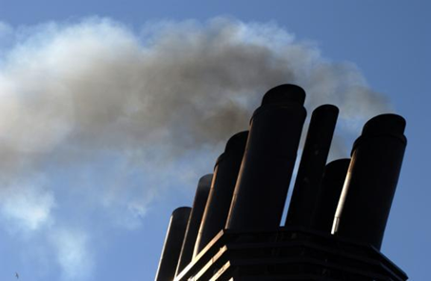
PM and Opacity Standards - Topics
Background
Changes being considered
Rationale for changes
Implementation schedule
Affected sources
Compliance issues

Slide 9
PM and Opacity Standards - Background
Standards adopted in early 1970’s as part of initial State Implementation Plan (SIP)
SIP required by Clean Air Act to maintain or attain compliance with National Ambient Air Quality Standards (NAAQS)
NAAQS for particulate matter was based on total particulate matter and was much less stringent than today’s standards.
Rules include different standards for pre and post 1970 sources (grandfathering provisions)

Slide 10
PM and Opacity Standards - Background
Opacity standards based on “aggregate time”
Uniform procedures (e.g., reference test method) have never been established for determining compliance
Federal standards are based on 6-minute average in accordance with EPA Reference Method 9
PM standards include only one significant digit
compliance rounding issue
EPA guidance/policy states that all ‘federal’ standards have at least 2 significant digits when not stated

Slide 11
Opacity Standard – potential changes
Change all opacity standards from 3 minute aggregate in 60 minutes to 6-minute averages
Compliance can be based on EPA Method 9
Change is consistent with other states
No change in stringency (either aggregate time or 6-minute average is theoretically more or less stringent)
Repeal Portland 4-county 20% opacity for 30 seconds for non-fuel burning equipment
No uniform procedures for determining compliance
Not a SIP provision

Slide 12
Opacity Standard – potential changes
Change opacity limit for old equipment (before 06/01/70) from 40% to 20%
Retain 40% limit for grate cleaning or soot blowing operations if:
Following grate or soot blowing plan; and
Plan approved by DEQ
Defer compliance until January 1, 2015 for businesses not located near sensitive air quality areas
Notes:
In going from 40% down to 20%, we are making standard the same as for post-1970 units.
Required operation and maintenance plans will ensure emissions are minimized and limit the amount of time for grate cleaning or soot blowing

Slide 13
PM Standard – potential changes
Add significant digit to standards consistent with EPA policy
0.1 » 0.10
0.2 » 0.20
Phase out 0.20 standard for older sources to help address newer/tighter ambient air quality standards
Provide schedule for complying with revised standards depending on location
All sources must comply with 0.10 standard by January 1, 2019.
Notes:
In going from 40% down to 20%, we are making standard the same as for post-1970 units.
Required operation and maintenance plans will ensure emissions are minimized and limit the amount of time for grate cleaning or soot blowing

Slide 14
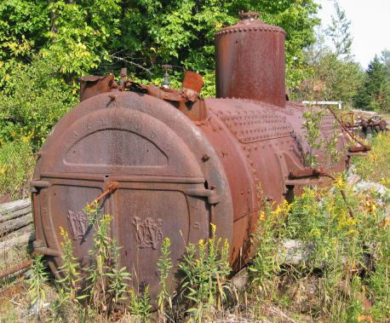
PM Grain loading standards
Source | Grain Loading Standards (gr/dscf)
 | Current Limit | Effective upon Rule Adoption | 2019
Built before 06/01/70 | 0.2 | 0.20 | 0.10
Built after 06/01/70 within 5 miles of “sensitive” area | 0.1 | 0.10 | 0.10
Built after 06/01/70 outside 5 miles of “sensitive” area | 0.1 | 0.1 | 0.10
“sensitive area” = nonattainment and maintenance areas; and, proposed sustainment and reattainment areas (to be covered later in presentation)
Notes:
This is an overview of the proposed changes to the grain loading standards.
“Sensitive areas” are designated because of air quality problems

Slide 15
Justification
Analysis of a typical source with 40% opacity and 0.2 gr/dscf
Located in Klamath Falls PM_{2.5} NAA
Potential single source impacts approximately 30% of ambient standard
Add background (e.g., woodstove emissions) and total impacts approximately 70% of ambient standard.
Impacts when meeting 0.10 standard » 13% of ambient standard (53% of ambient standard with background)
Notes:
If impacts are up to 75% of standard, we run the risk of violating the standard. This is a huge risk for public health and economic development. It affects our ability to deal with new facilities in an airshed.
The same concept is used in the Clean Air Act….new standards for newer sources.
DEQ believed that older units would be retired pr modifed/updated but this is not the case. Older sources use up a lot of the PM standard so that puts areas at risk. Even if the unit is not a large percentage of the airshed, it is still impacting public health. If it created a problem we would have to address it so we are addressing it now before there is a problem.
Other states??

Slide 16
Justification
Other affected businesses are located in areas similar to Klamath Falls:
Small communities that rely on woodstoves to heat homes
Similar terrain
Similar weather with potential for air stagnation periods in winter time.

Slide 17
Justification
Changes are proactive measures for helping to prevent violations of current PM2.5 standards and potentially more stringent standards in the future.
In the past, similar/more stringent changes were made to the standards in areas that were designated nonattainment for PM10 as reactive measures that were included the attainment plans.

Slide 18
Affected Sources
Approximately 11 wood-fired boilers
Two asphalt plants
Many of the units have tested below the proposed limits, but do not comply all of the time.
Test results range from 0.06 to 0.21 gr/dscf
Notes:
Units that were built before 1970

Slide 19
What might be necessary to comply with standards
Conduct more frequent tuning/maintenance
1977 28 MMBtu wood fired boiler; pre-test out of compliance; post-test less than 0.1 gr/dscf
Maintain consistent/high quality fuel
Improve combustion controls
Install additional control equipment
Add co-firing of natural gas
Replace boiler with natural gas-fired boiler

Slide 20
Categorically Insignificant Activities
Background
Potential changes
Effect of changes in relation to other regulatory programs

Slide 21
Categorically Insignificant Activities - background
Categorically insignificant activities identified in mid 90’s for Title V program – examples:
Food service activities;
Janitorial activities;
Groundskeeping activities including, but not limited to building painting and road and parking lot maintenance;
Instrument calibration;
Maintenance and repair shop;
Some activities at facilities that were previously considered insignificant are not actually insignificant when considered in aggregate

Slide 22
Categorically Insignificant Activities - background
Some of these activities are subject to new standards issued by EPA
Emissions from these activities were not considered when:
Determining what permits are necessary;
Establishing Plant Site Emissions Limits

Slide 23
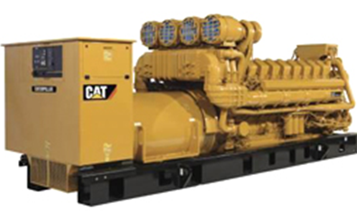
Emergency generators and pumps
Currently considered insignificant no matter how large or how many at site
Proposing to change categorically insignificant criteria to:
Any individual engine rated at less than 500 horsepower; or
emissions in aggregate are less than de minimis levels of 1 ton/year based on the readiness and maintenance testing hours of operation specified in the regulations or permit.

Slide 24
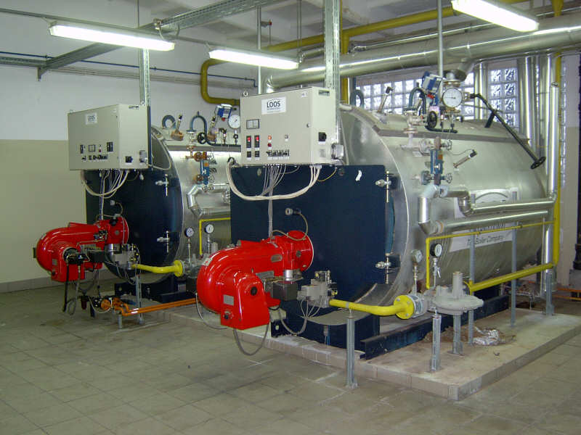
Small fuel burning equipment
Currently considered categorically insignificant no matter how many at a source
Proposing to change categorically insignificant criteria to:
Retain current size threshold for individual units; and add
emissions in aggregate are less than de minimis levels of 1 ton/year
Notes:
Units no longer considered insignificant. More stringent or have to get a permit? Not more stringent.

Slide 25
Regulatory Considerations
The following regulatory programs may now apply to emergency generators and boilers:
Notice of intent to construct may apply to small sources not otherwise required to have permits
Air Contaminant Discharge Permits may be required for some sources – e.g., data centers with numerous emergency generators
Notes:
Impacts on Business
Will need to provide emissions information for these small sources
A few businesses will need to get permits (data centers) and construction approval required for all
Small future emission increases may trigger other regulatory requirements for larger businesses
Impacts on Environment
Better accounting of emissions

Slide 26
Regulatory Considerations
Plant Site Emissions Limits (PSELs) for existing sources may need to be revised
Adding emissions to PSELs for existing sources will not trigger other requirements solely as a result of this rule change
Notes:
Impacts on Business
Will need to provide emissions information for these small sources
A few businesses will need to get permits (data centers) and construction approval required for all
Small future emission increases may trigger other regulatory requirements for larger businesses
Impacts on Environment
Better accounting of emissions

Slide 27
Extensions for NSR/PSD permits
Current rules allow extensions provided there is a “demonstrated need”
The rules do not specify how many extensions can be approved
The rules do not specify what requirements must be met to approve an extension
Potential for proposed projects to tie up increment indefinitely
Potential for proposed projects to cause significant impacts on air quality if delayed

Slide 28
Extensions for NSR/PSD permits – Proposed Changes
For the first extension:
Review LAER or BACT analysis for the original pollutants subject to NSR/PSD
Review limited to determining whether new control technologies have become commercially available since the original LAER or BACT analysis

Slide 29
Extensions for NSR/PSD permits – Proposed Changes
For the second extension:
Review the original LAER or BACT analysis for pollutants that were reviewed under the original application for potentially lower limits and any new control technologies
Review the air quality analysis for pollutants that were reviewed under the original application
any new competing sources or changes in ambient air quality, including any redesignation of the area impacted
any new ambient standards or increments
any changes to EPA approved models

Slide 30
Extensions for NSR/PSD permits – Proposed Changes
No third extensions:
Original NSR/PSD permit automatically terminated five years after it was issued
For approval beyond second extension, a new major NSR/PSD permit application must be submitted.
May continue to use original emission reduction credits provided the project remains the same (e.g., same two digit SIC code), and emission reduction credits are still contemporaneous and continue to satisfy the offset and net air quality benefit criteria.

Slide 31
Extensions for NSR/PSD permits
Public participation procedures for extensions:
If no air quality analysis:
minimum of 30 days to submit written comments; or
If air quality analysis:
minimum of 35 days to submit written comments; and
public hearing if requested.

Slide 32
Splitting Businesses - Issues
If a business shuts down, splits, and/or repurposes, what happens to its allowable emissions (e.g., netting basis and plant site emission limits)?
Current rule allows for splitting but needs clarification
Potential for new business to avoid construction approval if they use emissions from shutdown of one source to operate another source.

Slide 33
Splitting Businesses – Proposed Changes
Clarify how emissions are treated when a business splits
Emissions may only be transferred to:
New business(es) with same primary 2-digit SIC, or
A combined heat and power unit that supported the original primary activity

Slide 34
Splitting Businesses
Limits ability to use emissions for unrelated projects
Clarifies rules to ensure new type of source is subject to construction approval process programs

Slide 35
Next section about NSR and changes, break for lunch? Can leave or come back
Questions?

Slide 36
New Source Review (NSR)
What is NSR?
Nationwide regulatory program, ensures new or modified facilities:
install up to date emission control systems
do not adversely affect AQ
NSR program applies to:
Emission increases above certain levels at:
new facilities
existing facilities that modify or add new equipment and want to increase emissions

Slide 37
New Source Review (NSR)
Major and Minor NSR
Major NSR
Total emissions ≥ major source thresholds
Physical change with emission increase ≥ SER
Most stringent requirements

Slide 38
New Source Review (NSR)
Major and Minor NSR
Minor NSR
Total emissions ≥ SER but < major source, with physical change ≥ SER
Total emissions ≥ SER, physical change < SER or no physical change
Emissions < SER w/ or w/o physical change
No changes from current rules

Slide 39
New Source Review (NSR)
NSR requirements depend on area designation
3 types of areas:
Attainment
Nonattainment
Maintenance
Area designation is done by EPA

Slide 40
New Source Review (NSR)
Attainment/unclassified area = air quality is (or is assumed to be) below NAAQS
Nonattainment area = air quality is above NAAQS
Maintenance area = area was nonattainment but is back in attainment
Maintenance includes provisions to prevent going back into nonattainment

Slide 41
New Source Review (NSR)
Rulemaking Goals
Clarify major and minor NSR requirements
Create provisions to help
Prevent areas from becoming nonattainment
Get back into attainment sooner
Protect/improve air quality
Increase permitting flexibility for new development

Slide 42
New Source Review (NSR)
Rulemaking Goals, cont.
Provide incentives to address priority sources in problem areas
Priority sources = main source of the AQ problem (e.g. woodstoves)
Reduce the time that areas are “between area designations”
Puts area in permitting limbo
Takes years, must be done by EPA

Slide 43
New Source Review (NSR) Proposed Changes
Establish “state NSR” program
Minor NSR, excluding the lowest level (<SER)
Not new program; reorganizing and clarifying existing rules
Some changes
Put Major and State NSR rules in one place (Div. 224)

Slide 44
New Source Review (NSR) Proposed Changes
Change part of Federal Major Source definition
Attainment/unclassified areas:
No change
Still ≥ 100/250 tpy

Slide 45
New Source Review (NSR) Proposed Changes
Nonattainment and maintenance areas:
Federal major source = emissions ≥ 100 tpy
Currently ≥ Significant Emission Rate (SER)
Aligns DEQ definition with EPA definition
State NSR will apply to emissions ≥ SER but < federal major (i.e. “non-federal major”)
Equivalent stringency

Slide 46
Net Air Quality Benefit (NAQB)
NAQB is part of NSR program
Current NAQB modeling criteria (impact of new emissions) are nearly impossible to meet

Slide 47





Offsets and NAQB
Current criteria requires offsets
and new emission to overlap
at all times
Only happens
if sources and
wind line up
offsetting source
new source

Slide 48
Lower PM2.5 NAAQS has revealed this problem with current NAQB rules
New development is prevented, along with ability to obtain environmental benefits from new development

Slide 49
Net Air Quality Benefit (NAQB)
Proposals
Focus on addressing local air quality problems
EQC can designate priority sources (i.e. woodstoves)
Create incentive to address priority sources:
Increase offset ratio
Reduce ratio if offsets obtained from priority sources
Revise modeling criteria
Protect air quality
Eliminate near impossibility of meeting criteria

Slide 50
Net Air Quality Benefit (NAQB)
Redefine Net Air Quality Benefit for Federal Major Sources
Require 1.2:1 offsets or
Reduce ratio to not less than 1.0:1 by offsetting emissions with “priority” source emissions:
Woodstoves
Sources causing NAA problem
NAQB modeling backstop:
Source analysis<SIL at all receptors in the neighborhood scale around monitoring site
Competing source analysis <10% of NAAQS

Slide 51
Net Air Quality Benefit (NAQB)
Give non-federal major sources more flexibility for NAQB:
Allow < 1.0:1 offsets
Reduce ratio to not less than 0.5:1 by offsetting emissions with “priority” source emissions:
Woodstoves
Sources causing NAA problem
NAQB modeling backstop:
Source analysis<SIL at all receptors in the neighborhood scale around monitoring site
Competing source analysis <10% of NAAQS

Slide 52
New Source Review (NSR)
Currently three types of areas:
Attainment Nonattainment Maintenance
Goals:
Prevent nonattainment
If nonattainment, get to maintenance sooner
Structure so new sources help attain goals
Provide greater permitting flexibility for areas in transition

Slide 53
New Source Review (NSR)
Proposal
Define two new types of areas
Fit between existing areas:
Attainment Nonattainment Maintenance
Sustainment Reattainment
Designated by EQC, no EPA action required
For federal major sources, designation by EQC does not alter EPA designation

Slide 54
New Source Review (NSR)
“Sustainment” Areas
Monitoring data close to or exceeding NAAQS
Not yet designated NAA by EPA
Purpose: help prevent becoming nonattainment
“Reattainment” Areas:
NAA that has 3 years of data < NAAQS
Not yet re-designated as attainment by EPA
Purpose: permitting flexibility for State NSR

Slide 55
NSR Old vs. New
NONATTAINMENT AREAS
Current | Proposed
Major (SER or greater) | Federal Major (>100 tpy) | State NSR
LAER | LAER | BACT, if major modification
Offsets/NAQB 1.1:1 for ozone 1.0:1 for other pollutants Modeling Reduce impacts at majority of receptors; and Impacts less than SIL at all receptors | Offsets/NAQB 1.1:1 for ozone 1.2:1 for other pollutants, can reduce to 1:1 for offsets from priority sources Modeling <SIL in area around monitor Competing source analysis <10% of NAAQS | Offsets/NAQB 1.1:1 for ozone 1.0:1 for other pollutants, reduce to 0.5:1 for offsets from priority sources Modeling <SIL in area around monitor Competing source analysis <10% of NAAQS

Slide 56
NSR Old vs. New
MAINTENANCE AREAS
Current | Proposed
Major (SER or greater) | Federal Major | State NSR
BACT | BACT | BACT, if major modification
NAAQS and Increments | NAAQS and Increments | NAAQS and Increments OR
Offsets/NAQB 1.1:1 for ozone 1.0:1 for other pollutants Modeling Reduce impacts at majority of receptors; and Impacts less than SIL at all receptors | Offsets/NAQB 1.1:1 for ozone 1.0:1 for other pollutants, reduce to 0.5:1 for offsets from priority sources | Offsets/NAQB 1.1:1 for ozone ≤1.0:1 for other pollutants, reduce to 0.5:1 for offsets from priority sources Modeling <SIL in area around monitor Competing source analysis <10% of NAAQS

Slide 57
New Source Review (NSR)…make sure this is correct
Source | Attainment | Sustainment | Nonattainment | Reattainment | Maintenance
Major NSR | BACT AQ Analysis | BACT AQ Analysis Offsets (10% to 5%) | LAER Offsets (1.2:1 to 1.0:1) | LAER Offsets (1.2:1 to 1.0:1) | BACT AQ Analysis Offsets (1.0:1 to 0.5:1) or other alternative currently specified in rules
State NSR | AQ Analysis | AQ Analysis OR BACT if major modification Offsets (10% to 5%) | BACT if major modification Offsets (1.0:1 to 0.5:1) | BACT if major modification AQ Analysis OR Offsets (1.0:1 to 0.5:1) | BACT if major modification AQ Analysis OR Offsets (1.0:1 to 0.5:1)
Area designation for EPA purposes | Attainment | Attainment | Nonattainment | Nonattainment | Attainment
Notes:
Go over these tables now or later?

Slide 58
New Source Review (NSR)
Questions?

