Slide 1
Air Quality
Rule Changes and Updates
Notes:
Good morning! Thank you for taking the time to come today to this DEQ stakeholder meeting. I’m Jill Inahara and I work in our HQ office as a rule writer. I’d like to introduce our other presenters today....Mark and George.
In the notice for this meeting, you probably saw that the meeting will last from 10-12 and 1-2 if needed. We were planning to cover the New Source Review materials after lunch but may do so earlier if time allows.
The reason we are here today is to inform you and get input on some ideas on how we plan to change our rules. Of course you’ll be able to comment formally when the rules are proposed but we wanted to have an informal conversation with you first.
Originally this proposed rulemaking started out as a rule clean-up but it expanded when we looked at our rules thought about all the fixes we need to do. The nickname for it is the Kitchen Sink because it includes so many things and may also include some changes to our diesel program and the woodstove program, which will not be discussed today.

Slide 2
Rulemaking Goals
Make rules clearer
Update rules
Address air quality problems
Notes:
The goals of this rulemaking are to make sure our rules are clear, up to date and that they address air quality problems.
When addressing AQ problems, we want to make sure we are targeting our resources at the right place. We want to provide incentives to reduce emissions where needed and provide companies flexibility as long as it will improve air quality.

Slide 3
Rulemaking Schedule
Public Notice: October – November
Public Hearing: November
Proposed EQC Rule Adoption: March 2014
SIP Submittal to EPA for Approval: ?

Slide 4
Overview
Rule clean-up
Update particulate matter (PM) standards
Categorically Insignificant Activities
Splitting businesses
New Source Review (NSR)
Extensions for NSR permits
Net air quality benefit for sensitive areas
Notes:
Here is an overview of the topics we are going to cover today:
Rule clean-up
Update statewide grain loading and opacity standards
We have a defined term: Categorically Insignificant Activities
How emissions are divided when a business splits into two or more businesses
Our pre-construction program called New Source Review (NSR)
If construction is delayed, how a business an get an extensions for their NSR permit
Another defined term: Net air quality benefit
All of these topics will be explained in more detail later in this presentation.

Slide 5
Rule Clean-Up
Unclear rules, not organized well
Reorganize by moving procedures out of definitions
Provide clarification when needed, especially regarding compliance requirements
Delete unused/redundant definitions
Correct errors
Maintain overall stringency
Notes:
The first part of this presentation covers rule clean-up.
Some of our rules are out of order so we want to move them to the right place. There are procedures in definitions like major modification, actual emissions and netting basis that need to be moved.
Some of our rules are missing important details so we worked on clarifying them. (compliance methods)
We want a clean set of definitions. Throughout all of our divisions there are multiple definitions of the same term – 5 definitions of the word person! Make sure the definitions agree and get rid of the redundant ones
We found cross-referencing errors and typos that need to be fixed.
None of these clean-up changes will affect stringency. We are just clarifying things.

Slide 6
Rule Clean-Up
Outdated rules repealed:
Consumer Spray Paint VOC limits replaced by EPA rules (19% vs. 15%)
Western Backstop SO2 Federal Trading Program – replaced by direct control of PGE Boardman
Notes:
As part of the clean up, we want to repeal some rules
Spray paint rules were part of plan to reduce ozone from consumer products. EPA adopted national rules that apply to manufacturers and so we don’t state rules any more.
DEQ worked with the western states on a SO₂ trading program but dropped out because it wasn’t cost effective. There are now specific rules but PGE is not involved in trading so we don’t need the state rules.

Slide 7
Rule Clean-Up
Repeal rules for sources that no longer exist in Oregon:
Neutral Sulfite Semi-Chemical Pulp Mills
Sulfite Pulp Mills
Primary Aluminum Standards
Laterite Ore Production of Ferronickel
Charcoal Producing Plants
New sources must comply with more stringent federal requirements for new sources
Notes:
Unfortunately many businesses have shut down in Oregon so we plan to repeal those industry specific rules.
All other industry rules are staying the same, including Kraft Pulp Mills
If one of those sources wants to locate in Oregon, they would have to comply with current federal rules which are more stringent than our existing state rules. (New Source Review, New Source Performance Standards, National Emission Standards for HAPs)

Slide 8

Rule Clean-Up
Questions?
Notes:
Do you have any questions before we move on to the next topic?
Our next presenter is Mark Fisher.

Slide 9
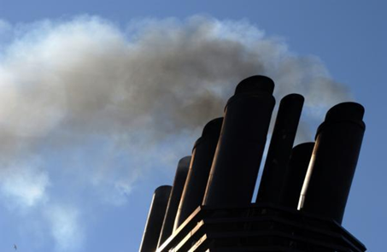
PM and Opacity Standards - Topics
Background
Changes being considered
Rationale for changes
Implementation schedule
Affected sources
Compliance issues

Slide 10
PM and Opacity Standards - Background
Standards adopted in early 1970’s as part of initial State Implementation Plan (SIP)
SIP required by Clean Air Act to maintain or attain compliance with National Ambient Air Quality Standards (NAAQS)
NAAQS for particulate matter was based on total particulate matter and was much less stringent than today’s standards.
Rules include different standards for pre and post 1970 sources (grandfathering provisions)

Slide 11
PM and Opacity Standards - Background
Opacity standards (40% and 20%) based on “aggregate time”
Uniform procedures (e.g., reference test method) have never been established for determining compliance
Federal standards are based on 6-minute average in accordance with EPA Reference Method 9
PM standards (0.2 and 0.1 gr/dscf) include only one significant digit
compliance rounding issue
EPA guidance/policy states that all ‘federal’ standards have at least 2 significant digits when not stated

Slide 12
Opacity Standard – suggested changes
Change all opacity standards from 3 minute aggregate in 60 minutes to any 6-minute block average
Compliance can be based on EPA Method 9
Change is consistent with other states
No change in stringency (either aggregate time or 6-minute average is theoretically more or less stringent)
Repeal Portland 4-county 20% opacity for 30 seconds for non-fuel burning equipment
No uniform procedures for determining compliance
Not a SIP provision
Still covered by statewide standards

Slide 13
Opacity Standard – suggested changes
Change opacity limit for old equipment (before 06/01/70) from 40% to 20%
Retain 40% limit for grate cleaning or soot blowing operations if:
Following grate or soot blowing plan; and
Plan to minimize emissions approved by DEQ
Defer compliance until January 1, 2015 for businesses not located near sensitive air quality areas
“sensitive area” = nonattainment and maintenance areas; and, proposed sustainment and reattainment areas (to be covered later in presentation)
Notes:
In going from 40% down to 20%, we are making standard the same as for post-1970 units.
Required operation and maintenance plans will ensure emissions are minimized and limit the amount of time for grate cleaning or soot blowing

Slide 14
PM Standard – suggested changes
Add significant digit to standards consistent with EPA policy
0.1 » 0.10
0.2 » 0.20
Phase out 0.20 standard for older sources to help address newer/tighter ambient air quality standards
Provide schedule for complying with revised standards depending on location
All sources must comply with 0.10 standard by January 1, 2019.

Slide 15
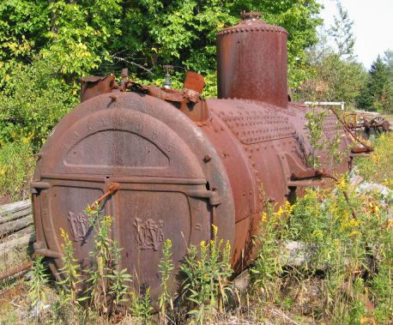
PM Grain loading standards
Source | Grain Loading Standards (gr/dscf)
 | Current Limit | Effective upon Rule Adoption | 2019
Built before 06/01/70 | 0.2 | 0.20 | 0.10
Built after 06/01/70 within 5 miles of “sensitive” area | 0.1 | 0.10 | 0.10
Built after 06/01/70 outside 5 miles of “sensitive” area | 0.1 | 0.1 | 0.10
Notes:
This is an overview of the proposed changes to the grain loading standards.
“Sensitive areas” are designated because of air quality problems

Slide 16
Justification
Analysis of a typical source with 40% opacity and 0.2 gr/dscf
Located in Klamath Falls PM_{2.5} NAA
Grain Loading | Source Impacts | Source + Background
0.2 gr/dscf | 30% of PM_{2.5} NAAQS | 70% of PM_{2.5} NAAQS
0.10 gr/dscf | 13% of PM_{2.5} NAAQS | 53% of PM_{2.5} NAAQS
Notes:
If impacts are up to 75% of standard, we run the risk of violating the standard. This is a huge risk for public health and economic development. It affects our ability to deal with new facilities in an airshed.
The same concept is used in the Clean Air Act….new standards for newer sources.
DEQ believed that older units would be retired pr modified/updated but this is not the case. Older sources use up a lot of the PM standard so that puts areas at risk. Even if the unit is not a large percentage of the airshed, it is still impacting public health. If it created a problem we would have to address it so we are addressing it now before there is a problem.
Other states??

Slide 17
Justification
Other affected businesses are located in areas similar to Klamath Falls:
Small communities that rely on woodstoves to heat homes
Similar terrain
Similar weather with potential for air stagnation periods in winter time.

Slide 18
Justification
Changes are proactive measures for helping to prevent violations of current PM2.5 standards and potentially more stringent standards in the future.
In the past, similar/more stringent changes were made to the standards in areas that were designated nonattainment for PM10 as reactive measures that were included the attainment plans.

Slide 19
Affected Sources
Approximately 11 wood-fired boilers
Two asphalt plants
Many of the units have tested below the suggested limits, but do not comply all of the time.
Test results range from 0.06 to 0.21 gr/dscf
Notes:
Units that were built before 1970

Slide 20
What might be necessary to comply with standards
Conduct more frequent tuning/maintenance
1977 28 MMBtu wood fired boiler; pre-test out of compliance; post-test less than 0.1 gr/dscf
Maintain consistent/high quality fuel
Improve combustion controls
Install additional control equipment
Add co-firing of natural gas
Replace boiler with natural gas-fired boiler

Slide 21

PM Standard – suggested changes
Notes:
In going from 40% down to 20%, we are making standard the same as for post-1970 units.
Required operation and maintenance plans will ensure emissions are minimized and limit the amount of time for grate cleaning or soot blowing

Slide 22
Categorically Insignificant Activities
Background
Suggested changes
Effect of changes in relation to other regulatory programs

Slide 23
Categorically Insignificant Activities - background
Categorically insignificant activities identified in mid 90’s for Title V program – examples:
Janitorial activities
Groundskeeping activities including
Instrument calibration
Maintenance and repair shop
Some activities at facilities that were previously considered insignificant are not actually insignificant when considered in aggregate

Slide 24
Categorically Insignificant Activities - background
Some of these activities are subject to new standards issued by EPA
Emissions from these activities were not considered when:
Determining what permits are necessary;
Establishing Plant Site Emissions Limits

Slide 25
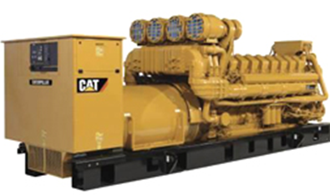
Emergency generators and pumps
Currently considered insignificant no matter how large or how many at site
Proposing to change categorically insignificant criteria to:
Any individual engine rated at less than 500 horsepower (375 kW); or
emissions in aggregate are less than de minimis levels of 1 ton/year based on the readiness and maintenance testing hours of operation specified in the regulations or permit.

Slide 26
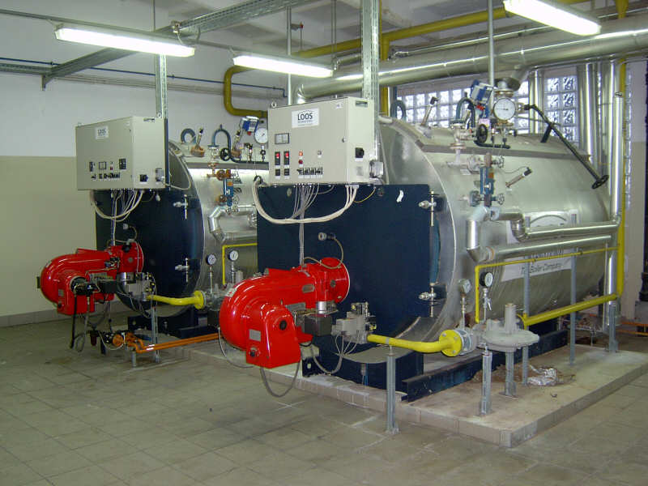
Small fuel burning equipment
Currently considered categorically insignificant no matter how many at a source
Proposing to change categorically insignificant criteria to:
Retain current size threshold for individual units; and add (0.4 MMBtu/hr oil; 2 MMBtu/hr gas)
emissions in aggregate are less than de minimis levels of 1 ton/year
Notes:
Units no longer considered insignificant. More stringent or have to get a permit? Not more stringent.

Slide 27
Regulatory Considerations
The following regulatory programs may now apply to emergency generators and boilers:
Notice of intent to construct may apply to small sources not otherwise required to have permits
Air Contaminant Discharge Permits may be required for some sources – e.g., data centers with numerous emergency generators
Notes:
Impacts on Business
Will need to provide emissions information for these small sources
A few businesses will need to get permits (data centers) and construction approval required for all
Small future emission increases may trigger other regulatory requirements for larger businesses
Impacts on Environment
Better accounting of emissions

Slide 28
Regulatory Considerations
Plant Site Emissions Limits (PSELs) for existing sources may need to be revised
Adding emissions to PSELs for existing sources will not trigger other requirements solely as a result of this rule change
Notes:
Impacts on Business
Will need to provide emissions information for these small sources
A few businesses will need to get permits (data centers) and construction approval required for all
Small future emission increases may trigger other regulatory requirements for larger businesses
Impacts on Environment
Better accounting of emissions

Slide 29

Categorically Insignificant Activities

Slide 30
Extensions for NSR/PSD permits
Background
Suggested Rule Changes
Public Notice

Slide 31
Extensions for NSR/PSD permits - Background
Current rules allow extensions provided there is a “demonstrated need”
The rules do not specify how many extensions can be approved
The rules do not specify what requirements must be met to approve an extension
Potential for proposed projects to tie up increment indefinitely
Potential for proposed projects to cause significant impacts on air quality if delayed

Slide 32
Extensions for NSR/PSD permits – Suggested Rule Changes
For the first 18-month extension:
Review control technology analysis for the original pollutants subject to NSR/PSD
Review limited to determining whether new control technologies have become commercially available since the original LAER or BACT analysis

Slide 33
Extensions for NSR/PSD permits – Suggested Rule Changes
For the second extension:
Review the original LAER or BACT analysis for pollutants that were reviewed under the original application for potentially lower limits and any new control technologies
Review the air quality analysis for pollutants that were reviewed under the original application
any new competing sources or changes in ambient air quality, including any redesignation of the area impacted
any new ambient standards or increments
any changes to EPA approved models

Slide 34
Extensions for NSR/PSD permits – Suggested Rule Changes
No third extensions:
Original NSR/PSD permit automatically terminated five years after it was issued
For approval beyond second extension, a new major NSR/PSD permit application must be submitted.
May continue to use original emission reduction credits provided the project remains the same (e.g., same two digit SIC code), and emission reduction credits are still contemporaneous and continue to satisfy the offset and net air quality benefit criteria.

Slide 35
Extensions for NSR/PSD permits – Public Notice
Public participation procedures for extensions:
If no air quality analysis:
minimum of 30 days to submit written comments; or
If air quality analysis:
minimum of 35 days to submit written comments; and
public hearing if requested.

Slide 36

Extensions for NSR/PSD permits

Slide 37
Splitting Businesses
Background/issues
Suggested Rule Changes
Program integrity

Slide 38
Splitting Businesses – Background/Issues
If a business shuts down, splits, and/or repurposes, what happens to its allowable emissions (e.g., netting basis and plant site emission limits)?
Current rule allows for splitting but needs clarification
Potential for new business to avoid construction approval if they use emissions from shutdown of one source to operate another source.

Slide 39
Splitting Businesses – Suggested Rule Changes
Clarify how emissions are treated when a business splits
Emissions may only be transferred to:
New business(es) with same primary 2-digit SIC, or
A combined heat and power unit that supported the original primary activity

Slide 40
Splitting Businesses – Program Integrity
Limits ability to use emissions for unrelated projects
Clarifies rules to ensure new type of source is subject to construction approval process programs

Slide 41

Splitting Businesses

Slide 42

LUNCH?
Next section about NSR and changes,
Break for lunch?
Can leave or come back after lunch

Slide 43
New Source Review (NSR)
This section is about New Source Review
Short explanation of what NSR is
Goals and why changes are suggested
Description of suggested changes

Slide 44
New Source Review (NSR)
What is NSR?
Nationwide regulatory program, ensures new or modified facilities:
install up to date emission control systems
do not adversely affect AQ
NSR program applies to:
Emission increases above certain levels at:
new facilities
existing facilities that modify or add new equipment and want to increase emissions

Slide 45
New Source Review (NSR)
Two broad divisions, Major and Minor
Major NSR
Total emissions ≥ “federal major” levels, with physical change ≥ SER (100, 40, 10, etc.)
Minor NSR
Total emissions ≥ SER but < federal major, with physical change ≥ SER
Total emissions ≥ SER with physical change < SER or no physical change

Slide 46
New Source Review (NSR)
Minor NSR also includes smallest category
Emissions < SER w/ or w/o physical change
No changes from current rules

Slide 47
New Source Review (NSR)
NSR requirements depend on area designation
3 types of areas:
Attainment/unclassified
Nonattainment
Maintenance
Area designation is done by EPA

Slide 48
New Source Review (NSR)
Attainment/unclassified area = air quality is (or is assumed to be) below NAAQS
Nonattainment area = air quality is above NAAQS
Maintenance area = area was nonattainment but is back in attainment
Maintenance includes provisions to prevent going back into nonattainment

Slide 49
New Source Review (NSR)
Rulemaking Goals
Clarify major and minor NSR requirements
Create provisions to help
Prevent areas from becoming nonattainment
Get back into attainment sooner
Protect/improve air quality in sensitive areas
Increase permitting flexibility for new development

Slide 50
New Source Review (NSR)
Rulemaking Goals, cont.
Provide incentives to address priority sources in sensitive areas
Priority sources = main source of the AQ problem (e.g. woodstoves)
Reduce the time that areas are “between area designations”
Takes years, must be done by EPA
Puts area in permitting limbo

Slide 51
New Source Review (NSR) Suggested Changes
Establish “state NSR” program
Minor NSR, excluding the lowest level (<SER)
Not new program; reorganizing and clarifying existing rules
Some changes
Put Major and State NSR rules in one place (Division 224)

Slide 52
New Source Review (NSR) Suggested Changes
Change part of Federal Major Source definition
Attainment/unclassified areas:
No change
Still ≥ 100*/250 tons per year
* 100 tpy for 28 source categories listed in rule (e.g. pulp and paper mills, iron and steel mills, chemical process plants)

Slide 53
New Source Review (NSR) Suggested Changes
Nonattainment and maintenance areas:
Federal major source = emissions ≥ 100 tpy
Currently ≥ Significant Emission Rate (SER)
Aligns DEQ definition with EPA definition
State NSR will apply to emissions ≥ SER but < federal major (“non-federal major”)
Overall stringency remains the same

Slide 54
New Source Review (NSR)
Offsets and Net Air Quality Benefit (NAQB)
Part of New Source Review - nonattainment and maintenance areas
Offsets: new or increased emissions > SER must be offset by emission reductions
Amount of emission reduction is specified by an offset ratio

Slide 55
New Source Review (NSR)
NAQB: DEQ requires modeling, demonstrate that air quality is being protected
For EPA, NAQB = offsets; Oregon’s program more stringent
Currently 2 modeling criteria, but 1 is nearly impossible to meet

Slide 56



New Source Review (NSR)
Current criteria requires offsets and new emissions to overlap at all times
Only happens if sources and wind line up
offsetting source
new source

Slide 57
New Source Review (NSR)
Lower PM2.5 NAAQS has revealed this problem with current NAQB rules
New development is prevented, along with ability to obtain environmental benefits from new development

Slide 58
New Source Review (NSR)
Suggestions
Focus on addressing local air quality problems
EQC can designate priority sources (i.e. woodstoves)
Create incentive to address priority sources:
Increase offset ratio
Reduce ratio if offsets obtained from priority sources
Revise modeling criteria
Continue to protect air quality
Eliminate near impossibility of meeting criteria

Slide 59
New Source Review (NSR)
Offsets and NAQB for Federal Major Sources
Require 1.2:1 offsets
Allow reduction to not less than 1.0:1 by offsetting emissions with “priority” source emissions
Woodstoves
Sources causing NAA problem
NAQB modeling:
Source analysis<SIL at all receptors in neighborhood scale area around monitoring site
Competing source analysis <10% of NAAQS

Slide 60
New Source Review (NSR)
Give non-federal major sources more flexibility for offset and NAQB
Require 1.0:1 offsets
Allow reduction to not less than 0.5:1 by offsetting emissions with “priority” source emissions
Woodstoves
Sources causing NAA problem
NAQB modeling:
Source analysis<SIL at all receptors in neighborhood scale area around monitoring site
Competing source analysis <10% of NAAQS

Slide 61
New Source Review (NSR)
Suggestion
Define two new types of areas
Fit between existing areas
Attainment Nonattainment Maintenance
Provide greater permitting flexibility for areas in transition
Structure requirements so new/expanding sources help attain goals
Sustainment
Reattainment

Slide 62
New Source Review (NSR)
“Sustainment” Areas
Monitoring data close to or exceeding NAAQS
Not yet designated NAA by EPA
Purpose: help prevent becoming nonattainment
“Reattainment” Areas:
NAA that has 3 years of data < NAAQS
Not yet re-designated as attainment by EPA
Purpose: permitting flexibility for State NSR

Slide 63
New Source Review (NSR)
Sustainment or Reattainment designated only by EQC
New areas overlay EPA designations
Federal major sources must still meet minimum federal requirements for EPA designated area
State designation |  | EPA designation
Attainment | --- | Attainment
Sustainment | --- | Attainment
Nonattainment | --- | Nonattainment
Reattainment | --- | Nonattainment
Maintenance | --- | Attainment

Slide 64
New Source Review (NSR)
Suggested parts of the NSR program have been described
Some tables follow to summarize and show how the pieces fit together
Apologies in advance: tables are rather busy
No changes in attainment areas (no table)
No changes to ozone offsets

Slide 65
NONATTAINMENT AREAS
Current | Proposed
Major (SER or greater) | Federal Major (>100 tpy) | State NSR (SER-100)
LAER | LAER | BACT, if major modification
Offsets/NAQB 1.0:1 Modeling Reduce impacts at majority of receptors; and Impacts less than SIL at all receptors | Offsets/NAQB 1.2:1, can reduce to NLT 1:1 for offsets from priority sources Modeling <SIL in area around monitor Competing source analysis <10% of NAAQS | Offsets/NAQB 1.0:1, can reduce to NLT 0.5:1 for offsets from priority sources Modeling <SIL in area around monitor Competing source analysis <10% of NAAQS

Slide 66
MAINTENANCE AREAS
Current | Proposed
Major (SER or greater) | Federal Major (>100 tpy) | State NSR (SER-100)
BACT | BACT | BACT, if major modification
NAAQS and Increments | NAAQS and Increments | NAAQS and Increments
 |  | OR
Offsets/NAQB 1.0:1 Modeling Reduce impacts at majority of receptors; and Impacts less than SIL at all receptors | Offsets/NAQB 1.0:1, can reduce to NLT 0.5:1 for offsets from priority sources | Offsets/NAQB 1.0:1, can reduce to 0.5:1 for offsets from priority sources Modeling <SIL in area around monitor Competing source analysis <10% of NAAQS

Slide 67
Source | Attainment | Sustainment | Non-attainment | Reattainment | Maintenance
Major NSR | BACT AQ Analysis | BACT AQ Analysis Offsets (10% to 5%) | LAER Offsets (1.2:1 to 1.0:1) | LAER Offsets (1.2:1 to 1.0:1) | BACT AQ Analysis Offsets (1.0:1 to 0.5:1) or alternatives currently in rules
State NSR | AQ Analysis | AQ Analysis OR BACT if major modification Offsets (10% to 5%) | BACT if major modification Offsets (1.0:1 to 0.5:1) | BACT if major modification AQ Analysis OR Offsets (1.0:1 to 0.5:1) | BACT if major modification AQ Analysis OR Offsets (1.0:1 to 0.5:1)
EPA Designation | Attainment | Attainment | Non- attainment | Non- attainment | Attainment
Notes:
Go over these tables now or later?

Slide 68

New Source Review (NSR)

