Slide 1
Air Quality
Rule Changes and Updates
Notes:
I’m here to update you on the comprehensive rule changes that AQ is doing to update and improve our permitting program. I wanted to give you this update before our stakeholder meetings in August in case you get any questions.

Slide 2
Rulemaking Goals
Make rules clearer
Update rules
Address air quality problems
Notes:
The goals of this rulemaking are to make sure our rules are clear, up to date and that they address air quality problems.
When addressing AQ problems, we want to make sure we are targeting our resources at the right place. We want to provide incentives to reduce emissions where needed and provide companies flexibility as long as it will improve air quality.

Slide 3
Rulemaking Schedule
Stakeholder meetings: August
Public Notice: October – November
Public Hearing: November
Proposed EQC Rule Adoption: March 2014

Slide 4
Overview
Rule clean-up
Update particulate matter (PM) standards
Permitting small sources (categorically insignificant activities)
New Source Review (NSR)
Net air quality benefit
Notes:
Here is an overview of the topics we are going to cover today:
Rule clean-up
Update statewide particulate matter standards
We have a defined term: Categorically Insignificant Activities
Our pre-construction program called New Source Review (NSR)
Another defined term: Net air quality benefit
All of these topics will be explained in more detail later in this presentation.

Slide 5
Rule Clean-Up
Background
Outdated rules are unclear
Recommendation
Clarify where necessary
Repeal unnecessary rules
DEQ Workload
Initial increase in workload to update permits
Overall improved timeliness and efficiency down the road
EPA has adopted new rules
Notes:
The first part of this presentation covers rule clean-up. To give you some background, some of our rules are missing important details. These elements of our program have created problems in the past. EPA has made changes to their rules so we need to catch up with those changes.
We are recommended that we clarify whenever necessary. For example, we are clarifying:
How emissions are divided when a business splits into two or more businesses
If construction is delayed, how a business an get an extensions for their NSR permit
EPA adopted national rules that apply to manufacturers of consumer spray paint rules so we don’t need state rules any more. These rules were part of plan to reduce ozone from consumer products.
Unfortunately many businesses have shut down in Oregon so we plan to repeal those industry specific rules. If one of those sources wants to locate in Oregon, they would have to comply with current federal rules which are more stringent than our existing state rules.
None of these clean-up changes will affect stringency and eventually will improve permit timeliness.

Slide 6
Rule Clean-Up
Impacts on Environment
Impacts on Development
Rules will be clearer
Rules will be clearer
No backsliding
No anticipated impact
Notes:
On the Cleanup part of the rules, there will be no change in stringency.

Slide 7
Update PM Standards
Background
Potential exceedances of PM_{2.5} ambient standards
Recommendation
Reduce opacity limit from 40% to 20%
DEQ Workload
Update all source specific permits, primarily at renewal
Pre-1970 sources have higher opacity and grain loading standards
Reduce grain loading limit from 0.2 to 0.10 gr/dscf
Provide additional time for compliance with lower limits
Notes:
From work on the Klamath Falls attainment plan, we found impacts from a single source could be up to 75% of standard. That puts us in danger of violating the standard. This is a huge risk for public health and economic development because it affects our ability to deal with new facilities in an airshed.
The National Ambient Air Quality Standard for particulate matter when these standards were adopted in 1970 was based on total particulate matter and was much less stringent than today’s standards.
In going from 40% down to 20% opacity (our limits on visible emissions) and 0.2 to 0.10 gr/dscf (a measurement of particulate matter). We are making standards the 43 year old sources comply with standards for 42 year old sources.
We didn’t think old boilers would still be around this long. It’s time for them to take measures to control their particulate matter emissions.
We made a similar change in our rules for PM10 nonattainment areas as reactive measures that were included the attainment plans, like Medford for example.

Slide 8
Update PM Standards
Impacts on Environment
Impacts on Development
Lower opacity not an issue
Better air quality
11 hog fuel boilers & 2 asphalt plants may not meet lower grain loading standard
May be able to comply with improved O&M
Notes:
From what we know about our sources, the only businesses that will have problems meeting the lower opacity limit are hog fuel boilers. This happens during grate cleaning and soot blowing so we made an exception for those times. We are requiring operation and maintenance plans that will minimize emissions during grate cleaning or soot blowing
There are 13 businesses that will have problems meeting the lower grain loading standards. I will talk with you shortly about our outreach to those businesses.
Businesses will have until January 1, 2015 to develop the O&M plans.
Of course tightening these standards will improve air quality.

Slide 9
Grain loading – sources may not meet 0.10 gr/dscf
Source | Permit No. | Emissions Unit | Source Test Data
Boise Cascade (Pilot Rock) | 30-0016 | 3 wood-fired boilers | 0.06-0.19
Collins (Fremont Sawmill) | 19-0002 | 2 wood-fired boilers | 0.08 - 0.13
Columbia Forest Products | 18-0014 | 2 wood-fired boilers | 0.08 – 0.19
Interfor Pacific | 18-0005 | 2 wood-fired boilers | 0.086 - 0.21
Frank Lumber | 22-2525 | Wood fired boiler | 0.137 , multiclone
Swanson Group (Roseburg) | 10-0030 | Wood fired boiler | 0.17
Harney Rock and Paving | 13-0010 | Asphalt plant | 0.22
Rogers Asphalt Paving | 31-0001 | Asphalt plant | 0.11
Notes:
This slide shows the businesses that we believe will have trouble meeting the lower grain loading standard. You can see there is a range of source test data and the black numbers indicate that these units have met the lower standards.
One of our sources, a 1977 wood fired boiler did a pre-test and was out of compliance. They did some tuning and maintenance and the post-test resulted in less than 0.1 gr/dscf.
As far as the asphalt plants go, we’re not sure why these plants aren’t meeting the lower grain loading. Everyone else in the state is able to meet the lower standards.
We’ll be doing individual outreach for all sources that may not be able to comply
The RMT will call all businesses to invite them to the August stakeholder meetings. We are also asking them if they want one-on-one meetings after the stakeholder meetings to talk about issues and compliance options. We’ll send follow-up letters to them also.

Slide 10
Permitting Small Sources
Background
Categorically insignificant activities have insignificant emissions
Recommendation
Require construction approval or permit
DEQ Workload
Need to revise a few existing permits
Aggregate emissions are significant
May need to issue a few new permits (i.e., general permit)
New standards for emergency generators
Notes:
The next topic covers permitting small sources. A list of categorically insignificant activities was identified in mid 90’s for Title V program because we had to account for ALL emissions. The list includes examples like:
Janitorial activities
Groundskeeping activities including
Emergency generators
Things have changed since then. EPA adopted new standards for emergency generators
One source has about 20 small boilers and their aggregate emissions are definitely not insignificant
So for emergency generators and small boilers, we are going to require they be included in existing permits or on new permits. They will also need construction approval for new units.
We’re making sure that the source won’t trigger any new regulatory requirements just because of this change

Slide 11
Permitting Small Sources
Impacts on Environment
Impacts on Development
Sources need to provide emissions information
Better accounting of emissions from sources
Few sources will need permits (data centers)
Notes:
What does this mean for businesses?
They will have to estimate emissions from these units, which will improve our emissions inventory
Some businesses will need a permit just for these units if the emissions are high enough
Some businesses may trigger our New Source Review program in the future because of these units

Slide 12
New Source Review (NSR)
Background
Prevent new nonattainment areas
Recommendation
DEQ Workload
Training for NSR permit writers to learn program revisions
Identify areas and develop prevention plans (e.g., PM Advance)
Change definition of major source: Separate Major NSR from non-Major NSR
EPA redesignation is slow
Improve existing nonattainment areas
Provide incentives to reduce emissions from problem sources
Construction ban in certain areas
Establish two new transitional areas: sustainment and reattainment
Notes:
The next topic is New Source Review. This is a nationwide regulatory program that ensures new or modified facilities install the latest control technologies and do not violate ambient air quality standards. The New Source Review program is designed to prevent areas from becoming new nonattainment areas and also improve the air quality in nonattainment areas to get back into attainment.
The problem is that EPA designation of areas is slow. The ways our rules are set up, the modeling requirements create an unnecessary construction ban in areas like Lakeview that haven’t been redesignated as nonattainment.
To solve this problem, we are establishing two new transitional areas: sustainment and reattainment areas. These will be designated by EQC, not EPA. Sustainment areas are designed to prevent areas from becoming nonattainment areas. Reattainment areas help transition an area back to attainment more quickly before the EPA redesignation.
We are changing our definition of a major source to match EPA’s definition. This change, along with the designation of sustainment and reattainment areas will give us more flexibility in permitting smaller sources. This will also help us allow construction that was previously prohibited but still be protective of air quality.

Slide 13
New Source Review (NSR)
Impacts on Environment
Impacts on Development
Higher offset ratios if using non-priority source offsets
Improve AQ in problem areas by providing incentives to reduce emissions
More flexibility for smaller sources in problem areas
Less stringent control requirements in nonattainment areas for smaller sources
Notes:
These proposed changes will have a direct impact on both businesses and the environment. We are raising the offset ratios in most areas but at the same time, creating an incentive to address priority sources by reducing the offset ratio if the business gets offsets from the priority sources. This will increase permitting flexibility for smaller sources.
This approach lets us focus on addressing local air quality problems.
We are allowing less stringent controls requirements for smaller sources in nonattainment areas. This won’t really make much of a difference because the stringent control technology for PM2.5 is the same as the less stringent control technology. If there happened to be more emissions from this less stringent control, that would be that much more emissions the business would have to offset.

Slide 14




Designated Areas
Attainment
Sustainment
(new)
Nonattainment
Reattainment
(new)
Maintenance
Notes:
This slide shows how the different areas interact with each other. Again, the sustainment area was developed to prevent an area from becoming a nonattainment area and the reattainment area will help a nonattainment area transition more quickly back to attainment.

Slide 15
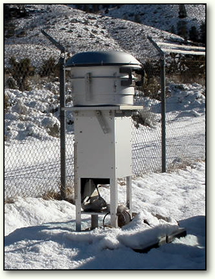
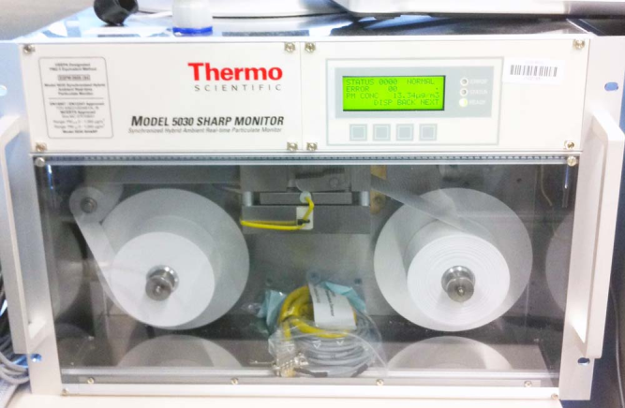
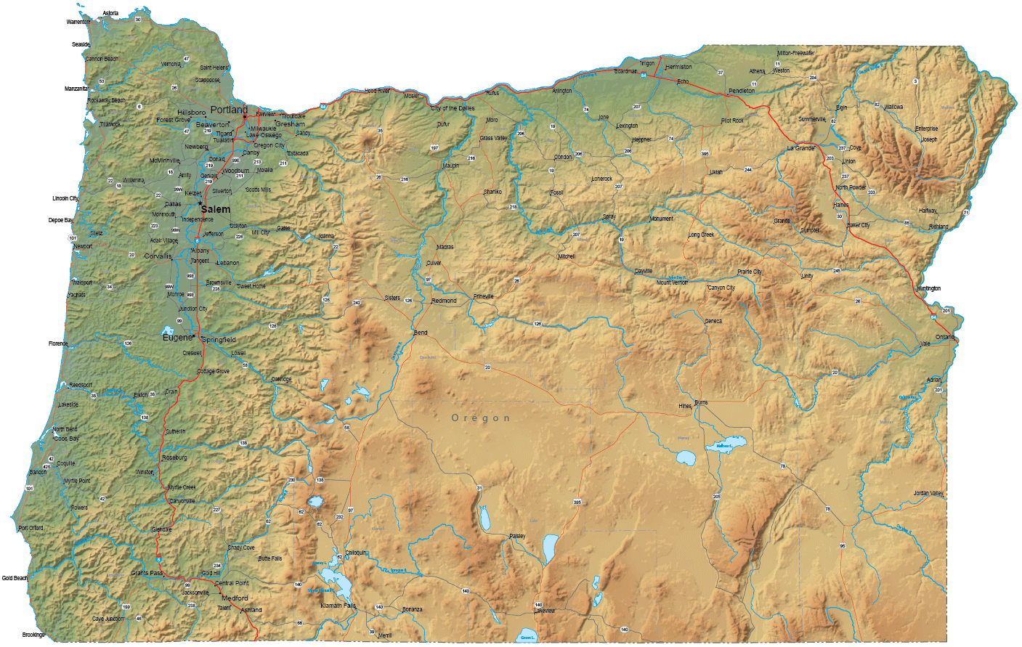
Designating a “Sustainment” Area
Gather ambient monitoring data
Define boundary
Notes:
As I mentioned earlier, there is a construction ban Lakeview because the monitoring data shows they are nonattainment but they are still officially designated as attainment. As such, larger businesses cannot build or expand in Lakeview so a sustainment area designation is just what they need.
In this rule package, we are going to specify how we will designate new sustainment and reattainment areas.
We’ll gather ambient monitoring data, define a boundary.

Slide 16

Designating a “Sustainment” Area
Identify priority sources:
Woodstoves
Work with local government/businesses to reduce emissions
Notes:
Identify priority sources and work with local governments.
This is exactly what we have done in Lakeview. Staff met with their town council, the city commissioners, and the PM Advance advisory committee last week. They explained this permitting limbo and all of these groups agreed that it would be good for them to be designated as a sustainment area. They will submit a letter at the EQC March 14 meeting requesting the designation.

Slide 17
Net Air Quality Benefit (NAQB)
Background
Sources impacting nonattainment areas cannot build
Recommendation
Revise modeling criteria for NAQB
DEQ Workload
Training for permit writers/modelers to learn program revisions
Increase offset ratios
Lower PM_{2.5} standard has revealed this problem
Focus on the local air quality problems
Reduce ratios if from priority sources
Notes:
The last topic we’re covering today is Net Air Quality Benefit. When a business triggers our New Source Review program, one thing they have to do is show that that will be providing a net air quality benefit in the area they are building or expanding.
Right now, our rules for showing that benefit are impossible to meet using modeling unless the increasing and offsetting businesses are co-located. The lower PM2.5 standard has revealed this problem.
We are proposing to revise this modeling criteria. We will make sure that we continue to protect air quality but we will eliminate near impossibility of meeting the modeling criteria. Another part of the net air quality benefit package is to increase the offset ratios as I mentioned before with the opportunity to reduce the ratio if offsets from priority sources are used.

Slide 18
Net Air Quality Benefit (NAQB)
Impacts on Environment
Impacts on Development
Provides ability to show Net Air Quality Benefit
Increases offset ratios unless priority sources addressed
Provides incentives to address priority sources
Ensures ambient air quality standards are protected
Allow some projects to go forward
Notes:
These changes will make our the net air quality benefit portion of our New Source Review program workable. I don’t know if you remember House Bill 2952 that was passed in 2009 for small scale local energy projects? Well that bill was a result of the problem we have in our rules regarding Net Air Quality Benefit. By fixing our rules, we’ll eliminate the need for bills like 2952 to amend our rules.
Environmentalists should also like this proposed rule change because we are addressing the cause of the problem in areas with marginal air quality and will ensure that the ambient air quality standards are protected. One thing that environmentalists might not like is that some projects would be able to go forward whereas now, they can’t.

Slide 19

Any Questions?
Notes:
We have been working with EPA on the proposed changes along the way. They have provided thoughtful suggestions and have told us that the changes we are proposing will be approvable so that’s good news.
Do you have any questions?

