Slide 1
Air Quality
Rule Changes and Updates
Notes:
Good morning! Thank you for taking the time to come today to this DEQ stakeholder meeting. I’m Jill Inahara and I work in our HQ office as a rule writer. I’d like to introduce our other presenters today....Mark and George.
In the notice for this meeting, you probably saw that the meeting will last from 10-12 and 1-2 if needed. We were planning to cover the New Source Review materials after lunch but may do so earlier if time allows.
The reason we are here today is to inform you and get input on some ideas on how we plan to change our rules. Of course you’ll be able to comment formally when the rules are proposed but we wanted to have an informal conversation with you first.
Originally this proposed rulemaking started out as a rule clean-up but it expanded when we looked at our rules thought about all the fixes we need to do. The nickname for it is the Kitchen Sink because it includes so many things and may also include some changes to our diesel program and the woodstove program, which will not be discussed today.

Slide 2
Rulemaking Goals
Make rules clearer
Update rules
Address air quality problems
Notes:
The goals of this rulemaking are to make sure our rules are clear, up to date and that they address air quality problems.
When addressing AQ problems, we want to make sure we are targeting our resources at the right place. We want to provide incentives to reduce emissions where needed and provide companies flexibility as long as it will improve air quality.

Slide 3
Rulemaking Schedule
Public Notice: October – November
Public Hearing: November
Proposed EQC Rule Adoption: March 2014
SIP Submittal to EPA for Approval: ?

Slide 4
Overview
Rule clean-up
Update particulate matter (PM) standards
Categorically Insignificant Activities
Splitting businesses
New Source Review (NSR)
Extensions for NSR permits
Net air quality benefit for sensitive areas
Notes:
Here is an overview of the topics we are going to cover today:
Rule clean-up
Update statewide grain loading and opacity standards
We have a defined term: Categorically Insignificant Activities
How emissions are divided when a business splits into two or more businesses
Our pre-construction program called New Source Review (NSR)
If construction is delayed, how a business an get an extensions for their NSR permit
Another defined term: Net air quality benefit
All of these topics will be explained in more detail later in this presentation.

Slide 5
Rule Clean-Up
Unclear rules, not organized well
  Reorganize by moving procedures out of definitions
  Provide clarification when needed, especially regarding compliance requirements
  Delete unused/redundant definitions
  Correct errors
  Maintain overall stringency
Notes:
The first part of this presentation covers rule clean-up.
Some of our rules are out of order so we want to move them to the right place. There are procedures in definitions like major modification, actual emissions and netting basis that need to be moved.
Some of our rules are missing important details so we worked on clarifying them. (compliance methods)
We want a clean set of definitions. Throughout all of our divisions there are multiple definitions of the same term – 5 definitions of the word person! Make sure the definitions agree and get rid of the redundant ones
We found cross-referencing errors and typos that need to be fixed.
None of these clean-up changes will affect stringency. We are just clarifying things.

Slide 6
Rule Clean-Up
Outdated rules repealed:
    Consumer Spray Paint VOC limits replaced by EPA rules (19% vs. 15%)
    Western Backstop SO2 Federal Trading Program – replaced by direct control of PGE Boardman
Notes:
As part of the clean up, we want to repeal some rules
Spray paint rules were part of plan to reduce ozone from consumer products. EPA adopted national rules that apply to manufacturers and so we don’t state rules any more.
DEQ worked with the western states on a SO₂ trading program but dropped out because it wasn’t cost effective. There are now specific rules but PGE is not involved in trading so we don’t need the state rules.

Slide 7
Rule Clean-Up
Repeal rules for sources that no longer exist in Oregon:
  Neutral Sulfite Semi-Chemical Pulp Mills
  Sulfite Pulp Mills
  Primary Aluminum Standards
  Laterite Ore Production of Ferronickel
  Charcoal Producing Plants
New sources must comply with more stringent federal requirements for new sources
Notes:
Unfortunately many businesses have shut down in Oregon so we plan to repeal those industry specific rules.
All other industry rules are staying the same, including Kraft Pulp Mills
If one of those sources wants to locate in Oregon, they would have to comply with current federal rules which are more stringent than our existing state rules. (New Source Review, New Source Performance Standards, National Emission Standards for HAPs)

Slide 8

Rule Clean-Up
Questions?
Notes:
Do you have any questions before we move on to the next topic?
Our next presenter is Mark Fisher.

Slide 9
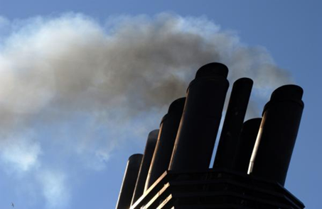
PM and Opacity Standards - Topics
Background
Changes being considered
Rationale for changes
Implementation schedule
Affected sources
Compliance issues

Slide 10
PM and Opacity Standards - Background
Standards adopted in early 1970’s as part of initial State Implementation Plan (SIP)
Rules include different standards for pre and post 1970 sources - grandfathering provision
  Pre-1970: 40% opacity and 0.2 gr/dscf
  Post 1970: 20% opacity and 0.1 gr/dscf
PM standard inconsistent with current EPA policy for significant figures/compliance
Notes:
SIP required by Clean Air Act to maintain or attain compliance with National Ambient Air Quality Standards (NAAQS)
NAAQS for particulate matter was based on total particulate matter and was much less stringent than today’s standards.

Slide 11
Opacity Standard – suggested changes
Change all opacity standards to 6-minute block average
  Replaces 3-minute aggregate in 60 minutes
  Compliance can be based on EPA Method 9
  Change is consistent with other states
  No change in stringency

Slide 12
Opacity Standard – suggested changes
Repeal Portland 4-county standard
  20% opacity for 30 seconds for non-fuel burning equipment
  No uniform procedures for determining compliance
  Not a SIP provision
  Still covered by statewide standards

Slide 13
Opacity Standard – suggested changes
Change opacity limit for old equipment from 40% to 20%
Retain 40% limit for grate cleaning or soot blowing operations if:
  Following grate or soot blowing plan; and
  Plan to minimize emissions approved by DEQ
Defer compliance until January 1, 2015 for businesses not located near sensitive air quality areas
“sensitive area” = nonattainment and maintenance areas; and proposed sustainment and reattainment areas (to be covered later in presentation)
Notes:
In going from 40% down to 20%, we are making standard the same as for post-1970 units.
Required operation and maintenance plans will ensure emissions are minimized and limit the amount of time for grate cleaning or soot blowing

Slide 14
PM Standard – suggested changes
Add significant digit to standards consistent with EPA policy
  0.1 » 0.10
  0.2 » 0.20
Phase out 0.20 standard for older sources to help address newer/tighter ambient air quality standards
All sources must comply with 0.10 standard by January 1, 2019.

Slide 15
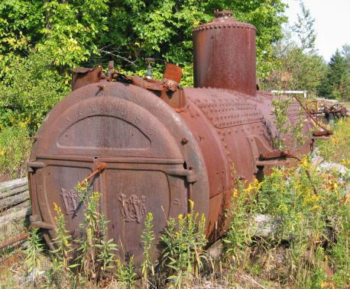
PM Grain loading standards
Source | Grain Loading Standards (gr/dscf)
 | Current Limit | Effective upon Rule Adoption | 2019
Built before 06/01/70 | 0.2 | 0.20 | 0.10
Built after 06/01/70 within 5 miles of “sensitive” area | 0.1 | 0.10 | 0.10
Built after 06/01/70 outside 5 miles of “sensitive” area | 0.1 | 0.1 | 0.10
Notes:
This is an overview of the proposed changes to the grain loading standards.
“Sensitive areas” are designated because of air quality problems

Slide 16
Explanation
Analysis of a typical source with 40% opacity and 0.2 gr/dscf
Located in Klamath Falls PM_{2.5} NAA
Grain Loading | Source Impacts | Source + Background
0.2 gr/dscf | 30% of PM_{2.5} NAAQS | 70% of PM_{2.5} NAAQS
0.10 gr/dscf | 13% of PM_{2.5} NAAQS | 53% of PM_{2.5} NAAQS
Notes:
If impacts are up to 75% of standard, we run the risk of violating the standard. This is a huge risk for public health and economic development. It affects our ability to deal with new facilities in an airshed.
The same concept is used in the Clean Air Act….new standards for newer sources.
DEQ believed that older units would be retired pr modified/updated but this is not the case. Older sources use up a lot of the PM standard so that puts areas at risk. Even if the unit is not a large percentage of the airshed, it is still impacting public health. If it created a problem we would have to address it so we are addressing it now before there is a problem.
Other states??

Slide 17
Explanation
Other affected businesses are located in areas similar to Klamath Falls:
  Small communities also have high background concentrations due to woodstoves
  Similar terrain
  Similar weather with potential for air stagnation periods in winter time.

Slide 18
Explanation
Changes are proactive measures for helping to prevent violations of current PM2.5 standards and potentially more stringent standards in the future
Changes are similar to more stringent changes adopted for PM10 nonattainment areas as reactive measures

Slide 19
Affected Sources
  Approximately 11 wood-fired boilers
  Two asphalt plants
Many of the units comply but not all the time.
  Test results range from 0.06 to 0.21 gr/dscf
  Individual outreach to these businesses after stakeholder meetings
Notes:
Units that were built before 1970

Slide 20
What might be necessary to comply with standards
Conduct more frequent tuning/maintenance
  1977 28 MMBtu wood fired boiler; pre-test out of compliance; post-test less than 0.1 gr/dscf
Maintain consistent/high quality fuel
Improve combustion controls
Install additional control equipment
Add co-firing of natural gas
Replace boiler with natural gas-fired boiler

Slide 21

PM Standard – suggested changes
Notes:
In going from 40% down to 20%, we are making standard the same as for post-1970 units.
Required operation and maintenance plans will ensure emissions are minimized and limit the amount of time for grate cleaning or soot blowing

Slide 22
Categorically Insignificant Activities
Background
Suggested changes
Effect of changes in relation to other regulatory programs

Slide 23
Categorically Insignificant Activities - background
Categorically insignificant activities identified in mid 90’s for Title V program – examples:
    Janitorial activities
    Groundskeeping activities
    Instrument calibration
    Maintenance and repair shop activities
Some activities at facilities that were previously considered insignificant are not actually insignificant when considered in aggregate

Slide 24
Categorically Insignificant Activities - background
Some of these activities are subject to new standards issued by EPA
Emissions from these activities were not considered when:
  Determining what permits are necessary;
  Establishing Plant Site Emissions Limits

Slide 25
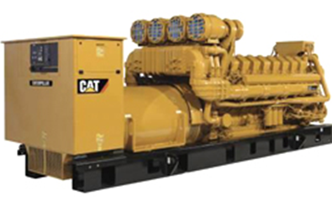
Emergency generators and pumps
  Currently considered insignificant no matter how large or how many at site
  Proposing to change categorically insignificant criteria to:
  Any individual engine rated at less than 500 horsepower (375 kW); or
  emissions in aggregate less than de minimis levels of 1 ton/year (2,756 tons/yr for GHG) based on the readiness and maintenance testing hours of operation specified in the regulations or permit.

Slide 26
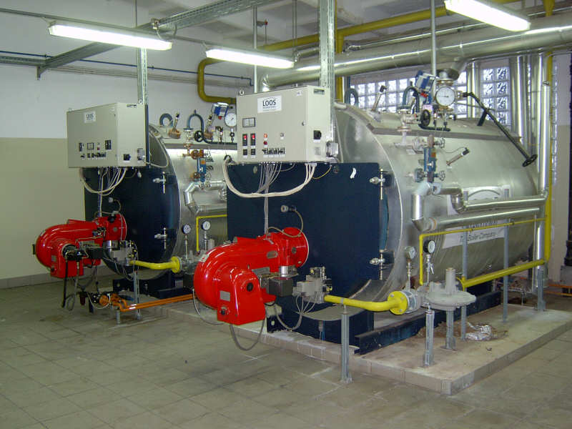
  Small fuel burning equipment
Currently considered categorically insignificant no matter how many at a source
Proposing to change categorically insignificant criteria to:
  Retain current size threshold for individual units; and add (0.4 MMBtu/hr oil; 2 MMBtu/hr gas)
  emissions in aggregate are less than de minimis levels of 1 ton/year (2756 tons/yr for GHG)
Notes:
Units no longer considered insignificant. More stringent or have to get a permit? Not more stringent.

Slide 27
Regulatory Considerations
The following regulatory programs may now apply to emergency generators and boilers:
  Notice of intent to construct (NC) may apply to small sources not otherwise required to have permits
  Air Contaminant Discharge Permits (ACDP) may be required for some sources – e.g., data centers with numerous emergency generators
Notes:
Impacts on Business
Will need to provide emissions information for these small sources
A few businesses will need to get permits (data centers) and construction approval required for all
Small future emission increases may trigger other regulatory requirements for larger businesses
Impacts on Environment
Better accounting of emissions

Slide 28
Regulatory Considerations
Plant Site Emissions Limits (PSELs) for existing sources may need to be revised
  Adding emissions to PSELs for existing sources will not trigger other requirements solely as a result of this rule change
  PSELs will be revised at next permit renewal after rules are adopted
Notes:
Impacts on Business
Will need to provide emissions information for these small sources
A few businesses will need to get permits (data centers) and construction approval required for all
Small future emission increases may trigger other regulatory requirements for larger businesses
Impacts on Environment
Better accounting of emissions

Slide 29

Categorically Insignificant Activities

Slide 30
Extensions for NSR/PSD permits
Background
Suggested Rule Changes
Public Notice

Slide 31
Extensions for NSR/PSD permits - Background
Current rules allow extensions provided there is a “demonstrated need”
  No limit on the number of extensions
  No criteria for approving extensions
If projects are delayed without further review, there is the potential for proposed projects to:
  tie up increment indefinitely
  cause significant impacts on air quality
  not have current control technology

Slide 32
Extensions for NSR/PSD permits – Suggested Rule Changes
Add provisions for two 18-month extensions – no additional extensions
Add criteria for approving extensions
Add procedures for requesting extensions
Add procedures for approving extensions

Slide 33
Extensions for NSR/PSD permits – Suggested Rule Changes
For the first 18-month extension:
  Review control technology analysis for the original pollutants subject to NSR/PSD
  Review limited to whether new control technologies have become commercially available since the original control technology analysis

Slide 34
Extensions for NSR/PSD permits – Suggested Rule Changes
For the second extension:
  Review whether any new control technologies have become commercially available
  Review original control technology analysis for potentially lower limits
  Review the air quality analysis for:
    any new competing sources or changes in ambient air quality, including any redesignation of the area impacted
      any new ambient standards or increments
      any changes to EPA approved models that would affect results

Slide 35
Extensions for NSR/PSD permits – Suggested Rule Changes
No third extensions:
    Original NSR/PSD permit automatically terminated five years after it was issued
    For approval beyond second extension, a new major NSR/PSD permit application must be submitted.
    May continue to use original emission reduction credits
      Same two digit SIC code
      Emission reduction credits contemporaneous and satisfy requirements

Slide 36
Extensions for NSR/PSD permits – Process to request extension
Business submits application for extension 30 days prior to end of current 18-month construction approval
DEQ will review extension request
DEQ will issue 18-month extension after public notice

Slide 37
Extensions for NSR/PSD permits – Public Notice
Public participation procedures for extensions:
  If no air quality analysis:
    30 days to submit written comments; or
  If air quality analysis:
    35 days to submit written comments; and
    public hearing if requested.

Slide 38

Extensions for NSR/PSD permits

Slide 39
Splitting Businesses
Background/issues
Suggested Rule Changes
Program integrity

Slide 40
Splitting Businesses – Background/Issues
If a business shuts down, splits, and/or repurposes, what happens to its allowable emissions?
Potential for new business to avoid construction approval if they use emissions from shutdown of one source to operate another source.
Clean Air Act construction approval ensures:
  State of the art control technologies
  No adverse impacts on air quality

Slide 41
Splitting Businesses –
Suggested Rule Changes
Clarify how emissions are treated when a business splits
Emissions may only be transferred to:
    New business(es) with same primary 2-digit SIC, or
    A combined heat and power unit that supported the original primary activity
    Amount of emissions transferred cannot exceed the “new” source’s potential to emit

Slide 42
Splitting Businesses –
Program Integrity
Limits ability to use emissions for unrelated projects
Clarifies rules to ensure new source, if different than existing source, is subject to construction approval
  Consistent with the provisions that apply to physical changes or changes in the method of operation that apply to all sources.

Slide 43

Splitting Businesses

Slide 44

LUNCH?
Next section about NSR and changes,
Break for lunch?
Can leave or come back after lunch

Slide 45
New Source Review (NSR)
This section is about New Source Review
  Short explanation of what NSR is
  Goals and why changes are suggested
  Description of suggested changes

Slide 46
New Source Review (NSR)
What is NSR?
Nationwide regulatory program, ensures new or modified facilities:
  install up to date emission control systems
  do not adversely affect AQ
NSR program applies to:
  Emission increases above certain levels at:
  new facilities
  existing facilities that modify or add new equipment and want to increase emissions

Slide 47
New Source Review (NSR)
Two broad divisions, Major and Minor
Major NSR
  Total emissions ≥ “federal major” levels, with physical change ≥ SER (100, 40, 10, etc.)
Minor NSR
  Total emissions ≥ SER but < federal major, with
  physical change ≥ SER
  Total emissions ≥ SER with
  physical change < SER or no physical change

Slide 48
New Source Review Applicability
Minor NSR 1 = physical change
Minor NSR 2 = no physical change
Minor NSR 3 = smallest businesses

Slide 49
New Source Review (NSR)
Minor NSR also includes smallest category
  Emissions < SER w/ or w/o physical change
    No changes from current rules

Slide 50
New Source Review (NSR)
NSR requirements depend on area designation
3 types of areas:
  Attainment/unclassified
  Nonattainment
  Maintenance
Area designation is done by EPA

Slide 51
New Source Review (NSR)
Attainment/unclassified area = air quality is (or is assumed to be) below NAAQS
Nonattainment area = air quality is above NAAQS
Maintenance area = area was nonattainment but is back in attainment
  Maintenance includes provisions to prevent going back into nonattainment

Slide 52

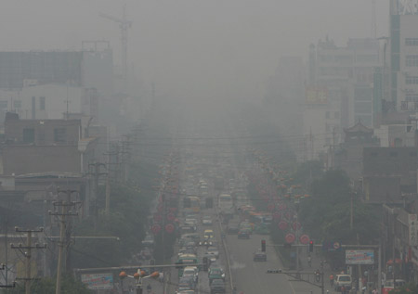
New Source Review (NSR)
Attainment/unclassified area
Nonattainment area
Maintenance area

Slide 53
New Source Review (NSR)
Rulemaking Goals
Clarify major and minor NSR requirements
Create provisions to help
  Prevent areas from becoming nonattainment
  Get back into attainment sooner
Protect/improve air quality in sensitive areas
Increase permitting flexibility for new development

Slide 54
New Source Review (NSR)
Rulemaking Goals, cont.
Address priority sources in sensitive areas
  Priority sources = main source of the AQ problem (e.g., fireworks, diamond mines, rutabaga processing plant)
Reduce the time that areas are “between area designations”
  Takes years, must be done by EPA
  Puts area in permitting limbo

Slide 55
New Source Review (NSR)
Suggested Changes
Establish “state NSR” program
  Minor NSR, excluding the lowest level (<SER)
  Not new program; reorganizing and clarifying existing rules
  Some changes
Put Major and State NSR rules in one place (Division 224)

Slide 56
New Source Review (NSR)
Suggested Changes
Clarify “state NSR” program
  Reorganize and clarify existing rules
  Some changes
Put Major and State NSR rules in one place (Division 224)

Slide 57
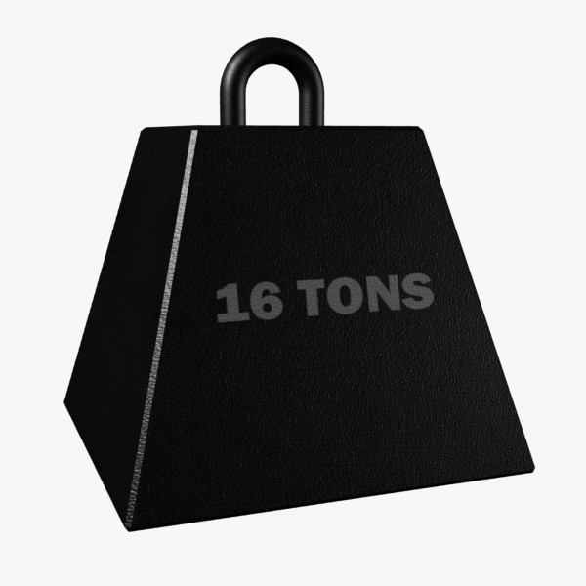
New Source Review (NSR)
Suggested Changes
Change part of Federal Major Source definition
In attainment/unclassified areas:
  No change
  Still ≥ 100*/250 tons per year
  * 100 tpy for 28 source categories listed in rule (e.g. pulp and paper mills, iron and steel mills, chemical process plants)
100/250

Slide 58
New Source Review (NSR)
Suggested Changes
In nonattainment and maintenance areas:
Federal major source = emissions ≥ 100 tpy
  Currently ≥ Significant Emission Rate (SER)
  Aligns DEQ definition with EPA definition
State NSR will apply to emissions ≥ SER but
< federal major (“non-federal major”)
Overall stringency remains the same

Slide 59
New Source Review (NSR)
Suggested Changes
In nonattainment and maintenance areas:
Change to federal major source threshold aligns with EPA definition:
State NSR applies to (“non-federal major”)
SER
100 tpy
Current
Proposed

Slide 60
New Source Review (NSR)
Offsets and Net Air Quality Benefit (NAQB)
Part of New Source Review - nonattainment and maintenance areas
Offsets: new or increased emissions > SER must be offset by emission reductions
Amount of emission reduction is specified by an offset ratio

Slide 61
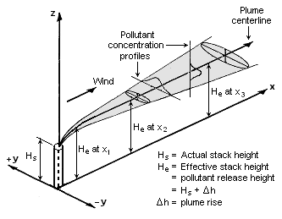
New Source Review (NSR)
NAQB: DEQ requires modeling, demonstrate that air quality is being protected
For EPA, NAQB = offsets; Oregon’s program more stringent
Currently 2 modeling
criteria, but 1 is nearly
impossible to meet

Slide 62



New Source Review (NSR)
Current criteria requires offsets
and new emissions to overlap
at all times
Only happens
if sources and
wind line up
offsetting source
new source

Slide 63
New Source Review (NSR)
Lower PM2.5 NAAQS has revealed this problem with current NAQB rules
New development is prevented, along with ability to obtain environmental benefits from new development

Slide 64
New Source Review (NSR)
Suggestions
Focus on addressing local air quality problems
  EQC can designate priority sources (i.e. woodstoves)
Create incentive to address priority sources:
  Increase offset ratio
  Reduce ratio if offsets obtained from priority sources
Revise modeling criteria
  Continue to protect air quality
  Eliminate near impossibility of meeting criteria

Slide 65
New Source Review (NSR)
Offsets and NAQB for Federal Major Sources
  Require 1.2:1 offsets
  Allow reduction to not less than 1.0:1 by offsetting emissions with “priority” source emissions
    Woodstoves
    Sources causing NAA problem
  NAQB modeling:
    Source analysis<SIL at all receptors in neighborhood scale area around monitoring site
    Competing source analysis <10% of NAAQS

Slide 66
New Source Review (NSR)
Give non-federal major sources more flexibility for offset and NAQB
  Require 1.0:1 offsets
  Allow reduction to not less than 0.5:1 by offsetting emissions with “priority” source emissions
      Woodstoves
      Sources causing NAA problem
  NAQB modeling:
    Source analysis<SIL at all receptors in neighborhood scale area around monitoring site
    Competing source analysis <10% of NAAQS

Slide 67
New Source Review (NSR)
Suggestion
  Define two new types of areas
  Fit between existing areas
Attainment Nonattainment Maintenance
  Provide greater permitting flexibility for areas in transition
  Structure requirements so new/expanding sources help attain goals
Sustainment
Reattainment

Slide 68
New Source Review (NSR)
“Sustainment” Areas
  Monitoring data close to or exceeding NAAQS
  Not yet designated NAA by EPA
  Purpose: help prevent becoming nonattainment
“Reattainment” Areas:
  NAA that has 3 years of data < NAAQS
  Not yet re-designated as attainment by EPA
  Purpose: permitting flexibility for State NSR

Slide 69




Designated Areas
Attainment
Sustainment
Nonattainment
Reattainment
Maintenance

Slide 70
New Source Review (NSR)
“Sustainment” Areas
  Monitoring data close to or exceeding NAAQS
  Not yet designated NAA by EPA
  Purpose: help prevent becoming nonattainment

Slide 71
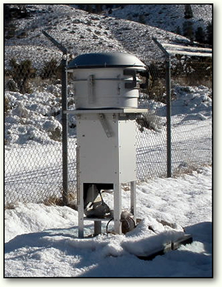
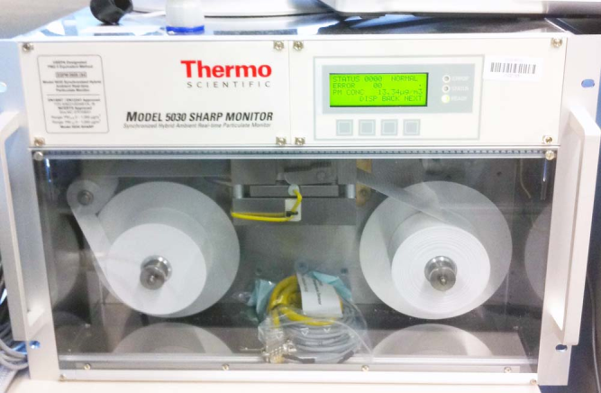
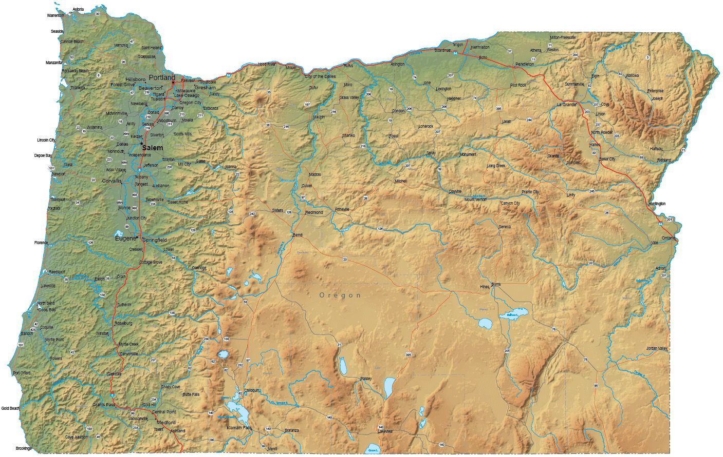
Designating a “Sustainment” Area
Gather ambient monitoring data
Define boundary

Slide 72

Designating a “Sustainment” Area
Identify priority sources:
Woodstoves plant
Hog Fuel Boiler
Work with local government/businesses to reduce emissions

Slide 73

“Reattainment” Areas:
  NAA that has 3 years of data < NAAQS
  Not yet re-designated as attainment by EPA
  Purpose: permitting flexibility for State NSR

Slide 74
New Source Review (NSR)
  Sustainment or Reattainment designated only by EQC
  New areas overlay EPA designations
  Federal major sources must still meet minimum federal requirements for EPA designated area
State designation |  | EPA designation
Attainment | --- | Attainment
Sustainment | --- | Attainment
Nonattainment | --- | Nonattainment
Reattainment | --- | Nonattainment
Maintenance | --- | Attainment

Slide 75

New Source Review (NSR)
Suggested parts of the NSR program have been described
Some tables follow to summarize and show how the pieces fit together
Apologies in advance: tables are rather busy
No changes in attainment areas (no table)
No changes to ozone offsets

Slide 76

NONATTAINMENT AREAS
Current | Proposed
Major (SER or greater) | Federal Major (>100 tpy) | State NSR (SER-100)
LAER | LAER | BACT, if major modification
Offsets/NAQB 1.0:1 Modeling Reduce impacts at majority of receptors; and Impacts less than SIL at all receptors | Offsets/NAQB 1.2:1, can reduce to NLT 1:1 for offsets from priority sources Modeling <SIL in area around monitor Competing source analysis <10% of NAAQS | Offsets/NAQB 1.0:1, can reduce to NLT 0.5:1 for offsets from priority sources Modeling <SIL in area around monitor Competing source analysis <10% of NAAQS

Slide 77
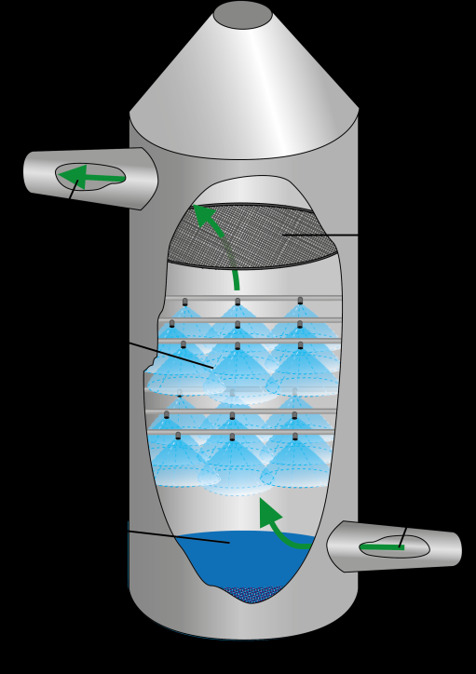
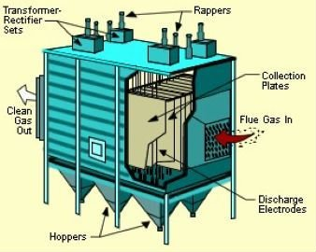
Differences in New Source Review
Nonattainment Areas
For major sources: Control technology stays at Lowest Achievable Emission Rate
For non-major sources: Change to Best Available Control Technology
BACT
LAER

Slide 78


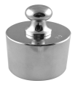


Differences in New Source Review
Nonattainment Areas
For major sources:
  Increase offset ratio to 1.2:1, reducible to NLT 1:1 for offsets from priority sources
Now
Proposed

Slide 79


Differences in New Source Review
Nonattainment Areas
For non-major sources:
  Offset ratio stays at 1.0:1, reducible to NLT 0.5:1 for offsets from priority sources
Proposed
Now

Slide 80

MAINTENANCE AREAS
Current | Proposed
Major (SER or greater) | Federal Major (>100 tpy) | State NSR (SER-100)
BACT | BACT | BACT, if major modification
NAAQS and Increments | NAAQS and Increments | NAAQS and Increments
 |  | OR
Offsets/NAQB 1.0:1 Modeling Reduce impacts at majority of receptors; and Impacts less than SIL at all receptors | Offsets/NAQB 1.0:1, can reduce to NLT 0.5:1 for offsets from priority sources | Offsets/NAQB 1.0:1, can reduce to 0.5:1 for offsets from priority sources Modeling <SIL in area around monitor Competing source analysis <10% of NAAQS

Slide 81
Differences in New Source Review
Maintenance Areas
For major sources:
  Offset ratio stays at 1.0:1, reducible to NLT 0.5:1 for offsets from priority sources
Proposed
Now

Slide 82

Differences in New Source Review
Maintenance Areas
For non-major sources:
  Modeling for standards OR
  Offset ratio stays at 1.0:1, reducible to NLT 0.5:1 for offsets from priority sources
OR
Proposed
Now

Slide 83
Source | Attainment | Sustainment | Non-attainment | Reattainment | Maintenance
Major NSR | BACT AQ Analysis | BACT AQ Analysis Offsets (10% to 5%) | LAER Offsets (1.2:1 to 1.0:1) | LAER Offsets (1.2:1 to 1.0:1) | BACT AQ Analysis Offsets (1.0:1 to 0.5:1) or alternatives currently in rules
State NSR | AQ Analysis | AQ Analysis OR BACT if major modification Offsets (10% to 5%) | BACT if major modification Offsets (1.0:1 to 0.5:1) | BACT if major modification AQ Analysis OR Offsets (1.0:1 to 0.5:1) | BACT if major modification AQ Analysis OR Offsets (1.0:1 to 0.5:1)
EPA Designation | Attainment | Attainment | Non- attainment | Non- attainment | Attainment
Notes:
Go over these tables now or later?

Slide 84

New Source Review (NSR)

