Slide 1
PM and Opacity Standards - Background
Standards adopted in early 1970’s as part of initial State Implementation Plan (SIP)
Rules include different standards for pre and post 1970 sources - grandfathering provision
  Pre-1970: 40% opacity and 0.2 gr/dscf
  Post 1970: 20% opacity and 0.1 gr/dscf
PM standard inconsistent with current EPA policy for significant figures/compliance
Notes:
SIP required by Clean Air Act to maintain or attain compliance with National Ambient Air Quality Standards (NAAQS)
NAAQS for particulate matter was based on total particulate matter and was much less stringent than today’s standards.

Slide 2
PM Standard – suggested changes
Add significant digit to standards consistent with EPA policy
  0.1 » 0.10
  0.2 » 0.20
Phase out 0.20 standard for older sources to help address newer/tighter ambient air quality standards
All sources must comply with 0.10 standard by January 1, 2019.

Slide 3
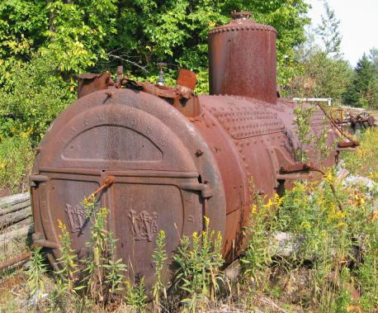
PM Grain loading standards
Source | Grain Loading Standards (gr/dscf)
 | Current Limit | Effective upon Rule Adoption | 2019
Built before 06/01/70 | 0.2 | 0.20 | 0.10
Built after 06/01/70 within 5 miles of “sensitive” area | 0.1 | 0.10 | 0.10
Built after 06/01/70 outside 5 miles of “sensitive” area | 0.1 | 0.1 | 0.10
Notes:
This is an overview of the proposed changes to the grain loading standards.
“Sensitive areas” are designated because of air quality problems

Slide 4
PM Grain loading standards
Analysis of a typical source with 40% opacity and 0.2 gr/dscf
Located in Klamath Falls PM_{2.5} NAA
Grain Loading | Source Impacts | Source + Background
0.2 gr/dscf | 30% of PM_{2.5} NAAQS | 70% of PM_{2.5} NAAQS
0.10 gr/dscf | 13% of PM_{2.5} NAAQS | 53% of PM_{2.5} NAAQS
Notes:
If impacts are up to 75% of standard, we run the risk of violating the standard. This is a huge risk for public health and economic development. It affects our ability to deal with new facilities in an airshed.
The same concept is used in the Clean Air Act….new standards for newer sources.
DEQ believed that older units would be retired pr modified/updated but this is not the case. Older sources use up a lot of the PM standard so that puts areas at risk. Even if the unit is not a large percentage of the airshed, it is still impacting public health. If it created a problem we would have to address it so we are addressing it now before there is a problem.
Other states??

Slide 5
PM Grain loading standards
Other affected businesses are located in areas similar to Klamath Falls:
  Small communities also have high background concentrations due to woodstoves
  Similar terrain
  Similar weather with potential for air stagnation periods in winter time.

Slide 6
PM Grain loading standards
Changes are proactive measures for helping to prevent violations of current PM2.5 standards and potentially more stringent standards in the future
Changes are similar to more stringent changes adopted for PM10 nonattainment areas as reactive measures

Slide 7
Affected Businesses
  Approximately 11 wood-fired boilers
  Two asphalt plants
Many of the units comply but not all the time.
  Test results range from 0.06 to 0.21 gr/dscf
  Individual outreach to these businesses after stakeholder meetings
Notes:
Units that were built before 1970

Slide 8
What might be necessary to comply with standards
Conduct more frequent tuning/maintenance
  1977 28 MMBtu wood fired boiler; pre-test out of compliance; post-test less than 0.1 gr/dscf
Maintain consistent/high quality fuel
Improve combustion controls
Install additional control equipment
Add co-firing of natural gas
Replace boiler with natural gas-fired boiler

Slide 9
Rulemaking Schedule
Public Notice: October – November
Public Hearing: November
Proposed EQC Rule Adoption: March 2014
SIP Submittal to EPA for Approval: ?

