Slide 1
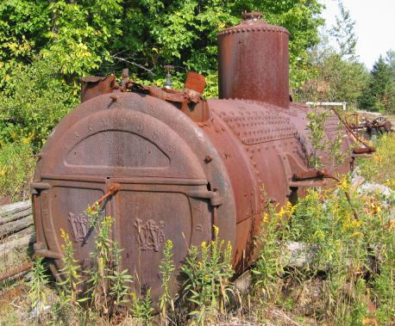
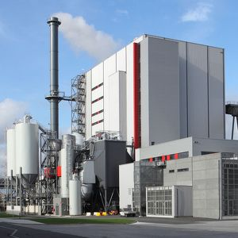
The Continuing Saga of 0.2 and 40%
Pre 1970 units
0.2 gr/dscf / 40%
Post 1970 units
0.1 gr/dscf / 20%

Slide 2
The Continuing Saga of 0.2 and 40%
Attempts to lower statewide standards to 0.1 gr/dscf and 20%:
SPPIT 1 – 1998
SPPIT 2 – 2007
PM2.5 rulemaking – 2011
Kitchen Sink rulemaking – 2014

Slide 3
The Continuing Saga of 0.2 and 40%
Changes are proactive measures for helping to prevent violations of current PM2.5 standards and potentially more stringent standards in the future
Changes are similar to more stringent changes adopted for PM10 nonattainment areas as reactive measures

Slide 4

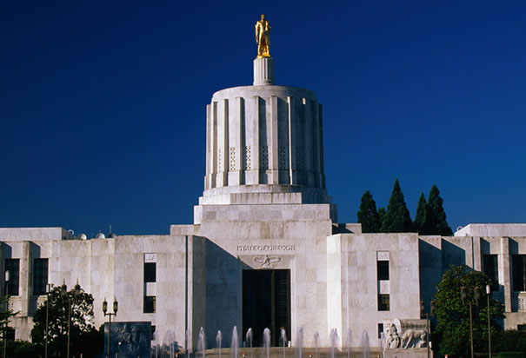
The Continuing Saga of 0.2 and 40%
_ _ _ _ _ Lumber Co., Inc.

Slide 5
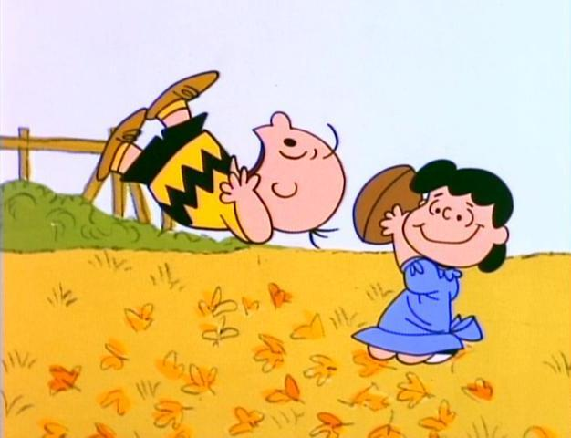
The Continuing Saga of 0.2 and 40%
So we decided to do some computer modeling and that’s where Phil got involved……..

