Slide 1
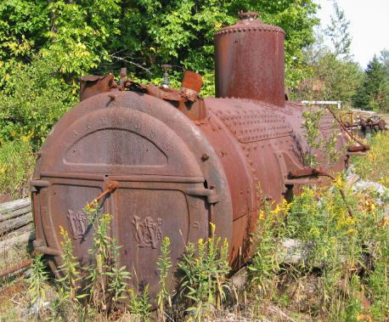
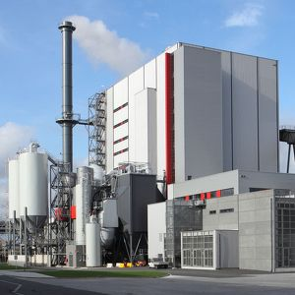
The Continuing Saga of 0.2 and 40%
Pre 1970 units
0.2 gr/dscf / 40% opacity
Post 1970 units
0.1 gr/dscf / 20% opacity

Slide 2
The Continuing Saga of 0.2 and 40%
Attempts to lower statewide standards to 0.1 gr/dscf and 20% opacity:
X SPPIT 1 – 1998
X SPPIT 2 – 2007
X PM2.5 rulemaking – 2011
? Kitchen Sink rulemaking – 2014

Slide 3
The Continuing Saga of 0.2 and 40%
Changes are proactive measures for helping to prevent violations of current PM2.5 standards and potentially more stringent standards in the future
Changes are similar to more stringent changes adopted for PM10 nonattainment areas as reactive measures

Slide 4
Sources with 0.2 gr/dscf and 40%
30-0016 | Boise Cascade Wood Products, L.L.C.
22-3501 | Cascade Pacific Pulp, LLC Halsey Pulp Mill
18-0014 | Columbia Forest Products, Inc.
22-2525 | Frank Lumber Co., Inc.
18-0005 | Interfor Pacific Inc.
10-0030 | Swanson Group Mfg. LLC Roseburg
13-0010 | Harney Rock & Paving Co.
37-0112 | Humbert Asphalt, Inc.

Slide 5

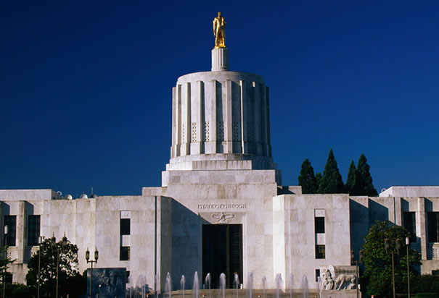
The Continuing Saga of 0.2 and 40%
______Lumber Co., Inc.

Slide 6
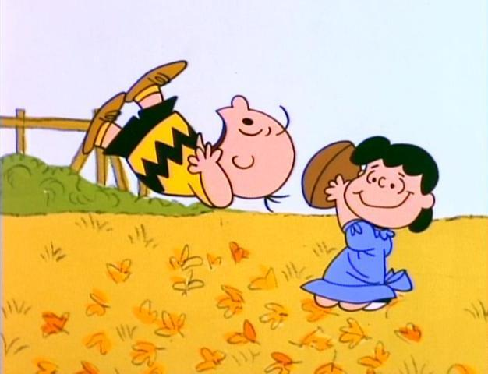
The Continuing Saga of 0.2 and 40%
So we decided to do some computer modeling and that’s where Phil got involved……..

Slide 7
The Continuing Saga of 0.2 and 40%

Slide 8
The Continuing Saga of 0.2 and 40%

Slide 9
The Continuing Saga of 0.2 and 40%

Slide 10
The Continuing Saga of 0.2 and 40%

