Slide 1
EQC Informational Item
XX, 2014
Air Quality
Rule Changes and Updates
Notes:
I’m here to update you on the comprehensive rule changes that AQ is doing to update and improve our permitting program.

Slide 2
Rulemaking Goals
Make rules clearer
Update rules
Address air quality problems
Notes:
The goals of this rulemaking are to make sure our rules are clear, up to date and that they address air quality problems.
When addressing AQ problems, we want to make sure we are targeting our resources at the right place. We want to provide incentives to reduce emissions where needed and provide companies flexibility as long as it will improve air quality.

Slide 3
Rulemaking Schedule
Stakeholder meetings: Aug. 2013
Public Notice: June-July, 2014
Public Hearing: July 24, 2014
Proposed EQC Adoption: Jan. 2015

Slide 4
Overview
Rule clean-up and update
Update particulate matter (PM) standards
Permit small fuel burning equipment and emergency generators
New Source Review (NSR)
Provide more flexibility for public hearings and meetings
Re-establish Heat Smart exemption for small commercial solid fuel boilers
Remove annual reporting requirements for small fuel dispensing facilities
Notes:
Here is an overview of the topics we are going to cover today:
Rule clean-up
Update statewide particulate matter standards
We have a defined term: Categorically Insignificant Activities that covers permitting of very small sources
Our pre-construction program called New Source Review (NSR)
All of these topics will be explained in more detail later in this presentation.

Slide 5
Rule Cleanup and Update
Move procedures from definitions
Actual emissions
Netting basis
Major modification
Repeal outdated rules
Aluminum plant
Sulfite pulp mill
Laterite ore processing
Spray paint
Include compliance method with all standards
Move tables to their own rule
Add SIP notes where necessary
Correct cross references

Slide 6
Rule Clean-Up & Update
Background
Outdated rules are unclear
Recommendation
Clarify where necessary
Repeal unnecessary rules
EPA has adopted new rules
Notes:
The first part of this presentation covers rule clean-up. To give you some background, some of our rules are missing important details. These elements of our program have created problems in the past. For example, we are clarifying if construction is delayed, how a business an get an extensions for their permit
EPA has made changes to their rules so we need to catch up with those changes, such as the definition of Volatile Organic Compounds.
Unfortunately many businesses have shut down in Oregon (aluminum smelters, sulfite pulp mills, laterite ore processing) so we plan to repeal those industry specific rules. If one of those sources wants to locate in Oregon, they would have to comply with current federal rules which are more stringent than our existing state rules.

Slide 7
Update PM Standards
Background
Potential exceedances of PM_{2.5} ambient standards
Recommendation
Reduce opacity limit from 40% to 20%
Pre-1970 sources have higher PM standards
Reduce PM concentrations from 0.2 to 0.15 gr/dscf
Provide additional time for compliance with lower limits
Notes:
We have 2 statewide standards for particulate matter. One type of standard sets concentration-based emission limits as mass per unit volume of exhaust gas, also called grain loading. A second type of standard, referred to as a visible emissions standard, limits the maximum visual density, or opacity, of a plume.
To give you some background on why we want to change our particulate matter standards, work on the Klamath Falls attainment plan showed impacts from a single source could be up to 75% of standard. That puts us in danger of violating the standard. This is a huge risk for public health and economic development. If the majority of the airshed is taken up already from a single source, new sources aren’t able to come into the area. This change allows economic expansion in the airshed.
Today’s PM2.5 ambient air quality standard is much more stringent than the standard that was in place when these old 1970 limits were adopted (260 ug/m3 versus 35 ug/m3).
In going from 40% down to 20% opacity (our limits on visible emissions) and 0.2 to 0.15 gr/dscf (a measurement of particulate matter), we are making standards for the 43 year old sources more stringent to avoid problems meeting the ambient air quality standards.

Slide 8
Opacity

Slide 9
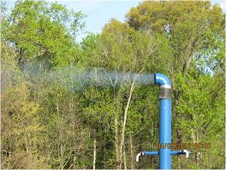
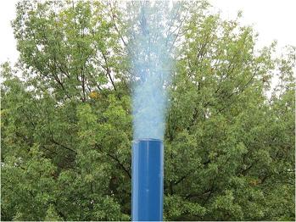
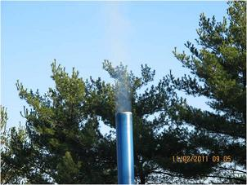
VA DEQ Standalone Trials 20%
Certification Image
VA DEQ Testing Images
Lesson Learned
Stay out of Shadows

Slide 10
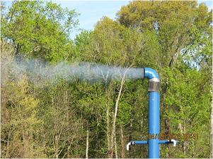
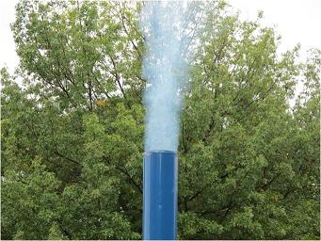
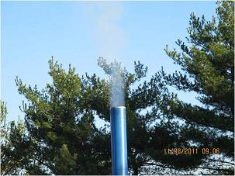
VA DEQ Standalone Trials 40%
Certification Image
VA DEQ Testing Images
Lesson Learned
Use the optical zoom

Slide 11
Permitting Small Sources
Background
Small sources considered
“categorically insignificant activities”
Recommendation
Require construction approval or permit
Aggregate emissions are significant
New standards for emergency generators
Notes:
The next topic covers permitting small sources. A list of categorically insignificant activities was identified in mid 90’s for Title V program because we had to account for ALL emissions. The list includes examples like:
Janitorial activities
Groundskeeping activities including
Emergency generators
Things have changed since 1994. EPA adopted new standards for emergency generators and we are permitting data centers that have multiple emergency generators
One source has about 20 small boilers and their aggregate emissions are definitely not insignificant. Oil or gasoline = 0.4 MMBTU/hr; NG = 2 MMBTU/hr; 40 gal NG H2O heater = 36,000 BTU/hr; 75 gallon 135,000 BTU gas water heater servicing 6 - 2 bedroom condominiums
So for emergency generators and small boilers, we are going to require they be included in new or existing permits. They will also need construction approval for new units.

Slide 12
New Source Review (NSR)
Background
Prevent new nonattainment areas
Recommendation
Change definition of major source: Separate Major NSR from non-Major NSR
EPA redesignation is slow
Improve air quality in existing nonattainment areas
Provide incentives to reduce emissions from problem sources
Construction ban in certain areas
Establish two new transitional areas: sustainment and reattainment
Notes:
The next topic is New Source Review. This is a nationwide regulatory program that ensures new or modified facilities install the latest control technologies and do not violate ambient air quality standards. The New Source Review program is designed to prevent areas from becoming new nonattainment areas and also improve the air quality in nonattainment areas to get back into attainment.
The problem is that EPA designation of areas is slow. The ways our rules are set up, the modeling requirements create an unnecessary construction ban in areas like Lakeview that haven’t been redesignated as nonattainment.
To solve this problem, we are establishing two new transitional areas: sustainment and reattainment areas. These will be designated by EQC, not EPA. Sustainment areas are designed to prevent areas from becoming nonattainment areas. This is what we are proposing to do to the Lakeview area. Reattainment areas help transition an area back to attainment more quickly before the EPA redesignation.
We are changing our definition of a major source to match EPA’s definition. This change, along with the designation of sustainment and reattainment areas will give us more flexibility in permitting smaller sources. This will also help us allow construction that was previously prohibited but still be protective of air quality.

Slide 13
Other Proposed Rule Changes
Provide more flexibility for public hearings and meetings
Re-establish Heat Smart exemption for small commercial solid fuel boilers
Remove annual reporting requirements for small gas stations
Notes:
The requirements are very prescriptive and in some cases do not allow DEQ to use technology such as the internet to hold “virtual” meetings.
DEQ proposes revisions to residential wood heating rules to remedy the inadvertent prohibition to sell small commercial biomass boilers in Oregon.
DEQ proposes repealing the annual reporting requirement for small gasoline dispensing facilities after finding the reports unnecessary to ensure compliance with emission standards that prevent leaks and spills. A gasoline dispensing facility with a monthly throughput of less than 10,000 gallons of gasoline is currently required to:
Meet work practice standards
Have a submerged fill tube installed on any tank at the facility that has a capacity of 250 gallons or more
If subject to the submerged fill tube requirement, submit a one-time initial notification and later a notification of compliance status
Submit annual reports of throughput

Slide 14
Questions?

