Slide 1
Air Quality
Rule Changes and Updates
Notes:
Good morning! Thank you for taking the time to come today to this DEQ stakeholder meeting. I’m Jill Inahara and I work in our HQ office as a rule writer. I’d like to introduce our other presenters today....Mark and George.
In the notice for this meeting, you probably saw that the meeting will last from 10-12 and 1-2 if needed. We were planning to cover the New Source Review materials after lunch but may do so earlier if time allows.
You will notice that there are also a lot of DEQ staff people here today. We invited them here today so they can learn about the potential rule changes too.
The reason we are here today is to inform you and get input on some ideas on how we plan to change our rules. Of course you’ll be able to comment formally when the rules are proposed but we wanted to have an informal conversation with you first.
Originally this proposed rulemaking started out as a rule clean-up but it expanded when we looked at our rules thought about all the fixes we need to do. The nickname for it is the Kitchen Sink because it includes so many things and may also include some changes to our diesel program and the woodstove program, which will not be discussed today.

Slide 2
Rulemaking Goals
Make rules clearer
Update rules
Address air quality problems
Notes:
The goals of this rulemaking are to make sure our rules are clear, up to date and that they address air quality problems.
When addressing AQ problems, we want to make sure we are targeting our resources at the right place. We want to provide incentives to reduce emissions where needed and provide companies flexibility as long as it will improve air quality.

Slide 3
Rulemaking Schedule
Public Notice: mid-June through July
Public Hearing: July
Proposed EQC Rule Adoption: January 2015
SIP Submittal to EPA: February 2015

Slide 4
Overview
Rule clean-up
Update particulate matter (PM) standards
Categorically Insignificant Activities
Splitting businesses
New Source Review (NSR)
Extensions for NSR permits
Net air quality benefit for sensitive areas
Notes:
Here is an overview of the topics we are going to cover today:
Rule clean-up
Update statewide grain loading and opacity standards
We have a defined term: Categorically Insignificant Activities
How emissions are divided when a business splits into two or more businesses
Our pre-construction program called New Source Review (NSR)
If construction is delayed, how a business an get an extensions for their NSR permit
Another defined term: Net air quality benefit
All of these topics will be explained in more detail later in this presentation.

Slide 5
Rule Clean-Up
Unclear rules, not organized well
Reorganize by moving procedures out of definitions
Provide clarification when needed, especially regarding compliance requirements
Delete unused/redundant definitions
Correct errors
Maintain overall stringency
Notes:
The first part of this presentation covers rule clean-up.
Some of our rules are out of order so we want to move them to the right place. There are procedures in definitions like major modification, actual emissions and netting basis that need to be moved.
Some of our rules are missing important details so we worked on clarifying them. (compliance methods)
We want a clean set of definitions. Throughout all of our divisions there are multiple definitions of the same term – 5 definitions of the word person! Make sure the definitions agree and get rid of the redundant ones
We found cross-referencing errors and typos that need to be fixed.
None of these clean-up changes will affect stringency. We are just clarifying things.

Slide 6
Rule Clean-Up
Outdated rules repealed:
Consumer Spray Paint VOC limits replaced by EPA rules (19% vs. 15%)
Western Backstop SO2 Federal Trading Program – replaced by direct control of PGE Boardman
Notes:
As part of the clean up, we want to repeal some rules
Spray paint rules were part of plan to reduce ozone from consumer products. EPA adopted national rules that apply to manufacturers and so we don’t state rules any more.
DEQ worked with the western states on a SO₂ trading program but dropped out because it wasn’t cost effective. There are now specific rules but PGE is not involved in trading so we don’t need the state rules.

Slide 7
Rule Clean-Up
Repeal rules for sources that no longer exist in Oregon:
Neutral Sulfite Semi-Chemical Pulp Mills
Sulfite Pulp Mills
Primary Aluminum Standards
Laterite Ore Production of Ferronickel
Charcoal Producing Plants
New sources must comply with more stringent federal requirements for new sources
Notes:
Unfortunately many businesses have shut down in Oregon so we plan to repeal those industry specific rules.
All other industry rules are staying the same, including Kraft Pulp Mills
If one of those sources wants to locate in Oregon, they would have to comply with current federal rules which are more stringent than our existing state rules. (New Source Review, New Source Performance Standards, National Emission Standards for HAPs)

Slide 8

Rule Clean-Up
Questions?
Notes:
Do you have any questions before we move on to the next topic?
Our next presenter is Mark Fisher.

Slide 9
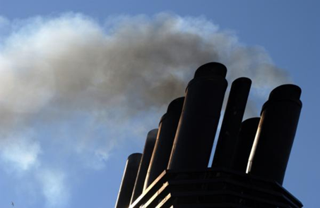
PM and Opacity Standards - Topics
Background
Changes being considered
Implementation schedule
Affected sources
Compliance issues

Slide 10
PM and Opacity Standards - Background
Standards adopted in early 1970’s as part of initial State Implementation Plan (SIP)
Rules include different standards for pre and post 1970 sources - grandfathering provision
Pre-1970: 40% opacity and 0.2 gr/dscf
Post 1970: 20% opacity and 0.1 gr/dscf
PM standard inconsistent with current EPA policy for significant figures/compliance
Notes:
SIP required by Clean Air Act to maintain or attain compliance with National Ambient Air Quality Standards (NAAQS)
NAAQS for particulate matter was based on total particulate matter and was much less stringent than today’s standards.

Slide 11
Opacity Standard – suggested changes
Change all opacity standards to 6-minute block average
Replaces 3-minute aggregate in 60 minutes
Compliance can be based on EPA Method 9
Change is consistent with other states
No change in stringency

Slide 12
Opacity Standard – suggested changes
Repeal Portland 4-county standard
20% opacity for 30 seconds for non-fuel burning equipment
No uniform procedures for determining compliance
Not a SIP provision
Still covered by statewide standards

Slide 13
Opacity Standard – suggested changes
Change opacity limit for old equipment from 40% to 20%
Retain 40% limit for grate cleaning or soot blowing operations if:
Following grate or soot blowing plan; and
Plan to minimize emissions approved by DEQ
Defer compliance until January 1, 2015 for businesses not located near sensitive air quality areas
“sensitive area” = nonattainment and maintenance areas; and proposed sustainment and reattainment areas (to be covered later in presentation)
Notes:
In going from 40% down to 20%, we are making standard the same as for post-1970 units.
Required operation and maintenance plans will ensure emissions are minimized and limit the amount of time for grate cleaning or soot blowing

Slide 14
PM Standard – suggested changes
Add significant digit to standards consistent with EPA policy
0.1 » 0.10
0.2 » 0.20
Phase out 0.20 standard for older sources to help address newer/tighter ambient air quality standards
All sources must comply with 0.10 standard by January 1, 2020.

Slide 15
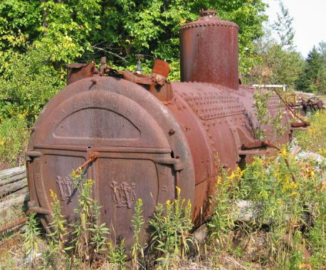
PM Grain loading standards
Source | Grain Loading Standards (gr/dscf)
 | Current Limit | Effective upon Rule Adoption | 2019
Built before 06/01/70 | 0.2 | 0.20 | 0.10
Built after 06/01/70 within 5 miles of “sensitive” area | 0.1 | 0.10 | 0.10
Built after 06/01/70 outside 5 miles of “sensitive” area | 0.1 | 0.1 | 0.10
Notes:
This is an overview of the proposed changes to the grain loading standards.
“Sensitive areas” are designated because of air quality problems

Slide 16
PM Grain loading standards
Analysis of a typical source with 40% opacity and 0.2 gr/dscf
Located in Klamath Falls PM_{2.5} NAA
Grain Loading | Source Impacts | Source + Background
0.2 gr/dscf | 30% of PM_{2.5} NAAQS | 70% of PM_{2.5} NAAQS
0.10 gr/dscf | 13% of PM_{2.5} NAAQS | 53% of PM_{2.5} NAAQS
Notes:
If impacts are up to 75% of standard, we run the risk of violating the standard. This is a huge risk for public health and economic development. It affects our ability to deal with new facilities in an airshed.
The same concept is used in the Clean Air Act….new standards for newer sources.
DEQ believed that older units would be retired pr modified/updated but this is not the case. Older sources use up a lot of the PM standard so that puts areas at risk. Even if the unit is not a large percentage of the airshed, it is still impacting public health. If it created a problem we would have to address it so we are addressing it now before there is a problem.
Other states??

Slide 17
PM Grain loading standards
Other affected businesses are located in areas similar to Klamath Falls:
Small communities also have high background concentrations due to woodstoves
Similar terrain
Similar weather with potential for air stagnation periods in winter time.

Slide 18
PM Grain loading standards
Changes are proactive measures for helping to prevent violations of current PM2.5 standards and potentially more stringent standards in the future
Changes are similar to more stringent changes adopted for PM10 nonattainment areas as reactive measures

Slide 19
Affected Businesses
Approximately 11 wood-fired boilers
Two asphalt plants
Many of the units comply but not all the time.
Test results range from 0.06 to 0.21 gr/dscf
Individual outreach to these businesses after stakeholder meetings
Notes:
Units that were built before 1970

Slide 20
What might be necessary to comply with standards
Conduct more frequent tuning/maintenance
1977 28 MMBtu wood fired boiler; pre-test out of compliance; post-test less than 0.1 gr/dscf
Maintain consistent/high quality fuel
Improve combustion controls
Install additional control equipment
Add co-firing of natural gas
Replace boiler with natural gas-fired boiler

Slide 21

PM Standards – suggested changes
Notes:
In going from 40% down to 20%, we are making standard the same as for post-1970 units.
Required operation and maintenance plans will ensure emissions are minimized and limit the amount of time for grate cleaning or soot blowing

Slide 22
Categorically Insignificant Activities
Background
Suggested changes
Effect of changes in relation to other regulatory programs

Slide 23
Categorically Insignificant Activities - background
Categorically insignificant activities identified in mid 90’s for Title V program – examples:
Janitorial activities
Groundskeeping activities
Instrument calibration
Maintenance and repair shop activities
Some activities at facilities that were previously considered insignificant are not actually insignificant when considered in aggregate

Slide 24
Categorically Insignificant Activities - background
Some of these activities are subject to new standards issued by EPA
Emissions from these activities were not considered when:
Determining what permits are necessary;
Establishing Plant Site Emissions Limits

Slide 25
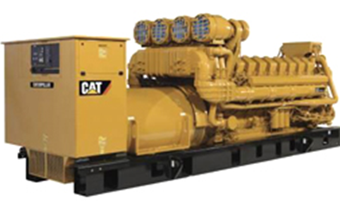
Emergency generators and pumps
Currently considered insignificant no matter how large or how many at site
Proposing to change categorically insignificant criteria to:
Any individual engine rated at less than 500 horsepower (375 kW); and
emissions in aggregate less than de minimis levels of 1 ton/year (2,756 tons/yr for GHG) based on the readiness and maintenance testing hours of operation specified in the regulations or permit.

Slide 26
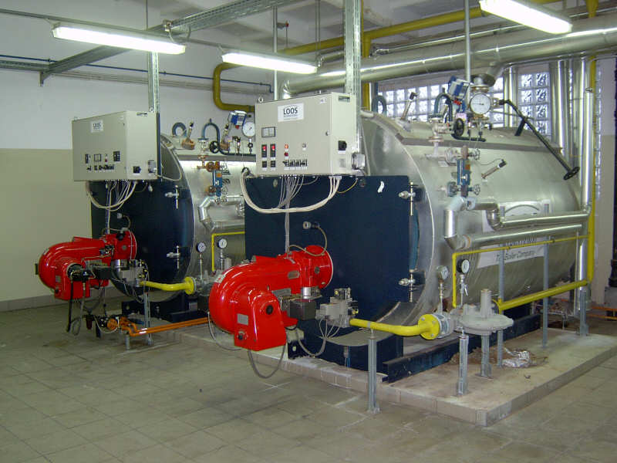
Small fuel burning equipment
Currently considered categorically insignificant no matter how many at a source
Proposing to change categorically insignificant criteria to:
Retain current size threshold for individual units; and add (0.4 MMBtu/hr oil; 2 MMBtu/hr gas)
emissions in aggregate are less than de minimis levels of 1 ton/year (2756 tons/yr for GHG)
Notes:
Units no longer considered insignificant. More stringent or have to get a permit? Not more stringent.

Slide 27
Regulatory Considerations
The following regulatory programs may now apply to emergency generators and boilers:
Notice of intent to construct (NC) may apply to small sources not otherwise required to have permits
Air Contaminant Discharge Permits (ACDP) may be required for some sources – e.g., data centers with numerous emergency generators
Notes:
Impacts on Business
Will need to provide emissions information for these small sources
A few businesses will need to get permits (data centers) and construction approval required for all
Small future emission increases may trigger other regulatory requirements for larger businesses
Impacts on Environment
Better accounting of emissions

Slide 28
Regulatory Considerations
Plant Site Emissions Limits (PSELs) for existing sources may need to be revised
Adding emissions to PSELs for existing sources will not trigger other requirements solely as a result of this rule change
PSELs will be revised at next permit renewal after rules are adopted
Notes:
Impacts on Business
Will need to provide emissions information for these small sources
A few businesses will need to get permits (data centers) and construction approval required for all
Small future emission increases may trigger other regulatory requirements for larger businesses
Impacts on Environment
Better accounting of emissions

Slide 29

Categorically Insignificant Activities

Slide 30
Extensions for NSR/PSD permits
Background
Suggested Rule Changes
Public Notice

Slide 31
Extensions for NSR/PSD permits - Background
Current rules allow extensions provided there is a “demonstrated need”
No limit on the number of extensions
No criteria for approving extensions
If projects are delayed without further review, there is the potential for proposed projects to:
tie up increment indefinitely
cause significant impacts on air quality
not have current control technology

Slide 32
Extensions for NSR/PSD permits – Suggested Rule Changes
Add provisions for two 18-month extensions – no additional extensions
Add criteria for approving extensions
Add procedures for requesting extensions
Add procedures for approving extensions

Slide 33
Extensions for NSR/PSD permits – Suggested Rule Changes
For the first 18-month extension:
Review control technology analysis for the original pollutants subject to NSR/PSD
Review limited to whether new control technologies have become commercially available since the original control technology analysis

Slide 34
Extensions for NSR/PSD permits – Suggested Rule Changes
For the second extension:
Review whether any new control technologies have become commercially available
Review original control technology analysis for potentially lower limits
Review the air quality analysis for:
any new competing sources or changes in ambient air quality, including any redesignation of the area impacted
any new ambient standards or increments
any changes to EPA approved models that would affect results

Slide 35
Extensions for NSR/PSD permits – Suggested Rule Changes
No third extensions:
Original NSR/PSD permit automatically terminated five years after it was issued
For approval beyond second extension, a new major NSR/PSD permit application must be submitted.
May continue to use original emission reduction credits
Same two digit SIC code
Emission reduction credits contemporaneous and satisfy requirements

Slide 36
Extensions for NSR/PSD permits – Process to request extension
Business submits application for extension 30 days prior to end of current 18-month construction approval
DEQ will review extension request
DEQ will issue 18-month extension after public notice

Slide 37
Extensions for NSR/PSD permits – Public Notice
Public participation procedures for extensions:
If no air quality analysis:
30 days to submit written comments; or
If air quality analysis:
35 days to submit written comments; and
public hearing if requested.

Slide 38

Extensions for NSR/PSD permits

Slide 39
Splitting Businesses
Background/issues
Suggested Rule Changes
Program integrity

Slide 40
Splitting Businesses – Background/Issues
If a business shuts down, splits, and/or repurposes, what happens to its allowable emissions?
Potential for new business to avoid construction approval if they use emissions from shutdown of one source to operate another source.
Clean Air Act construction approval ensures:
State of the art control technologies
No adverse impacts on air quality

Slide 41
Splitting Businesses – Suggested Rule Changes
Clarify how emissions are treated when a business splits
Emissions may only be transferred to:
New business(es) with same primary 2-digit SIC, or
A combined heat and power unit that supported the original primary activity
Amount of emissions transferred cannot exceed the “new” source’s potential to emit

Slide 42
Splitting Businesses – Program Integrity
Limits ability to use emissions for unrelated projects
Clarifies rules to ensure new source, if different than existing source, is subject to construction approval
Consistent with the provisions that apply to physical changes or changes in the method of operation that apply to all sources.

Slide 43

Splitting Businesses

Slide 44

LUNCH?
Next section about NSR and changes,
Break for lunch?
Can leave or come back after lunch

Slide 45
New Source Review (NSR)
Proposing revisions to New Source Review program

Slide 46
New Source Review (NSR)
Pre-construction permitting program mandated by Clean Air Act
Maintain and protect air quality
Requires pollution control devices where appropriate
Three distinct programs
Prevention of Significant Deterioration (PSD) in attainment areas
Nonattainment NSR
Minor NSR
}
Major
NSR

Slide 47
Things unique to DEQ’s program
Major source definition in nonattainment and maintenance areas
Lower threshold than EPA definition
Offsets and Net Air Quality Benefit
NAQB requires air dispersion modeling
EPA program only requires offsets
…

Slide 48
Things unique to DEQ’s program, cont.
DEQ program requires air quality impact analysis for minor sources
Maintenance areas
Former nonattainment areas
DEQ program has more stringent requirements than federal program

Slide 49
Why make changes?
Areas of the state are close to or are exceeding the PM2.5 National Ambient AQ Standards
New PM2.5 standards adopted in 2007 – much lower than PM10 standards
AQ problems mainly due to area sources, not industrial sources
Current rule structure
does not adequately address PM2.5 ambient air quality problems
prohibits development

Slide 50
How will the changes improve the program?
New or modified sources can help address ambient air quality problems
Allows for development while improving or maintaining air quality

Slide 51
What are the changes?
Align definition of major source with EPA’s definition
Different requirements for small and large sources
Create 2 new area designations
Help prevent nonattainment
Eliminate permitting roadblock
Get to maintenance faster
Primarily affect Minor New Source Review

Slide 52
Major / Minor NSR – currently With construction or change in method of operation (Major Modification)
Emission Rate> Area designation, major mod | SER or more | Less than SER
Nonattainment | Major | n/a
Maintenance | Major | n/a
Emission Rate> Area designation, major mod? | 100*/250 tpy or more | SER to 99*/249 | Less than SER
Attainment | Major | Minor | n/a
* Applies to 28 source categories listed in rule (e.g. pulp and paper mills, iron and steel mills, chemical process plants)

Slide 53
Major / Minor NSR – proposed With construction or change in method of operation (Major Modification)
Emission Rate> Area designation, major mod | 100 tpy or more | SER to 99 | Less than SER
Nonattainment | Major | Minor | n/a
Maintenance | Major | Minor | n/a
Emission Rate> Area designation, major mod? | 100*/250 tpy or more | SER to 99*/249 | Less than SER
Attainment | Major | Minor | n/a
Overall stringency remains the same

Slide 54
Significant Emission Rate (SER)
Pollutant | SER, tons per year
PM2.5 | 10
PM10 | 15
NOx, VOC, SO2 | 40
CO | 100
GHG | 75,000

Slide 55
Two New Area Designations
Sustainment area
Proposed rules designed to help keep area from becoming nonattainment
Reattainment area
Proposed rules designed to be more flexible for smaller sources to allow development, but still protect air quality

Slide 56
Current Area Designations
Attainment
(AQ below NAAQS)
Nonattainment
(AQ at/over NAAQS)
Maintenance
(attainment)

Slide 57
Areas in transition
Attainment
(AQ at/over NAAQS)
Attainment
(AQ below NAAQS)
Nonattainment
(AQ at/over NAAQS)
Nonattainment
(AQ below NAAQS)
Maintenance
(attainment)

Slide 58
New Area Designations
Attainment
(AQ at/over NAAQS)
Attainment
(AQ below NAAQS)
Sustainment
Nonattainment
(AQ at/over NAAQS)
Nonattainment
(AQ below NAAQS)
Maintenance
(attainment)
Reattainment

Slide 59
Changes to Improve Air Quality
“Priority sources” are primarily responsible for poor air quality (e.g. woodstoves in some communities)
Provide incentives for reducing priority source emissions
More credit for emission reductions from priority sources
EQC can specify Priority Sources

Slide 60
Offset Changes
Major NSR, some ratios higher than current (1.2:1)
Minor NSR, ratios lower than major NSR
Ratios area-specific
Ratios reducible for priority source offsets
e.g. 1.2:1 → 1:1
No changes to ozone offset requirements

Slide 61
Net Air Quality Benefit Changes
Current NAQB criteria nearly impossible
Revise NAQB criteria
Protect air quality:
Focus on areas with worst air quality, and
Prevent further degradation
Reduce emphasis on industrial emission offsets where area sources are the main contributors
Eliminate problem with current criteria

Slide 62
Last: Rule Organization
Minor New Source Review rules applicable to SER and over called State NSR program
No change to requirements applicable to minor sources less than SER
{
Major NSR
State NSR
Offset requirements
Net Air Quality Benefit
Division 224

Slide 63
Summary of Proposed Changes
Raise Major source threshold to 100 tpy in nonattainment and maintenance areas
Create two new area designations: sustainment and reattainment
Indentify Priority Sources
Revise offset requirements
Revise Net Air Quality Benefit requirements
Major and State NSR in Division 224

Slide 64

New Source Review (NSR)

Slide 65
Air Quality
Rule Changes and Updates
For further questions:
Jill Inahara
inahara.jill@deq.state.or.us
503-229-5001

