Slide 1
Air Quality
Rule Changes and Updates
Inspectors’ Forum
November 2014
Notes:
Good morning! Thank you for taking the time to come today to this DEQ stakeholder meeting. I’m Jill Inahara and I work in our HQ office as a rule writer. I’d like to introduce our other presenters today....Mark and George.
In the notice for this meeting, you probably saw that the meeting will last from 10-12 and 1-2 if needed. We were planning to cover the New Source Review materials after lunch but may do so earlier if time allows.
You will notice that there are also a lot of DEQ staff people here today. We invited them here today so they can learn about the potential rule changes too.
The reason we are here today is to inform you and get input on some ideas on how we plan to change our rules. Of course you’ll be able to comment formally when the rules are proposed but we wanted to have an informal conversation with you first.
Originally this proposed rulemaking started out as a rule clean-up but it expanded when we looked at our rules thought about all the fixes we need to do. The nickname for it is the Kitchen Sink because it includes so many things and may also include some changes to our diesel program and the woodstove program, which will not be discussed today.

Slide 2
Rulemaking Goals
Make rules clearer
Update rules
Address air quality problems
Notes:
The goals of this rulemaking are to make sure our rules are clear, up to date and that they address air quality problems.
When addressing AQ problems, we want to make sure we are targeting our resources at the right place. We want to provide incentives to reduce emissions where needed and provide companies flexibility as long as it will improve air quality.

Slide 3
Overview
Rule clean-up
Update particulate matter (PM) standards
Categorically Insignificant Activities
Splitting businesses
New Source Review (NSR)
Extensions for NSR permits
Net air quality benefit for sensitive areas
Notes:
Here is an overview of the topics we are going to cover today:
Rule clean-up
Update statewide grain loading and opacity standards
We have a defined term: Categorically Insignificant Activities
How emissions are divided when a business splits into two or more businesses
Our pre-construction program called New Source Review (NSR)
If construction is delayed, how a business an get an extensions for their NSR permit
Another defined term: Net air quality benefit
All of these topics will be explained in more detail later in this presentation.

Slide 4
Rulemaking Schedule
Public Notice: mid-June through August
Public Hearing: July
Proposed EQC Rule Adoption: March 2015
SIP Submittal to EPA: April 2015

Slide 5
Rule Clean-Up
Unclear rules, not organized well:
Reorganize by moving procedures out of definitions
Provide clarification when needed, especially regarding compliance requirements
Delete unused/redundant definitions
Correct errors
Maintain overall stringency
Notes:
The first part of this presentation covers rule clean-up.
Some of our rules are out of order so we want to move them to the right place. There are procedures in definitions like major modification, actual emissions and netting basis that need to be moved.
Some of our rules are missing important details so we worked on clarifying them. (compliance methods)
We want a clean set of definitions. Throughout all of our divisions there are multiple definitions of the same term – 5 definitions of the word person! Make sure the definitions agree and get rid of the redundant ones
We found cross-referencing errors and typos that need to be fixed.
None of these clean-up changes will affect stringency. We are just clarifying things.

Slide 6
Rule Clean-Up
Reorganize by moving procedures out of definitions:
Actual emissions
Baseline year
Baseline emission rate
Netting basis
Major modification
To division 222
To division 224
Notes:
The first part of this presentation covers rule clean-up.
Some of our rules are out of order so we want to move them to the right place. There are procedures in definitions like major modification, actual emissions and netting basis that need to be moved.
Some of our rules are missing important details so we worked on clarifying them. (compliance methods)
We want a clean set of definitions. Throughout all of our divisions there are multiple definitions of the same term – 5 definitions of the word person! Make sure the definitions agree and get rid of the redundant ones
We found cross-referencing errors and typos that need to be fixed.
None of these clean-up changes will affect stringency. We are just clarifying things.

Slide 7
Rule Clean-Up
New Definitions:
Capture efficiency
Control efficiency
Destruction efficiency
Removal efficiency
Notes:
The first part of this presentation covers rule clean-up.
Some of our rules are out of order so we want to move them to the right place. There are procedures in definitions like major modification, actual emissions and netting basis that need to be moved.
Some of our rules are missing important details so we worked on clarifying them. (compliance methods)
We want a clean set of definitions. Throughout all of our divisions there are multiple definitions of the same term – 5 definitions of the word person! Make sure the definitions agree and get rid of the redundant ones
We found cross-referencing errors and typos that need to be fixed.
None of these clean-up changes will affect stringency. We are just clarifying things.

Slide 8
Rule Clean-Up
New Definitions:
Fuel burning equipment: any type of equipment that burns fuel, except internal combustion engines, and includes but is not limited to boilers, dryers, and process heaters.
Internal combustion engine: means stationary gas turbines and reciprocating internal combustion engines.
Notes:
The first part of this presentation covers rule clean-up.
Some of our rules are out of order so we want to move them to the right place. There are procedures in definitions like major modification, actual emissions and netting basis that need to be moved.
Some of our rules are missing important details so we worked on clarifying them. (compliance methods)
We want a clean set of definitions. Throughout all of our divisions there are multiple definitions of the same term – 5 definitions of the word person! Make sure the definitions agree and get rid of the redundant ones
We found cross-referencing errors and typos that need to be fixed.
None of these clean-up changes will affect stringency. We are just clarifying things.

Slide 9

Rule Clean-Up
Move Division 200 tables into text:
De Minimis Emission Levels
Generic PSEL
Significant Emission Rate
Significant Impact Level
All other tables renumbered
OAR 340-XXX-80X0
Where is that table??
Notes:
The first part of this presentation covers rule clean-up.
Some of our rules are out of order so we want to move them to the right place. There are procedures in definitions like major modification, actual emissions and netting basis that need to be moved.
Some of our rules are missing important details so we worked on clarifying them. (compliance methods)
We want a clean set of definitions. Throughout all of our divisions there are multiple definitions of the same term – 5 definitions of the word person! Make sure the definitions agree and get rid of the redundant ones
We found cross-referencing errors and typos that need to be fixed.
None of these clean-up changes will affect stringency. We are just clarifying things.

Slide 10

Rule Clean-Up
Move PSD increment table moved to Division 202
Move Ambient Air Quality Limits for Maintenance Areas to Division 202
Notes:
The first part of this presentation covers rule clean-up.
Some of our rules are out of order so we want to move them to the right place. There are procedures in definitions like major modification, actual emissions and netting basis that need to be moved.
Some of our rules are missing important details so we worked on clarifying them. (compliance methods)
We want a clean set of definitions. Throughout all of our divisions there are multiple definitions of the same term – 5 definitions of the word person! Make sure the definitions agree and get rid of the redundant ones
We found cross-referencing errors and typos that need to be fixed.
None of these clean-up changes will affect stringency. We are just clarifying things.

Slide 11
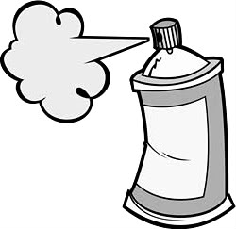
Rule Clean-Up
Outdated rules repealed:
Consumer Spray Paint VOC limits replaced by EPA rules (19% vs. 15%)
Western Backstop SO2 Federal Trading Program – replaced by direct control of PGE Boardman
Notes:
As part of the clean up, we want to repeal some rules
Spray paint rules were part of plan to reduce ozone from consumer products. EPA adopted national rules that apply to manufacturers and so we don’t state rules any more.
DEQ worked with the western states on a SO₂ trading program but dropped out because it wasn’t cost effective. There are now specific rules but PGE is not involved in trading so we don’t need the state rules.

Slide 12
Rule Clean-Up
Repeal rules for sources that no longer exist in Oregon:
Neutral Sulfite Semi-Chemical Pulp Mills
Sulfite Pulp Mills
Primary Aluminum Standards
Laterite Ore Production of Ferronickel
Charcoal Producing Plants
New sources must comply with more stringent federal requirements for new sources
Notes:
Unfortunately many businesses have shut down in Oregon so we plan to repeal those industry specific rules.
All other industry rules are staying the same, including Kraft Pulp Mills
If one of those sources wants to locate in Oregon, they would have to comply with current federal rules which are more stringent than our existing state rules. (New Source Review, New Source Performance Standards, National Emission Standards for HAPs)

Slide 13
Rule Clean-Up
Division 216 changes:
If more than one source category applies and not eligible for Basic or General, then Simple or Standard ACDP
Prorate annual fees for temporary closure based on length of closure in a calendar year, but will not be less than ½ of regular annual fee
Notes:
Unfortunately many businesses have shut down in Oregon so we plan to repeal those industry specific rules.
All other industry rules are staying the same, including Kraft Pulp Mills
If one of those sources wants to locate in Oregon, they would have to comply with current federal rules which are more stringent than our existing state rules. (New Source Review, New Source Performance Standards, National Emission Standards for HAPs)

Slide 14
Rule Clean-Up
Division 216 changes:
Reinstatement of Terminated Permit: automatically terminated permit only reinstated by:
Application for a new permit
Pay new source permit application fees, unless renewal application submitted within three months of expiration date
Notes:
Unfortunately many businesses have shut down in Oregon so we plan to repeal those industry specific rules.
All other industry rules are staying the same, including Kraft Pulp Mills
If one of those sources wants to locate in Oregon, they would have to comply with current federal rules which are more stringent than our existing state rules. (New Source Review, New Source Performance Standards, National Emission Standards for HAPs)

Slide 15
Rule Clean-Up
Division 216 changes:
Applications for new permits - submitted at least 60 days prior to when a permit is needed.
Consider the renewal timelines (mods too):
Permit Type | Renewal Submittal
General + Attachments | 30 days
Basic | 30 days
Simple | 120 days
Standard | 180 days
Notes:
Unfortunately many businesses have shut down in Oregon so we plan to repeal those industry specific rules.
All other industry rules are staying the same, including Kraft Pulp Mills
If one of those sources wants to locate in Oregon, they would have to comply with current federal rules which are more stringent than our existing state rules. (New Source Review, New Source Performance Standards, National Emission Standards for HAPs)

Slide 16
Rule Clean-Up
340-216-0064 Simple ACDPs
(2) Fees. Applicants for a new or modified Simple ACDP must pay the fees set forth in OAR 340-216-8020. Applicants for a new Simple ACDP must initially pay the High Annual Fee. Once the initial permit is issued, annual fees for Simple ACDPs will be assessed based on the following:
(a) Low Fee — A source may qualify for the low fee if:
(A) The source is, or will be, permitted under only one of the following categories from OAR 340-216-8010 Part B:
(i) Category 7. Asphalt felt and coatings;
(ii) Category 13. Boilers and other fuel burning equipment (can be combined with category 27. Electric power generation);
(iii) Category 27. Electric power generation;
(iv) Category 33. Galvanizing & pipe coating;
(v) Category 39. Gray iron and steel foundries, malleable iron foundries, steel investment foundries, steel foundries 100 or more tons/yr. metal charged (not elsewhere identified);
(vi) Category 40. Gypsum products;
(vii) Category 45. Liquid storage tanks subject to OAR 340 division 232;
(viii) Category 56. Non-ferrous metal foundries 100 or more tons/year of metal charged;
(ix) Category 57. Organic or inorganic industrial chemical manufacturing;
(x) Category 62. Perchloroethylene dry cleaning;
(xi) Category 73. Secondary smelting and/or refining of ferrous and non-ferrous metals; or
(xii) Category 85. All other sources not listed in OAR 340-216-8010 (can be combined with category 27. Electric Power Generation); and
(B) The actual emissions from the calendar year immediately preceding the invoice date are less than five tons/year of PM10 in a PM10 nonattainment or maintenance area or PM2.5 in a PM2.5 nonattainment or maintenance area, and less than 10 tons/year for each criteria pollutant; and
(C) The source is not creating a nuisance under OAR 340-208-0310 or 340-208-0450.
(b) High Fee — Any source required to have a Simple ACDP (OAR 340-216-8010 Part B) that does not qualify for the low fee under subsection (2)(a) will be assessed the high fee.
Notes:
Unfortunately many businesses have shut down in Oregon so we plan to repeal those industry specific rules.
All other industry rules are staying the same, including Kraft Pulp Mills
If one of those sources wants to locate in Oregon, they would have to comply with current federal rules which are more stringent than our existing state rules. (New Source Review, New Source Performance Standards, National Emission Standards for HAPs)

Slide 17
Rule Clean-Up
Division 216 Table changes:
New rule number for Table 1 – 340-216-8010
New rule number for Table 2 – 340-216-8020
Language in table moved to 340-216-0020 Applicability
Notes:
Unfortunately many businesses have shut down in Oregon so we plan to repeal those industry specific rules.
All other industry rules are staying the same, including Kraft Pulp Mills
If one of those sources wants to locate in Oregon, they would have to comply with current federal rules which are more stringent than our existing state rules. (New Source Review, New Source Performance Standards, National Emission Standards for HAPs)

Slide 18
Rule Clean-Up
Division 216 Table changes:
List no longer alphabetical (new sources added to end)
Modification types in footnotes moved to division 216 definitions
Notes:
Unfortunately many businesses have shut down in Oregon so we plan to repeal those industry specific rules.
All other industry rules are staying the same, including Kraft Pulp Mills
If one of those sources wants to locate in Oregon, they would have to comply with current federal rules which are more stringent than our existing state rules. (New Source Review, New Source Performance Standards, National Emission Standards for HAPs)

Slide 19
Rule Clean-Up
Division 216 Table changes:
New Source Categories:
Deleted grain terminal elevators #38 (use grain elevators #37 instead)
Added recreational vehicle manufacturing to manufactured home, mobile home manufacturing #47
Separated pathological waste incinerators #90 from crematory incinerators #25
Notes:
Unfortunately many businesses have shut down in Oregon so we plan to repeal those industry specific rules.
All other industry rules are staying the same, including Kraft Pulp Mills
If one of those sources wants to locate in Oregon, they would have to comply with current federal rules which are more stringent than our existing state rules. (New Source Review, New Source Performance Standards, National Emission Standards for HAPs)

Slide 20
Rule Clean-Up
Division 216 Table changes:
New Source Categories:
Stationary internal combustion engines #87 only if:
Emergency generators/firewater pumps, aggregate emissions >10 tons for any regulated pollutant for 100 hours of operation or other hours specified in permit; or
Individual non-emergency/non-fire pump engine subject to 40 CFR Part 63, Subpart ZZZZ, >500 horsepower, excluding two stroke lean burn engines, engines burning only landfill or digester gas, and four stroke engines in remote areas; or
Notes:
Unfortunately many businesses have shut down in Oregon so we plan to repeal those industry specific rules.
All other industry rules are staying the same, including Kraft Pulp Mills
If one of those sources wants to locate in Oregon, they would have to comply with current federal rules which are more stringent than our existing state rules. (New Source Review, New Source Performance Standards, National Emission Standards for HAPs)

Slide 21
Rule Clean-Up
Division 216 Table changes:
New Source Categories:
Stationary internal combustion engines only if (cont.):
Individual non-emergency engine subject to 40 CFR Part 60, Subpart IIII with:
Displacement of 30 liters or more per cylinder; or
Displacement of less than 30 liters per cylinder, >500 horsepower; or
Individual non-emergency engine subject to 40 CFR Part 60, Subpart JJJJ, is rated at >500 horsepower
Notes:
Unfortunately many businesses have shut down in Oregon so we plan to repeal those industry specific rules.
All other industry rules are staying the same, including Kraft Pulp Mills
If one of those sources wants to locate in Oregon, they would have to comply with current federal rules which are more stringent than our existing state rules. (New Source Review, New Source Performance Standards, National Emission Standards for HAPs)

Slide 22
Rule Clean-Up
Division 216 Table changes:
New Source Categories:
All other portable sources (#89) not listed herein for which DEQ determines that:
An air quality concern exists;
The source would emit significant malodorous emissions; or
The source would have actual emissions, if the source were to operate uncontrolled, of 5 or more tons per year of direct PM2.5 or PM10 if located in a PM2.5 or PM10 non-attainment or maintenance area, or 10 or more tons per year of any single criteria pollutant if located in any part of the state. Put PORTABLE in -0020?
Notes:
Unfortunately many businesses have shut down in Oregon so we plan to repeal those industry specific rules.
All other industry rules are staying the same, including Kraft Pulp Mills
If one of those sources wants to locate in Oregon, they would have to comply with current federal rules which are more stringent than our existing state rules. (New Source Review, New Source Performance Standards, National Emission Standards for HAPs)

Slide 23
Rule Clean-Up
Division 216 Table changes:
Consolidate Part C:
Remove duplicates already in Part B
Move other categories to Part B:
All Sources subject to a RACT, BACT, LAER, NESHAP adopted in OAR 340-244-0220, NSPS adopted in OAR 340-238-0060, State MACT, or other significant Air Quality regulation(s), except sources registered pursuant to OAR 340-210-0100(2).
Sources with less than 10 tons/yr. actual emissions that are subject to RACT, NSPS adopted in OAR 340-238-0060 or a NESHAP adopted in OAR 340-244-0220 which qualify for a Simple ACDP.
Chemical manufacturing facilities that do not transfer liquids containing organic HAP listed in Table 1 of 40 CFR part 63 subpart VVVVVV to tank trucks or railcars and are not subject to emission limits in Table 2, 3, 4, 5, 6, or 8 of 40 CFR part 63 subpart VVVVVV.
Notes:
Unfortunately many businesses have shut down in Oregon so we plan to repeal those industry specific rules.
All other industry rules are staying the same, including Kraft Pulp Mills
If one of those sources wants to locate in Oregon, they would have to comply with current federal rules which are more stringent than our existing state rules. (New Source Review, New Source Performance Standards, National Emission Standards for HAPs)

Slide 24
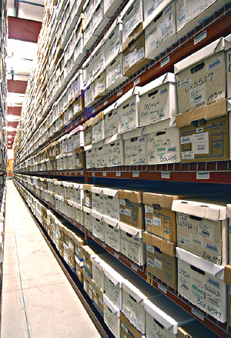
Rule Clean-Up
340-214-0114 Recordkeeping
ACDP sources must retain all records for at least five years from the date of the monitoring sample, measurement, report, or application,
Beginning July 1, 2015.
Notes:
Unfortunately many businesses have shut down in Oregon so we plan to repeal those industry specific rules.
All other industry rules are staying the same, including Kraft Pulp Mills
If one of those sources wants to locate in Oregon, they would have to comply with current federal rules which are more stringent than our existing state rules. (New Source Review, New Source Performance Standards, National Emission Standards for HAPs)

Slide 25
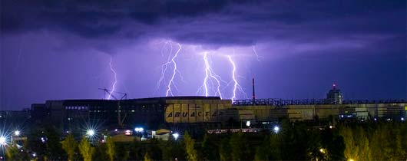
Rule Clean-Up
Emergency as an Affirmative Defense for Title V Permitted Sources ONLY
Affirmative defense is the ability to avoid civil penalties for violations. Under EPA’s interpretation, DEQ’s excess emissions rules incorrectly allow all permitted sources to assert an affirmative defense for emergencies, rather than just Title V sources.
Notes:
The first part of this presentation covers rule clean-up.
Some of our rules are out of order so we want to move them to the right place. There are procedures in definitions like major modification, actual emissions and netting basis that need to be moved.
Some of our rules are missing important details so we worked on clarifying them. (compliance methods)
We want a clean set of definitions. Throughout all of our divisions there are multiple definitions of the same term – 5 definitions of the word person! Make sure the definitions agree and get rid of the redundant ones
We found cross-referencing errors and typos that need to be fixed.
None of these clean-up changes will affect stringency. We are just clarifying things.

Slide 26
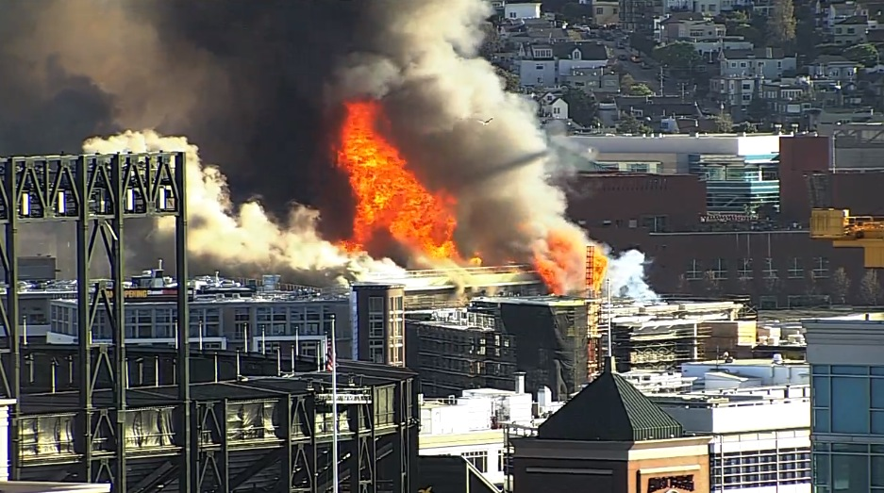
Rule Clean-Up
Enforcement Action Criteria for ACDP sources:
Added “whether the excess emissions event was due to an emergency” to OAR 340-214-0350
Notes:
The first part of this presentation covers rule clean-up.
Some of our rules are out of order so we want to move them to the right place. There are procedures in definitions like major modification, actual emissions and netting basis that need to be moved.
Some of our rules are missing important details so we worked on clarifying them. (compliance methods)
We want a clean set of definitions. Throughout all of our divisions there are multiple definitions of the same term – 5 definitions of the word person! Make sure the definitions agree and get rid of the redundant ones
We found cross-referencing errors and typos that need to be fixed.
None of these clean-up changes will affect stringency. We are just clarifying things.

Slide 27
Rule Clean-Up
Updates to:
Source Sampling Manual – Volume I
Source Sampling Manual – Volume II
Continuous Monitoring Manual
Notes:
The first part of this presentation covers rule clean-up.
Some of our rules are out of order so we want to move them to the right place. There are procedures in definitions like major modification, actual emissions and netting basis that need to be moved.
Some of our rules are missing important details so we worked on clarifying them. (compliance methods)
We want a clean set of definitions. Throughout all of our divisions there are multiple definitions of the same term – 5 definitions of the word person! Make sure the definitions agree and get rid of the redundant ones
We found cross-referencing errors and typos that need to be fixed.
None of these clean-up changes will affect stringency. We are just clarifying things.

Slide 28

Rule Clean-Up
Hearing and Meeting Procedures:
Repeal prescriptive language OAR 340-209-0070 to allow more flexibility in holding hearings/meetings
With Internet-based virtual meetings, more meetings across the state with fewer resources.
After establishing necessary technology, allow people to call in to hearings/meetings from any location instead of traveling.
Notes:
The first part of this presentation covers rule clean-up.
Some of our rules are out of order so we want to move them to the right place. There are procedures in definitions like major modification, actual emissions and netting basis that need to be moved.
Some of our rules are missing important details so we worked on clarifying them. (compliance methods)
We want a clean set of definitions. Throughout all of our divisions there are multiple definitions of the same term – 5 definitions of the word person! Make sure the definitions agree and get rid of the redundant ones
We found cross-referencing errors and typos that need to be fixed.
None of these clean-up changes will affect stringency. We are just clarifying things.

Slide 29

Rule Clean-Up
Questions?
Notes:
Do you have any questions before we move on to the next topic?
Our next presenter is Mark Fisher.

Slide 30
Categorically Insignificant Activities
Background
Suggested changes
Effect of changes in relation to other regulatory programs

Slide 31
Categorically Insignificant Activities - background
Categorically insignificant activities identified for Title V program – examples:
Janitorial activities
Groundskeeping activities
Instrument calibration
Maintenance and repair shop activities
Some activities previously considered insignificant are not actually insignificant when considered in aggregate

Slide 32
Categorically Insignificant Activities - background
Some of these activities are subject to new standards issued by EPA
Emissions from these activities were not considered when:
Determining what permits are necessary
Establishing Plant Site Emissions Limits

Slide 33
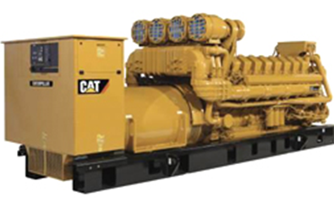
Emergency generators and pumps
Currently considered insignificant no matter how large or how many at site
Change categorically insignificant to:
Any individual engine rated at less than 500 horsepower (375 kW); and
emissions in aggregate less than de minimis levels of 1 ton/year (2,756 tons/yr for GHG) based on readiness/maintenance testing hours of operation in regulations or permit.

Slide 34
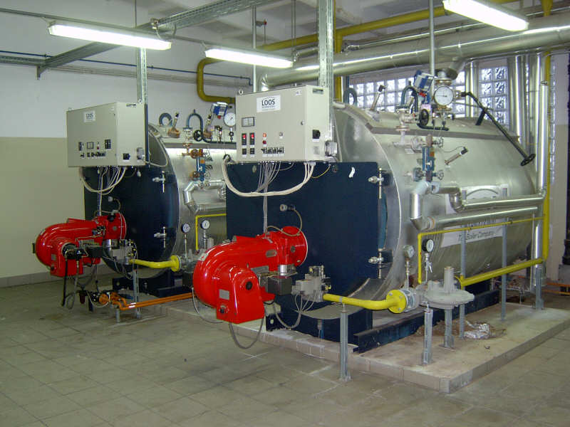
Small fuel burning equipment
Currently considered categorically insignificant no matter how many at a source
Change categorically insignificant to:
Retain current size threshold for individual units (0.4 MMBtu/hr oil; 2 MMBtu/hr gas)
Add emissions in aggregate < de minimis levels of 1 ton/year (2756 tons/yr for GHG)
Notes:
Units no longer considered insignificant. More stringent or have to get a permit? Not more stringent.

Slide 35
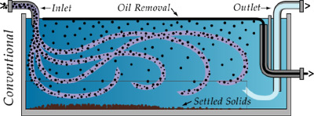
Oil/Water separators
Change categorically insignificant to:
Uncontrolled oil/water separators in effluent treatment systems with a throughput of less than 400,000 gallons per year;
Notes:
Units no longer considered insignificant. More stringent or have to get a permit? Not more stringent.

Slide 36
Regulatory Considerations
The following regulatory programs may now apply to emergency generators and boilers:
Notice of intent to construct (NC) may apply to small sources not otherwise required to have permits
Air Contaminant Discharge Permits (ACDP) may be required for some sources – e.g., data centers with numerous emergency generators
General Permit for emergency generators
Notes:
Impacts on Business
Will need to provide emissions information for these small sources
A few businesses will need to get permits (data centers) and construction approval required for all
Small future emission increases may trigger other regulatory requirements for larger businesses
Impacts on Environment
Better accounting of emissions

Slide 37
Regulatory Considerations
Plant Site Emissions Limits (PSELs) for existing sources may need to be revised:
Adding emissions to PSELs for existing CIA sources will not trigger other requirements solely as a result of rule change
PSELs and baselines will be revised at next permit renewal after rules are adopted
Notes:
Impacts on Business
Will need to provide emissions information for these small sources
A few businesses will need to get permits (data centers) and construction approval required for all
Small future emission increases may trigger other regulatory requirements for larger businesses
Impacts on Environment
Better accounting of emissions

Slide 38
Regulatory Considerations
Revise PSELs for existing sources to include emergency generators and small fuel burning equipment no longer CIA:
Probably no records for CIA during baseline year
Add emissions to PSEL and baseline based on current usage
Notes:
Impacts on Business
Will need to provide emissions information for these small sources
A few businesses will need to get permits (data centers) and construction approval required for all
Small future emission increases may trigger other regulatory requirements for larger businesses
Impacts on Environment
Better accounting of emissions

Slide 39

Categorically Insignificant Activities

Slide 40
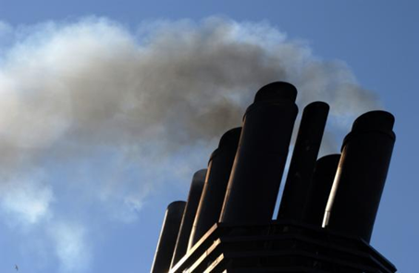
PM and Opacity Standards - Topics
Background
Proposed changes
Implementation schedule
Affected sources
Compliance issues

Slide 41
PM and Opacity Standards - Background
Standards adopted in early 1970’s as part of initial State Implementation Plan (SIP)
Rules include different standards for pre and post 1970 sources - grandfathering provision
Pre-1970: 40% opacity and 0.2 gr/dscf
Post 1970: 20% opacity and 0.1 gr/dscf
PM standard inconsistent with current EPA policy for significant figures/compliance
Notes:
SIP required by Clean Air Act to maintain or attain compliance with National Ambient Air Quality Standards (NAAQS)
NAAQS for particulate matter was based on total particulate matter and was much less stringent than today’s standards.

Slide 42
Opacity Standard – proposed changes
Change all opacity standards (except recovery furnaces) to 6-minute block average
Replaces 3-minute aggregate in 60 minutes
Compliance can be based on EPA Method 9
Change is consistent with other states
No change in stringency

Slide 43
Opacity Standard – proposed changes
Repeal Portland 4-county standard
20% opacity for 30 seconds for non-fuel burning equipment
No uniform procedures for determining compliance
Not a SIP provision
Still covered by statewide standards

Slide 44
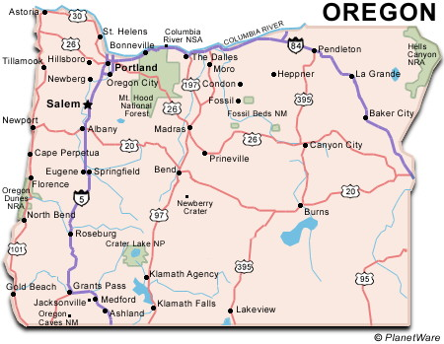
Opacity Standard – proposed changes
Pre-1970 sources (not HF Boilers)
Inside special control areas:
20% now
Outside special control areas:
40% now
20% starting 01/01/20

Slide 45
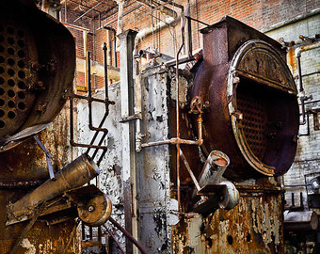
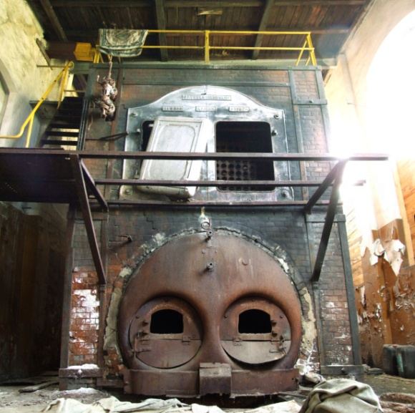
Opacity Standard – proposed changes
Pre-1970 HF Boilers
40% and 55%* for 12 minutes thru 12/31/19
20% except 40%** for 12 minutes and 40% for grate cleaning starting 01/01/20
OR source specific between 20% and 40% based on grain loading compliance test
*55% = 3 minutes at 100% and 9 minutes at 40%
**40% = 3 minutes at 100% and 9 minutes at 20%

Slide 46
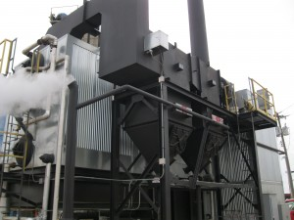
Opacity Standard – proposed changes
Post-1970 HF Boilers
20% except 40%** for 12 minutes
(**40% = 3 minutes at 100% and 9 minutes at 20%)

Slide 47
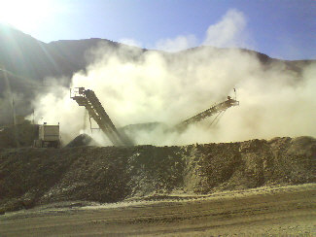
Opacity Standard – proposed changes
Fugitive Emissions
Fugitive emissions that leave property for more than 18 seconds in a 6-minute period must be abated
DEQ may request fugitive emission control plan
Use EPA Method 22 to read fugitive emissions

Slide 48
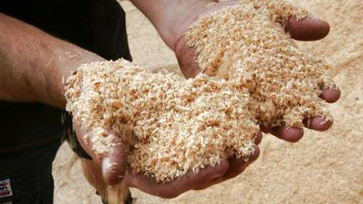
Opacity Standard – proposed changes
Particle Fallout
No person may cause or permit the deposition of particulate matter larger than 250 microns in size that creates an observable deposition upon the real property of another person.
Determine that deposition has occurred
Notify source that they are in violation
Resolve observed deposition with enforcement policy

Slide 49
Grain loading – proposed changes
Add significant digit to standards consistent with EPA policy
0.1 » 0.10
0.2 » 0.20
Phase out 0.2 gr/dscf for older sources to help address newer/tighter ambient air quality standards
Sources can request 1 year extension

Slide 50
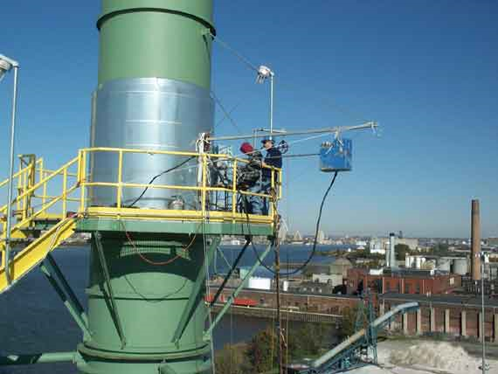
Grain Loading – proposed changes
0.10 gr/dscf for ALL sources with source test data < 0.080 gr/dscf
Notes:
In going from 40% down to 20%, we are making standard the same as for post-1970 units.
Required operation and maintenance plans will ensure emissions are minimized and limit the amount of time for grate cleaning or soot blowing

Slide 51
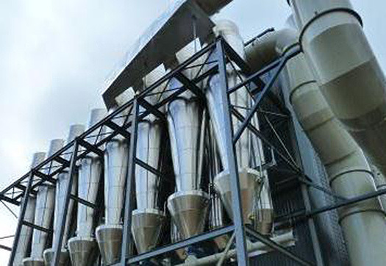
Grain loading – proposed changes Non-Fuel Burning Equipment
Source | Standard (gr/dscf)
 | Proposed Limit | Compliance Date
Pre 1970 | 0.2 | Until 12/31/19
Pre 1970 | 0.15 | On 01/01/20
Used < 876 hrs/yr | 0.20 | On 01/01/20
Post 1970 | 0.1 | Until 12/31/19
Post 1970 | 0.14 | On 01/01/20
After SOS date | 0.10 | After SOS date
Notes:
This is an overview of the proposed changes to the grain loading standards.
“Sensitive areas” are designated because of air quality problems

Slide 52
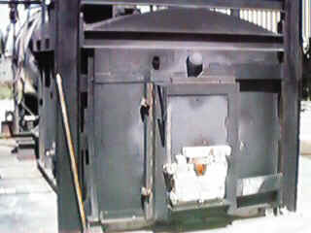
Grain loading – proposed changes Fuel Burning Equipment
Source | Standard (gr/dscf)
 | Proposed Limit | Compliance Date
Pre 1970 | 0.2 | Until 12/31/19
Pre 1970 | 0.15 | On 01/01/20
Used < 876 hrs/yr | 0.20 | On 01/01/20
Post 1970 | 0.1 | Until 12/31/19
Post 1970 | 0.14 | On 01/01/20
After SOS date | 0.10 | After SOS date
Notes:
This is an overview of the proposed changes to the grain loading standards.
“Sensitive areas” are designated because of air quality problems

Slide 53
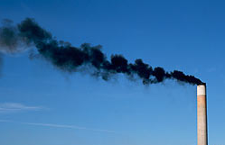
Grain loading – proposed changes Pre-1970 Fuel Burning Equipment
For boilers that cannot meet 0.15 gr/dscf:
Submit signed report by professional engineer after:
Multiclone maintenance and upgrade or
Boiler tune-up
Request specific limit of 0.17 gr/dscf by 10/01/19
Notes:
This is an overview of the proposed changes to the grain loading standards.
“Sensitive areas” are designated because of air quality problems

Slide 54
PM and Opacity Standards - Affected Sources
Boise Cascade (Pilot Rock) 30-0016
Collins (Fremont Sawmill) 19-0002
Columbia Forest Products 18-0014
Frank Lumber 22-2525
Interfor Pacific 18-0005
Swanson Group Roseburg 10-0030
Notes:
SIP required by Clean Air Act to maintain or attain compliance with National Ambient Air Quality Standards (NAAQS)
NAAQS for particulate matter was based on total particulate matter and was much less stringent than today’s standards.

Slide 55
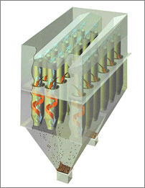
What might be necessary to comply with standards
Conduct more frequent tuning/maintenance
1977 28 MMBtu wood fired boiler; pre-test out of compliance; post-test less than 0.1 gr/dscf
Maintain consistent/high quality fuel
Improve combustion controls
Maintain/upgrade multiclone
Flue gas recirculation
Multiclone inspection

Slide 56

PM Standards – suggested changes
Notes:
In going from 40% down to 20%, we are making standard the same as for post-1970 units.
Required operation and maintenance plans will ensure emissions are minimized and limit the amount of time for grate cleaning or soot blowing

Slide 57
Splitting Businesses
Background/issues
Suggested Rule Changes
Program integrity

Slide 58
Splitting Businesses – Background/Issues
If a business shuts down, splits, and/or repurposes, what happens to its allowable emissions?
Potential for new business to avoid construction approval if they use emissions from shutdown of one source to operate another source.
Clean Air Act construction approval ensures:
State of the art control technologies
No adverse impacts on air quality

Slide 59
Splitting Businesses – Suggested Rule Changes
Clarify how emissions are treated when a business splits
Emissions may only be transferred to:
New business(es) with same primary 2-digit SIC, or
A combined heat and power unit that supported the original primary activity
Amount of emissions transferred cannot exceed the “new” source’s potential to emit

Slide 60
Splitting Businesses – Program Integrity
Limits ability to use emissions for unrelated projects
Clarifies rules to ensure new source, if different than existing source, is subject to construction approval
Consistent with the provisions that apply to physical changes or changes in the method of operation that apply to all sources.

Slide 61

Splitting Businesses

Slide 62

LUNCH?
Next section about NSR and changes,
Break for lunch?
Can leave or come back after lunch

Slide 63
New Source Review (NSR)
Proposing revisions to New Source Review program

Slide 64
New Source Review (NSR)
Pre-construction permitting program mandated by Clean Air Act
Maintain and protect air quality
Requires pollution control devices where appropriate
Three distinct programs
Prevention of Significant Deterioration (PSD) in attainment areas
Nonattainment NSR
Minor NSR
}
Major NSR

Slide 65
Things unique to DEQ’s program
Major source definition in nonattainment and maintenance areas
Lower threshold than EPA definition
Offsets and Net Air Quality Benefit
NAQB requires air dispersion modeling
EPA program only requires offsets
…

Slide 66
Things unique to DEQ’s program, cont.
DEQ program requires air quality impact analysis for minor sources
Maintenance areas
Former nonattainment areas
DEQ program has more stringent requirements than federal program

Slide 67
Why make changes?
Areas of the state are close to or are exceeding the PM2.5 National Ambient AQ Standards
New PM2.5 standards adopted in 2007 – much lower than PM10 standards
AQ problems mainly due to area sources, not industrial sources
Current rule structure
does not adequately address PM2.5 ambient air quality problems
prohibits development

Slide 68
How will the changes improve the program?
New or modified sources can help address ambient air quality problems
Allows for development while improving or maintaining air quality

Slide 69
What are the changes?
Align definition of major source with EPA’s definition
Different requirements for small and large sources
Create 2 new area designations
Help prevent nonattainment
Eliminate permitting roadblock
Get to maintenance faster
Primarily affect Minor New Source Review

Slide 70
What are the changes?
Need to talk about Type A and B State NSR
Move modeling from division 222 to 224

Slide 71
Major / Minor NSR – currently With construction or change in method of operation (Major Modification)
Emission Rate> Area designation, major mod | SER or more | Less than SER
Nonattainment | Major | n/a
Maintenance | Major | n/a
Emission Rate> Area designation, major mod? | 100*/250 tpy or more | SER to 99*/249 | Less than SER
Attainment | Major | Minor | n/a
* Applies to 28 source categories listed in rule (e.g. pulp and paper mills, iron and steel mills, chemical process plants)

Slide 72
Major / Minor NSR – proposed With construction or change in method of operation (Major Modification)
Emission Rate> Area designation, major mod | 100 tpy or more | SER to 99 | Less than SER
Nonattainment | Major | Minor | n/a
Maintenance | Major | Minor | n/a
Emission Rate> Area designation, major mod? | 100*/250 tpy or more | SER to 99*/249 | Less than SER
Attainment | Major | Minor | n/a
Overall stringency remains the same

Slide 73
Significant Emission Rate (SER)
Pollutant | SER, tons per year
PM2.5 | 10
PM10 | 15
NOx, VOC, SO2 | 40
CO | 100
GHG | 75,000

Slide 74
Two New Area Designations
Sustainment area
Proposed rules designed to help keep area from becoming nonattainment
Reattainment area
Proposed rules designed to be more flexible for smaller sources to allow development, but still protect air quality

Slide 75
Current Area Designations
Attainment
(AQ below NAAQS)
Nonattainment
(AQ at/over NAAQS)
Maintenance
(attainment)

Slide 76
Areas in transition
Attainment
(AQ at/over NAAQS)
Attainment
(AQ below NAAQS)
Nonattainment
(AQ at/over NAAQS)
Nonattainment
(AQ below NAAQS)
Maintenance
(attainment)

Slide 77
New Area Designations
Attainment
(AQ at/over NAAQS)
Attainment
(AQ below NAAQS)
Sustainment
Nonattainment
(AQ at/over NAAQS)
Nonattainment
(AQ below NAAQS)
Maintenance
(attainment)
Reattainment

Slide 78
Changes to Improve Air Quality
“Priority sources” are primarily responsible for poor air quality (e.g. woodstoves in some communities)
Provide incentives for reducing priority source emissions
More credit for emission reductions from priority sources
EQC can specify Priority Sources

Slide 79
Offset Changes
Major NSR, some ratios higher than current (1.2:1)
Minor NSR, ratios lower than major NSR
Ratios area-specific
Ratios reducible for priority source offsets
e.g. 1.2:1 → 1:1
No changes to ozone offset requirements

Slide 80
Net Air Quality Benefit Changes
Current NAQB criteria nearly impossible
Revise NAQB criteria
Protect air quality:
Focus on areas with worst air quality, and
Prevent further degradation
Reduce emphasis on industrial emission offsets where area sources are the main contributors
Eliminate problem with current criteria

Slide 81
Last: Rule Organization
Minor New Source Review rules applicable to SER and over called State NSR program
Move division 222 modeling to state NSR
No change to requirements applicable to minor sources less than SER
{
Major NSR
State NSR
Offset requirements
Net Air Quality Benefit
Division 224

Slide 82
Summary of Proposed Changes
Raise Major source threshold to 100 tpy in nonattainment and maintenance areas
Create two new area designations: sustainment and reattainment
Indentify Priority Sources
Revise offset requirements
Revise Net Air Quality Benefit requirements
Major and State NSR in Division 224

Slide 83

New Source Review (NSR)

Slide 84
Extensions for NSR/PSD permits
Background
Suggested Rule Changes
Public Notice

Slide 85
Extensions for NSR/PSD permits - Background
Current rules allow extensions provided there is a “demonstrated need”
No limit on the number of extensions
No criteria for approving extensions
If projects are delayed without further review, there is the potential for proposed projects to:
tie up increment indefinitely
cause significant impacts on air quality
not have current control technology

Slide 86
Extensions for NSR/PSD permits – Suggested Rule Changes
Add provisions for two 18-month extensions – no additional extensions
Add criteria for approving extensions
Add procedures for requesting extensions
Add procedures for approving extensions

Slide 87
Extensions for NSR/PSD permits – Suggested Rule Changes
For the first 18-month extension:
Review control technology analysis for the original pollutants subject to NSR/PSD
Review limited to whether new control technologies have become commercially available since the original control technology analysis

Slide 88
Extensions for NSR/PSD permits – Suggested Rule Changes
For the second extension:
Review whether any new control technologies have become commercially available
Review original control technology analysis for potentially lower limits
Review the air quality analysis for:
any new competing sources or changes in ambient air quality, including any redesignation of the area impacted
any new ambient standards or increments
any changes to EPA approved models that would affect results

Slide 89
Extensions for NSR/PSD permits – Suggested Rule Changes
No third extensions:
Original NSR/PSD permit automatically terminated five years after it was issued
For approval beyond second extension, a new major NSR/PSD permit application must be submitted.
May continue to use original emission reduction credits
Same two digit SIC code
Emission reduction credits contemporaneous and satisfy requirements

Slide 90
Extensions for NSR/PSD permits – Process to request extension
Business submits application for extension 30 days prior to end of current 18-month construction approval
DEQ will review extension request
DEQ will issue 18-month extension after public notice

Slide 91
Extensions for NSR/PSD permits – Public Notice
Public participation procedures for extensions:
If no air quality analysis:
30 days to submit written comments; or
If air quality analysis:
35 days to submit written comments; and
public hearing if requested.

Slide 92

Extensions for NSR/PSD permits

Slide 93
UARG v EPA (GHG PSD)
In June, Supreme Court invalidated portions of EPA’s so-called Tailoring Rule.
Sources cannot trigger PSD for greenhouse gases alone, but
Sources subject to PSD for other pollutants could be required to perform a BACT analysis for greenhouse gases.
Sources could not be subject to Title V for greenhouse gases alone.

Slide 94
UARG v EPA (GHG PSD)
EQC adopted rules in 2011 that implemented the Tailoring Rule in Oregon.
The court’s action does not invalidate any part of Oregon’s rules; those rules remain in effect.
DEQ is proposing revisions to air quality permitting rules at this time; the rules are on public notice until August 14 .

Slide 95
UARG v EPA (GHG PSD)
DEQ invites comments
Should Oregon’s rules regarding greenhouse gases and PSD and Title V applicability be:
Retained as they are?
Revised to agree with the court’s ruling?
Changed in other ways?

Slide 96

UARG v EPA (GHG PSD)

Slide 97
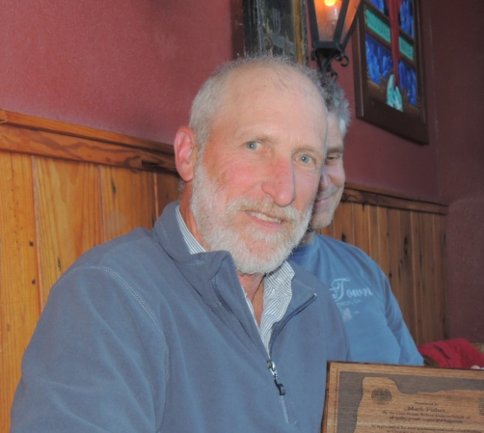
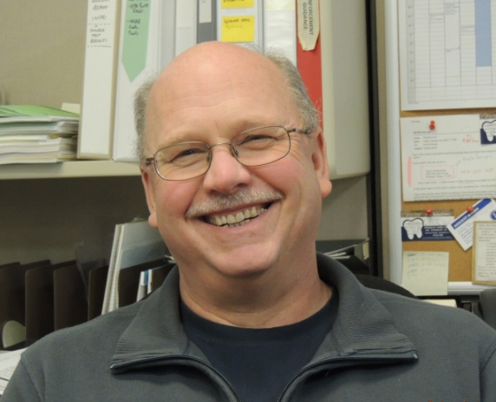
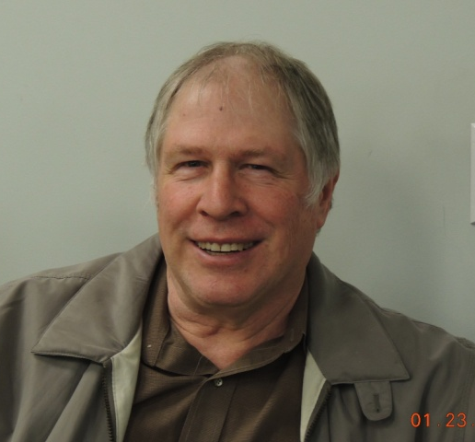

Rulemaking Team
Mark Fisher
George Davis
Gary Andes
Karen White-Fallon

Slide 98
SharePoint!

Slide 99
Air Quality
Rule Changes and Updates
For further questions:
Jill Inahara
inahara.jill@deq.state.or.us
503-229-5001

