Slide 1

Operations
Air quality permitting, Heat Smart and gasoline dispensing facility updates
EQC Proposed Rule Adoption
April 2015
George Davis and Jill Inahara | Oregon Department of Environmental Quality
Notes:
My name is Jill Inahara. I am a rule writer in the Operations Division. I’d also like to introduce George Davis, senior permit writer in NW region. George has been instrumental on my rule writing team and is here as a co-presenter.
We are here today to give you a brief overview of a large air quality rulemaking that we will be bringing to you for adoption in April.
The goals of this rulemaking are to make sure our rules are clear, up to date and that they address air quality problems.
When addressing AQ problems, we want to make sure we are targeting our resources at the right place. We want to provide incentives to reduce emissions where needed and provide companies flexibility as long as it will improve air quality.

Slide 2
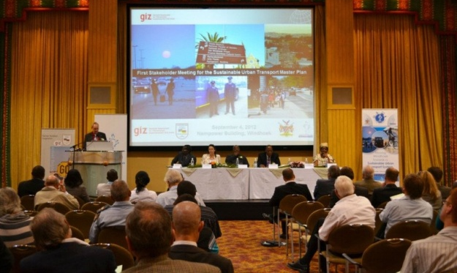
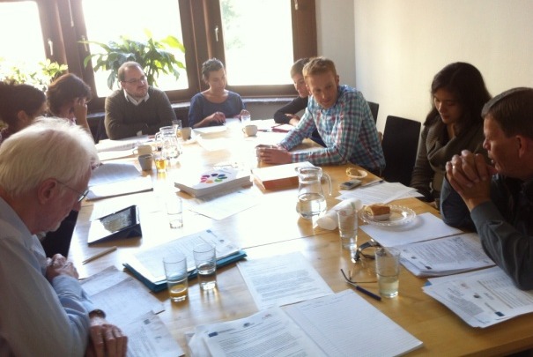

Public Notice
4 Stakeholder meetings
1 fiscal/economic impact advisory committee
9,274 Notifications – email/postcard
Notes:
We organized this rulemaking into nine categories. We’ll go into more detail on some of these topics later in this presentation
PROPOSING
READ THROUGH 1 THROUGH 3

Slide 3
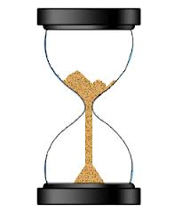

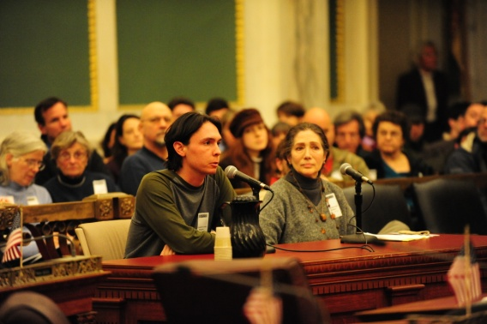
Public Notice
3 Public notice extensions
2 Months of public notice
5 Public Hearings
Notes:
We organized this rulemaking into nine categories. We’ll go into more detail on some of these topics later in this presentation
PROPOSING
READ THROUGH 1 THROUGH 3

Slide 4

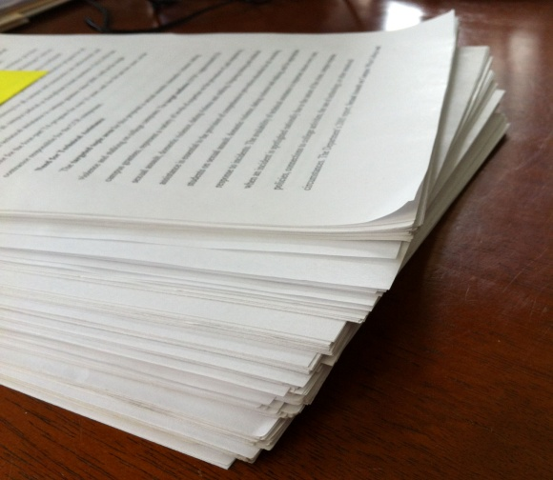
Public Notice
59 Commenters
91 Comments
Notes:
We organized this rulemaking into nine categories. We’ll go into more detail on some of these topics later in this presentation
PROPOSING
READ THROUGH 1 THROUGH 3

Slide 5
Public Comment
Category Number | Category | Number of Comments
0 | Align greenhouse gas permitting rules with Supreme Court decision | 2
1 | Clarify and update air quality rules | 40
2 | Update particulate matter emission standards | 4
3 | Change permitting requirements for emergency generators and small natural gas or oil-fired equipment | 4
Notes:
We organized this rulemaking into nine categories. We’ll go into more detail on some of these topics later in this presentation
PROPOSING
READ THROUGH 1 THROUGH 3

Slide 6
Public Comment
Category Number | Category | Number of Comments
4 | Establish two new state air quality area designations, “sustainment” and “reattainment” | 3
5 | Designate Lakeview as a state sustainment area | 1
6 | Revise parts of the New Source Review preconstruction permitting program | 20
Notes:
READ THROUGH 4 THROUGH 6
PROPOSING
These categories make up the bulk of the proposed rule changes that George will discuss in more detail later

Slide 7
Public Comment
Category Number | Category | Number of Comments
7 | Modernize methods allowed for holding public hearings and meetings | 1
8 | Re-establish the Heat Smart woodstove replacement program exemption for small commercial solid fuel boilers regulated under the permitting program | 0
9 | Remove annual reporting requirements for small gasoline dispensing facilities | 8
Notes:
Categories 7-9 are pretty minor changes but didn’t fit in with the other categories. I’ll explain them briefly here:
#7: The proposed rules would make it easier and more cost-effective for DEQ to hold and people to participate in public hearings and meetings. For example, with the option to hold Internet-based virtual meetings, DEQ could hold more meetings across the state using fewer resources. And eventually, DEQ hopes to give people the option to call in to hearings and meetings from any location instead of traveling.
#8: When EPA changed their rules to exempt small biomass boilers from federal standards, it made them subject to the Heat Smart rules, which did not allow them to be sold in OR. The proposed changes allow these sale again.
#9: The proposed rules would remove the annual reporting requirement for ~ 440 gasoline dispensing facilities with monthly throughput less than 10,000 gallons but would still require them to meet work practice standards (submerged fill tube)
Now we’ll focus on the other SIX categories

Slide 8
Public Comment
Category Number | Category | Number of Comments
10 | Public Notice | 2
11 | Other comments | 6
Notes:
Categories 7-9 are pretty minor changes but didn’t fit in with the other categories. I’ll explain them briefly here:
#7: The proposed rules would make it easier and more cost-effective for DEQ to hold and people to participate in public hearings and meetings. For example, with the option to hold Internet-based virtual meetings, DEQ could hold more meetings across the state using fewer resources. And eventually, DEQ hopes to give people the option to call in to hearings and meetings from any location instead of traveling.
#8: When EPA changed their rules to exempt small biomass boilers from federal standards, it made them subject to the Heat Smart rules, which did not allow them to be sold in OR. The proposed changes allow these sale again.
#9: The proposed rules would remove the annual reporting requirement for ~ 440 gasoline dispensing facilities with monthly throughput less than 10,000 gallons but would still require them to meet work practice standards (submerged fill tube)
Now we’ll focus on the other SIX categories

Slide 9
0.1 Greenhouse Gases
Background
U.S. Supreme Court struck down parts of federal rules pertaining to greenhouse gas permitting
Struck down
Sources subject to Title V permits for GHGs alone
Struck down
Sources subject to Prevention of Significant Deterioration program for GHGs alone
Affirmed
Sources subject to Prevention of Significant Deterioration for GHGs if subject to PSD for another pollutant (so-called “anyway sources”)
Notes:
The 2014 Supreme Court decision invalidates EPA’s authority to impose the federal greenhouse gas permitting requirements. Oregon’s rules were not affected by the Supreme Court’s decision and remain in effect, whereas for EPA and many states, the Court’s ruling took effect immediately. The discrepancy between federal and state requirements create uncertainty for the agency, regulated community and public.

Slide 10

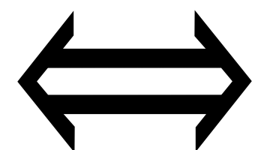
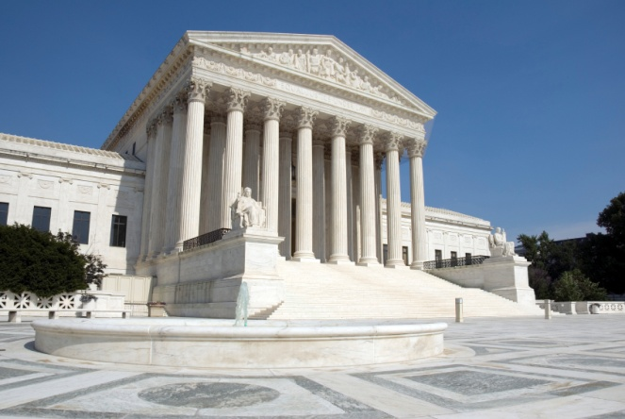

0.1 Greenhouse Gases continued
Background (continued)
TEMPORARY
Oregon rules not automatically struck down by Court’s decision
11/14
Notes:
Oregon rules were similar to federal rules
Oregon rules not automatically struck down by Court’s decision
EQC adopted temporary rule in November, revising Oregon rules to follow Court’s decision

Slide 11

0.1 Greenhouse Gases continued
Comments were received on both sides of the issue
Follow Supreme Court decision
Keep DEQ rules to regulate GHGs

Slide 12
0.1 Greenhouse Gases continued
Reasons to align with Supreme Court decision
No environmental benefit of Title V permit over Air Contaminant Discharge Permit
Best Available Control Technology for greenhouse gases:
Energy efficiency for combustion
Point of Use devices for semiconductor GHGs
National equity for businesses in Oregon

Slide 13

0.1 Greenhouse Gases continued
Title V = ACDP environmentally
Controls for GHGs most likely installed
National equity for Oregon businesses

Slide 14
6.19 Greenhouse Gases continued
Biogenic CO₂ Deferral
EPA continues work on CO₂ assessment framework
EPA defers biogenic CO₂ from permitting
Court invalidates EPA’s deferral
Biogenic CO₂ Deferral expires
07/2011
07/2013
0/72014
?
No Title V or Prevention of Significant permits needed for biogenic CO₂
DEQ must include biogenic CO₂
in permitting actions
DEQ will propose rules after EPA rule adoption

Slide 15
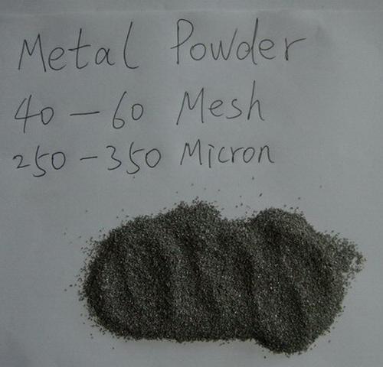
1.9 Deposition of large particles
No person may cause or permit the emission of particulate matter larger than 250 microns in size at sufficient duration or quantity as to create an observable deposition upon the real property of another person
when notified by the department that the deposition exists and must be controlled

Slide 16

1.19 Plant Site Emission Limit Gatekeeper
Use OAR 340-222-0041(4) as the “gate keeper” provision to New Source Review
Stay in division 222 for Plant Site Emission Limit increases
Increase emissions > Significant Emission Rate and go to division 224 for New Source Review

Slide 17
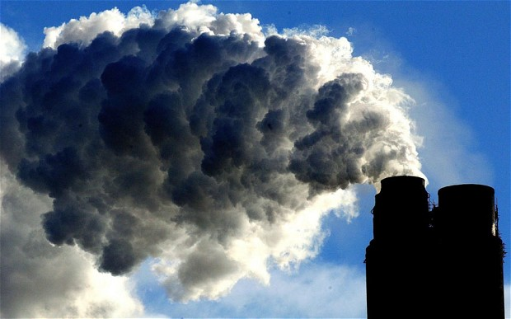
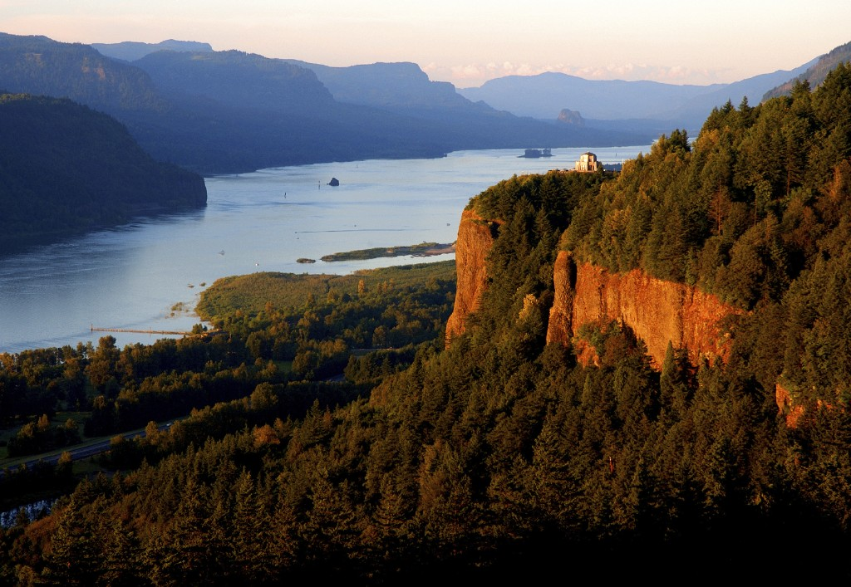
1.26 Visibility and deposition analyses for the Gorge
Require visibility and deposition analyses for the Columbia River Gorge

Slide 18
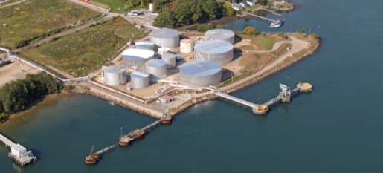
1.31 Gasoline Marine Loading
Expand the requirements of marine loading of gasoline to include any volatile organic compounds liquid with a true vapor pressure greater than 10.5 kPa (1.52 psia) in the Portland Air Quality Maintenance Area

Slide 19
1.31 Gasoline Marine Loading
Background:
Current rule requires control of gasoline vapor emissions to help reduce ozone levels
when gasoline is loaded onto marine vessels (ships and barges) at large terminals
only gasoline
only in Portland area
Bakken crude oil will eventually be stored and transloaded at Portland terminals
Involved in recent train catastrophes (Lac-Mégantic, Quebec, and Casselton, N. Dakota)
More volatile (higher emissions) than gasoline
Current rules state that gasoline has RVP of 4.0 psi or more
EPA might reduce the ozone standard –
Portland might not exceed but will be close
Pro-active control of emissions from loading all organic liquids

Slide 20
1.31 Clarify and update air quality rules
Proposed rule:
Requires control of VOC emissions from all organic liquids with vapor pressure greater than 1.5 psi
Comments received from terminals, WSPA and Port of Portland in opposition
Terminal expected such a rule and wants time to comply (3 years)
DEQ realized original proposal was far too stringent
Now considering requiring controls for:
Organic liquids with RVP of 4.0 psi or higher (includes Bakken crude)
Organic liquids that must be heated (heating liquids too thick to pump increases vapor pressure)
Exemption for organic liquids stored in pressurized tanks (LNG, LPG, propane, etc.)

Slide 21
3.1 Change permitting requirements for emergency generators and small natural gas or oil-fired equipment
Emergency generators and small fuel burning equipment classified as “categorically insignificant activities”
Categorically insignificant activities = a list of activities with insignificant emissions
Not included in permits
Notes:
When the Title V permitting program was established in 1993, DEQ developed a list of “categorically insignificant activities” that may take place at a source but are not addressed individually in the permit. This list includes activities such as:
Janitorial & groundskeeping activities
Also includes Emergency generators & Small fuel burning equipment (space heaters, water heaters)
While most cat. Insig. Activities are still considered insignificant, DEQ has found some facilities that have a large number of emergency generators or small heating devices, with emissions that can’t be considered insignificant.

Slide 22

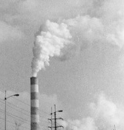
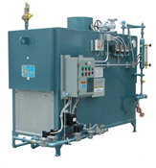
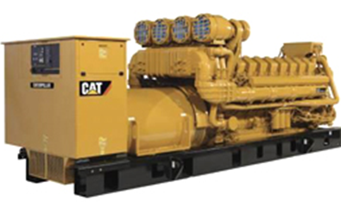
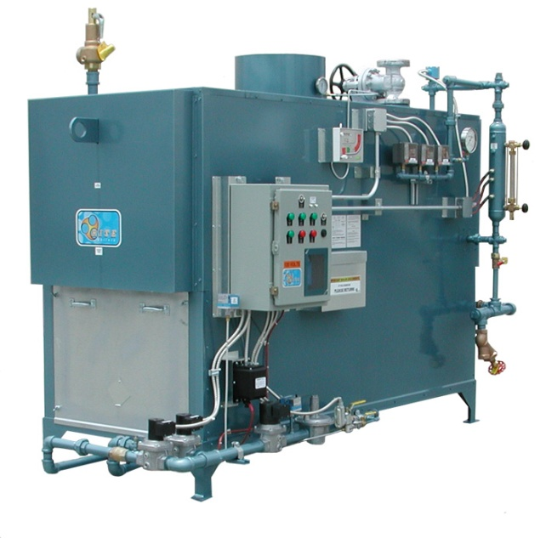
3.2 Change permitting requirements for emergency generators and small natural gas or oil-fired equipment
Individually insignificant, but a few facilities have many
More emissions than expected
Notes:
When the Title V permitting program was established in 1993, DEQ developed a list of “categorically insignificant activities” that may take place at a source but are not addressed individually in the permit. This list includes activities such as:
Janitorial & groundskeeping activities
Also includes Emergency generators & Small fuel burning equipment (space heaters, water heaters)
While most cat. Insig. Activities are still considered insignificant, DEQ has found some facilities that have a large number of emergency generators or small heating devices, with emissions that can’t be considered insignificant.

Slide 23
3.3 Change permitting requirements for emergency generators and small natural gas or oil-fired equipment
If emissions less than de minimis, still categorically insignificant
If emissions more than de minimis, must be in permit
Most facilities will be unaffected
Some additional work for some facilities
One-time workload increase for a few permits
Notes:
When the Title V permitting program was established in 1993, DEQ developed a list of “categorically insignificant activities” that may take place at a source but are not addressed individually in the permit. This list includes activities such as:
Janitorial & groundskeeping activities
Also includes Emergency generators & Small fuel burning equipment (space heaters, water heaters)
While most cat. Insig. Activities are still considered insignificant, DEQ has found some facilities that have a large number of emergency generators or small heating devices, with emissions that can’t be considered insignificant.

Slide 24
4.1 Designate Lakeview as a sustainment area
DEQ must not designate Lakeview as a sustainment area and allow the county to shirk the nonattainment area requirements of the CAA
DEQ should implement an offset ratio for sustainment areas that is at least 1:1, not 0.1:1
Notes:
Air quality in Lakeview currently does not meet the ambient air quality standards for fine particulates. However, EPA has not yet designated Lakeview a nonattainment area because Lakeview was not exceeding the standard at the time of the designations.
Upon request by the community of Lakeview, a sustainment area designation would:
Provide more flexible permitting requirements for non-federal major emission sources and
Avoid a federal nonattainment designation.

Slide 25
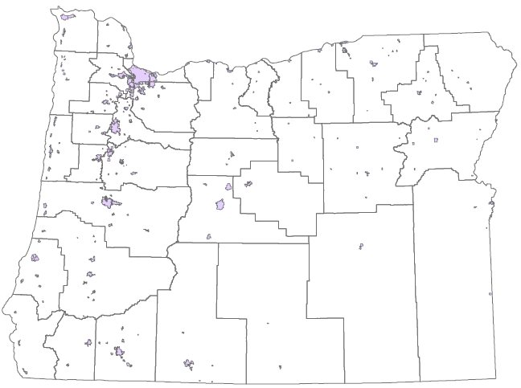
4.1 Designate Lakeview as a sustainment area
Oregon Particulate Matter (PM_{2.5})
Nonattainment Areas
Oakridge
Klamath Falls
Lakeview
Notes:
Air quality in Lakeview currently does not meet the ambient air quality standards for fine particulates. However, EPA has not yet designated Lakeview a nonattainment area because Lakeview was not exceeding the standard at the time of the designations.
Upon request by the community of Lakeview, a sustainment area designation would:
Provide more flexible permitting requirements for non-federal major emission sources and
Avoid a federal nonattainment designation.

Slide 26
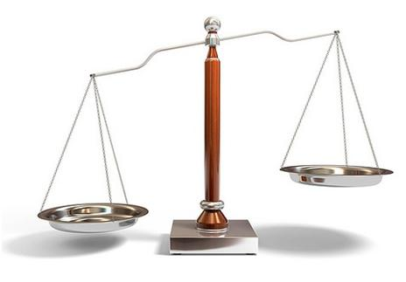

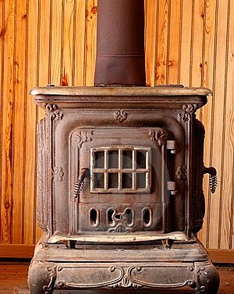
4.3 Designate Lakeview as a sustainment area
Recommendation:
Designate Lakeview as a sustainment area
Designate uncertified woodstoves as priority sources
Increase offset ratio to 1.2:1 with opportunity to reduce to 1.0:1
10 tons
12 tons
Notes:
Air quality in Lakeview currently does not meet the ambient air quality standards for fine particulates. However, EPA has not yet designated Lakeview a nonattainment area because Lakeview was not exceeding the standard at the time of the designations.
Upon request by the community of Lakeview, a sustainment area designation would:
Provide more flexible permitting requirements for non-federal major emission sources and
Avoid a federal nonattainment designation.

Slide 27



6.2 New Source Review Complexity
DEQ has added unnecessary complexity to the new source review process without any proportional environmental benefit.
Notes:
Air quality in Lakeview currently does not meet the ambient air quality standards for fine particulates. However, EPA has not yet designated Lakeview a nonattainment area because Lakeview was not exceeding the standard at the time of the designations.
Upon request by the community of Lakeview, a sustainment area designation would:
Provide more flexible permitting requirements for non-federal major emission sources and
Avoid a federal nonattainment designation.

Slide 28
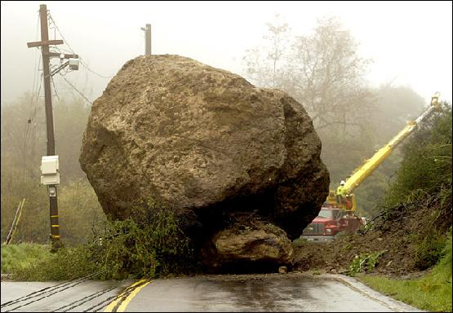

Intro to topics 4, 5 and 6
Topics 4, 5 and 6 relate to New Source Review
Many changes are proposed
NSR is complex; changes → more complex
Purpose:
Remove 2 roadblocks in current rules
Address air quality problem sources

Slide 29
Intro to topics 4, 5 and 6 continued
What is NSR?
NSR = Preconstruction permitting program
Facility must get permit before building new or modifying
Specifies requirements facility must meet
Required by federal regulations

Slide 30
Intro to topics 4, 5 and 6 continued
NSR requirements depend on emission rate, and how the area is designated
Emission level (Major NSR, Minor NSR)
Area designation (e.g. attainment, nonattainment)
(usually) reflects air quality in a geographic area

Slide 31
Intro to topics 4, 5 and 6 continued
Major NSR, at least as stringent as the federal major NSR program = little flexibility
Minor NSR, no minimum requirements = more flexibility
Expand Minor NSR → more flexibility
Use flexibility to address AQ problem sources
Other revisions remove roadblocks

Slide 32
Intro to topics 4, 5 and 6 continued
Proposed rule changes increase permitting flexibility, remove roadblocks
Benefits communities with AQ problems
Inability to obtain a permit prevents economic growth
Lack of economic growth hampers citizens’ and communities’ ability to solve the AQ problem

Slide 33
4.1 Revise the New Source Review preconstruction permitting program
Overview of NSR revisions
Raise Major NSR threshold
Revise offset requirements, specify priority sources
Revise Net Air Quality Benefit demonstration
Clarify what triggers NSR

Slide 34
4.2 Revise the New Source Review preconstruction permitting program
Raise Major NSR threshold
Federal Major NSR threshold 100 tons per year
Oregon’s threshold is lower, pollutant-specific PM2.5 = 10 tons/year; NOx = 40 tons/year
Raising threshold means fewer sources subject to Major NSR, more sources Minor (State) NSR

Slide 35
4.3 Revise the New Source Review preconstruction permitting program
Revise offset ratios, specify priority sources
Offsets are required in all areas except attainment
New or expanding source must offset its emission increases by obtaining emission decreases from other sources in the same area

Slide 36
4.4 Revise the New Source Review preconstruction permitting program
Priority sources = sources most responsible for the AQ problem in an area
Linked to offset requirements
Encourage sources to obtain offsets from priority sources
Offsets from priority sources reduce the offset ratio

Slide 37
4.5 Revise the New Source Review preconstruction permitting program
Proposed offset ratios
Sustainment: 0.1 to 1, can reduce to 0.05 to 1
Nonattainment: 1.2 to 1, can reduce to 1.0 to 1
Reattainment: 1.2 to 1, can reduce to 1.0 to 1
Maintenance: 1.0 to 1, State NSR can reduce to 0.5 to 1

Slide 38
4.6 Revise the New Source Review preconstruction permitting program
Revise Net Air Quality Benefit requirements
NAQB applies in all areas except attainment
Demonstrate that emissions impacts from new sources don’t adversely affect air quality
Not required by federal program

Slide 39
4.7 Revise the New Source Review preconstruction permitting program
Current requirement is minimal impact at all locations in designated area
Effectively impossible to meet
New sources cannot obtain permits

Slide 40
4.8 Revise the New Source Review preconstruction permitting program
Emission plume from new source – higher impacts
Emission plume from offset source – lower impacts
wind
Current rule requires minimal impacts everywhere –
Only possible if plumes always overlap

Slide 41
4.9 Revise the New Source Review preconstruction permitting program
Proposed Net Air Quality Benefit revisions remove permitting roadblock
Helps ensure that new sources won’t adversely affect air quality

Slide 42
4.10 Revise the New Source Review preconstruction permitting program
Clarify what triggers NSR
NSR triggered by
Specified level of emissions; and
Major Modification

Slide 43
4.11 Revise the New Source Review preconstruction permitting program
Major Modification
Emissions increases associated with new or modified equipment
Current rules don’t specify how to calculate
EPA indicated rules must be more specific
Calculations specified for all scenarios

Slide 44
4.12 Revise the New Source Review preconstruction permitting program
Summary
Raise Major NSR threshold
Revise offset requirements, specify priority sources
Revise Net Air Quality Benefit
Clarify what triggers NSR

Slide 45
5.1 Establish two new state air quality area designations, “sustainment” and “reattainment”
Sustainment - removes permitting roadblock in areas with borderline air quality
Reattainment – provides permitting flexibility in areas with improving air quality
Notes:
EPA designates areas that violate air quality standards as “nonattainment” areas and designates all other areas as “attainment” or “unclassified” areas. Oregon law designates former nonattainment areas that EPA reclassified to attainment as “maintenance” areas to ensure those areas avoid future violations. DEQ proposes to establish two new Oregon air quality area designations, “sustainment” and “reattainment,” to help areas avoid and more quickly end a federal nonattainment designation.

Slide 46
5.2 Establish two new state air quality area designations, “sustainment” and “reattainment”
Area designations are based on air quality: Attainment = air quality good, < standard Nonattainment = air quality poor, > standard
Rules area specific, matched to air quality
Redesignation requires 3 years of data, working with community, rulemaking, EPA approval
Notes:
EPA designates areas that violate air quality standards as “nonattainment” areas and designates all other areas as “attainment” or “unclassified” areas. Oregon law designates former nonattainment areas that EPA reclassified to attainment as “maintenance” areas to ensure those areas avoid future violations. DEQ proposes to establish two new Oregon air quality area designations, “sustainment” and “reattainment,” to help areas avoid and more quickly end a federal nonattainment designation.

Slide 47
5.3 Establish two new state air quality area designations, “sustainment” and “reattainment”
Problem
During multi-year process, permitting rules:
Don’t match actual air quality needs
Become a roadblock
Obtaining a permit difficult/impossible for medium and large sources
Notes:
EPA designates areas that violate air quality standards as “nonattainment” areas and designates all other areas as “attainment” or “unclassified” areas. Oregon law designates former nonattainment areas that EPA reclassified to attainment as “maintenance” areas to ensure those areas avoid future violations. DEQ proposes to establish two new Oregon air quality area designations, “sustainment” and “reattainment,” to help areas avoid and more quickly end a federal nonattainment designation.

Slide 48
5.4 Establish two new state air quality area designations, “sustainment” and “reattainment”
Proposed solution
Create 2 new areas with rules that (partially) solve the problem
State designations, federal approval not needed
Overlay federal area designations
Primarily affect medium-size sources
Notes:
EPA designates areas that violate air quality standards as “nonattainment” areas and designates all other areas as “attainment” or “unclassified” areas. Oregon law designates former nonattainment areas that EPA reclassified to attainment as “maintenance” areas to ensure those areas avoid future violations. DEQ proposes to establish two new Oregon air quality area designations, “sustainment” and “reattainment,” to help areas avoid and more quickly end a federal nonattainment designation.

Slide 49
5.5 Establish two new state air quality area designations, “sustainment” and “reattainment”
Attainment Area
AQ good
(below ambient standard)
Nonattainment Area
AQ poor
(over ambient standard)
Maintenance Area
AQ was poor,
Now good,
Prevent slipping back
Notes:
EPA designates areas that violate air quality standards as “nonattainment” areas and designates all other areas as “attainment” or “unclassified” areas. Oregon law designates former nonattainment areas that EPA reclassified to attainment as “maintenance” areas to ensure those areas avoid future violations. DEQ proposes to establish two new Oregon air quality area designations, “sustainment” and “reattainment,” to help areas avoid and more quickly end a federal nonattainment designation.

Slide 50
5.6 Establish two new state air quality area designations, “sustainment” and “reattainment”
Attainment Area
Nonattainment Area
Sustainment overlays attain.
Bridges the time gap
Sustainment Area
Sustainment area Minor NSR rules allow permitting medium size facilities
Can’t remove roadblock for Major NSR
Notes:
EPA designates areas that violate air quality standards as “nonattainment” areas and designates all other areas as “attainment” or “unclassified” areas. Oregon law designates former nonattainment areas that EPA reclassified to attainment as “maintenance” areas to ensure those areas avoid future violations. DEQ proposes to establish two new Oregon air quality area designations, “sustainment” and “reattainment,” to help areas avoid and more quickly end a federal nonattainment designation.

Slide 51
5.7 Establish two new state air quality area designations, “sustainment” and “reattainment”
Reattainment overlays nonattainment
Bridges the time gap
Nonattainment Area
Maintenance Area
Reattainment Area
Reattainment area Minor NSR rules allow less stringent permitting for medium size facilities
Can’t reduce stringency for Major NSR
Notes:
EPA designates areas that violate air quality standards as “nonattainment” areas and designates all other areas as “attainment” or “unclassified” areas. Oregon law designates former nonattainment areas that EPA reclassified to attainment as “maintenance” areas to ensure those areas avoid future violations. DEQ proposes to establish two new Oregon air quality area designations, “sustainment” and “reattainment,” to help areas avoid and more quickly end a federal nonattainment designation.

Slide 52
5.8 Establish two new state air quality area designations, “sustainment” and “reattainment”
Summary
2 new areas: Sustainment and Reattainment
State designations, not federal
Overlay federal designations, bridge over time needed to redesignate
For medium facilities: sustainment designation removes permitting roadblock
Notes:
EPA designates areas that violate air quality standards as “nonattainment” areas and designates all other areas as “attainment” or “unclassified” areas. Oregon law designates former nonattainment areas that EPA reclassified to attainment as “maintenance” areas to ensure those areas avoid future violations. DEQ proposes to establish two new Oregon air quality area designations, “sustainment” and “reattainment,” to help areas avoid and more quickly end a federal nonattainment designation.

Slide 53
11.1 INTEL
Text
Notes:
Air quality in Lakeview currently does not meet the ambient air quality standards for fine particulates. However, EPA has not yet designated Lakeview a nonattainment area because Lakeview was not exceeding the standard at the time of the designations.
Upon request by the community of Lakeview, a sustainment area designation would:
Provide more flexible permitting requirements for non-federal major emission sources and
Avoid a federal nonattainment designation.

Slide 54

Questions?

