Slide 1

Operations
Air quality permitting, Heat Smart and gasoline dispensing facility updates
EQC Proposed Rule Adoption
April 2015
George Davis and Jill Inahara | Oregon Department of Environmental Quality
Notes:
My name is Jill Inahara. I am a rule writer in the Operations Division. I’d also like to introduce George Davis, senior permit writer in NW region. George has been instrumental on my rule writing team and is here as a co-presenter.
We are here today to ask you to adopt a large air quality rulemaking.
The goals of this rulemaking are to make sure our rules are clear, up to date and that they address air quality problems.
When addressing AQ problems, we want to make sure we are targeting our resources at the right place. We want to provide incentives to reduce emissions where needed and provide companies flexibility as long as it will improve air quality.

Slide 2
Outline of Today’s Presentation
Summary of Rulemaking
Public Notice Process
Public Comments
Controversial/Numerous Comments
Summary
Questions
Notes:
High level summary of rulemaking since info item at January EQC meeting
Explain public notice process
Tell you about the public comments we received
Talk in more detail about the proposed rulemaking topics that were the most controversial and where we got the highest number of comments
Summarize the presentation
Time for questions

Slide 3

Reasons for Rulemaking
Started out initially as reorganization
Received input about:
  Permitting problems in areas of marginal air quality
  Unclear rules from permit writers/inspectors
Notes:
Originally the rulemaking started out to reorganize our rules and make them easier for people to use. We had procedures in definitions and tables that were impossible to find.
After talking with people, we realized that there were many areas in our rules that could be improved so the project grew.

Slide 4
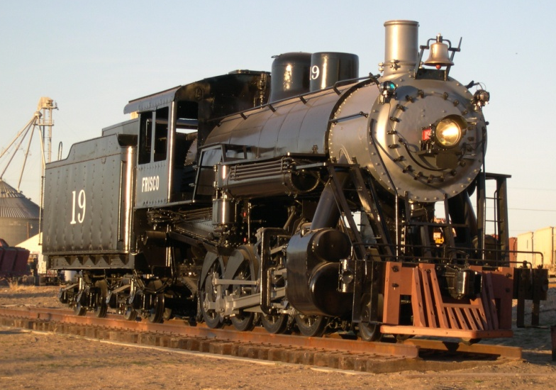

Reasons for Rulemaking continued
Decided to do major overhaul:
  Clarify rules
  Improve air quality
Before
After

Slide 5
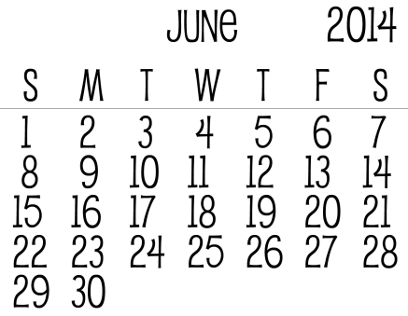


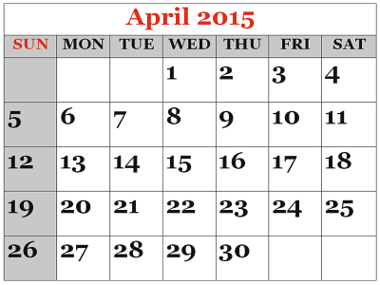
Presentations to EQC
Director’s Report
Temporary Rule Adoption
Informational Item
Proposed Rule Adoption

Slide 6
9 Categories of Rulemaking
Clarify and update air quality rules
Update particulate matter emission standards
Change permitting requirements for emergency generators and small natural gas or oil-fired equipment
Notes:
As you will recall from the informational item we presented at the January EQC meeting, we organized this rulemaking into nine categories.
PROPOSING
READ THROUGH 1 THROUGH 3

Slide 7
9 Categories of Rulemaking continued
Revise parts of the New Source Review preconstruction permitting program
Establish two new state air quality area designations, “sustainment” and “reattainment”
Designate Lakeview as a state sustainment area
Notes:
READ THROUGH 4 THROUGH 6
PROPOSING

Slide 8
9 Categories of Rulemaking continued
7. Modernize methods allowed for holding public hearings and meetings
8. Re-establish the Heat Smart woodstove replacement program exemption for small commercial solid fuel boilers regulated under the permitting program
9. Remove annual reporting requirements for small gasoline dispensing facilities
Notes:
Categories 7-9 are very minor changes but didn’t fit in with the other categories.

Slide 9
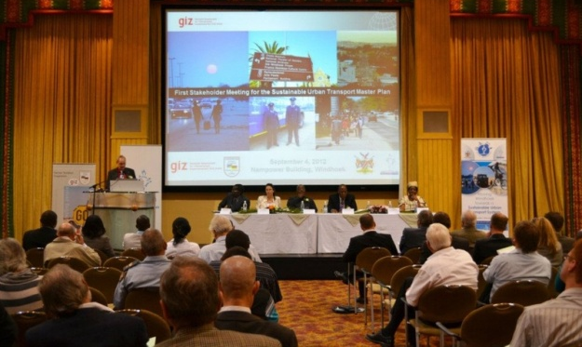
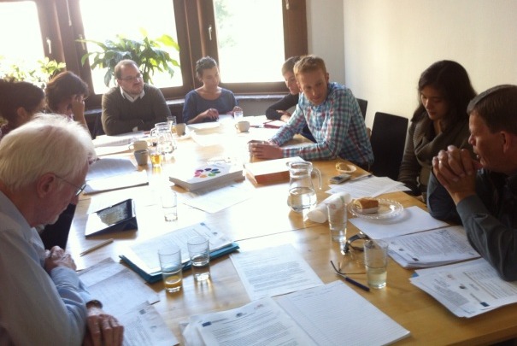

Public Notice
4 Stakeholder meetings
1 fiscal/economic impact advisory committee
9,274 Notifications – email/postcard
Notes:
I will start by explaining our public notice process for this rulemaking:
Stakeholder meetings in August 2013 (Portland, Pendleton, Eugene and Medford)
Fiscal and economic impact advisory committee meeting in January 2014
Public notice started on June 16, 2014

Slide 10


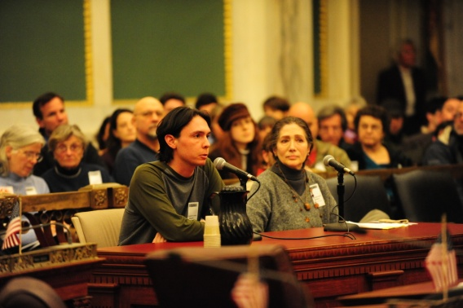
Public Notice continued
3 Public notice extensions
3 Months of public notice
5 Public Hearings
Notes:
Three public notice extensions by request
3 months of notice from June 16 – September 15
5 public hearings on July 16, 2014 (Portland, Medford, Bend, Pendleton and Lane Regional Air Protection Agency in Springfield)

Slide 11

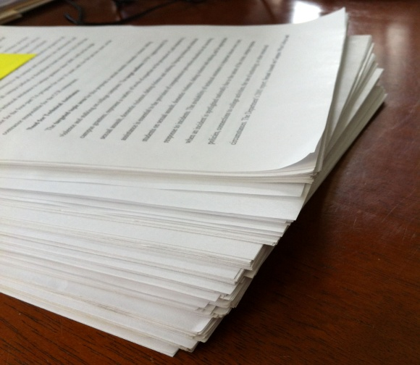
Public Notice continued
59 Commenters
85 Comments + 6 unrelated
Notes:
Received comments from 59 organizations and/or individuals
Received 85 different comments and 6 comments that were unrelated to this rulemaking

Slide 12
Public Comment
Category Number | Category | Number of Comments
0 | Align greenhouse gas permitting rules with Supreme Court decision | 2
1 | Clarify and update air quality rules | 40
2 | Update particulate matter emission standards | 4
3 | Change permitting requirements for emergency generators and small natural gas or oil-fired equipment | 4
Notes:
We received comments on most of the nine categories and also received comments in three other categories.
The Supreme Court decision on permitting GHG came out on June 23, one week after public notice began. So DEQ renoticed the rulemaking package, specifically asking for comments on how DEQ should implement the Supreme Court decision.

Slide 13
Public Comment continued
Category Number | Category | Number of Comments
4 | Establish two new state air quality area designations, “sustainment” and “reattainment” | 3
5 | Designate Lakeview as a state sustainment area | 1
6 | Revise parts of the New Source Review preconstruction permitting program | 20

Slide 14
Public Comment continued
Category Number | Category | Number of Comments
7 | Modernize methods allowed for holding public hearings and meetings | 1
8 | Re-establish the Heat Smart woodstove replacement program exemption for small commercial solid fuel boilers regulated under the permitting program | 0
9 | Remove annual reporting requirements for small gasoline dispensing facilities | 8
Notes:
We received one comment on modernizing public hearings and meetings and incorporated changes in the proposed rules. We received no comments on the Heat Smart rule changes. The comments we received on the gasoline dispensing facilities proposed rule changes needed only additional explanation and no rule changes.

Slide 15
Public Comment continued
Category Number | Category | Number of Comments
10 | Public Notice | 2
11 | Other comments | 6
Notes:
Received comments about the public notice process, mainly too short so allowed for three extensions
Received 6 comments not directly related to this rulemaking

Slide 16

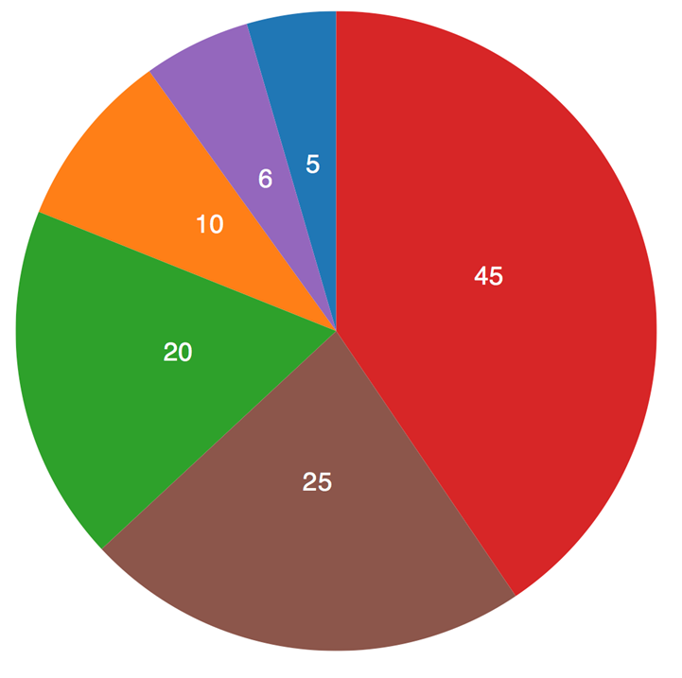
Today’s FOCUS
Comments that were:
Most controversial
Highest in number

Slide 17
Greenhouse Gases
  Background
  U.S. Supreme Court struck down parts of federal rules pertaining to greenhouse gas permitting
Struck down
Sources subject to Title V permits for GHGs alone
Struck down
Sources subject to Prevention of Significant Deterioration program for GHGs alone
Affirmed
Sources subject to Prevention of Significant Deterioration for GHGs if subject to PSD for another pollutant (so-called “anyway sources”)
Notes:
The part of the rulemaking that we got the most comments on was how to regulate greenhouse gases. 29 people/organizations were either for aligning with the Supreme Court Decision or staying with the Oregon rules.
As I mentioned earlier, the Supreme Court decision on permitting GHG came out on June 23, 2014. It struck down two requirements of the federal rules pertaining to greenhouse gas permitting and affirmed one requirement.

Slide 18


Greenhouse Gases continued
DEQ’s Greenhouse Gas Rules
Oregon rules not automatically struck down by Court’s decision
Oregon rules were similar to federal rules
EQC adopted temporary rule in November, to align Oregon rules to Court’s decision
TEMPORARY
Notes:
Even though the 2014 Supreme Court decision invalidated EPA’s authority to impose the federal greenhouse gas permitting requirements, it did not affect Oregon’s rules, even though our rules were similar to EPA’s rules. The discrepancy between federal and state requirements created uncertainty for DEQ, the regulated community and the public.
So in November of 2014, the EQC adopted temporary rules to align DEQ rules with the Supreme Court decision.

Slide 19

Greenhouse Gases continued
  Comments were received on both sides of the issue
Follow Supreme Court decision
Keep DEQ rules to regulate GHGs

Slide 20
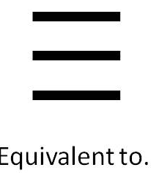


Greenhouse Gases continued
  Reasons to align with Supreme Court decision
Title V = ACDP environmentally
Controls for GHGs most likely installed
National equity for Oregon businesses
Notes:
After analyzing the effects the Supreme Court decision would have on GHG permitting in Oregon, DEQ is recommending that EQC adopt rules that permanently align Oregon rules for permitting greenhouse gas emissions with the Supreme Court decision for the following reasons:
READ SLIDE

Slide 21
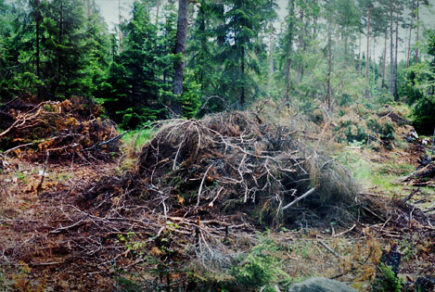
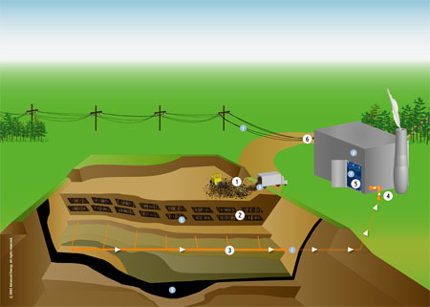
Biogenic CO₂ Deferral
Biogenic CO2 comes from:
Combustion of forest-derived and agriculture-derived feedstocks
Combustion of biogas collected from landfills, wastewater treatment or manure management processes
Notes:
The other area where we got comments on was concerning whether we should maintain the biogenic CO2 deferral from permitting, which occurred in 2011. Biogenic CO₂ come from the combustion of forest-derived and agriculture-derived and are also derived from the combustion of biogas collected from biological decomposition of waste in landfills, wastewater treatment, or manure management processes.

Slide 22
Biogenic CO₂ Deferral
EPA continues work on CO₂ assessment framework
EPA defers biogenic CO₂ from permitting
Court invalidates EPA’s deferral
Biogenic CO₂ Deferral expires
EQC Rule Adoption
07/11
07/13
06/14
07/14
11/14
02/15
04/15
?
No Title V or Prevention of Significant permits for biogenic CO₂
DEQ proposes permanent deferral for 3 years
EQC adopts temporary rule with permanent deferral
DEQ proposes “except to the extent required by federal law”
DEQ will propose rules after EPA rule adoption
Notes:
READ SLIDE
This is the chronology of events regarding the biogenic CO2 deferral.
DEQ now understands that the actual status of EPA’s biogenic GHG deferral rule is somewhat uncertain: while the Court of Appeals vacated the deferral rule, it has not yet issued the mandate that would make the vacatur effective. Because the actual status of EPA’s deferral is uncertain, DEQ finds that it is not appropriate to make a statement that the deferral did exist for a period of time. However, DEQ proposes to retain the existing rule language regarding the deferral to ensure that permitting in Oregon remains in compliance with federal law.

Slide 23
Greenhouse Gases continued
DEQ’s Greenhouse Gas Rules
The temporary rule adopted in November will be replaced with the proposed rules if adopted today.
TEMPORARY

Slide 24
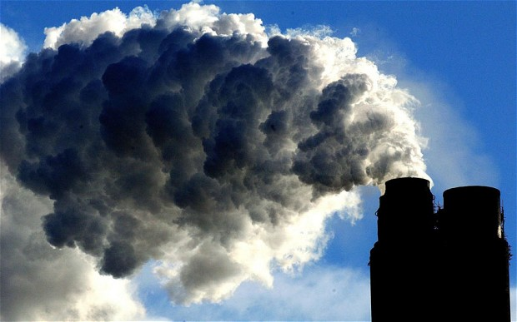
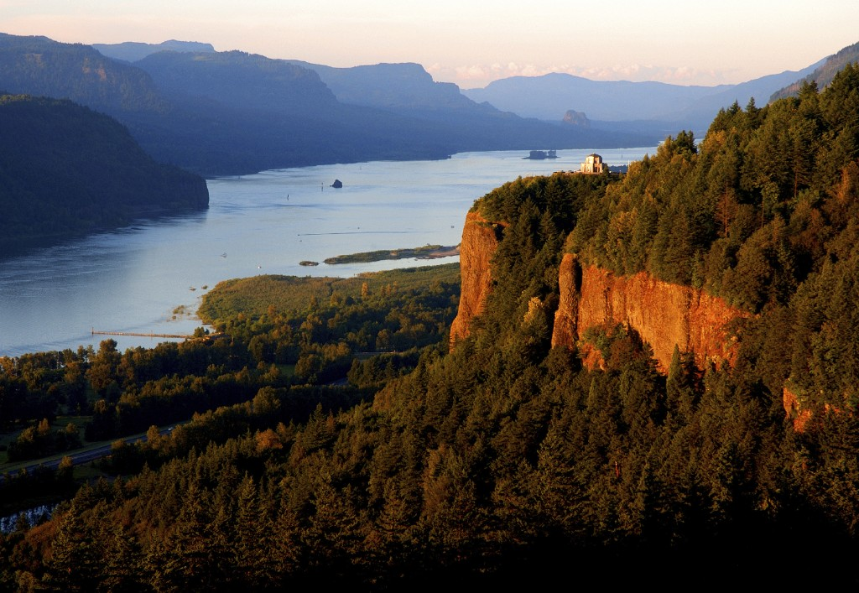
Clarify and update air quality rules
Require visibility and deposition analyses for the Columbia River Gorge
Notes:
Current rules “encourage” sources that may affect the Columbia River Gorge National Scenic area to perform visibility analysis. Silent on deposition in Gorge.
Proposed rules will require both visibility and deposition analyses on Gorge if affected by source (within 200 kilometers or 124 miles) and data will be used for informational purposes, as it has been in the past. (Took out language “demonstrate that these same emission increases or decreases will not cause or contribute to significant impairment of visibility on Gorge)

Slide 25
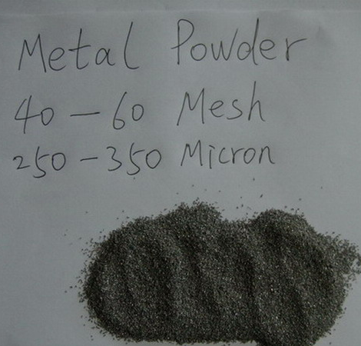
Clarify and update air quality rules
Deposition of large particles
No person may cause or permit the emission of particulate matter larger than 250 microns in size at sufficient duration or quantity as to create an observable deposition upon the real property of another person
when notified by the department that the deposition exists and must be controlled.
Notes:
Originally established for larger particles that fallout quickly. Deposition off the property means failure of equipment or process to manage discharge. Materials that trigger this rule are sawdust and paint overspray.
The phrase “when notified by the department that the deposition exists and must be controlled” was added in 2001. This phrase results in an unusual rule that says that any occurrences of the deposition that occur before DEQ staff have informed the source that the deposition exists and must be controlled cannot be cited as violations of this rule. There are few, if any other rules that operate in this unusual manner. Normally, a rule itself serves as the notification that a certain activity or emission is not allowed, and DEQ does not have to provide a second notification before citing a violation. DEQ can see no reason why this rule should not operate in the same manner.
DEQ recognizes that a source may not be aware that it has created an observable upon another’s real property and may therefore incorrectly certify compliance with the rule. But this problem is not unique to this rule, and does not justify the unusual requirement to give a second notice before a violation can be cited. For example, a facility may exceed an opacity standard, but if the exceedance is not observed by anyone, then a facility may in this instance also incorrectly certify compliance with the standard. In both of these cases, the key concept is that compliance or noncompliance with a rule or standard is verified by observation (i.e. monitoring).

Slide 26
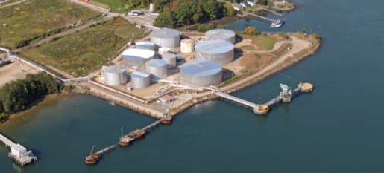
Clarify and update air quality rules
Gasoline Marine Loading
Expand marine loading of gasoline to include more volatile liquids in the Portland Air Quality Maintenance Area
Notes:
Background:
Current rule requires control of gasoline vapor emissions
when gasoline is loaded onto marine vessels at large terminals, only in Portland area to help reduce ozone levels

Slide 27
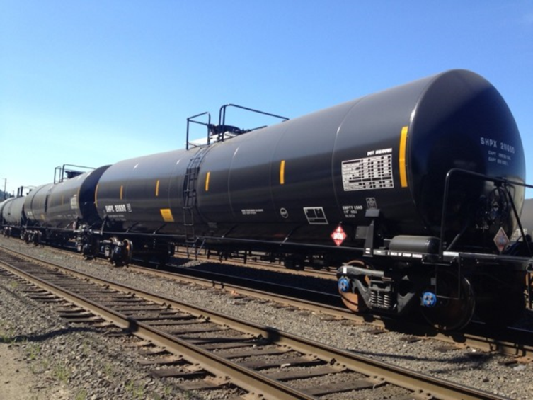
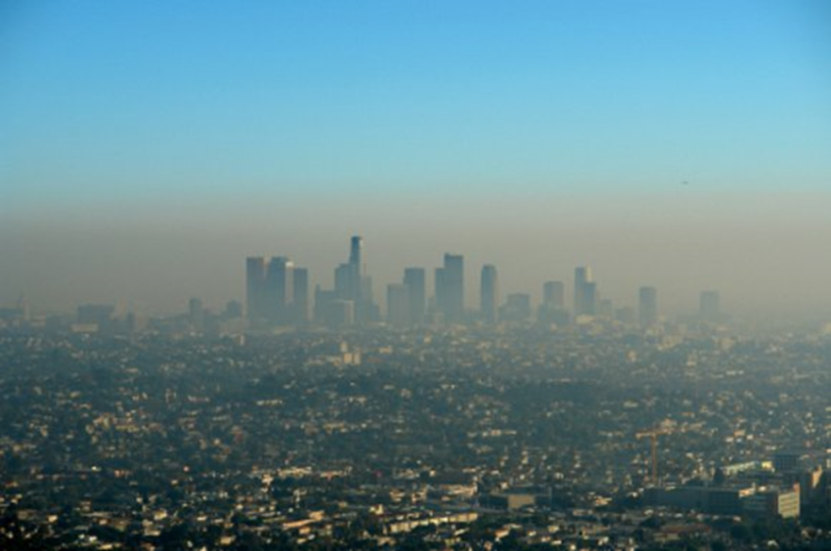
Clarify and update air quality rules
Gasoline Marine Loading
Bakken Crude shipments
EPA proposing lower ozone standard
Notes:
Bakken crude oil will eventually be stored and transloaded at Portland terminals
EPA might reduce the ozone standard
Based on comments, original proposal was far too stringent
Latest proposal reduces stringency and adds 3 years for compliance

Slide 28
3 Change permitting requirements for emergency generators and small natural gas or oil-fired equipment
  Emergency generators and small fuel burning equipment classified as
  “categorically insignificant activities”
  Categorically insignificant activities = a list of activities with insignificant emissions
  Not included in permits
Notes:
When the Title V permitting program was established in 1993, DEQ developed a list of “categorically insignificant activities” that may take place at a source but are not addressed individually in the permit. This list includes activities such as janitorial & groundskeeping activities. They also include emergency generators & small fuel burning equipment (space heaters, water heaters)
While most Categorically Insignificant Activities are still considered insignificant, DEQ has found some facilities that have many emergency generators or small heating devices, with emissions that are significant. In addition, EPA adopted requirements for Reciprocating Internal Combustion Engines (Emergency Generators) that Jerry Ebersole will be talking to you about next.

Slide 29
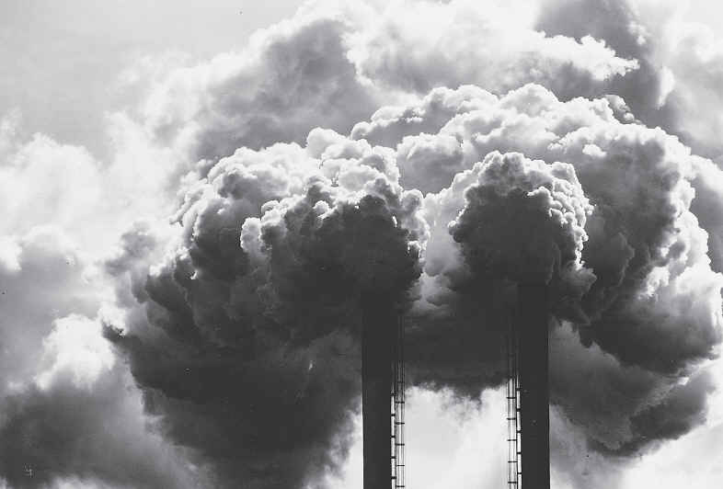
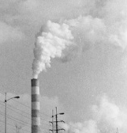
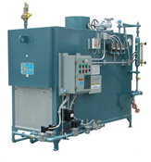
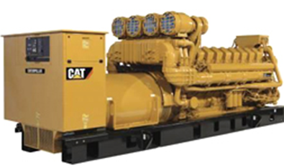
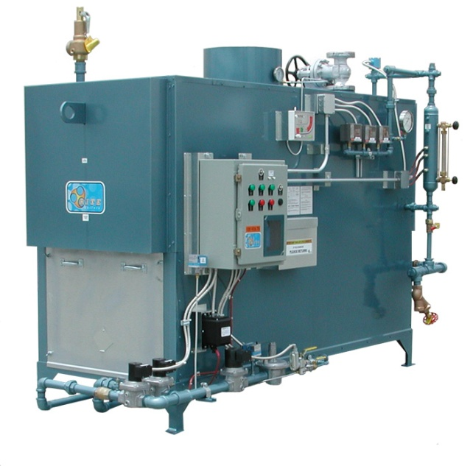
3 Change permitting requirements for emergency generators and small natural gas or oil-fired equipment
  Aggregated significant
  Individually insignificant
Notes:
If emissions less than de minimis, still categorically insignificant
If emissions more than de minimis, must be in permit
Most facilities will be unaffected
One-time workload increase for a few permits

Slide 30
6 New Source Review
What is NSR?
NSR = Preconstruction permitting program
  Facility must get permit before building new or modifying
  Specifies requirements facility must meet
Required by federal regulations

Slide 31
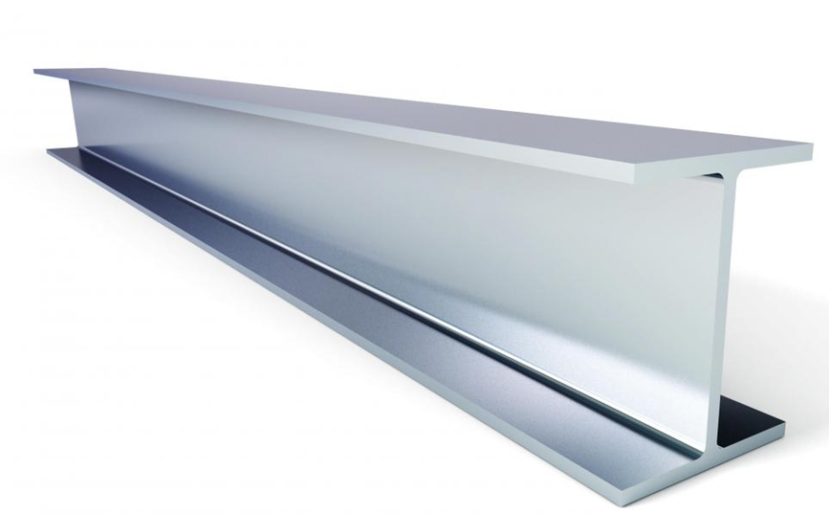

6 New Source Review continued
Major NSR: at least as stringent as the federal major NSR program = little flexibility
Minor NSR: no minimum requirements = more flexibility

Slide 32
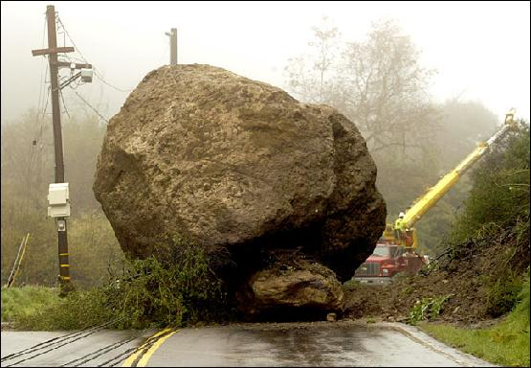

6 New Source Review Complexity
Purpose of changes to New Source Review
  Remove roadblocks in current rules
  Address air quality problem sources
Notes:
Proposed rule changes increase permitting flexibility, remove roadblocks and improves air quality
Benefits communities with AQ problems:
Inability to obtain a permit prevents economic growth
Lack of economic growth hampers citizens’ and communities’ ability to solve the AQ problem

Slide 33


6 New Source Review Complexity
  DEQ has added unnecessary complexity to the New Source Review process without any proportional environmental benefit.
Complexity
Flexibility

Slide 34
6 New Source Review Trigger
  Clarify what triggers NSR
  NSR triggered by
    Specified level of emissions; and
    Major Modification

Slide 35
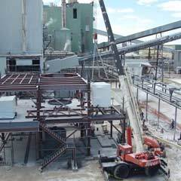
6 New Source Review Trigger
Major Modification
Emissions increases from new or modified equipment
  Current rules don’t specify calculation
  EPA requires more detail
Clarify and update air quality rules

Slide 36
5 Establish two new state air quality area designations, “sustainment” and “reattainment”
Attainment Area
AQ good
(below ambient standard)
Nonattainment Area
AQ poor
(over ambient standard)
Maintenance Area
AQ was poor,
Now good,
Prevent slipping back
Notes:
EPA designates areas that violate air quality standards as “nonattainment” areas and designates all other areas as “attainment” or “unclassified” areas. Oregon law designates former nonattainment areas that EPA reclassified to attainment as “maintenance” areas to ensure those areas avoid future violations.

Slide 37
5 Establish two new state air quality area designations, “sustainment” and “reattainment”
Attainment Area
Nonattainment Area
Sustainment
overlays attainment
Bridges the time
gap
Sustainment Area
  Sustainment area Minor NSR rules allow permitting medium size facilities
  Can’t remove roadblock for Major NSR
Notes:
DEQ proposes to establish two new Oregon air quality area designations, “sustainment” and “reattainment,” to help areas avoid and more quickly end a federal nonattainment designation.
Sustainment area for a federally designated attainment area that is in danger of failing to meet air quality standards and which EPA has not yet designated a nonattainment area.

Slide 38
5 Establish two new state air quality area designations, “sustainment” and “reattainment”
Reattainment
overlays
nonattainment
Bridges the time
gap
Nonattainment Area
Maintenance Area
Reattainment Area
  Reattainment area Minor NSR rules allow less stringent permitting for medium size facilities
  Can’t reduce stringency for Major NSR
Notes:
Reattainment area for a federally designated nonattainment area that is meeting air quality standards and which EPA has not yet redesignated an attainment area.

Slide 39
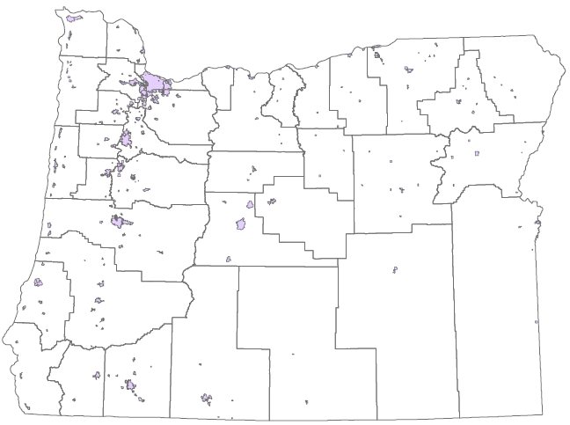
4 Designate Lakeview as a sustainment area
Oregon Particulate Matter (PM_{2.5})
Nonattainment Areas
DEQ should designate Lakeview as a nonattainment area
Oakridge
Klamath Falls
Lakeview
Notes:
Air quality in Lakeview currently does not meet the ambient air quality standards for fine particulates. However, EPA has not yet designated Lakeview a nonattainment area because Lakeview was not exceeding the standard at the time of the designations.
After an area is designated as NAA, DEQ must do the following:
Emissions inventory
Form community advisory committee
Develop attainment plan
EQC adopts plan and DEQ submits to EPA for approval
Implement rules and emission reduction strategies in attainment plan
Continue to monitor air quality
Try not to implement contingency plan

Slide 40
4 Designate Lakeview as a sustainment area
  Recommendation:
  Town of Lakeview and Lake County Commissioners requested sustainment designation
  Designate Lakeview as a sustainment area
Notes:
DEQ is working with the Lakeview community to reduce emissions through PM Advance program (EPA’s program). This would avoid years of delays triggered by a nonattainment area designation and then to a maintenance area after air quality has improved.
Upon request by the community of Lakeview, a sustainment area designation would:
Provide more flexible permitting requirements for non-federal major emission sources;
Avoid a federal nonattainment designation; and
Target the real problem causing poor air quality.

Slide 41
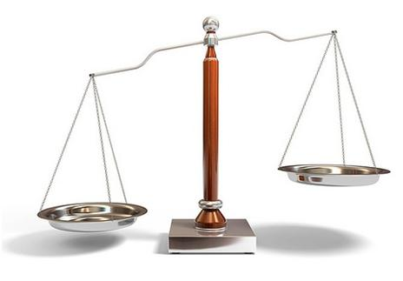
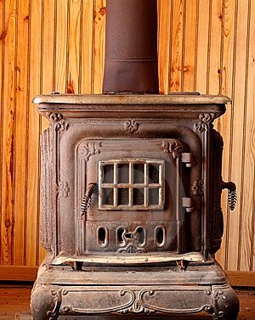

4 Designate Lakeview as a sustainment area
  Recommendation:
  Designate uncertified woodstoves as priority sources
  Increase offset ratio to 1.2:1 with opportunity to reduce to 1.0:1
10 tons
12 tons
Notes:
Priority sources = sources most responsible for the AQ problem in an area
Linked to offset requirements
Encourage sources to obtain offsets from priority sources by reducing reduce the offset ratio if priority sources used

Slide 42
11 Other Comments
Intel
Require Best Available Control Technology
Make federal major source
Notes:
Intel met the goal to reduce company-wide absolute perfluorocarbon emissions 10% below 1995 levels by the year 2010 in spite of the fact that manufacturing volumes have increased roughly fourfold since 1995. Reductions were accomplished in part by process changes, partly by using different gases, and partly by the use of greenhouse gas emission control devices, known as point of use devices. Since point of use devices are the only option DEQ is aware of, a Best Available Control Technology analysis would be limited to considering that single option and their use would be considered the Best Available Control Technology.
With respect to Title V, Intel will be required to get a Title V operating permit based on their projected emissions of NOx, CO and VOC.

Slide 43
Public Comment
  Summary
Agreed with 45 comments and made changes
Disagreed with 40 comments and made no changes
85 Comments + 6 unrelated

Slide 44

Questions for us?

Slide 45
Recommendation
DEQ recommends that the Environmental Quality Commission:
Adopt the proposed rules in attachments A1 through A4 as part of chapter 340 of the Oregon Administrative Rules.
Find that certain rules adopted as attachments A1 through A4 are more strict than existing Lane Regional Air Protection Agency rules, as described in attachment B, and direct Lane Regional Air Protection Agency to implement such state rules until it adopts its own rules that are equivalent or more strict and submits them to the Environmental Quality Commission under ORS 468A.135.

Slide 46
Recommendation continued
DEQ recommends that the Environmental Quality Commission:
3. Approve incorporating the rule amendments adopted as attachments A1 through A4 and the rule implementation directive to LRAPA described in attachment B into the Oregon Clean Air Act State Implementation Plan under OAR 340-200-0040 (the “SIP revision”).
4. Direct DEQ to submit the SIP revision to the U.S. Environmental Protection Agency for approval.

Slide 47
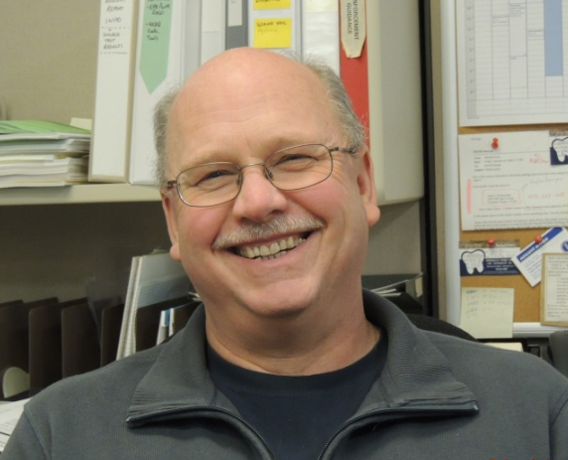
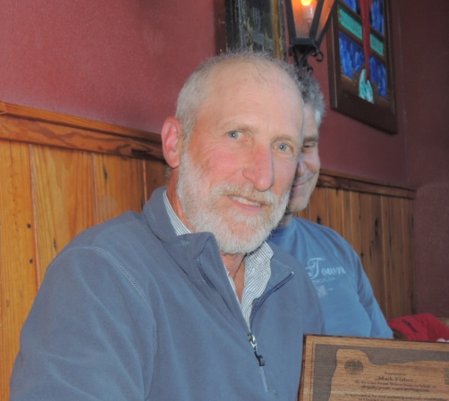
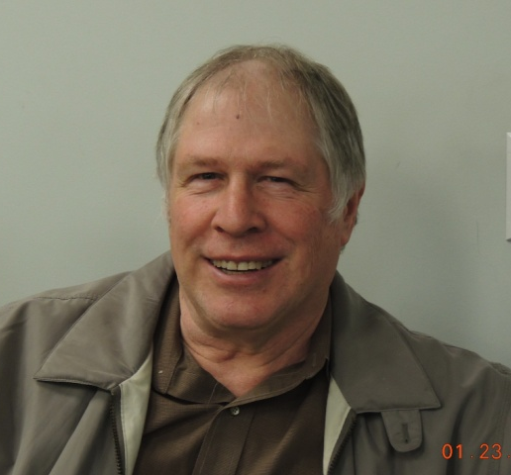

Rulemaking Team
George Davis
Mark Fisher
Gary Andes
Karen White-Fallon

