Slide 1
Air quality permitting, Heat Smart and gasoline dispensing facility updates
(aka the Kitchen Sink)
Inspectors’ Forum
May 2015

Slide 2
Outline of Today’s Presentation
Goals/Reasons for Rulemaking
Overview of Rulemaking
Rule clean-up
Division 216 Table 1 changes
Categorically Insignificant Activities
Update particulate matter (PM) standards
Splitting businesses
New Source Review (NSR)
Extensions for NSR permits
Net air quality benefit for sensitive areas
Notes:
Here is an overview of the topics we are going to cover today:
Rule clean-up
Update statewide grain loading and opacity standards
We have a defined term: Categorically Insignificant Activities
How emissions are divided when a business splits into two or more businesses
Our pre-construction program called New Source Review (NSR)
If construction is delayed, how a business an get an extensions for their NSR permit
Another defined term: Net air quality benefit
All of these topics will be explained in more detail later in this presentation.

Slide 3
Rulemaking Goals
Make rules clearer
Update rules
Address air quality problems
Notes:
The goals of this rulemaking are to make sure our rules are clear, up to date and that they address air quality problems.
When addressing AQ problems, we want to make sure we are targeting our resources at the right place. We want to provide incentives to reduce emissions where needed and provide companies flexibility as long as it will improve air quality.

Slide 4

Reasons for Rulemaking
Started out initially as reorganization
Received input about:
  Unclear rules from permit writers/inspectors
  Permitting problems in areas of marginal air quality
Notes:
Originally the rulemaking started out to reorganize our rules and make them easier for people to use. We had procedures in definitions and tables that were impossible to find.
After talking with people, we realized that there were many areas in our rules that could be improved so the project grew.

Slide 5
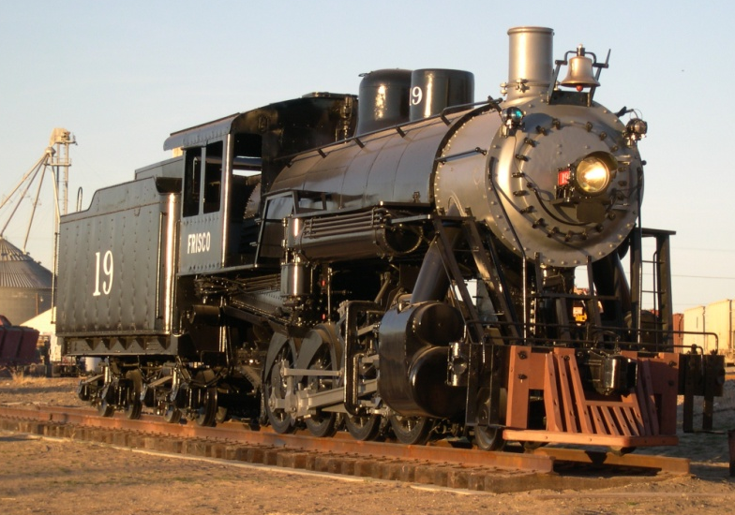

Reasons for Rulemaking continued
Addressing air quality problems changed reorganization to major overhaul of New Source Review rules
Before
After

Slide 6
9 Categories of Rulemaking
Clarify and update air quality rules
Update particulate matter emission standards
Change permitting requirements for emergency generators and small natural gas or oil-fired equipment
Notes:
Here is a high level overview of this rulemaking.
As you will recall from the informational item we presented at the January EQC meeting and from the staff report, we organized this rulemaking into nine categories.
We are PROPOSING the following
READ THROUGH 1 THROUGH 3

Slide 7
9 Categories of Rulemaking continued
Revise parts of the New Source Review preconstruction permitting program
Establish two new state air quality area designations, “sustainment” and “reattainment”
Designate Lakeview as a state sustainment area
Notes:
READ THROUGH 4 THROUGH 6

Slide 8
9 Categories of Rulemaking continued
7. Modernize methods allowed for holding public hearings and meetings
8. Re-establish the Heat Smart woodstove replacement program exemption for small commercial solid fuel boilers regulated under the permitting program
9. Remove annual reporting requirements for small gasoline dispensing facilities

Slide 9
Rule Clean-Up
Unclear rules, not organized well:
  Reorganize by moving procedures out of definitions
  Provide clarification when needed, especially regarding compliance requirements
  Delete unused/redundant definitions
  Correct errors
  Maintain overall stringency
Notes:
The first part of this presentation covers rule clean-up.
Some of our rules are out of order so we want to move them to the right place. There are procedures in definitions like major modification, actual emissions and netting basis that need to be moved.
Some of our rules are missing important details so we worked on clarifying them. (compliance methods)
We want a clean set of definitions. Throughout all of our divisions there are multiple definitions of the same term – 5 definitions of the word person! Make sure the definitions agree and get rid of the redundant ones
We found cross-referencing errors and typos that need to be fixed.
None of these clean-up changes will affect stringency. We are just clarifying things.

Slide 10
Rule Clean-Up continued
  Reorganize by moving procedures out of definitions:
    Actual emissions
    Baseline year
    Baseline emission rate
    Netting basis
    Major modification
    Net Air Quality Benefit
To division 222
To division 224
To division 224
Notes:
The first part of this presentation covers rule clean-up.
Some of our rules are out of order so we want to move them to the right place. There are procedures in definitions like major modification, actual emissions and netting basis that need to be moved.
Some of our rules are missing important details so we worked on clarifying them. (compliance methods)
We want a clean set of definitions. Throughout all of our divisions there are multiple definitions of the same term – 5 definitions of the word person! Make sure the definitions agree and get rid of the redundant ones
We found cross-referencing errors and typos that need to be fixed.
None of these clean-up changes will affect stringency. We are just clarifying things.

Slide 11

Rule Clean-Up continued
  Move Division 200 tables into text:
    De Minimis Emission Levels
    Generic PSEL
    Significant Emission Rate
    Significant Impact Level
Where is that table??
Notes:
The first part of this presentation covers rule clean-up.
Some of our rules are out of order so we want to move them to the right place. There are procedures in definitions like major modification, actual emissions and netting basis that need to be moved.
Some of our rules are missing important details so we worked on clarifying them. (compliance methods)
We want a clean set of definitions. Throughout all of our divisions there are multiple definitions of the same term – 5 definitions of the word person! Make sure the definitions agree and get rid of the redundant ones
We found cross-referencing errors and typos that need to be fixed.
None of these clean-up changes will affect stringency. We are just clarifying things.

Slide 12

Rule Clean-Up continued
  Move PSD increment table moved to Division 202
  Move Ambient Air Quality Levels Impact for Maintenance Areas to Division 202
Notes:
The first part of this presentation covers rule clean-up.
Some of our rules are out of order so we want to move them to the right place. There are procedures in definitions like major modification, actual emissions and netting basis that need to be moved.
Some of our rules are missing important details so we worked on clarifying them. (compliance methods)
We want a clean set of definitions. Throughout all of our divisions there are multiple definitions of the same term – 5 definitions of the word person! Make sure the definitions agree and get rid of the redundant ones
We found cross-referencing errors and typos that need to be fixed.
None of these clean-up changes will affect stringency. We are just clarifying things.

Slide 13
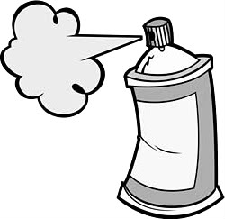
Rule Clean-Up continued
Outdated rules repealed:
    Consumer Spray Paint VOC limits replaced by EPA rules (19% vs. 15%)
    Western Backstop SO2 Federal Trading Program – replaced by direct control of PGE Boardman
Notes:
As part of the clean up, we want to repeal some rules
Spray paint rules were part of plan to reduce ozone from consumer products. EPA adopted national rules that apply to manufacturers and so we don’t state rules any more.
DEQ worked with the western states on a SO₂ trading program but dropped out because it wasn’t cost effective. There are now specific rules but PGE is not involved in trading so we don’t need the state rules.

Slide 14
Rule Clean-Up continued
Repeal rules for sources that no longer exist in Oregon:
  Neutral Sulfite Semi-Chemical Pulp Mills
  Sulfite Pulp Mills
  Primary Aluminum Standards
  Laterite Ore Production of Ferronickel
  Charcoal Producing Plants
New sources must comply with more stringent federal requirements for new sources
Notes:
Unfortunately many businesses have shut down in Oregon so we plan to repeal those industry specific rules.
All other industry rules are staying the same, including Kraft Pulp Mills
If one of those sources wants to locate in Oregon, they would have to comply with current federal rules which are more stringent than our existing state rules. (New Source Review, New Source Performance Standards, National Emission Standards for HAPs)

Slide 15
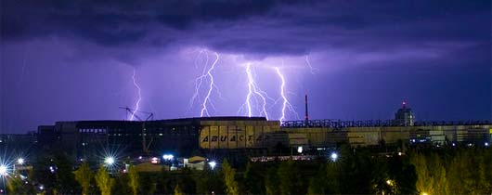
Rule Clean-Up continued
Emergency as an Affirmative Defense for Title V Permitted Sources ONLY
  Affirmative defense is the ability to avoid civil penalties for violations. Under EPA’s interpretation, DEQ’s excess emissions rules incorrectly allow all permitted sources to assert an affirmative defense for emergencies, rather than just Title V sources.
Notes:
The first part of this presentation covers rule clean-up.
Some of our rules are out of order so we want to move them to the right place. There are procedures in definitions like major modification, actual emissions and netting basis that need to be moved.
Some of our rules are missing important details so we worked on clarifying them. (compliance methods)
We want a clean set of definitions. Throughout all of our divisions there are multiple definitions of the same term – 5 definitions of the word person! Make sure the definitions agree and get rid of the redundant ones
We found cross-referencing errors and typos that need to be fixed.
None of these clean-up changes will affect stringency. We are just clarifying things.

Slide 16
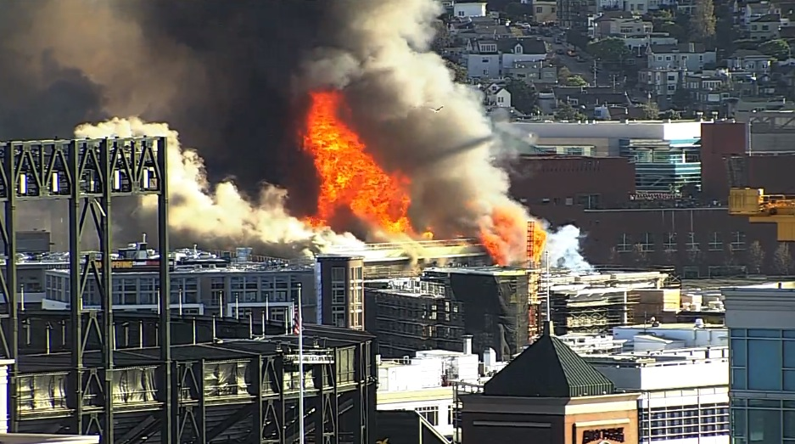
Rule Clean-Up continued
Enforcement Action Criteria for ACDP sources:
  Added “whether the excess emissions event was due to an emergency” to OAR 340-214-0350 Enforcement Action Criteria
Notes:
The first part of this presentation covers rule clean-up.
Some of our rules are out of order so we want to move them to the right place. There are procedures in definitions like major modification, actual emissions and netting basis that need to be moved.
Some of our rules are missing important details so we worked on clarifying them. (compliance methods)
We want a clean set of definitions. Throughout all of our divisions there are multiple definitions of the same term – 5 definitions of the word person! Make sure the definitions agree and get rid of the redundant ones
We found cross-referencing errors and typos that need to be fixed.
None of these clean-up changes will affect stringency. We are just clarifying things.

Slide 17
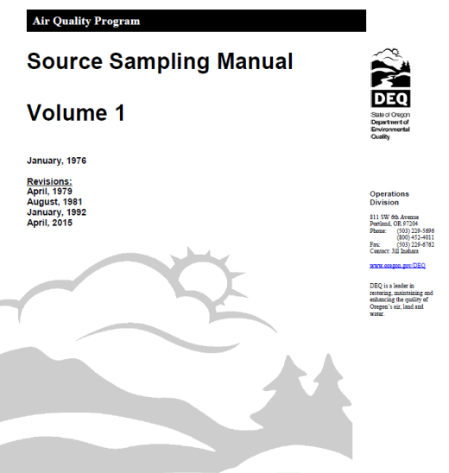
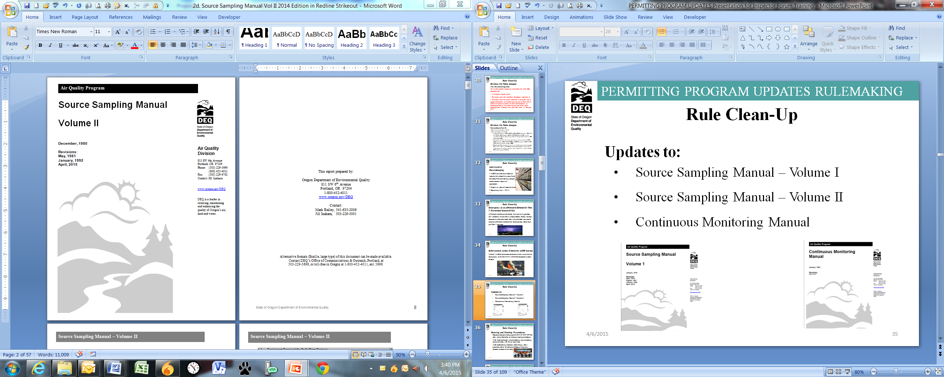
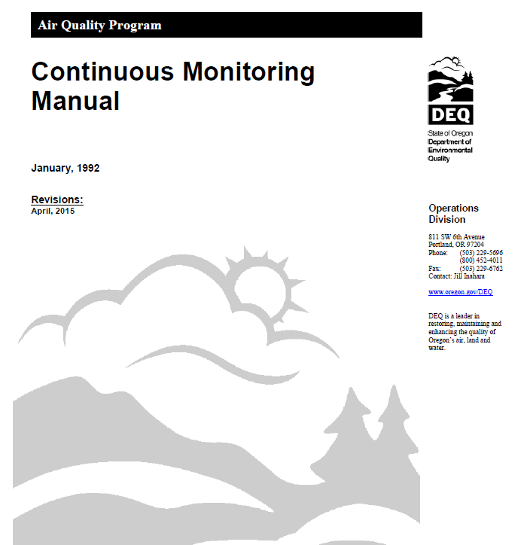
Rule Clean-Up continued
  Updates to:
    Source Sampling Manual – Volume I
    Source Sampling Manual – Volume II
    Continuous Monitoring Manual
Notes:
The first part of this presentation covers rule clean-up.
Some of our rules are out of order so we want to move them to the right place. There are procedures in definitions like major modification, actual emissions and netting basis that need to be moved.
Some of our rules are missing important details so we worked on clarifying them. (compliance methods)
We want a clean set of definitions. Throughout all of our divisions there are multiple definitions of the same term – 5 definitions of the word person! Make sure the definitions agree and get rid of the redundant ones
We found cross-referencing errors and typos that need to be fixed.
None of these clean-up changes will affect stringency. We are just clarifying things.

Slide 18

Rule Clean-Up continued
  Hearing and Meeting Procedures:
Repeal prescriptive language OAR 340-209-0070 to allow more flexibility in holding hearings/meetings
With Internet-based virtual meetings, more meetings across the state with fewer resources.
After establishing necessary technology, allow people to call in to hearings/meetings from any location instead of traveling.
Notes:
The first part of this presentation covers rule clean-up.
Some of our rules are out of order so we want to move them to the right place. There are procedures in definitions like major modification, actual emissions and netting basis that need to be moved.
Some of our rules are missing important details so we worked on clarifying them. (compliance methods)
We want a clean set of definitions. Throughout all of our divisions there are multiple definitions of the same term – 5 definitions of the word person! Make sure the definitions agree and get rid of the redundant ones
We found cross-referencing errors and typos that need to be fixed.
None of these clean-up changes will affect stringency. We are just clarifying things.

Slide 19
Rule Clean-Up continued
  New Definitions
Attainment area
Attainment pollutant
Capture efficiency
Class II area
Class III area
Control efficiency
Day
DEQ method [#]
Designated area
Destruction efficiency
Fuel burning equipment
Hazardous air pollutant
Internal combustion engine
Liquefied petroleum gas
Notes:
The first part of this presentation covers rule clean-up.
Some of our rules are out of order so we want to move them to the right place. There are procedures in definitions like major modification, actual emissions and netting basis that need to be moved.
Some of our rules are missing important details so we worked on clarifying them. (compliance methods)
We want a clean set of definitions. Throughout all of our divisions there are multiple definitions of the same term – 5 definitions of the word person! Make sure the definitions agree and get rid of the redundant ones
We found cross-referencing errors and typos that need to be fixed.
None of these clean-up changes will affect stringency. We are just clarifying things.

Slide 20
Rule Clean-Up continued
  New Definitions
Natural gas
Odor
Portable
Reattainment area
Reattainment pollutant
Removal efficiency
State New Source Review
Sustainment area
Sustainment pollutant
Type A State NSR action
Type B State NSR action
Unclassified area or attainment area
Wood fuel-fired device
Notes:
The first part of this presentation covers rule clean-up.
Some of our rules are out of order so we want to move them to the right place. There are procedures in definitions like major modification, actual emissions and netting basis that need to be moved.
Some of our rules are missing important details so we worked on clarifying them. (compliance methods)
We want a clean set of definitions. Throughout all of our divisions there are multiple definitions of the same term – 5 definitions of the word person! Make sure the definitions agree and get rid of the redundant ones
We found cross-referencing errors and typos that need to be fixed.
None of these clean-up changes will affect stringency. We are just clarifying things.

Slide 21
Rule Clean-Up continued
  New Definitions:
    Fuel burning equipment: equipment, other than internal combustion engines, the principal purpose of which is to produce heat or power by indirect heat transfer.
    Internal combustion engine: means stationary gas turbines and reciprocating internal combustion engines.
Notes:
The first part of this presentation covers rule clean-up.
Some of our rules are out of order so we want to move them to the right place. There are procedures in definitions like major modification, actual emissions and netting basis that need to be moved.
Some of our rules are missing important details so we worked on clarifying them. (compliance methods)
We want a clean set of definitions. Throughout all of our divisions there are multiple definitions of the same term – 5 definitions of the word person! Make sure the definitions agree and get rid of the redundant ones
We found cross-referencing errors and typos that need to be fixed.
None of these clean-up changes will affect stringency. We are just clarifying things.

Slide 22


Rule Clean-Up continued
  New Definitions:
    Portable: designed and capable of being carried or moved from one location to another. Indicia of portability include, but are not limited to, wheels, skids, carrying handles, dolly, trailer, or platform.
Notes:
Defined portable but didn’t put a time limit on it

Slide 23
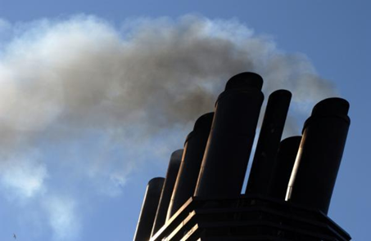
PM and Opacity Standards Topics
Background
Changes
Implementation schedule
Affected sources
Compliance issues

Slide 24
PM and Opacity Standards - Background
Standards adopted in early 1970’s as part of initial State Implementation Plan (SIP)
Rules include different standards for pre and post 1970 sources - grandfathering provision
  Pre-1970: 40% opacity and 0.2 gr/dscf
  Post 1970: 20% opacity and 0.1 gr/dscf
PM standard inconsistent with current EPA policy for significant figures/compliance
Notes:
SIP required by Clean Air Act to maintain or attain compliance with National Ambient Air Quality Standards (NAAQS)
NAAQS for particulate matter was based on total particulate matter and was much less stringent than today’s standards.

Slide 25
Opacity standard changes
Change all opacity standards (except recovery furnaces) to 6-minute block average
  Replaces 3-minute aggregate in 60 minutes
  Compliance can be based on EPA Method 9
  Change is consistent with other states
  No change in stringency

Slide 26
Opacity standard changes continued
Repeal Portland 4-county standard
  20% opacity for 30 seconds for non-fuel burning equipment
  No uniform procedures for determining compliance
  Not a SIP provision
  Still covered by statewide standards

Slide 27
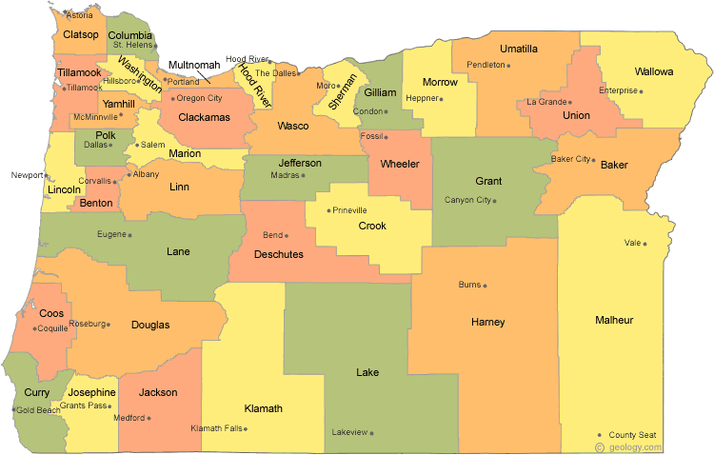
Special Control Areas
Willamette Valley, including Benton, Clackamas, Columbia, Lane, Linn, Marion, Multnomah, Polk, Washington and Yamhill Counties;
Umpqua Basin;
Rogue Basin;
In incorporated cities w/population of >4,000, and within three miles.

Slide 28
Opacity standard changes continued
Sources other than wood-fired boilers
Source | Location | Date | Limit
Pre 1970 | Outside special control area | Through 12/31/19 | 40%
Pre 1970 | Outside special control area | After 01/01/20 | 20%
Pre 1970 | Inside special control area | Upon rule adoption | 20%
Post 1970 | Statewide | Upon rule adoption | 20%
*55% = 3 minutes at 100% and 9 minutes at 40%
**40% = 3 minutes at 100% and 9 minutes at 20%

Slide 29
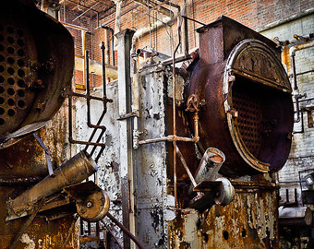
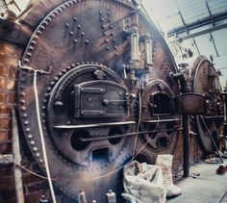
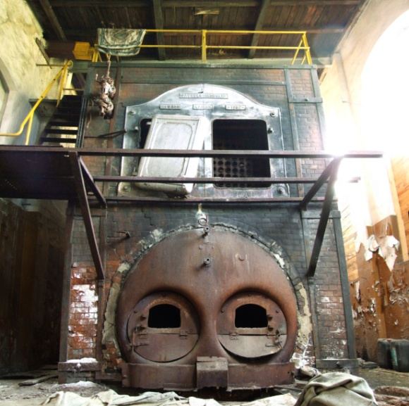
Opacity standard changes continued
Wood-fired boilers
Source | Date | Limit | Exception
Pre 1970 | Through 12/31/19 | 40% | 55% for 2 6-minute blocks*
*55% = 3 minutes at 100% and 9 minutes at 40%, currently allowed

Slide 30
Opacity standard changes continued
Wood-fired boilers
Source | Date | Limit | Exception
Pre 1970 | After 01/01/20 | 20% | 40% for 2 6-minute blocks
Pre 1970 | After 01/01/20 | 20% | 40% during grate cleaning*
Pre 1970 | After 01/01/20 | 20% | Boiler specific up to 40%**
*as long as grate cleaning is performed in accordance with DEQ approved grate cleaning plan
**Source can request boiler specific opacity between 20-40% measured during boiler specific grain loading source test

Slide 31
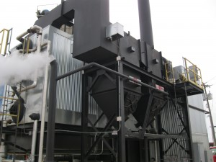
Opacity standard changes continued
Wood-fired boilers
Source | Date | Limit | Exception
Post 1970 | Upon rule adoption | 20% | 40% for 2 6-minute blocks
Post- 04/15/15 | Upon rule adoption | 20% | None
*40% = 3 minutes at 100% and 9 minutes at 20%, currently allowed

Slide 32
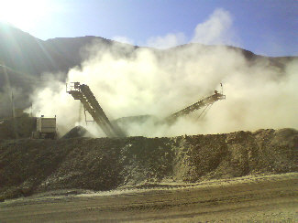
Opacity standard changes - Fugitive Emissions
Fugitive emissions that leave property for more than 18 seconds in a 6-minute period must be abated
DEQ may request fugitive emission control plan
Use EPA Method 22 to read fugitive emissions

Slide 33
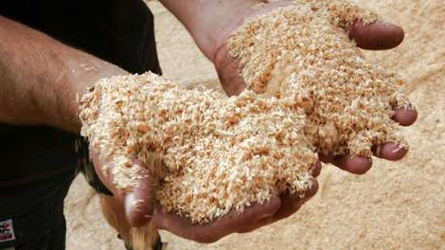
Particle Fallout
No person may cause or permit the deposition of particulate matter larger than 250 microns in size that creates an observable deposition upon the real property of another person when notified by the department that the deposition exists and must be controlled.
Permit serves as first “warning”
Resolve observed deposition with enforcement policy

Slide 34
Grain loading changes
Add significant digit to standards consistent with EPA policy
  0.1 » 0.10
  0.2 » 0.20
Phase out 0.2 gr/dscf for older sources to help address newer/tighter ambient air quality standards
Sources can request 1 year extension

Slide 35
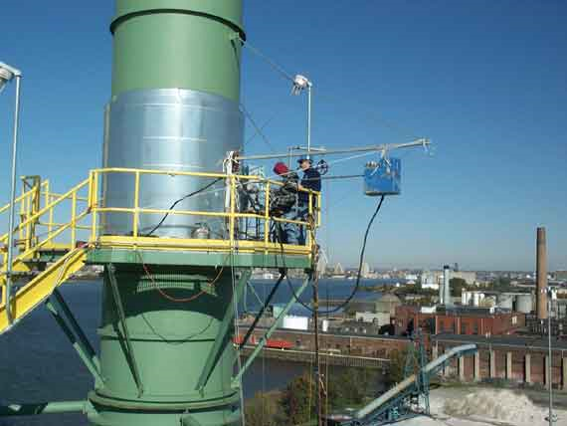
Grain loading changes continued
0.10 gr/dscf for ALL sources with “representative” compliance source test data < 0.080 gr/dscf
Notes:
In going from 40% down to 20%, we are making standard the same as for post-1970 units.
Required operation and maintenance plans will ensure emissions are minimized and limit the amount of time for grate cleaning or soot blowing

Slide 36
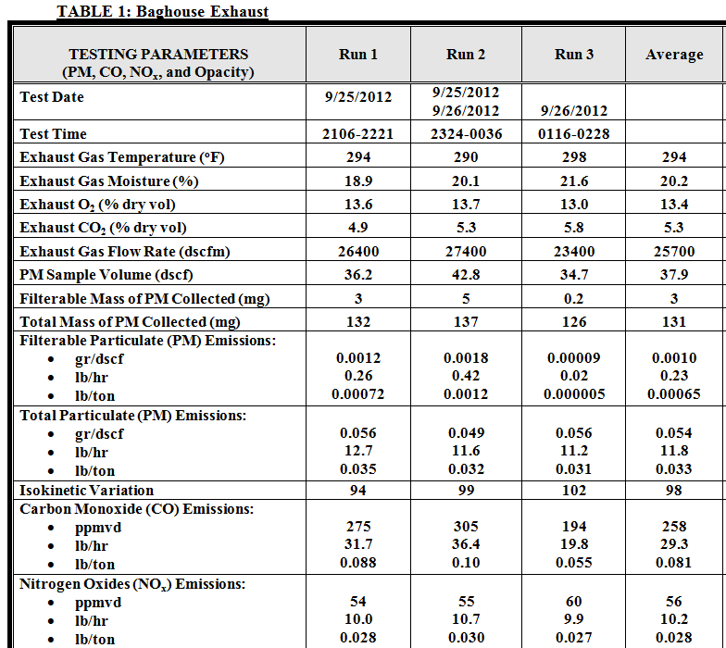
Grain loading changes continued
Representative compliance source test results obtained:
No more than ten years before 04/17/15; and
When a source is operating at Highest and Best
Notes:
In going from 40% down to 20%, we are making standard the same as for post-1970 units.
Required operation and maintenance plans will ensure emissions are minimized and limit the amount of time for grate cleaning or soot blowing

Slide 37
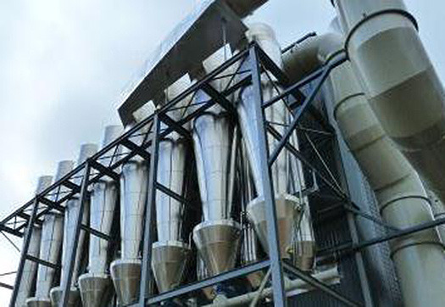
Grain loading changes continued
Non-Fuel Burning Equipment
Source | Standard (gr/dscf)
 | Limit | Compliance Date
Pre 1970 | 0.24 | Until 12/31/19
Pre 1970 | 0.15 | On 01/01/20
Used < 876 hrs/yr | 0.20 | On 01/01/20
Post 1970 | 0.14 | Until 12/31/19
Post 1970 | 0.14 | On 01/01/20
After SOS date | 0.10 | After SOS date
Notes:
This is an overview of the proposed changes to the grain loading standards.
“Sensitive areas” are designated because of air quality problems

Slide 38
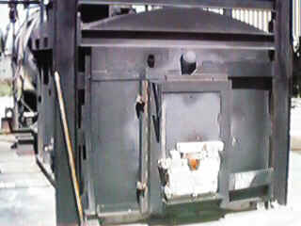
Grain loading changes continued
Fuel Burning Equipment
Source | Standard (gr/dscf)
 | Limit | Compliance Date
Pre 1970 | 0.24 | Until 12/31/19
Pre 1970 | 0.15 | On 01/01/20
Used < 876 hrs/yr | 0.20 | On 01/01/20
Post 1970 | 0.14 | Until 12/31/19
Post 1970 | 0.14 | On 01/01/20
After SOS date | 0.10 | After SOS date
Notes:
This is an overview of the proposed changes to the grain loading standards.
“Sensitive areas” are designated because of air quality problems

Slide 39
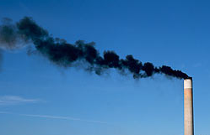
Grain loading changes continued
Pre-1970 Fuel Burning Equipment
For boilers that cannot meet 0.15 gr/dscf:
Submit signed report by professional engineer after:
  Multiclone maintenance and upgrade or
  Boiler tune-up
Request specific limit of 0.17 gr/dscf by 10/01/19
Notes:
This is an overview of the proposed changes to the grain loading standards.
“Sensitive areas” are designated because of air quality problems

Slide 40
PM and Opacity Standards -
Affected Sources
Boise Cascade (Pilot Rock) 30-0016
Collins (Fremont Sawmill) 19-0002
Columbia Forest Products 18-0014
Frank Lumber 22-2525
Interfor Pacific 18-0005
Swanson Group Roseburg 10-0030
Notes:
SIP required by Clean Air Act to maintain or attain compliance with National Ambient Air Quality Standards (NAAQS)
NAAQS for particulate matter was based on total particulate matter and was much less stringent than today’s standards.

Slide 41
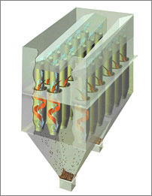
What might be necessary to comply with standards
Conduct more frequent tuning/maintenance
  1977 28 MMBtu wood fired boiler; pre-test out of compliance; post-test less than 0.1 gr/dscf
Maintain consistent/high quality fuel
Improve combustion controls
Maintain/upgrade multiclone
  Flue gas recirculation
  Multiclone inspection

Slide 42

PM Standards
Notes:
In going from 40% down to 20%, we are making standard the same as for post-1970 units.
Required operation and maintenance plans will ensure emissions are minimized and limit the amount of time for grate cleaning or soot blowing

Slide 43

Break

Slide 44
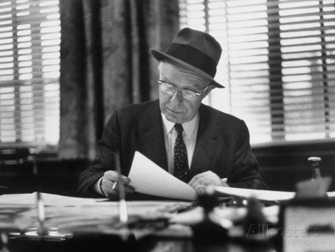
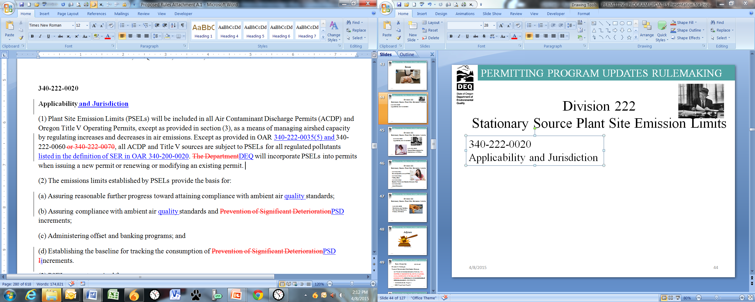
Division 222
Stationary Source Plant Site Emission Limits
340-222-0020
Applicability and Jurisdiction

Slide 45
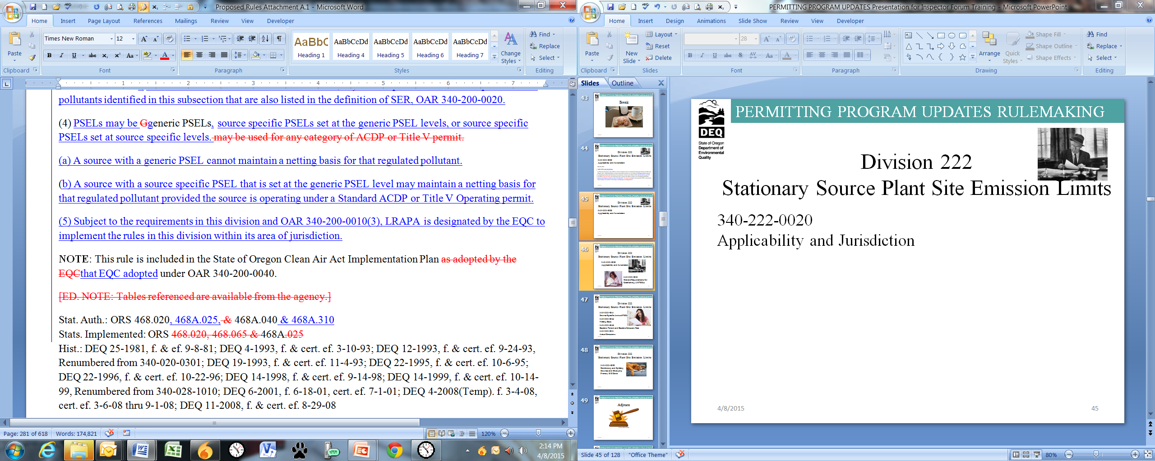
Division 222
Stationary Source Plant Site Emission Limits
340-222-0020
Applicability and Jurisdiction

Slide 46

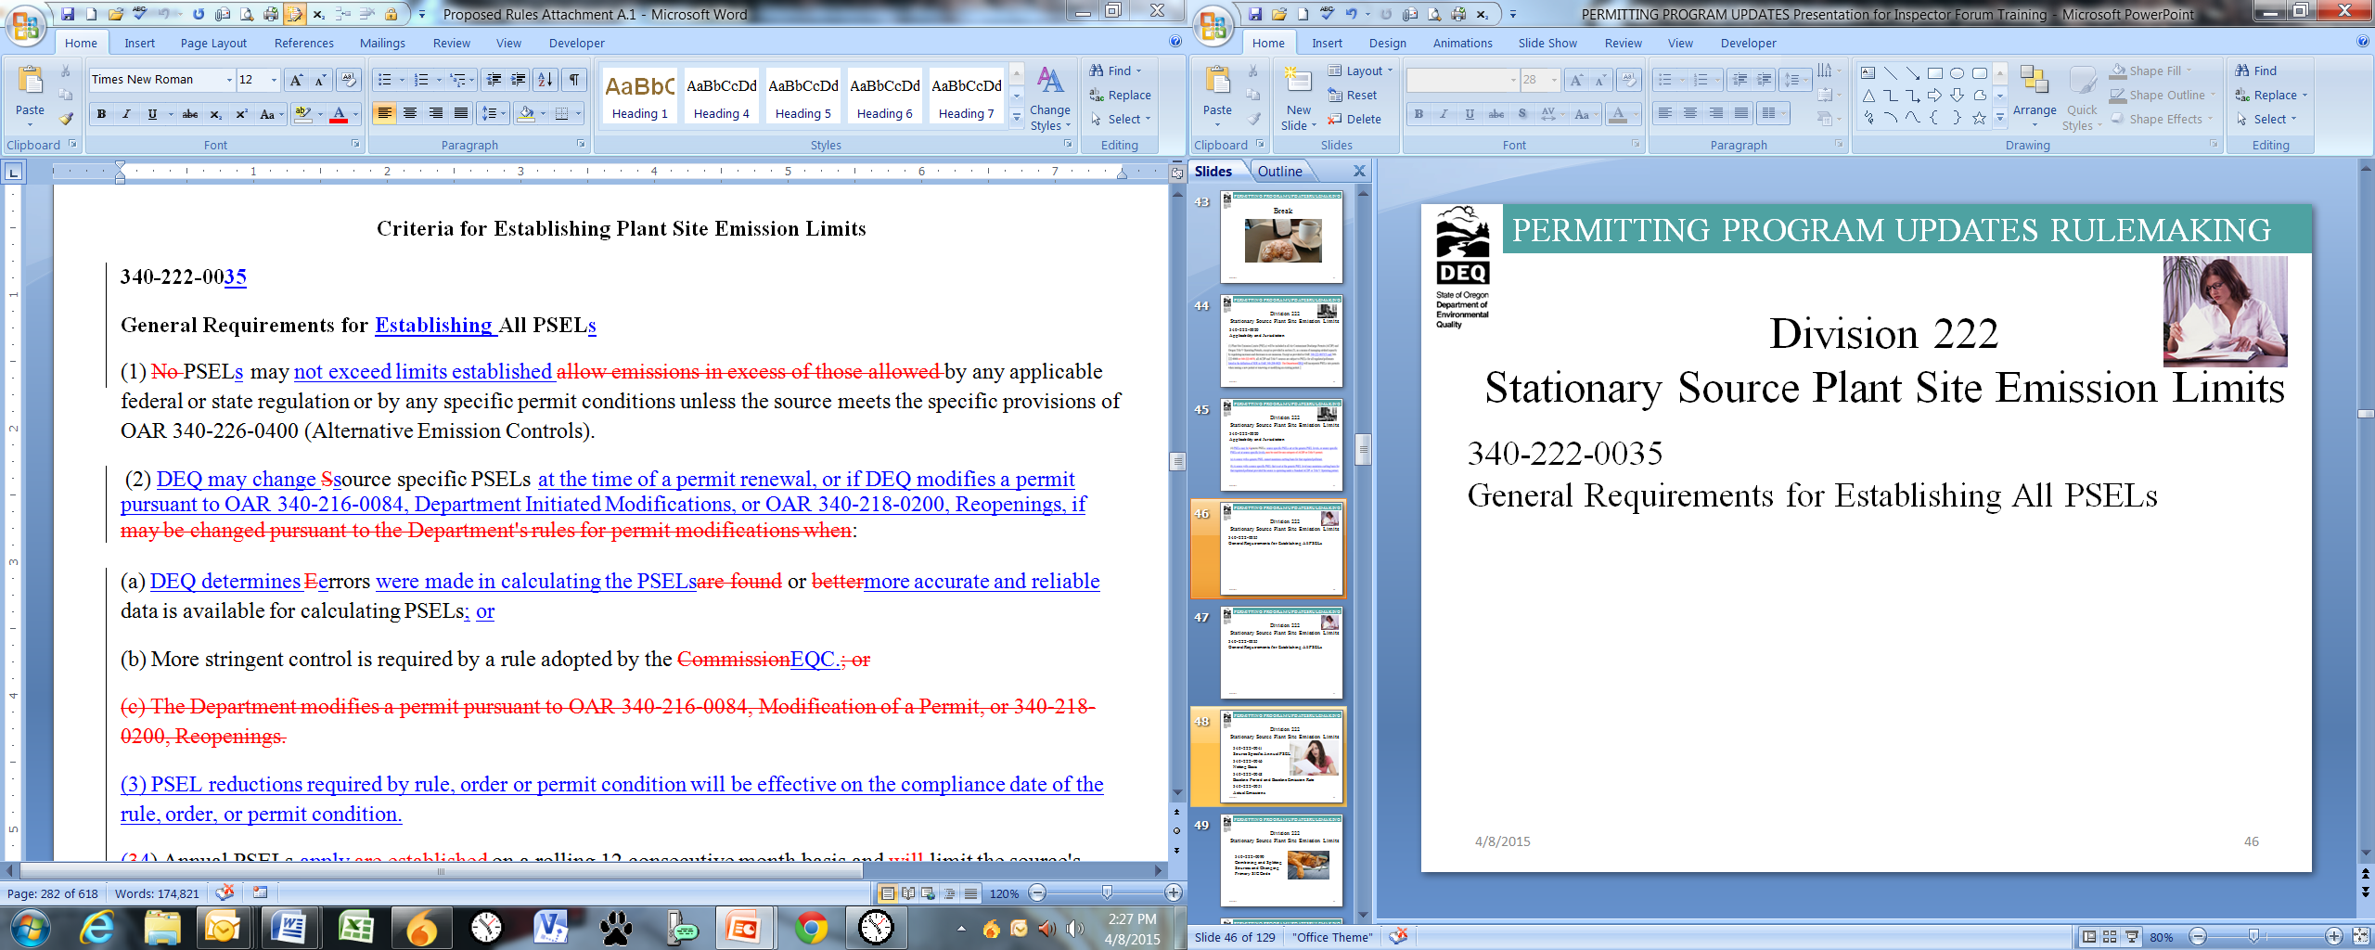
Division 222
Stationary Source Plant Site Emission Limits
340-222-0035
General Requirements for Establishing All PSELs

Slide 47
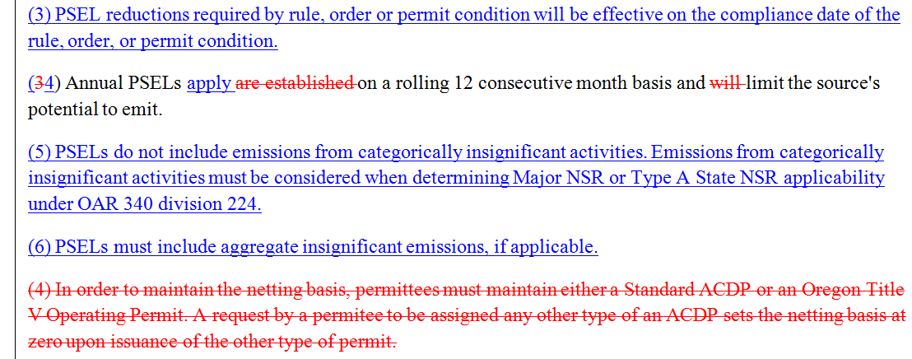
Division 222
Stationary Source Plant Site Emission Limits
340-222-0035
General Requirements for Establishing All PSELs

Slide 48

Division 222
Stationary Source Plant Site Emission Limits
340-222-0041
Source Specific Annual PSEL
340-222-0046
Netting Basis
340-222-0048
Baseline Period and Baseline Emission Rate
340-222-0051
Actual Emissions

Slide 49

Division 222
Stationary Source Plant Site Emission Limits
340-222-0090
Combining and Splitting Sources and Changing Primary SIC Code

Slide 50

Adjourn

Slide 51
Rule Clean-Up continued
Division 210 changes:
Types of Construction/Modification Changes
  (c) Would not increase emissions from any new, modified, or replaced device, activity or process, or any combination of devices, activities or processes at the stationary source or combination of stationary sources by more than the:
  de minimis levels (Type 1)
  SER (Type 2 and Type 2)
Notes:
Unfortunately many businesses have shut down in Oregon so we plan to repeal those industry specific rules.
All other industry rules are staying the same, including Kraft Pulp Mills
If one of those sources wants to locate in Oregon, they would have to comply with current federal rules which are more stringent than our existing state rules. (New Source Review, New Source Performance Standards, National Emission Standards for HAPs)

Slide 52
Rule Clean-Up continued
Division 216 changes:
If more than one source category applies and not eligible for Basic or General, then Simple or Standard ACDP
Prorate annual fees for temporary closure based on length of closure in a calendar year, but will not be less than ½ of regular annual fee
Notes:
Unfortunately many businesses have shut down in Oregon so we plan to repeal those industry specific rules.
All other industry rules are staying the same, including Kraft Pulp Mills
If one of those sources wants to locate in Oregon, they would have to comply with current federal rules which are more stringent than our existing state rules. (New Source Review, New Source Performance Standards, National Emission Standards for HAPs)

Slide 53
Rule Clean-Up continued
Division 216 changes:
Reinstatement of Terminated Permit: automatically terminated permit only reinstated by:
Application for a new permit
Pay new source permit application fees, unless renewal application submitted within three months of expiration date
Notes:
Unfortunately many businesses have shut down in Oregon so we plan to repeal those industry specific rules.
All other industry rules are staying the same, including Kraft Pulp Mills
If one of those sources wants to locate in Oregon, they would have to comply with current federal rules which are more stringent than our existing state rules. (New Source Review, New Source Performance Standards, National Emission Standards for HAPs)

Slide 54
Rule Clean-Up continued
Division 216 changes:
Applications for new permits - submitted at least 60 days prior to when a permit is needed.
Consider the renewal timelines (mods too):
Permit Type | Renewal Submittal
General + Attachments | 30 days
Basic | 30 days
Simple | 120 days
Standard | 180 days
Notes:
Unfortunately many businesses have shut down in Oregon so we plan to repeal those industry specific rules.
All other industry rules are staying the same, including Kraft Pulp Mills
If one of those sources wants to locate in Oregon, they would have to comply with current federal rules which are more stringent than our existing state rules. (New Source Review, New Source Performance Standards, National Emission Standards for HAPs)

Slide 55
Rule Clean-Up continued
340-216-0064 Simple ACDPs
(2) Fees. Applicants for a new or modified Simple ACDP must pay the fees set forth in OAR 340-216-8020. Applicants for a new Simple ACDP must initially pay the High Annual Fee. Once the initial permit is issued, annual fees for Simple ACDPs will be assessed based on the following:
(a) Low Fee — A source may qualify for the low fee if:
(A) The source is, or will be, permitted under only one of the following categories from OAR 340-216-8010 Part B:
(i) Category 7. Asphalt felt and coatings;
Notes:
Unfortunately many businesses have shut down in Oregon so we plan to repeal those industry specific rules.
All other industry rules are staying the same, including Kraft Pulp Mills
If one of those sources wants to locate in Oregon, they would have to comply with current federal rules which are more stringent than our existing state rules. (New Source Review, New Source Performance Standards, National Emission Standards for HAPs)

Slide 56
Rule Clean-Up continued
340-216-0064 Simple ACDPs
Low Fee – continued
(ii) Category 13. Boilers and other fuel burning equipment (can be combined with category 27. Electric power generation);
(iii) Category 27. Electric power generation;
…..
(xii) Category 85. All other sources not listed in OAR 340-216-8010 (can be combined with category 27. Electric Power Generation); and
Notes:
Unfortunately many businesses have shut down in Oregon so we plan to repeal those industry specific rules.
All other industry rules are staying the same, including Kraft Pulp Mills
If one of those sources wants to locate in Oregon, they would have to comply with current federal rules which are more stringent than our existing state rules. (New Source Review, New Source Performance Standards, National Emission Standards for HAPs)

Slide 57
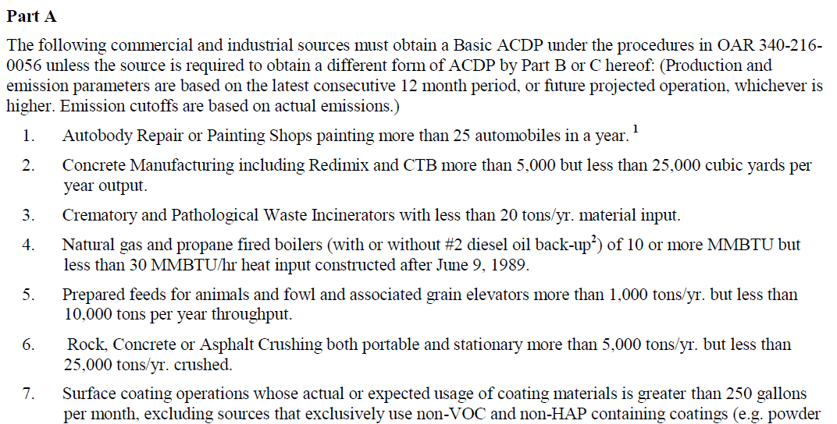
Rule Clean-Up continued
Division 216 Table changes:
Paragraphs at the top of each table moved to 340-216-0020 Applicability
Notes:
Unfortunately many businesses have shut down in Oregon so we plan to repeal those industry specific rules.
All other industry rules are staying the same, including Kraft Pulp Mills
If one of those sources wants to locate in Oregon, they would have to comply with current federal rules which are more stringent than our existing state rules. (New Source Review, New Source Performance Standards, National Emission Standards for HAPs)

Slide 58
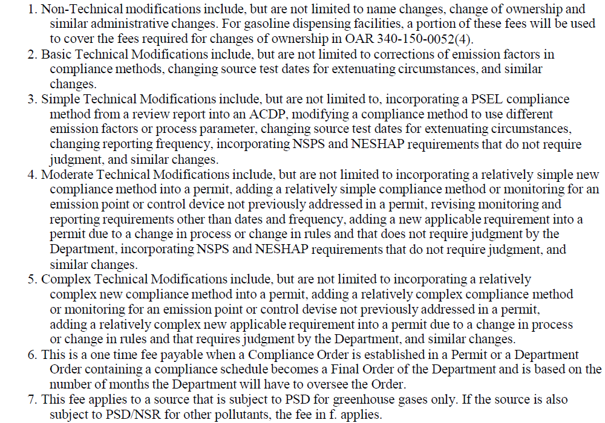
Rule Clean-Up continued
Division 216 Table changes:
Modification types in footnotes moved to division 216 definitions
Notes:
Unfortunately many businesses have shut down in Oregon so we plan to repeal those industry specific rules.
All other industry rules are staying the same, including Kraft Pulp Mills
If one of those sources wants to locate in Oregon, they would have to comply with current federal rules which are more stringent than our existing state rules. (New Source Review, New Source Performance Standards, National Emission Standards for HAPs)

Slide 59
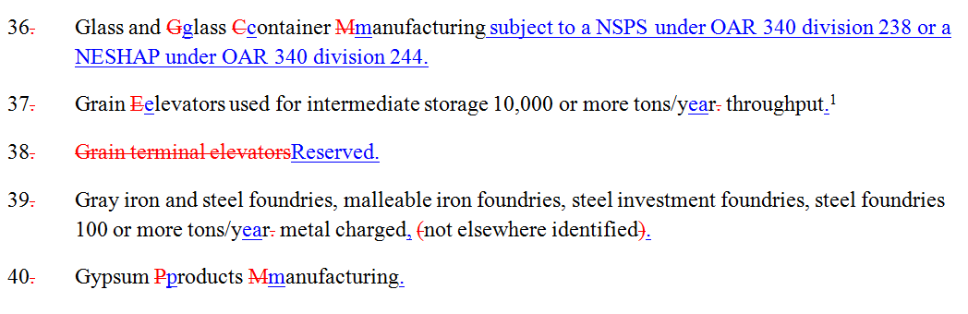

Rule Clean-Up continued
Division 216 Table changes:
List no longer alphabetical (new sources added to end)
No more renumbering Table 1 Codes!
Notes:
Unfortunately many businesses have shut down in Oregon so we plan to repeal those industry specific rules.
All other industry rules are staying the same, including Kraft Pulp Mills
If one of those sources wants to locate in Oregon, they would have to comply with current federal rules which are more stringent than our existing state rules. (New Source Review, New Source Performance Standards, National Emission Standards for HAPs)

Slide 60
Rule Clean-Up continued
Division 216 Table changes:
Source category changes:
Deleted grain terminal elevators #38 (use grain elevators #37 instead)
Added recreational vehicle manufacturing to manufactured home, mobile home manufacturing #47
Separated pathological waste incinerators #89 from crematory incinerators #25
Notes:
Unfortunately many businesses have shut down in Oregon so we plan to repeal those industry specific rules.
All other industry rules are staying the same, including Kraft Pulp Mills
If one of those sources wants to locate in Oregon, they would have to comply with current federal rules which are more stringent than our existing state rules. (New Source Review, New Source Performance Standards, National Emission Standards for HAPs)

Slide 61
Rule Clean-Up continued
Division 216 Table changes:
New Source Categories:
#87 Stationary internal combustion engines only if:
For emergency generators and firewater pumps, the aggregate engine horsepower rating is greater than 30,000 horsepower; or
For any individual non-emergency or non-fire pump engine, the engine is subject to 40 CFR part 63, subpart ZZZZ and is rated at 500 horsepower or more, excluding two stroke lean burn engines, engines burning exclusively landfill or digester gas, and four stroke engines located in remote areas; or
Notes:
Unfortunately many businesses have shut down in Oregon so we plan to repeal those industry specific rules.
All other industry rules are staying the same, including Kraft Pulp Mills
If one of those sources wants to locate in Oregon, they would have to comply with current federal rules which are more stringent than our existing state rules. (New Source Review, New Source Performance Standards, National Emission Standards for HAPs)

Slide 62
Rule Clean-Up continued
Division 216 Table changes:
New Source Categories:
#87 Stationary internal combustion engines only if (cont.):
Individual non-emergency engine subject to 40 CFR Part 60, Subpart IIII with:
      Displacement of 30 liters or more per cylinder; or
      Displacement of less than 30 liters per cylinder, >500 horsepower; or
Individual non-emergency engine subject to 40 CFR Part 60, Subpart JJJJ, is rated at >500 horsepower
Notes:
Unfortunately many businesses have shut down in Oregon so we plan to repeal those industry specific rules.
All other industry rules are staying the same, including Kraft Pulp Mills
If one of those sources wants to locate in Oregon, they would have to comply with current federal rules which are more stringent than our existing state rules. (New Source Review, New Source Performance Standards, National Emission Standards for HAPs)

Slide 63
Rule Clean-Up continued
Division 216 Table changes:
New Source Categories:
#88 All other portable sources not listed herein for which DEQ determines that:
An air quality concern exists;
The source would emit significant malodorous emissions; or
The source would have actual emissions, if the source were to operate uncontrolled, of 5 or more tons per year of direct PM2.5 or PM10 if located in a PM2.5 or PM10 non-attainment or maintenance area, or 10 or more tons per year of any single criteria pollutant if located in any part of the state.
Notes:
Unfortunately many businesses have shut down in Oregon so we plan to repeal those industry specific rules.
All other industry rules are staying the same, including Kraft Pulp Mills
If one of those sources wants to locate in Oregon, they would have to comply with current federal rules which are more stringent than our existing state rules. (New Source Review, New Source Performance Standards, National Emission Standards for HAPs)

Slide 64
Rule Clean-Up continued
Division 216 Table changes:
Consolidate Part C:
Remove duplicates already in Part B
Move other categories to Part B:
  All Sources subject to a RACT, BACT, LAER, NESHAP adopted in OAR 340-244-0220, NSPS adopted in OAR 340-238-0060, State MACT, or other significant Air Quality regulation(s), except sources registered pursuant to OAR 340-210-0100(2).
  Sources with less than 10 tons/year actual emissions that are subject to RACT, NSPS adopted in OAR 340-238-0060 or a NESHAP adopted in OAR 340-244-0220 which qualify for a Simple ACDP.
  Chemical manufacturing facilities that do not transfer liquids containing organic HAP listed in Table 1 of 40 CFR part 63 subpart VVVVVV to tank trucks or railcars and are not subject to emission limits in Table 2, 3, 4, 5, 6, or 8 of 40 CFR part 63 subpart VVVVVV.
Notes:
Unfortunately many businesses have shut down in Oregon so we plan to repeal those industry specific rules.
All other industry rules are staying the same, including Kraft Pulp Mills
If one of those sources wants to locate in Oregon, they would have to comply with current federal rules which are more stringent than our existing state rules. (New Source Review, New Source Performance Standards, National Emission Standards for HAPs)

Slide 65
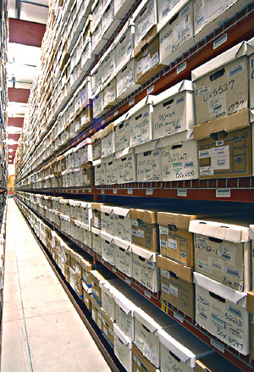
Rule Clean-Up continued
340-214-0114 Recordkeeping
ACDP sources must retain all records for at least five years from the date of the monitoring sample, measurement, report, or application
Keep two years of records onsite
Beginning July 1, 2015.
Notes:
Unfortunately many businesses have shut down in Oregon so we plan to repeal those industry specific rules.
All other industry rules are staying the same, including Kraft Pulp Mills
If one of those sources wants to locate in Oregon, they would have to comply with current federal rules which are more stringent than our existing state rules. (New Source Review, New Source Performance Standards, National Emission Standards for HAPs)

Slide 66

Rule Clean-Up
Questions?
Notes:
Do you have any questions before we move on to the next topic?
Our next presenter is Mark Fisher.

Slide 67
Nuisance Odor Update

Slide 68
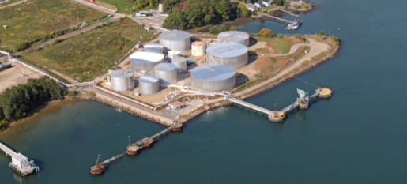
Gasoline Marine Loading
Expand marine loading rule to include other volatile liquids in the Portland Air Quality Maintenance Area

Slide 69
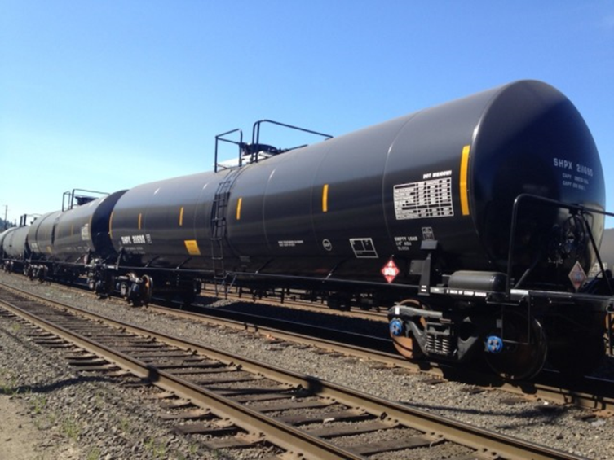
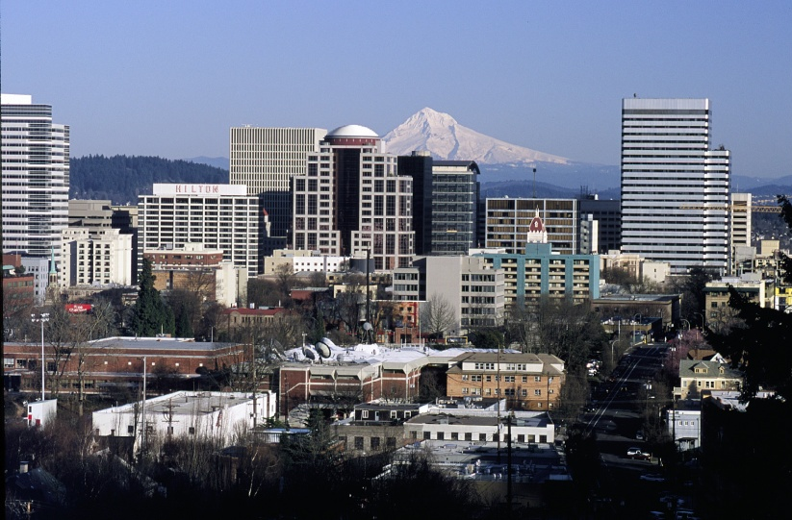
Why change marine loading rule?
Volatile crude oil shipments
EPA proposing stricter ozone standard

Slide 70
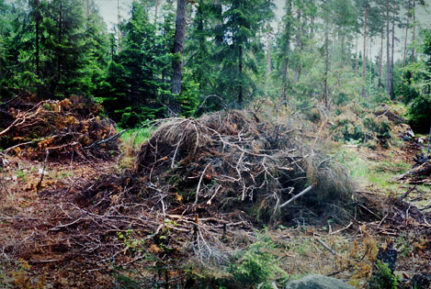
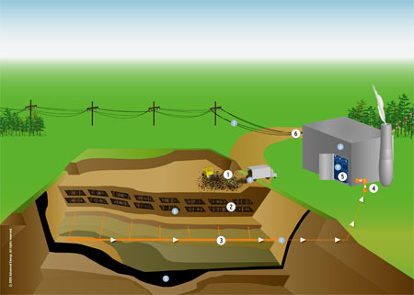
Biogenic CO₂ Deferral
Biogenic CO2 comes from:
Combustion of forest-derived and agriculture-derived feedstocks
Combustion of biogas collected from landfills, wastewater treatment or manure management processes

Slide 71
Biogenic CO₂ Deferral continued
2011 EPA exempted biogenic CO2 from permitting for 3 years
    Assumes 100% carbon neutrality
    Stopgap measure while EPA continues study
    EQC adopted rule to follow EPA rule – automatically exempts if EPA exempts
2014 Supreme Court issued ruling
    Deferral must be vacated, but…
    Not officially vacated yet, may take years

Slide 72
Biogenic CO₂ Deferral continued
  DEQ’s initial proposal was to:
    Eliminate deferral
    Acknowledge existence from 2011-2014
  Final proposal is to:
    Revert to 2011 rule
    Automatically align with court ruling
  Future Oregon rules won’t be more stringent than EPA’s rules

Slide 73

DEQ’s Greenhouse Gas Rules
The temporary rule adopted in November will be replaced with the proposed rules if adopted today.
TEMPORARY

Slide 74
Categorically Insignificant Activities
Background
Suggested changes
Effect of changes in relation to other regulatory programs

Slide 75

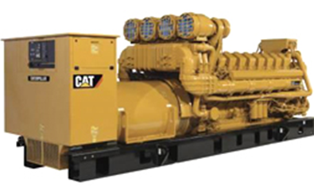
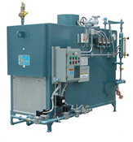
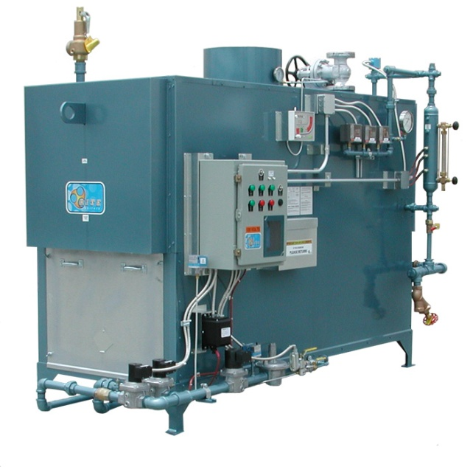
Categorically Insignificant Activities - background
  Multiple - significant
  Individual - insignificant

Slide 76
Categorically Insignificant Activities - background
Some of these activities are subject to new standards issued by EPA
Emissions from these activities were not considered when:
    Determining what permits are necessary
    Establishing Plant Site Emissions Limits

Slide 77
Emergency generators and pumps
  Currently considered insignificant no matter how large or how many at site
  Change categorically insignificant to:
  Aggregate horsepower rating of all EGUs and pump engines less than 3000 horsepower; and
  If aggregate horsepower rating of all EGUs and pump engines is more than 3,000 horsepower, then ALL considered significant.

Slide 78
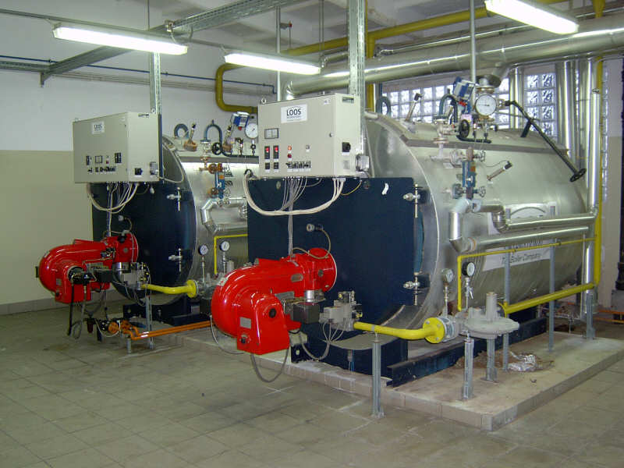
  Small fuel burning equipment
Currently considered categorically insignificant no matter how many at a source
Change categorically insignificant to:
  Retain current size threshold for individual units (0.4 MMBtu/hr oil; 2 MMBtu/hr gas)
Notes:
Units no longer considered insignificant. More stringent or have to get a permit? Not more stringent.

Slide 79
  Small fuel burning equipment continued
Change categorically insignificant to:
  Add emissions in aggregate < de minimis levels of 1 ton/year (2756 tons/yr for GHG)
  If emissions > de minimis levels, then identify subgroup of such equipment as categorically insignificant with the remainder significant and included in PSEL
Notes:
Units no longer considered insignificant. More stringent or have to get a permit? Not more stringent.

Slide 80
  Small fuel burning equipment continued
New Categorically Insignificant Activity:
Fuel burning equipment on site for < six months for maintenance, construction or similar purposes, (i.e., generators, pumps, hot water
pressure washers and space heaters) provided that equipment that performs same function as permanent equipment, must be operated within existing PSEL
Notes:
Units no longer considered insignificant. More stringent or have to get a permit? Not more stringent.

Slide 81
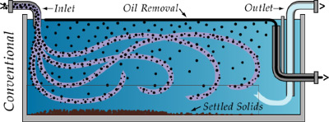
  Oil/Water separators
Change categorically insignificant to:
Uncontrolled oil/water separators in effluent treatment systems excluding systems with throughput > 400,000 gallons/year located at petroleum refineries and re-refining of lubricating oils, greases, asphalt production by distillation and reprocessing of oils and/or solvents for fuels; or bulk gasoline plants, bulk gasoline terminals, and pipeline facilities
Notes:
Units no longer considered insignificant. More stringent or have to get a permit? Not more stringent.

Slide 82
Regulatory Considerations
The following regulatory programs may now apply to emergency generators and small fuel burning equipment:
  Notice of intent to construct may apply to small sources not otherwise required to have permits
  Air Contaminant Discharge Permits may be required for some sources – e.g., data centers with numerous emergency generators
  General Permit for emergency generators
Notes:
Impacts on Business
Will need to provide emissions information for these small sources
A few businesses will need to get permits (data centers) and construction approval required for all
Small future emission increases may trigger other regulatory requirements for larger businesses
Impacts on Environment
Better accounting of emissions

Slide 83
Regulatory Considerations continued
Plant Site Emissions Limits (PSELs) for existing sources may need revision:
  Adding emissions to PSELs for existing CIA sources will not trigger other requirements solely as a result of rule change NOW
  Any future increase in the PSEL > to the de minimis level for any reason is subject to OAR 340-222-0041(4)
  PSELs and baselines will be revised at next permit renewal after rules are adopted
Notes:
Impacts on Business
Will need to provide emissions information for these small sources
A few businesses will need to get permits (data centers) and construction approval required for all
Small future emission increases may trigger other regulatory requirements for larger businesses
Impacts on Environment
Better accounting of emissions

Slide 84
Regulatory Considerations continued
Revise PSELs and baseline emission rates for existing sources to include EGUs, pump engines, small fuel burning equipment, and oil/water separators no longer CIA:
  If no records for CIA during baseline year….add emissions to PSEL and baseline based on current usage
Notes:
Impacts on Business
Will need to provide emissions information for these small sources
A few businesses will need to get permits (data centers) and construction approval required for all
Small future emission increases may trigger other regulatory requirements for larger businesses
Impacts on Environment
Better accounting of emissions

Slide 85

Categorically Insignificant Activities

Slide 86

LUNCH
Next section about NSR and changes,
Break for lunch?
Can leave or come back after lunch

Slide 87


Splitting Businesses
Background/issues
Suggested Rule Changes
Program integrity

Slide 88
Splitting Businesses – Background/Issues
If a business shuts down, splits, and/or repurposes, what happens to allowable emissions?
Potential for new business to avoid construction approval if using emissions from shutdown of one source to operate another source.
Clean Air Act construction approval ensures:
  State of the art control technologies
  No adverse impacts on air quality

Slide 89
Splitting Businesses – Rule Changes
Clarify how emissions are treated when a business splits
Emissions may only be transferred to:
    New business(es) with same primary 2-digit SIC, or
    different primary 2-digit SIC but DEQ determines the activities described by the two different primary 2-digit SIC essentially same
  Amount of emissions transferred cannot exceed the “new” source’s potential to emit

Slide 90
Splitting Businesses – Program Integrity
Limits ability to use emissions for unrelated projects
Clarifies rules to ensure new source, if different than existing source, is subject to construction approval
  Consistent with provisions that apply to physical changes or changes in the method of operation that apply to all sources.

Slide 91

Splitting Businesses

Slide 92
New Source Review
What is NSR?
NSR = Preconstruction permitting program
  Facility must get permit before building new or modifying
  Specifies requirements facility must meet
Required by federal regulations

Slide 93
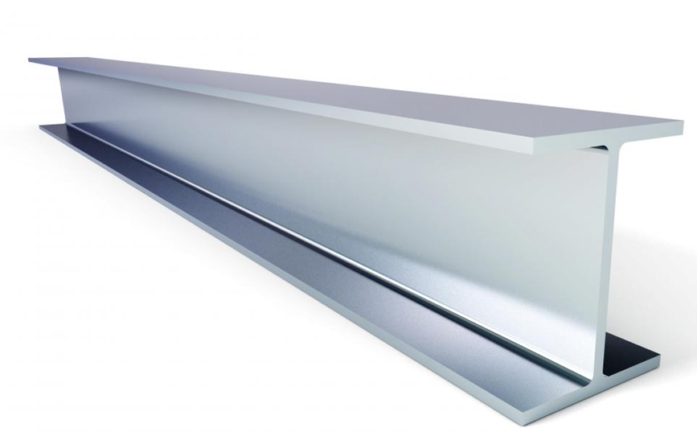

New Source Review continued
Major NSR: at least as stringent as the federal major NSR program = little flexibility
Minor NSR: no minimum requirements = more flexibility
Notes:
Broadly speaking, New Source Review consists of 2 programs, Major NSR and Minor NSR.
Major NSR applies to the larger facilities
May not be less stringent than the federal Major NSR program
Minor NSR applies to small and medium sized facilities.
The federal requirement is that we have a minor NSR program, but otherwise there is a fair amount of flexibility.
Many of the rule changes we’re proposing take advantage of that flexibility.

Slide 94

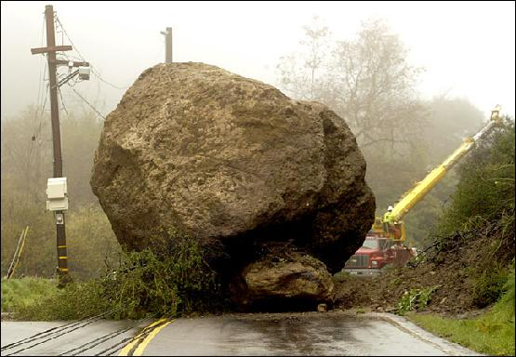

New Source Review continued
Purpose of changes to New Source Review
Reorganize the rules
  Remove roadblocks in current rules
  Address air quality problem sources
Notes:
GEORGE STARTS HERE
When certain air quality problems arise, the current rules also make it nearly impossible to issue a permit to a new or expanding source.
The main reason for revising the NSR rules was to address this permitting problem, but while we were at it we also proposed revisions that are intended help address the underlying air quality problem.
These problems and the proposed solutions will be discussed in the next few slides.
However, this work did result in some new sections in the rules.
To make the rules easier to use we felt that all of the NSR rule sections should have the same structure, and this led to reorganizing the rules.

Slide 95
New Source Review continued
NSR requirements depend on emission rate, and how the area is designated
  Emission level (Major NSR, Minor NSR)
  Area designation
  (e.g. attainment, nonattainment)
  (usually) reflects air quality in a geographic area

Slide 96
New Source Review continued
Major NSR, at least as stringent as the federal major NSR program = little flexibility
Minor NSR, no minimum requirements = more flexibility
    Expand Minor NSR → more flexibility
    Use flexibility to address AQ problem sources
    Other revisions remove roadblocks

Slide 97
New Source Review continued
Proposed rule changes increase permitting flexibility, remove roadblocks
Benefits communities with AQ problems
  Inability to obtain a permit prevents economic growth
  Lack of economic growth hampers citizens’ and communities’ ability to solve the AQ problem

Slide 98
New Source Review continued
  Overview of NSR revisions
  Raise Major NSR threshold
  Revise offset requirements, specify priority sources
  Revise Net Air Quality Benefit demonstration
  Clarify what triggers NSR

Slide 99
New Source Review continued
  Raise Major NSR threshold
  Federal Major NSR threshold 100 tons per year
  Oregon’s threshold is lower, pollutant-specific
  PM2.5 = 10 tons/year; NOx = 40 tons/year
  Raising threshold means fewer sources subject to Major NSR, more sources Minor (State) NSR

Slide 100
New Source Review continued
  Revise offset ratios, specify priority sources
  Offsets are required in all areas except attainment
  New or expanding source must offset its emission increases by obtaining emission decreases from other sources in the same area

Slide 101
New Source Review continued
  Priority sources = sources most responsible for the AQ problem in an area
  Linked to offset requirements
  Encourage sources to obtain offsets from priority sources
    Offsets from priority sources reduce the offset ratio

Slide 102
New Source Review continued
  Proposed offset ratios
  Sustainment: 0.1 to 1, can reduce to 0.05 to 1
  Nonattainment: 1.2 to 1, can reduce to 1.0 to 1
  Reattainment: 1.2 to 1, can reduce to 1.0 to 1
  Maintenance: 1.0 to 1, State NSR can reduce to 0.5 to 1

Slide 103
New Source Review continued
  Revise Net Air Quality Benefit requirements
  NAQB applies in all areas except attainment
  Demonstrate that emissions impacts from new sources don’t adversely affect air quality
  Not required by federal program

Slide 104
New Source Review continued
  Current requirement is minimal impact at all locations in designated area
  Effectively impossible to meet
  New sources cannot obtain permits

Slide 105
New Source Review continued
Emission plume from new source – higher impacts
Emission plume from offset source – lower impacts
wind
Current rule requires minimal impacts everywhere –
Only possible if plumes always overlap

Slide 106
New Source Review continued
  Proposed Net Air Quality Benefit revisions remove permitting roadblock
  Helps ensure that new sources won’t adversely affect air quality

Slide 107
New Source Review continued
  Clarify what triggers NSR
  NSR triggered by
    Specified level of emissions; and
    Major Modification

Slide 108
New Source Review continued
  Major Modification
  Emissions increases associated with new or modified equipment
    Current rules don’t specify how to calculate
    EPA indicated rules must be more specific
  Calculations specified for all scenarios

Slide 109
New Source Review continued
  Summary
  Raise Major NSR threshold
  Revise offset requirements, specify priority sources
  Revise Net Air Quality Benefit
  Clarify what triggers NSR

Slide 110
New Source Review continued
  Sustainment - removes permitting roadblock in areas with borderline air quality
  Reattainment – provides permitting flexibility in areas with improving air quality
Notes:
EPA designates areas that violate air quality standards as “nonattainment” areas and designates all other areas as “attainment” or “unclassified” areas. Oregon law designates former nonattainment areas that EPA reclassified to attainment as “maintenance” areas to ensure those areas avoid future violations. DEQ proposes to establish two new Oregon air quality area designations, “sustainment” and “reattainment,” to help areas avoid and more quickly end a federal nonattainment designation.

Slide 111
New Source Review continued
  Area designations are based on air quality:
  Attainment = air quality good, < standard
  Nonattainment = air quality poor, > standard
  Rules area specific, matched to air quality
  Redesignation requires 3 years of data, working with community, rulemaking, EPA approval
Notes:
EPA designates areas that violate air quality standards as “nonattainment” areas and designates all other areas as “attainment” or “unclassified” areas. Oregon law designates former nonattainment areas that EPA reclassified to attainment as “maintenance” areas to ensure those areas avoid future violations. DEQ proposes to establish two new Oregon air quality area designations, “sustainment” and “reattainment,” to help areas avoid and more quickly end a federal nonattainment designation.

Slide 112
New Source Review continued
  Problem
  During multi-year process, permitting rules:
    Don’t match actual air quality needs
    Become a roadblock
  Obtaining a permit difficult/impossible for medium and large sources
Notes:
EPA designates areas that violate air quality standards as “nonattainment” areas and designates all other areas as “attainment” or “unclassified” areas. Oregon law designates former nonattainment areas that EPA reclassified to attainment as “maintenance” areas to ensure those areas avoid future violations. DEQ proposes to establish two new Oregon air quality area designations, “sustainment” and “reattainment,” to help areas avoid and more quickly end a federal nonattainment designation.

Slide 113
New Source Review continued
  Proposed solution
  Create 2 new areas with rules that (partially) solve the problem
  State designations, federal approval not needed
  Overlay federal area designations
  Primarily affect medium-size sources
Notes:
EPA designates areas that violate air quality standards as “nonattainment” areas and designates all other areas as “attainment” or “unclassified” areas. Oregon law designates former nonattainment areas that EPA reclassified to attainment as “maintenance” areas to ensure those areas avoid future violations. DEQ proposes to establish two new Oregon air quality area designations, “sustainment” and “reattainment,” to help areas avoid and more quickly end a federal nonattainment designation.

Slide 114
New Source Review continued
Attainment Area
AQ good
(below ambient standard)
Nonattainment Area
AQ poor
(over ambient standard)
Maintenance Area
AQ was poor,
Now good,
Prevent slipping back
Rules in each area based on air quality needs
When air quality changes, takes years to redesignate area
Meanwhile rules don’t match air quality needs

Slide 115
New Source Review continued
Attainment Area
Nonattainment Area
Sustainment
overlays attainment
Bridges the time
gap
Sustainment Area
  Sustainment area Minor NSR rules:
    Are similar to nonattainment area rules
    Remove permitting roadblock for medium sized facilities

Slide 116
New Source Review continued
Reattainment
overlays
nonattainment
Bridges the time
gap
Nonattainment Area
Maintenance Area
Reattainment Area
  Reattainment area Minor NSR rules:
    Are closer to maintenance area rules
    Allow less stringent permitting for medium size facilities

Slide 117
Designate Lakeview as a sustainment area
  Town of Lakeview and Lake County Commissioners requested sustainment designation

Slide 118
UARG v EPA (GHG PSD)
In June, Supreme Court invalidated portions of EPA’s so-called Tailoring Rule.
Sources cannot trigger PSD for greenhouse gases alone, but
  Sources subject to PSD for other pollutants could be required to perform a BACT analysis for greenhouse gases.
Sources could not be subject to Title V for greenhouse gases alone.

Slide 119
UARG v EPA (GHG PSD)
EQC adopted rules in 2011 that implemented the Tailoring Rule in Oregon.
The court’s action does not invalidate any part of Oregon’s rules; those rules remain in effect.
DEQ is proposing revisions to air quality permitting rules at this time; the rules are on public notice until August 14 .

Slide 120
Greenhouse Gases
  Background
  U.S. Supreme Court struck down parts of federal rules pertaining to greenhouse gas permitting
Struck down
Sources subject to Title V permits for GHGs alone
Struck down
Sources subject to Prevention of Significant Deterioration program for GHGs alone
Affirmed
Sources subject to Prevention of Significant Deterioration for GHGs if subject to PSD for another pollutant (so-called “anyway sources”)
Notes:
The part of the rulemaking that we got the most comments on was how to regulate greenhouse gases. 29 people/organizations were either for aligning with the Supreme Court Decision or staying with the Oregon rules.
As I mentioned earlier, the Supreme Court decision on permitting GHG came out on June 23, 2014. It struck down two requirements of the federal rules pertaining to greenhouse gas permitting and affirmed one requirement.

Slide 121

DEQ’s Greenhouse Gas Rules
Oregon rules not automatically struck down by Court’s decision
Oregon rules were similar to federal rules
EQC adopted temporary rule in November to align Oregon rules to Court’s decision
TEMPORARY
Notes:
Even though the 2014 Supreme Court decision invalidated EPA’s authority to impose the federal greenhouse gas permitting requirements, it did not affect Oregon’s rules, even though our rules were similar to EPA’s rules. The discrepancy between federal and state requirements created uncertainty for DEQ, the regulated community and the public.
So in November of 2014, the EQC adopted temporary rules to align DEQ rules with the Supreme Court decision.

Slide 122
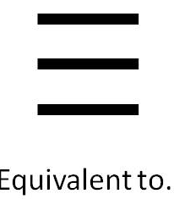


  Reasons to align with Supreme Court decision
Title V and ACDP equally stringent
Most GHG emissions from “anyway” sources
National equity for Oregon businesses
Notes:
After analyzing the effects the Supreme Court decision would have on GHG permitting in Oregon, DEQ is recommending that EQC adopt rules that permanently align Oregon rules for permitting greenhouse gas emissions with the Supreme Court decision for the following reasons:
READ SLIDE

Slide 123

Greenhouse Gases

Slide 124
New Source Review (NSR)
Pre-construction permitting program mandated by Clean Air Act
  Maintain and protect air quality
  Requires pollution control devices where appropriate
Three distinct programs
  Prevention of Significant Deterioration
  (PSD) in attainment areas
  Nonattainment NSR
  Minor NSR
}
Major NSR

Slide 125
Things unique to DEQ’s program
Major source definition in nonattainment and maintenance areas
  Lower threshold than EPA definition
Offsets and Net Air Quality Benefit
  NAQB requires air dispersion modeling
  EPA program only requires offsets
  …

Slide 126
Things unique to DEQ’s program continued
DEQ program requires air quality impact analysis for minor sources
Maintenance areas
  Former nonattainment areas
  DEQ program has more stringent requirements than federal program

Slide 127
Why make changes?
Areas of the state are close to or are exceeding the PM_{2.5} National Ambient AQ Standards
  New PM_{2.5} standards adopted in 2007 – much lower than PM₁₀ standards
AQ problems mainly due to area sources, not industrial sources
Current rule structure
  does not adequately address PM_{2.5} ambient air quality problems
  prohibits development

Slide 128
How will the changes improve the program?
New or modified sources can help address ambient air quality problems
Allows for development while improving or maintaining air quality

Slide 129
What are the changes?
Align definition of major source with EPA’s definition
  Different requirements for small and large sources
Create 2 new area designations
  Help prevent nonattainment
  Eliminate permitting roadblock
  Get to maintenance faster
Primarily affect Minor New Source Review

Slide 130
What are the changes?
Need to talk about Type A and B State NSR
Move modeling from division 222 to 224

Slide 131
Major / Minor NSR – currently
With construction or change in method of operation
(Major Modification)
Emission Rate> Area designation, major mod | SER or more | Less than SER
Nonattainment | Major | n/a
Maintenance | Major | n/a
Emission Rate> Area designation, major mod? | 100*/250 tpy or more | SER to 99*/249 | Less than SER
Attainment | Major | Minor | n/a
  * Applies to 28 source categories listed in rule (e.g. pulp and paper mills, iron and steel mills, chemical process plants)

Slide 132
Major / Minor NSR
With construction or change in method of operation
(Major Modification)
Emission Rate> Area designation, major mod | 100 tpy or more | SER to 99 | Less than SER
Nonattainment | Major | Minor | n/a
Maintenance | Major | Minor | n/a
Emission Rate> Area designation, major mod? | 100*/250 tpy or more | SER to 99*/249 | Less than SER
Attainment | Major | Minor | n/a
Overall stringency remains the same

Slide 133
Significant Emission Rate (SER)
Pollutant | SER, tons per year
PM2.5 | 10
PM10 | 15
NOx, VOC, SO2 | 40
CO | 100
GHG | 75,000

Slide 134
Two New Area Designations
Sustainment area
  Rules designed to help keep area from becoming nonattainment
Reattainment area
  Rules designed to be more flexible for smaller sources to allow development, but still protect air quality

Slide 135
Current Area Designations
Attainment
(AQ below NAAQS)
Nonattainment
(AQ at/over NAAQS)
Maintenance
(attainment)

Slide 136
Areas in transition
Attainment
(AQ at/over NAAQS)
Attainment
(AQ below NAAQS)
Nonattainment
(AQ at/over NAAQS)
Nonattainment
(AQ below NAAQS)
Maintenance
(attainment)

Slide 137
New Area Designations
Attainment
(AQ at/over NAAQS)
Attainment
(AQ below NAAQS)
Sustainment
Nonattainment
(AQ at/over NAAQS)
Nonattainment
(AQ below NAAQS)
Maintenance
(attainment)
Reattainment

Slide 138
Changes to Improve Air Quality
“Priority sources” are primarily responsible for poor air quality (e.g. woodstoves in some communities)
Provide incentives for reducing priority source emissions
  More credit for emission reductions from priority sources
EQC can specify Priority Sources

Slide 139
Offset Changes
Major NSR, some ratios higher than current (1.2:1)
Minor NSR, ratios lower than major NSR
Ratios area-specific
Ratios reducible for priority source offsets
  e.g. 1.2:1 → 1:1
No changes to ozone offset requirements

Slide 140
Net Air Quality Benefit Changes
Current NAQB criteria nearly impossible
Revise NAQB criteria
  Protect air quality:
    Focus on areas with worst air quality, and
    Prevent further degradation
  Reduce emphasis on industrial emission offsets where area sources are the main contributors
  Eliminate problem with current criteria

Slide 141
Last: Rule Organization
Minor New Source Review rules applicable to SER and over called State NSR program
  Move division 222 modeling to state NSR
  No change to requirements applicable to minor sources less than SER
{
Major NSR
State NSR
Offset requirements
Net Air Quality Benefit
Division 224

Slide 142
Summary of Changes
Raise Major source threshold to 100 tpy in nonattainment and maintenance areas
Create two new area designations: sustainment and reattainment
Indentify Priority Sources
Revise offset requirements
Revise Net Air Quality Benefit requirements
Major and State NSR in Division 224

Slide 143
5.8 Establish two new state air quality area designations, “sustainment” and “reattainment”
  Summary
  2 new areas: Sustainment and Reattainment
  State designations, not federal
  Overlay federal designations, bridge over time needed to redesignate
  For medium facilities: sustainment designation removes permitting roadblock
Notes:
EPA designates areas that violate air quality standards as “nonattainment” areas and designates all other areas as “attainment” or “unclassified” areas. Oregon law designates former nonattainment areas that EPA reclassified to attainment as “maintenance” areas to ensure those areas avoid future violations. DEQ proposes to establish two new Oregon air quality area designations, “sustainment” and “reattainment,” to help areas avoid and more quickly end a federal nonattainment designation.

Slide 144

New Source Review (NSR)

Slide 145
Extensions for NSR/PSD permits
Background
Rule Changes
Public Notice

Slide 146
Extensions for NSR/PSD permits - Background
Current rules allow extensions provided there is a “demonstrated need”
  No limit on the number of extensions
  No criteria for approving extensions
If projects are delayed without further review, there is the potential for proposed projects to:
  tie up increment indefinitely
  cause significant impacts on air quality
  not have current control technology

Slide 147
Extensions for NSR/PSD permits –
Rule Changes
Add provisions for two 18-month extensions – no additional extensions
Add criteria for approving extensions
Add procedures for requesting extensions
Add procedures for approving extensions

Slide 148
Extensions for NSR/PSD permits –
Rule Changes
For the first 18-month extension:
  Review control technology analysis for the original pollutants subject to NSR/PSD
  Review limited to whether new control technologies have become commercially available since the original control technology analysis

Slide 149
Extensions for NSR/PSD permits –
Rule Changes
For the second extension:
  Review whether any new control technologies have become commercially available
  Review original control technology analysis for potentially lower limits
  Review the air quality analysis for:
    any new competing sources or changes in ambient air quality, including any redesignation of the area impacted
      any new ambient standards or increments
      any changes to EPA approved models that would affect results

Slide 150
Extensions for NSR/PSD permits –
Rule Changes
No third extensions:
    Original NSR/PSD permit automatically terminated five years after it was issued
    For approval beyond second extension, a new major NSR/PSD permit application must be submitted.
    May continue to use original emission reduction credits
      Same two digit SIC code
      Emission reduction credits contemporaneous and satisfy requirements

Slide 151
Extensions for NSR/PSD permits – Process to request extension
Business submits application for extension 30 days prior to end of current 18-month construction approval
DEQ will review extension request
DEQ will issue 18-month extension after public notice

Slide 152
Extensions for NSR/PSD permits –
Public Notice
Public participation procedures for extensions:
  If no air quality analysis:
    30 days to submit written comments; or
  If air quality analysis:
    35 days to submit written comments; and
    public hearing if requested.

Slide 153

Extensions for NSR/PSD permits

Slide 154
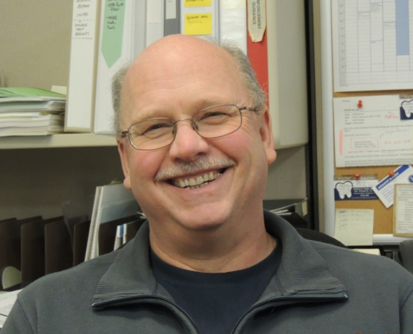
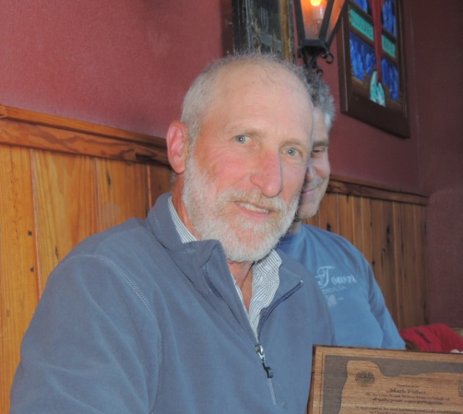
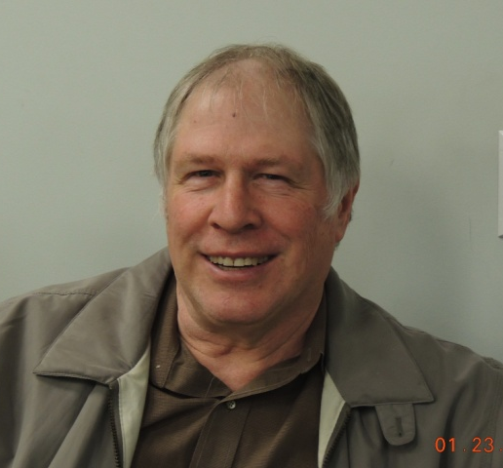

Rulemaking Team
George Davis
Mark Fisher
Gary Andes
Karen White-Fallon

Slide 155
SharePoint!

Slide 156
Air Quality
Rule Changes and Updates
For further questions:
  Jill Inahara
  inahara.jill@deq.state.or.us
  503-229-5001
  George Davis
  davis.george@deq.state.or.us
  503-229-5534

