Slide 1
Air quality permitting, Heat Smart and gasoline dispensing facility updates
(aka the Kitchen Sink)
Inspectors’ Forum
May 2015

Slide 2
New Source Review
What is NSR?
NSR = Preconstruction permitting program
Facility must get permit before building new or modifying
Specifies requirements facility must meet
Required by federal regulations

Slide 3
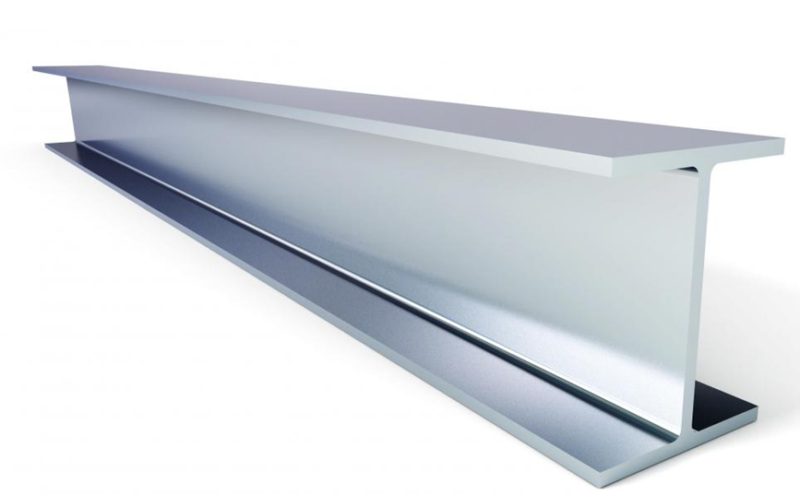

New Source Review continued
Major NSR: at least as stringent as the federal major NSR program = little flexibility
Minor NSR: no minimum requirements = more flexibility
Notes:
Broadly speaking, New Source Review consists of 2 programs, Major NSR and Minor NSR.
Major NSR applies to the larger facilities
May not be less stringent than the federal Major NSR program
Minor NSR applies to small and medium sized facilities.
The federal requirement is that we have a minor NSR program, but otherwise there is a fair amount of flexibility.
Many of the rule changes we’re proposing take advantage of that flexibility.

Slide 4

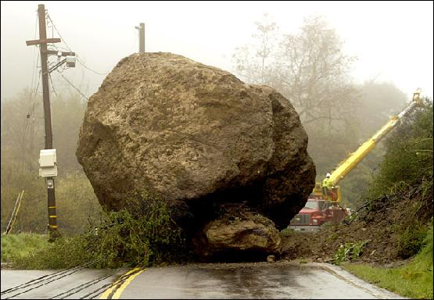

New Source Review continued
Purpose of changes to New Source Review
Reorganize the rules
Remove roadblocks in current rules
Address air quality problem sources
Notes:
GEORGE STARTS HERE
When certain air quality problems arise, the current rules also make it nearly impossible to issue a permit to a new or expanding source.
The main reason for revising the NSR rules was to address this permitting problem, but while we were at it we also proposed revisions that are intended help address the underlying air quality problem.
These problems and the proposed solutions will be discussed in the next few slides.
However, this work did result in some new sections in the rules.
To make the rules easier to use we felt that all of the NSR rule sections should have the same structure, and this led to reorganizing the rules.

Slide 5
New Source Review continued
NSR requirements depend on emission rate, and how the area is designated
Emission level (Major NSR, Minor NSR)
Area designation (e.g. attainment, nonattainment)
(usually) reflects air quality in a geographic area

Slide 6
New Source Review continued
Major NSR, at least as stringent as the federal major NSR program = little flexibility
Minor NSR, no minimum requirements = more flexibility
Expand Minor NSR → more flexibility
Use flexibility to address AQ problem sources
Other revisions remove roadblocks

Slide 7
New Source Review continued
Proposed rule changes increase permitting flexibility, remove roadblocks
Benefits communities with AQ problems
Inability to obtain a permit prevents economic growth
Lack of economic growth hampers citizens’ and communities’ ability to solve the AQ problem

Slide 8
New Source Review continued
Overview of NSR revisions
Raise Major NSR threshold
Revise offset requirements, specify priority sources
Revise Net Air Quality Benefit demonstration
Clarify what triggers NSR

Slide 9
New Source Review continued
Raise Major NSR threshold
Federal Major NSR threshold 100 tons per year
Oregon’s threshold is lower, pollutant-specific PM2.5 = 10 tons/year; NOx = 40 tons/year
Raising threshold means fewer sources subject to Major NSR, more sources Minor (State) NSR

Slide 10
New Source Review continued
Revise offset ratios, specify priority sources
Offsets are required in all areas except attainment
New or expanding source must offset its emission increases by obtaining emission decreases from other sources in the same area

Slide 11
New Source Review continued
Priority sources = sources most responsible for the AQ problem in an area
Linked to offset requirements
Encourage sources to obtain offsets from priority sources
Offsets from priority sources reduce the offset ratio

Slide 12
New Source Review continued
Proposed offset ratios
Sustainment: 0.1 to 1, can reduce to 0.05 to 1
Nonattainment: 1.2 to 1, can reduce to 1.0 to 1
Reattainment: 1.2 to 1, can reduce to 1.0 to 1
Maintenance: 1.0 to 1, State NSR can reduce to 0.5 to 1

Slide 13
New Source Review continued
Revise Net Air Quality Benefit requirements
NAQB applies in all areas except attainment
Demonstrate that emissions impacts from new sources don’t adversely affect air quality
Not required by federal program

Slide 14
New Source Review continued
Current requirement is minimal impact at all locations in designated area
Effectively impossible to meet
New sources cannot obtain permits

Slide 15
New Source Review continued
Emission plume from new source – higher impacts
Emission plume from offset source – lower impacts
wind
Current rule requires minimal impacts everywhere –
Only possible if plumes always overlap

Slide 16
New Source Review continued
Proposed Net Air Quality Benefit revisions remove permitting roadblock
Helps ensure that new sources won’t adversely affect air quality

Slide 17
New Source Review continued
Clarify what triggers NSR
NSR triggered by
Specified level of emissions; and
Major Modification

Slide 18
New Source Review continued
Major Modification
Emissions increases associated with new or modified equipment
Current rules don’t specify how to calculate
EPA indicated rules must be more specific
Calculations specified for all scenarios

Slide 19
New Source Review continued
Summary
Raise Major NSR threshold
Revise offset requirements, specify priority sources
Revise Net Air Quality Benefit
Clarify what triggers NSR

Slide 20
New Source Review continued
Sustainment - removes permitting roadblock in areas with borderline air quality
Reattainment – provides permitting flexibility in areas with improving air quality
Notes:
EPA designates areas that violate air quality standards as “nonattainment” areas and designates all other areas as “attainment” or “unclassified” areas. Oregon law designates former nonattainment areas that EPA reclassified to attainment as “maintenance” areas to ensure those areas avoid future violations. DEQ proposes to establish two new Oregon air quality area designations, “sustainment” and “reattainment,” to help areas avoid and more quickly end a federal nonattainment designation.

Slide 21
New Source Review continued
Area designations are based on air quality: Attainment = air quality good, < standard Nonattainment = air quality poor, > standard
Rules area specific, matched to air quality
Redesignation requires 3 years of data, working with community, rulemaking, EPA approval
Notes:
EPA designates areas that violate air quality standards as “nonattainment” areas and designates all other areas as “attainment” or “unclassified” areas. Oregon law designates former nonattainment areas that EPA reclassified to attainment as “maintenance” areas to ensure those areas avoid future violations. DEQ proposes to establish two new Oregon air quality area designations, “sustainment” and “reattainment,” to help areas avoid and more quickly end a federal nonattainment designation.

Slide 22
New Source Review continued
Problem
During multi-year process, permitting rules:
Don’t match actual air quality needs
Become a roadblock
Obtaining a permit difficult/impossible for medium and large sources
Notes:
EPA designates areas that violate air quality standards as “nonattainment” areas and designates all other areas as “attainment” or “unclassified” areas. Oregon law designates former nonattainment areas that EPA reclassified to attainment as “maintenance” areas to ensure those areas avoid future violations. DEQ proposes to establish two new Oregon air quality area designations, “sustainment” and “reattainment,” to help areas avoid and more quickly end a federal nonattainment designation.

Slide 23
New Source Review continued
Proposed solution
Create 2 new areas with rules that (partially) solve the problem
State designations, federal approval not needed
Overlay federal area designations
Primarily affect medium-size sources
Notes:
EPA designates areas that violate air quality standards as “nonattainment” areas and designates all other areas as “attainment” or “unclassified” areas. Oregon law designates former nonattainment areas that EPA reclassified to attainment as “maintenance” areas to ensure those areas avoid future violations. DEQ proposes to establish two new Oregon air quality area designations, “sustainment” and “reattainment,” to help areas avoid and more quickly end a federal nonattainment designation.

Slide 24
New Source Review continued
Attainment Area
AQ good
(below ambient standard)
Nonattainment Area
AQ poor
(over ambient standard)
Maintenance Area
AQ was poor,
Now good,
Prevent slipping back
Rules in each area based on air quality needs
When air quality changes, takes years to redesignate area
Meanwhile rules don’t match air quality needs

Slide 25
New Source Review continued
Attainment Area
Nonattainment Area
Sustainment overlays attainment
Bridges the time gap
Sustainment Area
Sustainment area Minor NSR rules:
Are similar to nonattainment area rules
Remove permitting roadblock for medium sized facilities

Slide 26
New Source Review continued
Reattainment overlays nonattainment
Bridges the time gap
Nonattainment Area
Maintenance Area
Reattainment Area
Reattainment area Minor NSR rules:
Are closer to maintenance area rules
Allow less stringent permitting for medium size facilities

Slide 27
Designate Lakeview as a sustainment area
Town of Lakeview and Lake County Commissioners requested sustainment designation

Slide 28
UARG v EPA (GHG PSD)
In June, Supreme Court invalidated portions of EPA’s so-called Tailoring Rule.
Sources cannot trigger PSD for greenhouse gases alone, but
Sources subject to PSD for other pollutants could be required to perform a BACT analysis for greenhouse gases.
Sources could not be subject to Title V for greenhouse gases alone.

Slide 29
UARG v EPA (GHG PSD)
EQC adopted rules in 2011 that implemented the Tailoring Rule in Oregon.
The court’s action does not invalidate any part of Oregon’s rules; those rules remain in effect.
DEQ is proposing revisions to air quality permitting rules at this time; the rules are on public notice until August 14 .

Slide 30
Greenhouse Gases
Background
U.S. Supreme Court struck down parts of federal rules pertaining to greenhouse gas permitting
Struck down
Sources subject to Title V permits for GHGs alone
Struck down
Sources subject to Prevention of Significant Deterioration program for GHGs alone
Affirmed
Sources subject to Prevention of Significant Deterioration for GHGs if subject to PSD for another pollutant (so-called “anyway sources”)
Notes:
The part of the rulemaking that we got the most comments on was how to regulate greenhouse gases. 29 people/organizations were either for aligning with the Supreme Court Decision or staying with the Oregon rules.
As I mentioned earlier, the Supreme Court decision on permitting GHG came out on June 23, 2014. It struck down two requirements of the federal rules pertaining to greenhouse gas permitting and affirmed one requirement.

Slide 31


DEQ’s Greenhouse Gas Rules
Oregon rules not automatically struck down by Court’s decision
Oregon rules were similar to federal rules
EQC adopted temporary rule in November to align Oregon rules to Court’s decision
TEMPORARY
Notes:
Even though the 2014 Supreme Court decision invalidated EPA’s authority to impose the federal greenhouse gas permitting requirements, it did not affect Oregon’s rules, even though our rules were similar to EPA’s rules. The discrepancy between federal and state requirements created uncertainty for DEQ, the regulated community and the public.
So in November of 2014, the EQC adopted temporary rules to align DEQ rules with the Supreme Court decision.

Slide 32



Reasons to align with Supreme Court decision
Title V and ACDP equally stringent
Most GHG emissions from “anyway” sources
National equity for Oregon businesses
Notes:
After analyzing the effects the Supreme Court decision would have on GHG permitting in Oregon, DEQ is recommending that EQC adopt rules that permanently align Oregon rules for permitting greenhouse gas emissions with the Supreme Court decision for the following reasons:
READ SLIDE

Slide 33

Greenhouse Gases

Slide 34
New Source Review (NSR)
Pre-construction permitting program mandated by Clean Air Act
Maintain and protect air quality
Requires pollution control devices where appropriate
Three distinct programs
Prevention of Significant Deterioration (PSD) in attainment areas
Nonattainment NSR
Minor NSR
}
Major NSR

Slide 35
Things unique to DEQ’s program
Major source definition in nonattainment and maintenance areas
Lower threshold than EPA definition
Offsets and Net Air Quality Benefit
NAQB requires air dispersion modeling
EPA program only requires offsets
…

Slide 36
Things unique to DEQ’s program continued
DEQ program requires air quality impact analysis for minor sources
Maintenance areas
Former nonattainment areas
DEQ program has more stringent requirements than federal program

Slide 37
Why make changes?
Areas of the state are close to or are exceeding the PM_{2.5} National Ambient AQ Standards
New PM_{2.5} standards adopted in 2007 – much lower than PM₁₀ standards
AQ problems mainly due to area sources, not industrial sources
Current rule structure
does not adequately address PM_{2.5} ambient air quality problems
prohibits development

Slide 38
How will the changes improve the program?
New or modified sources can help address ambient air quality problems
Allows for development while improving or maintaining air quality

Slide 39
What are the changes?
Align definition of major source with EPA’s definition
Different requirements for small and large sources
Create 2 new area designations
Help prevent nonattainment
Eliminate permitting roadblock
Get to maintenance faster
Primarily affect Minor New Source Review

Slide 40
What are the changes?
Need to talk about Type A and B State NSR
Move modeling from division 222 to 224

Slide 41
Major / Minor NSR – currently With construction or change in method of operation (Major Modification)
Emission Rate> Area designation, major mod | SER or more | Less than SER
Nonattainment | Major | n/a
Maintenance | Major | n/a
Emission Rate> Area designation, major mod? | 100*/250 tpy or more | SER to 99*/249 | Less than SER
Attainment | Major | Minor | n/a
* Applies to 28 source categories listed in rule (e.g. pulp and paper mills, iron and steel mills, chemical process plants)

Slide 42
Major / Minor NSR With construction or change in method of operation (Major Modification)
Emission Rate> Area designation, major mod | 100 tpy or more | SER to 99 | Less than SER
Nonattainment | Major | Minor | n/a
Maintenance | Major | Minor | n/a
Emission Rate> Area designation, major mod? | 100*/250 tpy or more | SER to 99*/249 | Less than SER
Attainment | Major | Minor | n/a
Overall stringency remains the same

Slide 43
Significant Emission Rate (SER)
Pollutant | SER, tons per year
PM2.5 | 10
PM10 | 15
NOx, VOC, SO2 | 40
CO | 100
GHG | 75,000

Slide 44
Two New Area Designations
Sustainment area
Rules designed to help keep area from becoming nonattainment
Reattainment area
Rules designed to be more flexible for smaller sources to allow development, but still protect air quality

Slide 45
Current Area Designations
Attainment
(AQ below NAAQS)
Nonattainment
(AQ at/over NAAQS)
Maintenance
(attainment)

Slide 46
Areas in transition
Attainment
(AQ at/over NAAQS)
Attainment
(AQ below NAAQS)
Nonattainment
(AQ at/over NAAQS)
Nonattainment
(AQ below NAAQS)
Maintenance
(attainment)

Slide 47
New Area Designations
Attainment
(AQ at/over NAAQS)
Attainment
(AQ below NAAQS)
Sustainment
Nonattainment
(AQ at/over NAAQS)
Nonattainment
(AQ below NAAQS)
Maintenance
(attainment)
Reattainment

Slide 48
Changes to Improve Air Quality
“Priority sources” are primarily responsible for poor air quality (e.g. woodstoves in some communities)
Provide incentives for reducing priority source emissions
More credit for emission reductions from priority sources
EQC can specify Priority Sources

Slide 49
Offset Changes
Major NSR, some ratios higher than current (1.2:1)
Minor NSR, ratios lower than major NSR
Ratios area-specific
Ratios reducible for priority source offsets
e.g. 1.2:1 → 1:1
No changes to ozone offset requirements

Slide 50
Net Air Quality Benefit Changes
Current NAQB criteria nearly impossible
Revise NAQB criteria
Protect air quality:
Focus on areas with worst air quality, and
Prevent further degradation
Reduce emphasis on industrial emission offsets where area sources are the main contributors
Eliminate problem with current criteria

Slide 51
Last: Rule Organization
Minor New Source Review rules applicable to SER and over called State NSR program
Move division 222 modeling to state NSR
No change to requirements applicable to minor sources less than SER
{
Major NSR
State NSR
Offset requirements
Net Air Quality Benefit
Division 224

Slide 52
Summary of Changes
Raise Major source threshold to 100 tpy in nonattainment and maintenance areas
Create two new area designations: sustainment and reattainment
Indentify Priority Sources
Revise offset requirements
Revise Net Air Quality Benefit requirements
Major and State NSR in Division 224

Slide 53
5.8 Establish two new state air quality area designations, “sustainment” and “reattainment”
Summary
2 new areas: Sustainment and Reattainment
State designations, not federal
Overlay federal designations, bridge over time needed to redesignate
For medium facilities: sustainment designation removes permitting roadblock
Notes:
EPA designates areas that violate air quality standards as “nonattainment” areas and designates all other areas as “attainment” or “unclassified” areas. Oregon law designates former nonattainment areas that EPA reclassified to attainment as “maintenance” areas to ensure those areas avoid future violations. DEQ proposes to establish two new Oregon air quality area designations, “sustainment” and “reattainment,” to help areas avoid and more quickly end a federal nonattainment designation.

Slide 54

New Source Review (NSR)

Slide 55
Extensions for NSR/PSD permits
Background
Rule Changes
Public Notice

Slide 56
Extensions for NSR/PSD permits - Background
Current rules allow extensions provided there is a “demonstrated need”
No limit on the number of extensions
No criteria for approving extensions
If projects are delayed without further review, there is the potential for proposed projects to:
tie up increment indefinitely
cause significant impacts on air quality
not have current control technology

Slide 57
Extensions for NSR/PSD permits – Rule Changes
Add provisions for two 18-month extensions – no additional extensions
Add criteria for approving extensions
Add procedures for requesting extensions
Add procedures for approving extensions

Slide 58
Extensions for NSR/PSD permits – Rule Changes
For the first 18-month extension:
Review control technology analysis for the original pollutants subject to NSR/PSD
Review limited to whether new control technologies have become commercially available since the original control technology analysis

Slide 59
Extensions for NSR/PSD permits – Rule Changes
For the second extension:
Review whether any new control technologies have become commercially available
Review original control technology analysis for potentially lower limits
Review the air quality analysis for:
any new competing sources or changes in ambient air quality, including any redesignation of the area impacted
any new ambient standards or increments
any changes to EPA approved models that would affect results

Slide 60
Extensions for NSR/PSD permits – Rule Changes
No third extensions:
Original NSR/PSD permit automatically terminated five years after it was issued
For approval beyond second extension, a new major NSR/PSD permit application must be submitted.
May continue to use original emission reduction credits
Same two digit SIC code
Emission reduction credits contemporaneous and satisfy requirements

Slide 61
Extensions for NSR/PSD permits – Process to request extension
Business submits application for extension 30 days prior to end of current 18-month construction approval
DEQ will review extension request
DEQ will issue 18-month extension after public notice

Slide 62
Extensions for NSR/PSD permits – Public Notice
Public participation procedures for extensions:
If no air quality analysis:
30 days to submit written comments; or
If air quality analysis:
35 days to submit written comments; and
public hearing if requested.

Slide 63

Extensions for NSR/PSD permits

Slide 64




Rulemaking Team
George Davis
Mark Fisher
Gary Andes
Karen White-Fallon

Slide 65
SharePoint!

Slide 66
Air Quality
Rule Changes and Updates
For further questions:
Jill Inahara
inahara.jill@deq.state.or.us
503-229-5001
George Davis
davis.george@deq.state.or.us
503-229-5534

