Slide 1

Operations
Air quality permitting, Heat Smart and gasoline dispensing facility updates
EQC Proposed Rule Adoption
April 2015
George Davis and Jill Inahara | Oregon Department of Environmental Quality
Notes:
We are here today to ask you to adopt the air quality permitting, Heat Smart and gasoline dispensing facility updates rulemaking.
The goals of this rulemaking are to make sure our rules are clear, up to date and that they address air quality problems.
When addressing AQ problems, we want to make sure we are targeting our resources at the right place. We want to provide incentives to reduce emissions where needed and provide companies flexibility as long as it will improve air quality.

Slide 2
Outline of Today’s Presentation
Summary of Rulemaking
Public Notice Process
Controversial/Numerous Comments
Summary
Questions
Notes:
I want to give you an outline of today’s presentation:
High level summary of rulemaking since we presented an informational item at the January EQC meeting
Explain public notice process
Talk in detail about the proposed rulemaking topics that were the most controversial and where we got the highest number of comments
Summarize the presentation
Time for questions

Slide 3

Reasons for Rulemaking
Started out as rule reorganization
Received input about:
  Unclear rules from permit writers/inspectors
  Permitting problems in areas of marginal air quality
Notes:
These next two slides explain the reasons for this rulemaking:
Originally the rulemaking started out to reorganize our rules and make them easier for people to use. We had procedures in definitions and tables that were difficult to find.
After talking with people, we realized that there were many areas in our rules that could be improved so the project grew.
READ SLIDE

Slide 4
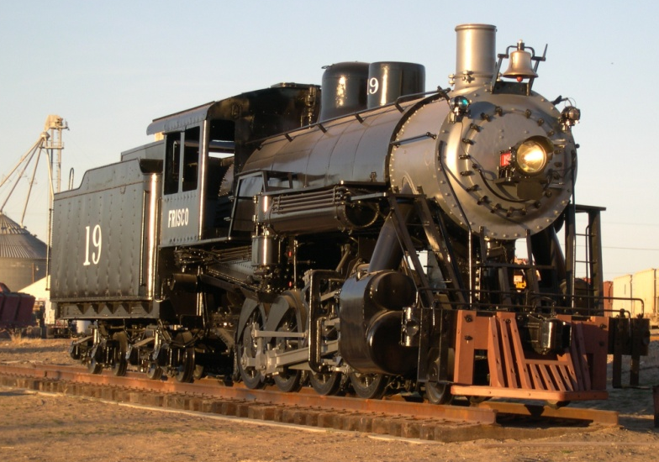

Reasons for Rulemaking continued
Addressing air quality problems changed reorganization to major overhaul of New Source Review rules
Before
After
Notes:
When we started to address the permitting problems in areas of marginal air quality, the reorganization of rules turned into a major overhaul of our New Source Review rules.

Slide 5
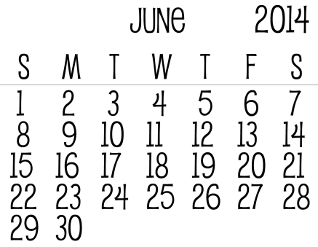


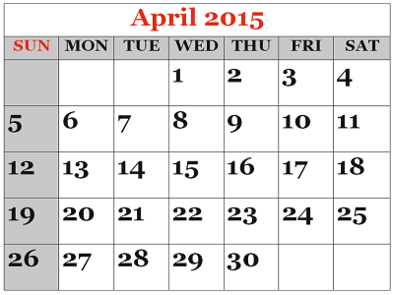
Presentations to EQC
Director’s Report
Temporary Rule Adoption
Informational Item
Proposed Rule Adoption
Notes:
This slide shows the different times we have talked to you about this rulemaking.
The first time was in a directors report in June 2014.
We brought a temporary rule to you in November of last year that covered the GHG portion of this rulemaking.
Info Item in January
Proposed rule adoption today

Slide 6
9 Categories of Rulemaking
Clarify and update air quality rules
Update particulate matter emission standards
Change permitting requirements for emergency generators and small natural gas or oil-fired equipment
Notes:
Now I would like to present a high level overview of this rulemaking.
As you will recall from the informational item we presented at the January EQC meeting and from the staff report, we organized this rulemaking into nine categories.
We are PROPOSING the following
READ THROUGH 1 THROUGH 3

Slide 7
9 Categories of Rulemaking continued
Revise parts of the New Source Review preconstruction permitting program
Establish two new state air quality area designations, “sustainment” and “reattainment”
Designate Lakeview as a state sustainment area
Notes:
READ THROUGH 4 THROUGH 6

Slide 8
9 Categories of Rulemaking continued
7. Modernize methods allowed for holding public hearings and meetings
8. Re-establish the Heat Smart woodstove replacement program exemption for small commercial solid fuel boilers regulated under the permitting program
9. Remove annual reporting requirements for small gasoline dispensing facilities
Notes:
The comments we received on these last three categories did not result in major changes to the rules so the rest of this presentation will focus on areas where there are more substantive proposed rule changes. Categories 7-9 contain very minor changes but didn’t fit in with the other categories.
DEQ proposes revisions to residential wood heating rules to remedy the inadvertent prohibition of selling small commercial biomass boilers in Oregon. DEQ’s Heat Smart program requires biomass and other solid fuel burning devices that have heat output of less than one million Btu per hour to meet certification requirements. The existing rules exempt small biomass boilers from certification requirements if they are subject to federal National Emission Standards for Hazardous Air Pollutants. However, EPA revised its rules in 2012 to exempt small biomass boilers from these standards. DEQ’s proposed rules reestablish the Heat Smart exemption for small commercial biomass boilers regulated through the construction approval or permit programs.

Slide 9

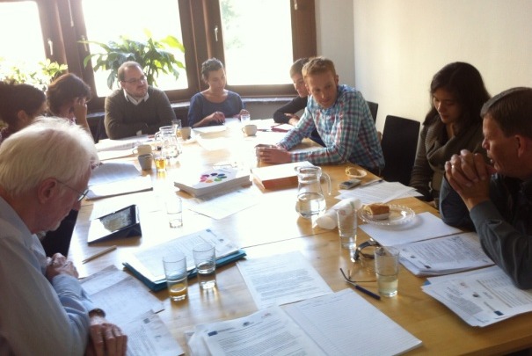

Public Involvement
4 Stakeholder meetings
1 fiscal/economic impact advisory committee
9,274 Notifications – email/postcard
Notes:
Now I would like to explain our public involvement process for this rulemaking:
Stakeholder meetings in August 2013 before rulemaking started to get input from the public (Portland, Pendleton, Eugene and Medford)
Fiscal and economic impact advisory committee meeting in January 2014 to ensure we identified the fiscal and economic impacts correctly
When we placed the rules on public notice on June 16, 2014, we sent out 9,274 notices in addition to posting information on our website

Slide 10
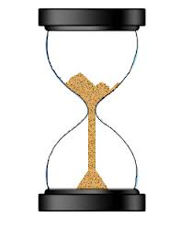

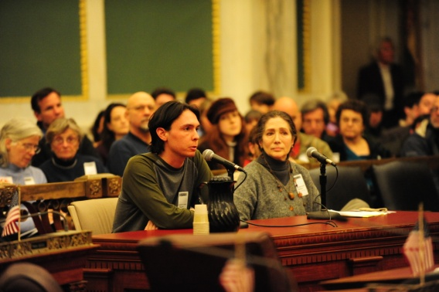
Public Notice (comment period) continued
3 Public notice extensions
3 Months for
public comment
5 Public Hearings
Notes:
Due to high public interest, we extended the public notice period 3 times
3 months of public comment from June 16 – September 15
5 public hearings on July 16, 2014 (Portland, Medford, Bend, Pendleton and Lane Regional Air Protection Agency in Springfield)

Slide 11

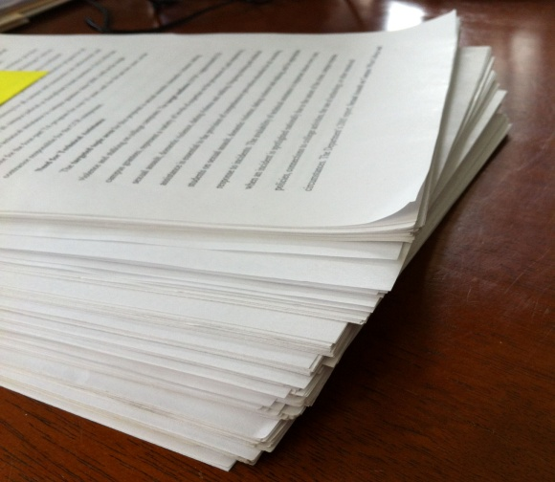
Public Comment continued
59 Commenters
85 Comments + 6 unrelated
Notes:
Received comments from 59 organizations and/or individuals
Received 85 distinct comments and 6 comments that were unrelated to this rulemaking

Slide 12

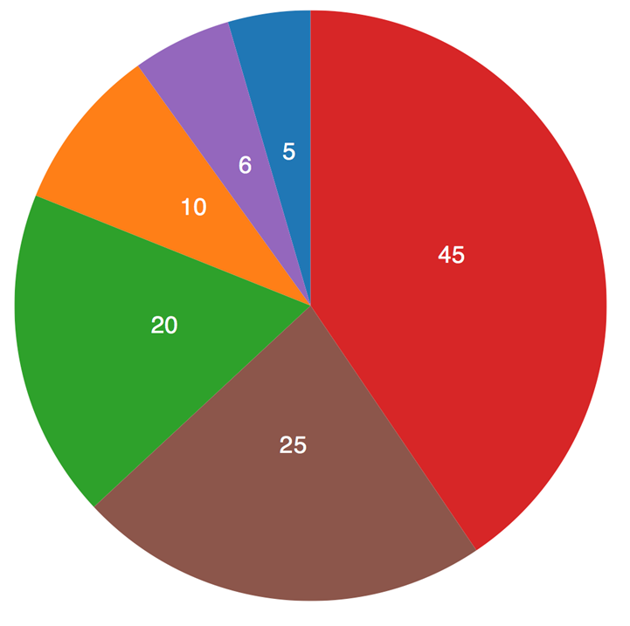
Today’s FOCUS
Comments that were:
Most controversial
Highest in number
Notes:
The focus for today’s presentation is going to be on comments that were the most controversial and the highest in number. Since we already presented an informational item in January, we didn’t want to repeat that information.
George will take over here to discuss these comments and our responses.

Slide 13
6 New Source Review
What is NSR?
NSR = Preconstruction permitting program
  Facility must get permit before building new or modifying
  Specifies requirements facility must meet
Required by federal regulations

Slide 14
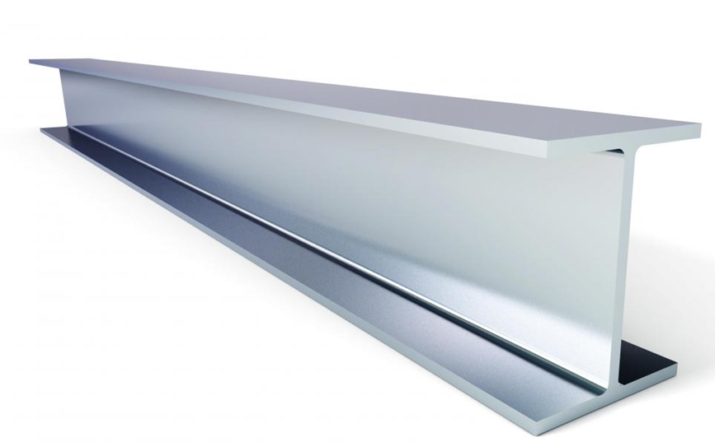

6 New Source Review continued
Major NSR: at least as stringent as the federal major NSR program = little flexibility
Minor NSR: no minimum requirements = more flexibility
Notes:
Broadly speaking, New Source Review consists of 2 programs, Major NSR and Minor NSR.
Major NSR applies to the larger facilities
May not be less stringent than the federal Major NSR program
Minor NSR applies to small and medium sized facilities.
The federal requirement is that we have a minor NSR program, but otherwise there is a fair amount of flexibility.
Many of the rule changes we’re proposing take advantage of that flexibility.

Slide 15

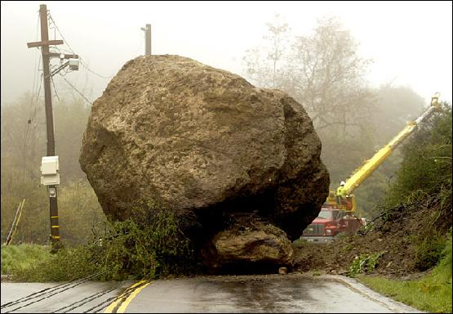

6 New Source Review continued
Purpose of changes to New Source Review
Reorganize the rules
  Remove roadblocks in current rules
  Address air quality problem sources
Notes:
GEORGE STARTS HERE
When certain air quality problems arise, the current rules also make it nearly impossible to issue a permit to a new or expanding source.
The main reason for revising the NSR rules was to address this permitting problem, but while we were at it we also proposed revisions that are intended help address the underlying air quality problem.
These problems and the proposed solutions will be discussed in the next few slides.
However, this work did result in some new sections in the rules.
To make the rules easier to use we felt that all of the NSR rule sections should have the same structure, and this led to reorganizing the rules.

Slide 16
5 New Source Review - current
Attainment Area
AQ good
(below ambient standard)
Nonattainment Area
AQ poor
(over ambient standard)
Maintenance Area
AQ was poor,
Now good,
Prevent slipping back
Rules in each area based on air quality needs
When air quality changes, takes years to redesignate area
Meanwhile rules don’t match air quality needs
Notes:
Under the current rules, areas in the state are designated as attainment, nonattainment or maintenance.
Attainment means AQ in the area meets the ambient air quality standards.
Nonattainment means the ambient air quality standards are not met for one or more pollutants, and maintenance means the area was nonattainment but has come back into attainment.
The NSR rules for each type of area are based upon the air quality in the area.
In attainment areas, the rules allow a small degradation in air quality but otherwise help keep the area in attainment.
In nonattainment areas the rules are more stringent and are intended to prevent degradation.
The maintenance area rules are similar to, but a bit less stringent than the nonattainment area rules and are intended to prevent the area from slipping back into nonattainment.
If the way the area is designated doesn’t match up with the actual air quality, the rules make it difficult or impossible for a new facility to locate in the area.
The attainment and nonattainment designations are made by EPA, and it takes years to redesignate an area, so there can be a period of several years during which we have this permitting problem.

Slide 17
5 Establish two new state air quality area designations, “sustainment” and “reattainment”
Attainment Area
Nonattainment Area
Sustainment
overlays attainment
Bridges the time
gap
Sustainment Area
  Sustainment area Minor NSR rules:
    Are similar to nonattainment area rules
    Remove permitting roadblock for medium sized facilities
Notes:
To address this permitting problem,
DEQ proposes to establish two new Oregon air quality area designations, “sustainment” and “reattainment,”.
A sustainment area is an area that is designated as attainment, but where the AQ is found to be close to or exceeding an AAQS.
Sustainment is a state designation and doesn’t require EPA approval.
The sustainment area designation overlays the attainment designation and covers the time gap before the area is officially designated as nonattainment.
Recall that the major NSR program can’t be less stringent than the federal major NSR program. Since the sustainment designation doesn’t change the underlying federal attainment designation, sources subject to major NSR must still meet the attainment area requirements. As a result, the sustainment area designation really doesn’t benefit the largest sources.
However, we have more flexibility under minor NSR, and the sustainment area designation mainly benefits medium sized sources that are subject to minor NSR. For those sources, the sustainment area designation removes the roadblock that exists under the current rules.
Another change DEQ is proposing is to be able to designate priority sources in any area. Priority sources are the sources that contribute the most to the air quality problem.
One of the requirements in nonattainment and sustainment areas is that new or expanding source must obtain offsets for their emissions. Offsets refer to emission reductions from other sources to balance out the emissions increases from the new or expanding source. The goal in designating priority sources is to encourage sources to obtain part of their offsets from the priority sources. In this way, the new or expanding source would actually help address the problem.
To create an incentive to get offsets from priority sources, DEQ is proposing to increase the minimum offset ratio, but at the same time to allow the offset ratio to be reduced if priority sources offsets are obtained.

Slide 18
5 Establish two new state air quality area designations, “sustainment” and “reattainment”
Reattainment
overlays
nonattainment
Bridges the time
gap
Nonattainment Area
Maintenance Area
Reattainment Area
  Reattainment area Minor NSR rules:
    Are closer to maintenance area rules
    Allow less stringent permitting for medium size facilities
Notes:
Similar to sustainment, the reattainment area designation overlays a federal nonattainment designation.
And again like sustainment, the reattainment designation doesn’t change the underlying federal nonattainment designation, so sources subject to major NSR must still meet the nonattainment area requirements.
However, we have more flexibility under minor NSR, and the reattainment area designation mainly benefits medium sized sources that are subject to minor NSR. For those sources, the reattainment area designation makes permitting a little less strigent by shifting the requirements to be closer to the maintenance area requirements.

Slide 19
4 Designate Lakeview as a sustainment area
  Town of Lakeview and Lake County Commissioners requested sustainment designation
Notes:
The town of Lakeview is in exactly the situation that the sustainment designation was intended to address. PM2.5 levels are close to or have exceeded the 24-hour ambient air quality standard, but the area is still designated as an attainment area. As a result, new medium-sized sources that emit PM2.5 are effectively prevented from getting a permit in Lakeview.
The town and county are working to address the air quality problem and have requested that the area be designated a sustainment area. In addition to proposing to designate Lakeview as a sustainment area, we are proposing to designate uncertified wood-burning devices as the priority sources.
Designating the Town of Lakeview a sustainment area would:
Provide more flexible permitting requirements for medium sized sources;
Help avoid a federal nonattainment designation; and
Target the main problem causing poor air quality.

Slide 20
Greenhouse Gases
  Background
  U.S. Supreme Court struck down parts of federal rules pertaining to greenhouse gas permitting
Struck down
Sources subject to Title V permits for GHGs alone
Struck down
Sources subject to Prevention of Significant Deterioration program for GHGs alone
Affirmed
Sources subject to Prevention of Significant Deterioration for GHGs if subject to PSD for another pollutant (so-called “anyway sources”)
Notes:
In 2014 the Supreme Court issued a ruling on EPA’s so-called Greenhouse Gas Tailoring Rule. The court struck down parts of the rule and affirmed other parts.
Click
Click
Click

Slide 21


Greenhouse Gases continued
DEQ’s Greenhouse Gas Rules
Oregon rules not automatically struck down by Court’s decision
Oregon rules were similar to federal rules
EQC adopted temporary rule in November to align Oregon rules to Court’s decision
TEMPORARY
Notes:
Even though the Supreme Court decision invalidated EPA’s authority to impose the federal greenhouse gas permitting requirements, it did not affect Oregon’s rules.
The discrepancy between federal and state requirements created uncertainty for DEQ, the regulated community and the public.
So in November of 2014, the EQC adopted temporary rules to align DEQ rules with the Supreme Court decision.

Slide 22

Greenhouse Gases continued
  Comments on both sides of the issue
Do follow Supreme Court decision
Don’t follow Supreme Court decision
Notes:
During the public comment period, DEQ asked for comments on whether or not the state should follow the court’s ruling or retain the rules that were based on the original Tailoring Rule.
We got the most comments on this part of the rulemaking, with 29 people/organizations were either supported or opposed aligning with the Supreme Court Decision.

Slide 23
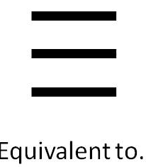


Greenhouse Gases continued
  Reasons to align with Supreme Court decision
Title V and ACDP equally stringent
Most GHG emissions from “anyway” sources
National equity for Oregon businesses
Notes:
After analyzing the effects the Supreme Court decision would have on GHG permitting in Oregon, DEQ is recommending that EQC adopt rules that permanently align Oregon rules for permitting greenhouse gas emissions with the Supreme Court decision for the following reasons:
Title V does not impose more stringent requirements;
According to EPA estimates, the majority of GHG emissions are from the so-called “anyway” sources, which will still be regulated ;
And
We believe most states will follow the court’s ruling, so this will help keep the playing field level for Oregon sources.

Slide 24
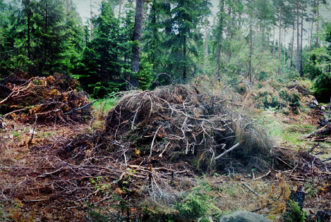
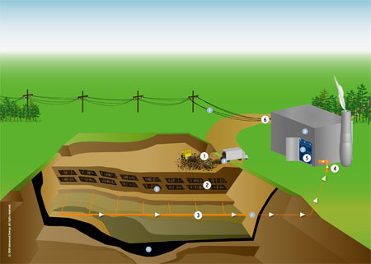
Biogenic CO₂ Deferral
Biogenic CO2 comes from:
Combustion of forest-derived and agriculture-derived feedstocks
Combustion of biogas collected from landfills, wastewater treatment or manure management processes
Notes:
In a related area, we received comments on the biogenic CO2 deferral .
Biogenic CO₂ comes from the combustion of forest-derived and agriculture-derived fuels, and
also from the combustion of biogas derived from the decomposition of biological waste in landfills, wastewater treatment systems, or manure management processes.
Since biogenic CO2 is derived from growing products that take CO2 out of the atmosphere, there is a belief that the CO2 emitted from combusting these materials is balanced, at least to some extent, by the CO2 taken up by growing these materials. If emissions and uptake were exactly balanced, these materials have no net effect on the amount of CO2 in the atmosphere, and would be considered 100% carbon-neutral.

Slide 25
Biogenic CO₂ Deferral
2011 EPA exempted biogenic CO2 from permitting for 3 years
    Assumes 100% carbon neutrality
    Stopgap measure while EPA continues study
    EQC adopted rule to follow EPA rule – automatically exempts if EPA exempts
2014 Supreme Court issued ruling
    Deferral must be vacated, but…
    Not officially vacated yet, may take years
Notes:
In 2011, EPA exempted, or deferred, biogenic CO2 from permitting for three years, and DEQ and EQC followed suit.
Our understanding is that EPA is continuing to study the question of carbon neutrality and there’s a chance that EPA will propose a revised rule some time in the future.
In the meantime, the deferral expired in 2014, and at about the same time the Supreme Court issued a ruling that the deferral must be vacated. However, the rule hasn’t actually been vacated yet, and both the Biogenic Deferral and the Tailoring Rule may not be fully resolved for several more years.

Slide 26
Biogenic CO₂ Deferral
  DEQ’s initial proposal was to:
    Eliminate deferral
    Acknowledge existence from 2011-2014
  Final proposal is to:
    Revert to 2011 rule
    Automatically align with court ruling
  Future Oregon rules won’t be more stringent than EPA’s rules
Notes:
Because of the unclear legal situation regarding EPA’s deferral rule, DEQ’s original propose in this rulemaking was to eliminate the deferral, but to acknowledge that was in effect for 3 years.
However, since that time we’ve learned that the situation probably won’t be resolved for some time and so we’ve proposed to revert to the rule language that was adopted in 2011. The rule language basically means that DEQ will automatically follow the final court actions and whatever final rules EPA may adopt.

Slide 27
Greenhouse Gases continued
DEQ’s Greenhouse Gas Rules
The temporary rule adopted in November will be replaced with the proposed rules if adopted today.
TEMPORARY

Slide 28
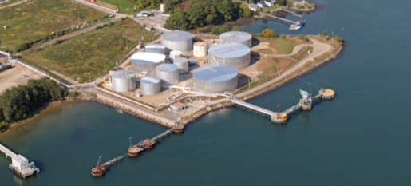
Clarify and update air quality rules
Gasoline Marine Loading
Expand marine loading rule to include other volatile liquids in the Portland Air Quality Maintenance Area
Notes:
Background:
Current rule requires control of gasoline vapor emissions
when gasoline is loaded onto marine vessels at large terminals.
This rule applies only in Portland area and was adopted several years ago to help keep Portland in attainment with the ambient ozone standards.

Slide 29
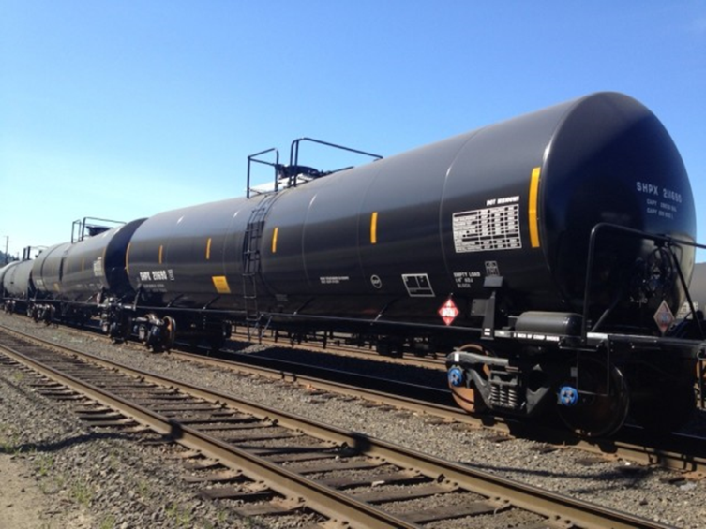
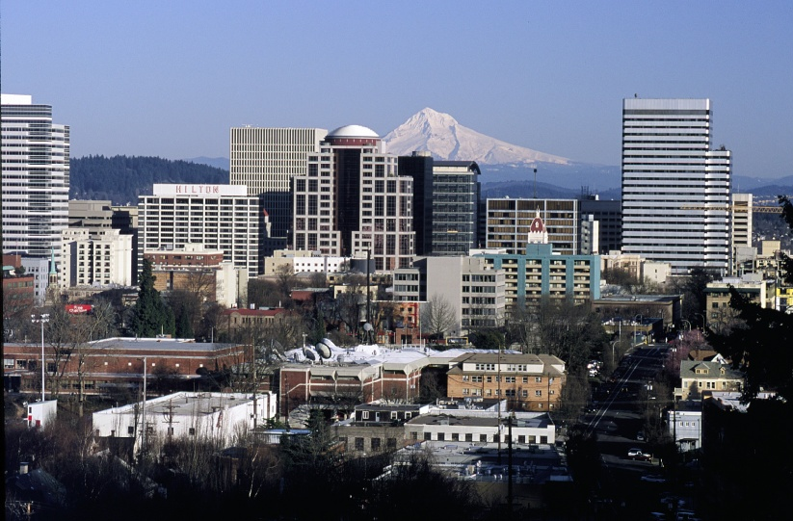
Clarify and update air quality rules
Why change marine loading rule?
Volatile crude oil shipments
EPA proposing stricter ozone standard
Notes:
Crude oil is also stored and transhipped in the Portland area.
Until recently crude oil has usually had low volatility, but now some of the crude oil being shipped has very high volatility, even higher than that of gasoline.
DEQ expects that eventually some of these volatile crude oils will be stored and transloaded at Portland terminals .
In addition, EPA might reduce the ozone standard , which will reduce the headspace between the standard and the ozone levels in Portland.
With both of these things happening we felt that we should take a proactive step to minimize emissions from very volatile products.
Based on comments we received, the original proposal was far too stringent. The affected terminals also indicated they would need time to upgrade their emission control systems.
The final proposal is less stringent than the original proposal but will still require control of emissions from gasoline, and from other volatile products starting in 3 years. This allows time to design and construct the necessary emission control systems.

Slide 30
3 Change permitting requirements for emergency generators and small natural gas or oil-fired equipment
  Emergency generators and small fuel burning equipment classified as
  “categorically insignificant activities”
  Categorically insignificant activities = a list of activities with insignificant emissions
  Not included in permits
Notes:
When the Title V permitting program was established in 1993, DEQ developed a list of “categorically insignificant activities” that may take place at a source but are not addressed individually in the permit. This list includes activities such as janitorial & groundskeeping activities. They also include emergency generators & small fuel burning equipment (space heaters, water heaters).
While most Categorically Insignificant Activities are still considered insignificant, DEQ has found some facilities that have many emergency generators or small heating devices, with emissions that are significant. In addition, EPA adopted requirements for Reciprocating Internal Combustion Engines (Emergency Generators) that Jerry Ebersole will be talking to you about next.

Slide 31

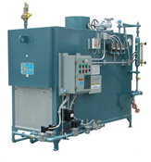
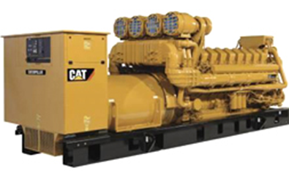
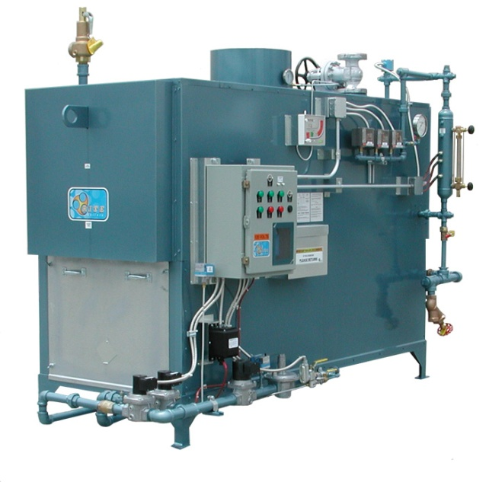
3 Change permitting requirements for emergency generators and small natural gas or oil-fired equipment
  Multiple - significant
  Individual - insignificant
Notes:
If emissions less than de minimis, still categorically insignificant
If emissions more than de minimis, must be in permit
Most facilities will be unaffected
One-time workload increase for a few permits

Slide 32
11 Other Comments unrelated to proposed rules
Intel
Comments:
  Make federal major source
  Require Best Available Control Technology
Response:
  Comments are permit issues, not rulemaking issues
  Permit is in process at this time
Notes:
The NWR office has been working on air permits for Intel since 2012, and the comments we received are related to those permitting actions.
We believe these issues are more appropriately dealt with in the permit process and did not propose any rule changes based on these comments.

Slide 33
Public Comment
  Summary
Agreed in whole or in part with 45 comments and made changes
Disagreed with 40 comments, responded to comments but made no changes
85 Comments + 6 unrelated

Slide 34

Questions for us?

Slide 35
Recommendation
DEQ recommends that the Environmental Quality Commission:
Adopt the proposed rules in attachments A1 through A4 as part of chapter 340 of the Oregon Administrative Rules.
Find that certain rules adopted as attachments A1 through A4 are more strict than existing Lane Regional Air Protection Agency rules, as described in attachment B, and direct Lane Regional Air Protection Agency to implement such state rules until it adopts its own rules that are equivalent or more strict and submits them to the Environmental Quality Commission under ORS 468A.135.

Slide 36
Recommendation continued
DEQ recommends that the Environmental Quality Commission:
3. Approve incorporating the rule amendments adopted as attachments A1 through A4 and the rule implementation directive to LRAPA described in attachment B into the Oregon Clean Air Act State Implementation Plan under OAR 340-200-0040 (the “SIP revision”).
4. Direct DEQ to submit the SIP revision to the U.S. Environmental Protection Agency for approval.
Notes:
I don’t mean for this to sound like the academy awards but George and I would like to thank the rest of our rulemaking team:
Mark Fisher has been retired for one year and 15 days. You probably know him because he was the permit writer for PGE Boardman. We wanted to get this rulemaking to you before he retired but as you can see, we didn’t quite make it.
Gary Andes and Karen White-Fallon are senior permit writers out of our Salem office. We spent weeks at a time, holed up in a small windowless conference room working on these rules until our brains turned to mush.
Phil Allen, our modeler out of HQ spent days with us hammering on Net Air Quality Benefit.
And last but not last, Paul Garrahan, our DOJ attorney, turned around his review of all of these rules on embarrassingly short notice. We worked until the last minute on the rules for all of our internal and external deadlines and didn’t give Paul nearly enough time. His review made our rules better.
Thank you.

