Slide 1
Air quality permitting, Heat Smart and gasoline dispensing facility updates
(aka the Kitchen Sink)
Inspectors’ Forum
May 2015

Slide 2
Outline of Today’s Presentation
Goals/Reasons for Rulemaking
Overview of Rulemaking
Rule clean-up
Division 216 Table 1 changes
Categorically Insignificant Activities
Update particulate matter (PM) standards
Splitting businesses
New Source Review (NSR)
Extensions for NSR permits
Net air quality benefit for sensitive areas
Notes:
Here is an overview of the topics we are going to cover today:
Rule clean-up
Update statewide grain loading and opacity standards
We have a defined term: Categorically Insignificant Activities
How emissions are divided when a business splits into two or more businesses
Our pre-construction program called New Source Review (NSR)
If construction is delayed, how a business an get an extensions for their NSR permit
Another defined term: Net air quality benefit
All of these topics will be explained in more detail later in this presentation.

Slide 3
Rulemaking Goals
Make rules clearer
Update rules
Address air quality problems
Notes:
The goals of this rulemaking are to make sure our rules are clear, up to date and that they address air quality problems.
When addressing AQ problems, we want to make sure we are targeting our resources at the right place. We want to provide incentives to reduce emissions where needed and provide companies flexibility as long as it will improve air quality.

Slide 4

Reasons for Rulemaking
Started out initially as reorganization
Received input about:
Unclear rules from permit writers/inspectors
Permitting problems in areas of marginal air quality
Notes:
Originally the rulemaking started out to reorganize our rules and make them easier for people to use. We had procedures in definitions and tables that were impossible to find.
After talking with people, we realized that there were many areas in our rules that could be improved so the project grew.

Slide 5
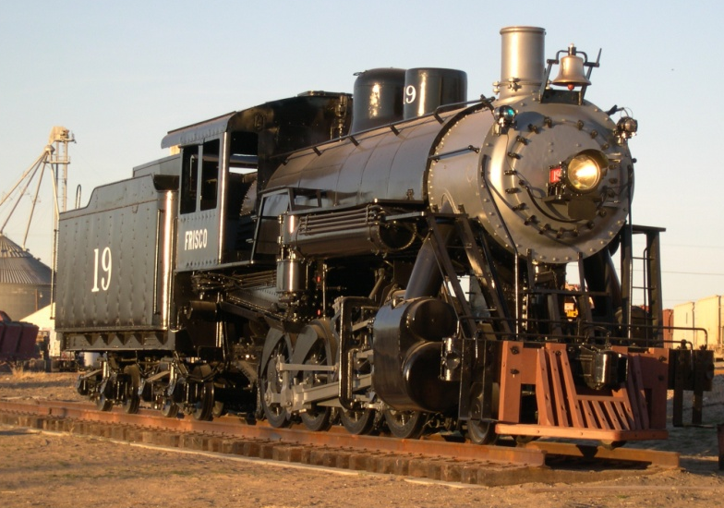

Reasons for Rulemaking continued
Addressing air quality problems changed reorganization to major overhaul of New Source Review rules
Before
After

Slide 6
9 Categories of Rulemaking
Clarify and update air quality rules
Update particulate matter emission standards
Change permitting requirements for emergency generators and small natural gas or oil-fired equipment
Notes:
Here is a high level overview of this rulemaking.
As you will recall from the informational item we presented at the January EQC meeting and from the staff report, we organized this rulemaking into nine categories.
We are PROPOSING the following
READ THROUGH 1 THROUGH 3

Slide 7
9 Categories of Rulemaking continued
Revise parts of the New Source Review preconstruction permitting program
Establish two new state air quality area designations, “sustainment” and “reattainment”
Designate Lakeview as a state sustainment area
Notes:
READ THROUGH 4 THROUGH 6

Slide 8
9 Categories of Rulemaking continued
7. Modernize methods allowed for holding public hearings and meetings
8. Re-establish the Heat Smart woodstove replacement program exemption for small commercial solid fuel boilers regulated under the permitting program
9. Remove annual reporting requirements for small gasoline dispensing facilities

Slide 9
Rule Clean-Up
Unclear rules, not organized well:
Reorganize by moving procedures out of definitions
Provide clarification when needed, especially regarding compliance requirements
Delete unused/redundant definitions
Correct errors
Maintain overall stringency
Notes:
The first part of this presentation covers rule clean-up.
Some of our rules are out of order so we want to move them to the right place. There are procedures in definitions like major modification, actual emissions and netting basis that need to be moved.
Some of our rules are missing important details so we worked on clarifying them. (compliance methods)
We want a clean set of definitions. Throughout all of our divisions there are multiple definitions of the same term – 5 definitions of the word person! Make sure the definitions agree and get rid of the redundant ones
We found cross-referencing errors and typos that need to be fixed.
None of these clean-up changes will affect stringency. We are just clarifying things.

Slide 10
Rule Clean-Up continued
Reorganize by moving procedures out of definitions:
Actual emissions
Baseline year
Baseline emission rate
Netting basis
Major modification
Net Air Quality Benefit
To division 222
To division 224
To division 224
Notes:
The first part of this presentation covers rule clean-up.
Some of our rules are out of order so we want to move them to the right place. There are procedures in definitions like major modification, actual emissions and netting basis that need to be moved.
Some of our rules are missing important details so we worked on clarifying them. (compliance methods)
We want a clean set of definitions. Throughout all of our divisions there are multiple definitions of the same term – 5 definitions of the word person! Make sure the definitions agree and get rid of the redundant ones
We found cross-referencing errors and typos that need to be fixed.
None of these clean-up changes will affect stringency. We are just clarifying things.

Slide 11

Rule Clean-Up continued
Move Division 200 tables into text:
De Minimis Emission Levels
Generic PSEL
Significant Emission Rate
Significant Impact Level
Where is that table??
Notes:
The first part of this presentation covers rule clean-up.
Some of our rules are out of order so we want to move them to the right place. There are procedures in definitions like major modification, actual emissions and netting basis that need to be moved.
Some of our rules are missing important details so we worked on clarifying them. (compliance methods)
We want a clean set of definitions. Throughout all of our divisions there are multiple definitions of the same term – 5 definitions of the word person! Make sure the definitions agree and get rid of the redundant ones
We found cross-referencing errors and typos that need to be fixed.
None of these clean-up changes will affect stringency. We are just clarifying things.

Slide 12

Rule Clean-Up continued
Move PSD increment table moved to Division 202
Move Ambient Air Quality Levels Impact for Maintenance Areas to Division 202
Notes:
The first part of this presentation covers rule clean-up.
Some of our rules are out of order so we want to move them to the right place. There are procedures in definitions like major modification, actual emissions and netting basis that need to be moved.
Some of our rules are missing important details so we worked on clarifying them. (compliance methods)
We want a clean set of definitions. Throughout all of our divisions there are multiple definitions of the same term – 5 definitions of the word person! Make sure the definitions agree and get rid of the redundant ones
We found cross-referencing errors and typos that need to be fixed.
None of these clean-up changes will affect stringency. We are just clarifying things.

Slide 13
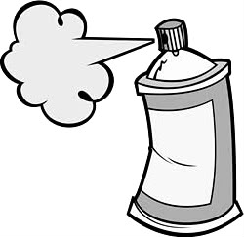
Rule Clean-Up continued
Outdated rules repealed:
Consumer Spray Paint VOC limits replaced by EPA rules (19% vs. 15%)
Western Backstop SO2 Federal Trading Program – replaced by direct control of PGE Boardman
Notes:
As part of the clean up, we want to repeal some rules
Spray paint rules were part of plan to reduce ozone from consumer products. EPA adopted national rules that apply to manufacturers and so we don’t state rules any more.
DEQ worked with the western states on a SO₂ trading program but dropped out because it wasn’t cost effective. There are now specific rules but PGE is not involved in trading so we don’t need the state rules.

Slide 14
Rule Clean-Up continued
Repeal rules for sources that no longer exist in Oregon:
Neutral Sulfite Semi-Chemical Pulp Mills
Sulfite Pulp Mills
Primary Aluminum Standards
Laterite Ore Production of Ferronickel
Charcoal Producing Plants
New sources must comply with more stringent federal requirements for new sources
Notes:
Unfortunately many businesses have shut down in Oregon so we plan to repeal those industry specific rules.
All other industry rules are staying the same, including Kraft Pulp Mills
If one of those sources wants to locate in Oregon, they would have to comply with current federal rules which are more stringent than our existing state rules. (New Source Review, New Source Performance Standards, National Emission Standards for HAPs)

Slide 15
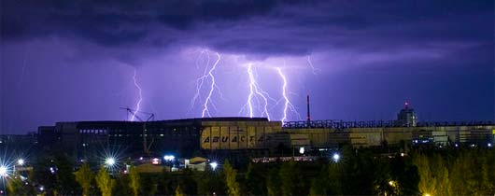
Rule Clean-Up continued
Emergency as an Affirmative Defense for Title V Permitted Sources ONLY
Affirmative defense is the ability to avoid civil penalties for violations. Under EPA’s interpretation, DEQ’s excess emissions rules incorrectly allow all permitted sources to assert an affirmative defense for emergencies, rather than just Title V sources.
Notes:
The first part of this presentation covers rule clean-up.
Some of our rules are out of order so we want to move them to the right place. There are procedures in definitions like major modification, actual emissions and netting basis that need to be moved.
Some of our rules are missing important details so we worked on clarifying them. (compliance methods)
We want a clean set of definitions. Throughout all of our divisions there are multiple definitions of the same term – 5 definitions of the word person! Make sure the definitions agree and get rid of the redundant ones
We found cross-referencing errors and typos that need to be fixed.
None of these clean-up changes will affect stringency. We are just clarifying things.

Slide 16
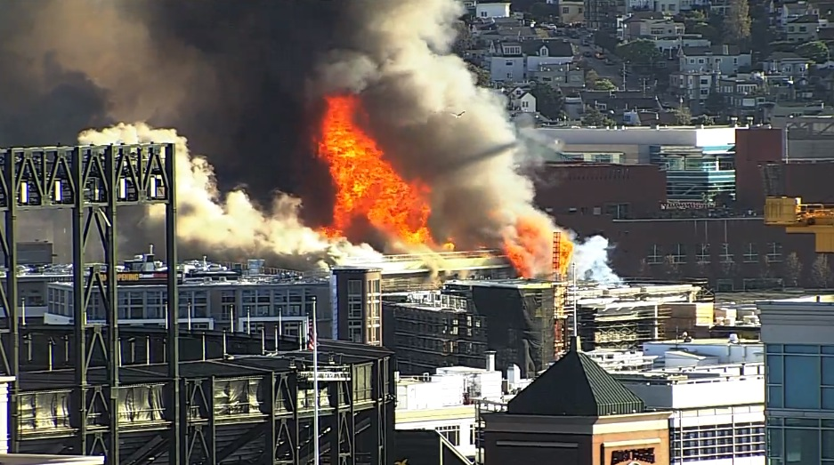
Rule Clean-Up continued
Enforcement Action Criteria for ACDP sources:
Added “whether the excess emissions event was due to an emergency” to OAR 340-214-0350 Enforcement Action Criteria
Notes:
The first part of this presentation covers rule clean-up.
Some of our rules are out of order so we want to move them to the right place. There are procedures in definitions like major modification, actual emissions and netting basis that need to be moved.
Some of our rules are missing important details so we worked on clarifying them. (compliance methods)
We want a clean set of definitions. Throughout all of our divisions there are multiple definitions of the same term – 5 definitions of the word person! Make sure the definitions agree and get rid of the redundant ones
We found cross-referencing errors and typos that need to be fixed.
None of these clean-up changes will affect stringency. We are just clarifying things.

Slide 17
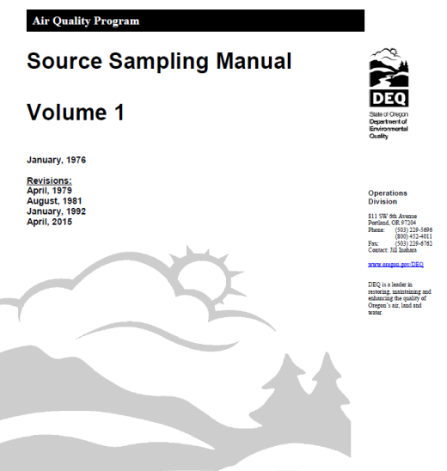
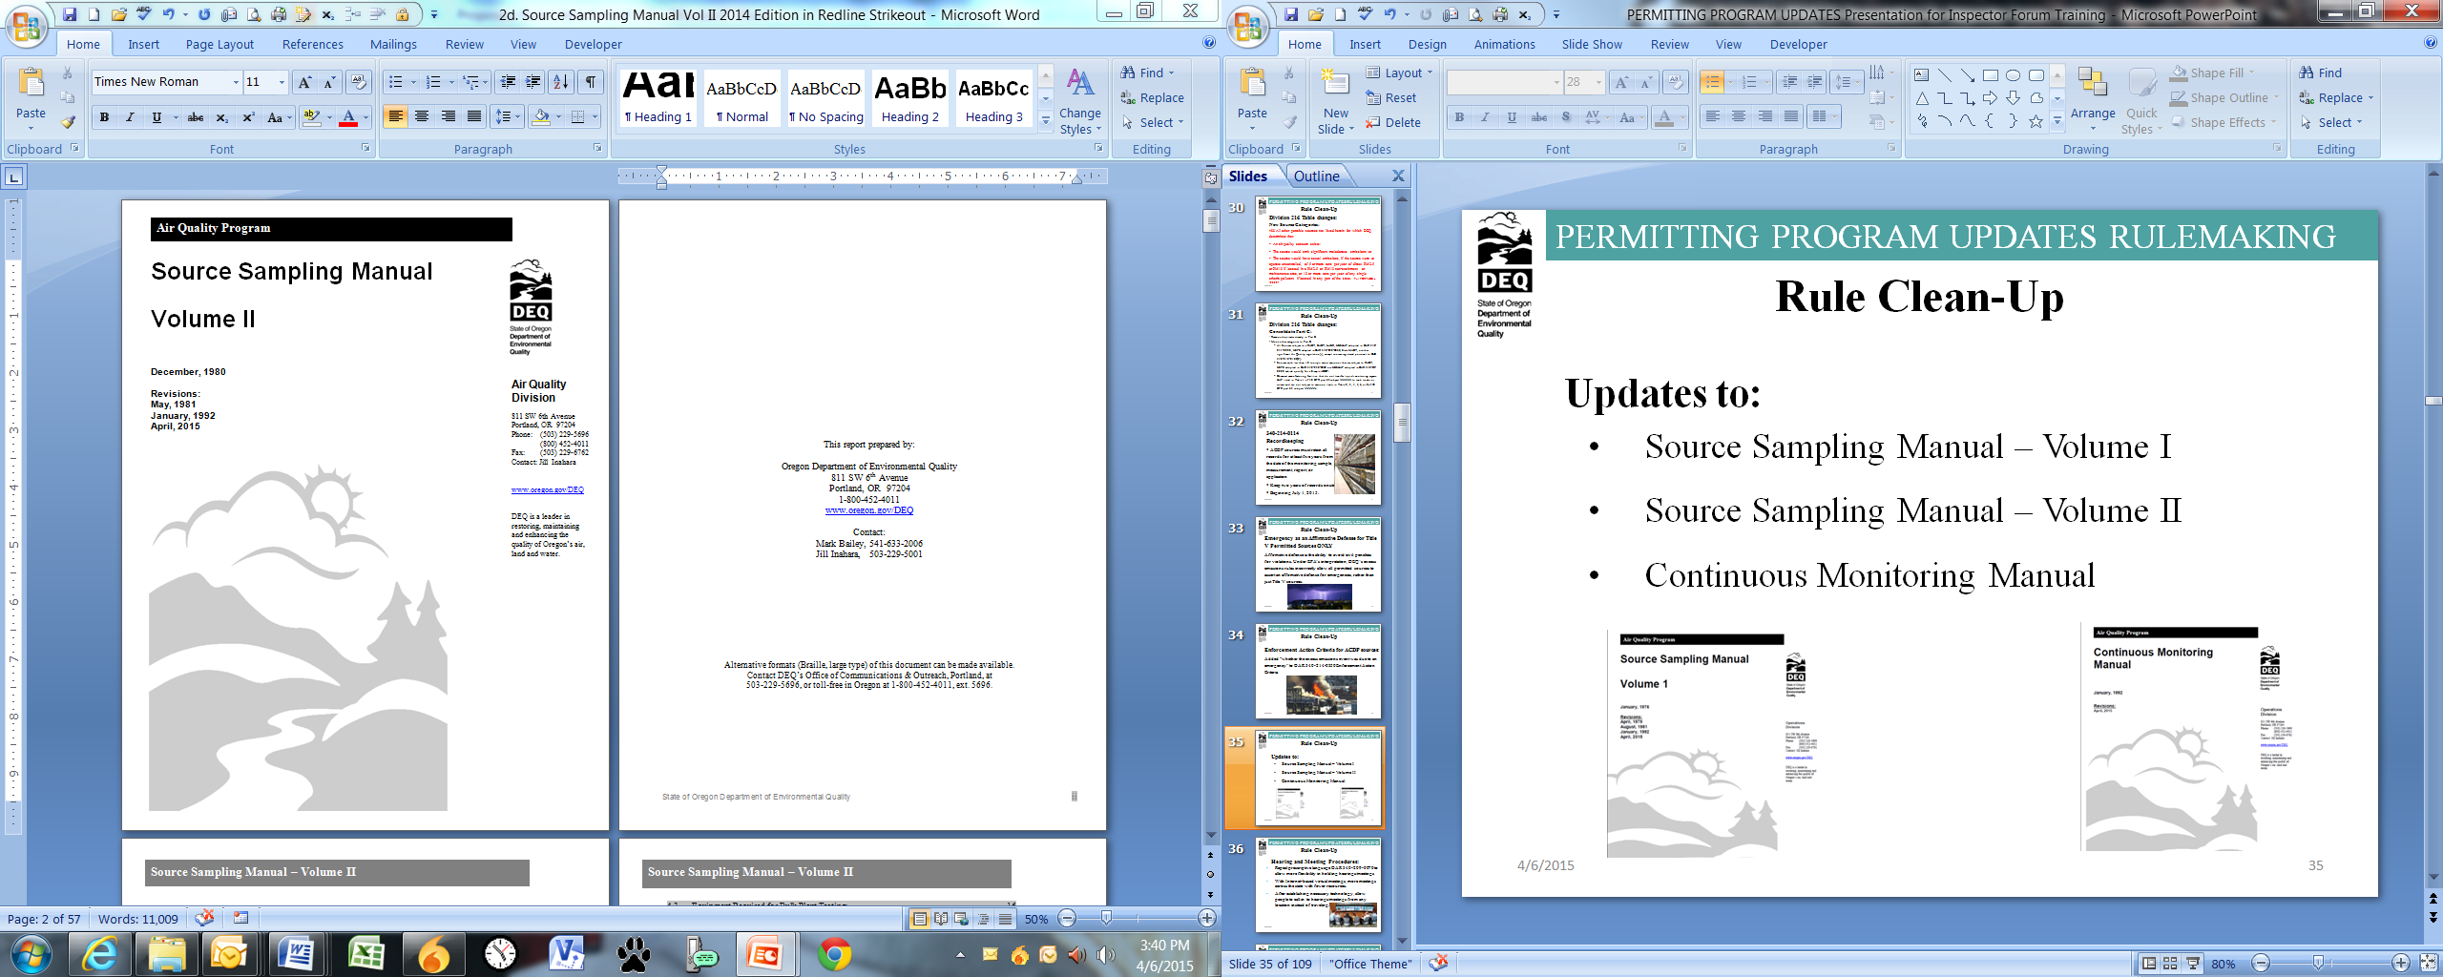
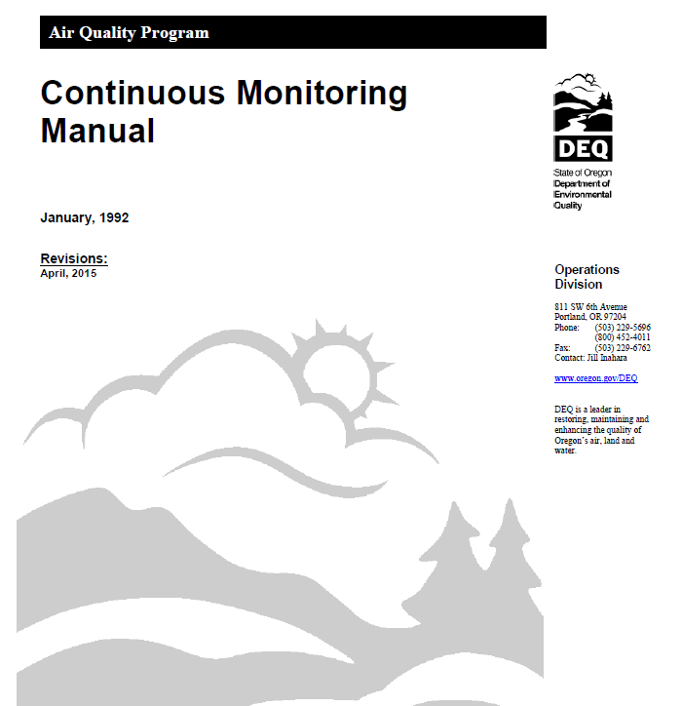
Rule Clean-Up continued
Updates to:
Source Sampling Manual – Volume I
Source Sampling Manual – Volume II
Continuous Monitoring Manual
Notes:
The first part of this presentation covers rule clean-up.
Some of our rules are out of order so we want to move them to the right place. There are procedures in definitions like major modification, actual emissions and netting basis that need to be moved.
Some of our rules are missing important details so we worked on clarifying them. (compliance methods)
We want a clean set of definitions. Throughout all of our divisions there are multiple definitions of the same term – 5 definitions of the word person! Make sure the definitions agree and get rid of the redundant ones
We found cross-referencing errors and typos that need to be fixed.
None of these clean-up changes will affect stringency. We are just clarifying things.

Slide 18

Rule Clean-Up continued
Hearing and Meeting Procedures:
Repeal prescriptive language OAR 340-209-0070 to allow more flexibility in holding hearings/meetings
With Internet-based virtual meetings, more meetings across the state with fewer resources.
After establishing necessary technology, allow people to call in to hearings/meetings from any location instead of traveling.
Notes:
The first part of this presentation covers rule clean-up.
Some of our rules are out of order so we want to move them to the right place. There are procedures in definitions like major modification, actual emissions and netting basis that need to be moved.
Some of our rules are missing important details so we worked on clarifying them. (compliance methods)
We want a clean set of definitions. Throughout all of our divisions there are multiple definitions of the same term – 5 definitions of the word person! Make sure the definitions agree and get rid of the redundant ones
We found cross-referencing errors and typos that need to be fixed.
None of these clean-up changes will affect stringency. We are just clarifying things.

Slide 19
Rule Clean-Up continued
New Definitions
Attainment area
Attainment pollutant
Capture efficiency
Class II area
Class III area
Control efficiency
Day
DEQ method [#]
Designated area
Destruction efficiency
Fuel burning equipment
Hazardous air pollutant
Internal combustion engine
Liquefied petroleum gas
Notes:
The first part of this presentation covers rule clean-up.
Some of our rules are out of order so we want to move them to the right place. There are procedures in definitions like major modification, actual emissions and netting basis that need to be moved.
Some of our rules are missing important details so we worked on clarifying them. (compliance methods)
We want a clean set of definitions. Throughout all of our divisions there are multiple definitions of the same term – 5 definitions of the word person! Make sure the definitions agree and get rid of the redundant ones
We found cross-referencing errors and typos that need to be fixed.
None of these clean-up changes will affect stringency. We are just clarifying things.

Slide 20
Rule Clean-Up continued
New Definitions
Natural gas
Odor
Portable
Reattainment area
Reattainment pollutant
Removal efficiency
State New Source Review
Sustainment area
Sustainment pollutant
Type A State NSR action
Type B State NSR action
Unclassified area or attainment area
Wood fuel-fired device
Notes:
The first part of this presentation covers rule clean-up.
Some of our rules are out of order so we want to move them to the right place. There are procedures in definitions like major modification, actual emissions and netting basis that need to be moved.
Some of our rules are missing important details so we worked on clarifying them. (compliance methods)
We want a clean set of definitions. Throughout all of our divisions there are multiple definitions of the same term – 5 definitions of the word person! Make sure the definitions agree and get rid of the redundant ones
We found cross-referencing errors and typos that need to be fixed.
None of these clean-up changes will affect stringency. We are just clarifying things.

Slide 21
Rule Clean-Up continued
New Definitions:
Fuel burning equipment: equipment, other than internal combustion engines, the principal purpose of which is to produce heat or power by indirect heat transfer.
Internal combustion engine: means stationary gas turbines and reciprocating internal combustion engines.
Notes:
The first part of this presentation covers rule clean-up.
Some of our rules are out of order so we want to move them to the right place. There are procedures in definitions like major modification, actual emissions and netting basis that need to be moved.
Some of our rules are missing important details so we worked on clarifying them. (compliance methods)
We want a clean set of definitions. Throughout all of our divisions there are multiple definitions of the same term – 5 definitions of the word person! Make sure the definitions agree and get rid of the redundant ones
We found cross-referencing errors and typos that need to be fixed.
None of these clean-up changes will affect stringency. We are just clarifying things.

Slide 22


Rule Clean-Up continued
New Definitions:
Portable: designed and capable of being carried or moved from one location to another. Indicia of portability include, but are not limited to, wheels, skids, carrying handles, dolly, trailer, or platform.
Notes:
Defined portable but didn’t put a time limit on it

Slide 23
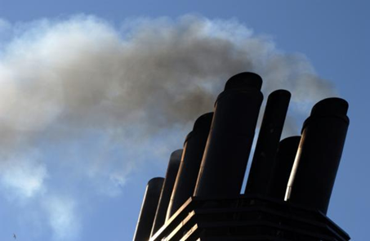
PM and Opacity Standards Topics
Background
Changes
Implementation schedule
Affected sources
Compliance issues

Slide 24
PM and Opacity Standards - Background
Standards adopted in early 1970’s as part of initial State Implementation Plan (SIP)
Rules include different standards for pre and post 1970 sources - grandfathering provision
Pre-1970: 40% opacity and 0.2 gr/dscf
Post 1970: 20% opacity and 0.1 gr/dscf
PM standard inconsistent with current EPA policy for significant figures/compliance
Notes:
SIP required by Clean Air Act to maintain or attain compliance with National Ambient Air Quality Standards (NAAQS)
NAAQS for particulate matter was based on total particulate matter and was much less stringent than today’s standards.

Slide 25
Opacity standard changes
Change all opacity standards (except recovery furnaces) to 6-minute block average
Replaces 3-minute aggregate in 60 minutes
Compliance based on EPA Method 9
Change is consistent with other states
No change in stringency

Slide 26
Opacity standard changes continued
Repeal Portland 4-county standard
20% opacity for 30 seconds for non-fuel burning equipment
No uniform procedures for determining compliance
Not a SIP provision
Still covered by statewide standards

Slide 27
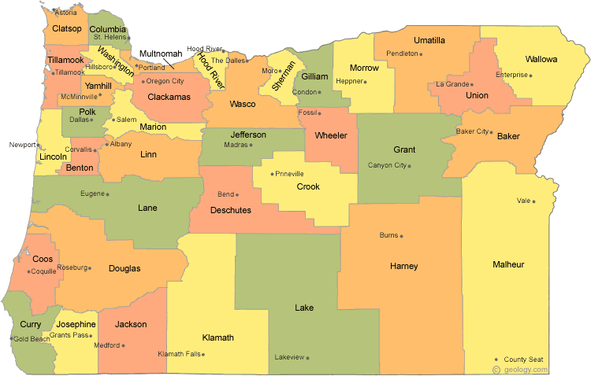
Special Control Areas
Willamette Valley, including Benton, Clackamas, Columbia, Lane, Linn, Marion, Multnomah, Polk, Washington and Yamhill Counties;
Umpqua Basin;
Rogue Basin;
In incorporated cities w/population of >4,000, and within three miles.

Slide 28
Opacity standard changes continued
Sources other than wood-fired boilers
Source | Location | Date | Limit
Pre 1970 | Outside special control area | Through 12/31/19 | 40%
Pre 1970 | Outside special control area | After 01/01/20 | 20%
Pre 1970 | Inside special control area | Upon rule adoption | 20%
Post 1970 | Statewide | Upon rule adoption | 20%
*55% = 3 minutes at 100% and 9 minutes at 40%
**40% = 3 minutes at 100% and 9 minutes at 20%

Slide 29
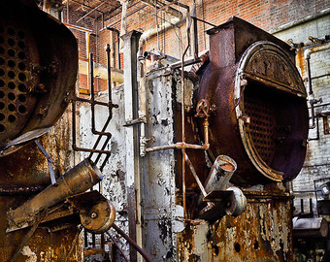
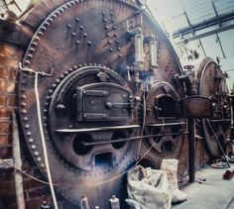
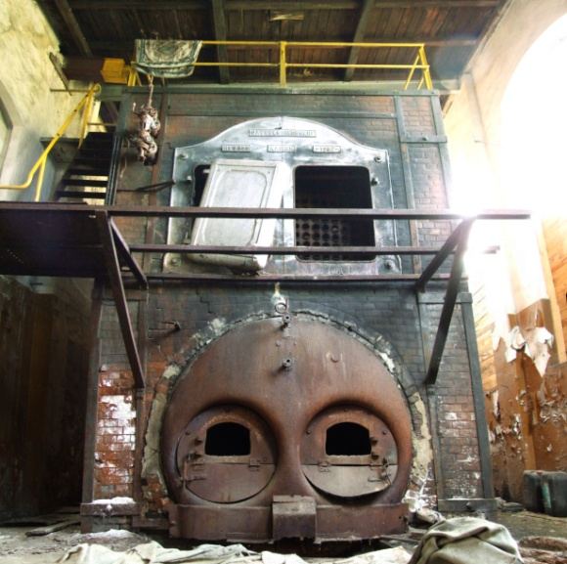
Opacity standard changes continued
Wood-fired boilers
Source | Date | Limit | Exception
Pre 1970 | Through 12/31/19 | 40% | 55% for 2 6-minute blocks*
*55% = 3 minutes at 100% and 9 minutes at 40%, currently allowed

Slide 30
Opacity standard changes continued
Wood-fired boilers
Source | Date | Limit | Exception
Pre 1970 | After 01/01/20 | 20% | 40% for 2 6-minute blocks
Pre 1970 | After 01/01/20 | 20% | 40% during grate cleaning*
Pre 1970 | After 01/01/20 | 20% | Boiler specific up to 40%**
*as long as grate cleaning is performed in accordance with DEQ approved grate cleaning plan **Source can request boiler specific opacity between 20-40% measured during boiler specific grain loading source test

Slide 31
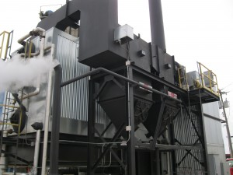
Opacity standard changes continued
Wood-fired boilers
Source | Date | Limit | Exception
Post 1970 | Upon rule adoption | 20% | 40% for 2 6-minute blocks
Post- 04/15/15 | Upon rule adoption | 20% | None
*40% = 3 minutes at 100% and 9 minutes at 20%, currently allowed

Slide 32

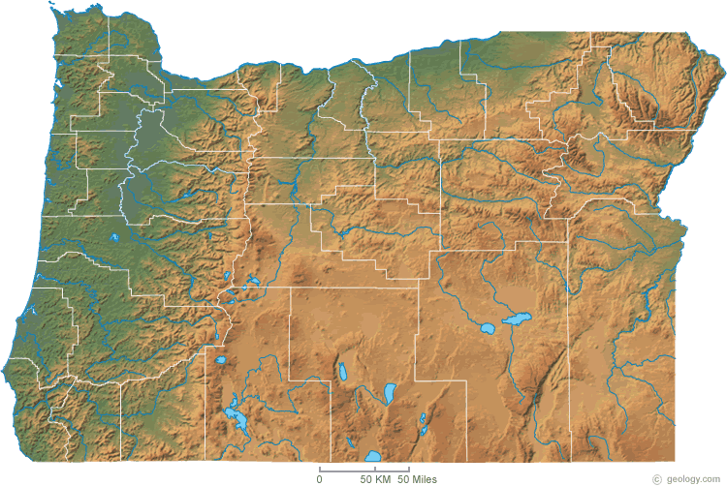
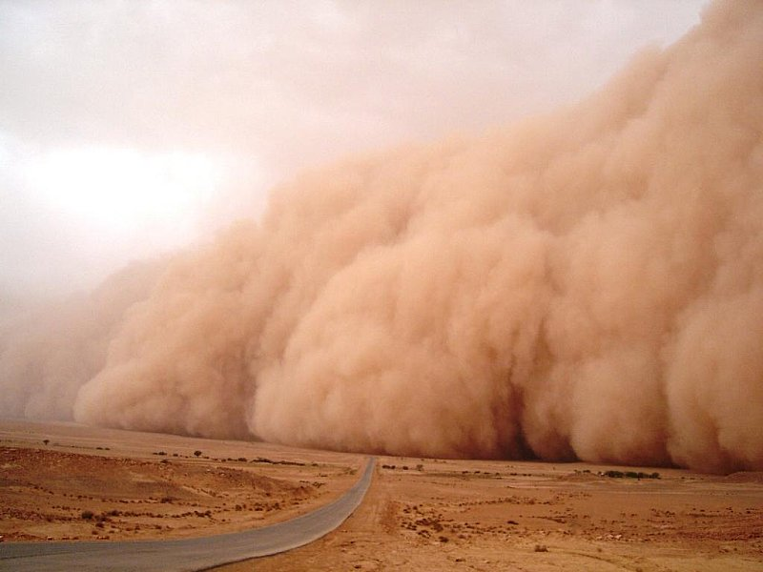
Opacity standard changes - Fugitive Emissions
Opacity limits no longer apply to fugitive emissions
Fugitive emission requirements apply statewide

Slide 33
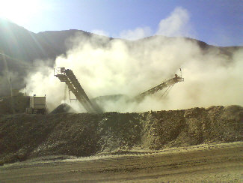
Opacity standard changes - Fugitive Emissions
Fugitive emissions that leave property for more than 18 seconds in a 6-minute period must be abated
DEQ may request fugitive emission control plan
Use EPA Method 22 to read fugitive emissions

Slide 34
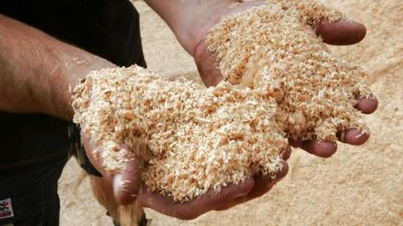
Particle Fallout
No person may cause or permit the deposition of particulate matter larger than 250 microns in size that creates an observable deposition upon the real property of another person when notified by the department that the deposition exists and must be controlled.
Permit serves as first “warning”
Resolve observed deposition with enforcement policy

Slide 35
Grain loading changes
Add significant digit to standards consistent with EPA policy
0.1 » 0.10
0.2 » 0.20
Phase out 0.2 gr/dscf for older sources to help address newer/tighter ambient air quality standards
Sources can request 1 year extension

Slide 36
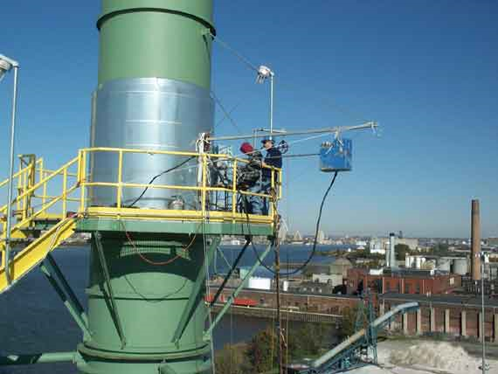
Grain loading changes continued
0.10 gr/dscf for ALL sources with “representative” compliance source test data < 0.080 gr/dscf
Notes:
In going from 40% down to 20%, we are making standard the same as for post-1970 units.
Required operation and maintenance plans will ensure emissions are minimized and limit the amount of time for grate cleaning or soot blowing

Slide 37
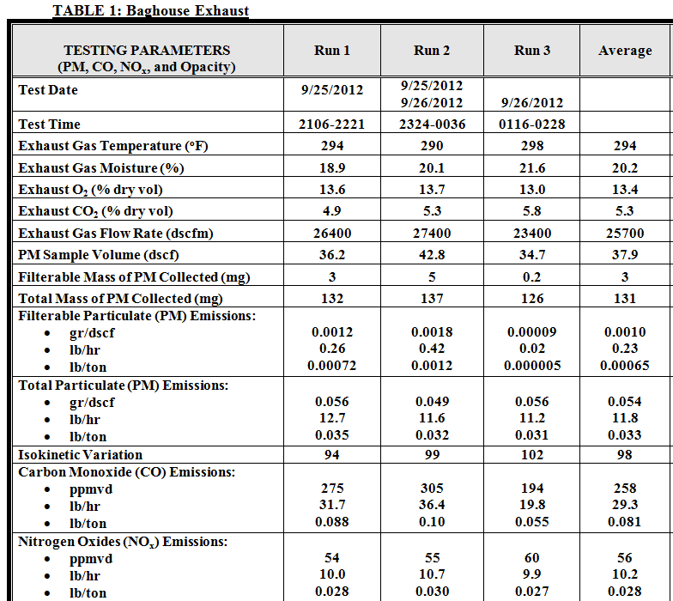
Grain loading changes continued
Representative compliance source test results obtained:
No more than ten years before 04/17/15; and
When a source is operating at Highest and Best
Notes:
In going from 40% down to 20%, we are making standard the same as for post-1970 units.
Required operation and maintenance plans will ensure emissions are minimized and limit the amount of time for grate cleaning or soot blowing

Slide 38
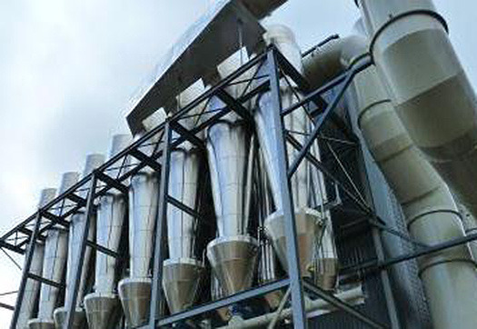
Grain loading changes continued Non-Fuel Burning Equipment
Source | Standard (gr/dscf)
 | Limit | Compliance Date
Pre 1970 | 0.24 | Until 12/31/19
Pre 1970 | 0.15 | On 01/01/20
Used < 876 hrs/yr | 0.20 | On 01/01/20
Post 1970 | 0.14 | Until 12/31/19
Post 1970 | 0.14 | On 01/01/20
After SOS date | 0.10 | After SOS date
Notes:
This is an overview of the proposed changes to the grain loading standards.
“Sensitive areas” are designated because of air quality problems

Slide 39
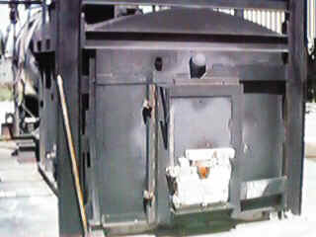
Grain loading changes continued Fuel Burning Equipment
Source | Standard (gr/dscf)
 | Limit | Compliance Date
Pre 1970 | 0.24 | Until 12/31/19
Pre 1970 | 0.15 | On 01/01/20
Used < 876 hrs/yr | 0.20 | On 01/01/20
Post 1970 | 0.14 | Until 12/31/19
Post 1970 | 0.14 | On 01/01/20
After SOS date | 0.10 | After SOS date
Notes:
This is an overview of the proposed changes to the grain loading standards.
“Sensitive areas” are designated because of air quality problems

Slide 40
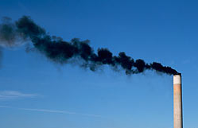
Grain loading changes continued Pre-1970 Fuel Burning Equipment
For boilers that cannot meet 0.15 gr/dscf:
Submit signed report by professional engineer after:
Multiclone maintenance and upgrade or
Boiler tune-up
Request specific limit of 0.17 gr/dscf by 10/01/19
Notes:
This is an overview of the proposed changes to the grain loading standards.
“Sensitive areas” are designated because of air quality problems

Slide 41
PM and Opacity Standards - Affected Sources
Boise Cascade (Pilot Rock) 30-0016
Collins (Fremont Sawmill) 19-0002
Columbia Forest Products 18-0014
Frank Lumber 22-2525
Interfor Pacific 18-0005
Swanson Group Roseburg 10-0030
Notes:
SIP required by Clean Air Act to maintain or attain compliance with National Ambient Air Quality Standards (NAAQS)
NAAQS for particulate matter was based on total particulate matter and was much less stringent than today’s standards.

Slide 42
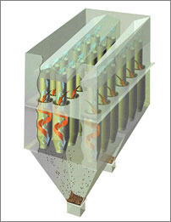
What might be necessary to comply with standards
Conduct more frequent tuning/maintenance
1977 28 MMBtu wood fired boiler; pre-test out of compliance; post-test less than 0.1 gr/dscf
Maintain consistent/high quality fuel
Improve combustion controls
Maintain/upgrade multiclone
Flue gas recirculation
Multiclone inspection

Slide 43

PM Standards
Notes:
In going from 40% down to 20%, we are making standard the same as for post-1970 units.
Required operation and maintenance plans will ensure emissions are minimized and limit the amount of time for grate cleaning or soot blowing

Slide 44

Break

Slide 45
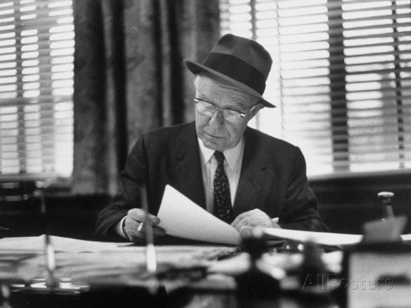
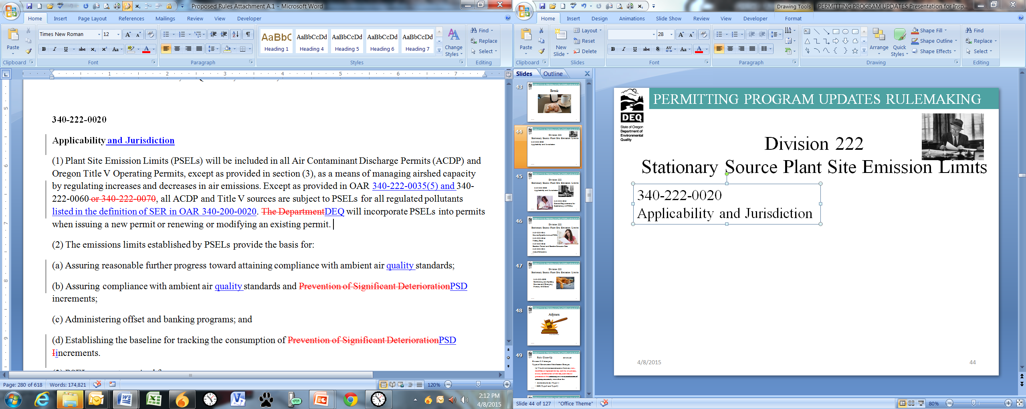
Division 222 Stationary Source Plant Site Emission Limits
340-222-0020
Applicability and Jurisdiction

Slide 46
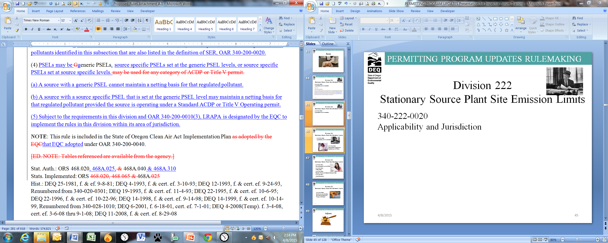
Division 222 Stationary Source Plant Site Emission Limits
340-222-0020
Applicability and Jurisdiction

Slide 47

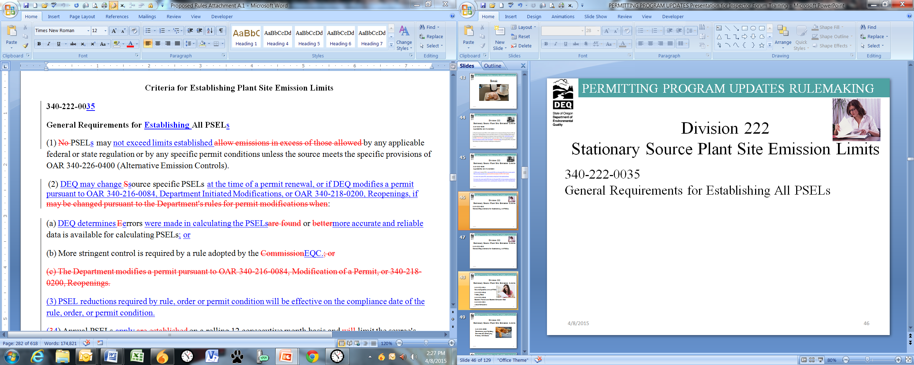
Division 222 Stationary Source Plant Site Emission Limits
340-222-0035
General Requirements for Establishing All PSELs

Slide 48
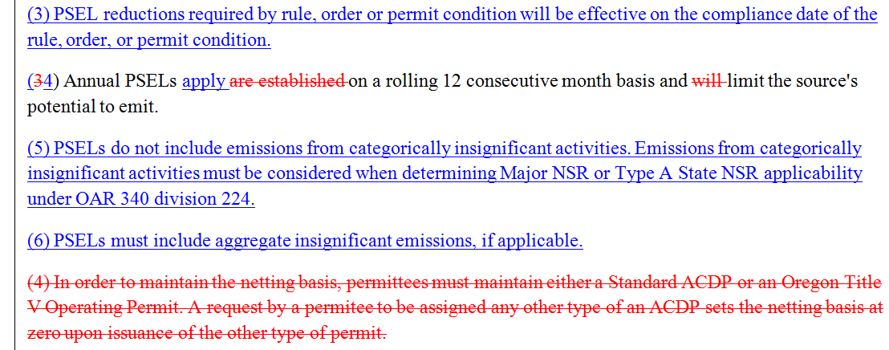
Division 222 Stationary Source Plant Site Emission Limits
340-222-0035
General Requirements for Establishing All PSELs

Slide 49

Division 222 Stationary Source Plant Site Emission Limits
340-222-0041
Source Specific Annual PSEL
340-222-0046
Netting Basis
340-222-0048
Baseline Period and Baseline Emission Rate
340-222-0051
Actual Emissions

Slide 50

Division 222 Stationary Source Plant Site Emission Limits
340-222-0090
Combining and Splitting Sources and Changing Primary SIC Code

Slide 51

Adjourn

Slide 52
Rule Clean-Up continued
Division 210 changes:
Types of Construction/Modification Changes
(c) Would not increase emissions from any new, modified, or replaced device, activity or process, or any combination of devices, activities or processes at the stationary source or combination of stationary sources by more than the:
de minimis levels (Type 1)
SER (Type 2 and Type 2)
Notes:
Unfortunately many businesses have shut down in Oregon so we plan to repeal those industry specific rules.
All other industry rules are staying the same, including Kraft Pulp Mills
If one of those sources wants to locate in Oregon, they would have to comply with current federal rules which are more stringent than our existing state rules. (New Source Review, New Source Performance Standards, National Emission Standards for HAPs)

Slide 53
Rule Clean-Up continued
Division 216 changes:
If more than one source category applies and not eligible for Basic or General, then Simple or Standard ACDP
Prorate annual fees for temporary closure based on length of closure in a calendar year, but will not be less than ½ of regular annual fee
Notes:
Unfortunately many businesses have shut down in Oregon so we plan to repeal those industry specific rules.
All other industry rules are staying the same, including Kraft Pulp Mills
If one of those sources wants to locate in Oregon, they would have to comply with current federal rules which are more stringent than our existing state rules. (New Source Review, New Source Performance Standards, National Emission Standards for HAPs)

Slide 54
Rule Clean-Up continued
Division 216 changes:
Reinstatement of Terminated Permit: automatically terminated permit only reinstated by:
Application for a new permit
Pay new source permit application fees, unless renewal application submitted within three months of expiration date
Notes:
Unfortunately many businesses have shut down in Oregon so we plan to repeal those industry specific rules.
All other industry rules are staying the same, including Kraft Pulp Mills
If one of those sources wants to locate in Oregon, they would have to comply with current federal rules which are more stringent than our existing state rules. (New Source Review, New Source Performance Standards, National Emission Standards for HAPs)

Slide 55
Rule Clean-Up continued
Division 216 changes:
Applications for new permits - submitted at least 60 days prior to when a permit is needed.
Consider the renewal timelines (mods too):
Permit Type | Renewal Submittal
General + Attachments | 30 days
Basic | 30 days
Simple | 120 days
Standard | 180 days
Notes:
Unfortunately many businesses have shut down in Oregon so we plan to repeal those industry specific rules.
All other industry rules are staying the same, including Kraft Pulp Mills
If one of those sources wants to locate in Oregon, they would have to comply with current federal rules which are more stringent than our existing state rules. (New Source Review, New Source Performance Standards, National Emission Standards for HAPs)

Slide 56
Rule Clean-Up continued
340-216-0064 Simple ACDPs
(2) Fees. Applicants for a new or modified Simple ACDP must pay the fees set forth in OAR 340-216-8020. Applicants for a new Simple ACDP must initially pay the High Annual Fee. Once the initial permit is issued, annual fees for Simple ACDPs will be assessed based on the following:
(a) Low Fee — A source may qualify for the low fee if:
(A) The source is, or will be, permitted under only one of the following categories from OAR 340-216-8010 Part B:
(i) Category 7. Asphalt felt and coatings;
Notes:
Unfortunately many businesses have shut down in Oregon so we plan to repeal those industry specific rules.
All other industry rules are staying the same, including Kraft Pulp Mills
If one of those sources wants to locate in Oregon, they would have to comply with current federal rules which are more stringent than our existing state rules. (New Source Review, New Source Performance Standards, National Emission Standards for HAPs)

Slide 57
Rule Clean-Up continued
340-216-0064 Simple ACDPs
Low Fee – continued
(ii) Category 13. Boilers and other fuel burning equipment (can be combined with category 27. Electric power generation);
(iii) Category 27. Electric power generation;
…..
(xii) Category 85. All other sources not listed in OAR 340-216-8010 (can be combined with category 27. Electric Power Generation); and
Notes:
Unfortunately many businesses have shut down in Oregon so we plan to repeal those industry specific rules.
All other industry rules are staying the same, including Kraft Pulp Mills
If one of those sources wants to locate in Oregon, they would have to comply with current federal rules which are more stringent than our existing state rules. (New Source Review, New Source Performance Standards, National Emission Standards for HAPs)

Slide 58
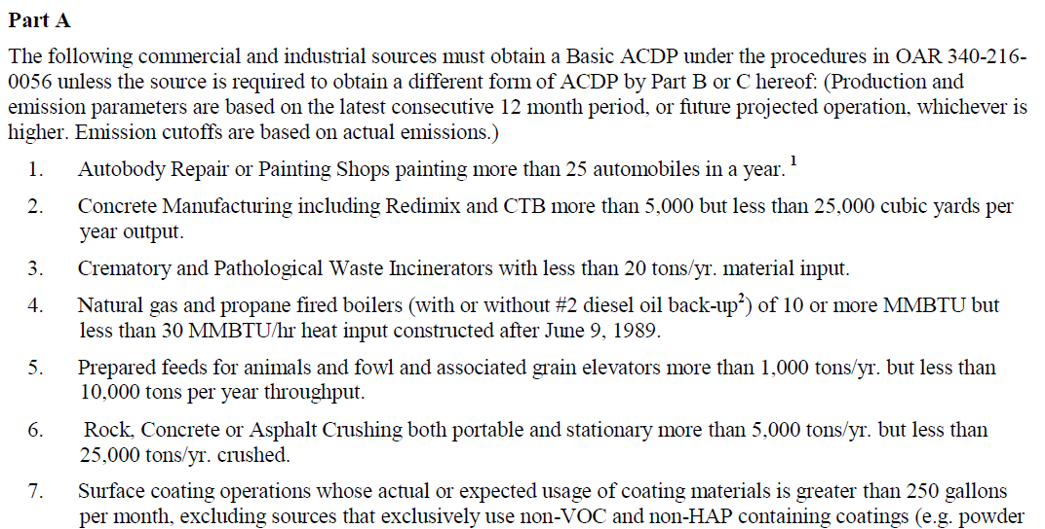
Rule Clean-Up continued
Division 216 Table changes:
Paragraphs at the top of each table moved to 340-216-0020 Applicability
Notes:
Unfortunately many businesses have shut down in Oregon so we plan to repeal those industry specific rules.
All other industry rules are staying the same, including Kraft Pulp Mills
If one of those sources wants to locate in Oregon, they would have to comply with current federal rules which are more stringent than our existing state rules. (New Source Review, New Source Performance Standards, National Emission Standards for HAPs)

Slide 59
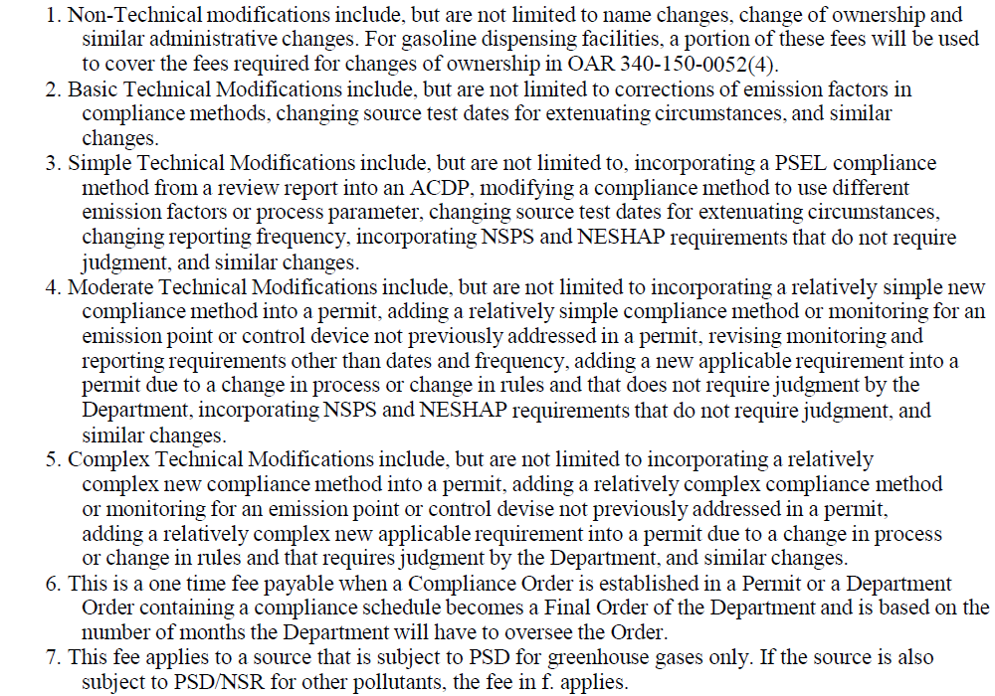
Rule Clean-Up continued
Division 216 Table changes:
Modification types in footnotes moved to division 216 definitions
Notes:
Unfortunately many businesses have shut down in Oregon so we plan to repeal those industry specific rules.
All other industry rules are staying the same, including Kraft Pulp Mills
If one of those sources wants to locate in Oregon, they would have to comply with current federal rules which are more stringent than our existing state rules. (New Source Review, New Source Performance Standards, National Emission Standards for HAPs)

Slide 60
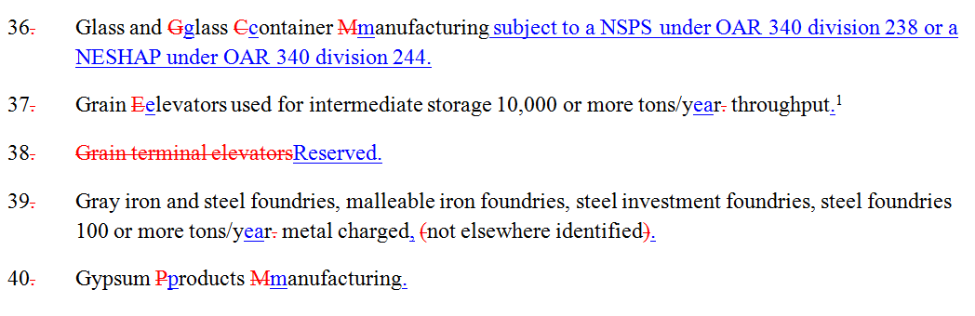

Rule Clean-Up continued
Division 216 Table changes:
List no longer alphabetical (new sources added to end)
No more renumbering Table 1 Codes!
Notes:
Unfortunately many businesses have shut down in Oregon so we plan to repeal those industry specific rules.
All other industry rules are staying the same, including Kraft Pulp Mills
If one of those sources wants to locate in Oregon, they would have to comply with current federal rules which are more stringent than our existing state rules. (New Source Review, New Source Performance Standards, National Emission Standards for HAPs)

Slide 61
Rule Clean-Up continued
Division 216 Table changes:
Source category changes:
Deleted grain terminal elevators #38 (use grain elevators #37 instead)
Added recreational vehicle manufacturing to manufactured home, mobile home manufacturing #47
Separated pathological waste incinerators #89 from crematory incinerators #25
Notes:
Unfortunately many businesses have shut down in Oregon so we plan to repeal those industry specific rules.
All other industry rules are staying the same, including Kraft Pulp Mills
If one of those sources wants to locate in Oregon, they would have to comply with current federal rules which are more stringent than our existing state rules. (New Source Review, New Source Performance Standards, National Emission Standards for HAPs)

Slide 62
Rule Clean-Up continued
Division 216 Table changes:
New Source Categories:
#87 Stationary internal combustion engines only if:
For emergency generators and firewater pumps, the aggregate engine horsepower rating is greater than 30,000 horsepower; or
For any individual non-emergency or non-fire pump engine, the engine is subject to 40 CFR part 63, subpart ZZZZ and is rated at 500 horsepower or more, excluding two stroke lean burn engines, engines burning exclusively landfill or digester gas, and four stroke engines located in remote areas; or
Notes:
Unfortunately many businesses have shut down in Oregon so we plan to repeal those industry specific rules.
All other industry rules are staying the same, including Kraft Pulp Mills
If one of those sources wants to locate in Oregon, they would have to comply with current federal rules which are more stringent than our existing state rules. (New Source Review, New Source Performance Standards, National Emission Standards for HAPs)

Slide 63
Rule Clean-Up continued
Division 216 Table changes:
New Source Categories:
#87 Stationary internal combustion engines only if (cont.):
Individual non-emergency engine subject to 40 CFR Part 60, Subpart IIII with:
Displacement of 30 liters or more per cylinder; or
Displacement of less than 30 liters per cylinder, >500 horsepower; or
Individual non-emergency engine subject to 40 CFR Part 60, Subpart JJJJ, is rated at >500 horsepower
Notes:
Unfortunately many businesses have shut down in Oregon so we plan to repeal those industry specific rules.
All other industry rules are staying the same, including Kraft Pulp Mills
If one of those sources wants to locate in Oregon, they would have to comply with current federal rules which are more stringent than our existing state rules. (New Source Review, New Source Performance Standards, National Emission Standards for HAPs)

Slide 64
Rule Clean-Up continued
Division 216 Table changes:
New Source Categories:
#88 All other portable sources not listed herein for which DEQ determines that:
An air quality concern exists;
The source would emit significant malodorous emissions; or
The source would have actual emissions, if the source were to operate uncontrolled, of 5 or more tons per year of direct PM2.5 or PM10 if located in a PM2.5 or PM10 non-attainment or maintenance area, or 10 or more tons per year of any single criteria pollutant if located in any part of the state.
Notes:
Unfortunately many businesses have shut down in Oregon so we plan to repeal those industry specific rules.
All other industry rules are staying the same, including Kraft Pulp Mills
If one of those sources wants to locate in Oregon, they would have to comply with current federal rules which are more stringent than our existing state rules. (New Source Review, New Source Performance Standards, National Emission Standards for HAPs)

Slide 65
Rule Clean-Up continued
Division 216 Table changes:
Consolidate Part C:
Remove duplicates already in Part B
Move other categories to Part B:
All Sources subject to a RACT, BACT, LAER, NESHAP adopted in OAR 340-244-0220, NSPS adopted in OAR 340-238-0060, State MACT, or other significant Air Quality regulation(s), except sources registered pursuant to OAR 340-210-0100(2).
Sources with less than 10 tons/year actual emissions that are subject to RACT, NSPS adopted in OAR 340-238-0060 or a NESHAP adopted in OAR 340-244-0220 which qualify for a Simple ACDP.
Chemical manufacturing facilities that do not transfer liquids containing organic HAP listed in Table 1 of 40 CFR part 63 subpart VVVVVV to tank trucks or railcars and are not subject to emission limits in Table 2, 3, 4, 5, 6, or 8 of 40 CFR part 63 subpart VVVVVV.
Notes:
Unfortunately many businesses have shut down in Oregon so we plan to repeal those industry specific rules.
All other industry rules are staying the same, including Kraft Pulp Mills
If one of those sources wants to locate in Oregon, they would have to comply with current federal rules which are more stringent than our existing state rules. (New Source Review, New Source Performance Standards, National Emission Standards for HAPs)

Slide 66
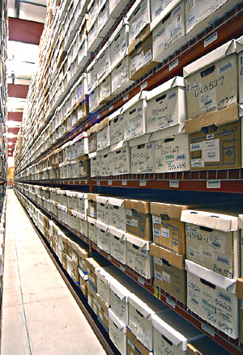
Rule Clean-Up continued
340-214-0114 Recordkeeping
ACDP sources must retain all records for at least five years from the date of the monitoring sample, measurement, report, or application
Keep two years of records onsite
Beginning July 1, 2015.
Notes:
Unfortunately many businesses have shut down in Oregon so we plan to repeal those industry specific rules.
All other industry rules are staying the same, including Kraft Pulp Mills
If one of those sources wants to locate in Oregon, they would have to comply with current federal rules which are more stringent than our existing state rules. (New Source Review, New Source Performance Standards, National Emission Standards for HAPs)

Slide 67

Rule Clean-Up
Questions?
Notes:
Do you have any questions before we move on to the next topic?
Our next presenter is Mark Fisher.

Slide 68
Nuisance Odor Update

Slide 69
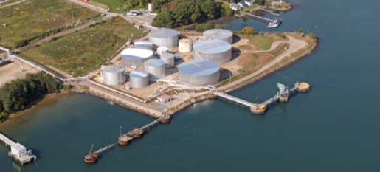
Gasoline Marine Loading
Expand marine loading rule to include other volatile liquids in the Portland Air Quality Maintenance Area

Slide 70
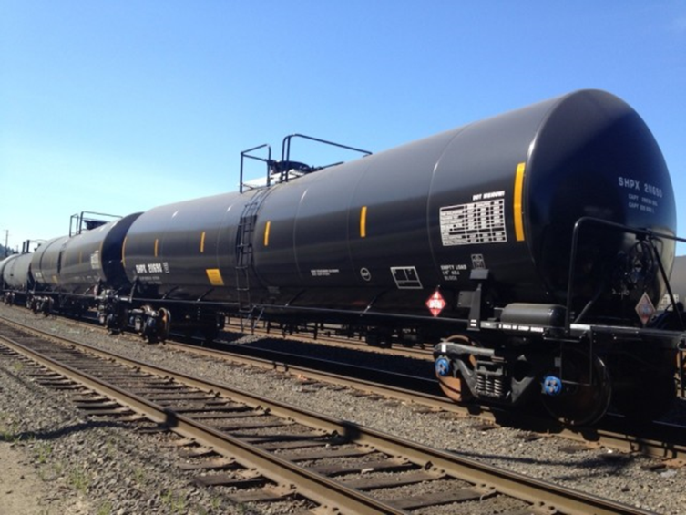
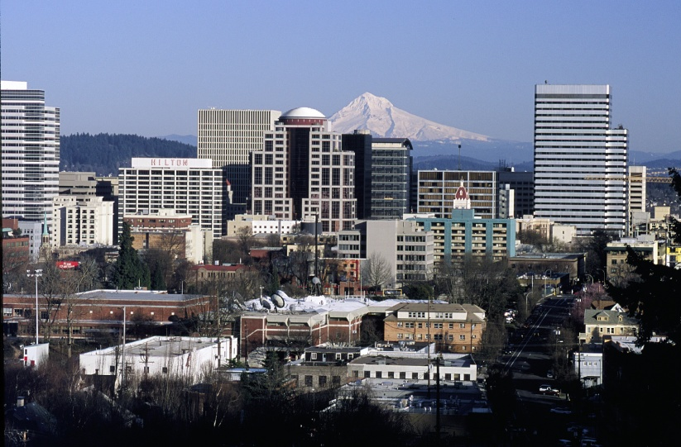
Why change marine loading rule?
Volatile crude oil shipments
EPA proposing stricter ozone standard

Slide 71
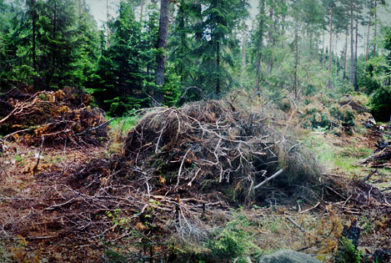
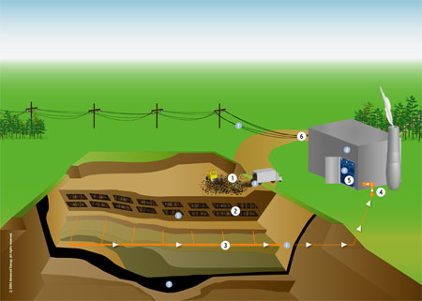
Biogenic CO₂ Deferral
Biogenic CO2 comes from:
Combustion of forest-derived and agriculture-derived feedstocks
Combustion of biogas collected from landfills, wastewater treatment or manure management processes

Slide 72
Biogenic CO₂ Deferral continued
2011 EPA exempted biogenic CO2 from permitting for 3 years
Assumes 100% carbon neutrality
Stopgap measure while EPA continues study
EQC adopted rule to follow EPA rule – automatically exempts if EPA exempts
2014 Supreme Court issued ruling
Deferral must be vacated, but…
Not officially vacated yet, may take years

Slide 73
Biogenic CO₂ Deferral continued
DEQ’s initial proposal was to:
Eliminate deferral
Acknowledge existence from 2011-2014
Final proposal is to:
Revert to 2011 rule
Automatically align with court ruling
Future Oregon rules won’t be more stringent than EPA’s rules

Slide 74

DEQ’s Greenhouse Gas Rules
The temporary rule adopted in November will be replaced with the proposed rules if adopted today.
TEMPORARY

Slide 75
Categorically Insignificant Activities
Background
Suggested changes
Effect of changes in relation to other regulatory programs

Slide 76

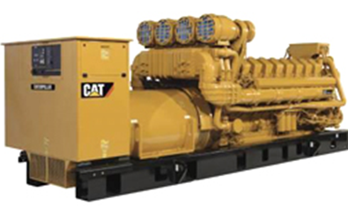
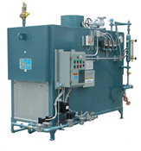
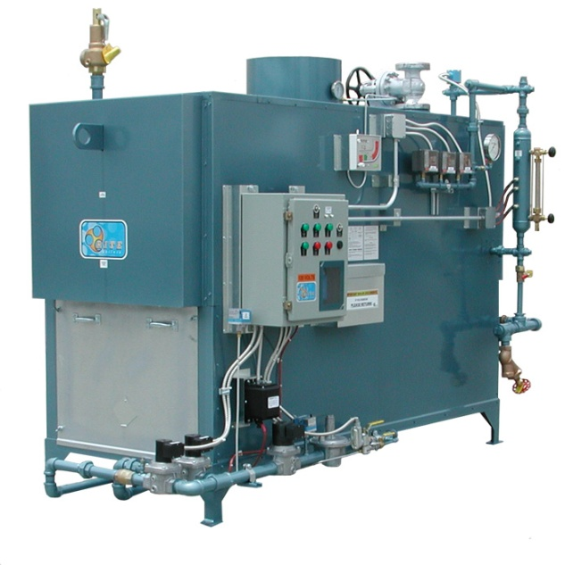
Categorically Insignificant Activities - background
Multiple - significant
Individual - insignificant

Slide 77
Categorically Insignificant Activities - background
Some of these activities are subject to new standards issued by EPA
Emissions from these activities were not considered when:
Determining what permits are necessary
Establishing Plant Site Emissions Limits

Slide 78
Emergency generators and pumps
Currently considered insignificant no matter how large or how many at site
Change categorically insignificant to:
Aggregate horsepower rating of all EGUs and pump engines less than 3000 horsepower; and
If aggregate horsepower rating of all EGUs and pump engines is more than 3,000 horsepower, then ALL considered significant.

Slide 79
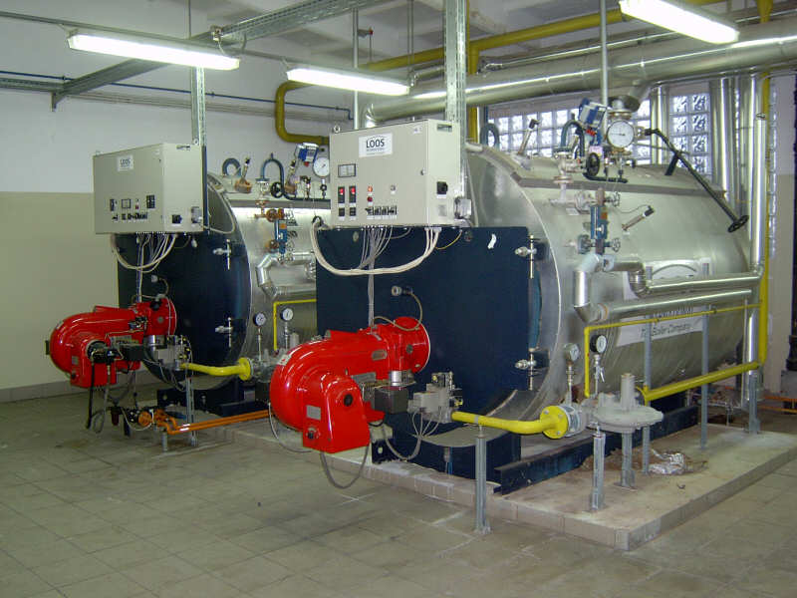
Small fuel burning equipment
Currently considered categorically insignificant no matter how many at a source
Change categorically insignificant to:
Retain current size threshold for individual units (0.4 MMBtu/hr oil; 2 MMBtu/hr gas)
Notes:
Units no longer considered insignificant. More stringent or have to get a permit? Not more stringent.

Slide 80
Small fuel burning equipment continued
Change categorically insignificant to:
Add emissions in aggregate < de minimis levels of 1 ton/year (2756 tons/yr for GHG)
If emissions > de minimis levels, then identify subgroup of such equipment as categorically insignificant with the remainder significant and included in PSEL
Notes:
Units no longer considered insignificant. More stringent or have to get a permit? Not more stringent.

Slide 81
Small fuel burning equipment continued
New Categorically Insignificant Activity:
Fuel burning equipment on site for < six months for maintenance, construction or similar purposes, (i.e., generators, pumps, hot water
pressure washers and space heaters) provided that equipment that performs same function as permanent equipment, must be operated within existing PSEL
Notes:
Units no longer considered insignificant. More stringent or have to get a permit? Not more stringent.

Slide 82
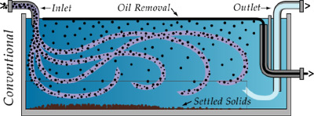
Oil/Water separators
Change categorically insignificant to:
Uncontrolled oil/water separators in effluent treatment systems excluding systems with throughput > 400,000 gallons/year located at petroleum refineries and re-refining of lubricating oils, greases, asphalt production by distillation and reprocessing of oils and/or solvents for fuels; or bulk gasoline plants, bulk gasoline terminals, and pipeline facilities
Notes:
Units no longer considered insignificant. More stringent or have to get a permit? Not more stringent.

Slide 83
Regulatory Considerations
The following regulatory programs may now apply to emergency generators and small fuel burning equipment:
Notice of intent to construct may apply to small sources not otherwise required to have permits
Air Contaminant Discharge Permits may be required for some sources – e.g., data centers with numerous emergency generators
General Permit for emergency generators
Notes:
Impacts on Business
Will need to provide emissions information for these small sources
A few businesses will need to get permits (data centers) and construction approval required for all
Small future emission increases may trigger other regulatory requirements for larger businesses
Impacts on Environment
Better accounting of emissions

Slide 84
Regulatory Considerations continued
Plant Site Emissions Limits (PSELs) for existing sources may need revision:
Adding emissions to PSELs for existing CIA sources will not trigger other requirements solely as a result of rule change NOW
Any future increase in the PSEL > to the de minimis level for any reason is subject to OAR 340-222-0041(4)
PSELs and baselines will be revised at next permit renewal after rules are adopted
Notes:
Impacts on Business
Will need to provide emissions information for these small sources
A few businesses will need to get permits (data centers) and construction approval required for all
Small future emission increases may trigger other regulatory requirements for larger businesses
Impacts on Environment
Better accounting of emissions

Slide 85
Regulatory Considerations continued
Revise PSELs and baseline emission rates for existing sources to include EGUs, pump engines, small fuel burning equipment, and oil/water separators no longer CIA:
If no records for CIA during baseline year….add emissions to PSEL and baseline based on current usage
Notes:
Impacts on Business
Will need to provide emissions information for these small sources
A few businesses will need to get permits (data centers) and construction approval required for all
Small future emission increases may trigger other regulatory requirements for larger businesses
Impacts on Environment
Better accounting of emissions

Slide 86

Categorically Insignificant Activities

Slide 87

LUNCH
Next section about NSR and changes,
Break for lunch?
Can leave or come back after lunch

Slide 88


Splitting Businesses
Background/issues
Suggested Rule Changes
Program integrity

Slide 89
Splitting Businesses – Background/Issues
If a business shuts down, splits, and/or repurposes, what happens to allowable emissions?
Potential for new business to avoid construction approval if using emissions from shutdown of one source to operate another source.
Clean Air Act construction approval ensures:
State of the art control technologies
No adverse impacts on air quality

Slide 90
Splitting Businesses – Rule Changes
Clarify how emissions are treated when a business splits
Emissions may only be transferred to:
New business(es) with same primary 2-digit SIC, or
different primary 2-digit SIC but DEQ determines the activities described by the two different primary 2-digit SIC essentially same
Amount of emissions transferred cannot exceed the “new” source’s potential to emit

Slide 91
Splitting Businesses – Program Integrity
Limits ability to use emissions for unrelated projects
Clarifies rules to ensure new source, if different than existing source, is subject to construction approval
Consistent with provisions that apply to physical changes or changes in the method of operation that apply to all sources.

Slide 92
Small Boiler Permitting
CRITERIA | NO PERMIT | BASIC ACDP | GENERAL, SIMPLE OR STANDARD ACDP
NSPS | Not applicable | Applicable | Not applicable or Applicable
Combined heat input | < 30 MMBtu/hr | < 30 MMBtu/hr | > 30 MMBtu/hr
Natural gas | Exclusive | Exclusive | No
#2 diesel backup | <10,000 gal/yr | <10,000 gal/yr | >10,000 gal/yr or any other backup fuel

Slide 93

Splitting Businesses

