Slide 1
Environmental Solutions, Water Quality Standards and Assessment Section
EQC Action Item: Water Quality Standards – Revisions to Freshwater Ammonia Criteria
January 7-8, 2014
Portland
Debra Sturdevant, Interim Manager | Andrea Matzke, WQ Standards Specialist
Notes:
Deb will introduce herself and then Andrea
Chair O’Keefe
Introductions
Today we are here to recommend that the Commission adopt amendments to Oregon’s water quality standards for ammonia, which are established to protect fish and other aquatic organisms.
We will give you some background information, explain why we propose these amendments and then we would be happy to answer questions.

Slide 2
DEQ’s recommendation
DEQ recommends that the EQC adopt proposed amendments to the Water Quality Standards rules as shown in Attachment A. These amendments:
  Revise Oregon’s freshwater ammonia criteria
  Correct a minor error in the Snake River rule language
  Amend site-specific standards for an irrigation canal in the Umatilla Basin
  Inform the reader that the general and temperature-specific natural conditions criteria are not in effect due to EPA disapproval
  Incorporate plain language revisions consistent with the Oregon Administrative Procedures Act
Notes:
In addition, staff recommend that the Commission adopt a few other minor rule amendments, outlined here.
These include:
Correcting an error in pH rule language for the Snake River
Revising the site specific standards for an irrigation canal in the Umatilla basin
Adding informational notes about the status of the natural conditions criteria
And incorporating some plain English revisions to the rules, which are not substantive.
I will explain these clarifications in more detail later in the presentation. But first, Andrea will provide some background information and an overview of the recommended changes to the ammonia criteria.

Slide 3
Why is DEQ proposing revisions?
To update Oregon’s ammonia criteria based on the latest science
  EPA’s latest recommendations (2013) are based on the sensitivity of ammonia to mussels, snails and other aquatic life
To address EPA disapproval of criteria adopted in 2004
Notes:
-Last year, EPA disapproved OR’s ammonia criteria that were adopted 10 yrs. ago in 2004. Since 2004, new toxicity data on the effects of ammonia to freshwater mussels and snails have become available and EPA has developed new recommendations for ammonia to protect mollusks and other aquatic life. These recommendations were finalized in 2013. DEQ intends to address EPA’s disapproval by adopting these recommendations based on the latest science.
-Ammonia is a pollutant commonly found in animal/human waste products and fertilizers

Slide 4
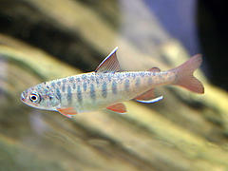
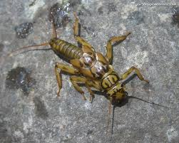
What are aquatic life toxics criteria?
Concentrations of a pollutant at which fish, shellfish and other aquatic life are protected
Toxics criteria are used in wastewater discharge permits, water quality assessments, TMDLs and the Cleanup Program
Beneficial use protected: fish and aquatic life
Notes:
-NH3 is one of the aquatic life toxic pollutants. OR has a total of 41 aquatic life pollutants. These criteria, including NH3, apply in waterbodies where the beneficial use is for fish and aquatic life. Although OR has a number of beneficial uses, the protection of fish and aquatic life is usually the most sensitive beneficial use to protect. Most waterbodies in OR have fish and aquatic life as a beneficial use.
-Toxics criteria are used in a number of CWA programs, so the criteria serve as a foundation for other programs.

Slide 5
2004 ammonia standards adoption
EQC adopted ammonia criteria based on EPA’s 1999 recommendations—these criteria have never been in effectusable for Clean Water Act actions
EPA must approve state revisions to water quality standards before they are in effect
  REQUIRED: Endangered Species Act (ESA) consultation with National Marine Fisheries Service (NMFS) and U.S. Fish & Wildlife Service for criteria affecting threatened and endangered species
Notes:
-In 2004, the EQC adopted revised ammonia criteria based on EPA’s latest recommendations at that time (1999). Any revisions to state WQS must be approved by the EPA to be effective for CWA purposes. However, before EPA could act on OR’s criteria, they needed to consult with the Services. The Endangered Species Act requires federal agencies, including EPA, to consult with the U.S. Fish and Wildlife Service and National Marine Fisheries Service to ensure that its actions, such as approval of DEQ water quality standards, are not likely to jeopardize the existence of threatened or endangered species or their critical habitats

Slide 6
2004 ammonia standards disapproval
Aug. 2012: NMFS ESA consultation indicated that Oregon’s ammonia criteria would cause harm to T&E species
Jan. 2013: EPA disapproved the ammonia criteria:
  do not protect freshwater mussels and snails, and
  according to NMFS would cause jeopardy to T&E species
Oregon’s effective criteria continue to be based on EPA’s 1985 recommendations
Oregon needs to respond to disapprovals in a timely manner
Notes:
-It took almost 8 yrs. to complete ESA consultation given technical issues and eventually litigation to get EPA and the Services to complete their analyses.
-read through bullets
-The CWA requires EPA to propose criteria for OR if OR doesn’t adopt the changes specified in the disapproval w/in 90 days of action. (not realistic given a state’s rulemaking process)
BACKPOCKET: FWS also issued a BiOp on OR’s ALC (July 30, 2012), but did not find jeopardy with OR’s 1999 ammonia criteria (based on effects to bull trout, OR chub, Lost River sucker, shortnose sucker, vernal pool fairy shrimp, marbled murrelet)

Slide 7
EPA’s Aug. 2013 recommendations
DEQ proposes to adopt EPA’s 2013 ammonia criteria recommendations
EPA used 27 years of toxicity data—largest dataset of all aquatic life criteria, including data on:
  Mussels and snails, some of the most sensitive species
  14 threatened and endangered species (5 are mussels)
Ammonia toxicity depends on pH and temperature
  As pH and temperature increase, the criteria become more stringent
Notes:
Deb’s suggestion:
1. DEQ recommends that Oregon adopt EPA’s latest ammonia recommendations, which were finalized in 2013.
2. EPA used a very large data set for the development of these recommended criteria. They included toxicity impacts to sensitive mussels and snails, as well as to 14 different T&E species, including several salmon and trout species found in Oregon.
Backpocket:
-EPA conducted literature reviews from 1985 through October 2012 (27 yrs.) and have been working on developing updated NH3 criteria since their 1999 rec’s (13 yrs.)
-- first explicit analysis of T&E species in an EPA criteria doc—14 T&E species OR species: Coho salmon, Rainbow trout (OR-steelhead), Chinook salmon, Lost River sucker, Lahontan cutthroat trout, Sockeye salmon
Topeka shiner, Shortnose sturgeon, Atlantic salmon
BACKPOCKET: Data met EPA’s guidelines for developing ALC--All 8 families are represented in the dataset:
Eight families:
1.Salmonid 4.Planktonic Crustacean—daphnia, copepods, amphipods
2.Second Fish Family 5.Benthic Crustacean—crabs, lobster
3.Chordata—salamanders, frogs 6.Insect—mayflies, stoneflies, dragonflies
7.Rotifer, Annelida, Mollusca 8.Other Insect or Mollusca

Slide 8
Proposed ammonia criteria revisions
Expressed as mg/L TAN—Total Ammonia Nitrogen (NH3 and NH4)
Acute criteria (1-hr duration)
  Generally more stringent than Oregon’s current criteria
  Two sets of criteria apply based on presence or absence of salmon and trout
Chronic criteria (4-day and 30-day duration)
  Generally, less stringent than Oregon’s current criteria
  One set of criteria, not dependent on presence of salmon and trout
Notes:
-EPA has rec’d TAN expression since 1999. OR’s current criteria are expressed as unionized ammonia
-ACUTE CRITERIA
- The majority of OR waterbodies support salmonid use, so the more stringent criteria would apply in most waterbodies here in OR
(other waterbodies support cool water species or Borax Lake chub (i.e. include highly alkaline and saline lakes in Goose and Summer Lake subbasin, the lower portions of the Klamath, Malheur and Owyhee Rivers and a few other stream reaches)
-The 4 most sensitive species are mussels
-CHRONIC CRITERIA
-30 day averaging period began with EPA’s 1999 criteria rec’s
-The 5 most sensitive species are mussels, a clam, bluegills/sunfish and the pebblesnail

Slide 9
Notes:
-This graph shows a comparison between OR’s current acute criteria and the proposed (EPA) criteria at pHs of 6.5, 7 and 8. The solid lines are the proposed criteria, while the dotted lines are OR’s current criteria
-As indicated earlier, ammonia toxicity is dependent on pH and temperature
-as pH and temperature increases, the amount of unionized ammonia, the more toxic form of ammonia, predominates. Therefore, the criteria are more stringent as pH and temperature rise.
At higher temps, the proposed criteria are more stringent, while at lower temps, the proposed criteria are generally less stringent than OR’s current criteria

Slide 10
Note: The graph above shows current ammonia chronic criteria at pH of 6.5 and 7.0 on one line because they are almost identical. Current criteria based on salmonid presence. Presence or absence of salmonids is not applicable for the proposed chronic criteria.
Notes:
-This is a comparison graph of the proposed chronic criteria using the 4-day statistic against OR’s current chronic criteria which is based on a 4-day average.
-The solid lines are the proposed criteria, while the dotted lines are OR’s current criteria. Again, criteria become more stringent as temp and pH increase
-The proposed chronic criteria are less stringent than OR’s chronic criteria, particularly at lower temps
-There will be 3 look up tables for the ammonia criteria

Slide 11
NMFS and EPA discussions
NMFS and EPA are currently evaluating whether EPA’s 2013 criteria address the Reasonable and Prudent Alternatives in NMFS’s biological opinion.
Notes:
-EPA and NMFS are evaluating how EPA’s latest 2013 recommendations are consistent with the Reasonable and Prudent Alternatives in NMFS’s jeopardy opinion. If NMFS determines that EPA’s criteria derivation method generally followed the Reasonable and Prudent Alternatives in the BiOp, then NMFS can conclude that EPA’s 2013 ammonia criteria protect threatened and endangered species in Oregon, thus satisfying Endangered Species Act consultation requirements. A positive conclusion would likely lead to EPA approval of OR’s proposed criteria.
-EPA has been working w/ NMFS since this summer.
Backpocket only: NMFS believes EPA’s 2013 chronic criterion would likely be protective because the value is so close to Oregon’s 1985 criterion which was a value stated in the BiOp. EPA needs to show how the acute criteria are consistent with the “specific process” NMFS specified in the BiOp.
EPA is optimistic that its criteria are protective of T&E salmonids
Under the CWA, DEQ is obligated to address disapprovals in a timely manner
Submittal of state adopted criteria encourages EPA and NMFS to act in a timely manner
If Oregon’s adoption of EPA’s 2013 recommended criteria not approvable, DEQ would seek guidance from EPA on acceptable alternatives.

Slide 12
Proposed revisions to Toxics Rule OAR 340-041-0033
Toxics Substances
DEQ is proposing to move Tables 30 (Aquatic Life Criteria), 31 (Guidance Values for Aquatic Life) and 40 (Human Health Criteria) to a separate rule in OAR 340-041-8033.
  Table 30: edits to ammonia criteria and addition of three ammonia criteria tables
  Table 31: minor non-substantive edits
  Table 40: no amendments
Incorporate plain language into -0033 consistent with the Oregon Administrative Procedures Act.
Notes:
-DEQ is proposing changes to its regulations in Chapter 340 in the Toxic Substances rule. This is where the toxics WQ criteria are found.
-DEQ’s intention is to begin moving all tables to the rule 8000 series for every division to make it easier for the public to find all the tables associated with a division.
-Plain English: should not be substantive changes (e.g. department to DEQ)

Slide 13
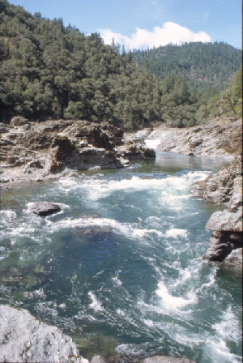
Implementing revised criteria
Integrated Report
16 ammonia-impaired waterbodies
DEQ will re-assess listings in the next cycle of the Integrated Report
  DEQ may de-list waterbodies that meet the new ammonia criteria
Notes:
- Revisions to the ammonia criteria impact other CWA programs
IR:
2010:15 waterbodies impaired for ammonia—5 need TMDLs, 10 approved TMDLs
2012: 1 additional impaired ammonia listing needing a TMDL
-DEQ’s Integrated Report staff use the chronic criteria for ammonia to evaluate whether waterbodies are meeting state water quality standards. The chronic criteria are expected to be less stringent than Oregon’s criteria.

Slide 14
Implementing revised criteria
Total Maximum Daily Loads (TMDLs)
If a waterbody is listed for ammonia, DEQ must develop a TMDL—ten approved TMDLs
DEQ may need to re-assess current ammonia TMDL wasteload and load allocations based on revised ammonia criteria
Notes:
-6 waterbodies need a TMDL
-Could be based on the chronic 30-day rolling average, the 2.5 times the chronic criterion four-day average within the 30-day rolling average, or even the acute criteria duration based on a one-hour average. TMDL considerations will be addressed following adoption of criteria

Slide 15
Implementing revised criteria
Wastewater and Industrial Dischargers
Generally, the proposed chronic criteria are less stringent than current criteria
Some facilities may need to update mixing zone studies or collect more monitoring data to characterize effluent based on the new 30-day chronic average (rather than the current 4-day average)
Notes:
-A change in NH3 criteria primarily affects individual discharge permits, rather than general permits, stormwater or construction permits. Generally, the proposed criteria are less stringent than current criteria.
-Due to anti-backsliding rules, in cases where the proposed ammonia criteria result in effluent limits that are less stringent than the current limits, DEQ would typically preserve the more stringent limit
[Antideg exceptions: (1) approved TMDL results in less stringent effluent limits; (2) EQC-approved pollutant load; (3) exceptions in CWA 402(o)(2) (e.g. technical mistakes, new info available, etc.]
[MZs: DEQ has the option to use 30Q5 (lowest 30 day ave. Q based on a 5 yr. interval) or 30Q10 design flows to determine compliance w/ chronic criteria. 30Q5 is what dischargers use for the human health toxics criteria]
-additional permitting and monitoring considerations will be addressed following adoption of criteria
-Debra will be covering the next few slides on the corrections we’re proposing
BACKPOCKET: Currently, the amount of monitoring required is based upon a facility’s flow capacity
larger facilities (4 per month) require more monitoring than smaller facilities (1-2 per month)

Slide 16
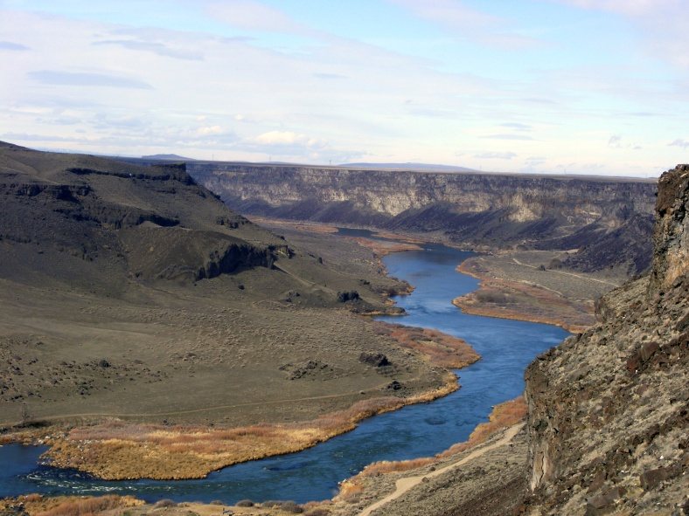
Other proposed rule amendments
Snake River pH Rule
In 2003, DEQ identified the wrong river miles for the main stem Snake River
Proposed revision clarifies that the pH criteria applies to the entire main stem Snake River.
Notes:
HAND OVER TO DEBRA
The pH criteria in Oregon’s water quality standards vary slightly by basin or waterbody. In 2003, DEQ reorganized Division 41 rules. During this process, criteria for the main stem Snake River were place in one rule, but the wrong river miles were inadvertently identified in the pH criteria. The rule amendment proposed today simply removes the river miles identified in the pH criterion language to remove any ambiguity about where the pH criterion applies.
Shown on P. of Attachment A.
(OAR 340-041-0124) –
Standard is 7.0 – 9.0
Had previously been divided into different basins (Grand Ronde, Owyhee, Powder, Malheur)

Slide 17
Other proposed rule amendments
West Division Main Canal Site-Specific Criteria
In 2012, EQC removed certain designated uses and adopted site-specific criteria for this irrigation canal in the Umatilla Basin.
EPA partially approved and partially disapproved the changes.
Proposed revisions make Oregon’s rule language consistent with the effective criteria following EPA’s action.
Notes:
Where appropriate, indicate where sections apply to upper (constructed channel) portion or lower portion only. Changes to OAR 340-041-0315, Table 315 and Table 310A.

Slide 18
Proposed rule clarifications
Natural Conditions Criteria Notes
In 2013, EPA disapproved:
  the temperature natural conditions criterion, and
  a general natural conditions narrative.
Proposed editorial notes are informational:
  these provisions are no longer effective for Clean Water Act purposes, such as permitting and TMDLs
Notes:
-As a result of litigation
-Not amending any rules, but only adding clarifying notes, so DEQ did not take public comment on these clarifications.
One public commenter believes the addition of these notes are ambiguous, while several other commenters supported the notes.
-DEQ did not remove the disapproved portions of the statewide natural conditions criterion and the natural conditions criterion for temperature because the agency has not yet determined how it proposes to address EPA’s disapproval of these standards. DEQ will consider how to address natural variability in stream temperature and other situations in which water quality criteria are unattainable due to natural conditions, and expects to make recommendations to the EQC for revising these water quality standards. As a result, the natural conditions provisions are still part of EQC’s policy, even though they are not effective for Clean Water Act purposes. As part of the standards review and rulemaking process, DEQ will provide an opportunity to comment on the proposed revisions to the temperature standard.

Slide 19
Public input
Stakeholder discussions prior to rulemaking
No advisory committee—DEQ did not anticipate significant fiscal impacts or controversy
DEQ webinar on Sept. 10 prior to public comment period
Public comment: Sept. 16 – Oct. 30
  Five commenters
One public hearing in Portland: Oct. 15
  One attendee
Notes:
-HAND BACK TO ANDREA
-Prior to initiating rulemaking, DEQ sent an invitation to Oregon tribes and to a wide range of stakeholders to discuss and provide input to DEQ on rulemaking priorities to address EPA disapproved criteria for aluminum, ammonia, cadmium (acute) and copper. During these meetings, DEQ also shared information about EPA’s updated criteria for freshwater copper and ammonia. Several stakeholders indicated that an advisory committee was not needed and that DEQ should initiate rulemaking as quickly as possible
-DEQ did not convene an advisory committee because we did not anticipate that the proposed rules would have a significant fiscal or economic impact or would be controversial.
-5 public comments received: Generally, commenters either supported the ammonia rule revisions or were neutral
NH3 Comments:
-DEQ received one public comment questioning why we propose to adopt revisions now, rather than wait for NMFS’s opinion
-One public commenter stated concern in allowing mixing zones
-Sensitive, non-mobile species, such as mussels cannot move out of the toxic zone like fish can
-DEQ is not proposing revisions to its mixing zone policy as a part of this rulemaking—DEQ

Slide 20
When will the proposed rules become effective?
The ammonia revisions will become effective after EQC adoption and subsequent EPA approval
Other revisions will become effective upon EQC adoption and filing with Secretary of State.
Notes:
-EPA has 90 days to take action on OR’s revised criteria.

Slide 21
DEQ’s recommendation
DEQ recommends that the EQC adopt proposed amendments to OAR 340, Division 41 as shown in Attachment A. These amendments:
  Revise Oregon’s freshwater ammonia criteria
  Correct a minor error in the Snake River rule language
  Amend site-specific standards for an irrigation canal in the Umatilla Basin
  Inform the reader that the general and temperature-specific natural conditions criteria are not in effect due to EPA disapproval
  Incorporate plain language revisions consistent with the Oregon Administrative Procedures Act
Notes:
-This is the conclusion of DEQ’s formal presentation on this proposed rule. We would be happy to answer any questions the commissioners may have.

Slide 22
Extra Slides

Slide 23

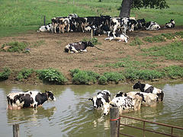
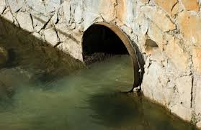
Sources of Ammonia
Pollutant found in fertilizers and waste products:
Municipal and industrial waste
Septic systems seepage and landfill leachate
Fertilizer runoff from agricultural and urban sources
Manure application
Aquaculture

Slide 24
Effects to Aquatic Life
Fish
Gill damage and increased ventilation rates
Reduction in blood oxygen capacity
Disruption of osmoregulation (cell function/excretion)
Invertebrates (mussels)
Reduced opening of valve for respiration and feeding
Impairs secretion of the byssus or “anchoring threads” in bivalves
Reduced ciliary action on gills

Slide 25
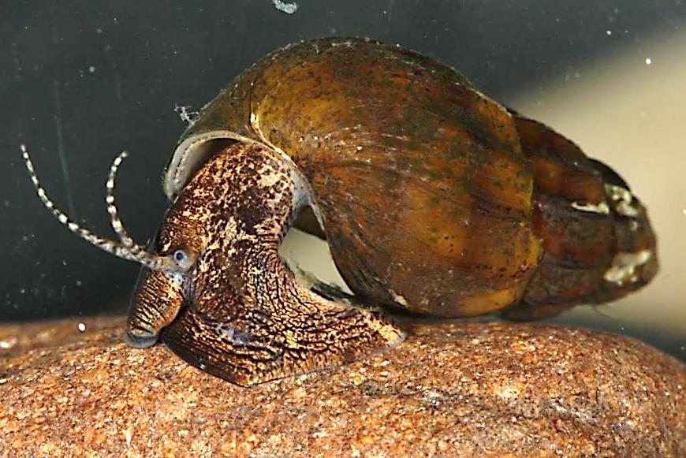
Mollusks—Freshwater Sentinel
Diverse- there are over 1000 North American freshwater taxa
Broadly distributed in benthic habitats (especially snails)
Long-lived and sedentary
(especially mussels)
Sensitive e.g. ammonia, chlorine, Cu
Protected species 118 federally listed
(88 mussels, 30 snails)
Photo Credit: Chris Barnhart
Photo Credit: Chris Barnhart
Notes:
-Borrowed this slide from Chris Barnhart at Missouri State Univ. who has done quite a bit of research on mussel toxicity
-Mussels and snails are important to food webs, water quality, nutrient cycling and habitat quality in freshwater systems.
-much higher diversity of mussels in the eastern part of the U.S. (AL, TN, GA, KY, MS)

Slide 26
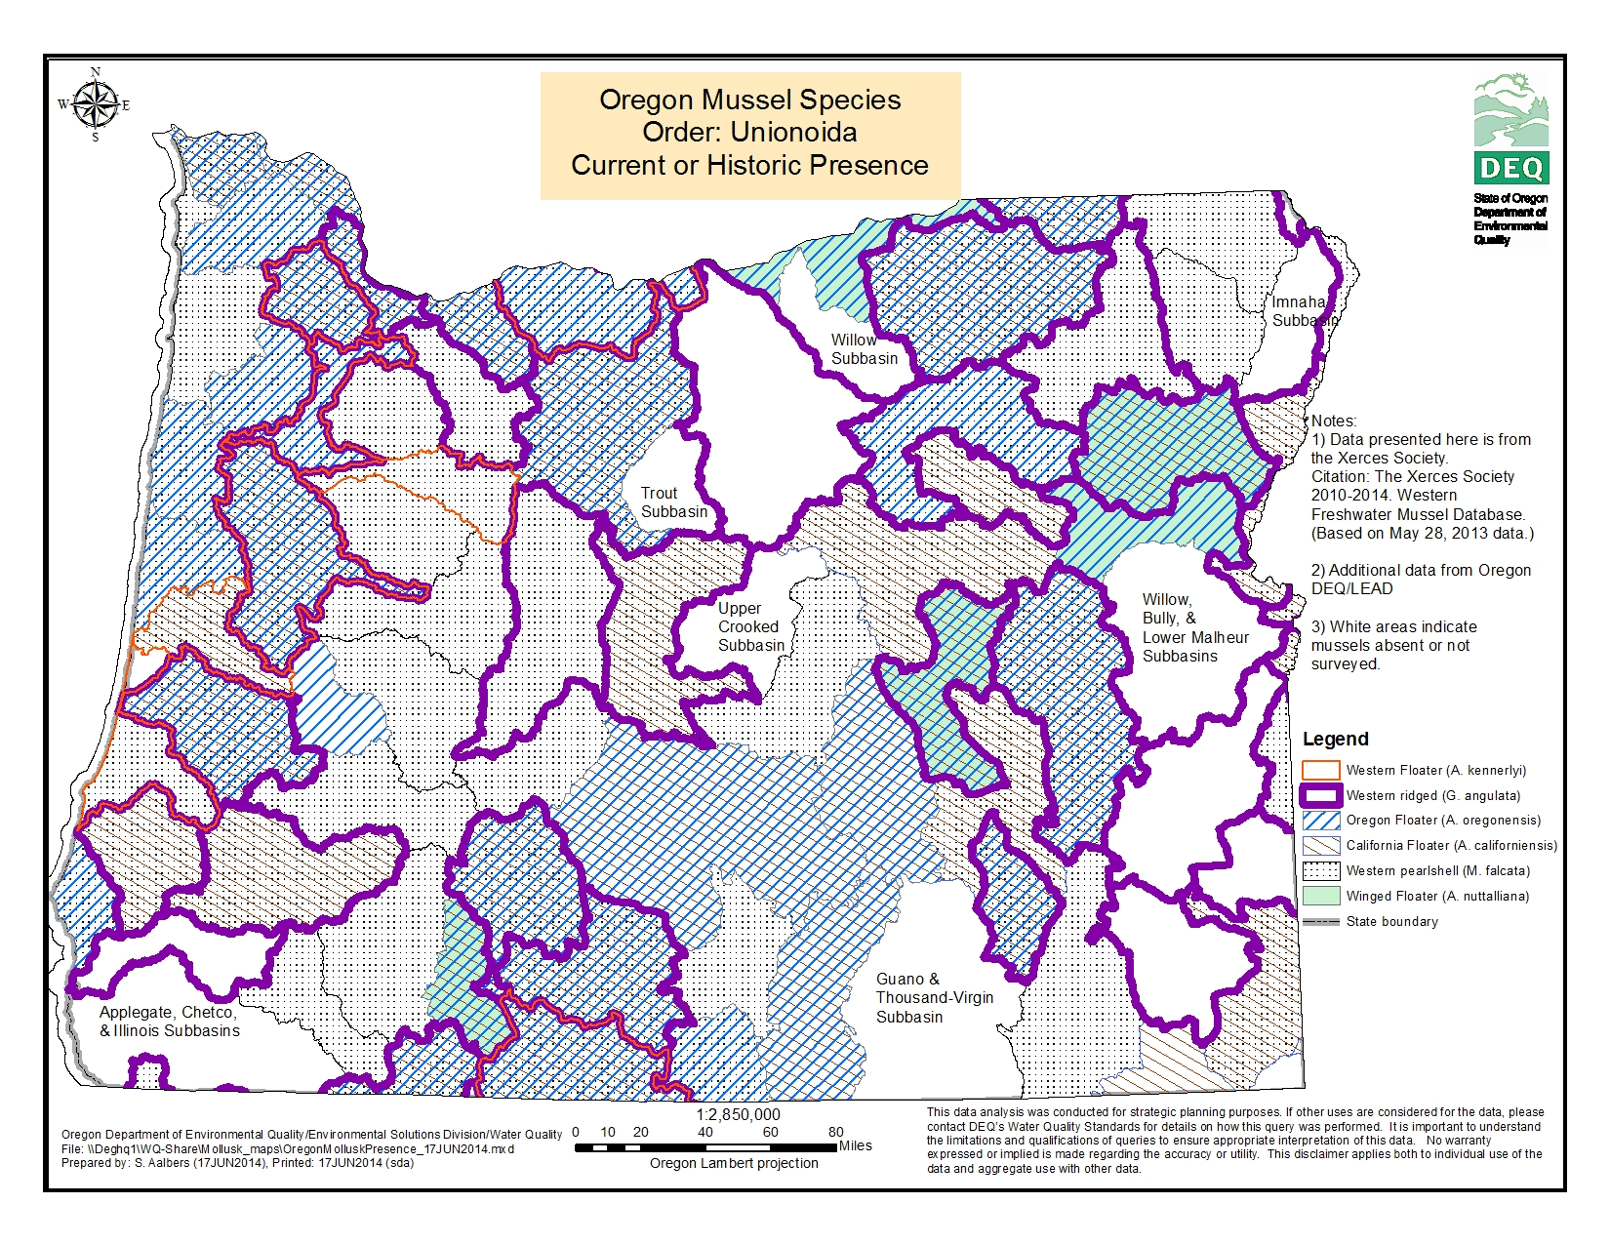
Notes:
-DEQ worked with the Xerces Society to locate mussel data in OR. Data indicates there are 6 species of mussels in Oregon. None of these species are federally listed. ussels are pretty widespread across the state, although just because the subbasin shows mussels present, it doesn’t necessarily mean ALL waterbodies in that basin have mussels.
-The majority of N.A. freshwater mussels are in the Unionidae family
-Unionid families in OR: Gonidia and Anodonta (“floaters”)
-We also have the Western Pearlshell which is in the Margaritifera family (pearl mussels)
-The 6 subbasins don’t necessarily reflect absence of mussels, but more likely that specific mussel surveys have not been done there

Slide 27
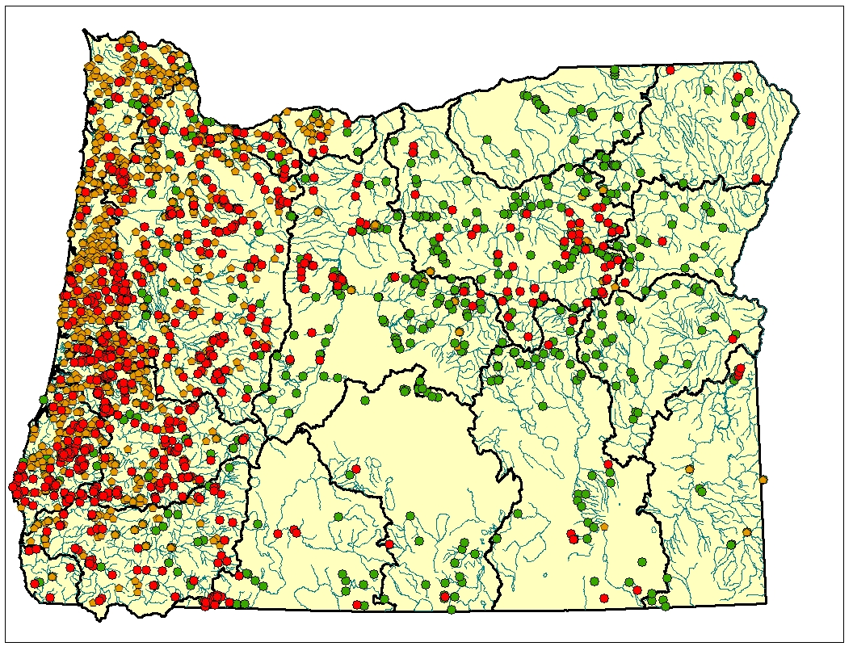
Pulmonate and Non-Pulmonate Snail Presence in Oregon
Pulmonate snails
DEQ database
WMC database
Non-pulmonate (gilled) snails
DEQ database
WMC database
Notes:
-DEQ and Western Monitoring Center (UT state univ.) data sources indicate there are approximately 16 species or taxa of snails in Oregon (probably more though). As you can see from this map, snails are widespread across OR.

Slide 28
Table 1: Ammonia Acute Criteria Values (One-hour Average)—Salmonid Species Present Temperature and pH-Dependent and expressed as Total Ammonia Nitrogen (mg/L TAN)
Criteria cannot be exceeded more than once every three years
Temperature (ºC)
pH | 0-14 | 15 | 16 | 17 | 18 | 19 | 20 | 21 | 22 | 23 | 24 | 25 | 26 | 27 | 28 | 29 | 30
6.5 | 33 | 33 | 32 | 29 | 27 | 25 | 23 | 21 | 19 | 18 | 16 | 15 | 14 | 13 | 12 | 11 | 9.9
6.6 | 31 | 31 | 30 | 28 | 26 | 24 | 22 | 20 | 18 | 17 | 16 | 14 | 13 | 12 | 11 | 10 | 9.5
6.7 | 30 | 30 | 29 | 27 | 24 | 22 | 21 | 19 | 18 | 16 | 15 | 14 | 13 | 12 | 11 | 9.8 | 9.0
6.8 | 28 | 28 | 27 | 25 | 23 | 21 | 20 | 18 | 17 | 15 | 14 | 13 | 12 | 11 | 10 | 9.2 | 8.5
6.9 | 26 | 26 | 25 | 23 | 21 | 20 | 18 | 17 | 15 | 14 | 13 | 12 | 11 | 10 | 9.4 | 8.6 | 7.9
7.0 | 24 | 24 | 23 | 21 | 20 | 18 | 17 | 15 | 14 | 13 | 12 | 11 | 10 | 9.4 | 8.6 | 8.0 | 7.3
7.1 | 22 |  | 21 | 20 | 18 | 17 | 15 | 14 | 13 | 12 | 11 | 10 | 9.3 | 8.5 | 7.9 | 7.2 | 6.7
7.2 | 20 | 20 | 19 | 18 | 16 | 15 | 14 | 13 | 12 | 11 | 9.8 | 9.1 | 8.3 | 7.7 | 7.1 | 6.5 | 6.0
7.3 | 18 | 18 | 17 | 16 | 14 | 13 | 12 | 11 | 10 | 9.5 | 8.7 | 8.0 | 7.4 | 6.8 | 6.3 | 5.8 | 5.3
7.4 | 15 | 15 | 15 | 14 | 13 | 12 | 11 | 9.8 | 9.0 | 8.3 | 7.7 | 7.0 | 6.5 | 6.0 | 5.5 | 5.1 | 4.7
7.5 | 13 | 13 | 13 | 12 | 11 | 10 | 9.2 | 8.5 | 7.8 | 7.2 | 6.6 | 6.1 | 5.6 | 5.2 | 4.8 | 4.4 | 4.0
7.6 | 11 | 11 | 11 | 10 | 9.3 | 8.6 | 7.9 | 7.3 | 6.7 | 6.2 | 5.7 | 5.2 | 4.8 | 4.4 | 4.1 | 3.8 | 3.5
7.7 | 9.6 | 9.6 | 9.3 | 8.6 | 7.9 | 7.3 | 6.7 | 6.2 | 5.7 | 5.2 | 4.8 | 4.4 | 4.1 | 3.8 | 3.5 | 3.2 | 3.0
7.8 | 8.1 | 8.1 | 7.9 | 7.2 | 6.7 | 6.1 | 5.6 | 5.2 | 4.8 | 4.4 | 4.0 | 3.7 | 3.4 | 3.2 | 2.9 | 2.7 | 2.5
7.9 | 6.8 | 6.8 | 6.6 | 6.0 | 5.6 | 5.1 | 4.7 | 4.3 | 4.0 | 3.7 | 3.4 | 3.1 | 2.9 | 2.6 | 2.4 | 2.2 | 2.1
8.0 | 5.6 | 5.6 | 5.4 | 5.0 | 4.6 | 4.2 | 3.9 | 3.6 | 3.3 | 3.0 | 2.8 | 2.6 | 2.4 | 2.2 | 2.0 | 1.9 | 1.7
8.1 | 4.6 | 4.6 | 4.5 | 4.1 | 3.8 | 3.5 | 3.2 | 3.0 | 2.7 | 2.5 | 2.3 | 2.1 | 2.0 | 1.8 | 1.7 | 1.5 | 1.4
8.2 | 3.8 | 3.8 | 3.7 | 3.5 | 3.1 | 2.9 | 2.7 | 2.4 | 2.3 | 2.1 | 1.9 | 1.8 | 1.6 | 1.5 | 1.4 | 1.3 | 1.2
8.3 | 3.1 | 3.1 | 3.1 | 2.8 | 2.6 | 2.4 | 2.2 | 2.0 | 1.9 | 1.7 | 1.6 | 1.4 | 1.3 | 1.2 | 1.1 | 1.0 | 0.96
8.4 | 2.6 | 2.6 | 2.5 | 2.3 | 2.1 | 2.0 | 1.8 | 1.7 | 1.5 | 1.4 | 1.3 | 1.2 | 1.1 | 1.0 | 0.93 | 0.86 | 0.79
8.5 | 2.1 | 2.1 | 2.1 | 1.9 | 1.8 | 1.6 | 1.5 | 1.4 | 1.3 | 1.2 | 1.1 | 0.98 | 0.90 | 0.83 | 0.77 | 0.71 | 0.65
8.6 | 1.8 | 1.8 | 1.7 | 1.6 | 1.5 | 1.3 | 1.2 | 1.1 | 1.0 | 0.96 | 0.88 | 0.81 | 0.75 | 0.69 | 0.63 | 0.59 | 0.54
8.7 | 1.5 | 1.5 | 1.4 | 1.3 | 1.2 | 1.1 | 1.0 | 0.94 | 0.87 | 0.80 | 0.74 | 0.68 | 0.62 | 0.57 | 0.53 | 0.49 | 0.45
8.8 | 1.2 | 1.2 | 1.2 | 1.1 | 1.0 | 0.93 | 0.86 | 0.79 | 0.73 | 0.67 | 0.62 | 0.57 | 0.52 | 0.48 | 0.44 | 0.41 | 0.37
8.9 | 1.0 | 1.0 | 1.0 | 0.93 | 0.85 | 0.79 | 0.72 | 0.67 | 0.61 | 0.56 | 0.52 | 0.48 | 0.44 | 0.40 | 0.37 | 0.34 | 0.32
9.0 | 0.88 | 0.88 | 0.86 | 0.79 | 0.73 | 0.67 | 0.62 | 0.57 | 0.52 | 0.48 | 0.44 | 0.41 | 0.37 | 0.34 | 0.32 | 0.29 | 0.27
Notes:
-This is the table of ammonia criteria based on salmonids present. DEQ is proposing to add ammonia look up tables to Table 30 which is the table for all our toxics criteria to protect aquatic life.
-There would be one table based on the presence of salmonids and another table based on salmonids absent.

